Slide 1
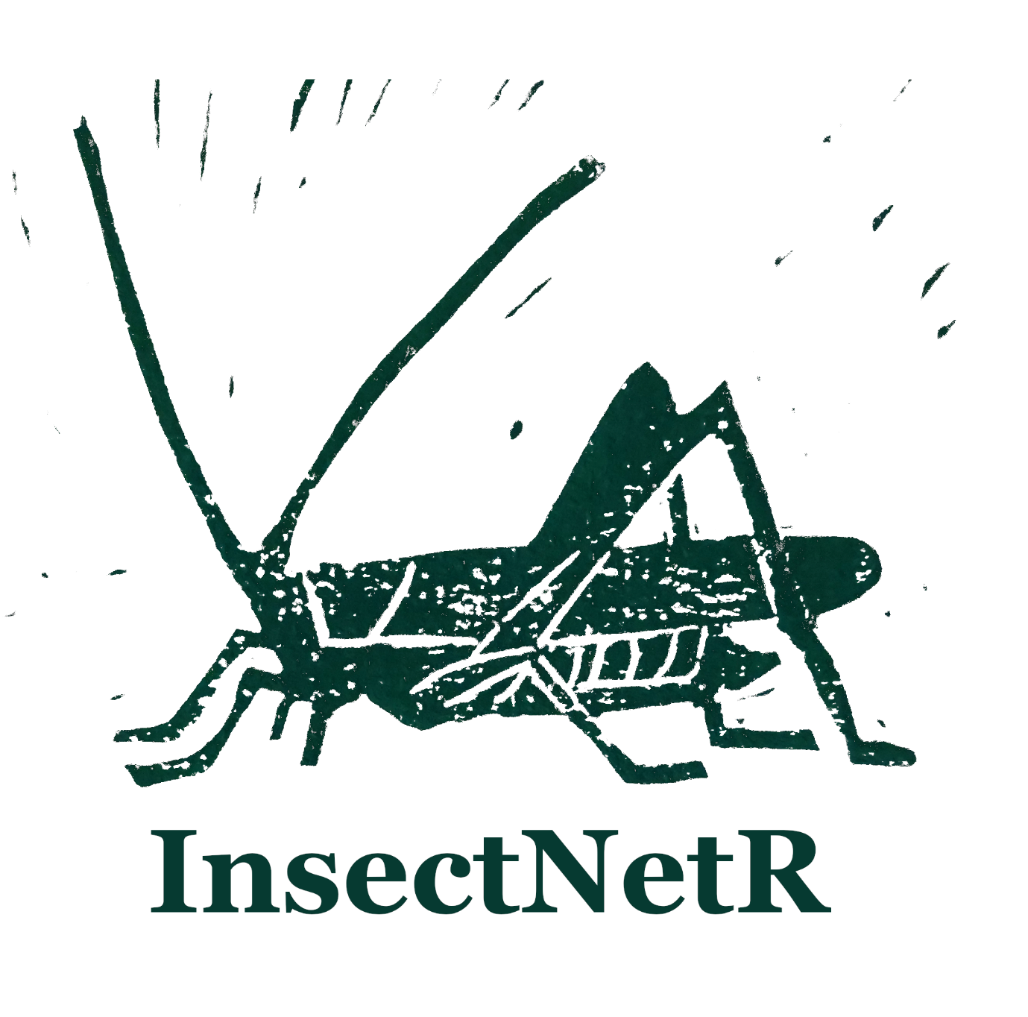
Raw Audio
Predict with Autrainer
Python: autrainer inference
Predictions created by Autrainer
Validate subset of prediction by expert
create_validation_segments()
run_shiny_app()
Use uniform confidence score threshold
Aggregated time series
Set Thresholds with regression
Run_shiny_app()
Apply Thresholds apply_thresholds()
Put in usable format reshape_predictions()
Retrieve species range get_records_OrthopteraWeb()
get_records_INaturalist()
Spatiotemporal filtering check_spatiotemporal_plausibility()
Flags detections out of range
Then decide on what to do with flagged detection
Retrieve species temporal phenology data(temporal_species_phenology)
Or build own dataset with season and time of day
Bring data in usable form for further processing predictions_to_iNext()
Predictions_to_vegan()
?
Retrieve species with similar stridulation data(confusable_species)
Or build own species “confusion table”

