Slide 1

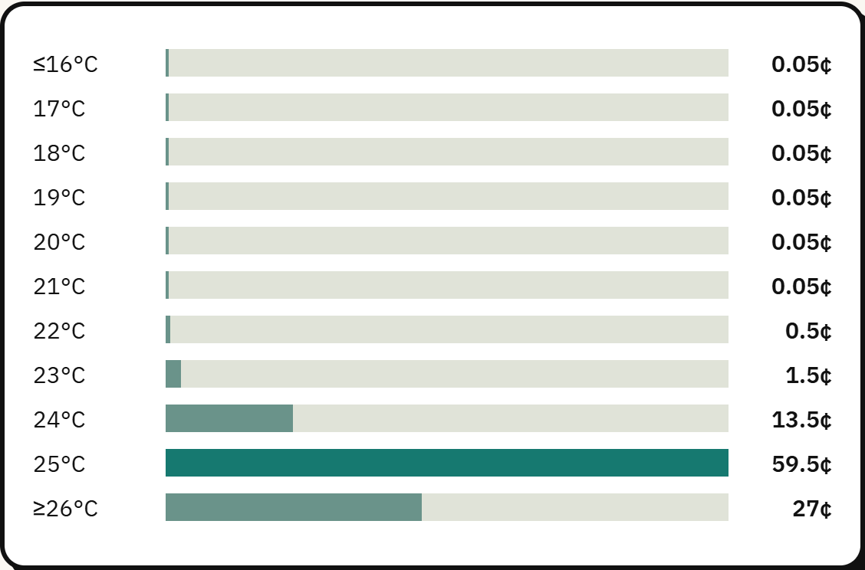
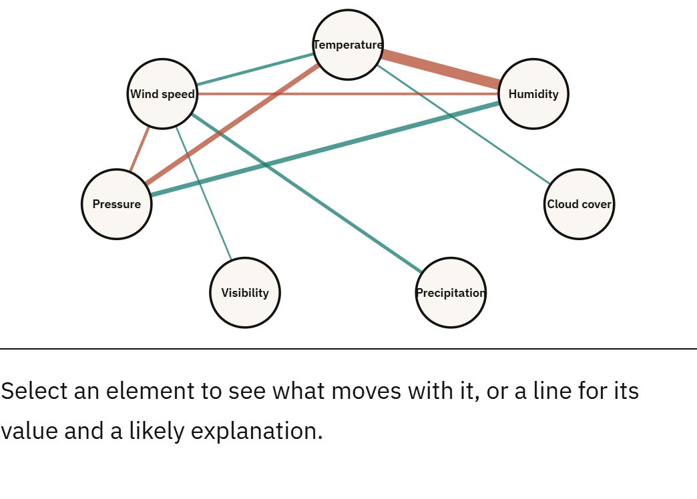
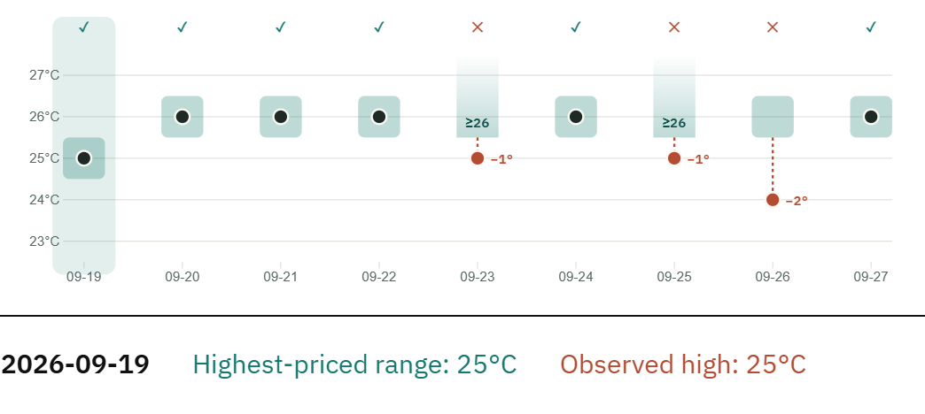
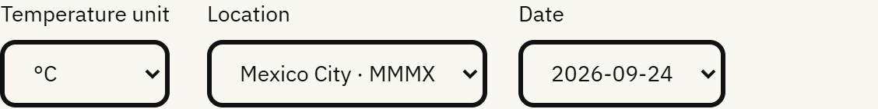
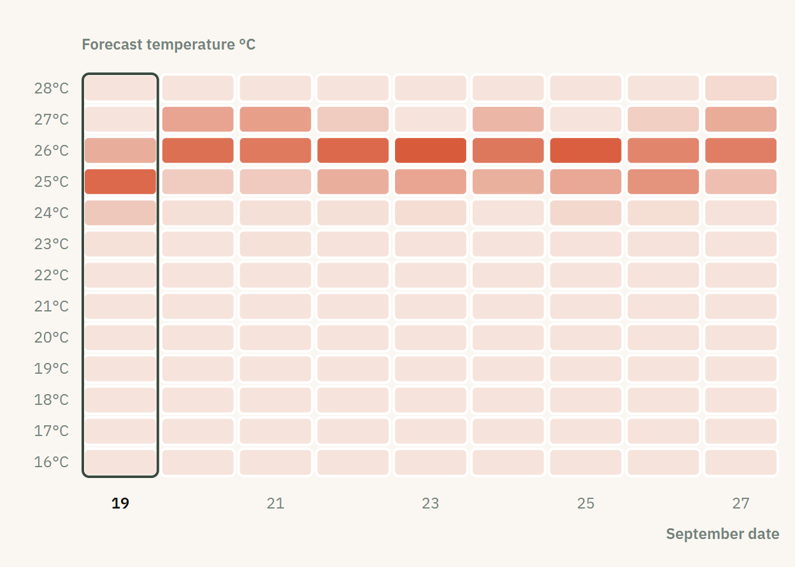
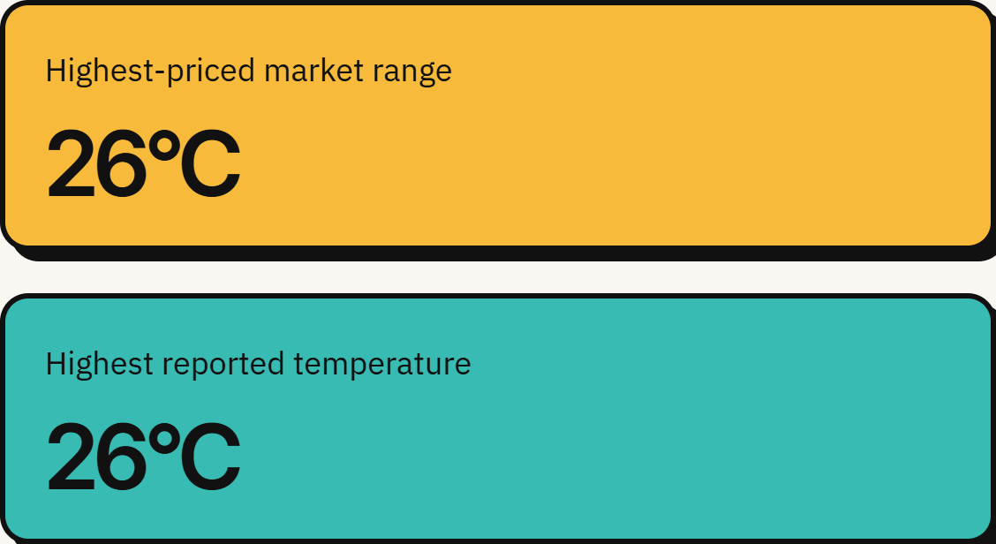

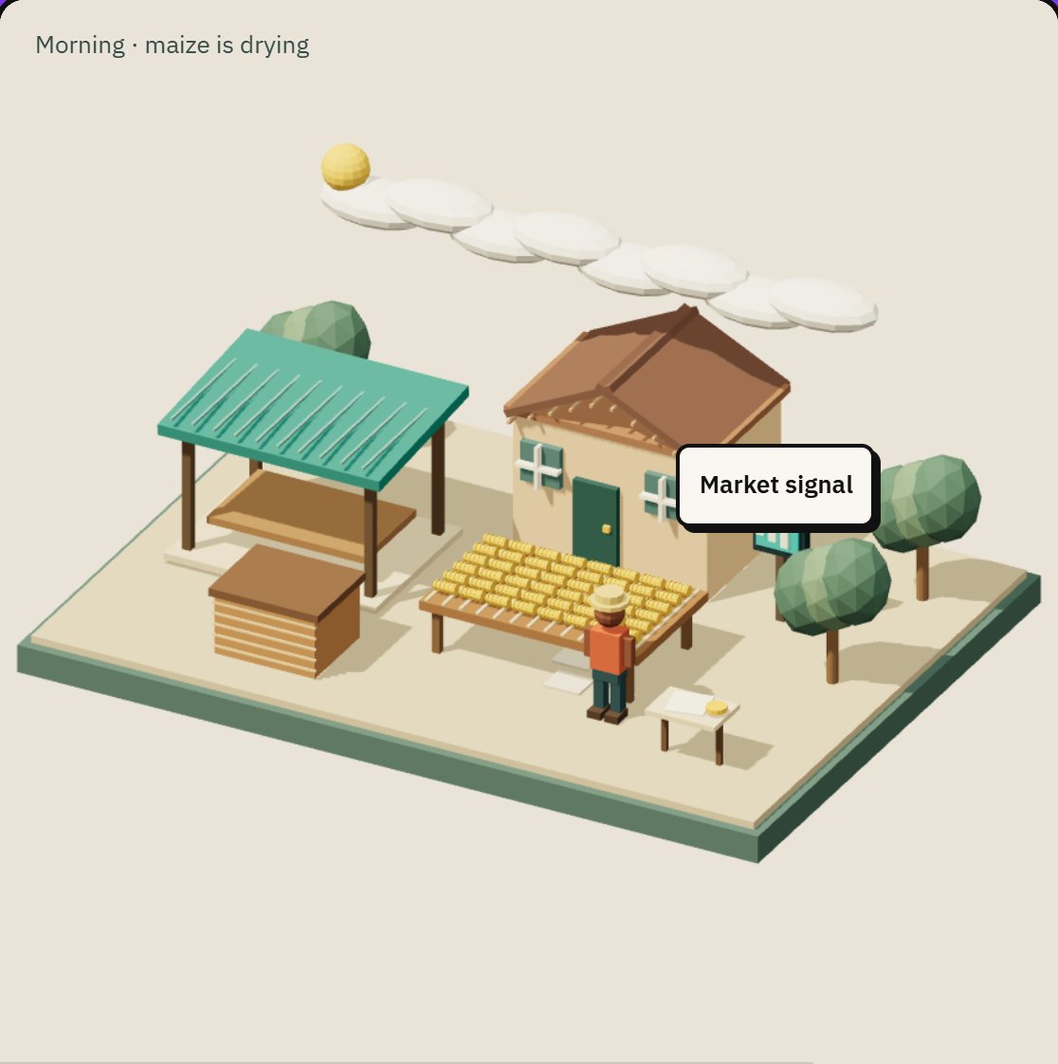
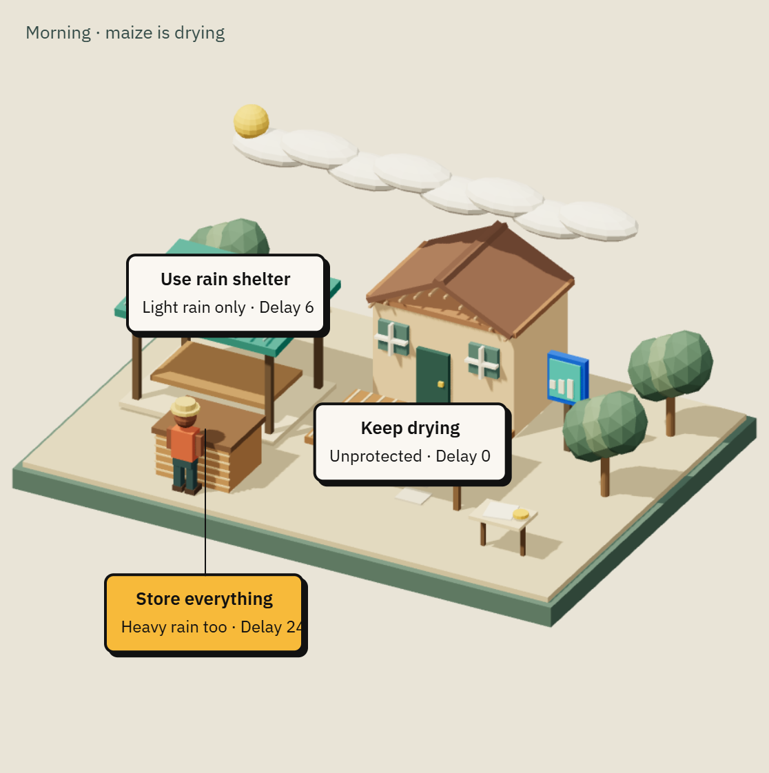
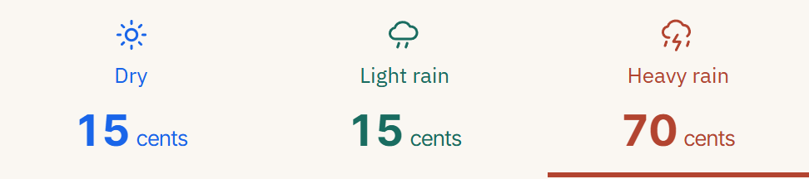
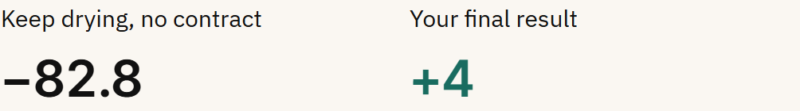
INFOSCI 301 · FINAL GROUP PROJECT · A0 LANDSCAPE
Weatherbridge: Weather Signals and Everyday Decisions
Weather-sensitive workers can inspect market quotes beside airport observations. Nine-day range matches are descriptive, and learning gains remain unmeasured.
Team 3 Shudan Guan: bilingual communication Yizhou Zhang: implementation Xinyuan Lan: evaluation 13 Oct 2026 / 67cf9b2f Prof. Luyao Zhang Autumn 2026
01 Question, user task and claim
FIG 1 Five views for one evidence-comparison task
QUESTION
How can people compare weather-market signals with observations and explain their limits?
Task: compare the highest-priced range with the airport reported high, inspect sources, and explain what the comparison can establish.
AUDIENCE
Jinxi boat operators, food-drying households and outdoor business owners.
A BASIC: PRICE BARS
B WEATHER NETWORK
C TEMPORAL COMPARISON
D LINKED SELECTION
E ADVANCED: HEATMAP
TASK
Choose airport and date. Compare range with observed high; explain one finding and one limit.
LOCAL EVIDENCE
18 Sep museum visits informed weather-exposure questions. Local usefulness is an inference.
CURRENT CLAIM
Inspectable comparisons: MMMX 6/9 and KLGA 2/9 observed highs fall in the leading price range.
MMMX, 19 Sep: 25°C leads at 59.5 cents.
Seven variables. Edge color shows sign; width shows strength at |r| ≥ 0.3.
Range blocks and observed-high points show nine daily comparisons.
Selecting 24 Sep changes the highlighted date and supporting record.
A bin-by-date matrix exposes price mass beyond the leading range.
BOUNDARY
Nine days; no proven forecast skill, learning gain or community benefit.
Evidence: archived raw Yes quotes.
Select a date to update all bars.
Limit: prices lack established calibration.
Evidence: pooled routine-METAR archive.
Select an edge for r and report count.
Limit: association, not a daily cause.
Evidence: MMMX, 19–27 Sep 2026.
Select any date on the timeline.
Limit: reported high is not official TMAX.
Evidence: working linked date controls.
°C/°F display keeps native-bin verdict.
Limit: no measured comprehension gain.
Evidence: normalized archived price share.
Select a date to inspect its profile.
Tradeoff: denser than bars; task value untested.
SDG 13, Climate Action. Target 13.3
Intended: support learning about weather uncertainty.
Implemented exercise; climate-learning impact unmeasured.
Sources: NOAA/AviationWeather, https://aviationweather.gov/api/data/metar; Polymarket, https://polymarket.com/ (public access, source terms apply). MMMX/KLGA: 19–27 Sep, °C observations / native °C or °F bins / Yes prices. No daily gaps; ≥20 reports across ≥20 local hours. Quote times differ. Heatmap adds distribution detail; usefulness awaits testing.
FIG 2 Software architecture at 67cf9b2f
FIG 3 Courtyard walkthrough and revised outcome explanation
1 · DATA
2 · TRANSFORM
3 · LOGIC
4 · VIEW
5 · RELEASE
START
ACTION: VIEW SIGNAL
RESPONSE: STORE
REVISED RESULT
Airport reports + quotes
public/signals/data/
{mexico,laguardia}-
unified.json
→
scripts/
fetch-unified-history.ps1
Local dates + coverage
Pre-day quote snapshots
→
src/evidence-model.js
src/weather-network.js
src/decision-model.js
Native bins, r, synthetic draw
→
src/journey-app.js
src/decision-diorama.js
D3 linked evidence
Lazy Three.js courtyard
→
Vite production dist/
Render deployment
27 accounting fixtures
EN/ZH, text + reduced motion
→
→
→
Archived JSON feeds browser comparisons; synthetic decision logic separately feeds the courtyard. A data error points to Research & Data. The courtyard offers text and reduced-motion modes; a failed exercise load asks users to retry.
Step 1: maize is outside.
Task: protect it and explain costs.
Step 2: inspect 15 / 15 / 70 cents.
Teaching probabilities match quotes.
Step 3: store all maize.
Buy heavy contract: cost 21.
Step 4: heavy-rain replay.
Baseline −82.8; chosen result +4.
Observed evidence: peer reviewer Sitong Chang questioned market/forecast reliability. Decision: revise source labels and distinguish evidence from simulation. On 13 Oct, the courtyard adds a same-weather baseline: preparation +77.8 and contract +9, total +86.8 in this replay. This developer walkthrough is not a participant retest. Real-world benefit remains unmeasured.
Release: https://temperature-comparison.onrender.com/
Exact paths above; README.md includes video preview. Code: 67cf9b2f11e2853d8a754cbfebf352c12e32b5b4. Deployed version equality remains unverified.
02 Research, design and validation
03 Acknowledgements, credits and AI disclosure
04 Artifact access and version
Primary frontier: Open Science, Data Governance and Responsible AI.
Munzner’s nested validation model informs four checks below. Archived sources and linked selections make the comparison inspectable.
https://doi.org/10.1109/TVCG.2009.111
Instructor: Prof. Luyao Zhang. Peer input: Yixuan Chen, language access; Zhixin Liu, spatial context and explicit comparison; Sitong Chang, forecast reliability and simpler views. Responses: wording review, linked comparisons and source labels. EN/ZH access preceded review; no measured retest gains.
Course field context: Tencent’s Shanghai Office and Shanghai Science and Technology Museum (4 Sep 2026); Jinxi Intangible Cultural Heritage Museum and China Ancient Brick and Tile Museum (18 Sep). Boat-making and brick/tile exhibits informed weather-exposure questions. Visits do not imply project review or endorsement.
Credits: NOAA/AviationWeather and Polymarket (sources and terms in Fig 1). Mike Bostock, D3 7.9.0, https://d3js.org/ (ISC); three.js authors, Three.js 0.186.1, https://threejs.org/ (MIT); Vite contributors, Vite 8.3.0, https://vite.dev/ (MIT). Course A0 template and DKU logo: supplied by INFOSCI 301. UN SDG icon: official communications asset, source below. Team code/screenshots: this release; no repository license declared.
AI disclosure: Cursor, https://cursor.com/ and OpenAI Codex, https://openai.com/codex/ (proprietary services; model versions unrecorded). Humans verify claims and remain responsible. Member contributions appear in the header.
Working artifact: https://temperature-comparison.onrender.com/
Repository: https://github.com/Rick-1091/Temperature-Comparison
Pinned release:
https://github.com/Rick-1091/Temperature-Comparison/tree/67cf9b2f11e2853d8a754cbfebf352c12e32b5b4
Poster and paper: supplied with submission. Public URLs not yet available.
Demo video: https://youtu.be/J4l93IC2vnM
Recorded 6 Oct; predates the current courtyard model.
Domain: field context; Jinxi usefulness untested.
Data/task: 9 days each, strict 6/9 and 2/9.
Idiom: five working views; human task value untested.
Algorithm: 27 independent accounting fixtures pass.
Next: Xinyuan leads consenting novice comparison and teach-back tasks, including Jinxi volunteers if permission allows. Shudan reviews EN/ZH wording; Yizhou audits the weather parser.
Version boundary: screenshots show the local production build at 67cf9b2f. README contains a clickable video preview. Live-site equality, cross-device public access and a version-matched video remain to be checked.
UN SDG source: https://sdgs.un.org/goals/goal13 Icon: https://sdgs.un.org/sites/default/files/goals/goal-13.png This publication is not approved by or representative of the United Nations.
Notes:
Poster made from the supplied A0 template and all four pages of INFOSCI301_Final_Poster_Annotated_Guide.pdf. Latest GitHub main verified 13 Oct 2026: 67cf9b2f11e2853d8a754cbfebf352c12e32b5b4. Source https://github.com/Rick-1091/Temperature-Comparison/tree/67cf9b2f11e2853d8a754cbfebf352c12e32b5b4 . Exact parent snapshot copied and all seven changed files fetched from the pinned commit. All screenshots freshly captured from the rebuilt production output. Historical results verified with scripts/verify-guided-data.mjs. Courtyard fixture test: scripts/verify-decision-accounting.mjs. Fig 3 is a known heavy-rain developer replay, not a user study. Latest fair-priced contracts: light cost 4.5, heavy cost 21; matching payout 30. Storage has no-contract net -5; heavy-rain baseline -82.8, storage/heavy contract +4. Preparation difference +77.8 and contract +9. Quote/probability correspondence is an explicit teaching assumption. Site and video URLs from supplied records; no claim of site equality. User confirmed no public paper/poster links. Peer names, four sites and roles from supplied report. Research reference https://doi.org/10.1109/TVCG.2009.111 . Official target https://sdgs.un.org/goals/goal13 and icon https://sdgs.un.org/sites/default/files/goals/goal-13.png . Course supplied template and DKU logo preserved.

