Slide 1
AdcCalTest Data taken on 7/28/2022 by Rick

Slide 2
C Code in modules
// Find the high-point of the segment with the greatest slope where the
// high point is positive
int16_t d0;
int16_t slope;
int16_t data = *d++;
d = samples;
int ix = 0;
int16_t mx = 0;
data = *d++;
for (i = 1; i < nadc; i++) {
// Find the slope between the previous point and the current point
d0 = data;
data = *d++;
slope = data - d0;
// If the curent data is positive and the slope is greatest so far
if ((data > 0) && (slope > mx)) {
// Store the slope and the index
mx = slope;
ix = i;
}
}

Slide 3
Python code in AdcCalTest.py
d1 = signal[0]
ix = 0
mx = 0
i = 1
for d in signal[1:]:
d0 = d1
d1 = d
slope = d1 - d0
if (d1 > 0) and (slope > mx):
mx = slope
ix = i
i += 1
print("mx", round(mx), "ix", ix)

Slide 4
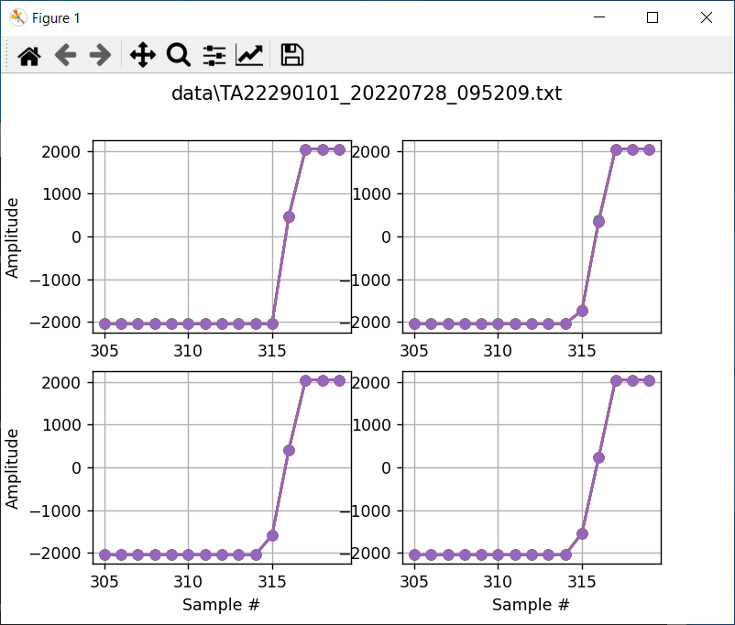
mx 2518 ix 316
mx 2091 ix 316
mx 1998 ix 316
mx 1810 ix 317

Slide 5
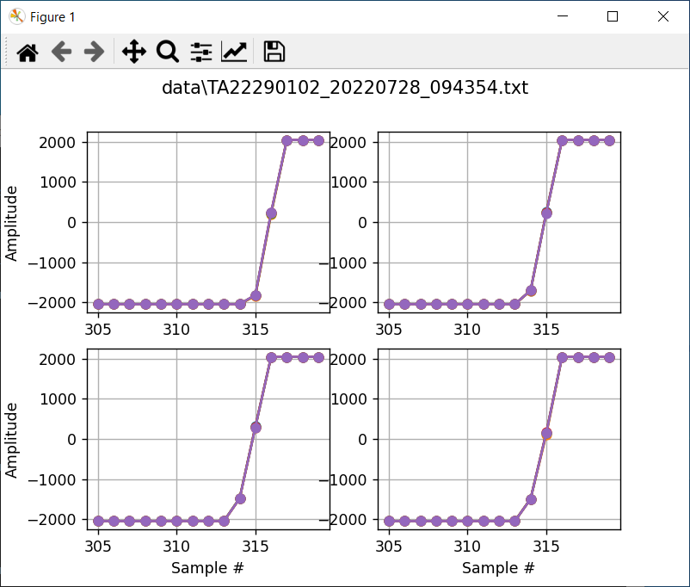
mx 2045 ix 316
mx 1941 ix 315
mx 1780 ix 315
mx 1903 ix 316

Slide 6
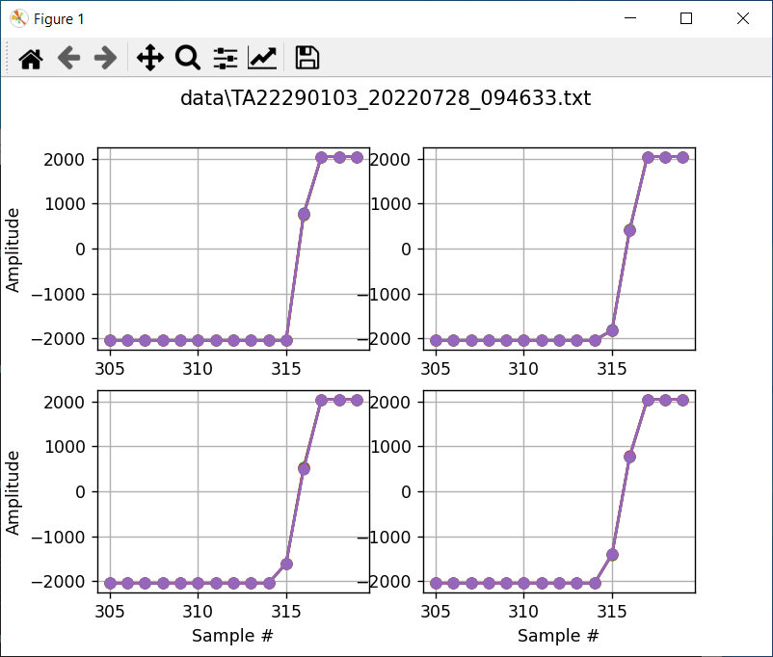
mx 2814 ix 316
mx 2234 ix 316
mx 2127 ix 316
mx 2174 ix 316

Slide 7

mx 2894 ix 316
mx 2188 ix 316
mx 2645 ix 316
mx 1887 ix 316

Slide 8
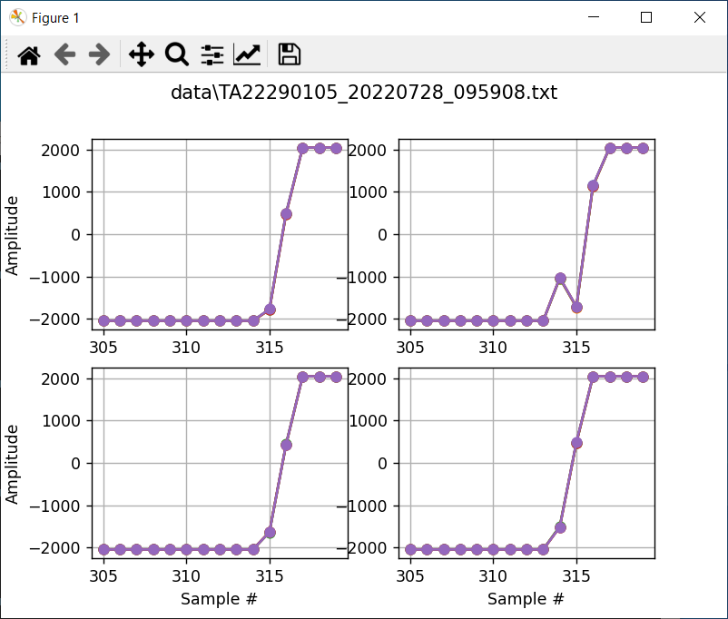
mx 2263 ix 316
mx 2863 ix 316
mx 2069 ix 316
mx 1994 ix 315

Slide 9

mx 1892 ix 315
mx 2034 ix 316
mx 2986 ix 316
mx 1893 ix 316

Slide 10
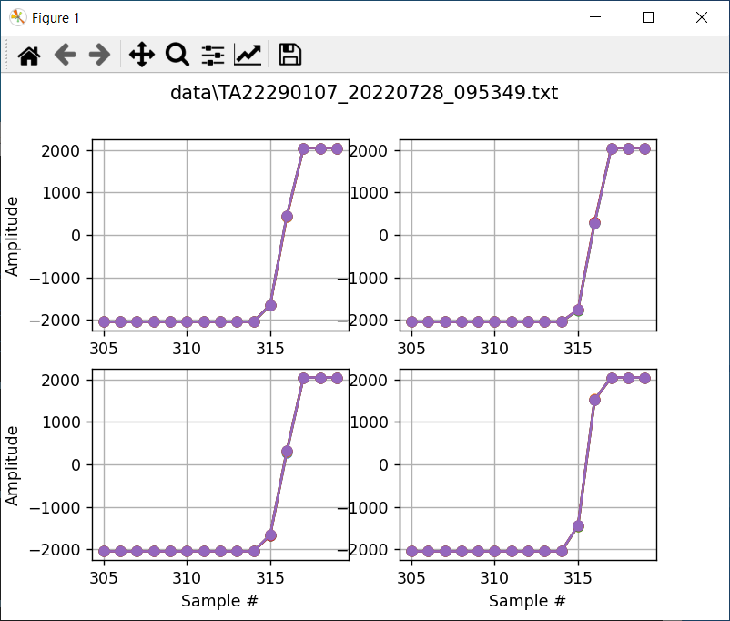
mx 2096 ix 316
mx 2054 ix 316
mx 1975 ix 316
mx 2974 ix 316

Slide 11
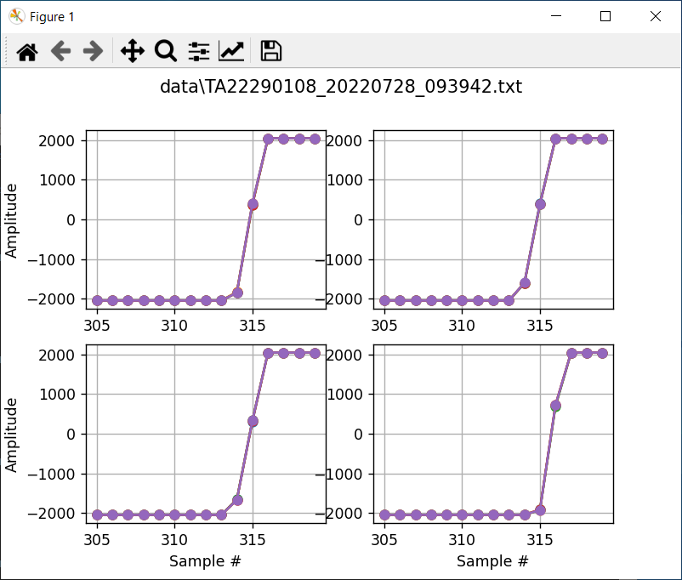
mx 2232 ix 315
mx 1991 ix 315
mx 1990 ix 315
mx 2639 ix 316

Slide 12

mx 2149 ix 315
mx 1986 ix 315
mx 2069 ix 316
mx 2093 ix 316

Slide 13
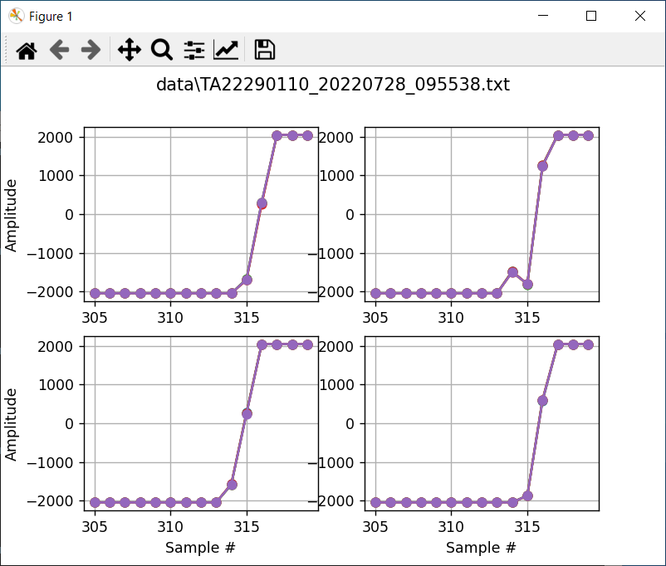
mx 1978 ix 316
mx 3059 ix 316
mx 1838 ix 315
mx 2466 ix 316

