Slide 1

Online Video Launch Strategy
By Rick Takeuchi
(Rockbuster Stealth LLC)

Slide 2
Introduction
The Rockbuster Stealth LLC is a massive rental company that used to have stores globally. Due to stiff competitions from companies like Netflix and Amazon Prime, the management plans to use it’s existing movie license to launch an online video rental company to stay the business afloat. To accomplish the business goal requires deeper analysis of the video rental market industry.

Slide 3
KEY BUSINESS QUESTIONS
Which movies contributes most or least to revenue gain?
What was the average rental duration of videos?
Which countries are Rockbuster customers mostly located in?
Were are customers having highest lifetime values located in?
Do sales vary by different geographic regions?

Slide 4
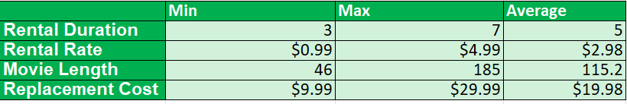
DATA OVERVIEW

Slide 5
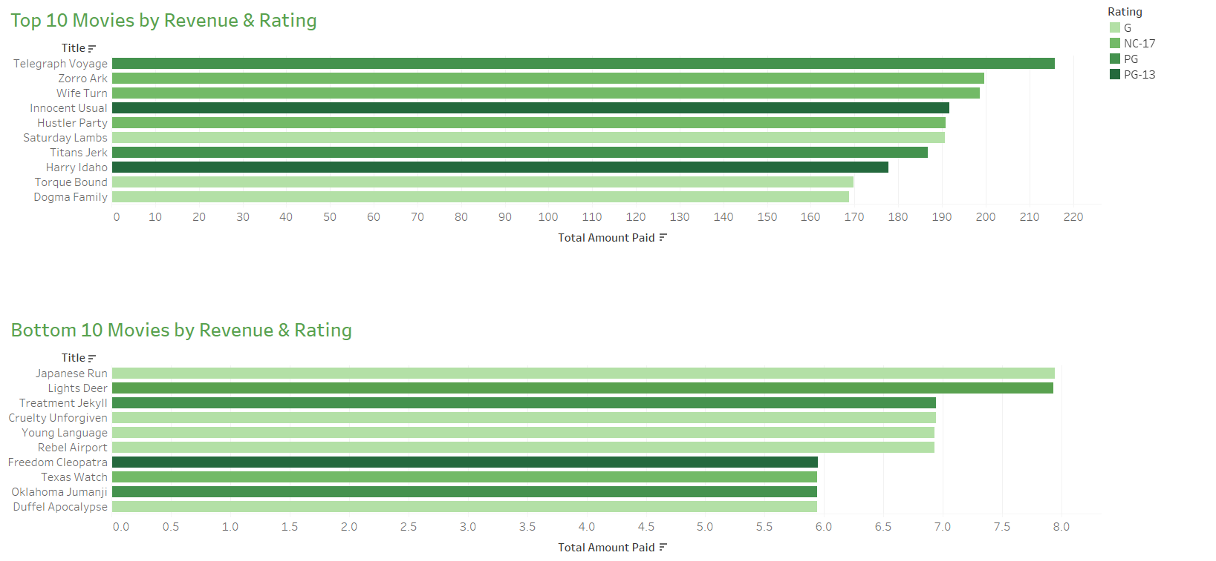
Contribution by Revenue by Rating

Slide 6
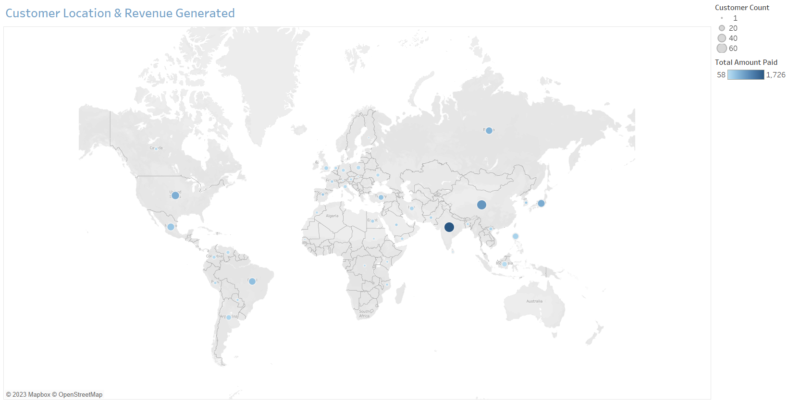
Countries Where Customers are Located
From the map above, the top 10 countries with the most revenue are:
India, China, USA, Japan, Mexico, Brazil, Russia, Philippines, Turkey, and Indonesia

Slide 7
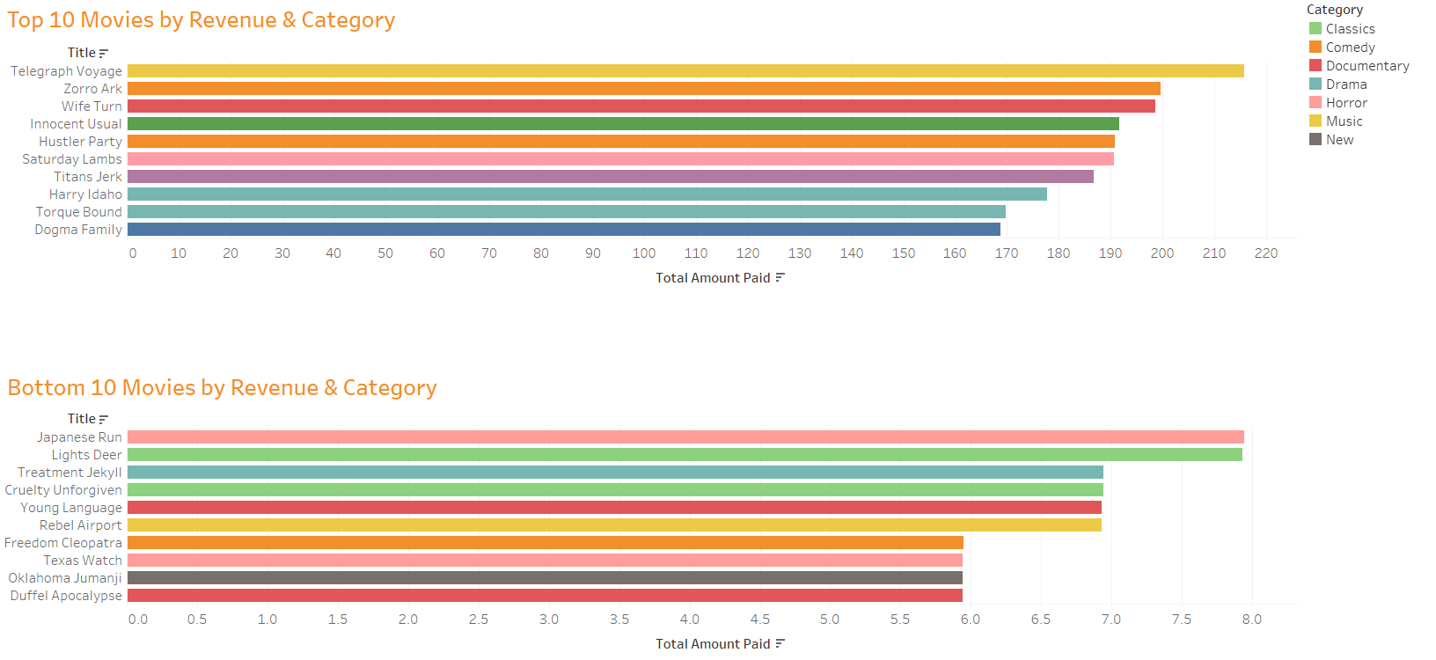
Contribution by Revenue by Category
It can be inferred from the charts above that category with highest revenue is Music and the category
with lowest revenue

Slide 8
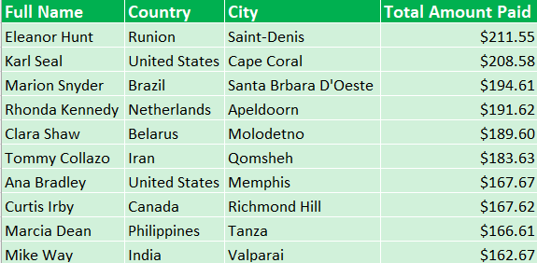
Top 10 Customers with Highest Value

Slide 9
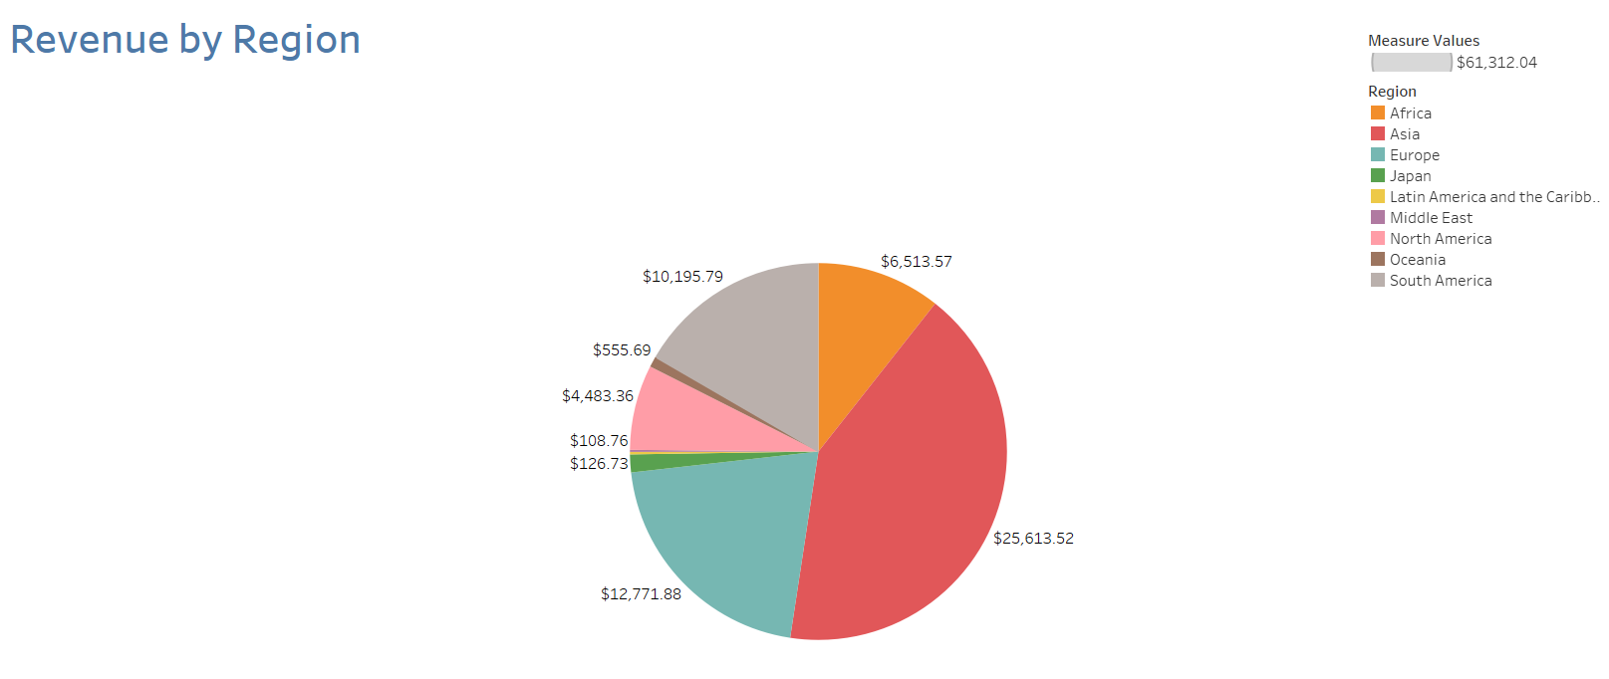
Where Sales Vary Between Regions
It can be inferred from the chart that Asia have the largest market share, followed by Europe, then South America, followed by North America.

Slide 10
Recommendations
Movies with rating G and NC-17 must be generated highly since it constitutes most movies within the top 10 by revenue generation
Movie genres: Comedy, Drama, and music must be given more attention because these movies compose of majority of top 10 movies that generate revenue
Regions that generate most clients and revenue must not be taken for granted. Areas include Asia, South America, and Europe. All efforts must be placed in every continent to improve market share of Rockbuster Stealth LLC

Slide 11

THANK YOU!
Tableau Link: https://public.tableau.com/app/profile/rick.takeuchi/viz/RockbusterStealthLLCLaunchStrategy/

