Slide 1
LSTN: A Linear Model of Industrial Production Process for Demand Response
Ruike Lyu, Hongye Guo, Qixin Chen et al.
Department of Electrical Engineering,
Tsinghua University, Beijing, China
Paper №: A8709RL
1/9

Slide 2
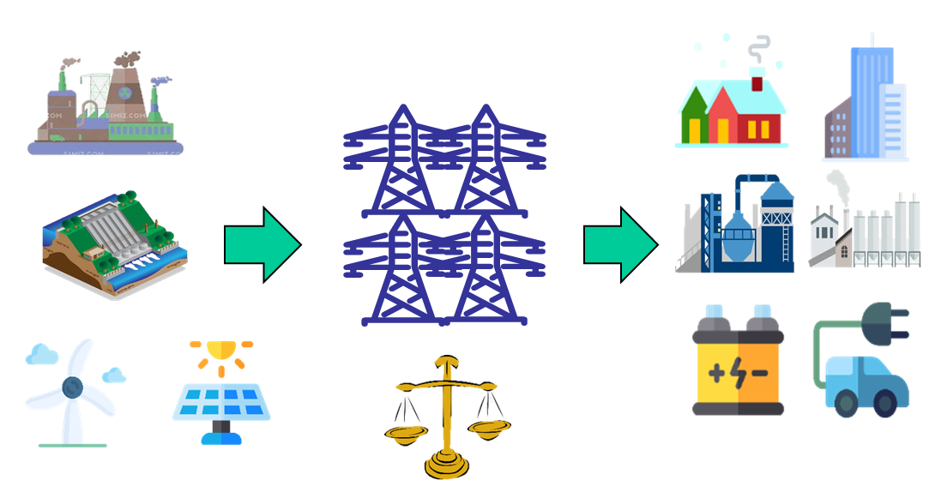
Introduction
Electricity load (10MW)
Output of wind/PV power (10MW)
Why demand response?
104520 MW
Cost-effective for securing electricity supply in the power system
Low output during peak load
5940 MW
Electricity load and wind/PV power output curve on Aug 3, 2020, Jiangsu Province, China
Why industrial users?
Large response volume (MWs)
Sensitive to the prices
Ability to implement DR
Demand response (DR) has huge potential for maintaining demand-supply balance
2 /9

Slide 3
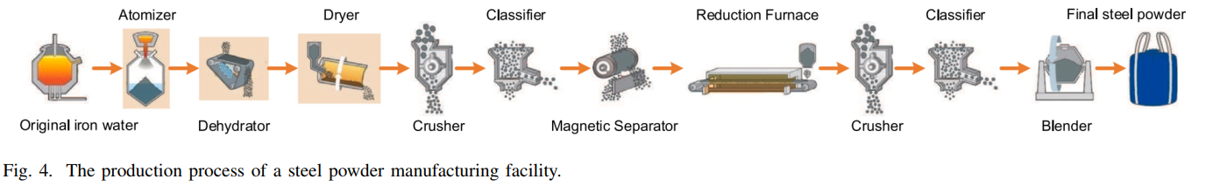
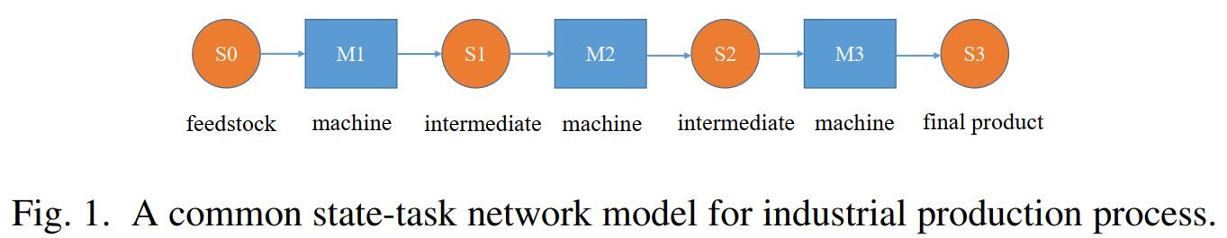
Introduction
Industrial Production Processes (IPPs).
Contributes most energy consumption of typical industrial users
Exists technical constraints and production targets
Modelled by: state-task network (STN), resource-task network…
MILP formulations for the on/off operating states of devices
Why industrial users?
STN modelling
3 /9

Slide 4
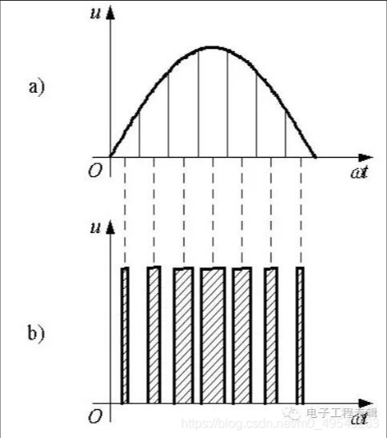
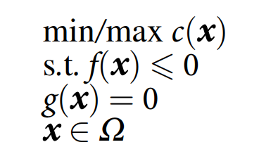
Objectives
Linear model instead of MILP-based models
Overcome computation complexity issues
Increase production model accuracy
Easier to embed into existing models
An analogy:
PWM rectification
(Pulse Width
Modulation)
Power is discrete, but the energy integrated over a time interval can be close to continuous
Linear constraints are more “friendly” for power system dispatch models
4 /9

Slide 5

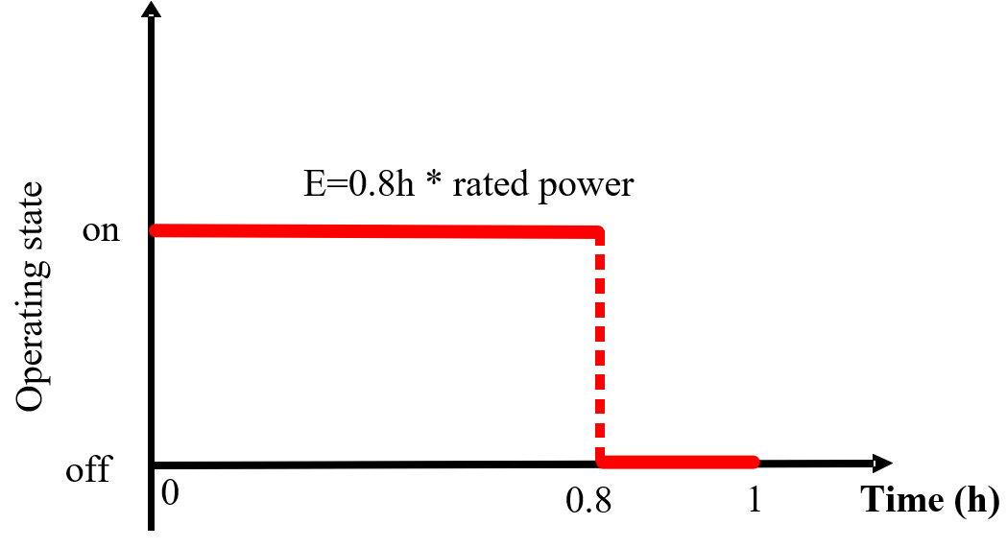
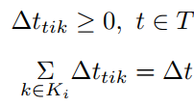
Methodology
Use operating time as the variable
Under the time intervals of DR (e.g. hour by hour)
Change the variable: device operating state -> operating time
Feasible; up to the industrial user to implement
hour | 1 | 2 | 3 | …
state of device 1 | on | on | off | …
STN
hour | 1 | 2 | 3 | …
on-time of device 1 | 1h | 0.8h | 0h | …
off-time of device 1 | 0h | 0.2h | 1h
The industrial user implements the operation of the devices
LSTN: linear STN
5 /9

Slide 6

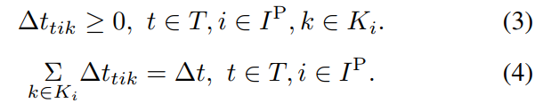
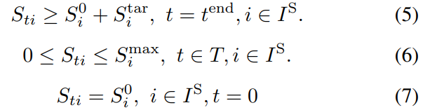
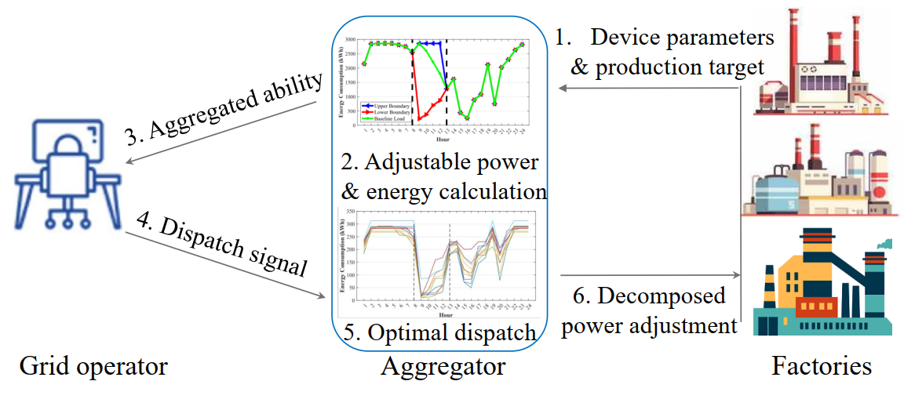
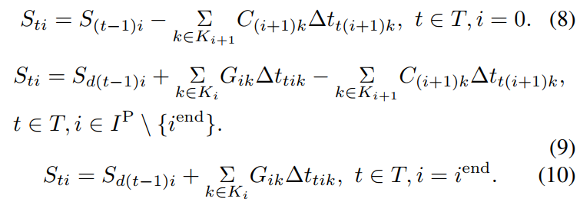
Methodology
Use operating time as the variable
A linear model
Fast to compute
Suits aggregation
Accuracy?
No need to worry about the equations :)
A two-layer framework for aggregating
industrial facilities for large-scale DR
6 /9

Slide 7
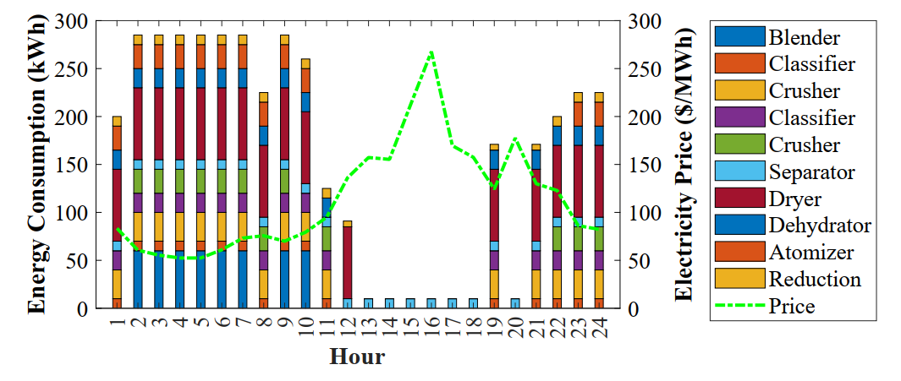
Case Study
Tested using electricity price of PJM and parameters of a steel powder manufacturing.
“True” value: STN-2min (it takes 2 min to switch)
7 /9

Slide 8
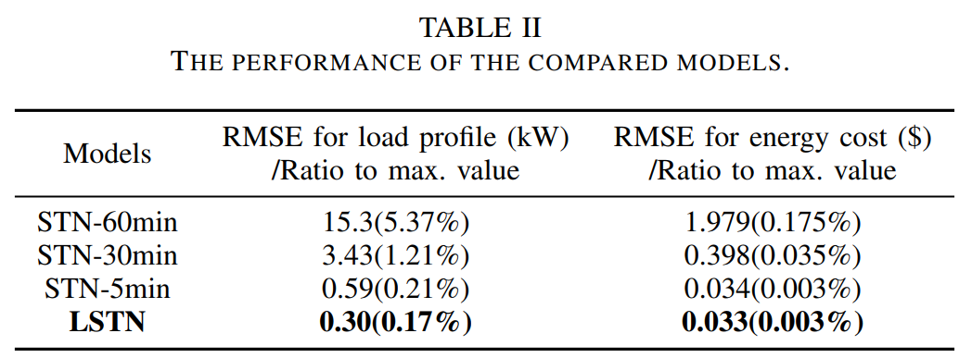
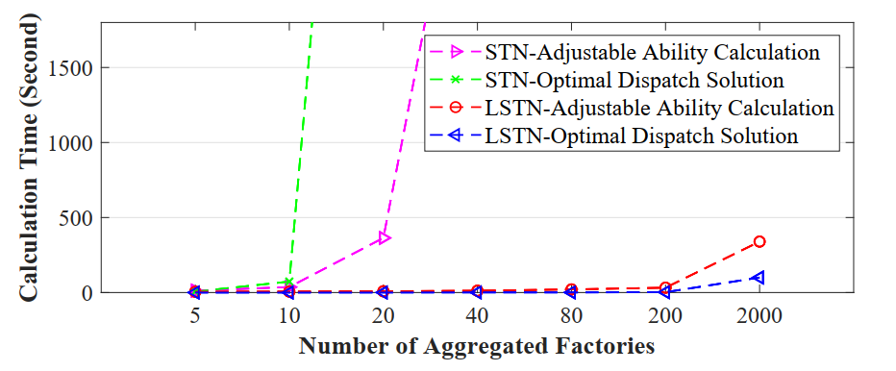
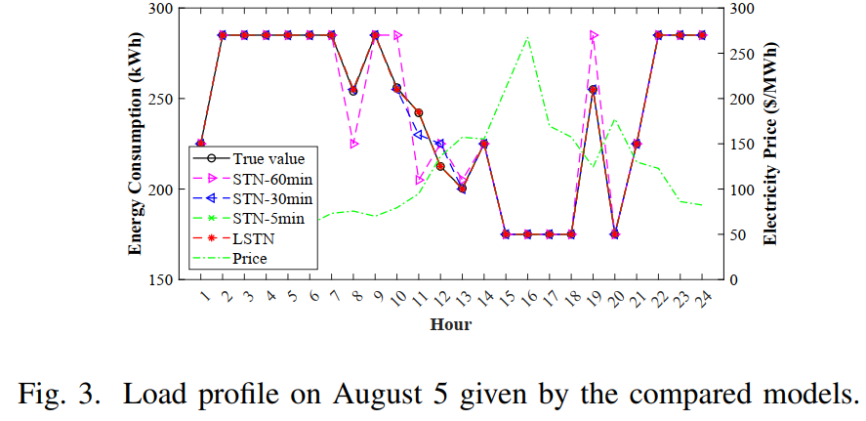
Results
Modeling Accuracy
Computational Time
STN-60min: Computationally intractable with more than 80 industrial facilities
LSTN: Computationally tractable with 2000 industrial facilities or more
LSTN: red True: black
8/9

Slide 9
Conclusions
My email: lrk21@mails.tsinghua.edu.cn
LSTN: Linear STN instead of MILP-based models
Overcome computation complexity issues
Increased model accuracy
Easier to embed into dispatch models
An analogy: PWM rectification
Power is discrete, but the energy integrated over a time interval can be close to continuous!
9/9

