Slide 1




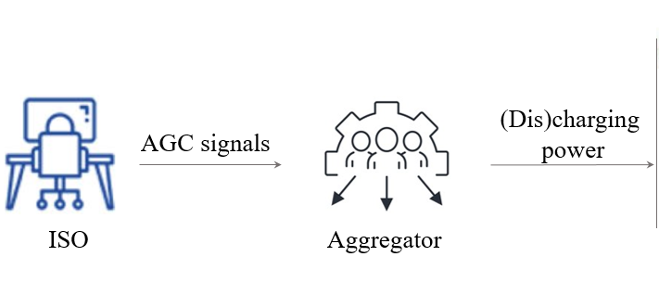

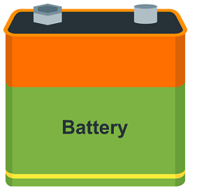
4-Optimization with Heterogeneous Resources
Motivation: when deploying regulation services, the VPP disaggregates the requested power adjustment signals in real time among its internal heterogeneous resources. Achieving optimal power disaggregation is challenging due to the temporal coupling characteristics of the resources. Existing research relies on proportional disaggregation, which is far from optimal.
Intuition: optimally allocate discharging power to resources with lower costs!
PV
Reduce 15 kW!
IPP
Can we always allocate discharging power to resources with lower costs?
ES
- 15 kW?
…

Slide 2


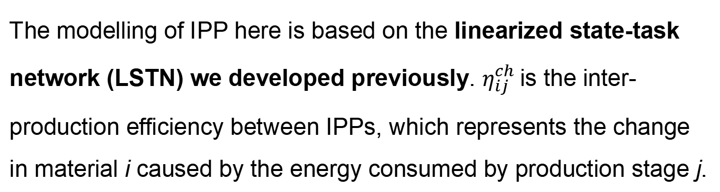
4-Optimization with Heterogeneous Resources
Method (step1) : Establish a standardized VPP internal resource operation model, using one set of models to describe the operation of various resources, such as industrial production processes, air conditioning system, electric vehicle, energy storage.
 | Power limit
 | State limit
 | State change
 | Initial state
 | Response cost
PV
IPP
TCL
EV fleet
ES
The modelling of IPP here is based on the linearized state-task network (LSTN) we developed previously. $η_{ij}^{ch}$is the inter-production efficiency between IPPs, which represents the change in material i caused by the energy consumed by production stage j.
Standardized operating model
for VPP internal resources

Slide 3
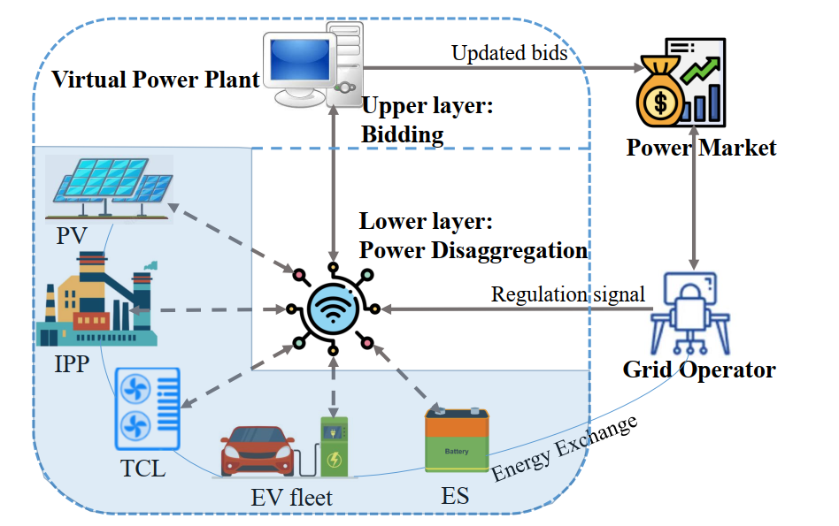
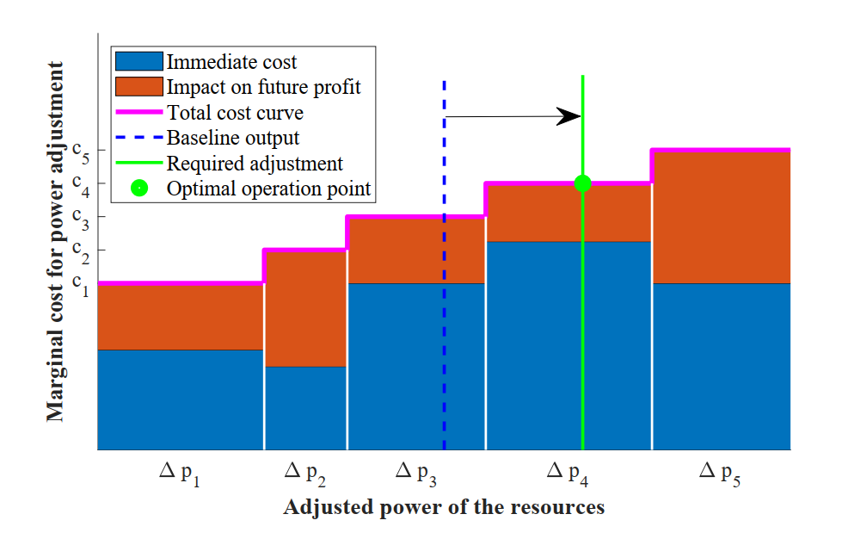
4-Optimization with Heterogeneous Resources
Method (Step 2): Establish a multi-timescale optimization model, with the upper layer for bid decision-making and the lower layer responsible for power disaggregation. The optimization disaggregation strategy is to prioritize the use of low-cost resources while considering the coupling characteristics of time periods (i.e., the opportunity cost/ impact on future profit).
Visual representation of the Optimal Disaggregation algorithm
Qixin Chen, Ruike Lyu, Hongye Guo, and Xiangbo Su. "Real-Time Operation Strategy of Virtual Power Plants With Optimal Power Disaggregation Among Heterogeneous Resources." Applied Energy 361 (2024): 122876.
Notes:
The VPP originally operating at the baseline output point (blue dashed line). In order to achieve the required power adjustment for frequency regulation signals (green line), a two-step approach is employed. Firstly, based on the original resource operating costs (immediately incurred) and the opportunity cost of resource output adjustments derived from the optimal operation problem (influencing future profits), the marginal adjustment costs for each resource are calculated. Subsequently, within the constraints of resource output, the utilisation of low-cost resources is selectively invoked.

Slide 4
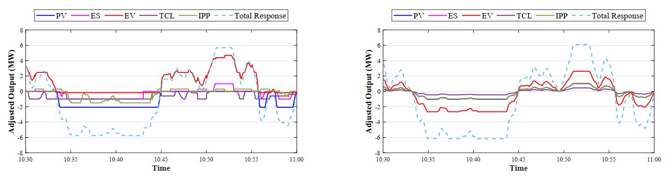
4-Optimization with Heterogeneous Resources
Case study: The VPP consists of PV, ES, a fleet of EVs, TCLs, and IPP resources.
We use the real-time prices of energy and frequency regulationof the PJM in July 2022 as boundary conditions.
More diversified, more flexible
(a) Our method:
power disaggregation optimally
(b) Compared method:
power disaggregated with the same proportion

Slide 5
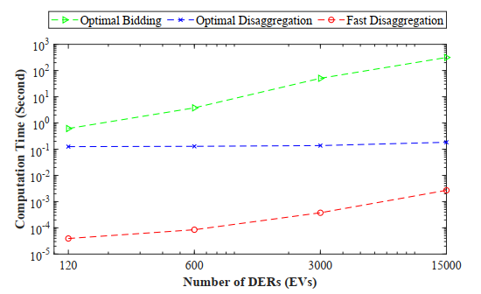
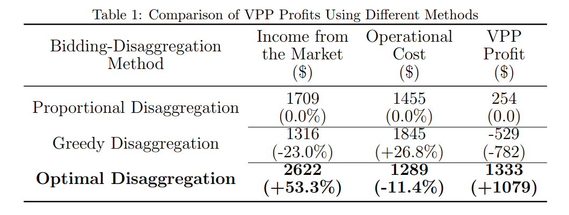
4-Optimization with Heterogeneous Resources
Results: Achieving real-time control optimization of thousands of different types of resources (including industrial production processes) within a calculation time of less than 1ms, leading to a 40% increase in VPP profit in energy & frequency regulation market under typical scenarios.
calculation time
Qixin Chen, Ruike Lyu, Hongye Guo, and Xiangbo Su. "Real-Time Operation Strategy of Virtual Power Plants With Optimal Power Disaggregation Among Heterogeneous Resources." Applied Energy 361 (2024): 122876.

