Slide 1
Tagline │ Ad SPEC
Notes:
http://tw.promo.yahoo.com/2009sales/k_una/testpage_tagline_study.html

Slide 2
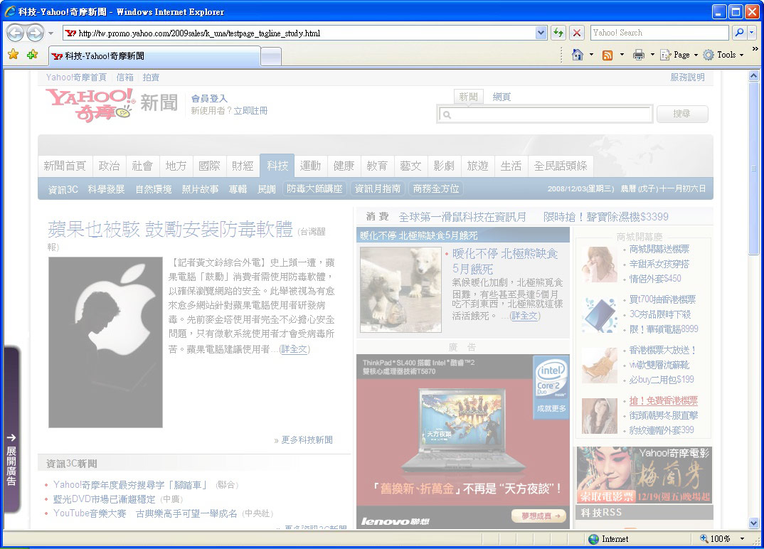
Tagline │Restrictions
Position
An 25x240 initial ad resides in lower left corner with a height of 10 pixels to the
bottom of the page
Fixed position in lower left corner of browser
_{10px}

Slide 3
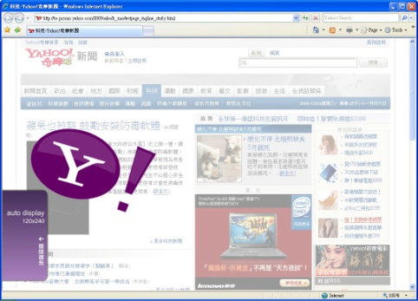
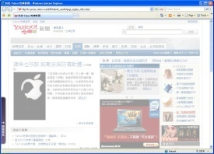
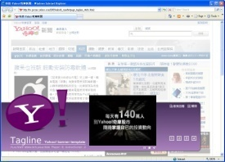
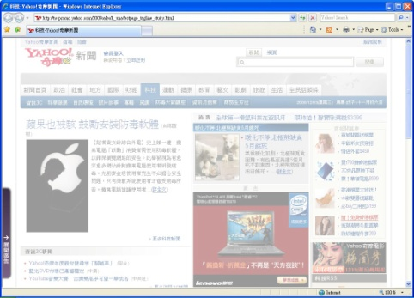

Tagline │Ad Assembly
1st & 2nd appearance
The auto display banner + crazy ad plays automatically at 1st & 2nd appearance.
Tab
After the animation finishes or user click on close button, the ad collapses to 25x240 pixels.
user click on banner
Panel
The panel(950x315) will be expanded by user click on banner.
Banner + Crazy Ad
later appearance / click on tab
user mouseover on expand button
Tab
Banner + Crazy Ad
Panel

Slide 4
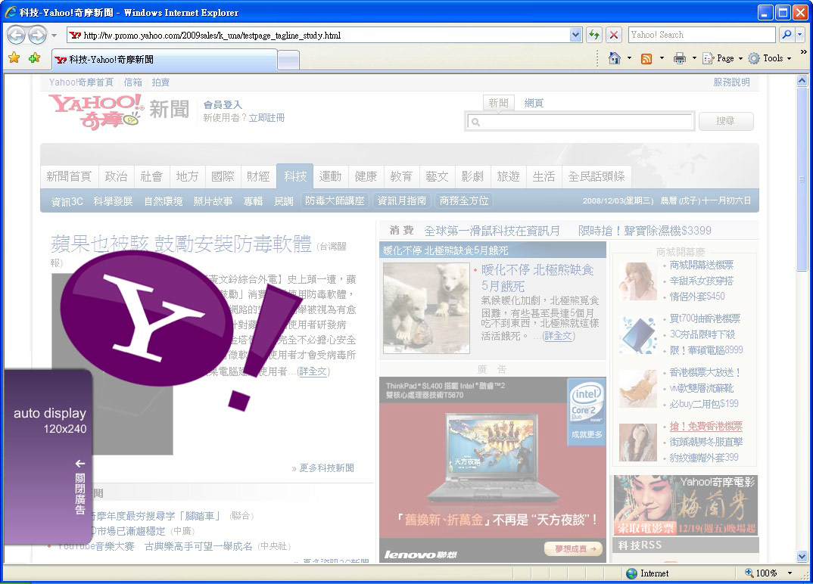
Tagline │Restrictions
- Auto Display Banner (120x240) & Crazy Ad (400x400)
Crazy ad (400x400)
Max Animation Time: 5 seconds.
Not larger than 400x200 pixel.
Do not cover the close button (on banner) at any time.
Floating area must be transparent so the page links are still clickable.
Floating elements must be images instead of SP text.
Banner (120x240)
Max. animation duration: 5 seconds, the crazy ad play with banner synchronized.
After the animation finishes, the ad collapses to 25x240 pixels automatically.
The panel (950x315) will be expanded by user click on banner.
Close button is compulsory, the color can be customized but the position is fixed.

Slide 5
Tagline │Restrictions
- Tab (25x240)
- Use a strong "Call to Action" on tab.
- Max. animation duration: 5 seconds (no looping)
Rollover Tab appear expand button (compulsory) :
This close button should remain on the fixed position.

Slide 6
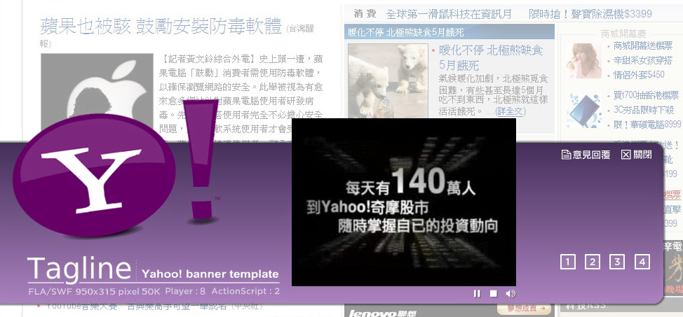
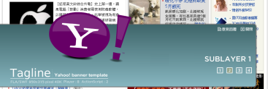
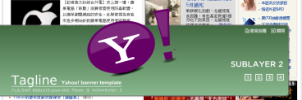
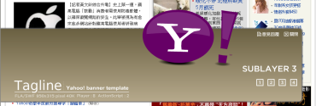
Tagline │Restrictions
- Panel (950x315)
Survey / Close button (compulsory) :
These buttons should remain on the upper right corner at all time.
The color can be modified where the font size should remain the same.
The background of this area must be transparent.
Button usage rules:
‧Button Icon should be well defined and easy to identify.
‧Background color of the button should be opaque.
The Max. dimension
for video module
for 4:3 video is
320x240 pixels
Video only shows
in main panel
315
px
240
px
Video Control button (Compulsory):
Button borders and backgrounds can
be customized.
Color variation is allowed on mouse
rollover.
Play / Stop / Pause / Sound: can be
customized to different colors.
Sub Panel (optional)
The expanded panel can contain up to 3
buttons linking to individual flash animation
with maximum file size of 50KB each.

Slide 7
Tagline │Specification Summarize
Please use the template for production
Items | Dimension (Width x Height pixels) | File Formats | Max. file size
Main Panel | 950x315 | swf & fla | 50K
Sub Panel (optional) | 950x315 (The ad can contain up to 3 sub panels.) | swf & fla | 50K
Crazy Ad | 400x400 | swf & fla | 50K
Backup Image | 25x240 | gif or jpg | 10K
Video Sources | 1.If the video ratio is 4:3, Player area should also be 4:3 Same case for ratio 16:9 2.Max. duration: 30 seconds 3.The video width should be wider than 320 pixels (for ratio 4:3) | wmv or mov or avi | 100MB
．Y! accept creative files only with flash 8 version
．Frame rate setting : 18 or below 18
．All font should be broken apart in the FLA source file.
．Please attach both fla and swf files for Yahoo! banner, panel, movie files are all creative independently.
．Lead time : 7 working day (coding and demo page) for Yahoo!
．This ad format is supported for IE only.

Slide 8
For further questions, please contact:
tw-adtech@yahoo-inc.com

