Slide 1
Login AD│Guideline

Slide 2
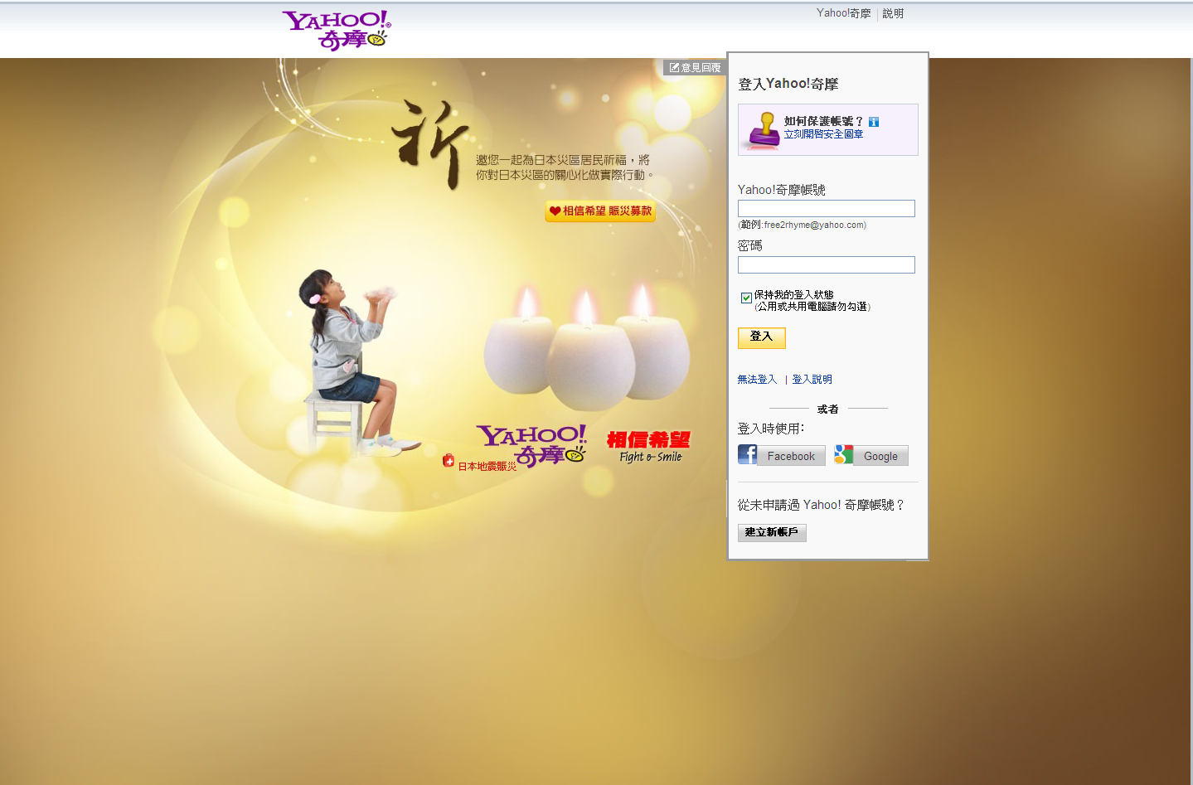

Slide 3
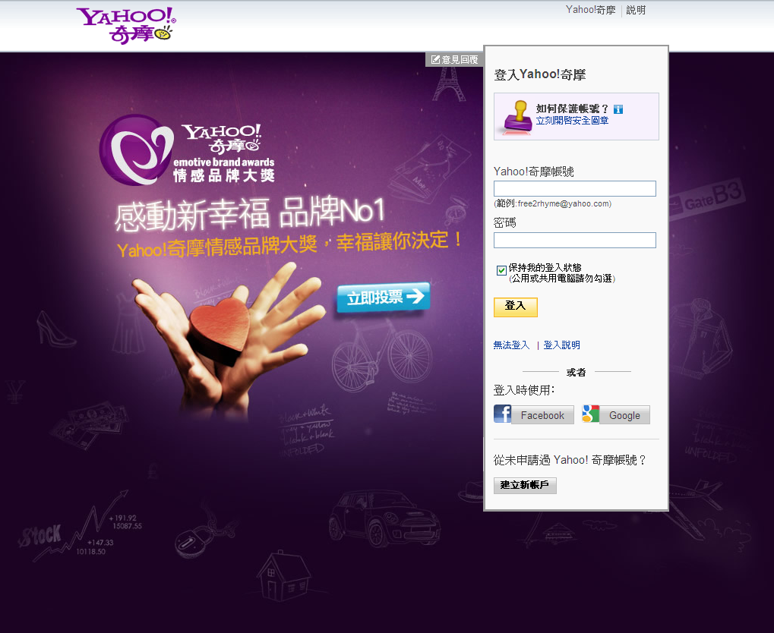
Login Ad | Style 1：Static Image
Size: 450 x 450px
Please place all the content and message related to the Ad in this area only.
Please make the area 50 px to the top of the background image, 50px to the login module.
this clickable areas is stationary
Please optimize the image 1024x768px, avoid cropping important message due to various resolution.
Image Size：
Under
1440 x 1024 px / 100 K

Slide 4
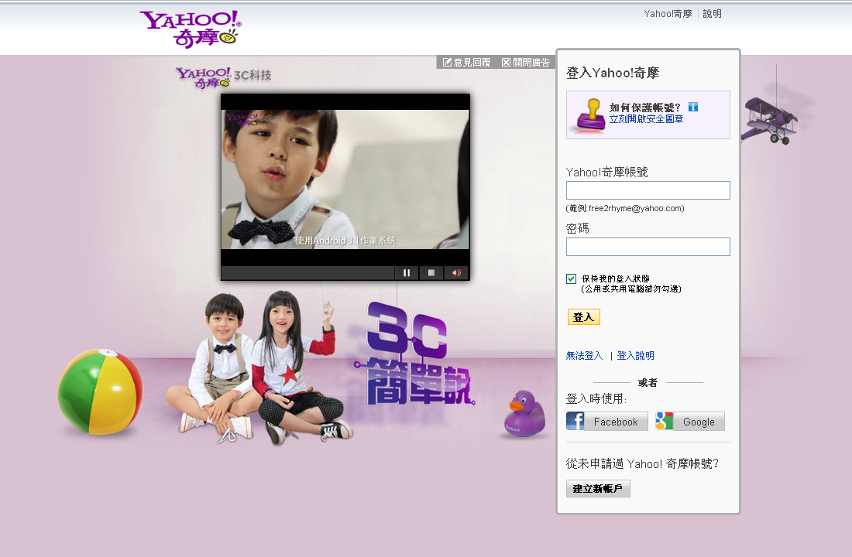
Login Ad | Style 2：Interactive Flash / Video
"Survey" & “Close/Open” button (compulsory)
clickable / interaction area
Max. 450 x 450 px
Max. video width: 450 px
Max. video duration: 30 sec.
Flash dimension：1000 x 520 px
Max. flash animation duration: 10 sec.
Max. file size: 100 K
No background image，
But please set a background color,
Provide the HEX code.

Slide 5
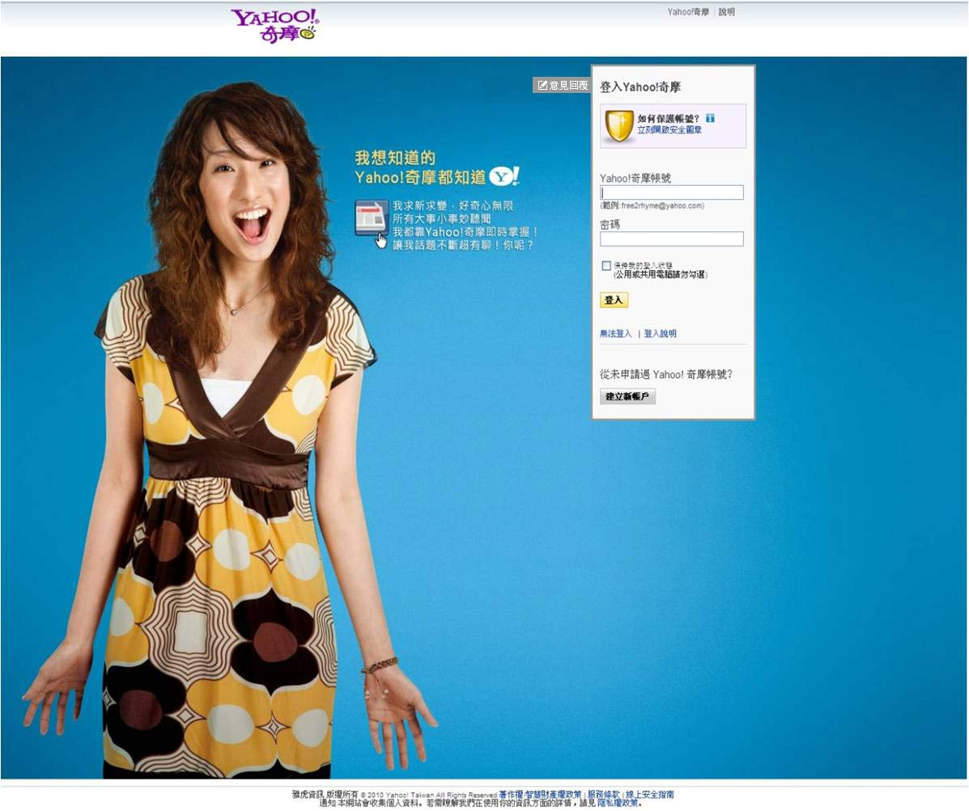
Login Ad | Guideline
1
The link『意見回覆』is required for user survey.
2
Header and footer would show on the first screen.
3
Please optimize the background image:1024x768px

Slide 6
Login Ad | Guideline
1
The message must be clear.
2
Please make the brand name/logo clear.
3
Please make all the flash materials (animation and video ) click and play. No auto-play and auto-load permitted.
6
No column or form require the users to fill out permitted.
7
You may not require user to register or subscribe any products and service.
8
5
Please provide only one group of materials. Any ad rotation is not permitted.
4
Please provide all the image, logo and typeface with great resolution.
Please make the text easy for reading. Do not use any SP promotion.

Slide 7
Login AD│Material Size
Style 1：Image
Name | Length x Width (pix) | File Type | File Size Limit
Background Image | 1440 x 1024 | GIF / JPG | 100K
Background color (optional) | N/A | Color Hex Code (e.g. #000000) | N/A
Diagram | Please indicate the location for clickable area.
The background image is un-clickable, but you may set a button or area （Max 450x450px）that directs to another webpage.
Please provide all the materials 7 days prior to deadline as we need to verify, testing and create demo page.

Slide 8
Login AD│Material Size
Style 2：Interactive flash / video version
Name | Length x Width (pix) | File Type | File Size Limit
Flash | 660x 520 px Animation duration max:10 seconds | SWF & FLA | 100K
Video | 1. For 4:3, max video player is 450x335px. For 16:9, max video player is 450x255px. 2. Duration: 30 seconds max | MOV / WMV | 100MB
Backup Image | 1000x 520 px | GIF / JPG | 100K
Background Color(optional) | N/A | Color Hex Code (e.g. #000000) | N/A
Diagram | Please indicate the location for clickable area.
The background image is un-clickable, but you may set a button or area （Max 450x450px）that directs to another webpage.
Break apart all the text into image and export SWF with Flash Player 8 / AS2.
Flash frame rate: Under 18 fps。
Please provide a fine quality video, as the video provided affects the FLV resolution after converting.
Please provide all the materials 7 days prior to deadline as we need to verify, testing and create demo page.

Slide 9
Login AD│Attention
If the internet bandwidth is too slow, the ad system would show the Yahoo! TW text message, not the login ad.
You may not ask the user to download any software or plug-ins.
Please upload all the materials to Yahoo!, any 3rd party material and tracking pixel are not allowed.

Slide 10
Should you have any inquiries, please contact
tw-adtech@yahoo-inc.com

