Slide 1

Improving Response Times for NYC Service Agencies
Using Predictive Analytics to Enhance Operational Efficiency

Slide 2

The Challenge: Delays in Responding to Complaints
NYC service agencies handle millions of complaints every year, but delays in resolving these complaints are a significant challenge. For example, noise complaints in Brooklyn often take 2 hours to resolve, while complaints of Heat or hot water in Queens may remain unresolved for days! These delays reduce public trust and satisfaction. When residents don’t see timely action, they feel neglected, which impacts their perception of city services. The root causes of these delays include limited resources, inefficient allocation of staff, and unpredictable spikes in complaint volumes. Without a clear understanding of where delays are likely to occur, agencies struggle to prioritize and respond effectively. Our solution addresses this challenge by using predictive analytics to forecast response times. By predicting delays before they happen, NYC agencies can allocate resources more strategically and ensure faster resolutions. This will not only improve operational efficiency but also restore public confidence in city services.

Slide 3

Forecasting Response Times with Predictive Analytics
We’ve developed a predictive model that forecasts response times for NYC service complaints using historical data. The model takes into account key factors such as the type of complaint, location, time of day, and other relevant variables to generate accurate predictions.
By analyzing these inputs, the model provides actionable outputs: predicted response times for different types of complaints. This enables agencies to anticipate potential delays, allocate resources effectively, and address high-priority issues proactively for NYC service complaints using historical data.
The model takes into account key factors such as the type of complaint, location, time of day, and other relevant variables to generate accurate predictions. By analyzing these inputs, the model provides actionable outputs: predicted response times for different types of complaints. This enables agencies to anticipate potential delays, allocate resources effectively, and address high-priority issues proactively.

Slide 4

Benefits for Agencies
By forecasting response times, this model empowers NYC agencies to operate more efficiently in three key ways.
First, it enables resource allocation by identifying areas with predicted delays, allowing agencies to strategically assign staff and vehicles where they are needed most.
Second, it supports prioritization by flagging high priority complaints, such as safety related issues, ensuring that critical cases receive immediate attention.
Finally, it facilitates proactive planning by helping agencies anticipate busy periods such as holidays or seasonal spikes and prepare in advance. These capabilities not only reduce delays but also enhance public satisfaction and trust in city services.

Slide 5

Real-World Example
For Illegal Parking complaint type in Brooklyn, the model predicts an average delay of 204 hours. Using this insight, agencies can take proactive measures, such as allocating additional staff or resources to the area during peak complaint periods. For example, reallocating staff would reduce delays by 30%, ensuring faster resolutions and improving resident satisfaction. This demonstrates how predictive analytics translates into actionable decisions that directly benefit the community.

Slide 6

Next Steps, Putting the Model into Action
To implement this solution, NYC service agencies can take the following steps:
First, integrate the predictive model into existing systems for real-time predictions.
Second, monitor its performance regularly and retrain it periodically with new data to maintain accuracy.
Finally, collaborate with stakeholders to identify additional use cases, such as predicting complaint volumes or identifying systemic bottlenecks. By adopting this model, NYC agencies can transform their operations and better serve the community.

Slide 7
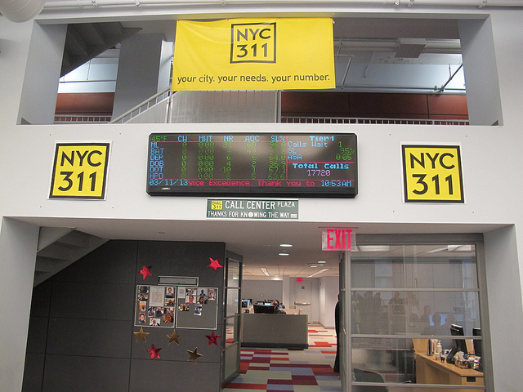
Transforming NYC Services with Predictive Analytics
To conclude, this predictive model provides actionable insights to help NYC service agencies operate more efficiently. By forecasting response times, agencies can allocate resources effectively, prioritize critical complaints, and plan ahead for peak periods. Together, we can reduce delays, improve public satisfaction, and restore trust in city services. Let’s work together to make NYC services faster and more efficient.

