Slide 1

Washington State DOT ADCMS

Slide 2
Sign Lifecycle at WSDOT
TRAFFIC
Existing Signing Inventory Added from LiDAR
TSMS
Existing Signing Uploaded into OpenRoads for sign design
Central Database
Maintenance:
Modifies sign attributes in HATS
MAINTENANCE
Sign Design
Signing Uploaded into HATS for Maintenance Inspection
Item Type Information Added: All Items from the Sign Specifications Sheet
DESIGN
Sign Specification Sheets for Manufacturing generated from OpenRoads
Item Type Information Added
Signing Uploaded into Unifier for Construction Inspection
Construction: As-Built Information Added Using Unifier
Orange = Items the study will work on
Blue = Processes that put data in Green = Programs that take out data
CONSTRUCTION
Notes:
AIM allows users to query the data for things that have been joined or nearby on a map
Gate keeper
Some testing with ramps, crosswalks, and MIRE

Slide 3


TRAFFIC
Existing Signing Inventory Added from LiDAR
TSMS Viewer
Maintenance:
Modifies sign attributes in HATS
Existing Signing Uploaded into OpenRoads for sign design
Central Database
MAINTENANCE
Signing Uploaded into HATS for Maintenance Inspection
Sign Design
Item Type Information Added: All Items from the Sign Specifications Sheet
DESIGN
Sign Specification Sheets for Manufacturing generated from OpenRoads
Item Type Information Added
IFC from other sources
IFC to other applications
Signing Uploaded into Unifier for Construction Inspection
Construction: As-Built Information Added Using Unifier
Orange = Items the study will work on
Blue = Processes that put data in Green = Programs that take out data
CONSTRUCTION
Notes:
We examined how IFC could be the link between Design, Construction, and the sign database

Slide 4
IFC to ORD
9 step process to get all the sign attributes into ORD
Notes:
We found that importing IFC to ORD was orphaning the majority of data fields
This is the process we developed to get closer to a lossless import of IFC

Slide 5
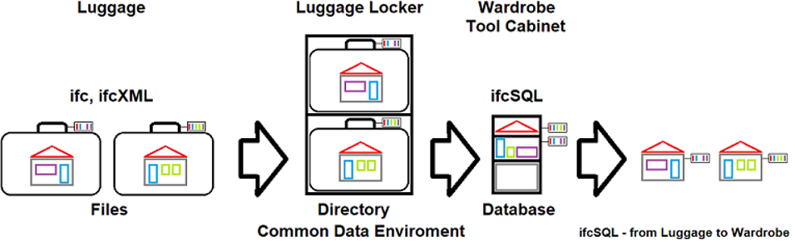
IFC to SQL
IfcSharp/IfcSQL
Swap out the house in your mind for an intersection
windows = signs, structure = road surface, doors = striping, roof = lights
Suitcase is a design project and may contain multiple IFC files by discipline, area, demo/install
The luggage locker is our IFC file manager. It makes projects available to construction and is an archive of past projects.
The elements of the design can be extracted and inserted in a SQL database (CTRL_SMS)
The SQL database can be queried
Data for a road section can be put back into IFC format for new design projects
Notes:
This is about getting IFC data back into our database
IFCShell is another option

Slide 6
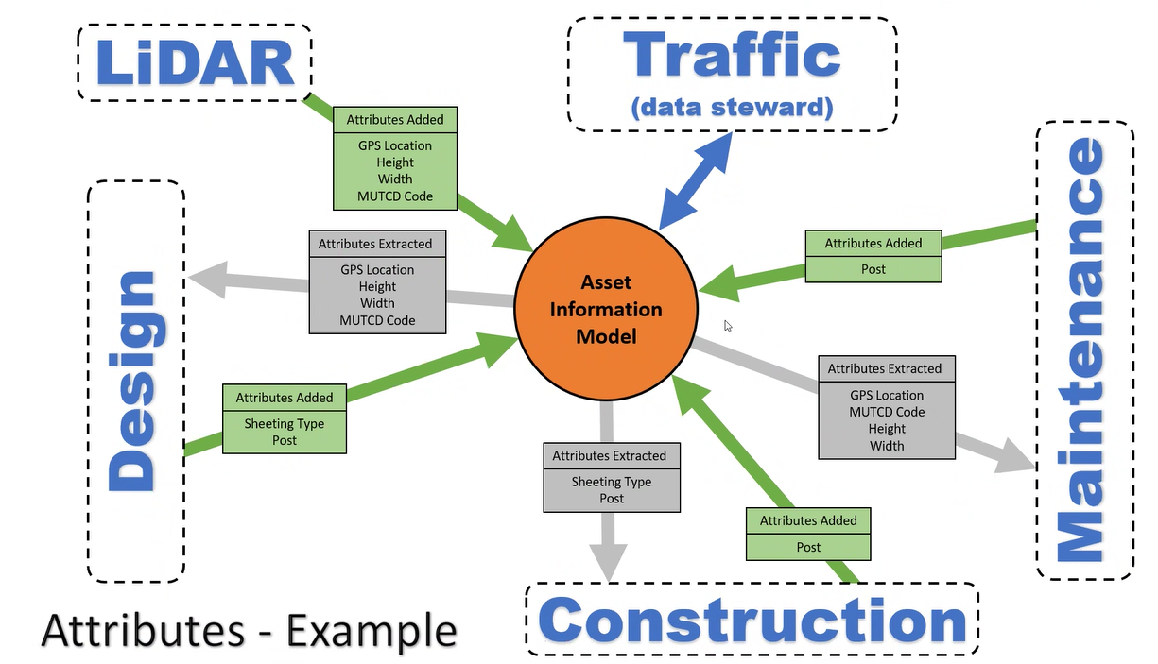
IFC or GIS
AASHTO Digital As-Builts
GIS datasets. As-built information that will be federated with an existing GIS-based asset inventory can be collected directly into a compatible file format. GIS data is searchable and extractable and is stored in a durable database format.
3D models. AASHTO has resolved to adopt Industry Foundation Class (IFC), an international open data standard, ISO 16739
ADCMS Scope of Work excerpt:
The central database (aka. Asset Information Model) must be developed using national standards (e.g., Industry Foundation Classes and data dictionaries) that will allow the exchange of data to be vendor agnostic
Notes:
Do the assets you are working with warrant IFC or can they be communicated using GIS

Slide 7
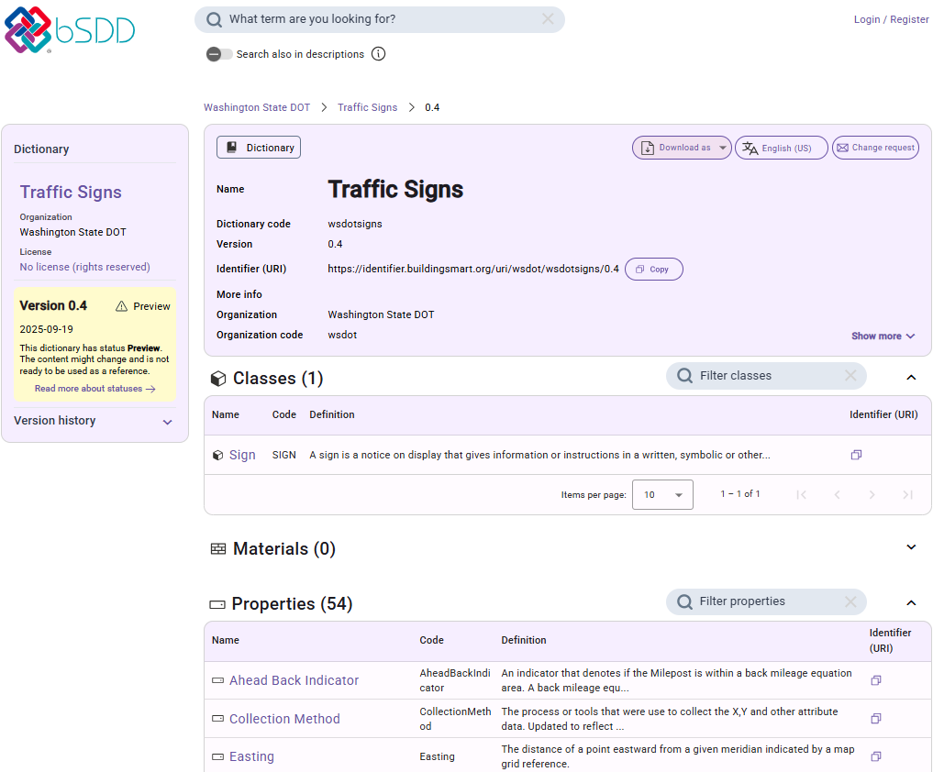

Data Dictionary
https://search.bsdd.buildingsmart.org/uri/wsdot/wsdotsigns/
Notes:
Ideally you define a common language including a dictionary to define words
Explain effort to create bsdd and resources we used and created

Slide 8
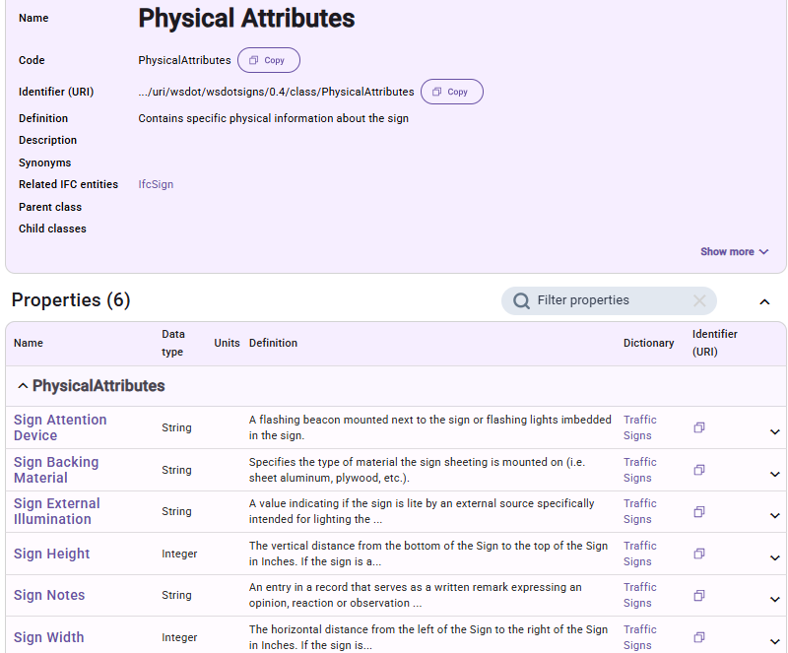
Data Dictionary
Organize data in Property Sets
https://search.bsdd.buildingsmart.org/uri/wsdot/wsdotsigns/

Slide 9
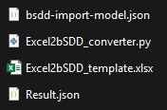
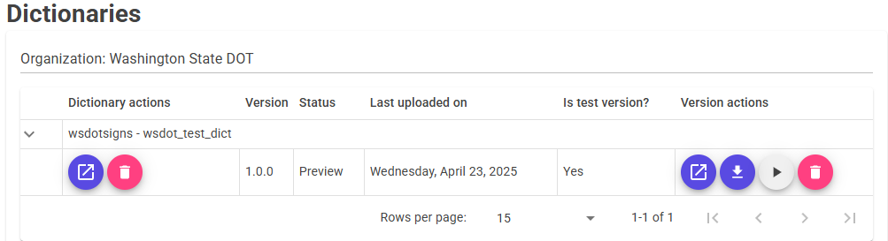
Process
Create bSDD organization
Fill out Excel template
Run Python script (Excel2bSSD_converter.py)
Using the following files -------------------------- >
Generate JSON (Result.json)
Validate JSON using bsDD import model (bsdd-import-model.json)
Upload to manage.bsdd.buildingsmart.org

Slide 10
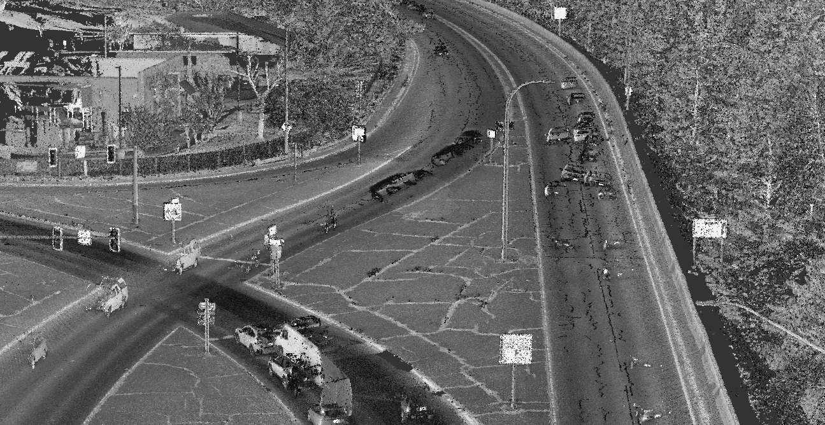



Michael Ross
Digital & Data Lead Jacobs
503-736-4095 Micahel.Ross10@jacobs.com
Doug Howe
Americas Geospatial Technical Excellence Leader & Northwest Geospatial Group Leader Jacobs
720-276-2333 Doug.Howe@jacobs.com
Jim Mahugh
Digital Delivery Lead Washington State DOT
360-705-7245
Jim.Mahugh@wsdot.wa.gov

