Slide 1



NATA/NWCA/NSAA
Wrestling Weight Management
NSAA Assessor’s Guide to Testing Athletes

Slide 2
History Of Weight Management
1997- Three college wrestlers died while engaged in unsafe “weight loss” activities.
1999 - The NCAA Medical Advisory Committee established and mandated a comprehensive weight certification program to safeguard wrestlers.
1999 - Several State High School Athletic Associations begin mandating the rule.
2006 – Nebraska began to mandate Weight Management.

Slide 3
Weight Management Program Components:
Preseason Assessments For:
    Weight
    Hydration
    Body Fat
To Establish:
    Minimum Wrestling Weight
    Safe Weight loss Plan
    Daily nutrient goals

Slide 4
NFHS and NSAA
The NFHS has 50 states plus the District of Columbia (51). There are 50 of 51 members who offer state wrestling championships.
In April 2005, the NFHS Medical Advisory Committee & NFHS Wrestling Committee transformed its wrestling weight management recommendation into a mandated rule. The NSAA was in compliance of this national rule for the 2006-2007 wrestling season.

Slide 5
Regulations
-The establishment of a minimum wrestling weight based on 7% body fat for males and 12% body fat for females.
-Hydration level of 1.025.
-Weight loss no greater than 1.5% per week of the athlete’s body weight – calculated daily.
-Nutrition education program for student-athletes.

Slide 6
Getting Ready to Test

Slide 7
Establishing Minimum Weights
Assessments may begin November 9th 2010. Assessments must be performed prior to the first competition for any individual at any level.

Slide 8
Suggested Preparation of Wrestlers for Assessments
Preparation begins the day before. Athletes should drink plenty of fluids 24 hours in advance.
No vigorous activity on the evening before and the day of the testing.
Avoid any caffeinated beverages on the day before and day of the testing.
On the day of testing, drink 500ml (17 oz.) of fluid. (A sports drink is an excellent choice).

Slide 9
Avoid any vitamin or mineral supplements two days before and the day of testing.
Be awake three hours prior to testing.
Do not eat two hours prior to testing.

Slide 10
Data Collection
All assessment data for each wrestler should be initially recorded on a data collection form or an index card so a “hard copy” backup system is available.
A data collection form for both BIA measurements and skin fold measurements is available within the NSAA Assessor login or on the NSAA Wrestling website: http://www.nsaahome.org/textfile/wrest/datarecord.pdf

Slide 11
Materials Needed for Testing Site
Site | Data Forms (Labels) | Collection Cups & Gloves | Refractometer OR Hydration Test Strips
Accurate Scale – if using Skin Fold Calipers OR Height Assessment Tool if using Tanita Scale | Skin Fold Calipers OR Tanita Scale | On Line Computer | Additional Staff NO Wrestling Coaches!

Slide 12
Step 1
Assessment of Hydration Status

Slide 13
Completion of a hydration test is required BEFORE any wrestler can undergo a body composition or weight assessment.
Purpose is twofold.
  Dehydration can significantly affect a BIA body composition measure which will result in an invalid percent body fat.
  Dehydration or loss of water weight will directly affect minimal wrestling weight.

Slide 14
Step 1 - Assessment of Hydration Status
Two methods commonly used to assess urine specific gravity (Usg) are: 1) hydration test strips and 2) refractometer. Test strips are mailed to the school AD in October. Assessor’s choice as to which hydration test mode will be used.
Refractometry is considered the gold standard. Reagent strips are supplied to schools and are a acceptable alternative in Nebraska at this time.
The NSAA does not supply refractometers for assessors.

Slide 15
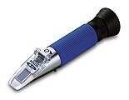
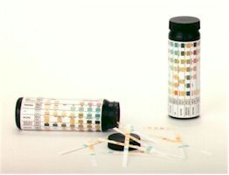
Step 1 - Assessment of Hydration Instruments
Refractometer
Urine Test Strips

Slide 16
Step 1 - Assessment of Hydration Status
If a wrestler has a urine specific gravity above 1.025 (as set by the NFHS) the wrestler should not be allowed to undergo the body composition assessment.
If wrestler fails the hydration test they may not be weighed or body fat tested. The wrestler must weight 48 hours to be tested again.

Slide 17
Step 1 - Assessment of Hydration Status: Protocol
Evaluator assistant wears rubber gloves during the assessment.
Practice and enforce secure procedures during urine collection and assessment: Subject is provided a cup (marked by name or identification number). Sample should never leave the possession of the subject. IMPORTANT: If using test strips – the assessor should control from test to disposal each athlete’s sample and test strip.
Subject is then instructed to provide a 2-3oz. urine sample (mid-stream) in the urinal/bathroom under supervision.

Slide 18
Step 1- Assessment of Hydration Status: Protocol
Urine specific gravity is then measured by reagent strips or a refractometer. (follow manufacturer's guidelines – strips require one minute wait time for accurate reading)
Upon successful completion of the hydration test the subject should dispose of sample and then proceed to the body weight and body composition assessment stations.

Slide 19
Step 2
Assessment of Height
Only necessary when using Tanita (Athletic Mode only) B.I.A. to measure body fat

Slide 20
Step 3
Assessment of Body Composition
Skin calipers, bio-impedance, hydrostatic weighing, and BodPod are all currently approved by the NSAA.

Slide 21
Step 3 - Assessment of Body Composition
The most used methods to assess body fat in Nebraska with the critical masses are: 1) skinfold analysis and 2) bioelectrical impedance analysis (BIA).
All personnel conducting the body composition assessment should have advanced training and education in whichever method is being employed before November 9th, 2009.
NOTE: A wrestler’s weight measurement may be in the nude only if the assessor is of the same gender.

Slide 22
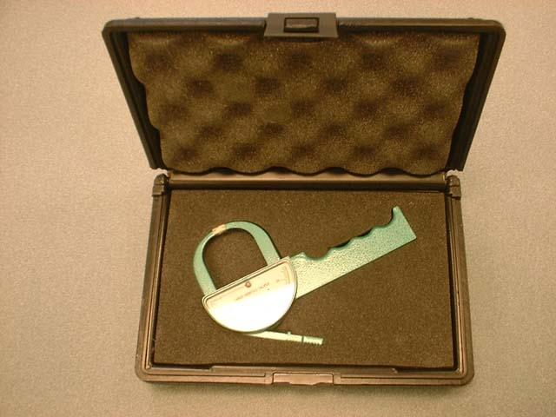
NSAA Approved Skinfold Calipers
Baseline Harpenden Holtain
Lange Lafayette Skyndex
No Plastic calipers will be permitted.

Slide 23
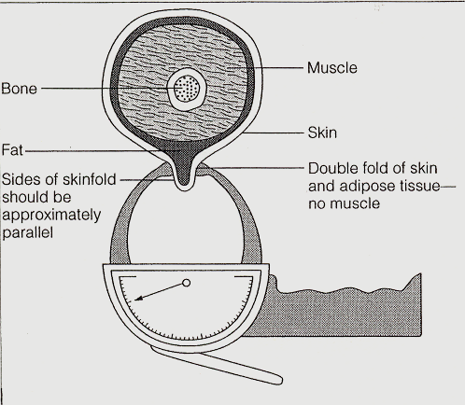
As shown below, the goal is to measure a double fold of skin and subcutaneous tissue (with sides of skinfold approximately parallel). The thicker the fat layer, the wider the fold.

Slide 24
Basic Rules for Taking Skinfolds
Take skinfold measurements on the right side of the body (most skinfold equations were developed from measurements on the right side).
Do not take measurements when the subject's skin is moist (ensure that the skin is dry, and has no lotion). Do not take measurements immediately after exercise.
To reduce error during the learning phase, prior to November 9th, 2009, skinfold sites should be precisely determined, marked, and verified by a trained instructor. The largest source of error in skinfold testing is inaccurate site selection.

Slide 25
Skinfold Rules (continued)
Firmly grasp the skinfold with the thumb and index finger of the left hand, and pull away.
Hold the caliper in the right hand, perpendicular to the skinfold and with the skinfold dial facing up and easily readable. Place the caliper heads ¼-½ inch away from the fingers holding the skinfold. Try to visualize where a true double-fold of skin thickness is, and place the caliper heads there.

Slide 26
Skinfold Rules (continued)
Read the caliper dial to the nearest 1 millimeter within 4 seconds. During the measurement, ensure that the left thumb and forefinger maintains the shape of the skinfold.
Assessors must take and record a minimum of 3 measurements at each site (at least 15 seconds apart).
For female athletes, only the triceps and subscapular skinfolds are required.

Slide 27
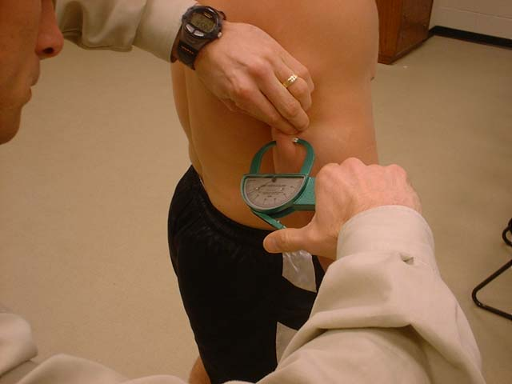
Triceps Skinfold
Vertical fold on posterior aspect of arm, midway between lateral projection of acromion process and inferior margin of olecranon process. Flex the elbow to 90 degrees to identify the landmarks.

Slide 28
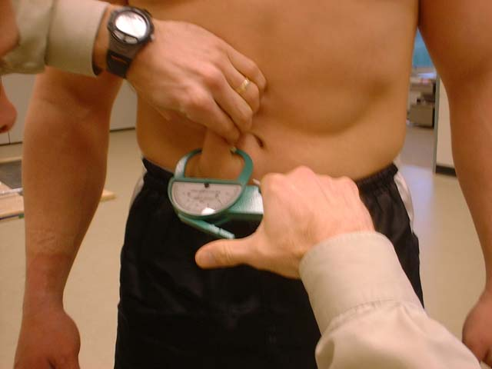
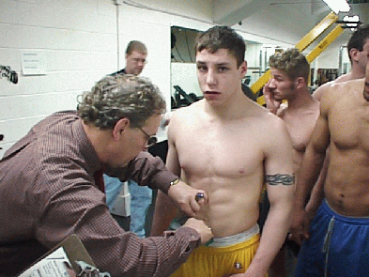
Abdomen Skinfold Site
Vertical fold, one inch to the right side of and ½ inch below the navel.
The Jackson-Pollock procedure uses a vertical fold 2 cm to the right of the umbilicus.

Slide 29
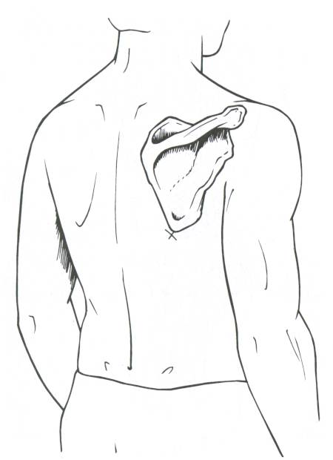
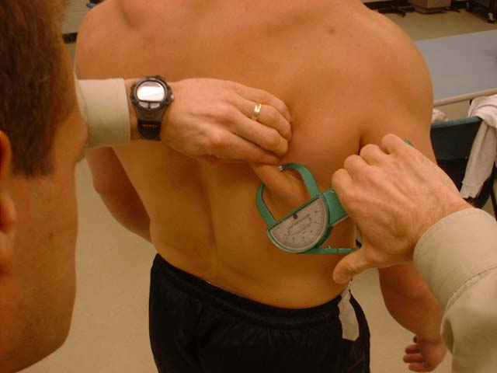
Subscapular Skinfold
Diagonal fold just below the inferior angle of scapula.

Slide 30
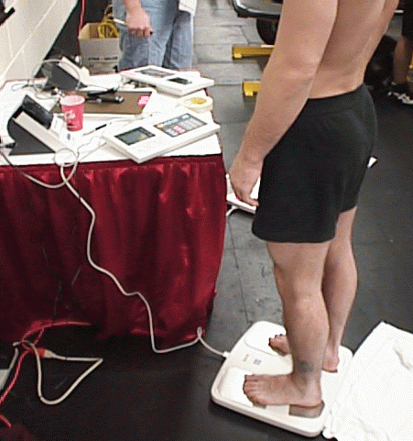
Assessment of Body Composition Option #2:
Leg-to-Leg BIA
(Tanita Scale TBF-300WA – Athletic Mode)

Slide 31
Assessment of Body Composition: Bioelectrical Impedance Analysis (BIA)
BIA does not requires a high degree of technician skill and therefore is easy to use, and provides simultaneous measurements of body weight and body composition in a short time period. Use only NSAA approved Tanita scale TBF-300WA. The scale must be in the “Athletic Mode”.
Wrestler simply stands on the scale after entering a few pieces of information (age, gender, height) and results are generated in less than 1 minute.
NOTE: A wrestler’s weight measurement may be in the nude only if the assessor is of the same gender.
Body fat results are then entered into the Initial Assessment page for calculation of minimal wrestling weight.
The Tanita scale print out should be attached to the Data Collection Form of each athlete.

Slide 32
Step 4
Record Weight

Slide 33
Step 5
Enter the Data into the NWCA Optimal Performance Calculator

Slide 34
Step 5 – Entering the Data
The registered NSAA assessor is the only person allowed to enter data into the OPC. NO wrestling coach shall be present during testing or during this process as well.
Please follow the specific OPC instructions for entering data. You may find the instructions on your NSAA assessor login page or the NSAA Wrestling web site at:
http://www.nsaahome.org/textfile/wrest/assessorinstructions.pdf

Slide 35
Step 5 – Entering the Data
Results of the hydration, height (if using BIA) and body weight assessment will be entered into the NWCA Optimal Performance Calculator on the Initial Assessment page located at:
www.nwcaonline.com/nwcaonline/default.aspx

Slide 36
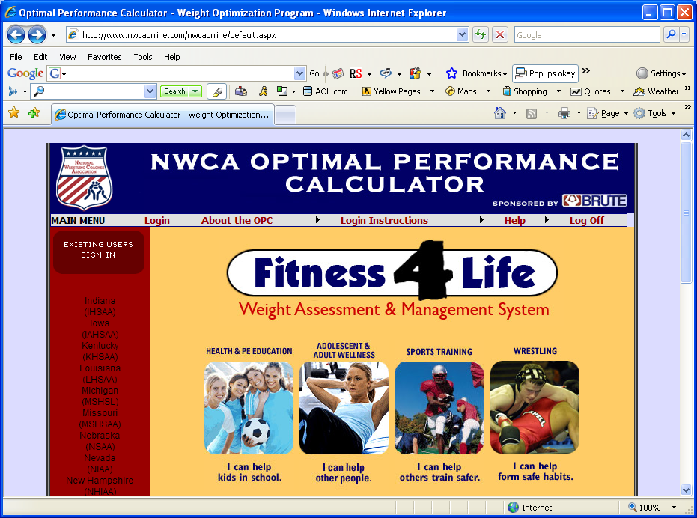
www.nwcaonline.com

Slide 37
Logging In
Assessor Codes:
User Name & Password
(same as NSAA codes)

Slide 38
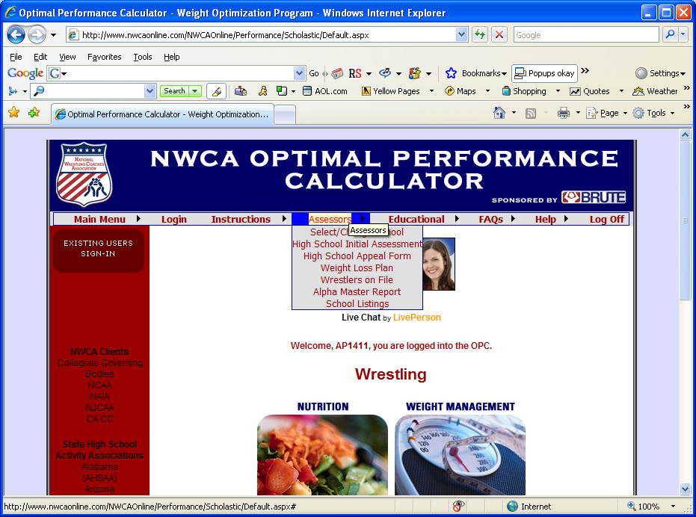
Assessor Toolbar

Slide 39
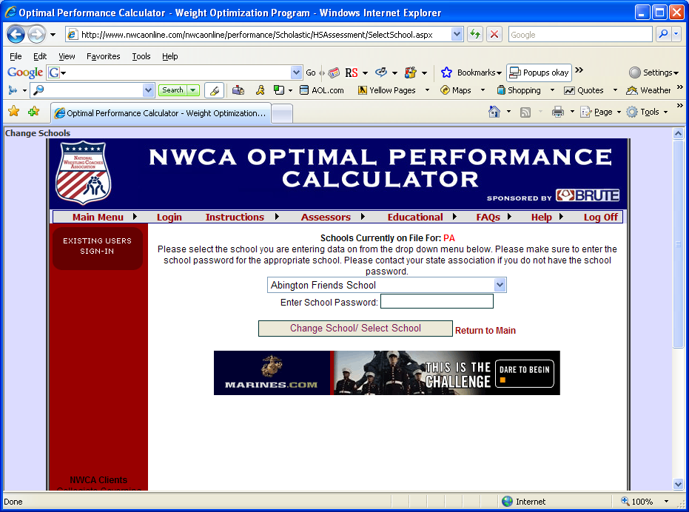
Select School to Enter Data
& Enter School Password – (sent to school in the fall) Contact the NSAA if you do not have the school password.

Slide 40
Entering the Data for Males
Name, Class, etc.
Urine specific gravity
Alpha body weight
Height (if using Tanita Scale)
Skin Fold Measurements (must enter all three for each site)
Percentage of Body Fat
The OPC will automatically calculate the following:
Fat weight
Fat Free Weight
Minimum Wrestling Weight

Slide 41
Entering the Data for Female Wrestlers
Click on the Add female wrestler link of the initial assessment page.
Data entry is the same as males with the following exception:
Only the triceps and subscapular skinfolds will be entered. (if using skin fold)
Minimal wrestling weight will be calculated at 12%.

Slide 42
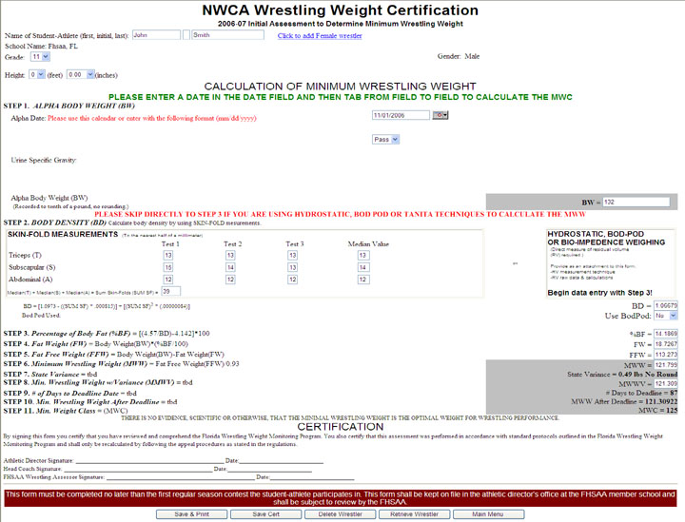
Skinfold data then entered into the Initial Assessment form for the calculation of minimal wrestling weight.
Notes:
Note:
Note: On this assessment form, the person entering the data will type in the signatures. The states have the option of choosing either manual or electronic signatures.

Slide 43
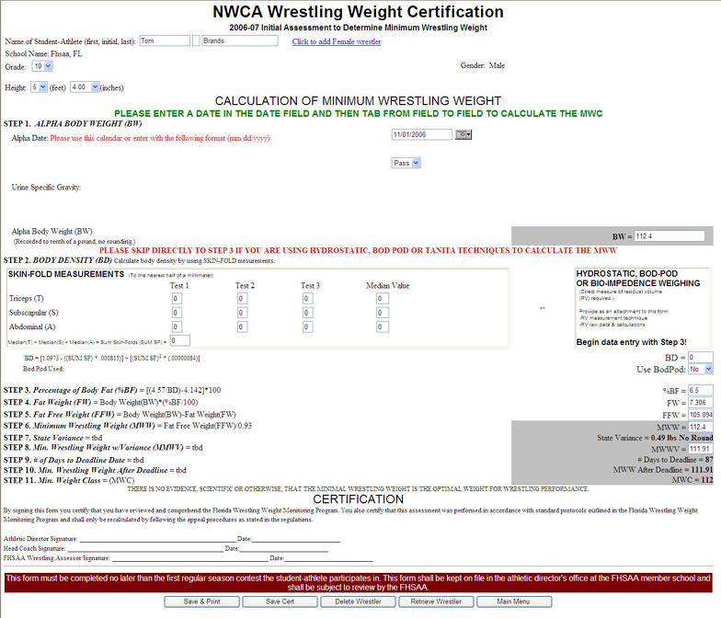
How to enter BIA into the Initial Assessment form for the calculation of minimal wrestling weight.
Notes:
Note: On this assessment form, the state is using manual signatures. You manually have to sign the forms after they are printed.

Slide 44
Appeal process for body composition assessment:
If the wrestler is dissatisfied with his or her body fat measurement they have the opportunity to appeal their results. The wrestler must wait 48 hours to be tested again for an appeal by any registered assessor. If you are testing as an appeal make sure you follow the appeal instructions. The rest of the data entry is the same.
All wrestlers, regardless of body fat percentage, may also request a Medical Clearance for an additional 2% body weight loss after the minimum wrestling weight has been established through a successful test or appeal.
A Medical Clearance may NOT be granted by an assessor.

Slide 45
Nutrition Education Program
Available for athletes through the head coach.

Slide 46
Questions or Concerns:
Questions concerning NSAA Weight Management should be directed to Darin Boysen – NSAA Office:
402-489-0386 or dboysen@nsaahome.org
Questions concerning the NWCA web site or the OPC should be directed to Betsy Peachey – NWCA Office:
717-653-8009 or bpeachey@nwca.cc

Slide 47
Thank You

