Slide 1

Predictive Model & Present by Ricky Nguyen
19/9/2020

Slide 2
Agenda
Company Background
Business Question/Data Question
Project Pipeline
Data insights
Modelling
Conclusion/ Recommendation
Future Improvements

Slide 3
What is Lending Club
Lending Club is an American peer-to-peer lending company
A platform connecting borrower to investor
2019 default rate at 6.6%
Default wiped off $811 millions USD in 2019 for Lending Club’s investors

Slide 4
Business Question
How can we detect DEFAULT Borrower from loan application?

Slide 5
Data Question
What factors indicated a Loan Default and what model could be used to effectively identify Default Borrower?

Slide 6
Project Pipeline
Data Acquisition
EDA
Preprocessing
Modelling
Validation

Slide 7
Dataset Summary
Lending Club Loan Dataset
396,000 observations (2007-2016)
26 features (12 numeric, 14 object)
Imbalance Data (20%-80%)

Slide 8
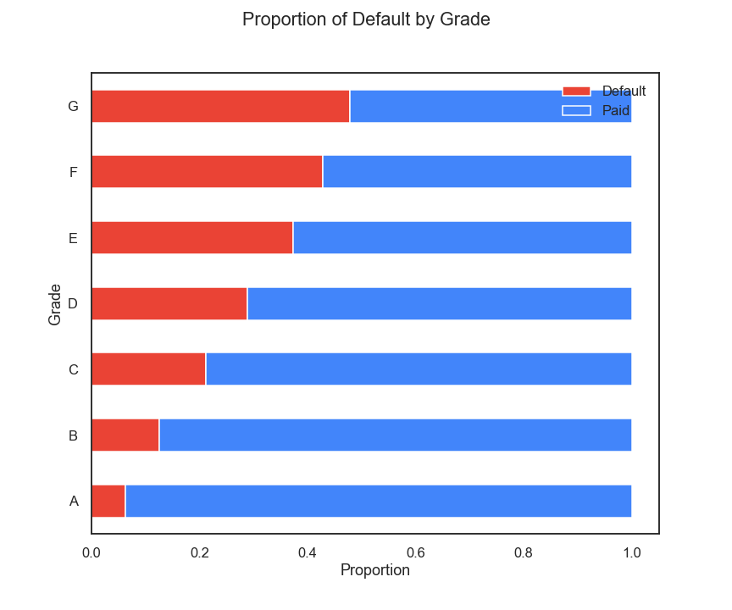
Grade
Grade is based on credit scores
G-grade has 45% default rate

Slide 9
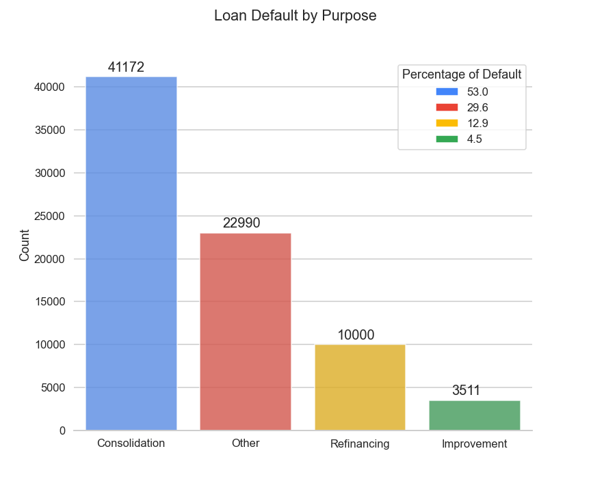
Purpose
44817 unique purposes
Categories by most repeated words
4 Main Unique words

Slide 10
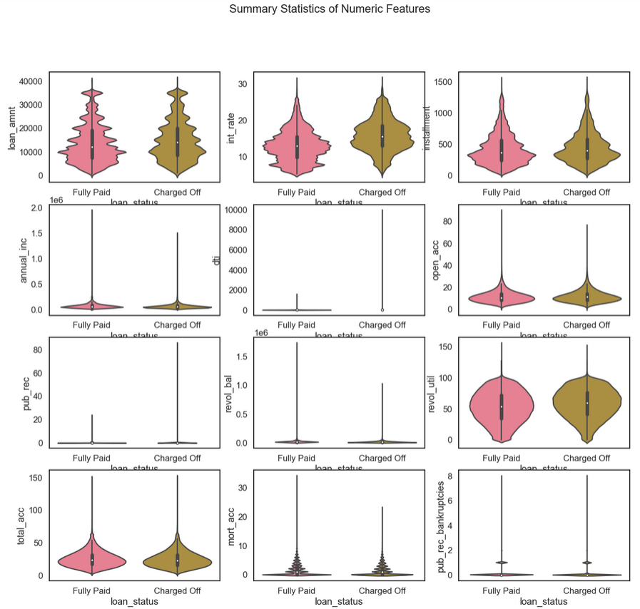
Distributions & Summary Statistics
Features
Loan Status

Slide 11
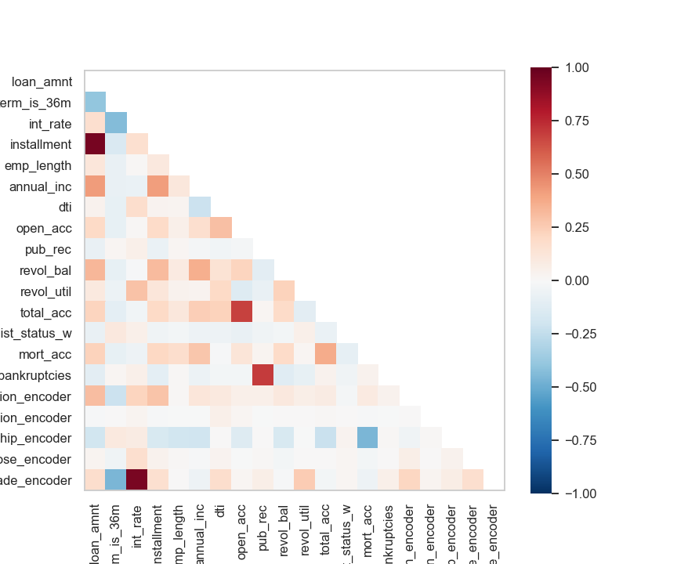
Feature Selection
Pearson Correlation between features
Correlation to Target
Correlation between features
9 Features Selected

Slide 12
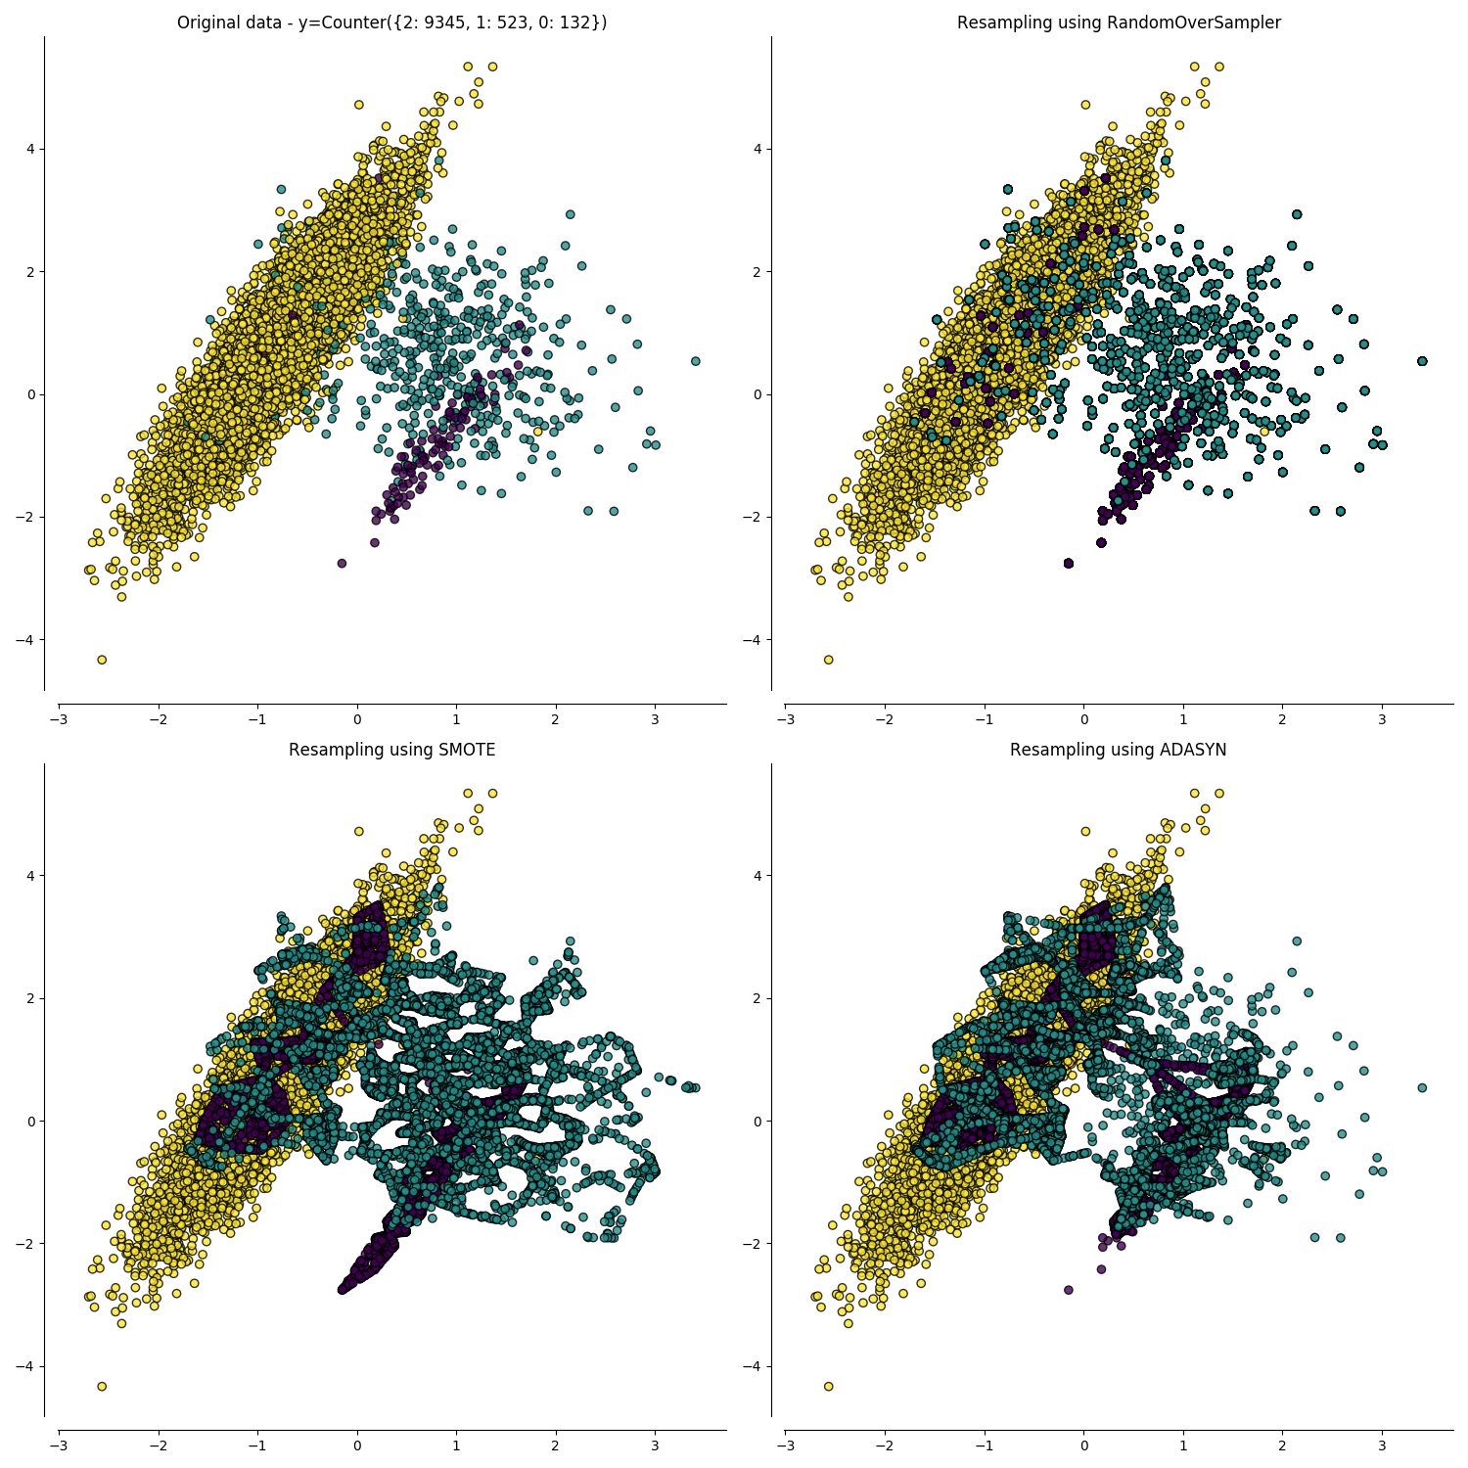
Preprocessing
Scaling
Robust Scaler
Standardization
Sampling
SMOTENC
ADASYN
Under-sampling

Slide 13
Model Selection
Models
Logistic Regression
AdaBoost
Random Forest
Neural Network
Extreme Gradient Boosting
Metrics
F1 weighted
Recall
False Negative
Model | Method | F1 Weighted | Recall | False Negative
Logistic | ADASYN Scaled | 68 | 66 | 5329
ADA | SMOTENC Scaled | 67 | 64 | 5516
RFC | SMOTENC | 73 | 37 | 9702
Neural | SMOTENC Scaled | 66 | 65 | 5474
XG-Boost | Under Sampling | 68 | 67 | 5099

Slide 14
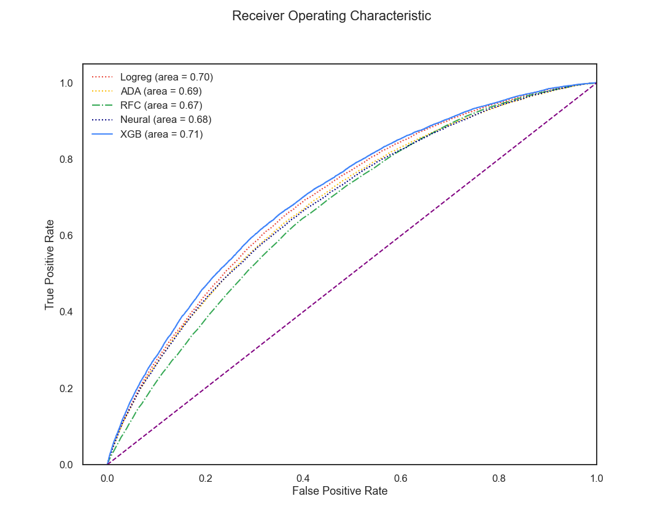
ROC-AUC
XG-Boost
Under-sampling
Resample Validation

Slide 15
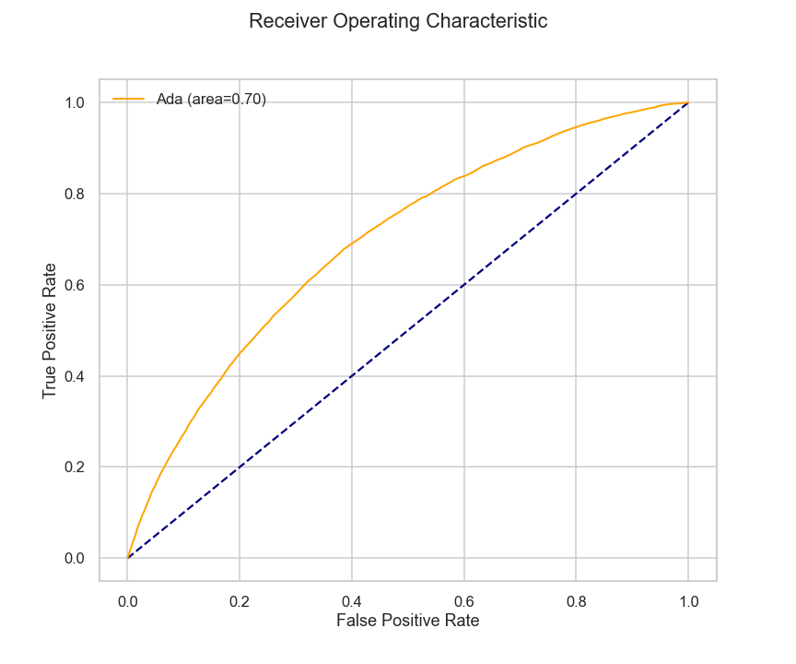
Adaptive Boosting
6 Features
SMOTENC
71% validation on 5 Folds
F1 Weighted | Recall | False Negative
67 | 67 | 5065

Slide 16
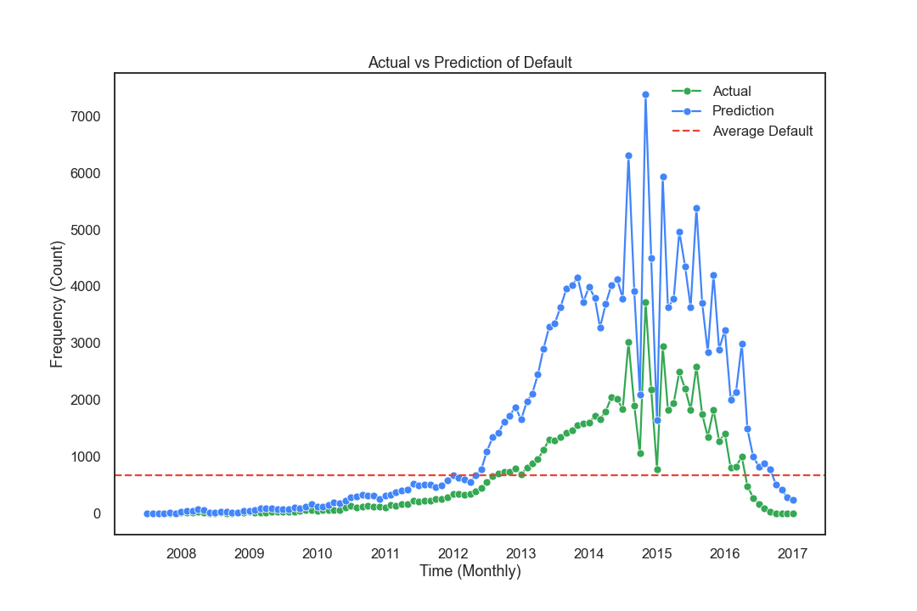
Actual vs Predicted (Investor’s Model)

Slide 17
Conclusion/Recommendation
Interest rate
Debt-to-limit
Total number of credit lines
Grade
Employment length
Debt-to-Income
Investor’s model: Adaptive Boosting
Recall: 67%
$543 millions in investor’s return if the model applied in 2019
It is the trade-off between investor’s returns & company profitability

Slide 18
Future improvements
Acquire more data.
US Unemployment rate (Micro).
US Federal Reserve Bank’s interest rates (Macro).
Reform the applicant’s verification process to improve data quality.

