Slide 1

Predictive Model & Present by Ricky Nguyen
19/9/2020

Slide 2
Agenda
Company Background
Business Question/Data Question
Project Pipeline
Data insights
Modelling
Conclusion/ Recommendation
Future Improvements

Slide 3
What is Lending Club
Lending Club is an American peer-to-peer lending company
A platform connecting borrower to investor
50 Billion USD borrowed
3 Million Customers
2019 default rate at 6.6%
Default wiped off $811 millions USD in 2019 for Lending Club’s investors

Slide 4
Business Question
How can we detect LOAN DEFAULT from borrower’s application?

Slide 5
Data Question
What factors indicated a Loan Default and what model could be used to effectively identify Default Borrower?
Loan originations in 2019 is $12.3 billion USD
6.6% Default is $811 millions USD

Slide 6
Project Pipeline
Data Acquisition
EDA
Preprocessing
Modelling
Validation

Slide 7
Dataset Summary
Lending Club Loan Dataset
396,000 observations (2007-2016)
26 features (12 numeric, 14 object)
Imbalance Data

Slide 8
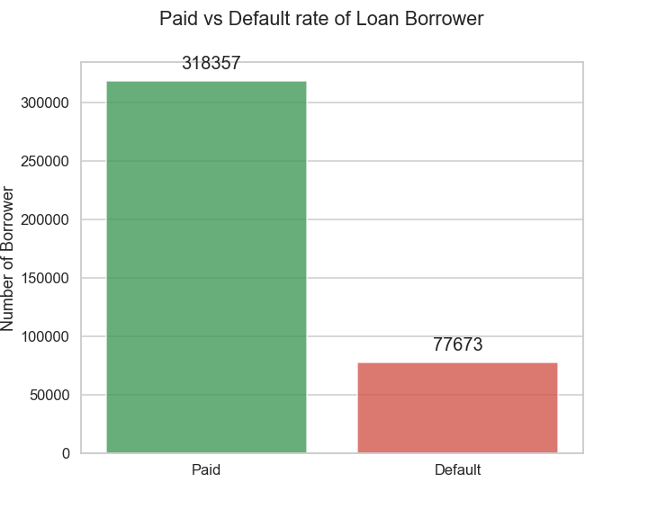
Imbalance
318357 Fully Paid (80%)
77673 Charged Off (20%)

Slide 9
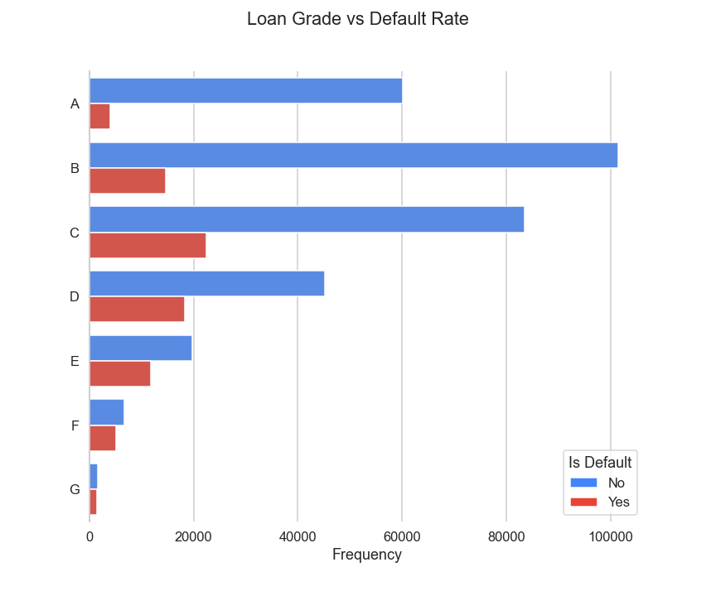
Grade
Grade is based on credit scores
A – G
C Grade has the most default borrower
Cash cow is grade B

Slide 10
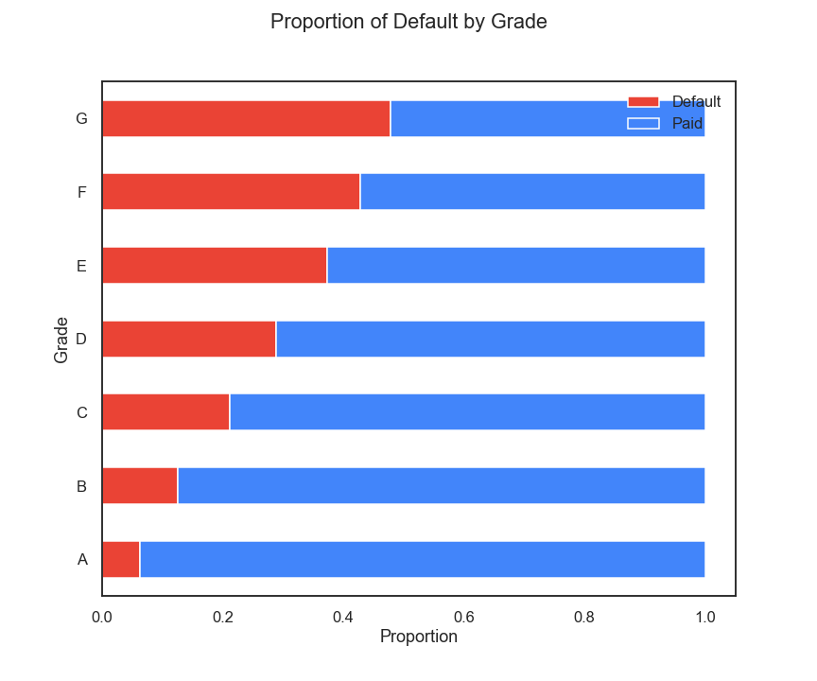
Grade cont.
G-grade has 45% default rate
G-grade has highest interest rate 30.99%

Slide 11
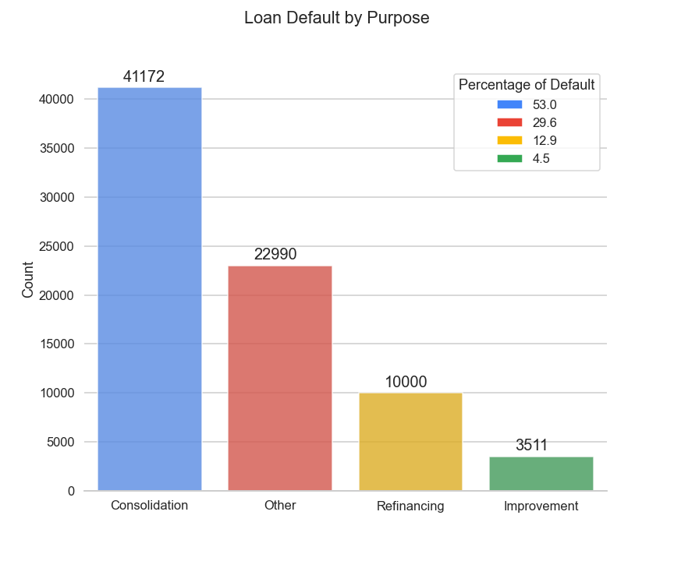
Purpose
44817 unique purposes
Categories by most repeated words
4 Main Unique words

Slide 12
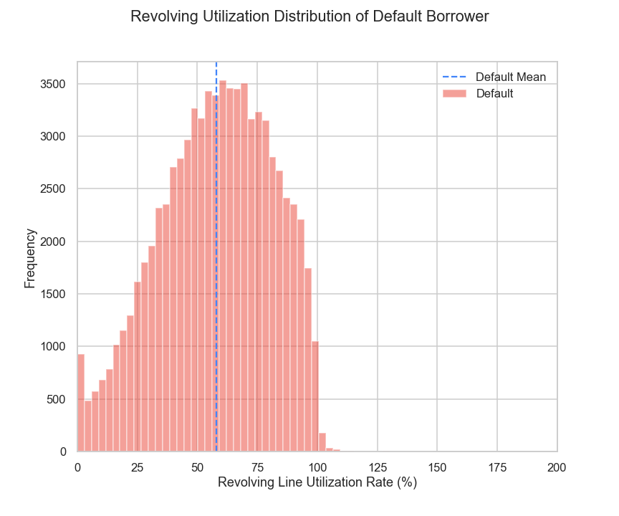
Debt-to-limit
High debt-to-limit leads to default

Slide 13
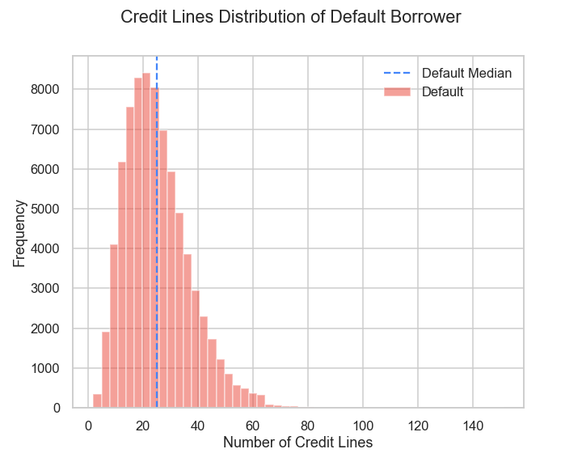
Credit Lines
Majority of default’s borrowers have over 20 available open credit lines

Slide 14
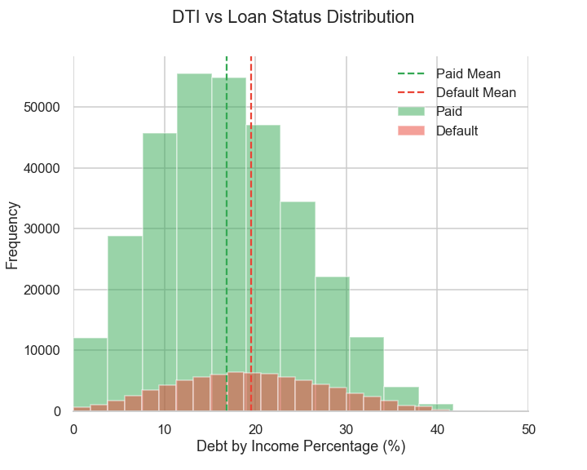
Debt-to-income

Slide 15
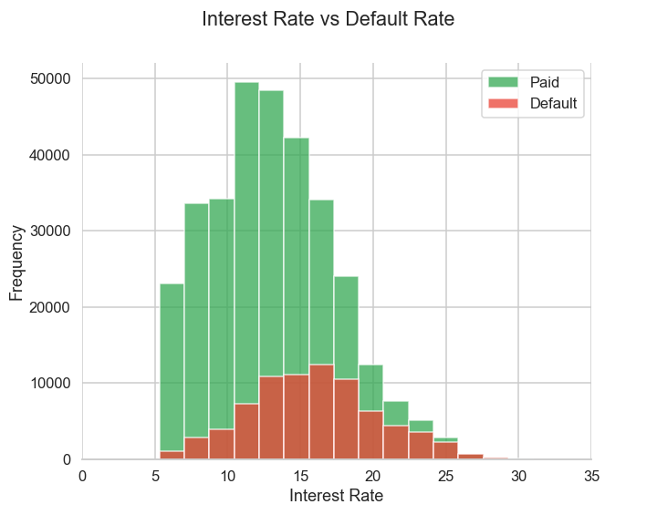
Interest Rate

Slide 16
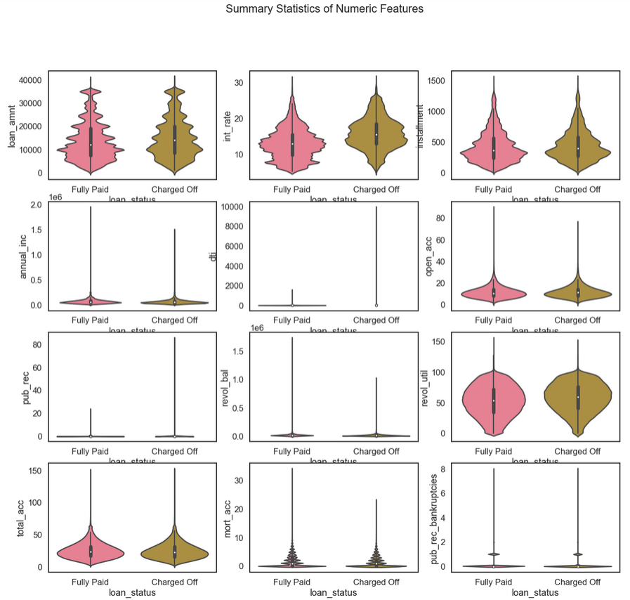
Distributions & Summary Statistics
Features
Loan Status

Slide 17
Trends
Data:
Grade G has 45% default rate
Majority of default is from Grade C
High chances of default if debt-to-limit above 50%
Behaviors:
Low employment length + consolidation purpose = likely to default
High debt-to-limit ratio + many credit lines = extremely likely to default
Applicant tends to make up their annual income intentionally

Slide 18
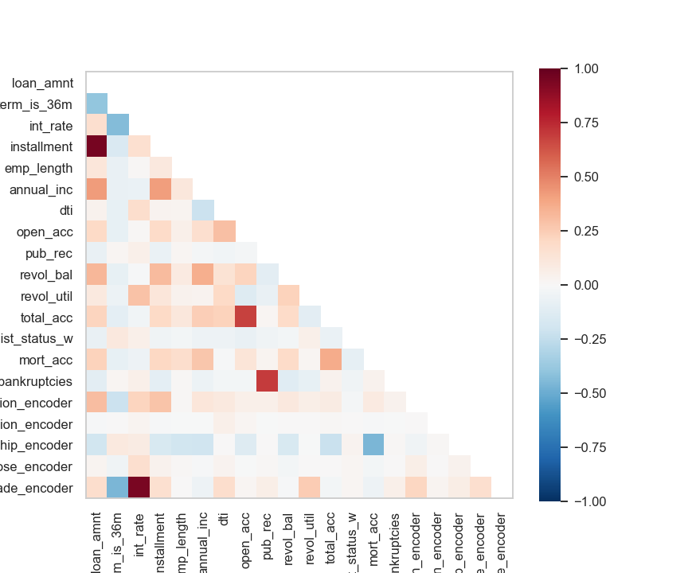
Feature Selection
Pearson Correlation between features
Correlation to Target
Correlation between features
9 Features Selected

Slide 19
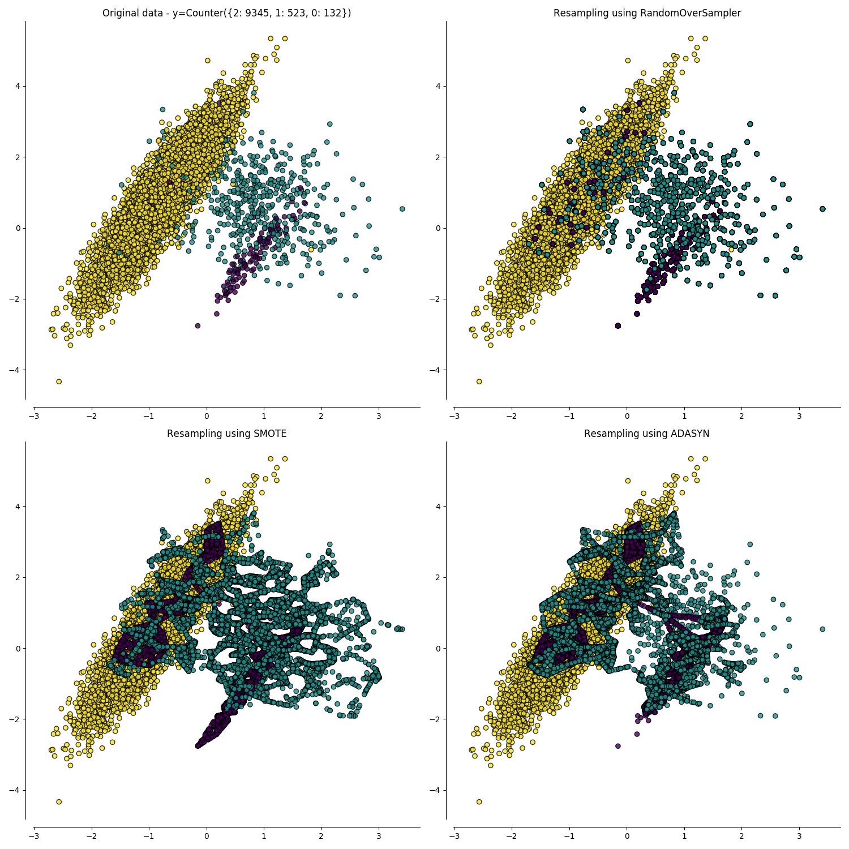
Preprocessing
Scaling
Robust Scaler
Standardization
Sampling
SMOTENC
ADASYN
Under-sampling

Slide 20
Model Selection
Models
Logistic Regression
AdaBoost
Random Forest
Neural Network
Extreme Gradient Boosting
Metrics
F1 weighted
Recall
False Negative
Model | Method | F1 Weighted | Recall | False Negative
Logistic | ADASYN Scaled | 68 | 66 | 5329
ADA | SMOTENC Scaled | 67 | 64 | 5516
RFC | SMOTENC | 73 | 37 | 9702
Neural | SMOTENC Scaled | 66 | 65 | 5474
XG-Boost | Under Sampling | 68 | 67 | 5099

Slide 21
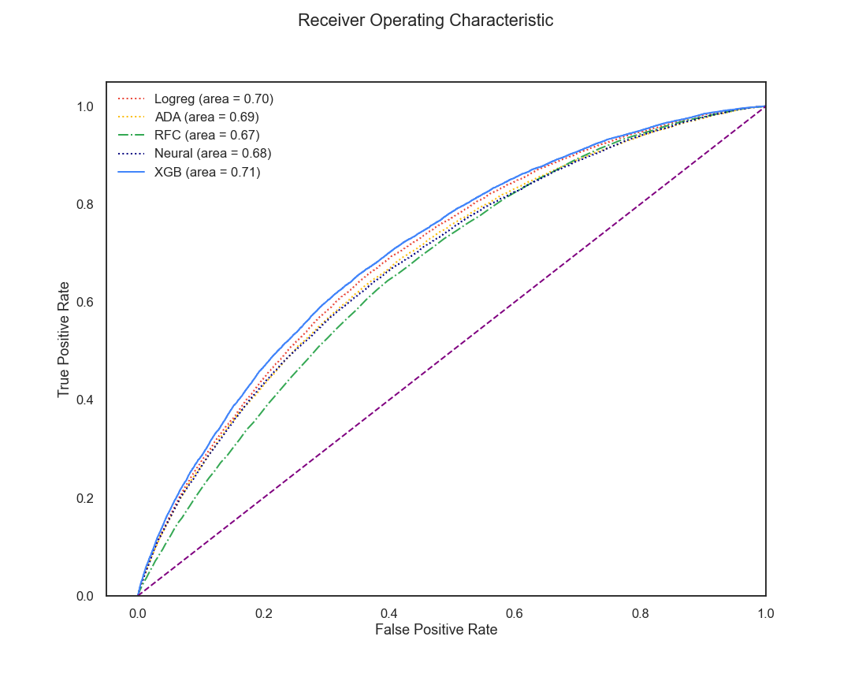
ROC-AUC
XG-Boost
Under-sampling
Resample Validation

Slide 22
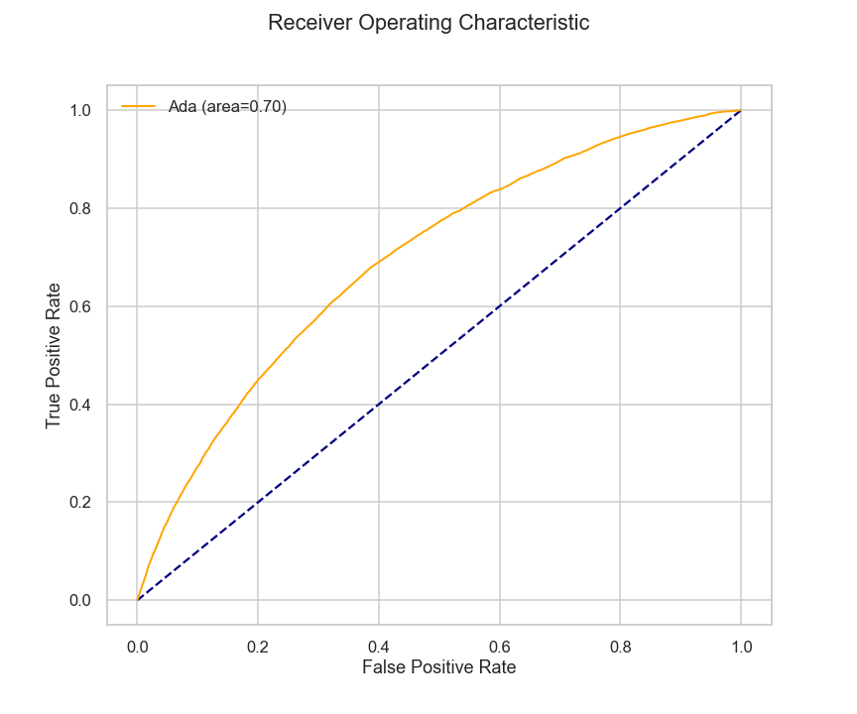
Adaptive Boosting
6 Features
SMOTENC
F1 Weighted | Recall | False Negative
67 | 67 | 5065

Slide 23
Validation
5-folds Cross Validation Score: 71% auc

Slide 24
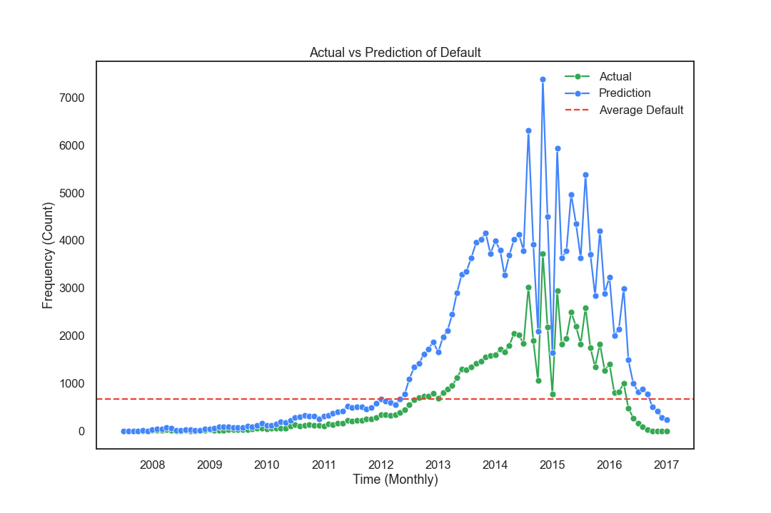
Actual vs Predicted (Investor’s Model)

Slide 25
Conclusion/Recommendation
Interest rate
Debt-to-limit
Total number of credit lines
Grade
Employment length
Debt-to-Income
Investor’s model: Adaptive Boosting
Recall: 67%
$543 millions in investor’s return if the model applied in 2019
It is the trade-off between investor’s returns & company profitability

Slide 26
Future improvements
Acquire more data.
US Unemployment rate (Micro).
US Federal Reserve Bank’s interest rates (Macro).
Reform the applicant’s verification process to improve data quality.

