Slide 1
Mini Project 3
Identify Target Market by Lifetime Value Clusters
By Ricky K Nguyen
31/10/2020

Slide 2
Agenda
Business Question/ Data Question
Project Pipeline
Data Set
RFM model for customer purchase behavior
Lifetime Value
Apply Machine Learning
Future Improvements

Slide 3
Business Question
Business Question
Project Pipeline
Data Set
RFM model for customer purchase behavior
Lifetime Value
Apply Machine Learning
Future Improvements

Slide 4
Business Question
Who is our target market?
Data Question
1. Can we find the ideal target market from existing sale data?
2. Can we predict the ideal target market for the next 6 months?

Slide 5
Project Pipeline
Business Question
Project Pipeline
Data Set
RFM model for customer purchase behavior
Lifetime Value
Apply Machine Learning
Future Improvements

Slide 6
Project Pipeline
RFM
LTV
Features
Business Question
Data Analysis
Machine Learning
Implement
Objectives
Test Group
Control Group

Slide 7
Data Set
Business Question
Project Pipeline
Data Set
RFM model for customer purchase behavior
Lifetime Value
Apply Machine Learning
Future Improvements

Slide 8
Data Set
9 months of sale data
3 months – Data A - Analyze the behavior, feature engineer, predictors
6 months – Data B – Target Variables (LTV)
Features:
Quantity
Price
Invoice date
Customer ID

Slide 9
Recency, Frequency, Monetary
Business Question
Project Pipeline
Data Set
RFM model for customer purchase behavior
Lifetime Value
Apply Machine Learning
Future Improvements

Slide 10
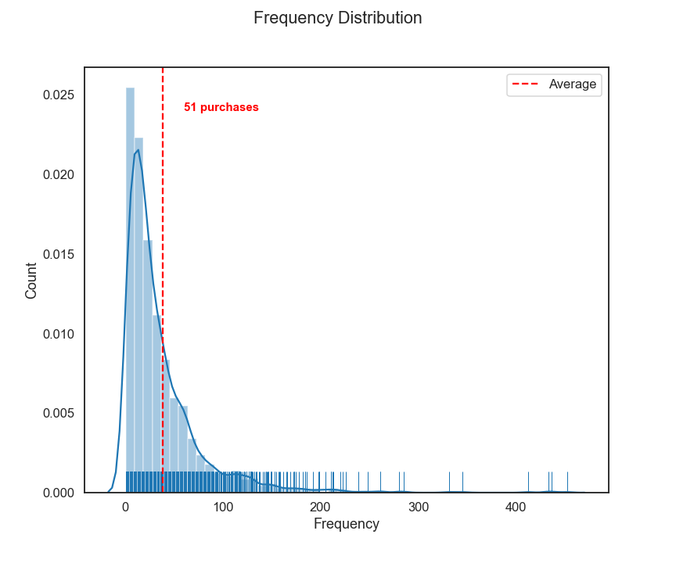
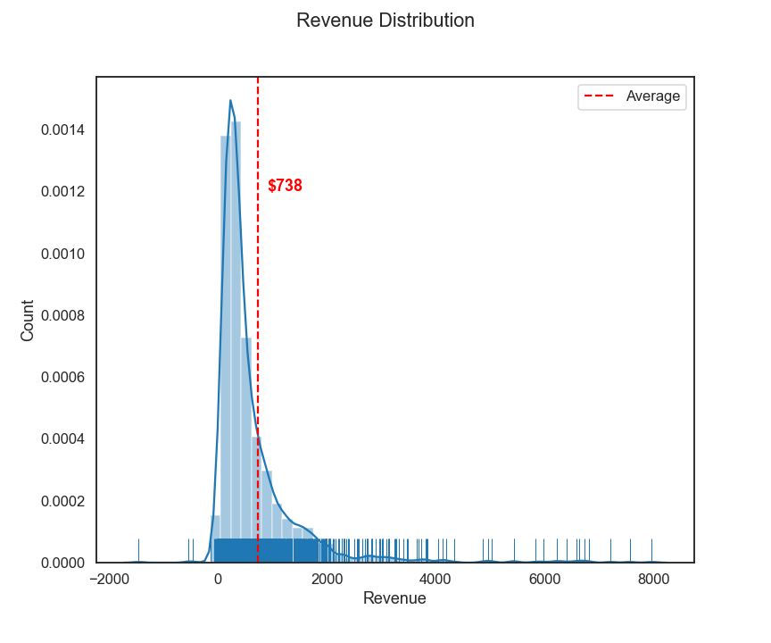
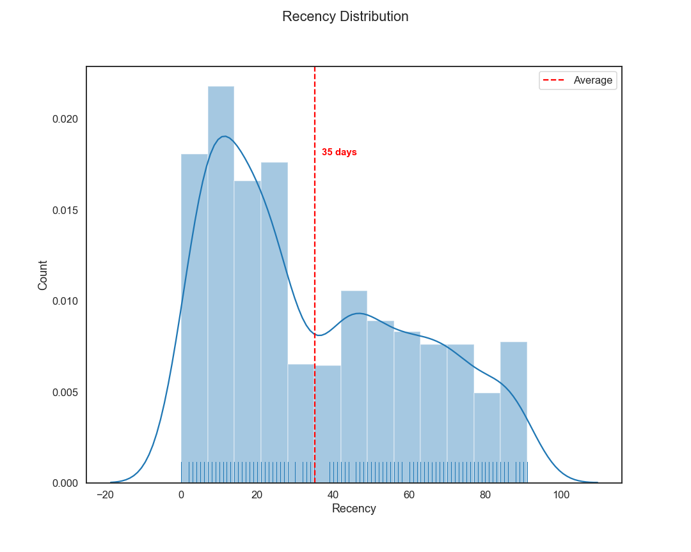
RFM Analysis

Slide 11
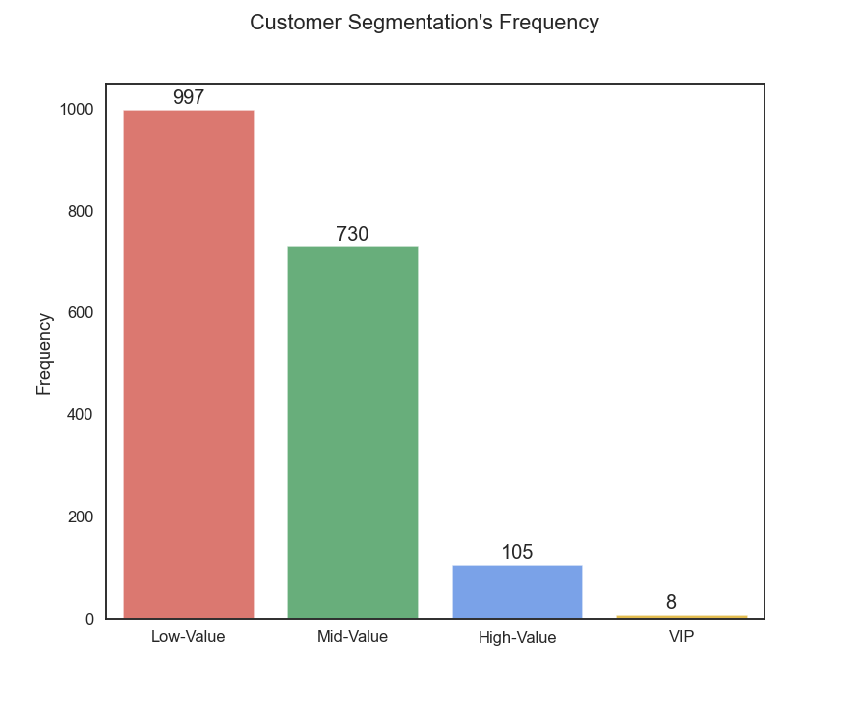
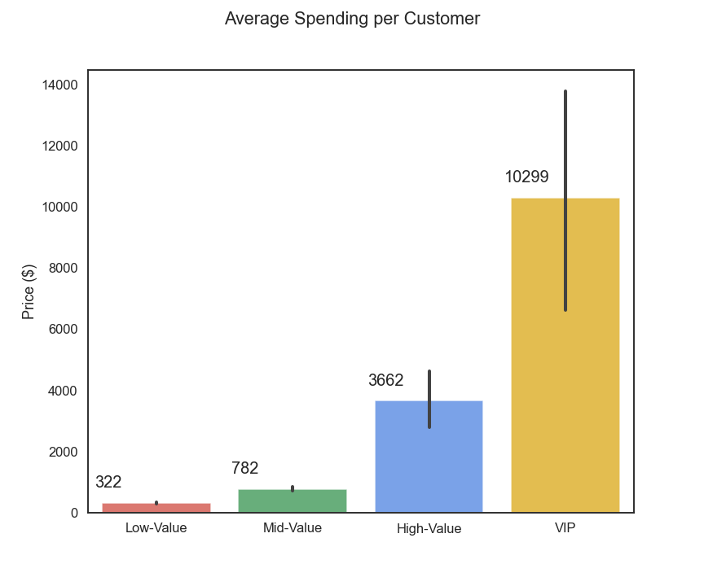
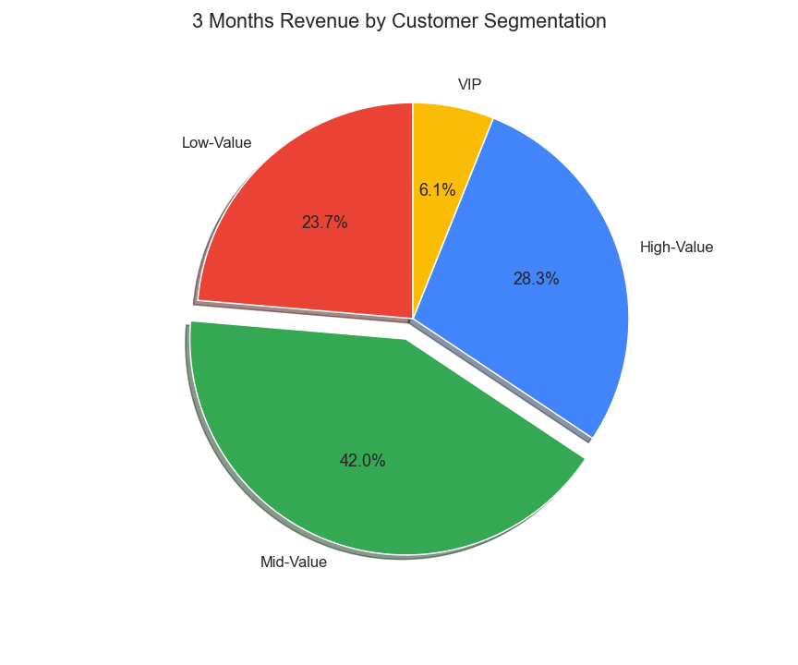
RFM Statistics

Slide 12
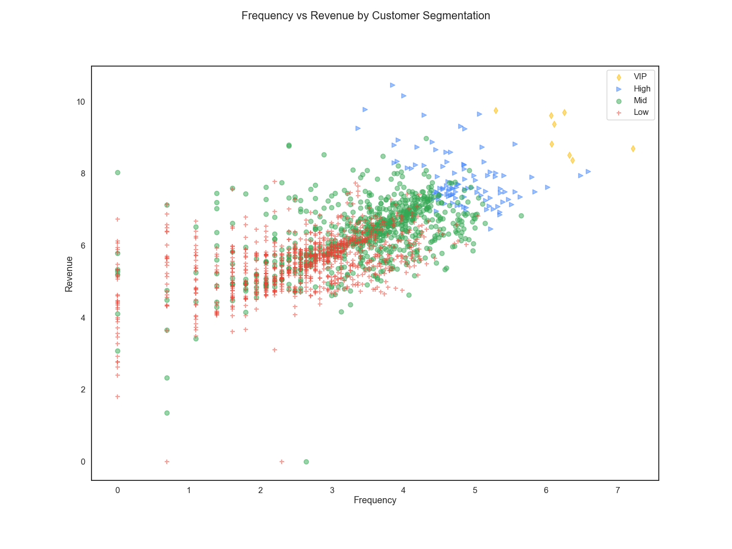

Slide 13
Lifetime Value (LTV)
Business Question
Project Pipeline
Data Set
RFM model for customer purchase behavior
Lifetime Value
Apply Machine Learning
Future Improvements

Slide 14
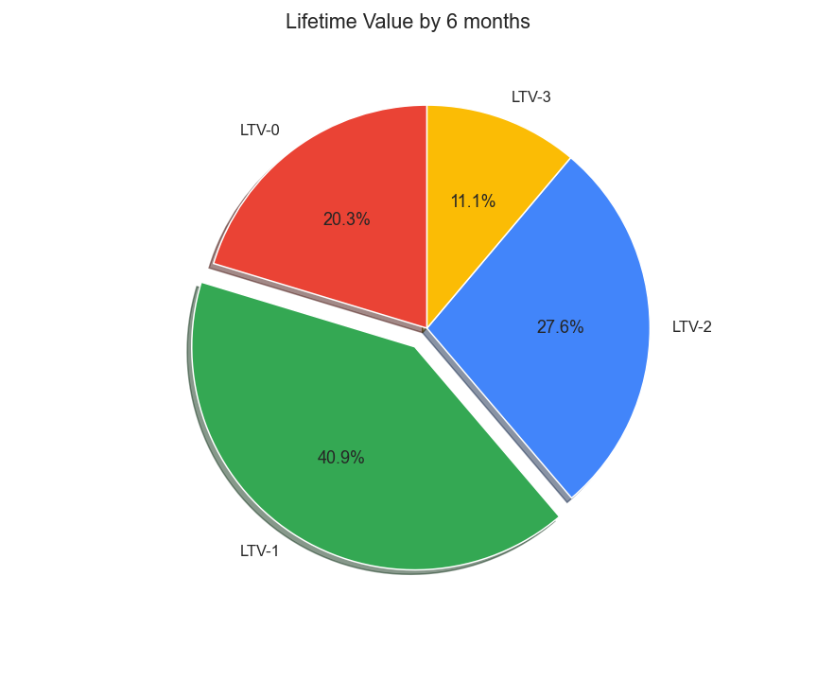
Lifetime Value
Data B (6 Months)
LTV = (Unit Price * Quantity – COST)
LTV as target variables
Multi-class Imbalanced classification problem
Use Data A to predict Data B LTV-1/LTV-2 clusters

Slide 15
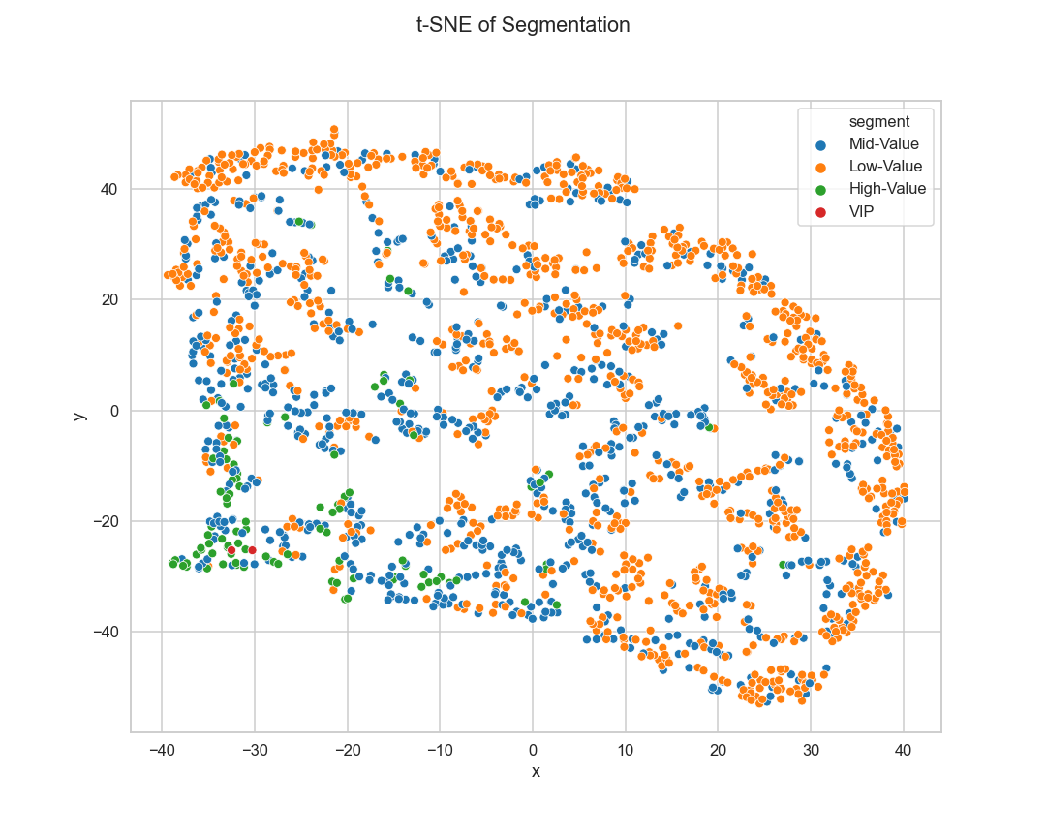
t-SNE of Segmentation

Slide 16
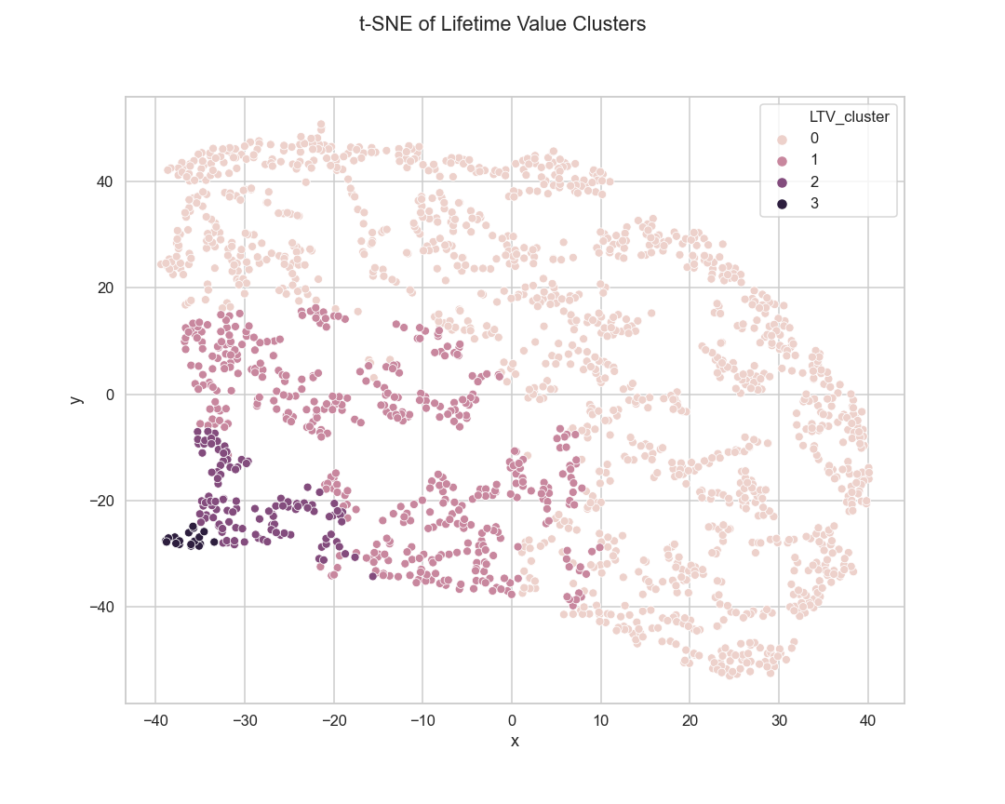
t-SNE of LTV clusters

Slide 17
Apply Machine Learning
Business Question
Project Pipeline
Data Set
RFM model for customer purchase behavior
Lifetime Value
Apply Machine Learning
Future Improvements

Slide 18
Recursive Feature Elimination(RFE)
RFE
Lasso CV
Random Forest Classifier (Bagging)
Gradient Boosting Classifier (Boosting)
Extracted features
Recency
Frequency
Revenue

Slide 19
Extreme gradient boosting
Cross Validation Score on 5 folds : 70% accuracy
LTV-0 = 78% recall
LTV-1 = 40% recall
LTV-2 = 40% recall
LTV-3 = 100% recall

Slide 20
Future improvements
Business Question
Project Pipeline
Data Set
RFM model for customer purchase behavior
Lifetime Value
Apply Machine Learning
Future Improvements

Slide 21
Future Improvements
1.Data Acquisition
Demographic Data – age, gender, income, dependent
Geographic Data – locations, cities, regions
2.The error between predicted and actual of the control group for further analysis.

Slide 22
End of Presentation

