Slide 1
Zero-Knowledge Proofs on Secret-Shared Data via Fully Linear PCPs
2021/9/9

Slide 2
Synopsis
Introduction
Construction 1
Construction 2
Application

Slide 3
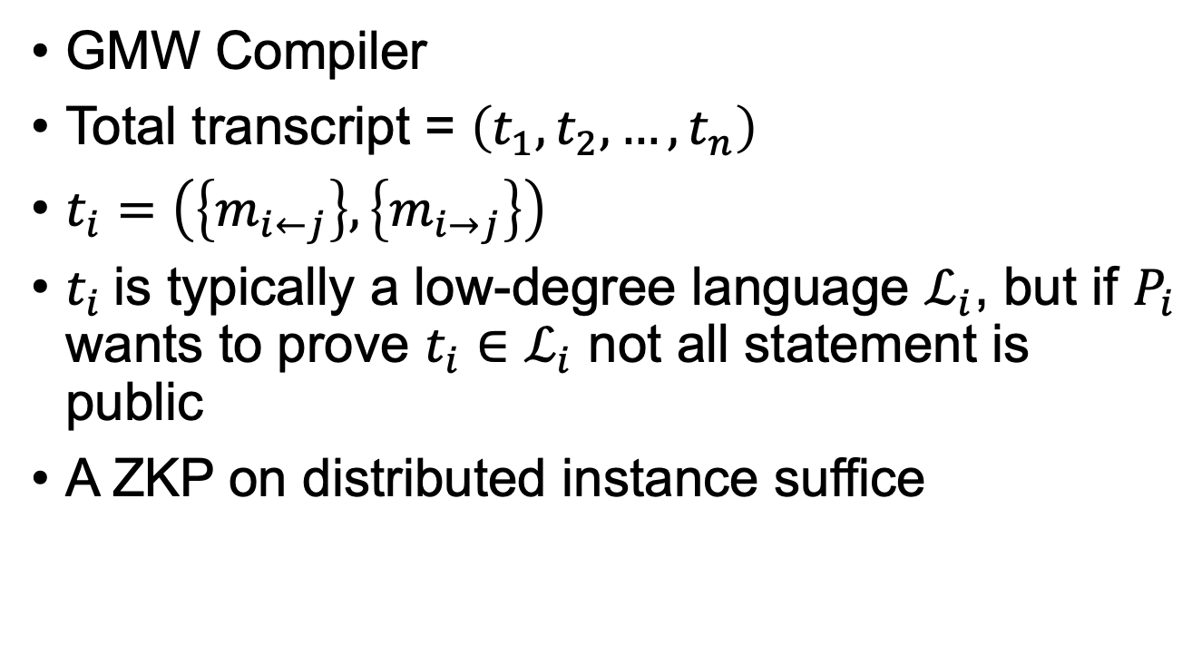
ZKP on Secret-Shared Data
GMW Compiler
Total transcript = $\left(t_{1},t_{2},…,t_{n}\right)$
$t_{i}=\left(\left\{m_{i←j}\right\},\left\{m_{i→j}\right\}\right)$
$t_{i}$is typically a low-degree language $ℒ_{i}$, but if $P_{i}$ wants to prove $t_{i}∈ℒ_{i}$ not all statement is public
A ZKP on distributed instance suffice

Slide 4
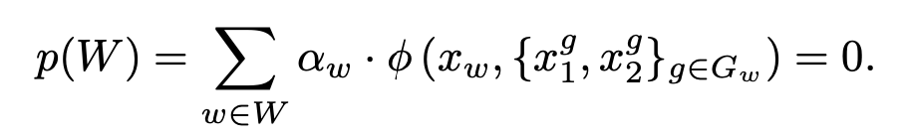
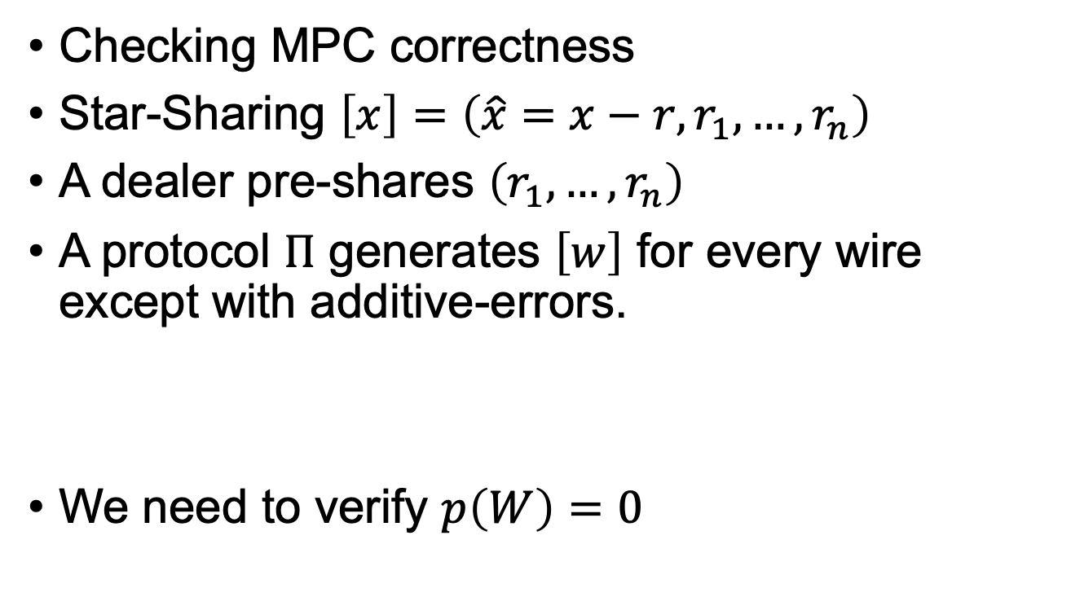
ZKP on Secret-Shared Data
Checking MPC correctness
Star-Sharing $\left[x\right]=\left(\hat{x}=x−r,r_{1},…,r_{n}\right)$
A dealer pre-shares $\left(r_{1},…,r_{n}\right)$
A protocol $Π$ generates $\left[w\right]$ for every wire except with additive-errors.
We need to verify $p\left(W\right)=0$

Slide 5
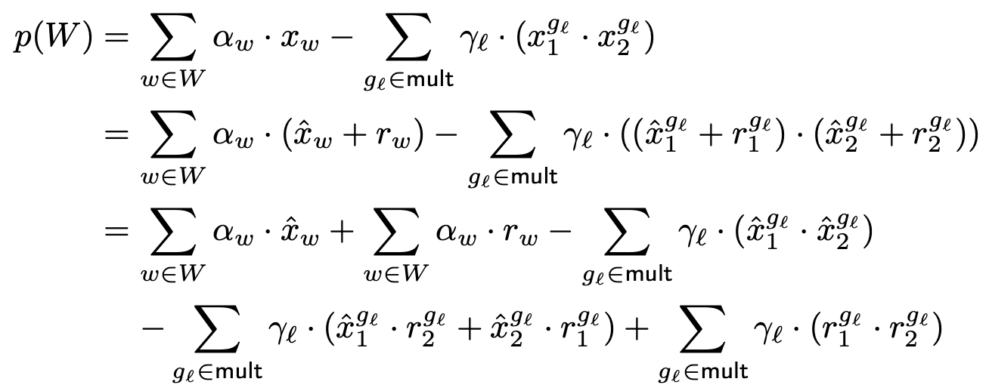
ZKP on Secret-Shared Data

Slide 6
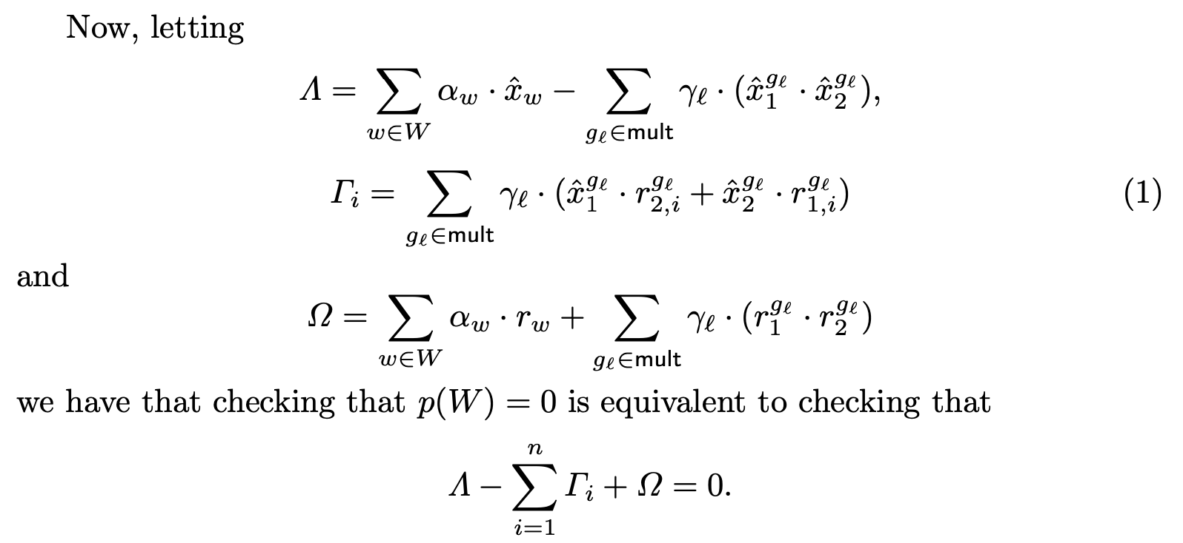
ZKP on Secret-Shared Data

Slide 7
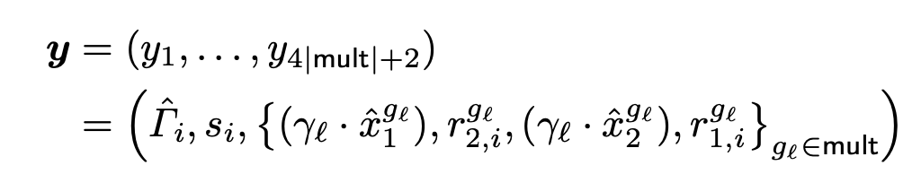
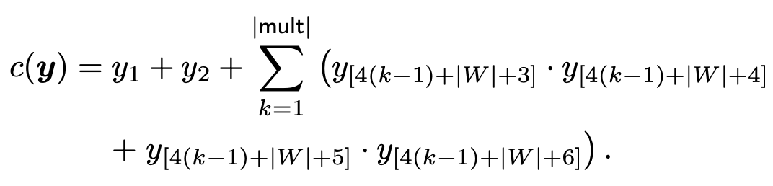

ZKP on Secret-Shared Data
$P_{i}$ computes $\hat{Γ_{i}}≔Γ_{i}−s_{i}$ ($s_{i}$ is sampled by dealer)
$P_{i}$ wants to prove to all parties (dealer, ${\left\{P_{j}\right\}}_{j≠i}$) that for

Slide 8
ZKP on Secret-Shared Data
Another case is when the statement is secret-shared among multiple verifiers
Or encrypted using homomorphic encryption or commitment
Anonymous messaging
Verifiable function secret sharing
Systems for the private computation of aggregate statistics

Slide 9
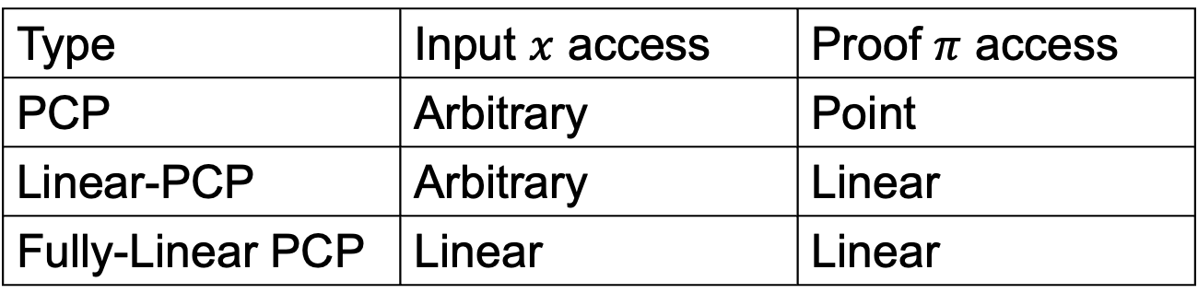
Techniques
The authors propose Fully-Linear PCP/IOP to solve this problem
Linear query can be distributed among multiple shares/pieces
Type | Input $x$ access | Proof $π$ access
PCP | Arbitrary | Point
Linear-PCP | Arbitrary | Linear
Fully-Linear PCP | Linear | Linear

Slide 10
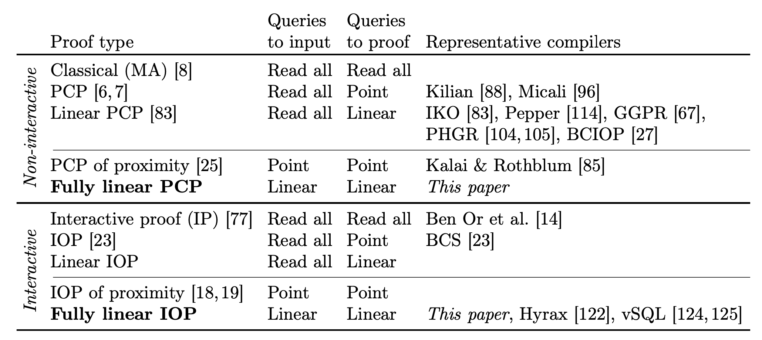
Comparison

Slide 11
Synopsis
Introduction
Construction 1
Construction 2
Application

Slide 12
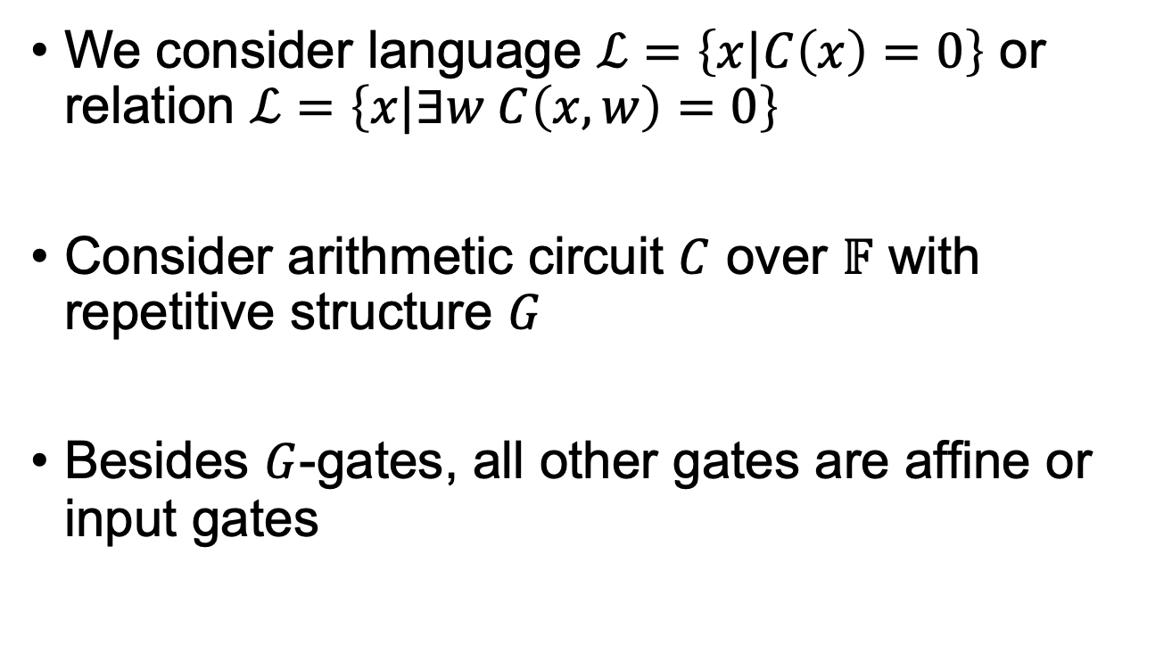

FLPCP over $𝔽$
We consider language $ℒ=\left\{x|C\left(x\right)=0\right\}$ or relation $ℒ=\left\{x|∃w C\left(x,w\right)=0\right\}$
Consider arithmetic circuit $C$ over $𝔽$ with repetitive structure $G$
Besides $G$-gates, all other gates are affine or input gates

Slide 13
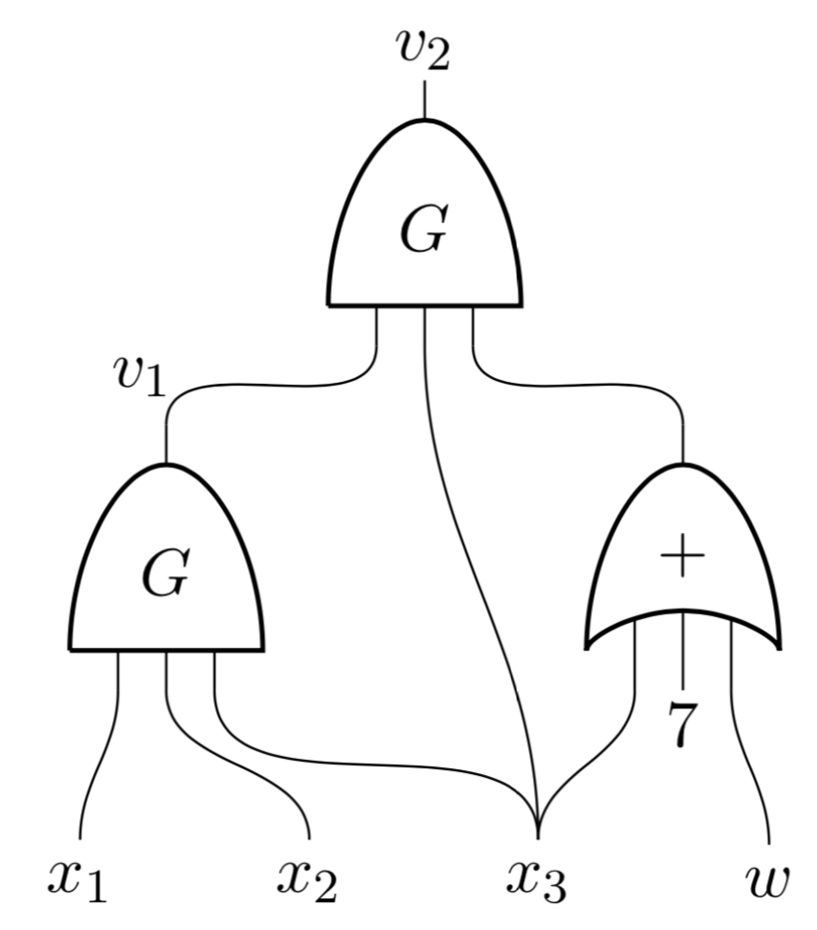
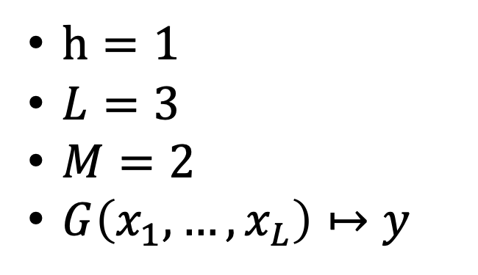
An Example of C
$h=1$
$L=3$
$M=2$
$G\left(x_{1},…,x_{L}\right)↦y$

Slide 14
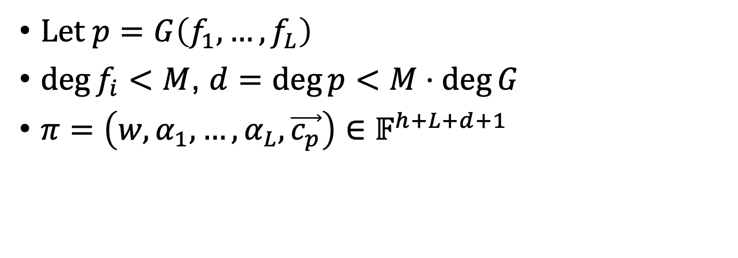


FLPCP Construction
Prover interpolates polynomials $f_{1},…,f_{L}$ s.t.
$$f_{i}\left(0\right), f_{i}\left(1\right), …, f_{i}\left(M\right)$$
=
=
=
i-th input wire
of the 1st G-gate
i-th input wire
of the Mth G-gate
$$α_{i}←𝔽$$
Let $p=G\left(f_{1},…,f_{L}\right)$
$\deg{f_{i}}<M$, $d=\deg{p}<M⋅\deg{G}$
$π=\left(w,α_{1},…,α_{L},\vec{c_{p}}\right)∈𝔽^{h+L+d+1}$

Slide 15
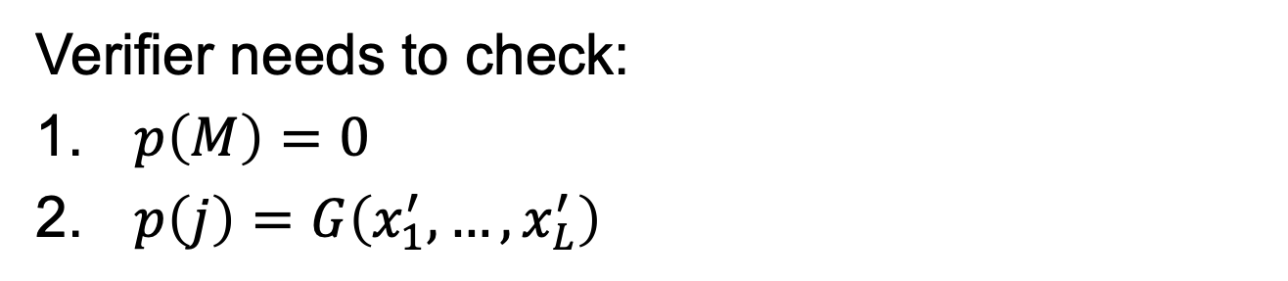
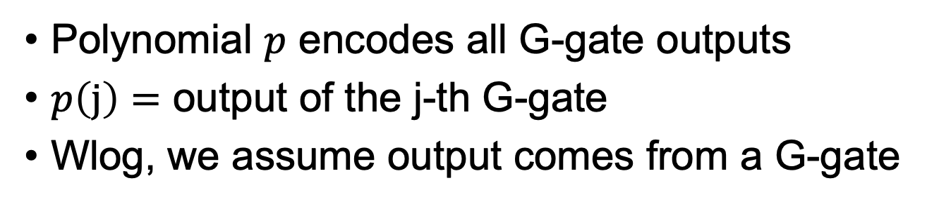
FLPCP Construction
Polynomial $p$ encodes all G-gate outputs
$p\left(j\right)=$ output of the j-th G-gate
Wlog, we assume output comes from a G-gate
Verifier needs to check:
$p\left(M\right)=0$
$p\left(j\right)=G\left(x_{1}^{′},…,x_{L}^{′}\right)$

Slide 16
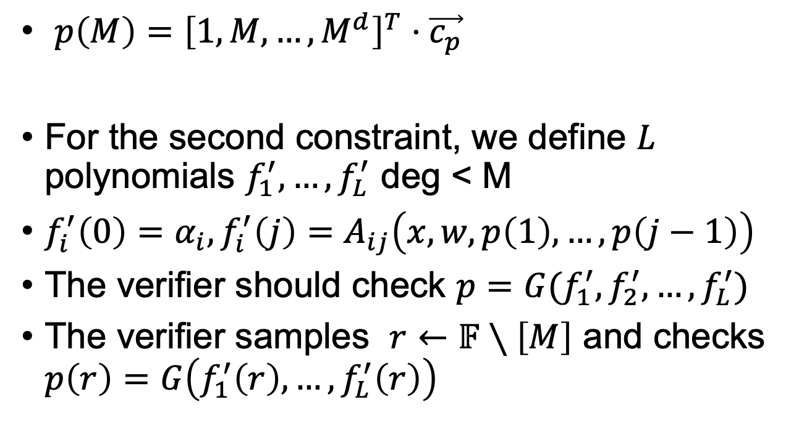
FLPCP Construction
$p\left(M\right)={\left[1,M,…,M^{d}\right]}^{T}⋅\vec{c_{p}}$
For the second constraint, we define $L$ polynomials $f_{1}^{′},…,f_{L}^{′}$ deg < M
$f_{i}^{′}\left(0\right)=α_{i},f_{i}^{′}\left(j\right)=A_{ij}\left(x,w,p\left(1\right),…,p\left(j−1\right)\right)$
The verifier should check ${p=G(f}_{1}^{′},f_{2}^{′},…,f_{L}^{′})$
The verifier samples $r←𝔽∖\left[M\right]$ and checks $p\left(r\right)=G\left(f_{1}^{′}\left(r\right),…,f_{L}^{′}\left(r\right)\right)$

Slide 17
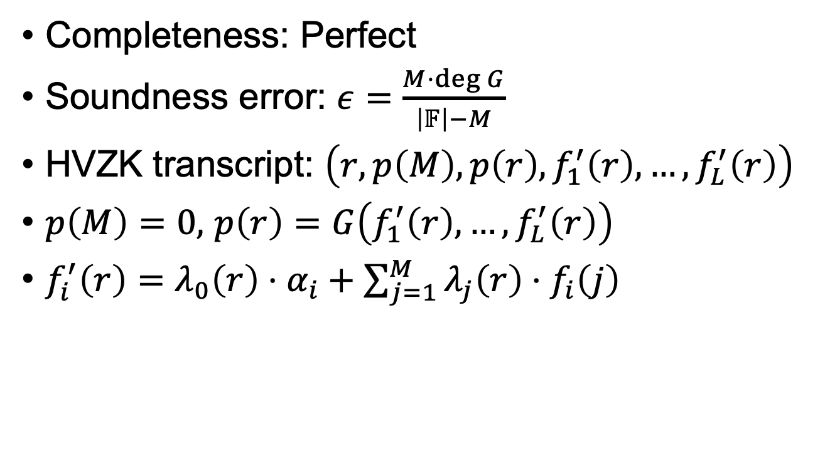
Security and Parameters
Completeness: Perfect
Soundness error: $ε=\frac{M⋅\deg{G}}{\left|𝔽\right|−M}$
HVZK transcript: $\left(r,p\left(M\right),p\left(r\right),f_{1}^{′}\left(r\right),…,f_{L}^{′}\left(r\right)\right)$
$p\left(M\right)=0,$ $p\left(r\right)=G\left(f_{1}^{′}\left(r\right),…,f_{L}^{′}\left(r\right)\right)$
$f_{i}^{′}\left(r\right)=λ_{0}\left(r\right)⋅α_{i}+\sum_{j=1}^{M}{λ_{j}\left(r\right)⋅f_{i}\left(j\right)}$

Slide 18
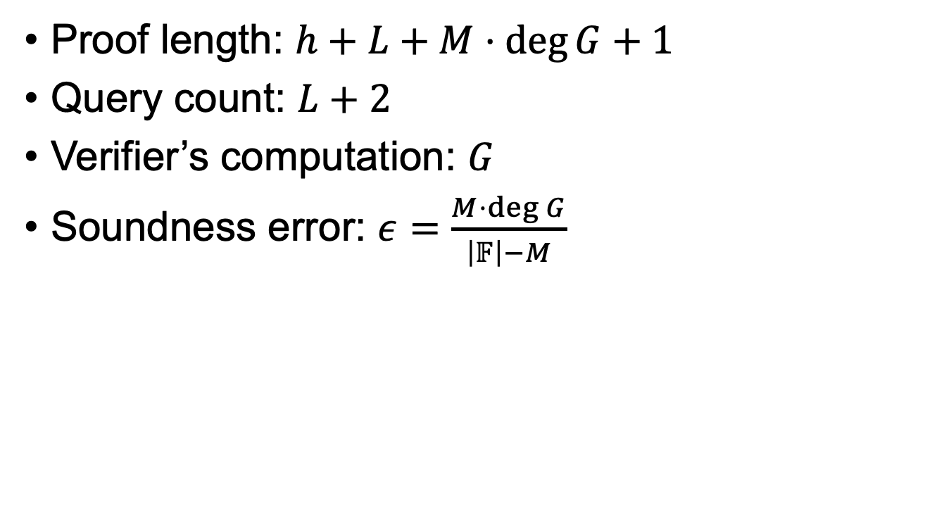
Summary
Proof length: $h+L+M⋅\deg{G}+1$
Query count: $L+2$
Verifier’s computation: $G$
Soundness error: $ε=\frac{M⋅\deg{G}}{\left|𝔽\right|−M}$

Slide 19
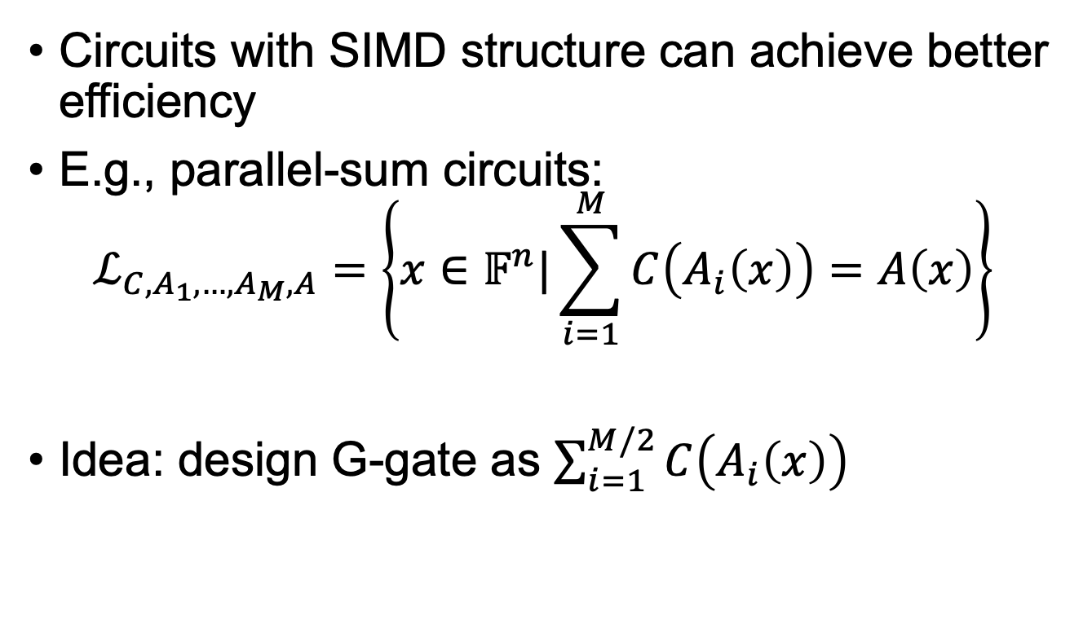
Better Efficiency
Circuits with SIMD structure can achieve better efficiency
E.g., parallel-sum circuits: $ℒ_{C,A_{1},…,A_{M},A}=\left\{x∈𝔽^{n}|\sum_{i=1}^{M}{C\left(A_{i}\left(x\right)\right)=A\left(x\right)}\right\}$
Idea: design G-gate as $\sum_{i=1}^{M/2}{C\left(A_{i}\left(x\right)\right)}$

Slide 20


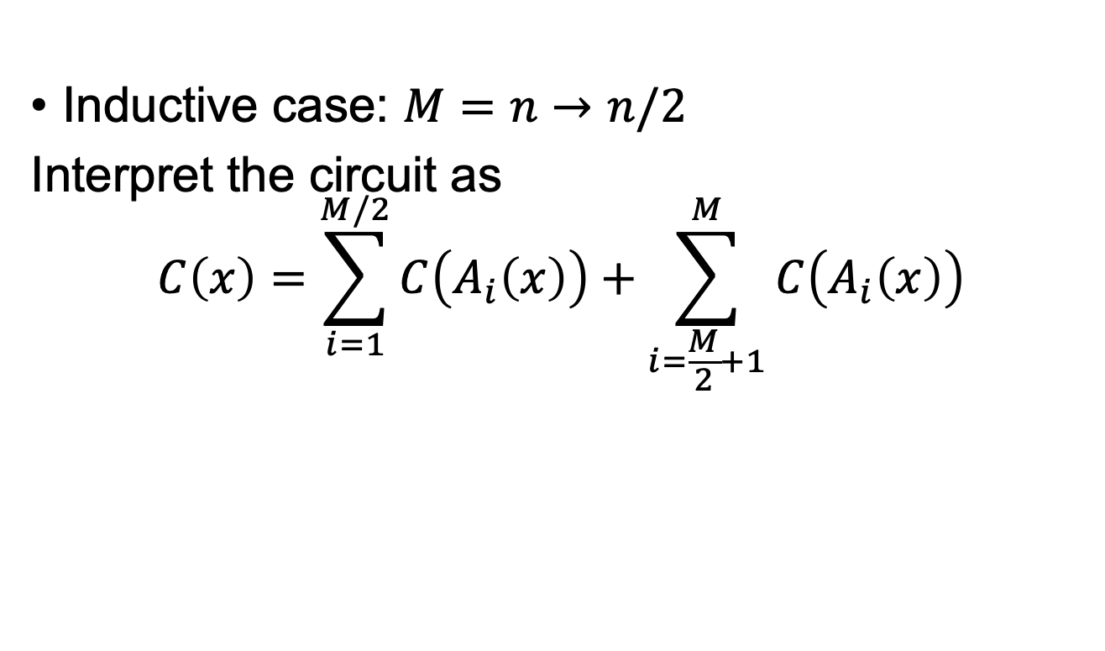
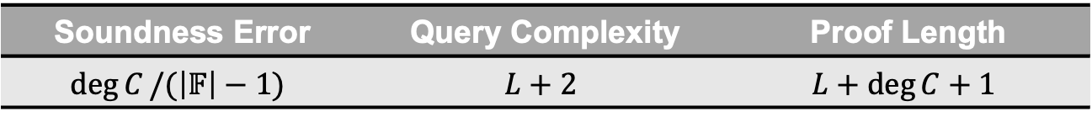
FLIOP over $𝔽$
Base case: $M=1$, apply previous FLPCP
Soundness Error | Query Complexity | Proof Length
$$\deg{C}/(\left|𝔽\right|−1)$$ | $$L+2$$ | $$L+\deg{C}+1$$
Inductive case: $M=n→n/2$
Interpret the circuit as
$$C\left(x\right)=\sum_{i=1}^{M/2}{C\left(A_{i}\left(x\right)\right)+\sum_{i=\frac{M}{2}+1}^{M}{C\left(A_{i}\left(x\right)\right)}}$$

Slide 21
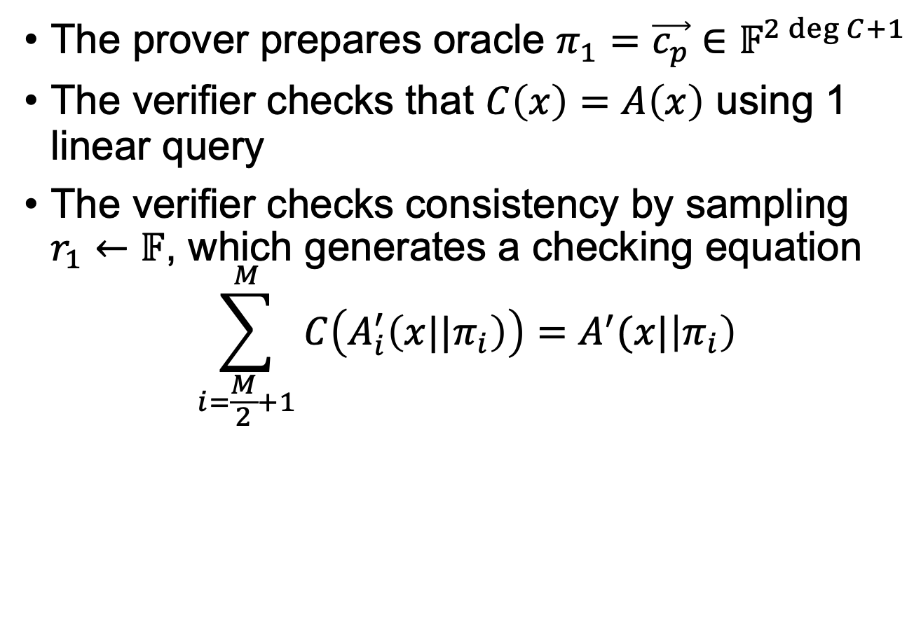
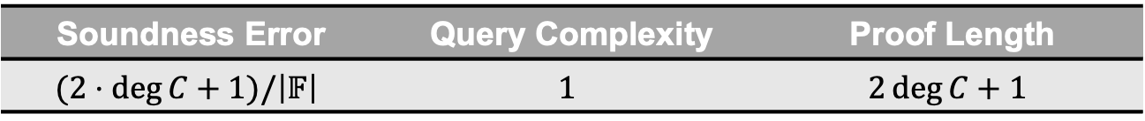
FLIOP over $𝔽$
The prover prepares oracle $π_{1}=\vec{c_{p}}∈𝔽^{2\deg{C+1}}$
The verifier checks that $C\left(x\right)=A\left(x\right)$ using 1 linear query
The verifier checks consistency by sampling $r_{1}←𝔽$, which generates a checking equation
$$\sum_{i=\frac{M}{2}+1}^{M}{C\left(A_{i}^{′}\left(x||π_{i}\right)\right)}=A^{′}(x|\left|π_{i}\right)$$
Soundness Error | Query Complexity | Proof Length
$$(2⋅\deg{C}+1)/\left|𝔽\right|$$ | $$1$$ | $$2\deg{C+1}$$

Slide 22
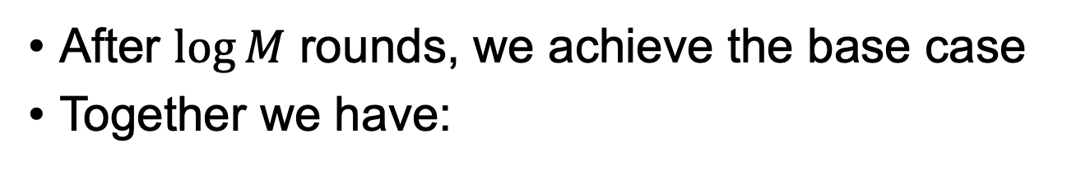
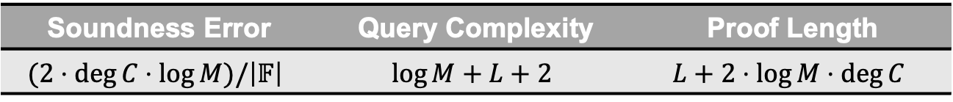
FLIOP over $𝔽$
After $\log{M}$ rounds, we achieve the base case
Together we have:
Soundness Error | Query Complexity | Proof Length
$$(2⋅\deg{C}⋅\log{M})/\left|𝔽\right|$$ | $$\log{M}+L+2$$ | $$L+2⋅\log{M}⋅\deg{C}$$

Slide 23
Synopsis
Introduction
Construction 1
Construction 2
Application

Slide 24
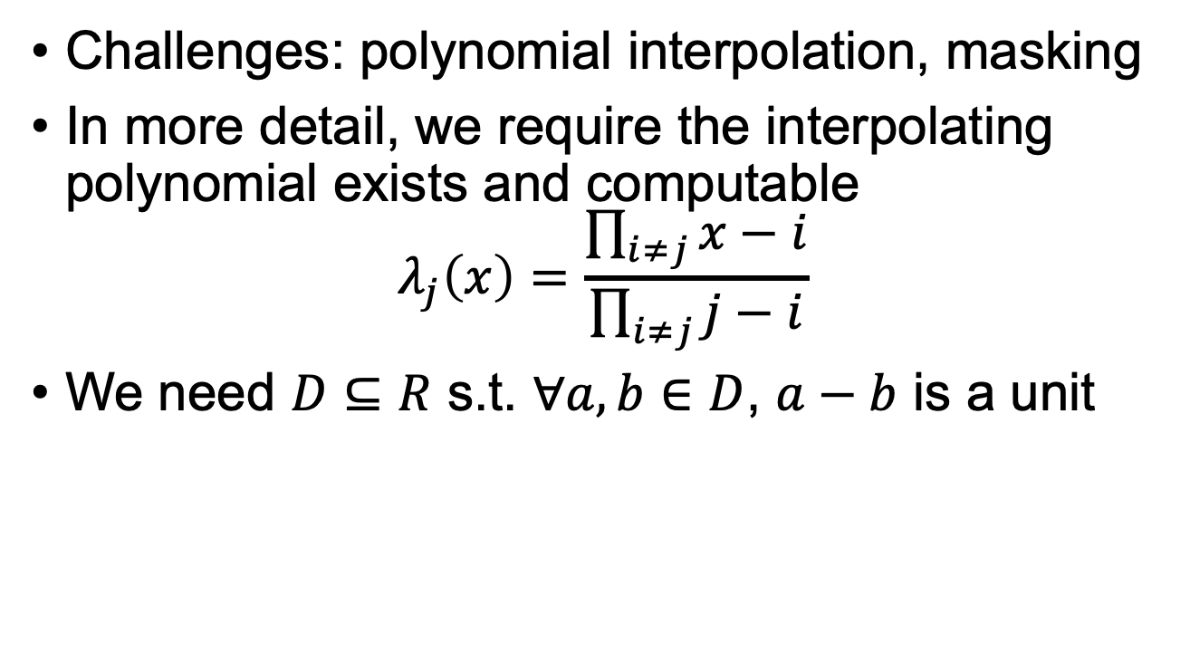

Extension to $R=ℤ_{2^{w}}/f\left(x\right)$
Challenges: polynomial interpolation, masking
In more detail, we require the interpolating polynomial exists and computable
$$λ_{j}\left(x\right)=\frac{\prod_{i≠j}{x−i}}{\prod_{i≠j}{j−i}}$$
We need $D⊆R$ s.t. $∀a,b∈D$, $a−b$ is a unit

Slide 25
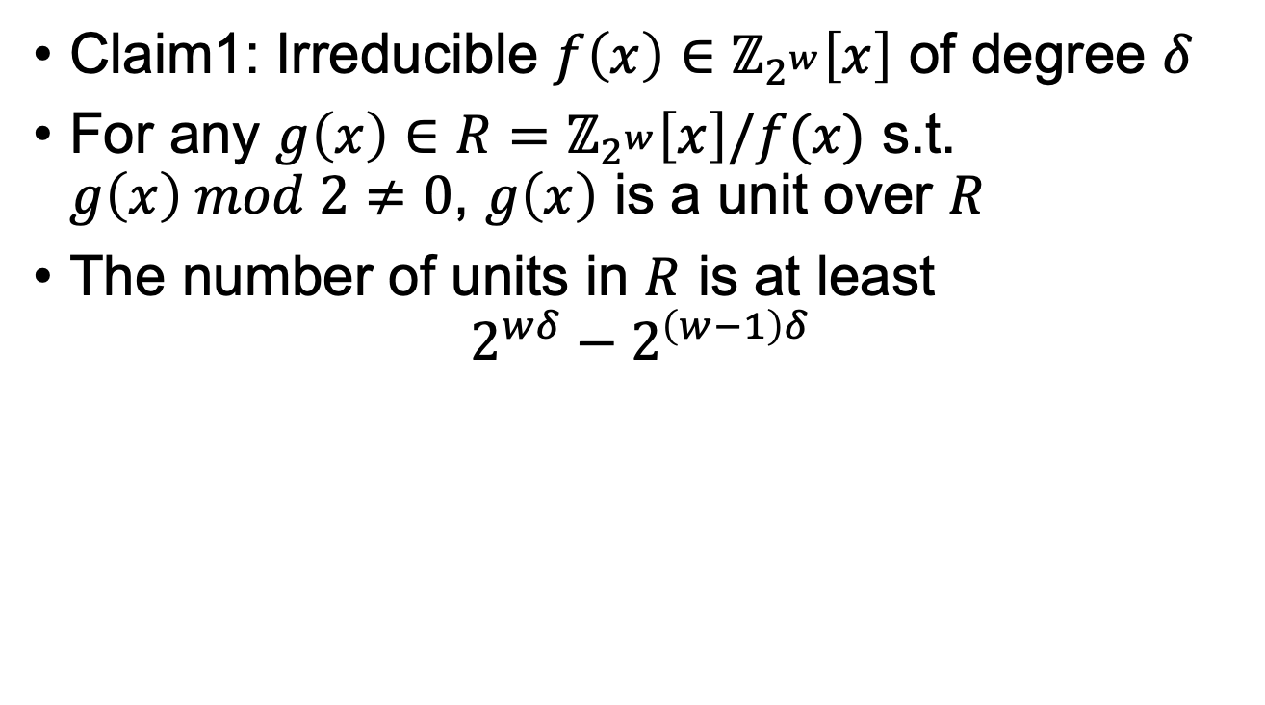
Algebra
Claim1: Irreducible $f\left(x\right)∈ℤ_{2^{w}}\left[x\right]$ of degree $δ$
For any $g\left(x\right)∈R=ℤ_{2^{w}}\left[x\right]/f(x)$ s.t. $g\left(x\right) mod 2≠0$, $g\left(x\right)$ is a unit over $R$
The number of units in $R$ is at least
$$2^{wδ}−2^{\left(w−1\right)δ}$$

Slide 26

Algebra
Claim2: For a commutative ring $R$with $z$ zero devisors
A polynomial $h$ of degree $δ$ has at most $z⋅δ$ roots over $R$

Slide 27
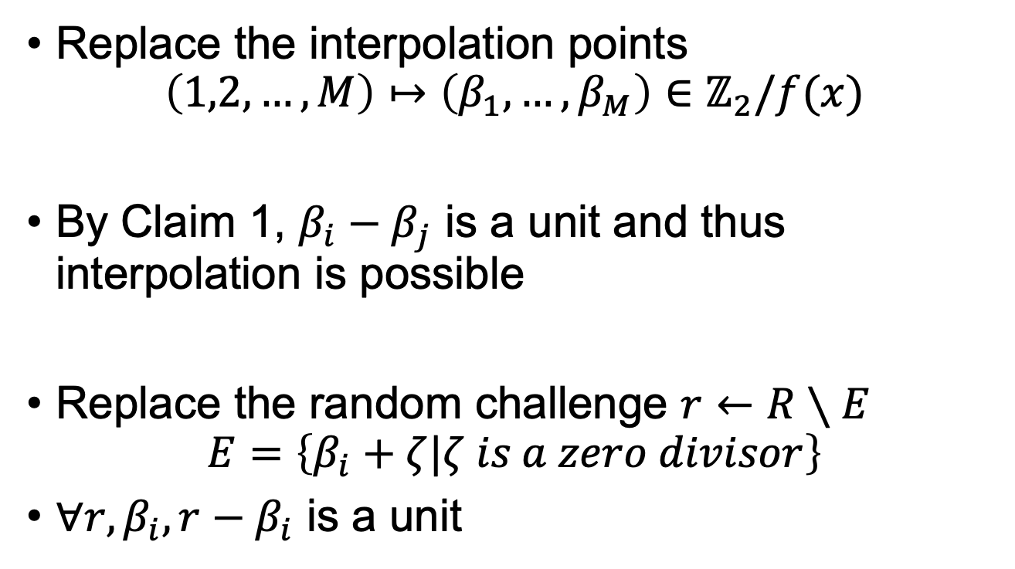
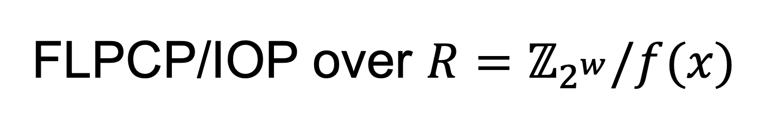
FLPCP/IOP over $R=ℤ_{2^{w}}/f(x)$
Replace the interpolation points
$$\left(1,2,…,M\right)↦\left(β_{1},…,β_{M}\right)∈ℤ_{2}/f(x)$$
By Claim 1, $β_{i}−β_{j}$ is a unit and thus interpolation is possible
Replace the random challenge $r←R∖E$
$$E=\left\{β_{i}+ζ|ζ is a zero divisor\right\}$$
$∀r,β_{i}, r−β_{i}$ is a unit

Slide 28
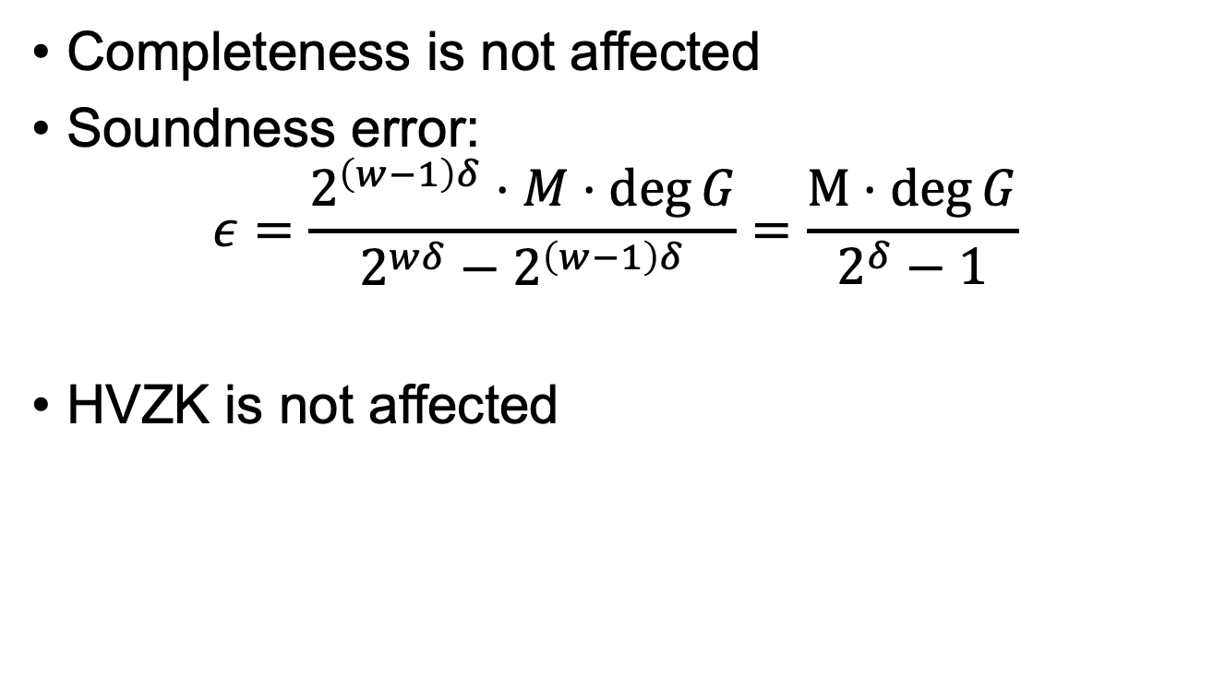
Security and Performance
Completeness is not affected
Soundness error:
$$ε=\frac{2^{\left(w−1\right)δ}⋅M⋅\deg{G}}{2^{wδ}−2^{\left(w−1\right)δ}}=\frac{M⋅\deg{G}}{2^{δ}−1}$$
HVZK is not affected

Slide 29
Synopsis
Introduction
Construction 1
Construction 2
Application

Slide 30
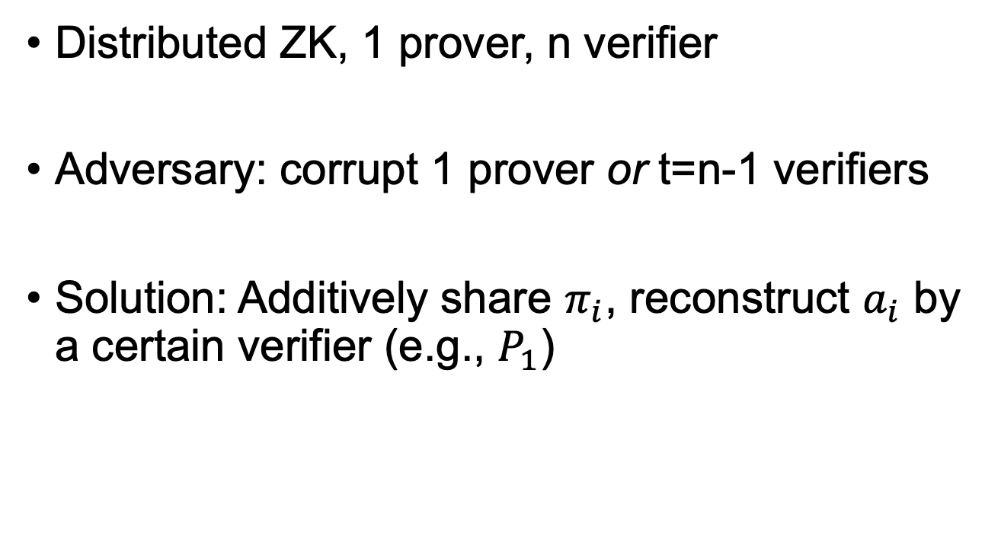
Application I
Distributed ZK, 1 prover, n verifier
Adversary: corrupt 1 prover or t=n-1 verifiers
Solution: Additively share $π_{i}$, reconstruct $a_{i}$ by a certain verifier (e.g., $P_{1}$)

Slide 31
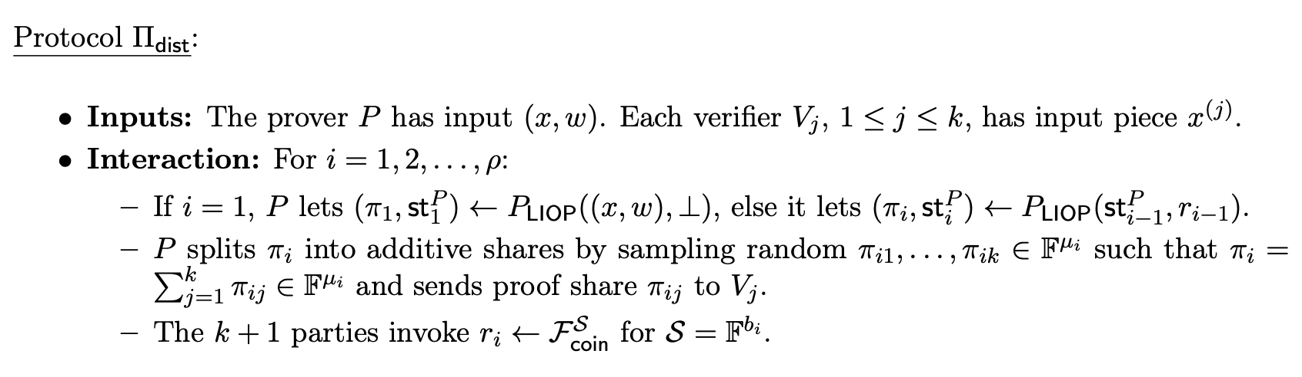
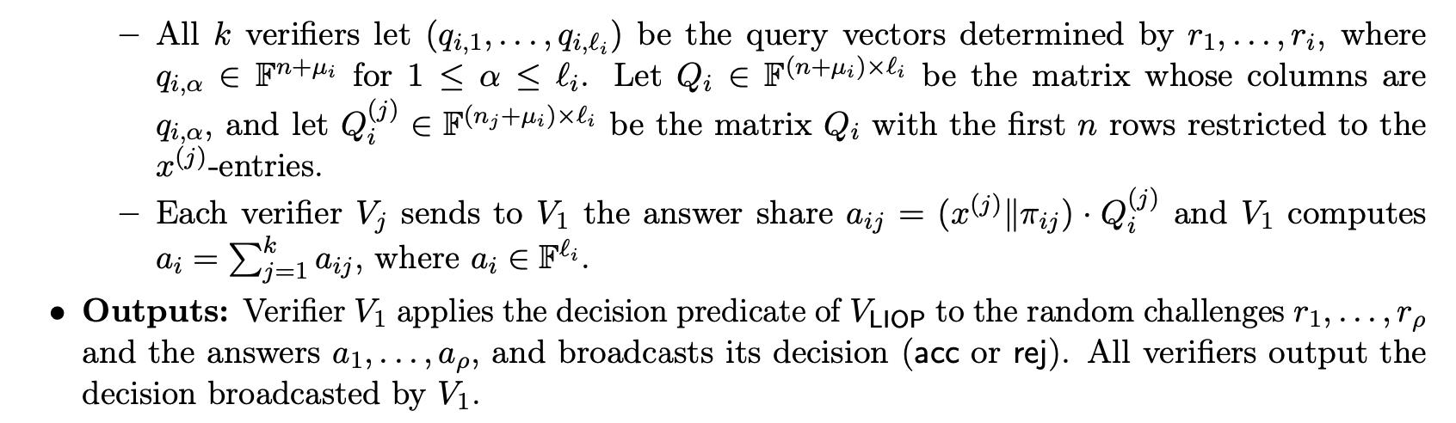
Application I

Slide 32



Application II
Distributed ZK, 1 prover, n verifier
Adversary: corrupt 1 prover and t=n/2-1 verifiers
Solution: robustly-share every field element
$$𝒞⊆𝔽^{n}$$
$$x∈𝔽^{m}$$
$$\hat{x}∈𝔽^{n×m}$$

Slide 33
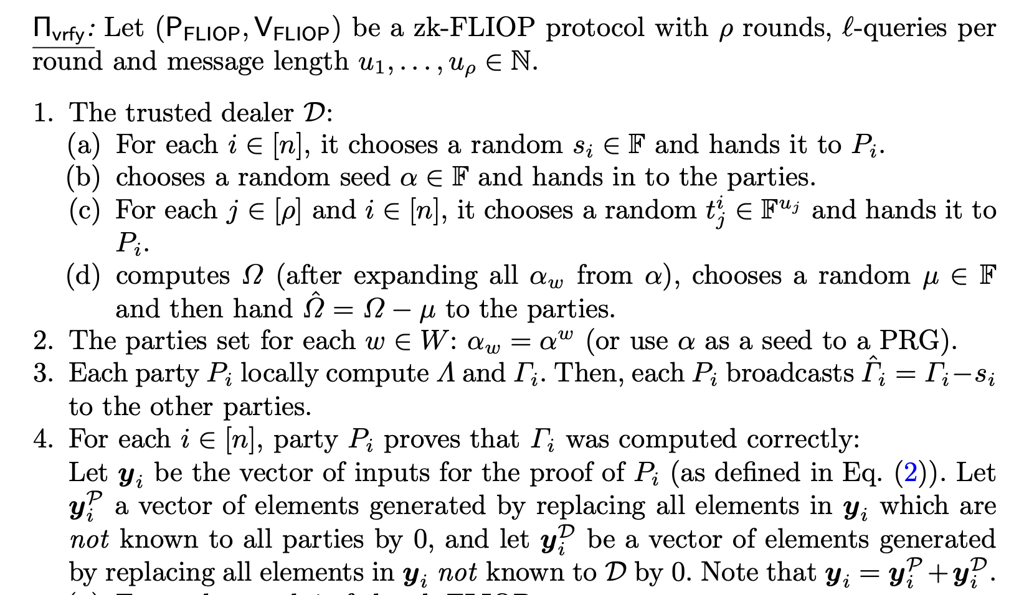
MPC Verification

Slide 34
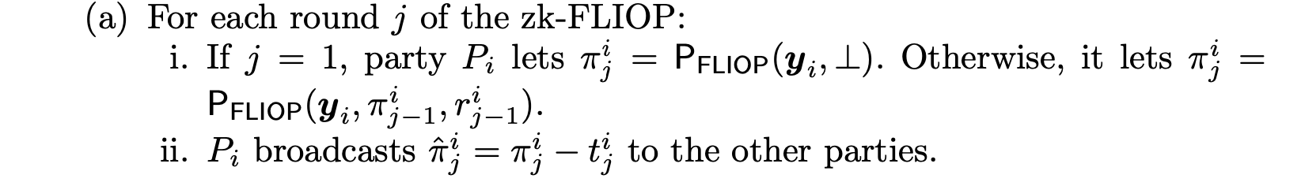
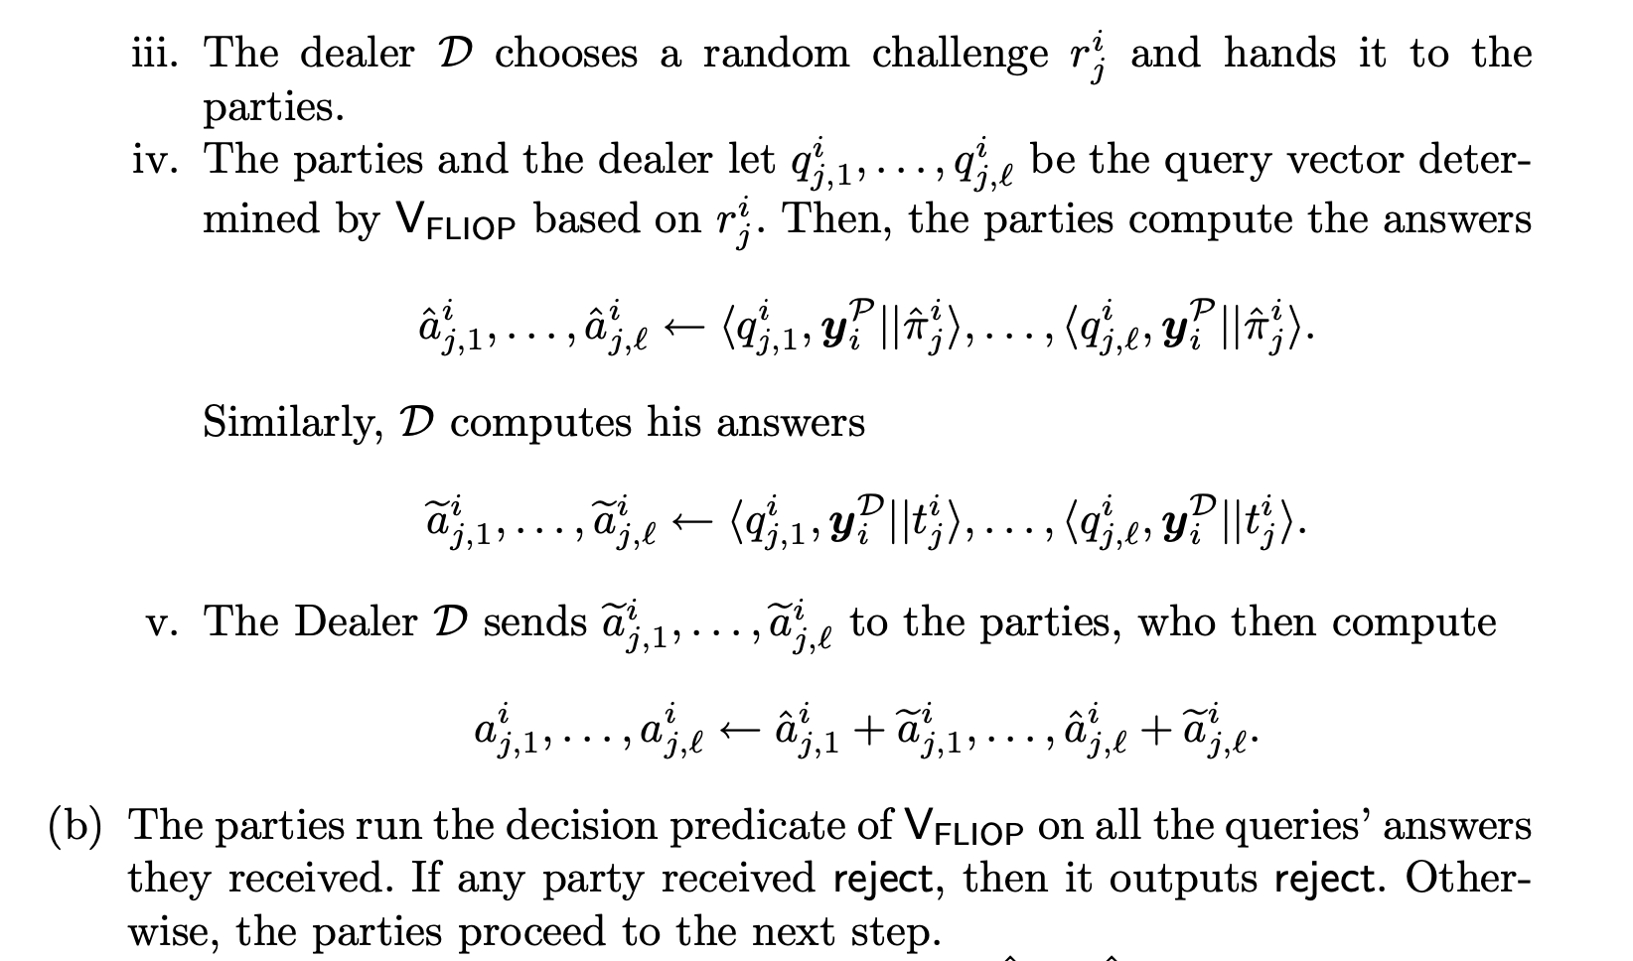

Slide 35
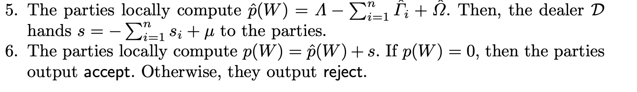

Slide 36
Questions
How to prove Claim 1
How to identify and sample non-zero-divisors
Applications

