Slide 1
Multiparty PCG for Authenticated Triples
2021/12/12

Slide 2
Synopsis
Functionality
Proposal

Slide 3
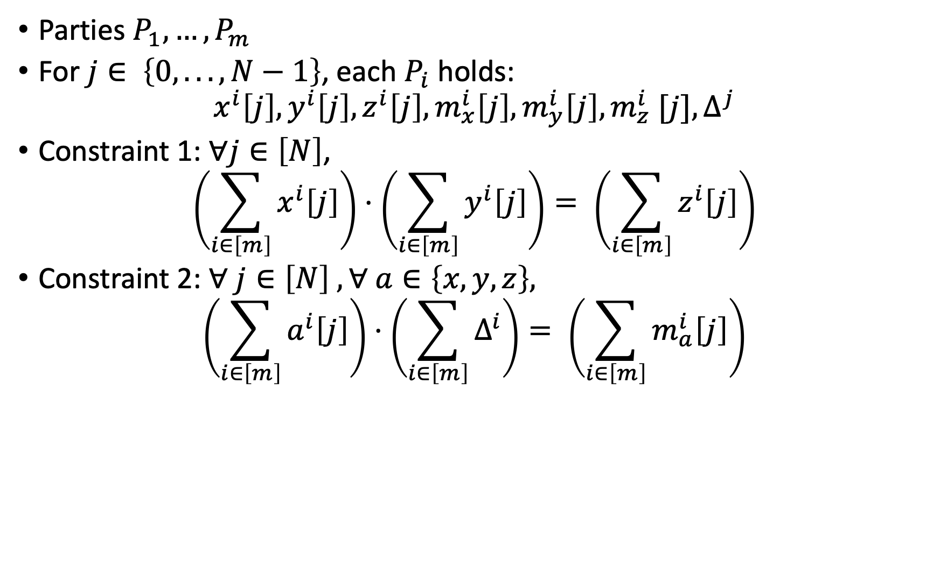
Auth Triples Functionality
Parties $P_{1},…,P_{m}$
For $j∈ \left\{0,...,N−1\right\}$, each $P_{i}$ holds:
$$x^{i}\left[j\right],y^{i}\left[j\right],z^{i}\left[j\right],m_{x}^{i}\left[j\right],m_{y}^{i}\left[j\right],m_{z}^{i} [j], Δ^{j}$$
Constraint 1: $∀j∈\left[N\right]$,
$$\left(\sum_{i∈\left[m\right]}{x^{i}\left[j\right]}\right)⋅\left(\sum_{i∈\left[m\right]}{y^{i}\left[j\right]}\right)= \left(\sum_{i∈\left[m\right]}{z^{i}\left[j\right]}\right)$$
Constraint 2: $∀ j∈\left[N\right] , ∀ a∈\left\{x,y,z\right\},$
$$\left(\sum_{i∈\left[m\right]}{a^{i}\left[j\right]}\right)⋅\left(\sum_{i∈\left[m\right]}{Δ^{i}}\right)= \left(\sum_{i∈\left[m\right]}{m_{a}^{i}\left[j\right]}\right)$$

Slide 4
Building Blocks
Semi-Honest Ring-LPN OLE
Malicious LPN sVOLE (Wolverine)
FLIOP
Ideas:
Run SH-OLE to get unauthenticated triples
Run Wolverine to get MAC (deg-3)
Run FLIOP to check consistency

Slide 5
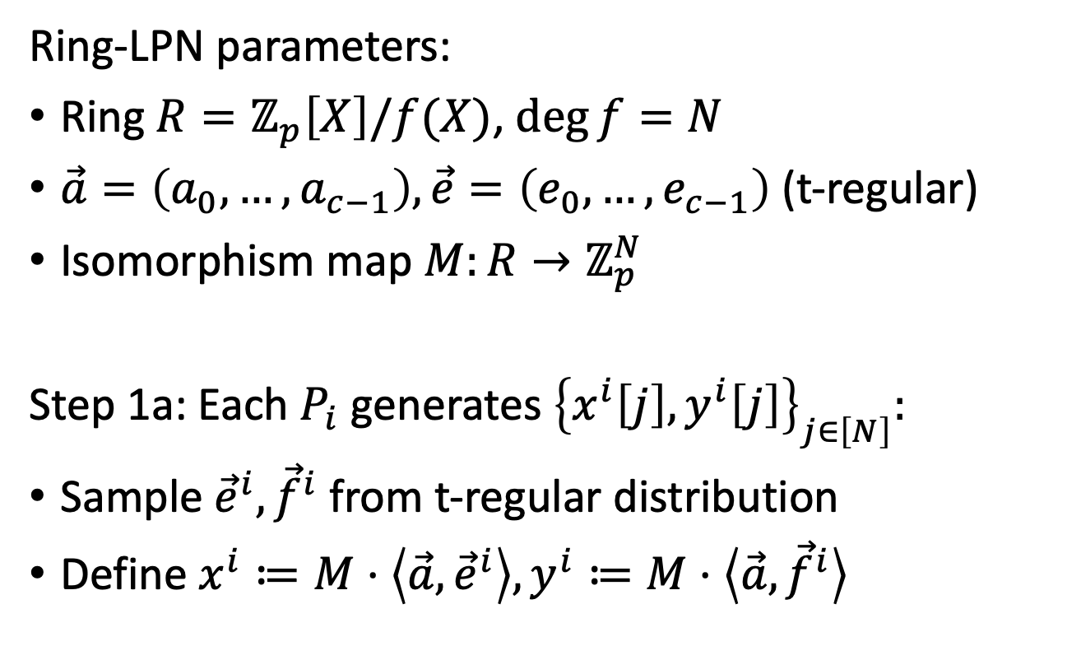
Step 1: Unauthenticated Triple
Ring-LPN parameters:
Ring $R=ℤ_{p}\left[X\right]/f(X)$, $\deg{f}=N$
$\vec{a}=\left(a_{0},…,a_{c−1}\right), \vec{e}=\left(e_{0},…,e_{c−1}\right)$ (t-regular)
Isomorphism map $M:R→ℤ_{p}^{N}$
Step 1a: Each $P_{i}$ generates ${\left\{x^{i}\left[j\right],y^{i}\left[j\right]\right\}}_{j∈\left[N\right]}:$
Sample ${\vec{e}}^{i},{\vec{f}}^{i}$ from t-regular distribution
Define $x^{i}≔M⋅\left\langle \vec{a},{\vec{e}}^{i}\right\rangle ,y^{i}≔M⋅\left\langle \vec{a},{\vec{f}}^{i}\right\rangle$

Slide 6
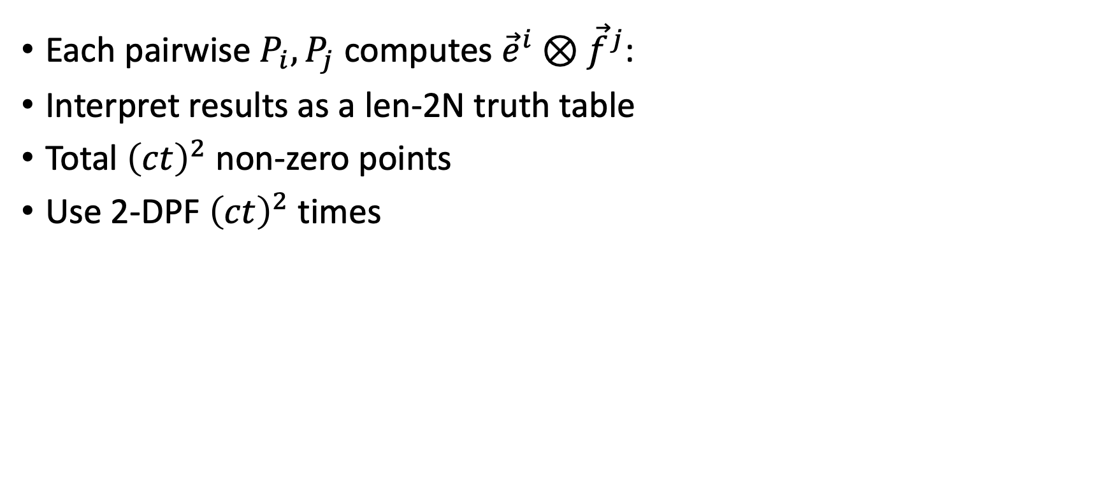
Cross-terms
Each pairwise $P_{i},P_{j}$ computes ${\vec{e}}^{i}⊗{\vec{f}}^{j}$:
Interpret results as a len-2N truth table
Total ${\left(ct\right)}^{2}$ non-zero points
Use 2-DPF ${\left(ct\right)}^{2}$ times

Slide 7



A Deeper Look at 2-DPF
$$P_{i}$$
$$P_{j}$$
$$ε$$
$$ε$$
0,0
0,1
0,0
0,1
1,0
1,1
1,2
1,3
1,0
1,1
1,2
1,3
2,0
2,1
2,2
2,3
2,4
2,5
2,6
2,7
2,0
2,1
2,2
2,3
2,4
2,5
2,6
2,7
Input is in secret-shared form
At each level compute bit-vector multiplication

Slide 8








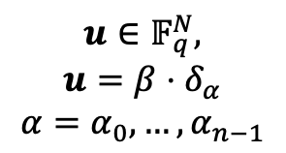



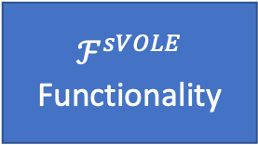









Wolverine
$$Δ∈𝔽_{q^{r}}$$
$ℱ^{sVOLE}$
Functionality
$$u∈𝔽_{q},M∈𝔽_{q^{r}}$$
$$K∈𝔽_{q^{r}}$$
Receiver
Sender
$$M=K+Δ⋅u$$
Single-Point sVOLE
$$u∈𝔽_{q}$$
$$Δ∈𝔽_{q^{r}}$$
$ℱ^{sVOLE}$
Functionality
Sender
$$M^{∗}∈𝔽_{q^{r}}$$
$$K′∈𝔽_{q^{r}}$$
Receiver
$$u∈𝔽_{q}^{N},$$
$$u=β⋅δ_{α}$$
$$α=α_{0},…,α_{n−1}$$
$$β^{′}=u−β$$
$$K^{∗}=K^{′}+Δ⋅β′$$
$$α_{i}∈\left\{0,1\right\}$$
2-1 OT
$$k_{0}^{i},k_{1}^{i}$$
$$s←{\left\{0,1\right\}}^{λ}$$
$$K_{\left\{α\right\}}∈{\left\{0,1\right\}}^{nλ}$$
$$\left(k_{0}^{i},k_{1}^{i}\right)←GGM\left(s\right)$$
$$δ=K^{∗}−∑K^{′}\left[i\right]$$
$$K^{′}\left[i\right]≔Leaf(i)$$
$$M\left[α\right]=−∑\left(Expand\left(K_{\left\{α\right\}}\right)\right)−δ+M^{∗}$$
$$M=K+Δ⋅u$$

Slide 9




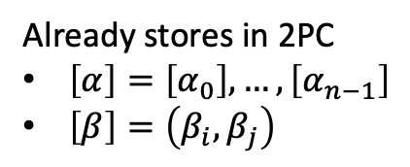










Idea for Seed Reuse (Authenticate x)
$$P_{i}$$
$$e_{i}=…+β⋅X^{α}+…$$
$$P_{j}$$
$$P_{k}$$
Already stores in 2PC
$\left[α\right]=\left[α_{0}\right],…,\left[α_{n−1}\right]$
$\left[β\right]=\left(β_{i},β_{j}\right)$
2PC
Protocol
$${\left[α\right]}_{j}∈𝔽_{q}$$
$$s←{\left\{0,1\right\}}^{λ}$$
$${\left[α\right]}_{i}$$
$$k_{0}^{i},k_{1}^{i},{\left[α\right]}_{j}$$
2PC
$$\left(k_{0}^{i},k_{1}^{i}\right)←GGM\left(s\right)$$
$$K_{\left\{α\right\}}∈{\left\{0,1\right\}}^{nλ}$$
$$δ=K^{∗}−∑K^{′}\left[i\right]$$
$$K^{′}\left[i\right]≔Leaf(i)$$
$$M\left[α\right]=−∑\left(Expand\left(K_{\left\{α\right\}}\right)\right)−δ+M^{∗}$$
$$M=K+Δ⋅u$$

Slide 10
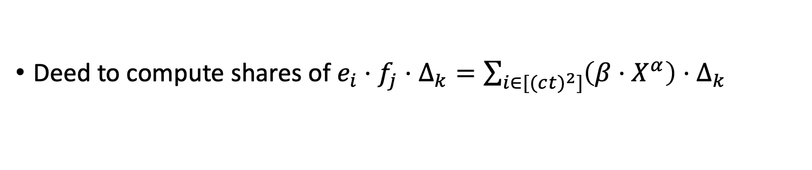
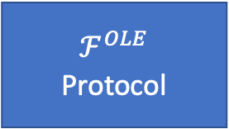








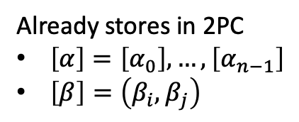

Idea for deg-3 multiplication
Deed to compute shares of $e_{i}⋅f_{j}⋅Δ_{k}=\sum_{i∈[(c{t)}^{2}]}{\left(β⋅X^{α}\right)}⋅Δ_{k}$
$$P_{i}$$
$$P_{j}$$
$$P_{k}$$
Already stores in 2PC
$\left[α\right]=\left[α_{0}\right],…,\left[α_{n−1}\right]$
$\left[β\right]=\left(β_{i},β_{j}\right)$
$ℱ^{OLE}$
Protocol
$$β_{j}∈𝔽_{q}$$
$$Δ_{k}∈𝔽_{q^{r}}$$
$$β_{i}∈𝔽_{q}$$
$ℱ^{sVOLE}$
Functionality
$$K_{i},K_{j}∈𝔽_{q^{r}}$$
$$M_{i}=K_{i}+{Δ_{k}⋅β}_{i}$$
$$M_{j}=K_{j}+{Δ_{k}⋅β}_{j}$$
$$M_{i}+M_{j}−\left(K_{i}+K_{j}\right)=Δ_{k}⋅β$$

Slide 11







Idea for deg-3 multiplication
$$P_{i}$$
$$P_{j}$$
$$P_{k}$$
Already stores in 2PC
$\left[α\right]=\left[α_{0}\right],…,\left[α_{n−1}\right]$
$\left[β\right]=\left(β_{i},β_{j}\right)$
2-DPF
Protocol
$$β_{j}∈𝔽_{q}$$
$$Δ_{k}∈𝔽_{q^{r}}$$
$$β_{i}∈𝔽_{q}$$
$ℱ^{sVOLE}$
Functionality
$$K_{i},K_{j}∈𝔽_{q^{r}}$$
$$M_{i}=K_{i}+{Δ_{k}⋅β}_{i}$$
$$M_{j}=K_{j}+{Δ_{k}⋅β}_{j}$$
$$M_{i}+M_{j}+\left(K_{i}+K_{j}\right)=Δ_{k}⋅β$$

Slide 14
Synopsis
Functionality
Proposal

