Slide 1
Sublinear GMW-Style Compiler for MPC with Preprocessing
2021/10/27

Slide 2
Synopsis
Introduction
Online Protocol
Distributed Dealer
Discussion

Slide 3
Introduction
Malicious multiparty computation over arbitrary ring/field in the preprocessing model.
Secure computation: semi-honest vs. malicious
Preprocessing: circuit-dependent vs. circuit independent

Slide 4
Contributions
A novel online malicious MPC protocol without authenticated beaver’s triples
Main technique: FLIOP for inner-product relation to enforce consistency
Application of Crypto 2019 paper: Zero-knowledge proofs on secret-shared data via fully linear PCPs

Slide 5

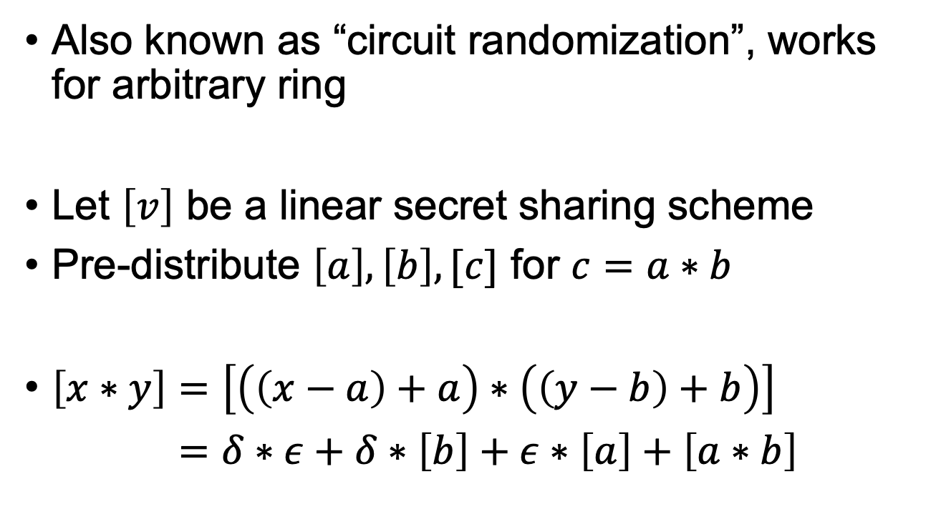
Beaver’s Triples
Also known as “circuit randomization”, works for arbitrary ring
Let $\left[v\right]$ be a linear secret sharing scheme
Pre-distribute $\left[a\right],\left[b\right],[c]$ for $c=a∗b$
$\left[x∗y\right]=\left[\left(\left(x−a\right)+a\right)∗\left(\left(y−b\right)+b\right)\right]$
$\left[x∗y\right]=δ∗ε+δ∗\left[b\right]+ε∗\left[a\right]+\left[a∗b\right]$
Open $δ=x−a,$
$$ε=y−b$$
Beaver, Donald. "Efficient multiparty protocols using circuit randomization." Annual International Cryptology Conference. Springer, Berlin, Heidelberg, 1991.

Slide 6
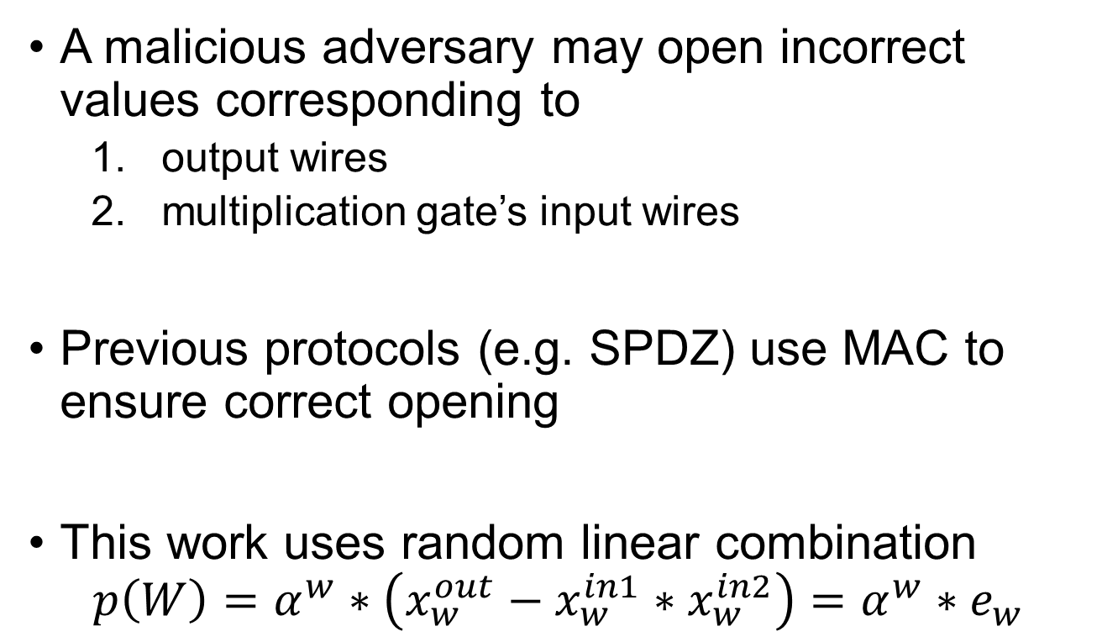
Beaver’s Triples
A malicious adversary may open incorrect values corresponding to
output wires
multiplication gate’s input wires
Previous protocols (e.g. SPDZ) use MAC to ensure correct opening
This work uses random linear combination
$$p\left(W\right)=α^{w}∗\left(x_{w}^{out}−x_{w}^{in1}∗x_{w}^{in2}\right)=α^{w}∗e_{w}$$

Slide 7
Synopsis
Introduction
Online Protocol
Distributed Dealer
Discussion

Slide 8
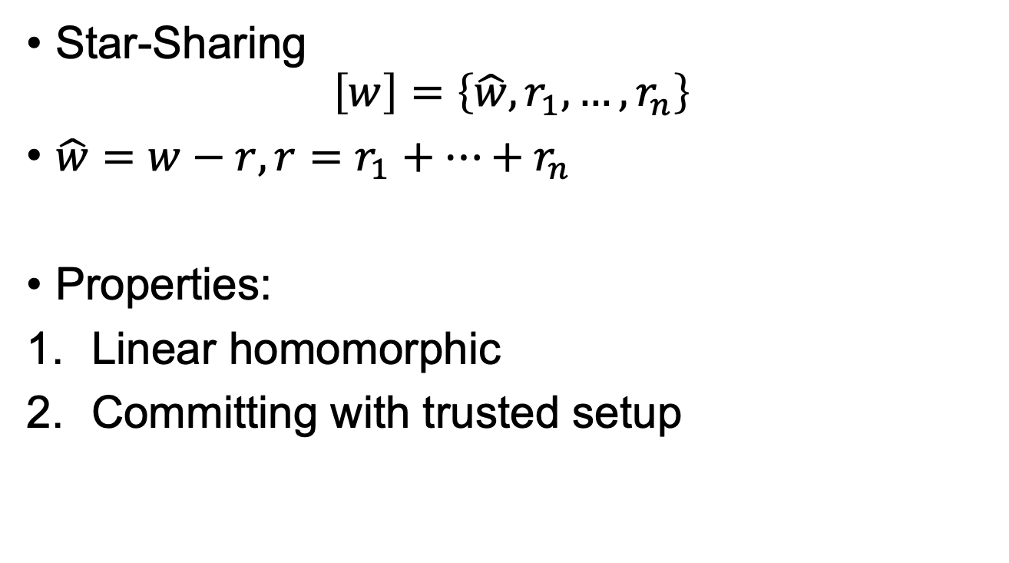
Online Protocol
Star-Sharing
$$\left[w\right]=\left\{\hat{w}, r_{1},…,r_{n}\right\}$$
$\hat{w}=w−r, r=r_{1}+…+r_{n}$
Properties:
Linear homomorphic
Committing with trusted setup

Slide 9
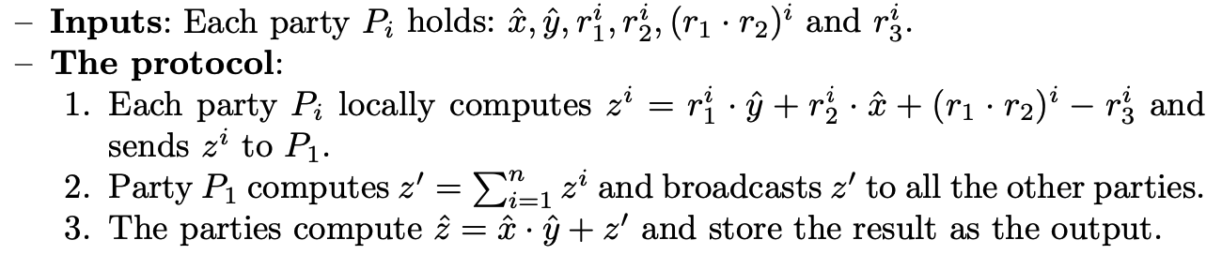
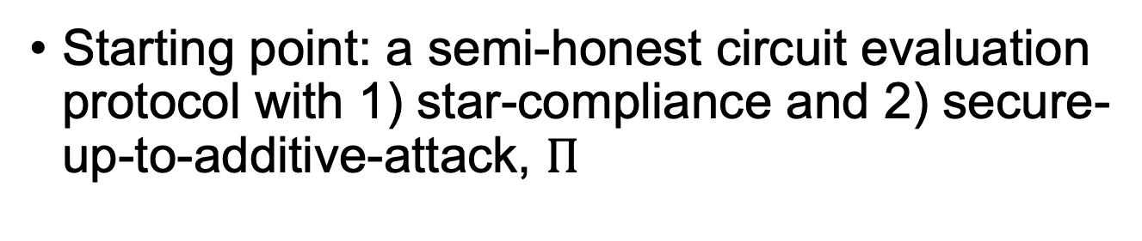
Online Protocol
Starting point: a semi-honest circuit evaluation protocol with 1) star-compliance and 2) secure-up-to-additive-attack, $Π$
Note that this preprocessing depends on the circuit structure

Slide 10










Multiplication Protocol
$$4$$
Mult
$$6$$
$${[r}_{3}],\left[r_{4}\right],\left[r_{3}∗r_{4}\right],[r_{6}]$$
$$1$$
Mult
$$3$$
$$2$$
$${[r}_{1}],\left[r_{2}\right],\left[r_{1}∗r_{2}\right],[r_{3}]$$
Mult
$$7$$
$$5$$
$${[r}_{3}],\left[r_{5}\right],\left[r_{3}∗r_{5}\right],[r_{7}]$$

Slide 11
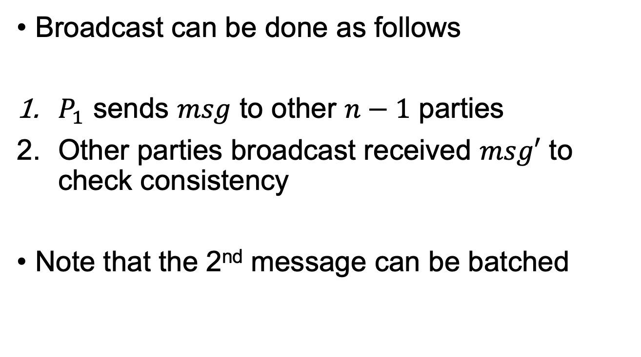
Online Protocol
Broadcast can be done as follows
$P_{1}$ sends $msg$ to other $n−1$ parties
Other parties broadcast received $msg′$ to check consistency
Note that the 2nd message can be batched

Slide 12
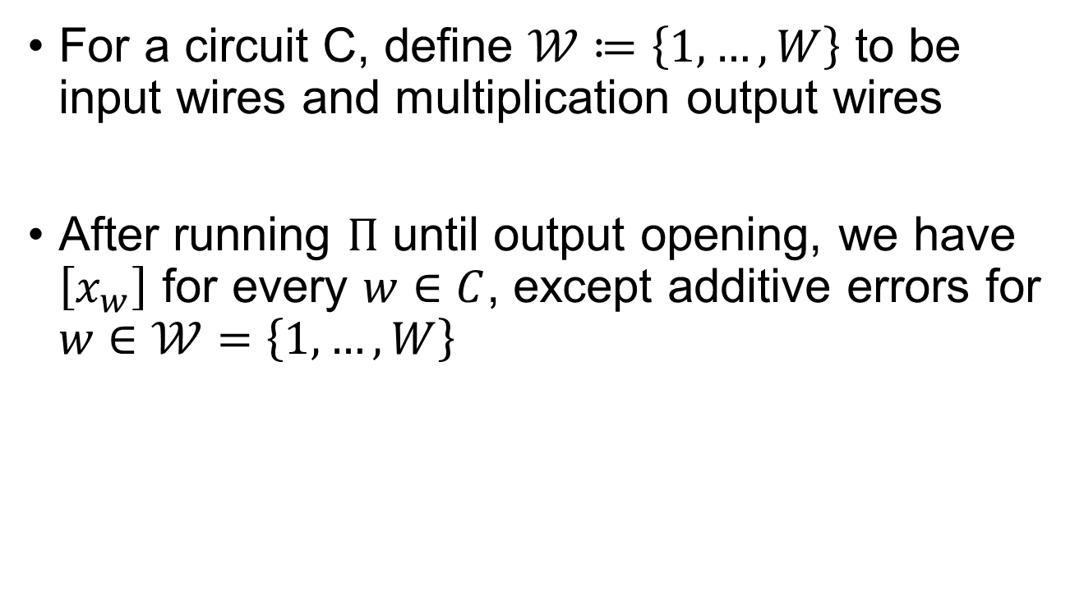
Online Protocol
For a circuit C, define $𝒲≔\left\{1,…,W\right\}$ to be input wires and multiplication output wires
After running $Π$ until output opening, we have $\left[x_{w}\right]$ for every $w∈C$, except additive errors for $w∈𝒲=\left\{1,…,W\right\}$

Slide 13
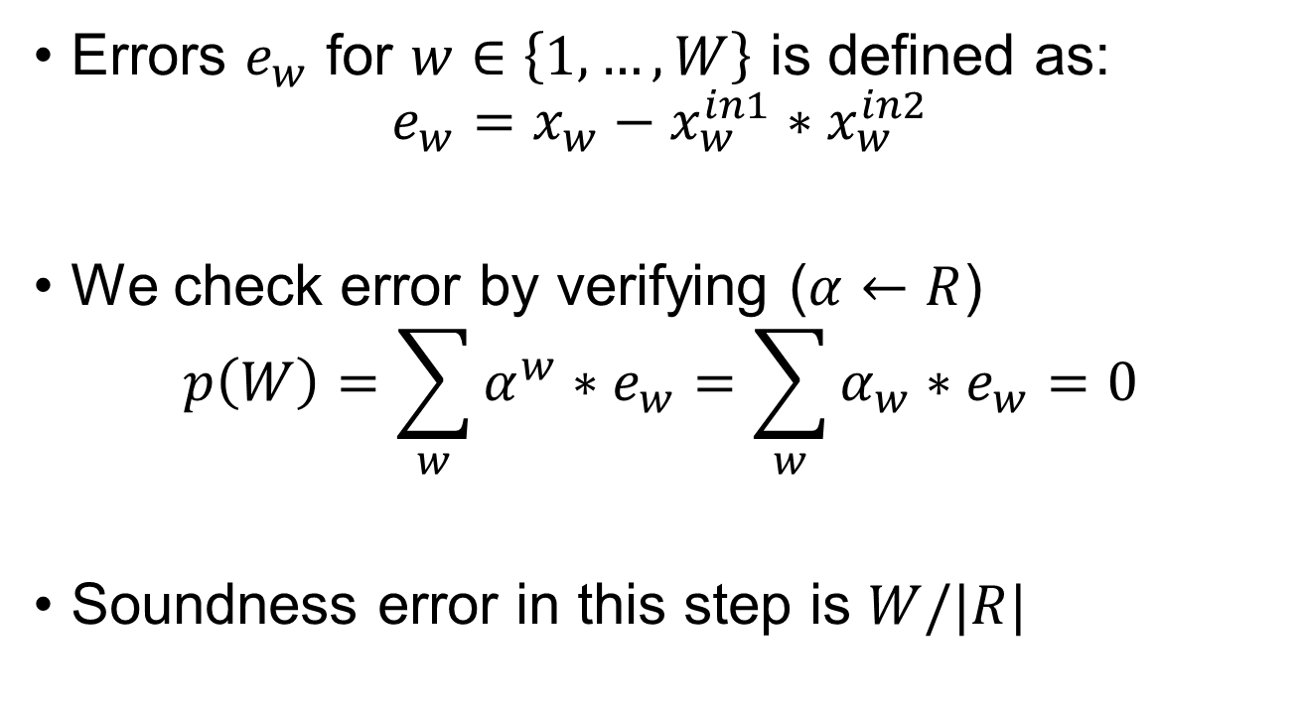
Online Protocol
Errors $e_{w}$ for $w∈\left\{1,…,W\right\}$ is defined as:
$$e_{w}=x_{w}−x_{w}^{in1}∗x_{w}^{in2}$$
We check error by verifying ($α←R$)
$$p\left(W\right)=\sum_{w}{α^{w}∗e_{w}}=\sum_{w}{α_{w}∗e_{w}}=0$$
Soundness error in this step is $W/|R|$

Slide 14
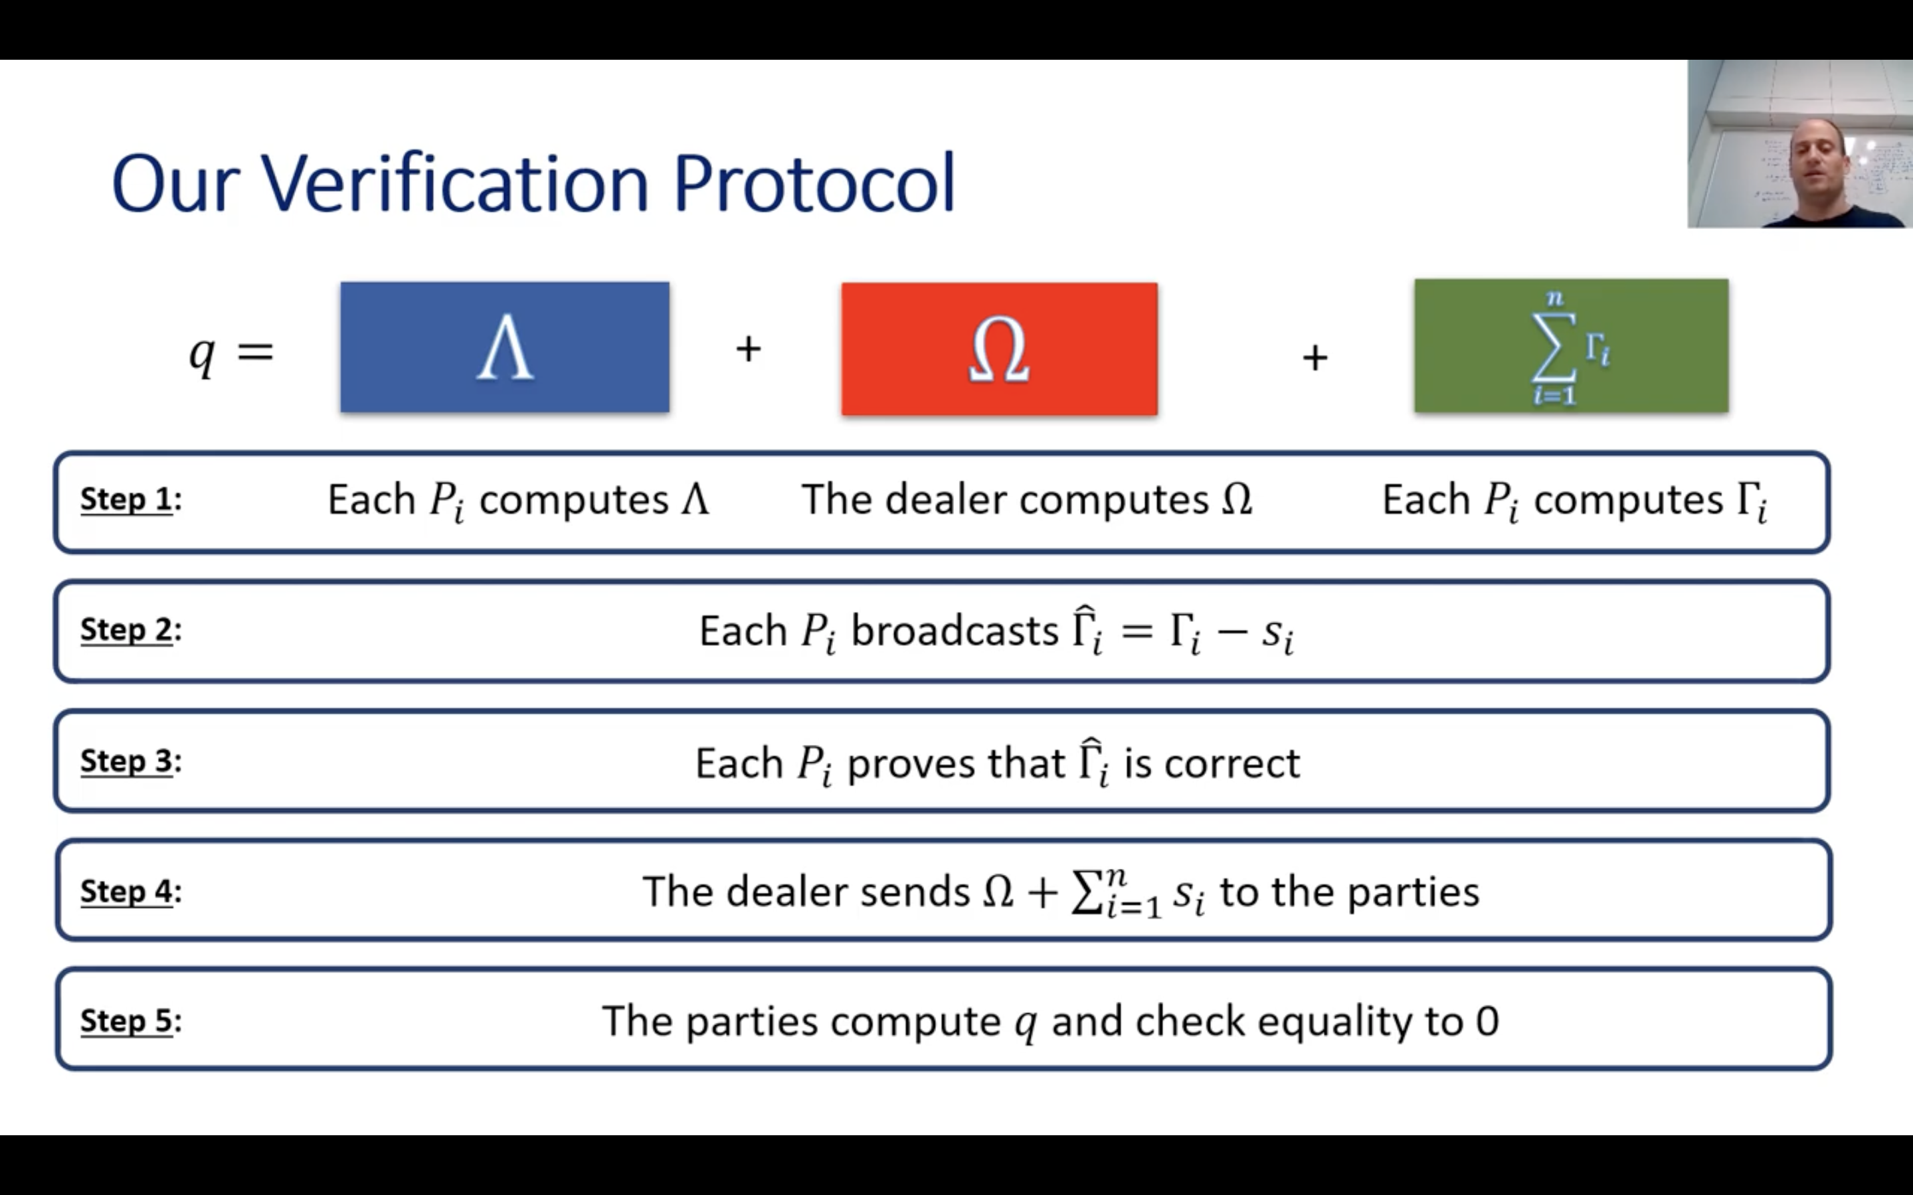
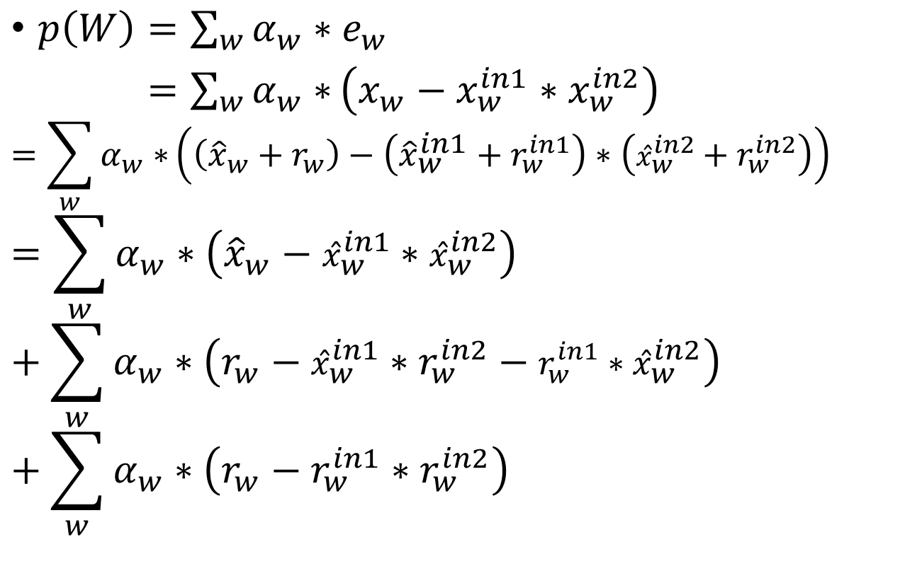
Online Protocol
$p\left(W\right)=\sum_{w}{α_{w}∗e_{w}}$
$p\left(W\right)=\sum_{w}{α_{w}∗}\left(x_{w}−x_{w}^{in1}∗x_{w}^{in2}\right)$
$$=\sum_{w}{α_{w}∗}\left(\left({{\hat{x}}_{w}+r}_{w}\right)−\left({\hat{x}}_{w}^{in1}+r_{w}^{in1}\right)∗\left({\hat{x}}_{w}^{in2}+r_{w}^{in2}\right)\right)$$
$$=\sum_{w}{α_{w}∗\left({\hat{x}}_{w}−{\hat{x}}_{w}^{in1}∗{\hat{x}}_{w}^{in2}\right)}+\sum_{w}{α_{w}∗\left(r_{w}−{\hat{x}}_{w}^{in1}∗r_{w}^{in2}−{r_{w}^{in1}∗\hat{x}}_{w}^{in2}\right)}+\sum_{w}{α_{w}∗\left(r_{w}−r_{w}^{in1}∗r_{w}^{in2}\right)}$$
Public Terms
Linear Terms
Input-Independent Terms

Slide 15
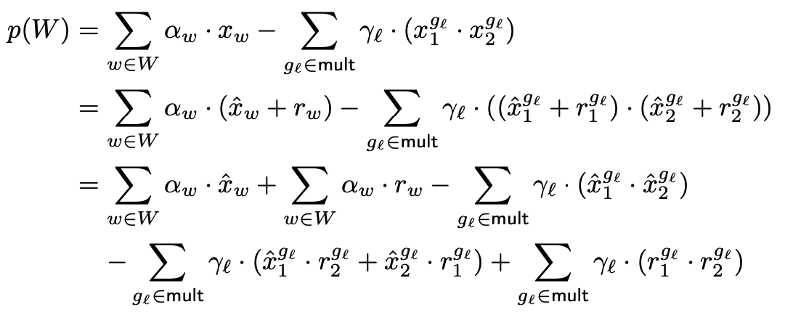
Online Protocol

Slide 16
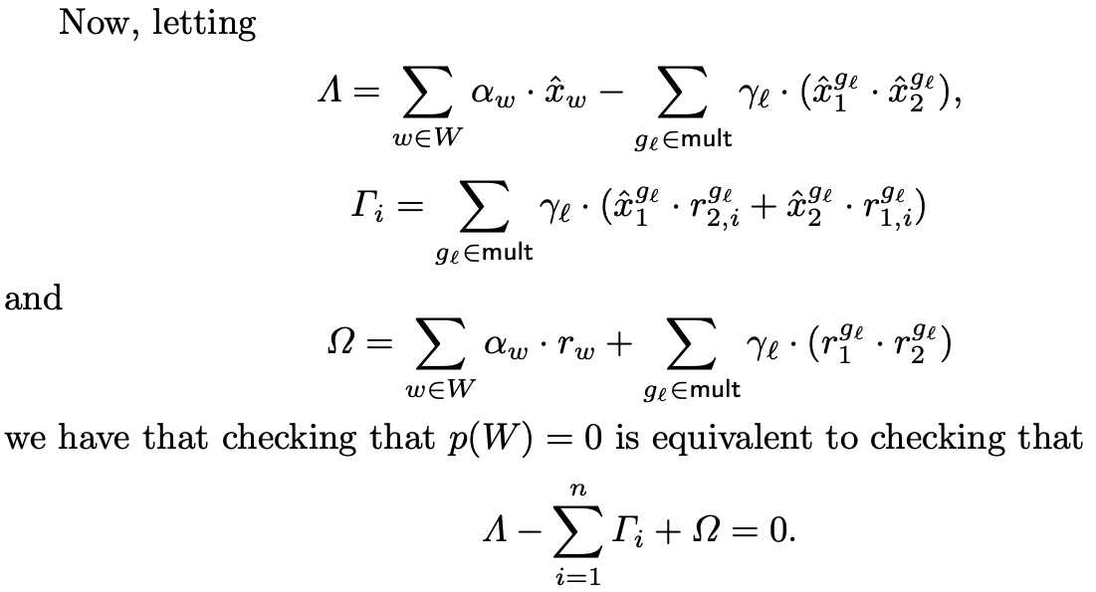
Online Protocol

Slide 17
Online Protocol
From Ariel Nof’s CRYPTO 2021 talk: https://youtu.be/Lu3ci1ARNDc

Slide 18
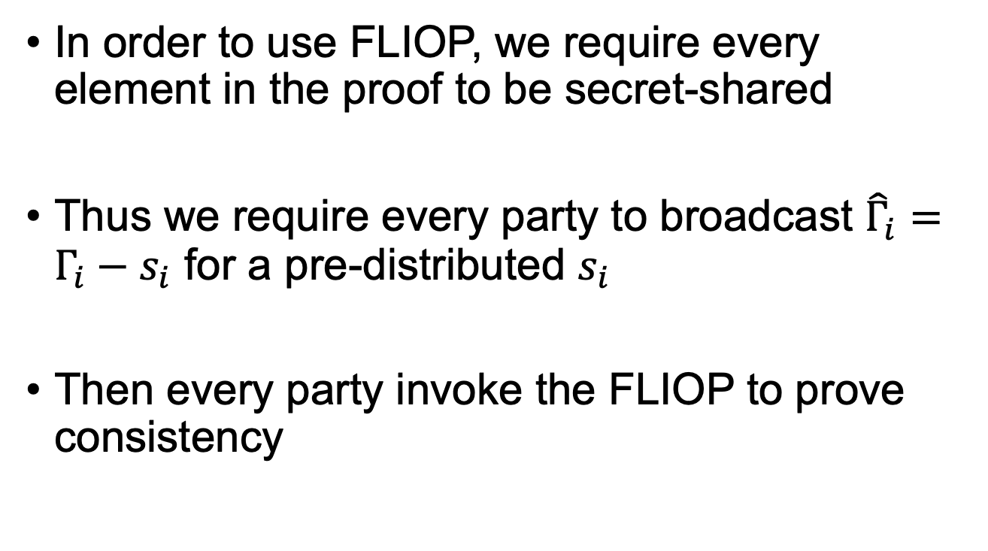
Online Protocol
In order to use FLIOP, we require every element in the proof to be secret-shared
Thus we require every party to broadcast ${\hat{Γ}}_{i}=Γ_{i}−s_{i}$ for a pre-distributed $s_{i}$
Then every party invoke the FLIOP to prove consistency

Slide 19
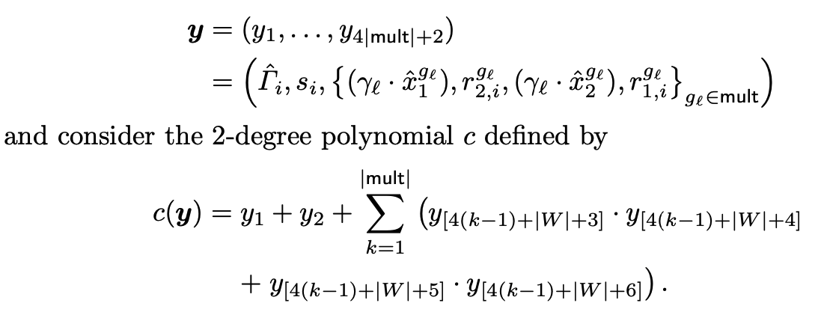
FLIOP Language

Slide 20
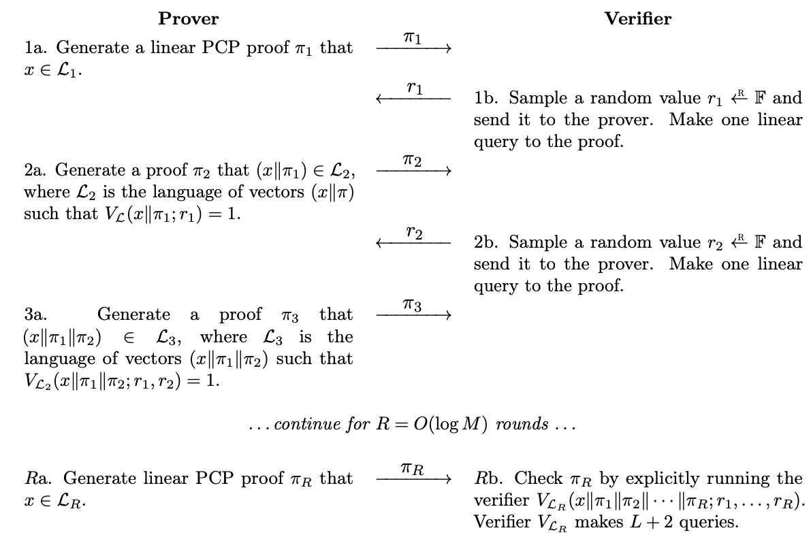

Slide 21
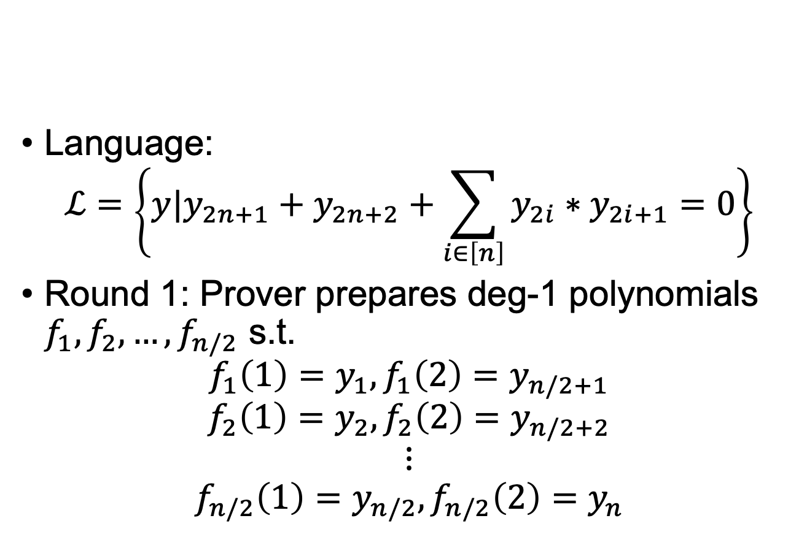
FLIOP Recap
Language:
$$ℒ=\left\{y|y_{2n+1}+y_{2n+2}+\sum_{i∈\left[n\right]}{y_{2i}∗y_{2i+1}=0}\right\}$$
Round 1: Prover prepares deg-1 polynomials $f_{1},f_{2},…,f_{n/2}$ s.t.
$$f_{1}\left(1\right)=y_{1},f_{1}\left(2\right)=y_{n/2+1}$$
$$f_{2}\left(1\right)=y_{2},f_{2}\left(2\right)=y_{n/2+2}$$
$$⋮$$
$$f_{n/2}\left(1\right)=y_{n/2},f_{n/2}\left(2\right)=y_{n}$$

Slide 22
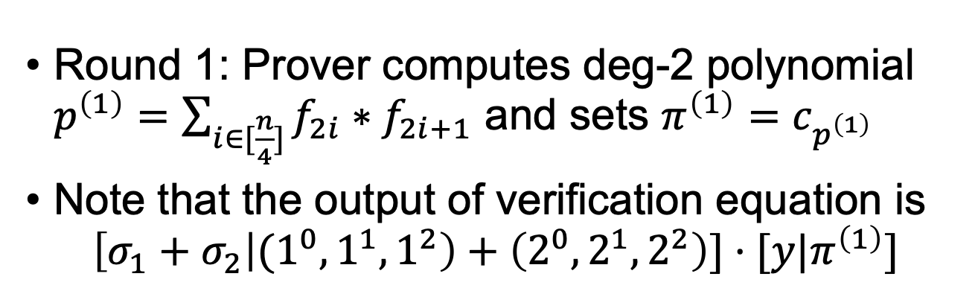
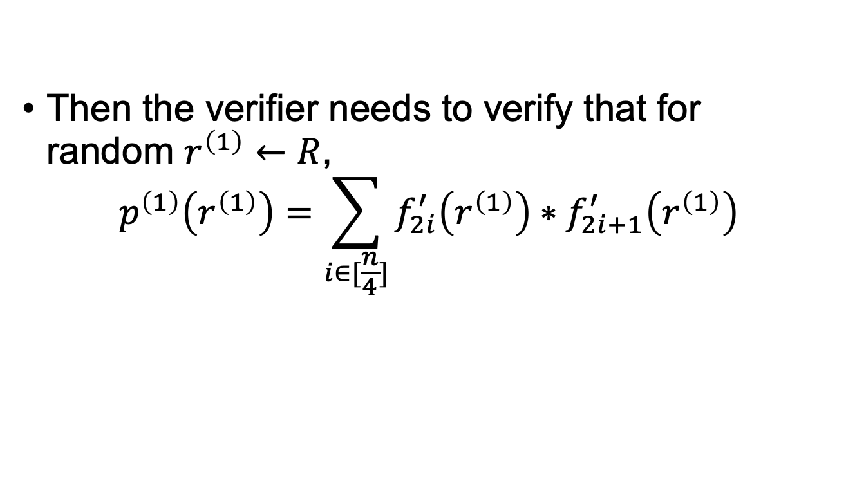
FLIOP Recap
Round 1: Prover computes deg-2 polynomial $p^{\left(1\right)}=\sum_{i∈[\frac{n}{4}]}{f_{2i}∗f_{2i+1}}$ and sets $π^{\left(1\right)}=c_{p^{\left(1\right)}}$
Note that the output of verification equation is
$$\left[σ_{1}+σ_{2} | {(1}^{0},1^{1},1^{2}\right)+\left(2^{0},2^{1},2^{2}\right)]⋅[y|π^{\left(1\right)}]$$
Linear Query
Then the verifier needs to verify that for random $r^{\left(1\right)}←R$,
$$p^{\left(1\right)}\left(r^{\left(1\right)}\right)=\sum_{i∈[\frac{n}{4}]}{f_{2i}^{′}\left(r^{\left(1\right)}\right)∗f_{2i+1}^{′}\left(r^{\left(1\right)}\right)}$$

Slide 23
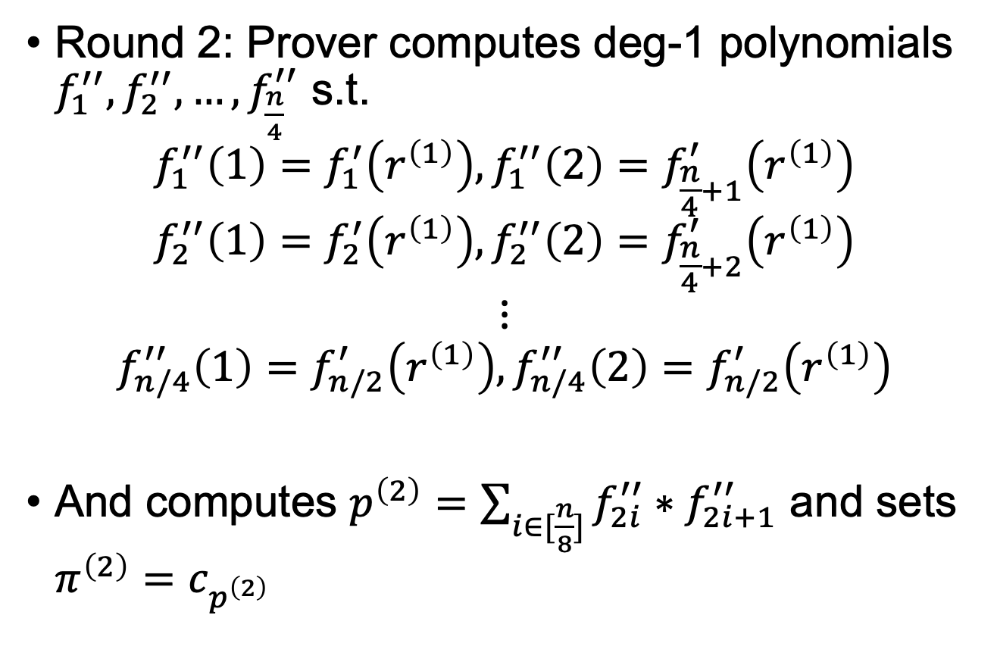
FLIOP Recap
Round 2: Prover computes deg-1 polynomials $f_{1}^{′′},f_{2}^{′′},…,f_{\frac{n}{4}}^{′′}$ s.t.
$$f_{1}^{′′}\left(1\right)=f_{1}^{′}\left(r^{\left(1\right)}\right),f_{1}^{′′}\left(2\right)=f_{\frac{n}{4}+1}^{′}\left(r^{\left(1\right)}\right)$$
$$f_{2}^{′′}\left(1\right)=f_{2}^{′}\left(r^{\left(1\right)}\right),f_{2}^{′′}\left(2\right)=f_{\frac{n}{4}+2}^{′}\left(r^{\left(1\right)}\right)$$
$$⋮$$
$$f_{n/4}^{′′}\left(1\right)=f_{n/2}^{′}\left(r^{\left(1\right)}\right),f_{n/4}^{′′}\left(2\right)=f_{n/2}^{′}\left(r^{\left(1\right)}\right)$$
And computes $p^{\left(2\right)}=\sum_{i∈[\frac{n}{8}]}{f_{2i}^{′′}∗f_{2i+1}^{′′}}$ and sets $π^{\left(2\right)}=c_{p^{\left(2\right)}}$

Slide 24
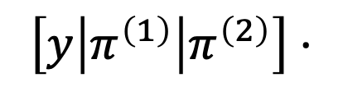
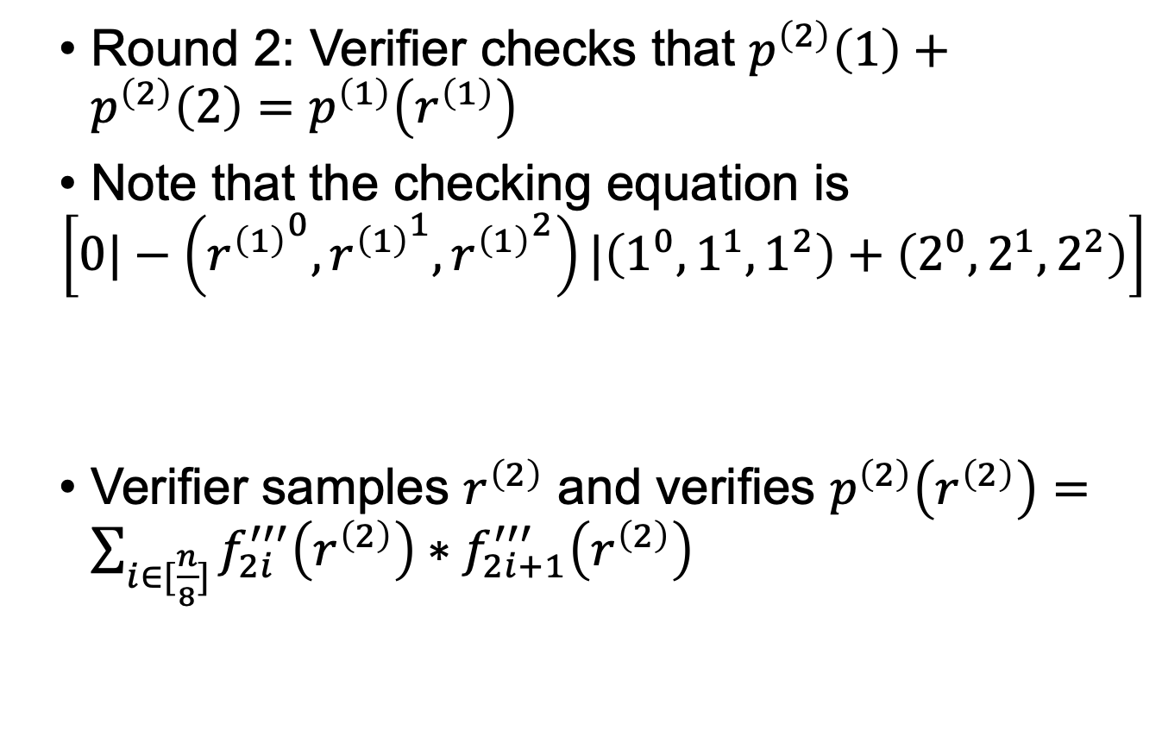
FLIOP Recap
Round 2: Verifier checks that $p^{\left(2\right)}\left(1\right)+p^{\left(2\right)}\left(2\right)=p^{\left(1\right)}\left(r^{\left(1\right)}\right)$
Note that the checking equation is
$$\left[0|−\left({r^{\left(1\right)}}^{0},{r^{\left(1\right)}}^{1},{r^{\left(1\right)}}^{2}\right)|\left(1^{0},1^{1},1^{2}\right)+\left(2^{0},2^{1},2^{2}\right)\right]$$
Verifier samples $r^{\left(2\right)}$ and verifies $p^{\left(2\right)}\left(r^{\left(2\right)}\right)=\sum_{i∈[\frac{n}{8}]}{f_{2i}^{′′′}\left(r^{\left(2\right)}\right)∗f_{2i+1}^{′′′}\left(r^{\left(2\right)}\right)}$
$$\left[y\left|π^{\left(1\right)}\right|π^{\left(2\right)}\right]⋅$$
Linear Query

Slide 25
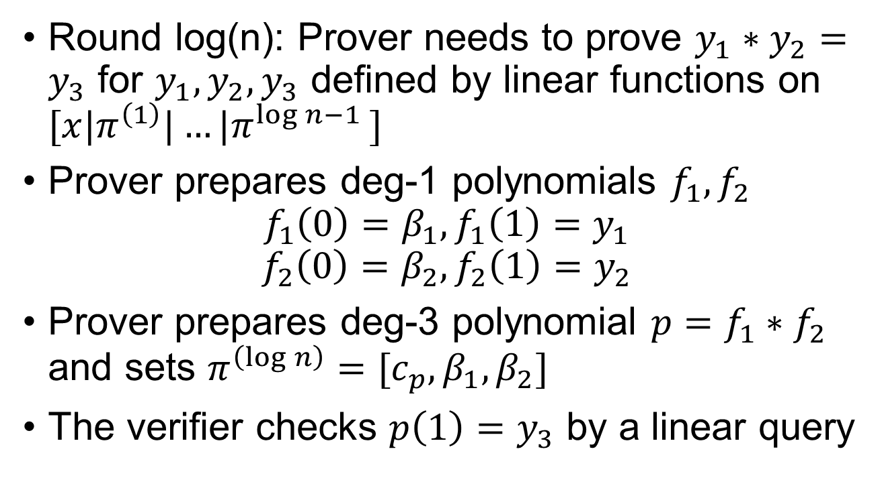
FLIOP Recap
Round log(n): Prover needs to prove $y_{1}∗y_{2}=y_{3}$ for $y_{1},y_{2},y_{3}$ defined by linear functions on $[x|π^{\left(1\right)}|…|π^{\log{n}−1 }]$
Prover prepares deg-1 polynomials $f_{1},f_{2}$
$$f_{1}\left(0\right)=β_{1},f_{1}\left(1\right)=y_{1}$$
$$f_{2}\left(0\right)=β_{2},f_{2}\left(1\right)=y_{2}$$
Prover prepares deg-3 polynomial $p=f_{1}∗f_{2}$ and sets $π^{\left(\log{n}\right)}={[c}_{p},β_{1},β_{2}]$
The verifier checks $p\left(1\right)=y_{3}$ by a linear query

Slide 26

FLIOP Recap
The verifier samples $r^{(\log{n})}←R$ and checks $p\left(r^{(\log{n})}\right)=f_{1}^{′}\left(r^{\left(\log{n}\right)}\right)∗f_{2}^{′}\left(r^{(\log{n})}\right)$ by three additional queries

Slide 27
Online Protocol

Slide 28
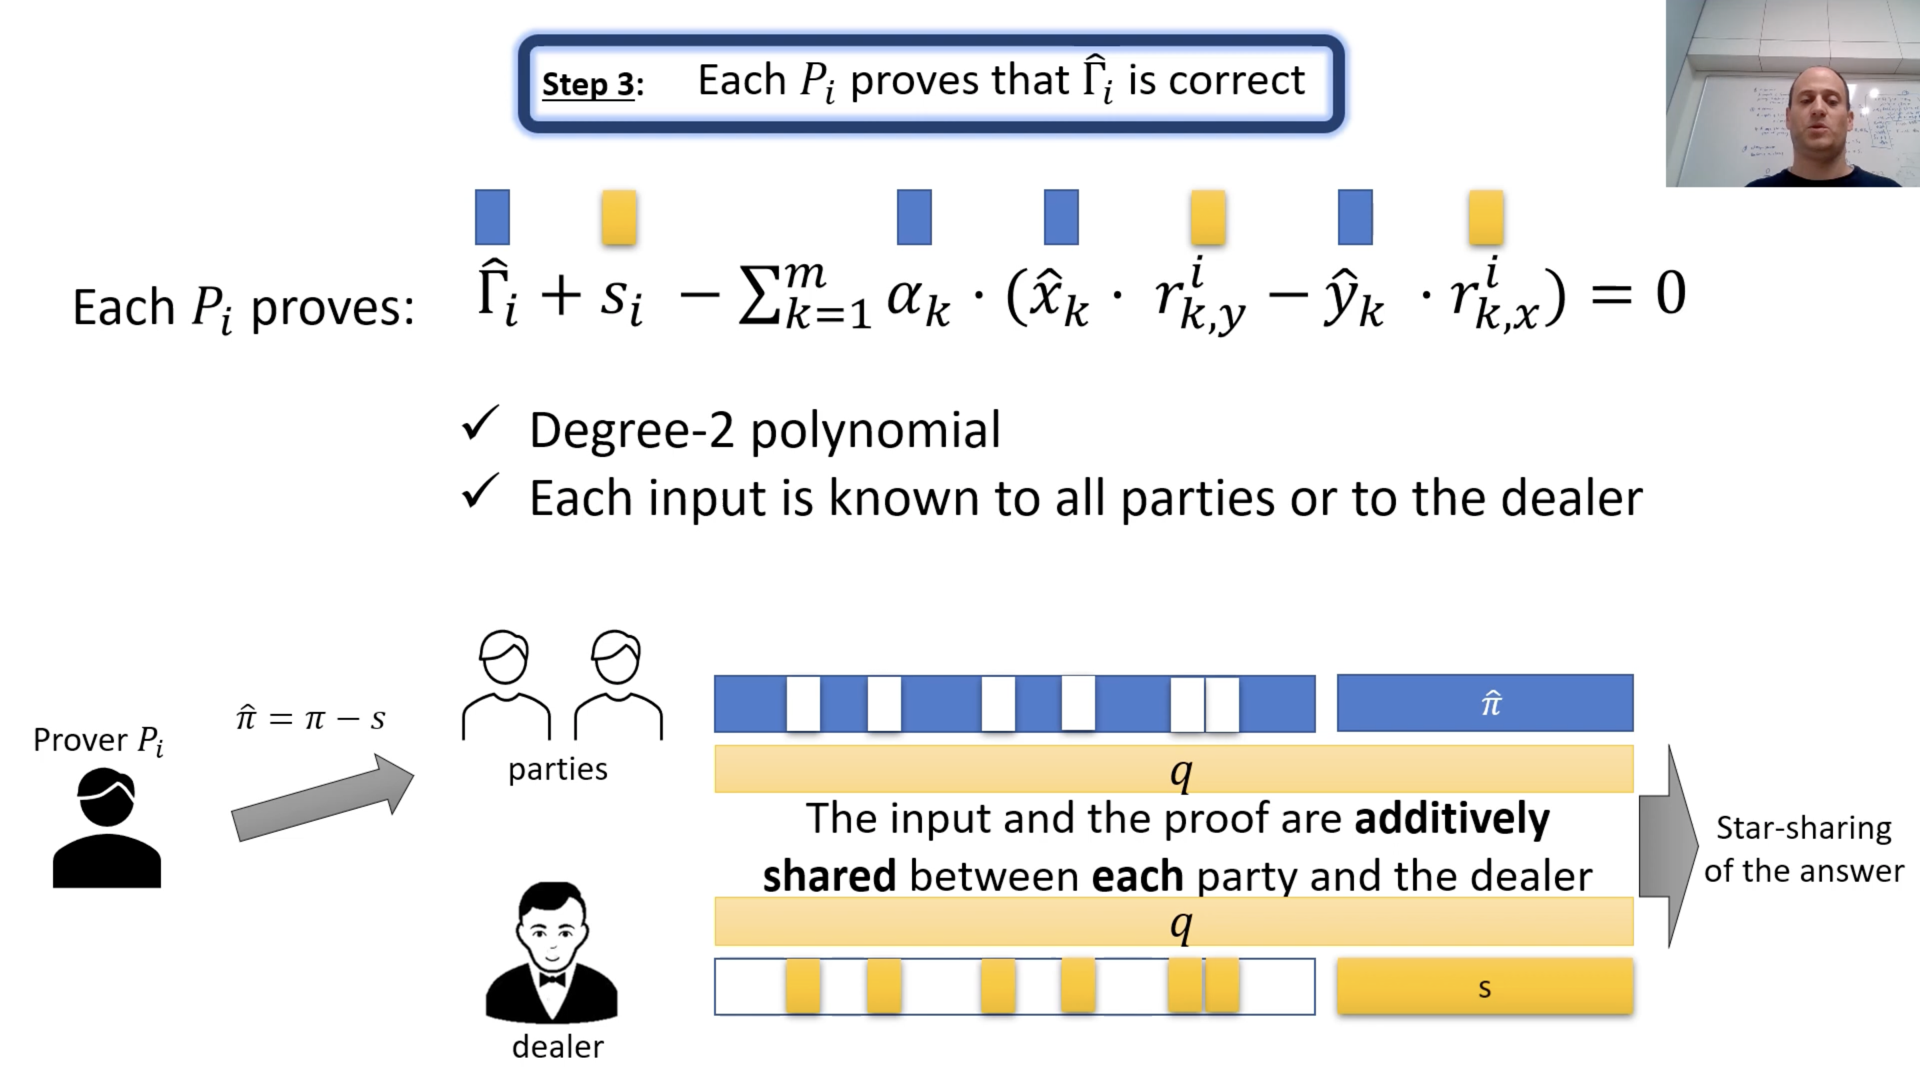
Using the Dealer as a Verifier
From Ariel Nof’s CRYPTO 2021 talk: https://youtu.be/Lu3ci1ARNDc

Slide 29
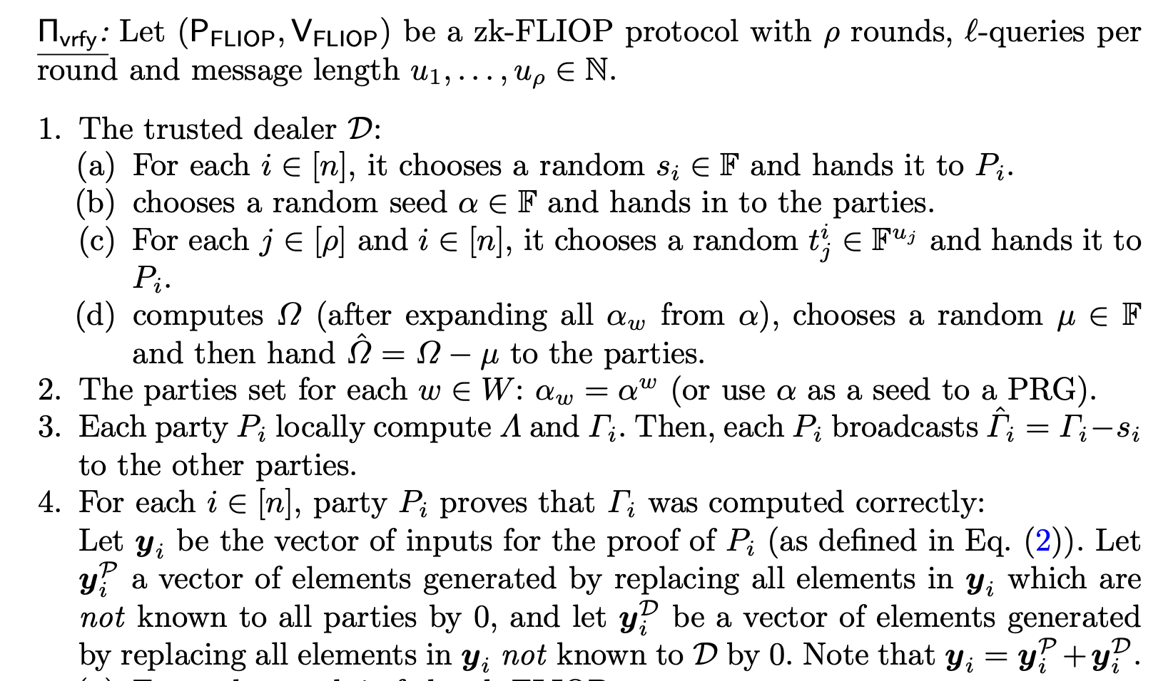
Online Verification

Slide 30
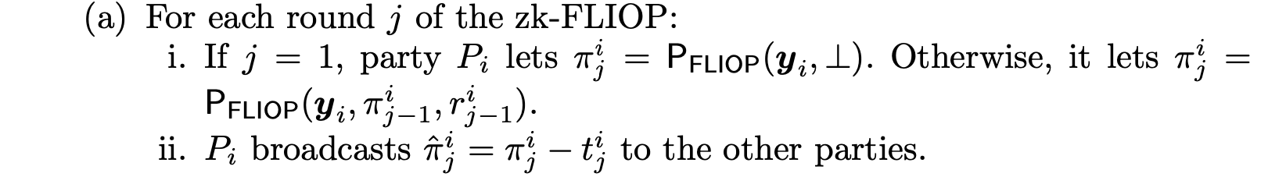
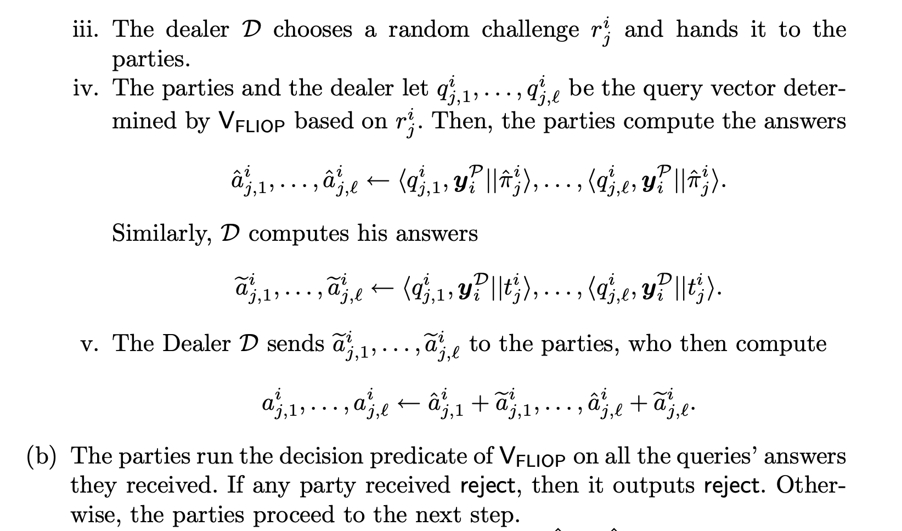

Slide 31
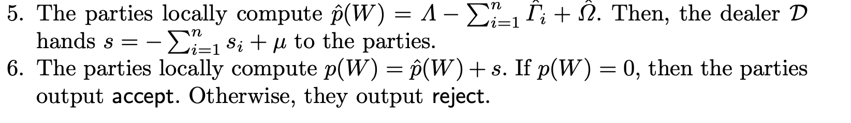
Properties of the above verification:
Dealer’s computation is input-independent and thus can be included in preprocessing
By star-sharing, prover’s only action is committing to proof strings, and thus the reduction to FLIOP soundness is trivial

Slide 32
Synopsis
Introduction
Online Protocol
Distributed Dealer
Discussion

Slide 33
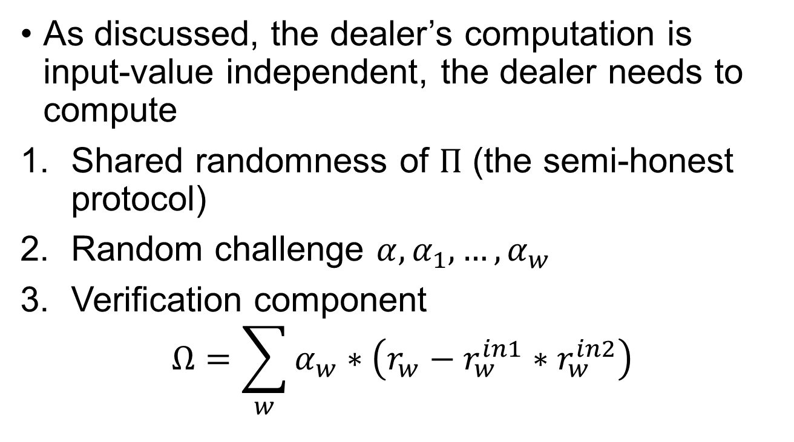
Distributed Dealer
As discussed, the dealer’s computation is input-value independent, the dealer needs to compute
Shared randomness of $Π$ (the semi-honest protocol)
Random challenge $α,α_{1},…,α_{w}$
Verification component
$$Ω=\sum_{w}{α_{w}∗\left(r_{w}−r_{w}^{in1}∗r_{w}^{in2}\right)}$$

Slide 34
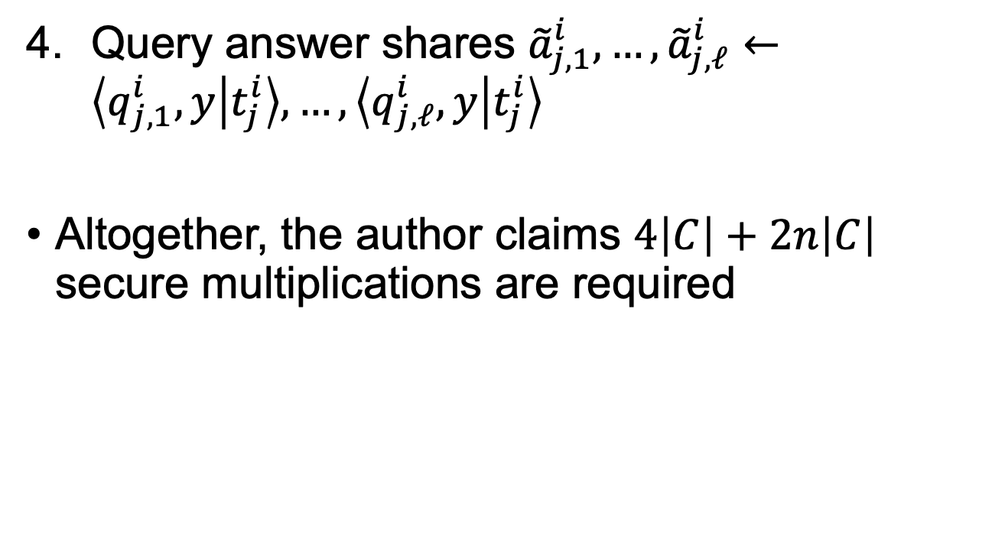
Distributed Dealer
Query answer shares ${\tilde{a}}_{j,1}^{i},…,{\tilde{a}}_{j,ℓ}^{i}←\left\langle q_{j,1}^{i},y | t_{j}^{i}\right\rangle ,…,\left\langle q_{j,ℓ}^{i},y | t_{j}^{i}\right\rangle$
Altogether, the author claims $4\left|C\right|+2n\left|C\right|$ secure multiplications are required

Slide 35
Synopsis
Introduction
Online Protocol
Distributed Dealer
Discussion

Slide 36
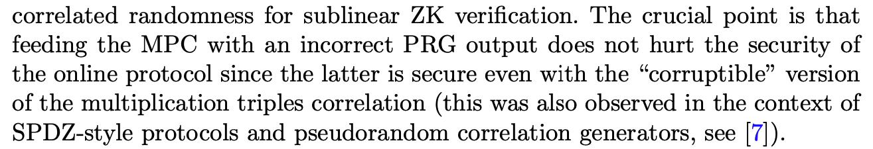
Discussion
Security level for preprocessing
The composition theorem requires UC-secure implementation, but the authors claim that imperfect security suffices without proof

Slide 37
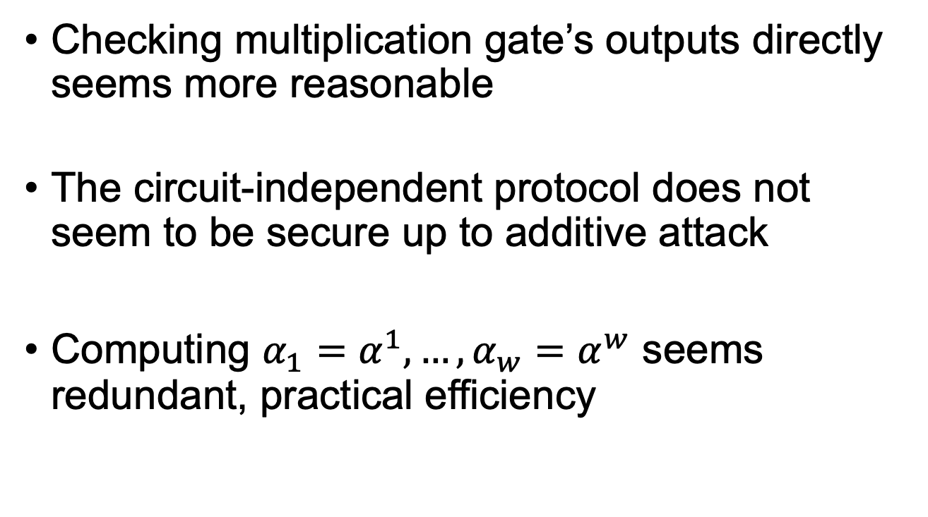
Discussion
Checking multiplication gate’s outputs directly seems more reasonable
The circuit-independent protocol does not seem to be secure up to additive attack
Computing $α_{1}=α^{1},…,α_{w}=α^{w}$ seems redundant, practical efficiency

