Slide 1
Braking Event
Speeding Up
Going Back to Start Position
Speeding Up

Slide 3
for Step = Initial Step : Total Steps
if average( Current Step, Next Step, …. ) < User Threshold
Not extracted = Signal;
else
Extracted = Signal;
end
end

Slide 4
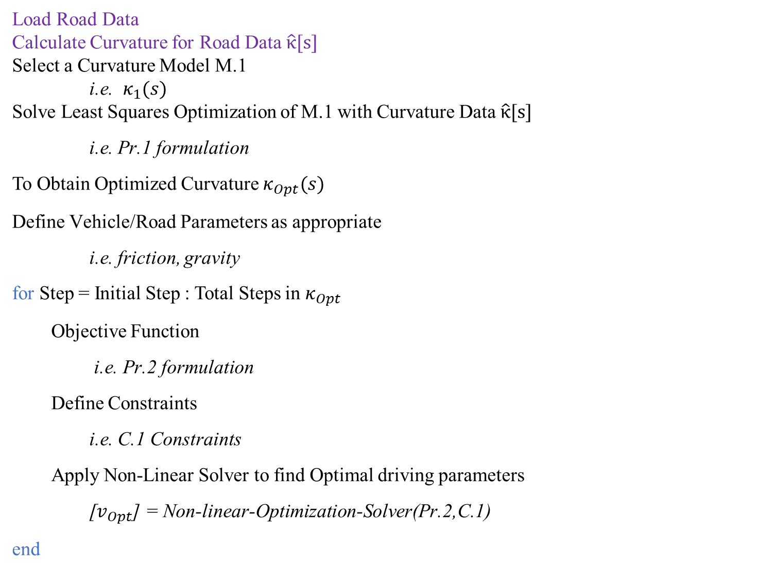
Load Road Data
Calculate Curvature for Road Data $\hat{κ}[s]$
Select a Curvature Model M.1
i.e. $κ_{1}(s)$
Solve Least Squares Optimization of M.1 with Curvature Data $\hat{κ}[s]$
i.e. Pr.1 formulation
To Obtain Optimized Curvature $κ_{Opt}(s)$
Define Vehicle/Road Parameters as appropriate
i.e. friction, gravity
for Step = Initial Step : Total Steps in $κ_{Opt}$
Objective Function
i.e. Pr.2 formulation
Define Constraints
i.e. C.1 Constraints
Apply Non-Linear Solver to find Optimal driving parameters
[$v_{Opt}$] = Non-linear-Optimization-Solver(Pr.2,C.1)
end

