Slide 1
Biological Impacts of Contrasting Economic Goals for Commercial and Recreational Marine Fisheries
American Fisheries Society
Tampa, FL
Aug 24, 2017
Richard Methot, Ph.D.
NOAA Fisheries Senior Scientist for Stock Assessment

Slide 2
Background
Stock assessment goals are to:
Advise on sustainable catch policy (MSY)
Detect overfished and overfishing conditions
Project catch levels that implement the policy
Age-structured population models are foundation of most fish stock assessments.
Model and management focus is on:
yield in units of weight, and
impact on reproductive potential (typically spawning biomass)

Slide 3
Preview
Age-structured population models allow for management advice in terms of biomass and numbers
These models already calculate additional quantities, such as expected mean age and size of fish, that can be useful for management
Area-specific models are already feasible, but dependent on knowledge of movement rates
Area-specific models can evaluate pros/cons of area-specific management

Slide 4
What is a “Stock”?
Well-mixed stock
Population models typically treat the stock as if it is well-mixed throughout its range (high diffusion rate)
Hence fishing mortality caused by one fishery directly affects modeled stock abundance and availability of fish to other fisheries
Notes:
Stock definition should be based on biology because the stock assessment model is a demographic analysis assuming biological attributes

Slide 5
More Realistic Stock Structure
Northern Area
Fishery sectors tend to operate in somewhat different sub-areas
Fish diffusion rates are not always that high
Localized protection or depletion are possible
Southern Area
Notes:
Stock definition should be based on biology because the stock assessment model is a demographic analysis assuming biological attributes

Slide 6
Basic Sustainable Fisheries Dynamics
Results obtained by simulation across a range of F levels

Slide 7
What More Might We Want to Know?
Biological make-up of the population
Tangible interpretation for F, “fishing intensity”
Distribution across space
Other factors that I will not discuss here:
Effect of this F on bycatch of other species
Irreducible fraction of this F that is bycatch in other fisheries
Feedback on fleet dynamics

Slide 8
Biological Characteristics
Models have explicit age composition of the population and the catch, so mean age, mean size, fraction above size limit, fraction of “trophy” size are all calculable

Slide 9
What is fishing mortality?
Fraction of population caught by a unit of fishing effort
May have nonlinear relationship to some nominal measure of fishing effort, say angler-trip
Differing expectations for commercial vs recreational fisheries
Excessive fishing effort is costly and wasteful for commercial fishery
Standard bio-economics modeling can estimate F rate that produces maximum economic yield
But more fishing trips are likely desirable for recreational fishery, as long as the trip has a good enough chance to be rewarding
Need more social and economic information to determine optimum fishing rate
Accounting for self-reported catch & release, and release mortality

Slide 10
What is spatial range of the stock?
Dynamic biogeography (MacCall, 1990) suggest that population spreads over larger range and into marginal habitat as abundance increases
But spread may be highly punctuated by localized attractor habitats and by barriers to movement
We haven’t done enough to present information on spatial range, especially with respect to fishing pressure and to climate influence
Hardly any stock assessment population modeling has spatial structuring.
New statistical models and advanced computing power make spatial models more feasible

Slide 11
Biomass and Numbers
Project Population
Catch_{a} ~ F * sel_{a} * N_{a}
F_{comm}
F_{recr}
55% by weight
45% by weight
Quota with allocation by weight

Slide 12
Consider this situation:
There are commercial and recreational fisheries with different fishing patterns (selectivity);
The fisheries are spread across three areas among which there is limited adult fish movement, but complete larval mixing;
The fishing effort varies across the areas.
Area 1
Area 3
Area 2

Slide 13
Uniform Fishing Rate Across Space
Same result for one area, 3 equal areas, 45:45:10 areas if fishing rate is same across range of the stock
Optimum F is lower for Comm in this case
because they target/select older fish

Slide 14
Effect of Protected Area
Protecting 10% of recruits from fishing:
(1) buffers total spawners from high depletion at high F
(2) provides recruits to all areas to provide some catch at high F
(3) only sacrifices 6% of MSY at Fmsy
Uniform Fishing
10% Reserve
(1)
(3)
(2)

Slide 15
Separate Comm and Recr Fishing Zones
Area 1 – Comm; area 2 – Recr; area 3 – no fishing
(1) Different depletion levels in the 2 areas
(2) Catch ratio between fleets is more decoupled from F level
10% Reserve;
Comm & Recr Together
Separate areas
(1)
(2)

Slide 16
Higher Recreational Allocation
Increase the Recr:Comm ratio of F’s from 1:1 to 3:1
Separate areas- 45:45:10
Higher Recr Allocation

Slide 17
More Movement Between Areas
Increase exchange rate from nil to 5% per year for all ages
(1) Movement makes areas more similar [20% exchange is high enough to homogenize the areas]
(2) More linkage between catch levels for the two fleets
(3) Mean age goes up due to movement of old fish out of protected area
Higher Recr Allocation
5% Movement
(1)
(2)
(3)

Slide 18
Conclusions
Age-structured assessment models can provide fleet-specific catch recommendations in weight and numbers
Greater efforts can be made to communicate relevant model outputs
Effect of F on age distribution, etc.
Recreational catch recommendation in numbers
When fleet selectivity differs, the ratio of catch among competing fleets depends on the overall fishing intensity
When areas and fish movement rates are modeled, effects of area-specific fleet allocations can be analyzed

Slide 19
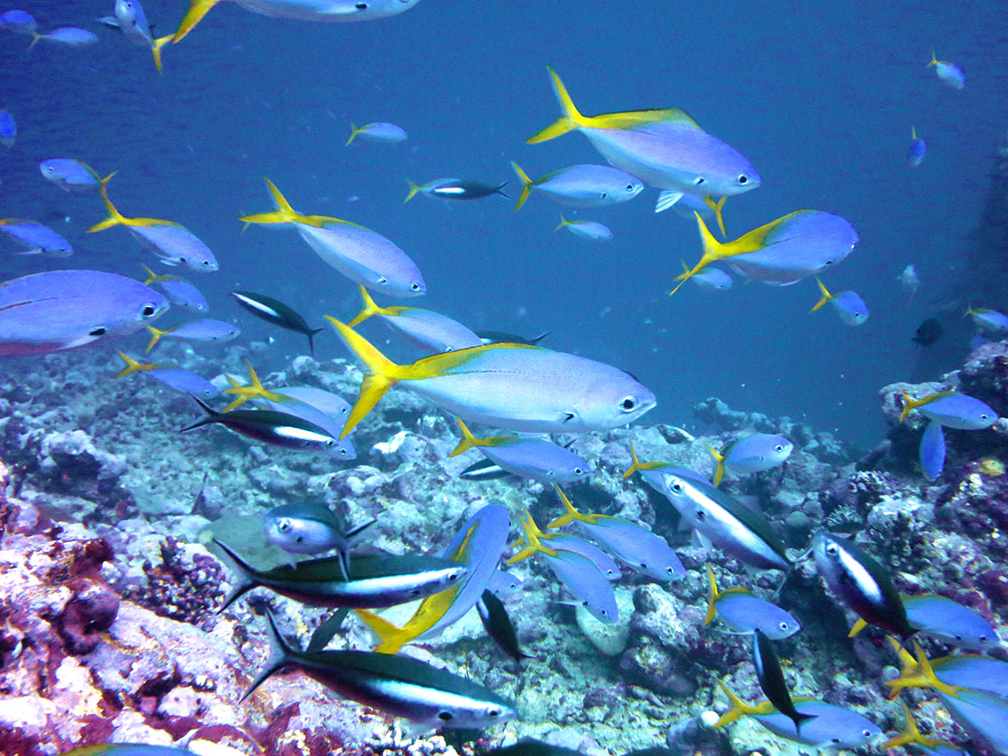
Thank you!

