Slide 1
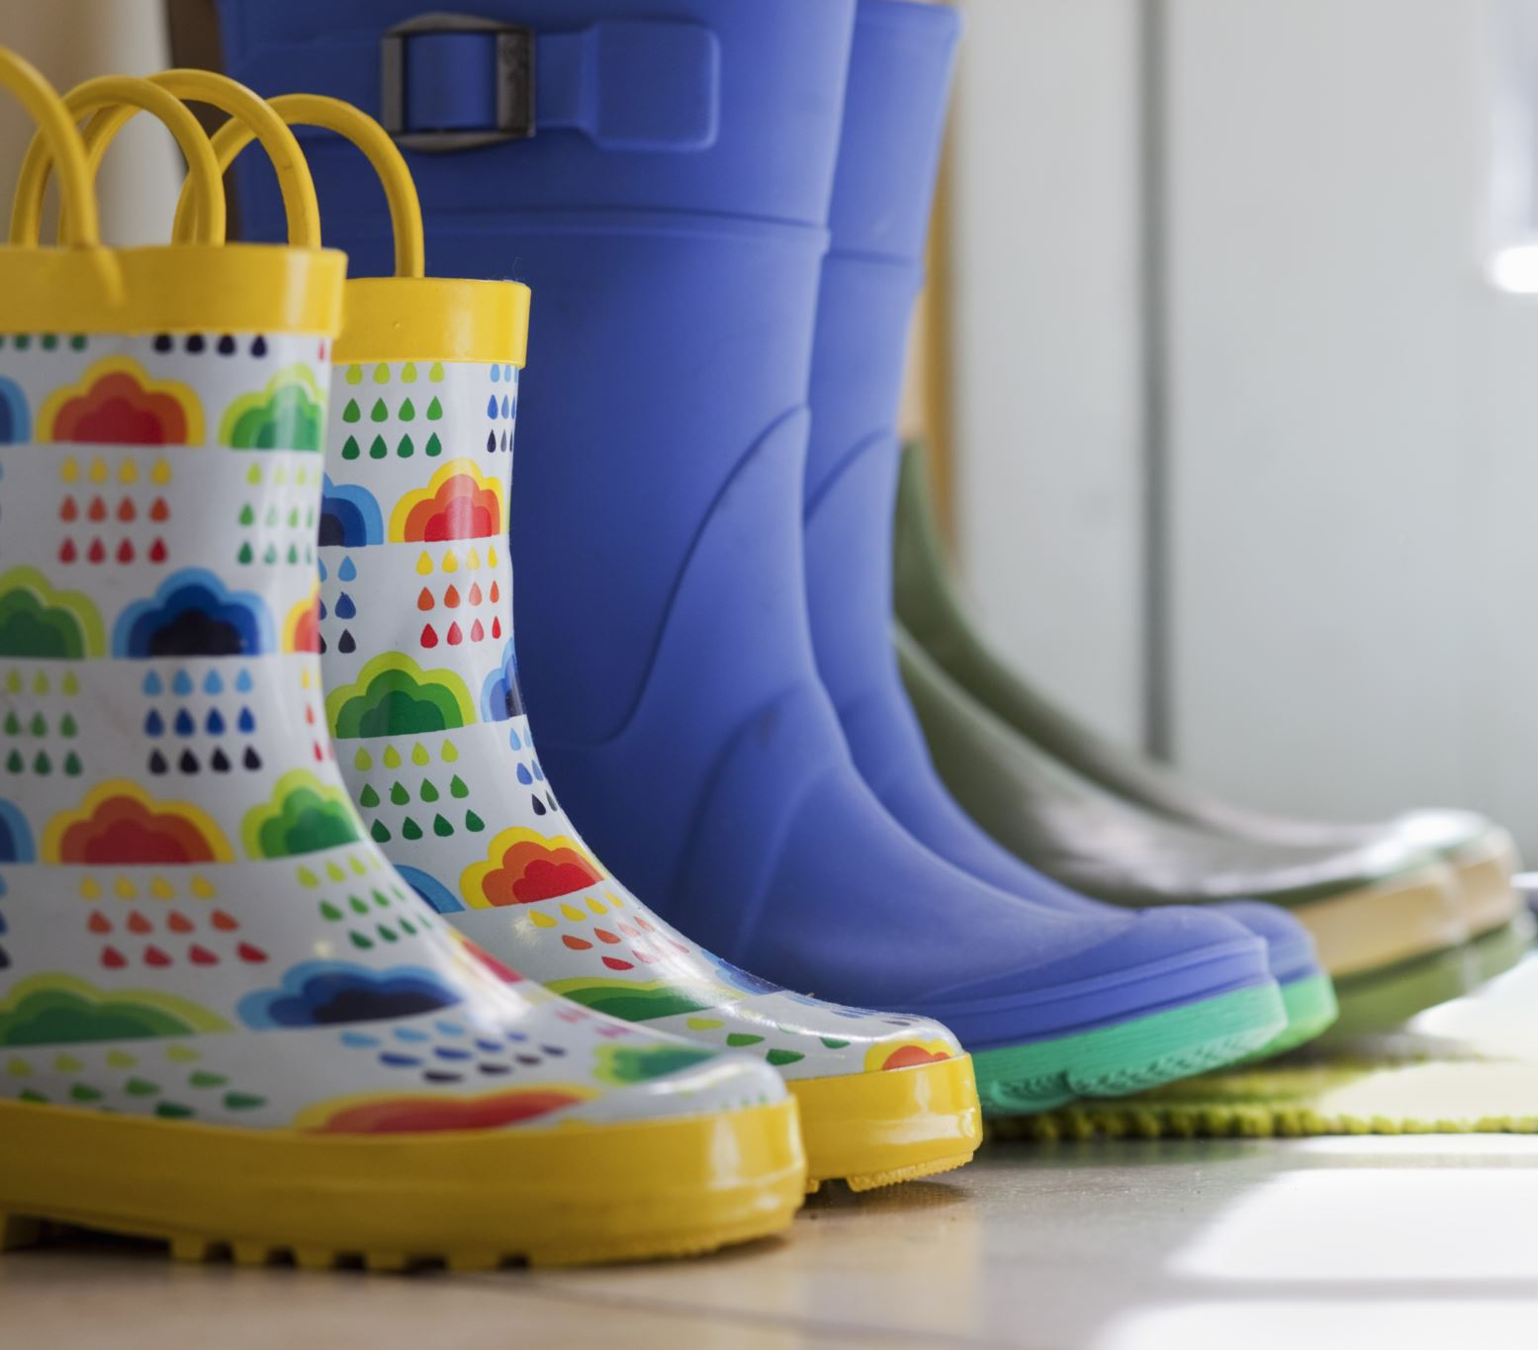
PERMANENT VALUE OF THE FAMILY

Slide 2
Definition:
The family is the basic cell or unit of society.
Functions of The Family:
(a) Procreation- for propagation of the species.
(b) Formation - in human virtues
(c) Education - in general.
The family performs very important functions and interference in any of these can adversely affect the life of a person.

Slide 3

Our own powers of observation show that a person:-
(a) Is born in the family
(b) The first physical and emotional contacts are established in the family.
(c) The basic security of the person depends on the family until he or she leaves home.

Slide 4
Parents have a serious obligation to educate their children – this education is so important that
when it is lacking, it cannot be substituted
What constitutes a family?
Modernists tell us that any combination of two people constitutes a family. This goes against our reason.

Slide 5
CHARACTERISTIC FEATURES OF THE FAMILY
The features of the family are as follows:
1. Efficiency
2. A group of people who share
3. Provides security and permanence
4. Teaches personal style
5. First school of human virtues
6. Unity

Slide 6
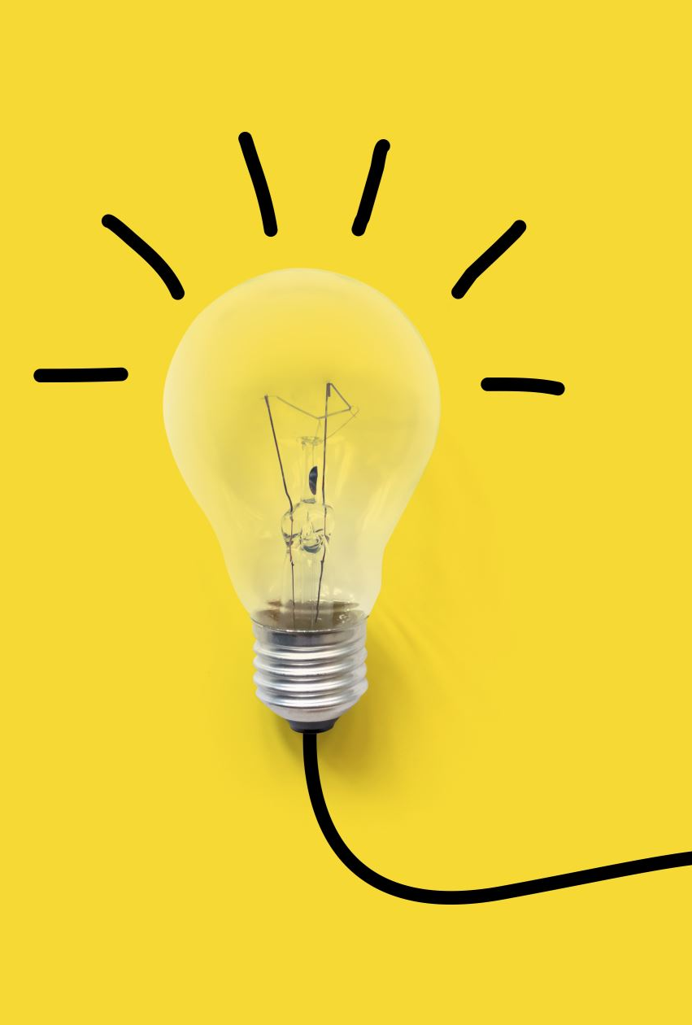
1. The efficiency of the family
Efficiency is characterized by:
Improved performance
The family follows a set of values or ideals that they learn and put into practice. It trains people to work.
It means the children and parents become better in the things and jobs they do.
b. Personal satisfaction
One becomes happy with their achievements e.g. a child can make a bed or wash dishes without supervision.
NB: Efficiency implies that there be results for the does.
.

Slide 7
1. The efficiency of the family
c. Personal development
Means growth in knowledge and wisdom, as he becomes more experienced.
It is the result of (a) and (b)
One is therefore able to care for him and others.
One becomes a better person

Slide 8

2. A group of people who share
- The members of the family live in the same place, sharing space, food utensils and also values, etc.
- Members do not perform specific functions and for that reason, one has to think of each person more for what he is rather than what he does

Slide 9
2. A group of people who share
In the family, no one chooses his children and no child chooses parents or brothers or sisters. One is accepted wholly, unreservedly, as a person without reference to anything else..
- Therefore in the family one has the assurance of being accepted and loved for what he/she is as a unique individual

Slide 10

3. Security and permanence
-The acceptance of one member of the family by another is permanent. This is so because what one accepts in others is not transitory.
- This unconditional acceptance provides the sense of security a person needs for developing and improving

Slide 11

4. Personal Style
In the family the children find their security by being accepted by their parents and in the permanence of the relationships.
Because one feels secure or feels at home, he is free to try things out in his or her own way, thus developing his style of working.
The family also develops its own way of doing things e.g. prayers or other organization.
This way of working is called personal style.
Therefore in the family every member has the possibility of growing with personal style instead of being influenced from outside.
This style, based on the values being practiced, will transfer into standards and values

Slide 12

5. The First School of Human Virtues
- The family is responsible for the education of the inner core of the person, i.e. teaches one to be human.
- This development goes through three stages of self – knowledge that leads to self – discipline i.e. one is able to chat his way to follow by setting his own goals, and lastly self – surrender i.e. able to serve other people.
- This overall growth is achieved through education in human virtues.

Slide 13

6. The Unity of the Family
- The unity of the family is not the result of parents forcing their children to do certain things. The unity of family consists in all members sharing and respecting a series of correct and true criteria that they have agreed on as a family
- If there is agreement about the criteria and about what they mean, each member can behave in whatever way he likes with personal style and initiative but respecting them and others.

