Slide 2
Media-Influence-Connections-Sweep- Caught bug all bullshit now

Slide 3
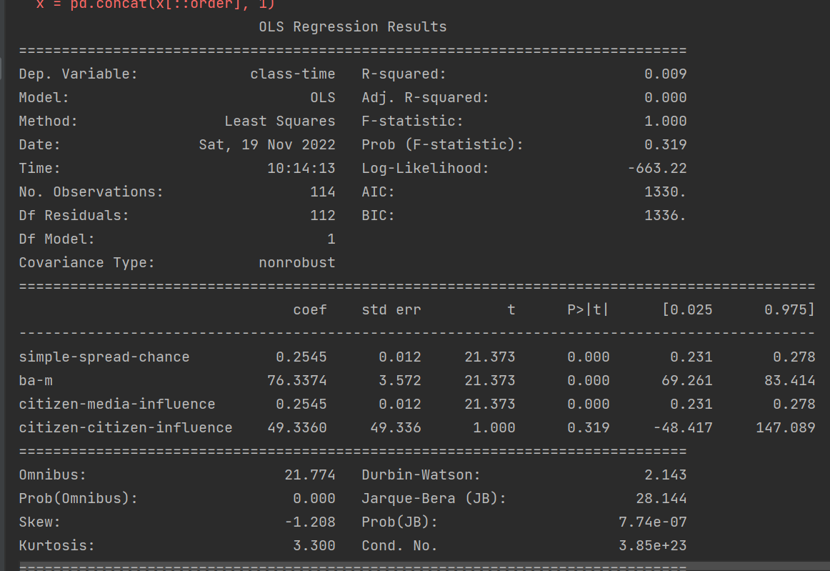

Slide 4
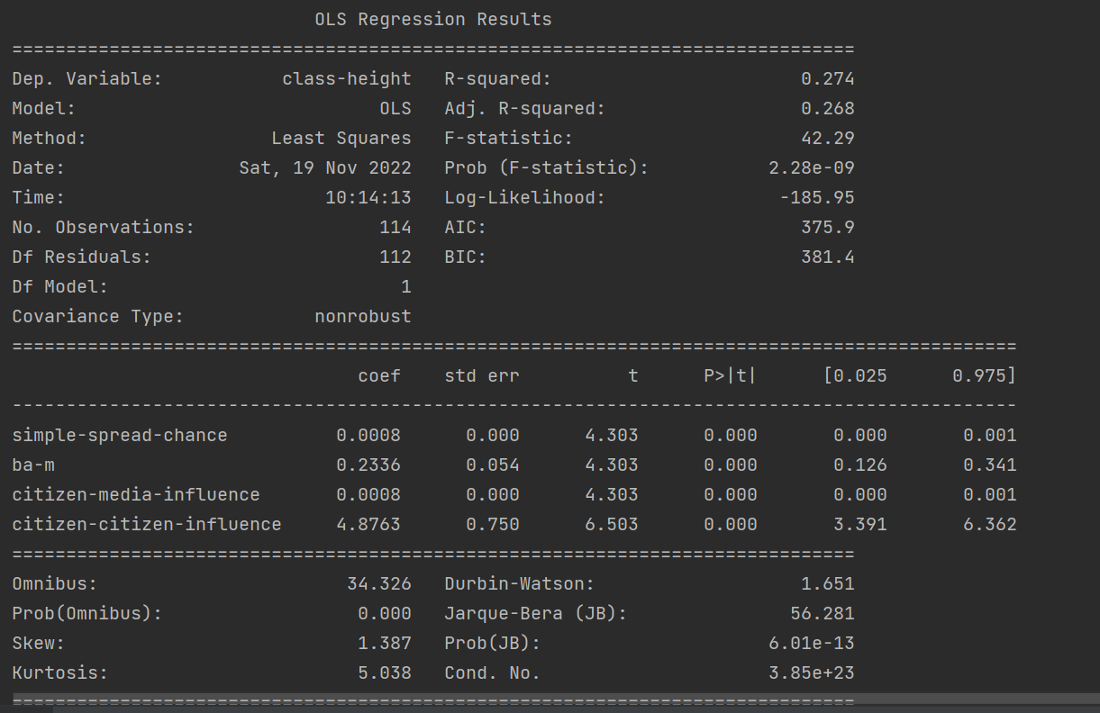

Slide 5
LR Comparison Table
LR (exp and t/h) | Most impact (coef/p) |  |  |  | Least Impact (coef/p)
Media-connections-influence (t) | Ba-m (76.33/0) | Citizen-citizen influence (43.33/.319) | Simple-spread-chance (.2545/0) | Citizen-media-influence (.2545/0)
Media-connections-influence (h) | Citizen-citizen-influence (4.8763/0) | Ba-m (.2336/0) | Simple-spread-chance (.0008/0) | Citizen-media-influence (.0008/0)

Slide 7
Questions
Why do the two lr methods fit differently?

