Slide 1
TriPASS Data Science: Using the meetupr Package
Rick Pack
TriPASS Vice-President of Marketing
October 13, 2020

Slide 2

R Packages
“Packages are the fundamental concept of code reusability in R programming. A package in R is a collection of functions, sample data, and the documentation that describes how to use them.”
Notes:
Nice R Package tutorial: https://www.tutorialgateway.org/install-r-packages/

Slide 3
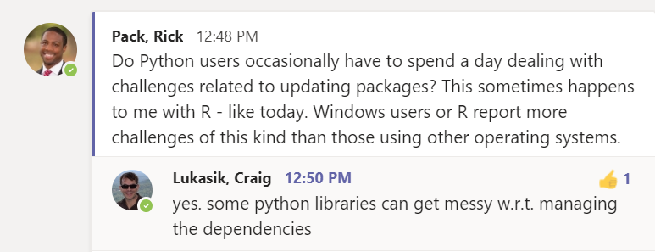
Managing packages and their dependencies can be a drag

Slide 4


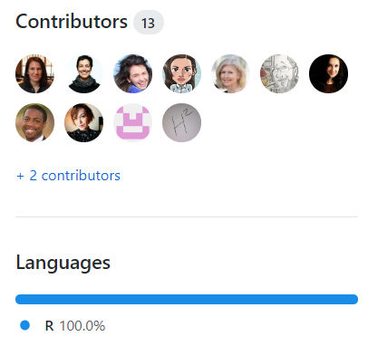


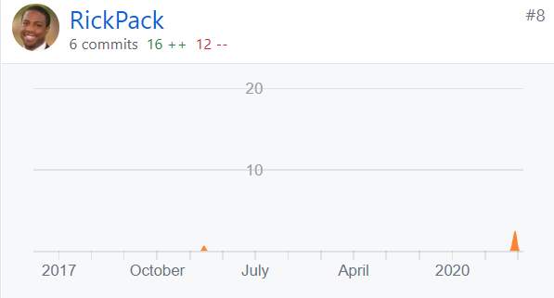
That’s me
Notes:
https://github.com/rladies/meetupr

Slide 5
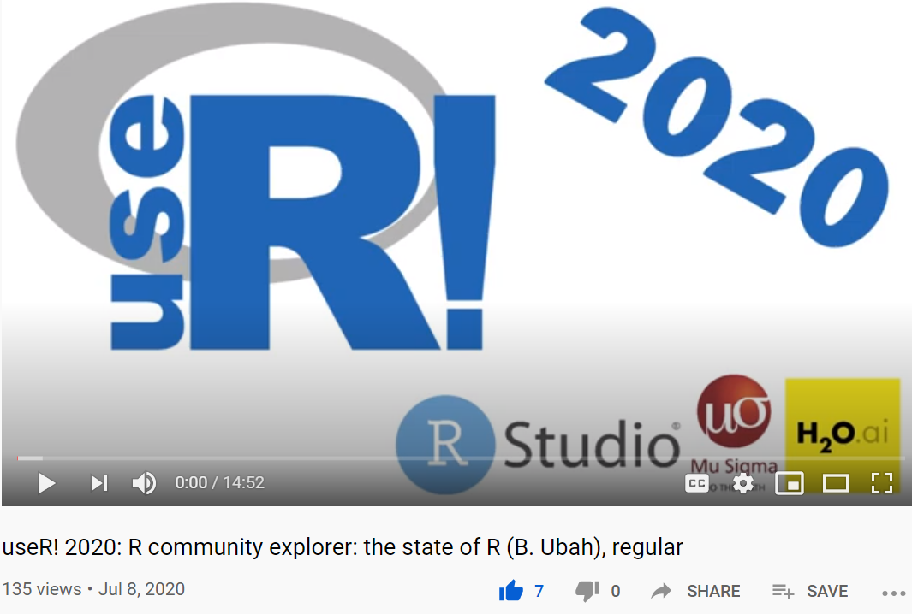
That’s me
Notes:
https://www.youtube.com/watch?v=7F7iQdcV8RY

Slide 6
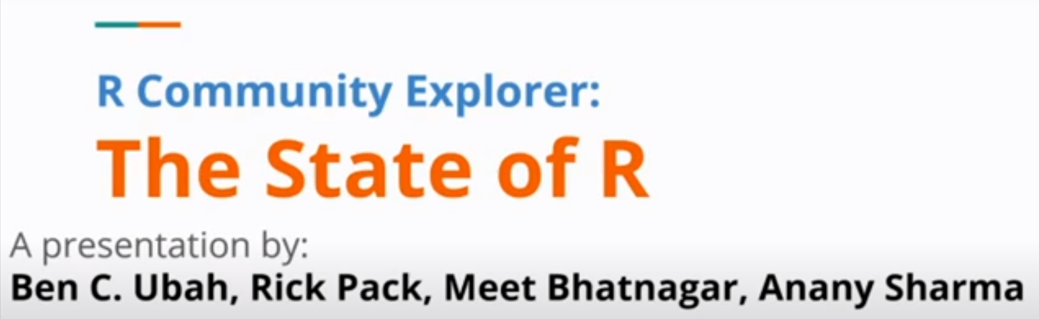
That’s me
Notes:
https://www.youtube.com/watch?v=7F7iQdcV8RY

Slide 7
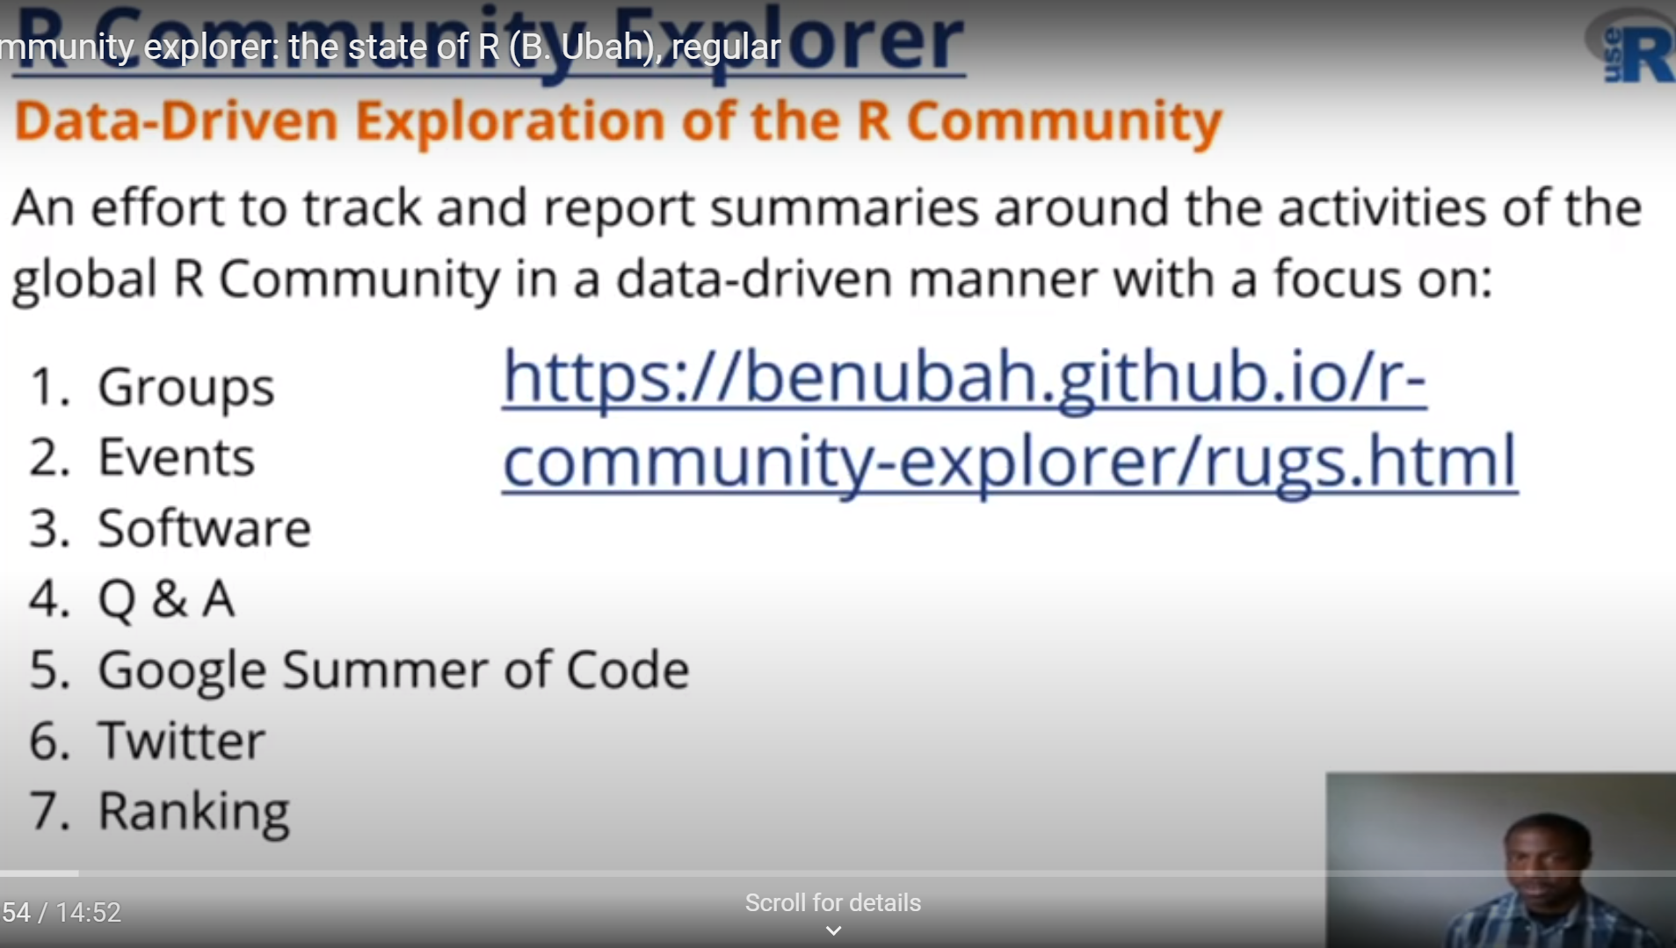
Notes:
https://benubah.github.io/rcentral/rugs.html

Slide 8
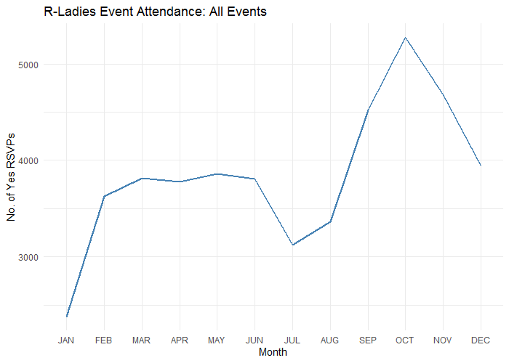
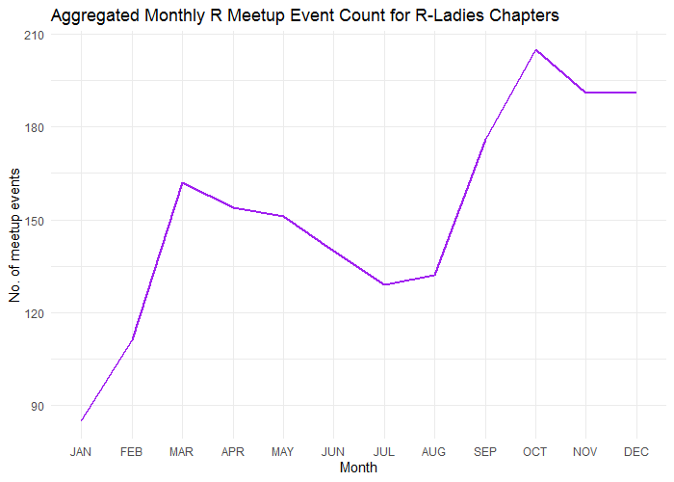
Global R-Ladies Events Data-Driven Exploration

Slide 9
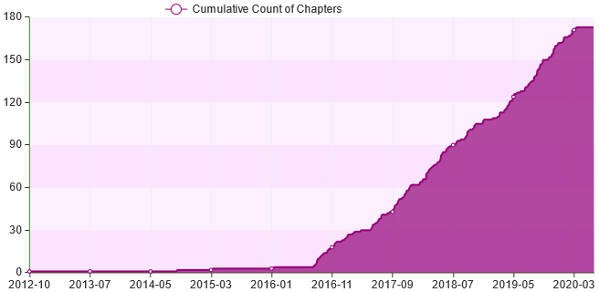
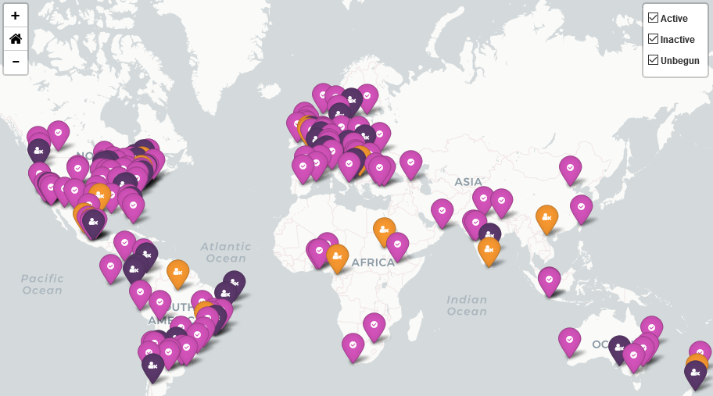
R-Ladies Chapters Data-Driven Exploration
Notes:
Data collected: 15th June, 2020
The growth of R-Ladies chapters represents a noteworthy achievement and I want to take the opportunity to credit R Ladies founders including Claudia Vitolo, with whom Ben Ubah and I worked on the Google Summer of Code 2019 project that enabled Ben in particular to focus many hours on developing this dashboard.

Slide 10
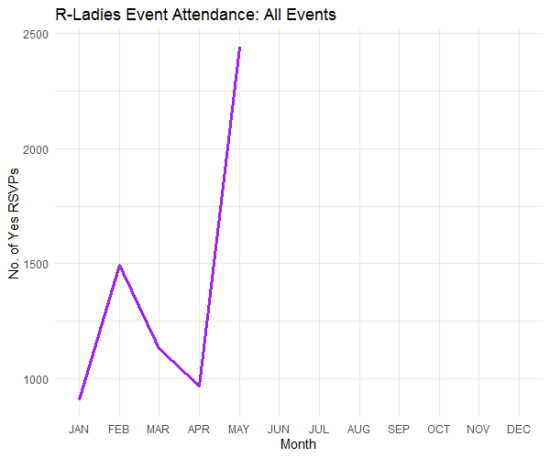
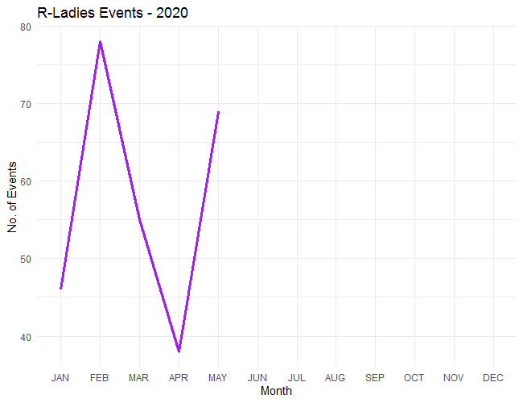
Global R-Ladies Events: COVID-19 Data-Driven Exploration

Slide 11

Sponsors
Help us build an automated, data-driven website that covers all these and much more...

Slide 12
INITIAL GOALS
Update meetupr R package so “joined date” is date when member joined the respective Meetup group, not Meetup.com
Do all this stuff…

Slide 13
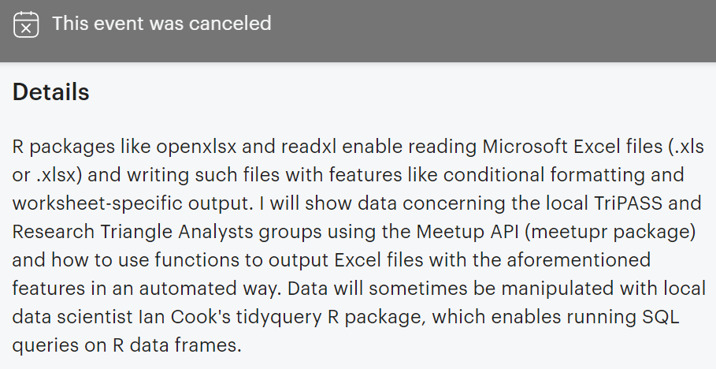
INITIAL GOALS
Notes:
Too much but aiming to complete by Analytics>Forward 2020.

Slide 14
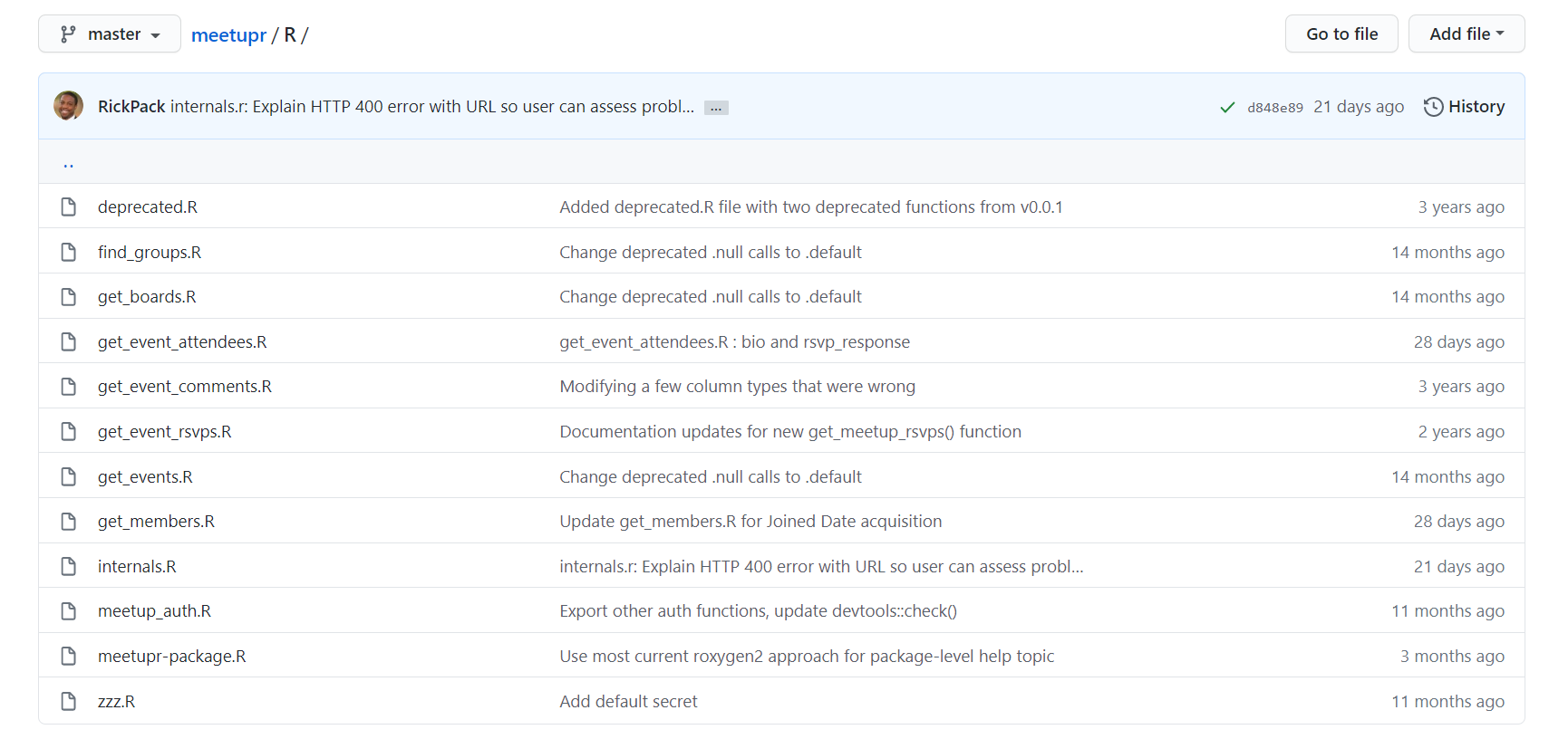
Github
Notes:
This is not a tutorial. Focusing on the story in pursuit of connection and inspiring deeper engagement with R packages.

Slide 15

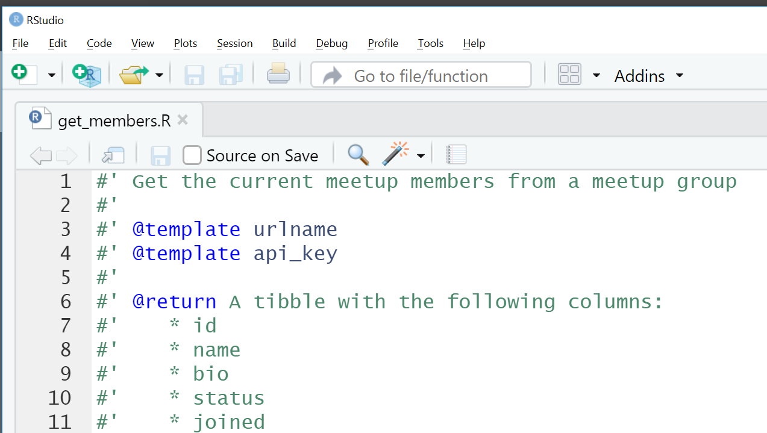
Notes:
Integrated Development Environment, R Studio

Slide 16
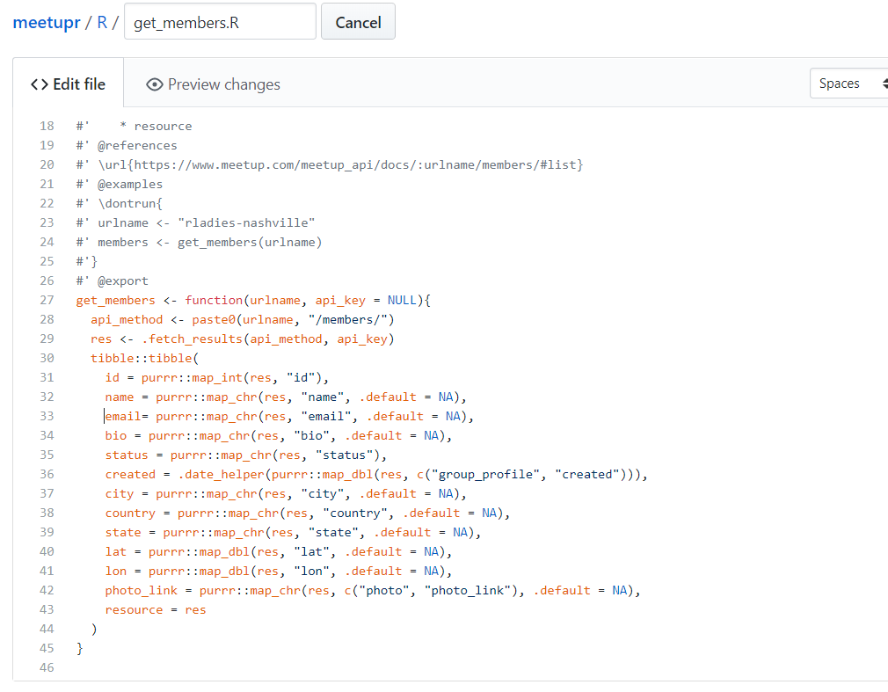
Get_members.R
Notes:
On the Github page, small print, so let’s zoom in before you experience eye strain.

Slide 17
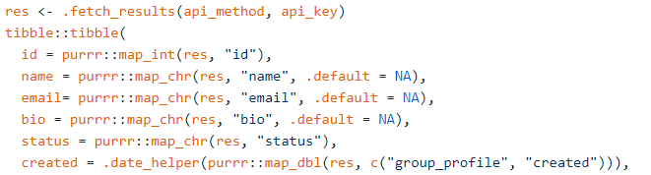
Get_members.R
Update meetupr R package so “joined date” is date when member joined the respective Meetup group, not Meetup.com
HELPFUL

Slide 18
Get_members.R
NO
Notes:
Only returned my email address.

Slide 19
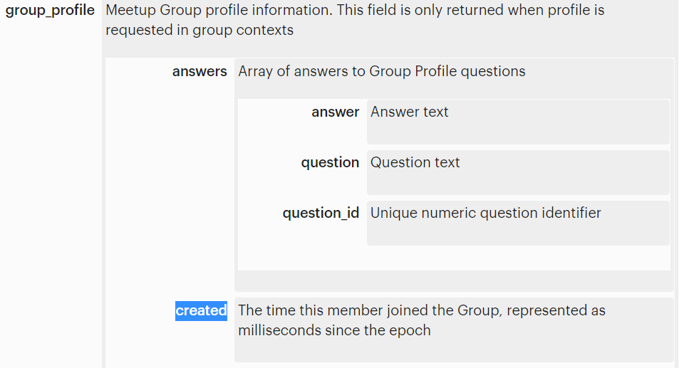
Get_members.R
Notes:
joined: Time member joined, represented as milliseconds since the epoch

Slide 20
Get_members.R
From https://www.meetup.com/meetup_api/docs/:urlname/members/#list

Slide 21
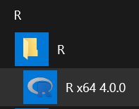
Package Name
Package Function
devtools::install_github('RickPack/meetupr')
May have to terminate R Studio and install in new instance of R GUI ------------------------------------->
install.packages(‘vctrs’)

Slide 22
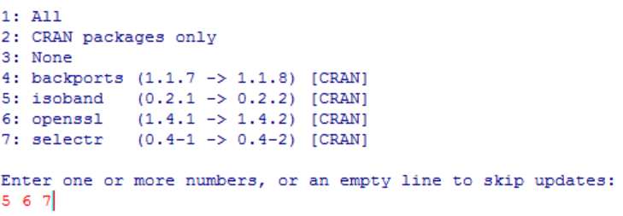
Excel_Meetup_Animate_Attendees.R
Delete package from folder(s) identified by .libPaths()…and keep trying
Notes:
Maybe skip backports

Slide 23
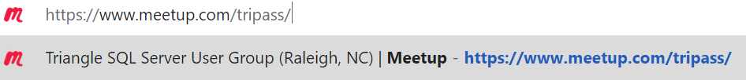
Excel_Meetup_Animate_Attendees.R

Slide 24
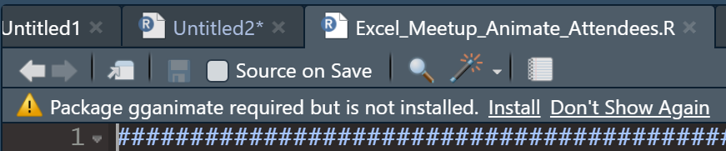

Excel_Meetup_Animate_Attendees.R
At least in the May, 2020 release of R Studio – prompted when need to install packages
Notes:
install.packages('gganimate')

Slide 25
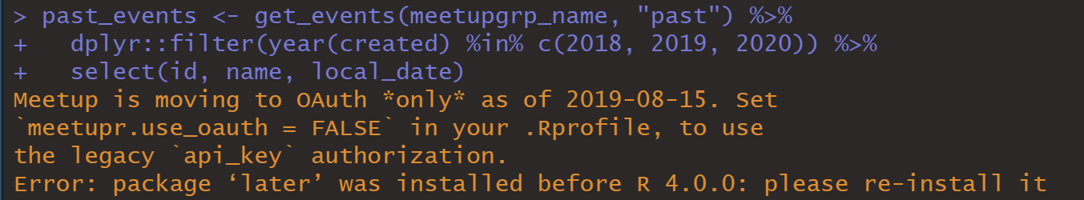
Excel_Meetup_Animate_Attendees.R
Notes:
After upgrading R, error may be hidden in code if run all at the same time. Meetup is moving to OAuth *only* as of 2019-08-15. Set `meetupr.use_oauth = FALSE` in your .Rprofile, to use the legacy `api_key` authorization. Error: package ‘later’ was installed before R 4.0.0: please re-install it

Slide 26
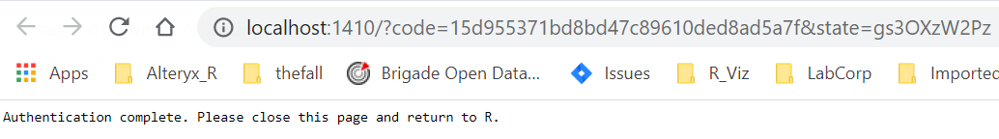
Excel_Meetup_Animate_Attendees.R
Notes:
As of sometime in 2019, The Meetup API provides support for OAuth 2. First Meetupr usage: Authentication complete. Please close this page and return to R.

Slide 27
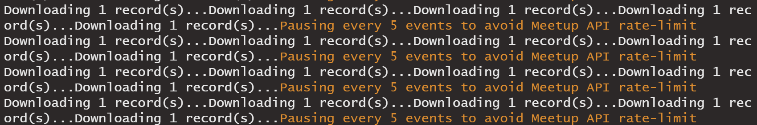
Excel_Meetup_Animate_Attendees.R
Patience: avoids HTTP 400 error
Notes:
First Meetupr usage: Authentication complete. Please close this page and return to R.
I thought I was nearly ready. I had the Research Triangle Analysts animation and experienced this error with the TriPASS. Data. I increased the delay between 5-event downloads thinking that a long enough delay, that is – sufficient patience, would yield a successful download. Then I would create a few examples of conditional formatting in Excel using the openxlsx package, which I do at work sometimes and analyze the RTA and TriPASS data in a few ways that included at least one use of fellow Research Triangle Analyst board member, Ian D Cook’s, tidyquery package.

Slide 28
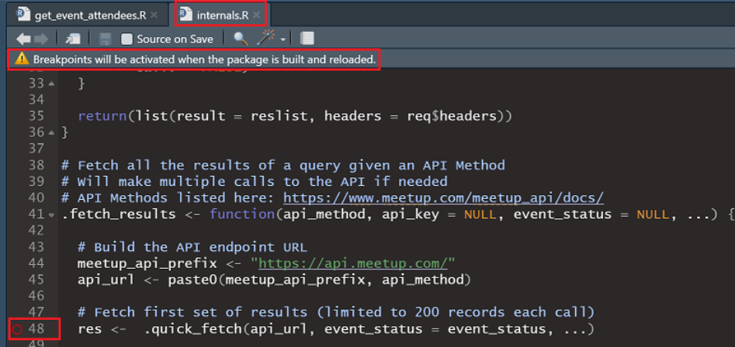
internals.R
About that HTTP 400 error
Rladies MeetupR package’s internals.R.
Shift+F9 to set a break point.

Slide 29


internals.R
About that HTTP 400 error
Rladies MeetupR package’s internals.R.
Shift+F9 to set a break point.
A breakpoint
Notes:
First Meetupr usage: Authentication complete. Please close this page and return to R.

Slide 30
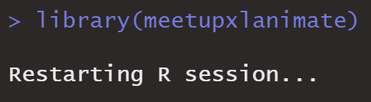
Internals.R
About that HTTP 400 error
CTRL+SHIFT+B to build package
Notes:
First Meetupr usage: Authentication complete. Please close this page and return to R.

Slide 31
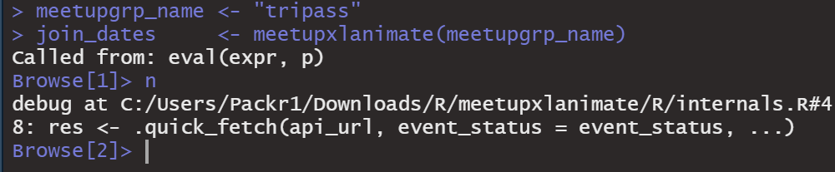
Debug Mode
About that HTTP 400 error
Notes:
Maybe skip backports

Slide 32
added to internals.R
if (req$status_code == 400) {
stop(paste0("HTTP 400 Bad Request error encountered for: ",
api_url,".\n As of June 30, 2020, this may be ",
"because a presumed bug with the Meetup API ",
"causes this error for a future event. Please ",
"confirm the event has ended."),
call. = FALSE) }

Slide 33
Excel_Meetup_Animate_Attendees.R
About that HTTP 400 error
Notes:
CTRL+SHIFT+B to include this added line in the built package. And run.

Slide 34

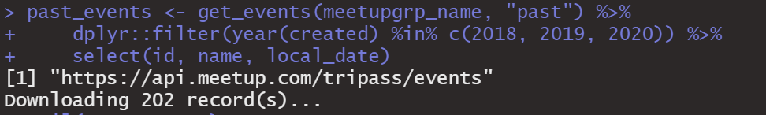
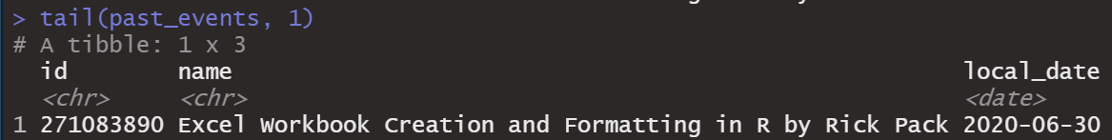
Excel_Meetup_Animate_Attendees.R
The event has not happened yet…
but it occurred in the past?
Notes:
The Meetup API admitted this event into the pool of past events and then rejected it.

Slide 35
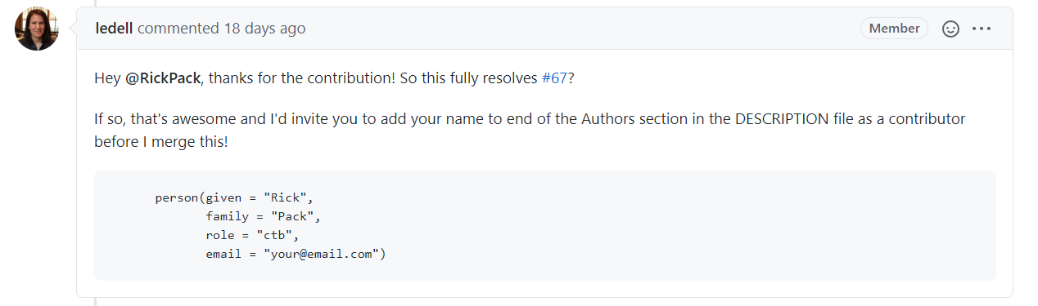
Doctor Erin LeDell Co-founder of R-Ladies and Chief Machine Learning Scientist at H20.ai
Notes:
There are currently 22 Issues identified for meetupr.

Slide 36
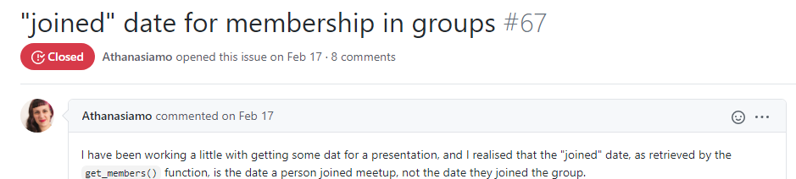
Meetupr Github page
Notes:
There are currently 22 Issues identified for meetupr.

Slide 37
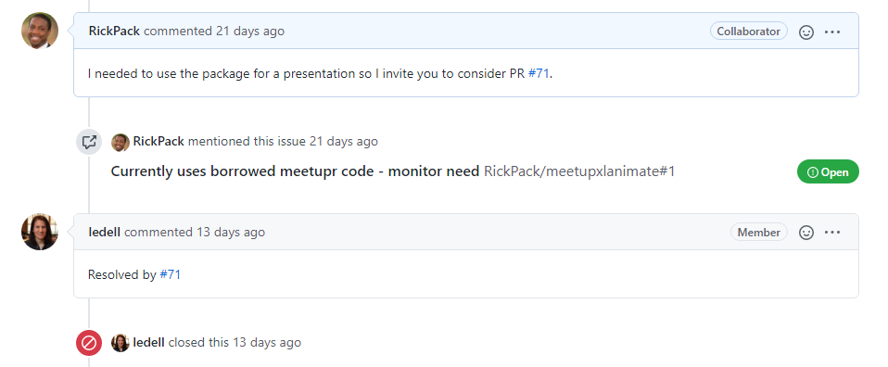
Meetupr Github page
Notes:
There are currently 22 Issues identified for meetupr.

Slide 38
Collaborate?
Download and install the latest versions of R and R Studio
Package concerns may take time
Download and install R Tools
Notes:
https://cran.r-project.org/bin/windows/Rtools/

Slide 39
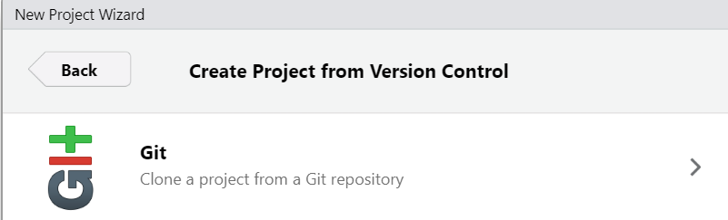
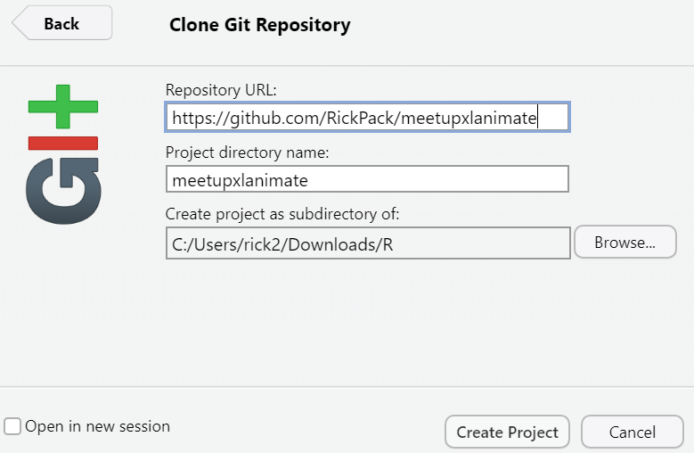
R Studio
File -> New Project -> Version Control -> Git
Make https://github.com/RickPack/meetupxlanimate the Repository URL -> Create Project
Notes:
https://cran.r-project.org/bin/windows/Rtools/

Slide 40

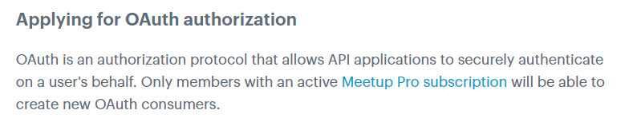
Collaborate?
Notes:
https://cran.r-project.org/bin/windows/Rtools/

Slide 41
Rick Pack
Email: rickeyhp@gmail.com
Github: RickPack
Twitter: @rick_pack2
Notes:
The Meetup API admitted this event into the pool of past events and then rejected it.

