Slide 2
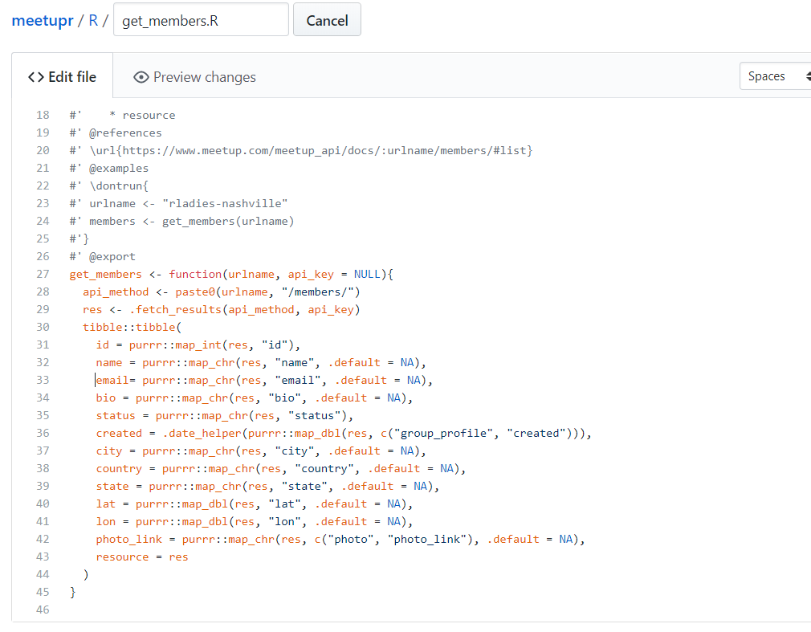
Get_members.R

Slide 3
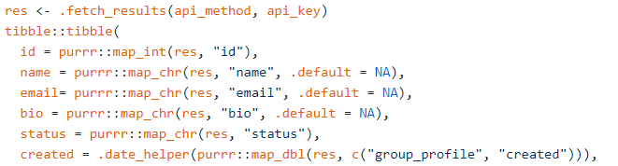
Get_members.R
HELPFUL

Slide 4
Get_members.R
NO

Slide 5
Get_members.R
From https://www.meetup.com/meetup_api/docs/:urlname/members/#list

Slide 6
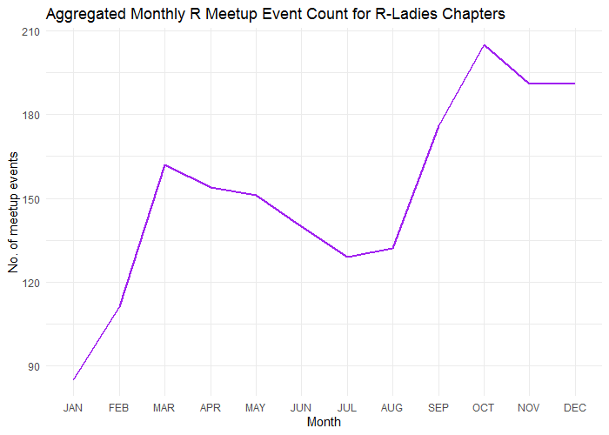
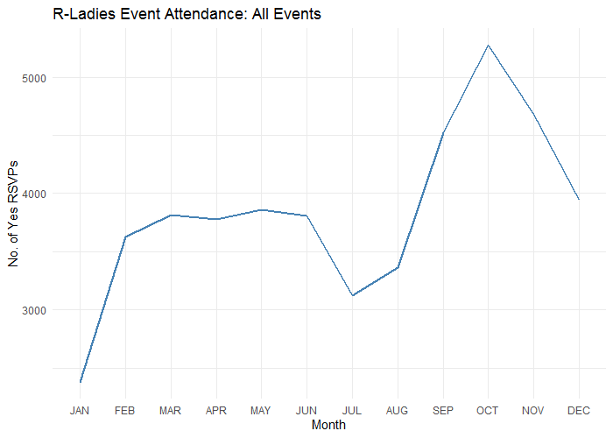
Global R-Ladies Events Data-Driven Exploration

Slide 7
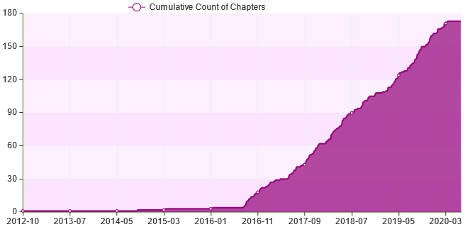
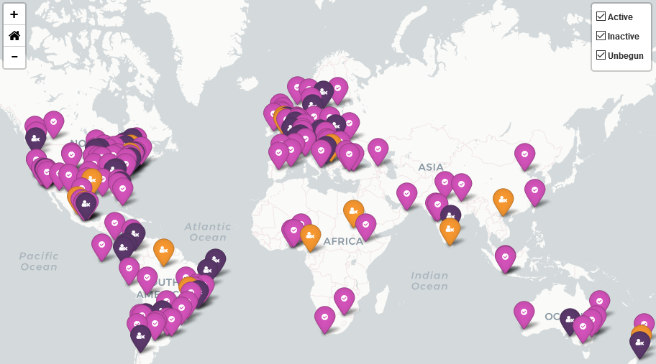
R-Ladies Chapters Data-Driven Exploration
Notes:
Data collected: 15th June, 2020
The growth of R-Ladies chapters represents a noteworthy achievement and I want to take the opportunity to credit R Ladies founders including Claudia Vitolo, with whom Ben Ubah and I worked on the Google Summer of Code 2019 project that enabled Ben in particular to focus many hours on developing this dashboard.

Slide 8
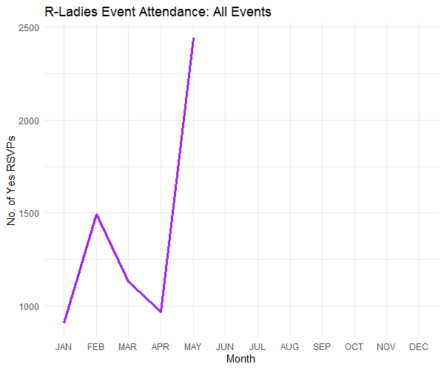
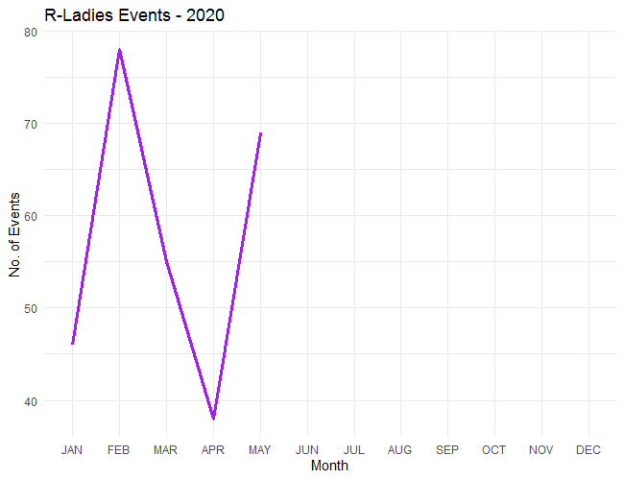
Global R-Ladies Events: COVID-19 Data-Driven Exploration

Slide 9

Sponsors
Help us build an automated, data-driven website that covers all these and much more...

Slide 10
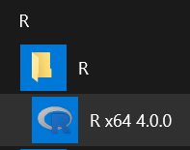
devtools::install_github('RickPack/meetupr')
May have to terminate R Studio and install in new instance of R GUI ------------------------------------->
install.packages(‘vctrs’)

Slide 11
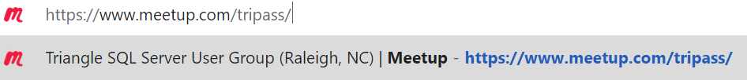
Excel_Meetup_Animate_Attendees.R

Slide 12
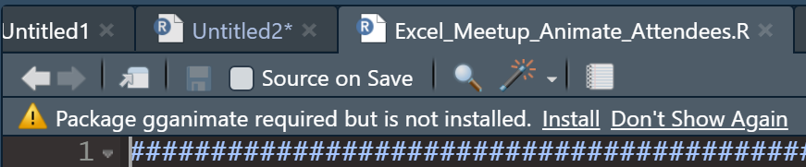

Excel_Meetup_Animate_Attendees.R
At least in the May, 2020 release of R Studio – prompted when need to install packages
Notes:
install.packages('gganimate')

Slide 13
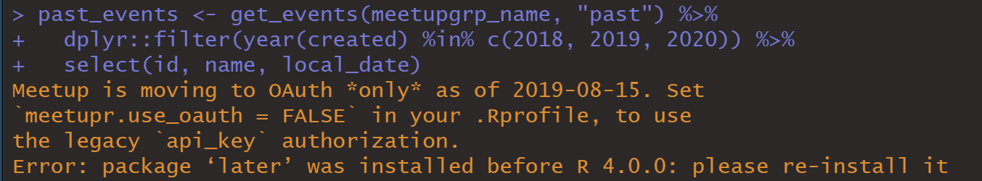
Excel_Meetup_Animate_Attendees.R
Notes:
After upgrading R, error may be hidden in code if run all at the same time. Meetup is moving to OAuth *only* as of 2019-08-15. Set `meetupr.use_oauth = FALSE` in your .Rprofile, to use the legacy `api_key` authorization. Error: package ‘later’ was installed before R 4.0.0: please re-install it

Slide 14
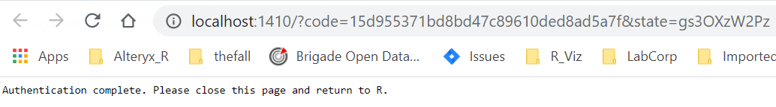
Excel_Meetup_Animate_Attendees.R
Notes:
First Meetupr usage: Authentication complete. Please close this page and return to R.

Slide 15
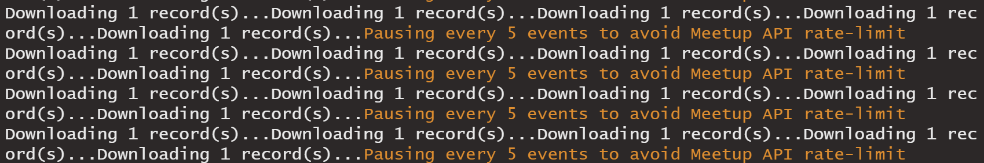
Excel_Meetup_Animate_Attendees.R
Patience: avoids HTTP 400 error
Notes:
First Meetupr usage: Authentication complete. Please close this page and return to R.

Slide 16
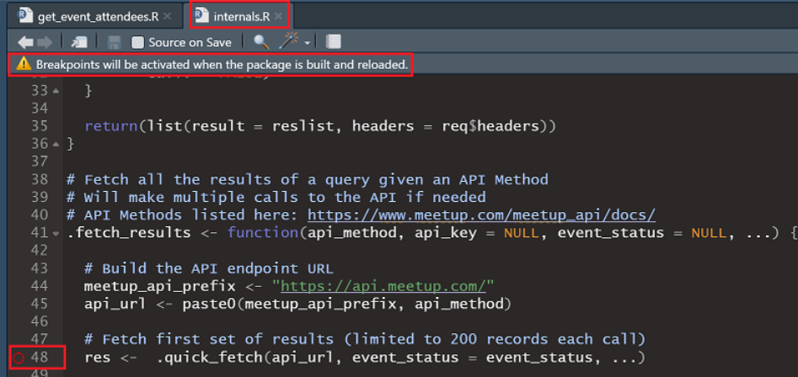
Excel_Meetup_Animate_Attendees.R
About that HTTP 400 error
Rladies MeetupR package’s internals.R.
Shift+F9 to set a break point.
Notes:
First Meetupr usage: Authentication complete. Please close this page and return to R.

Slide 17


Excel_Meetup_Animate_Attendees.R
About that HTTP 400 error
Rladies MeetupR package’s internals.R.
Shift+F9 to set a break point.
A breakpoint
Notes:
First Meetupr usage: Authentication complete. Please close this page and return to R.

Slide 18
Excel_Meetup_Animate_Attendees.R
About that HTTP 400 error
Rladies MeetupR package’s internals.R.
Shift+F9 to set a break point.
A breakpoint
Notes:
First Meetupr usage: Authentication complete. Please close this page and return to R.

Slide 19
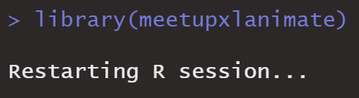
Excel_Meetup_Animate_Attendees.R
About that HTTP 400 error
CTRL+SHIFT+B to build package
Notes:
First Meetupr usage: Authentication complete. Please close this page and return to R.

Slide 20

Excel_Meetup_Animate_Attendees.R
About that HTTP 400 error
Notes:
Find package in your libpaths and delete if get “cannot remove” error

Slide 21
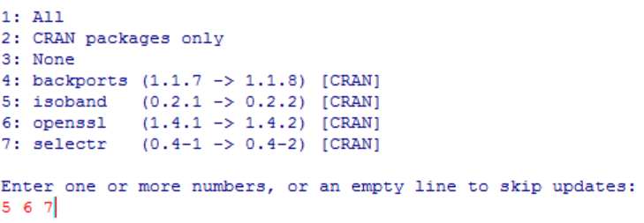
Excel_Meetup_Animate_Attendees.R
About that HTTP 400 error
Notes:
Maybe skip backports

Slide 22
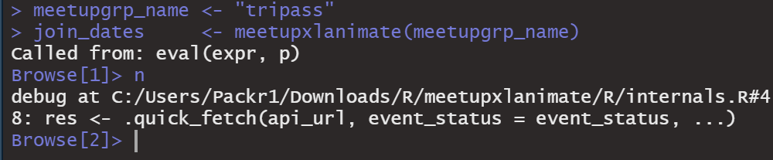
Excel_Meetup_Animate_Attendees.R
About that HTTP 400 error
Notes:
Maybe skip backports

Slide 23
Excel_Meetup_Animate_Attendees.R
About that HTTP 400 error
Notes:
CTRL+SHIFT+B to include this added line in the built package. And run.

Slide 24

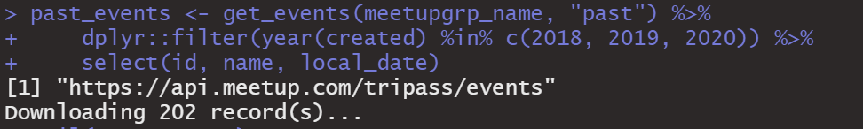
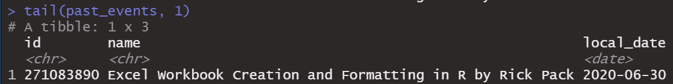
Excel_Meetup_Animate_Attendees.R
The event has not happened yet…
but it occurred in the past.
Notes:
CTRL+SHIFT+B to include this added line in the built package. And run.

