Slide 1
Sprinting in jupyter through r track results
RICK PACK (LABCORP DATA SCIENTIST)
Notes:
Thank you to the JupyterTriangle coordinators for inviting me to the dance, to borrow Dr. Kari Jordan's language.
I really enjoyed your talk by the way.
My name is Rick Pack and I am a data scientist at LabCorp focusing on a value-based healthcare initiative. My talk today
will focus on a hobby of mine, running in master's track meets, that ties naturally into improving
population health given the known benefits of exercise on many health outcomes including blood sugar
regulation and the maintenance of muscle composition as we age (i.e., reducing sarcopenia), an important
item to consider given the last I checked, the number one cause of death in those
65 and older is falls.

Slide 2
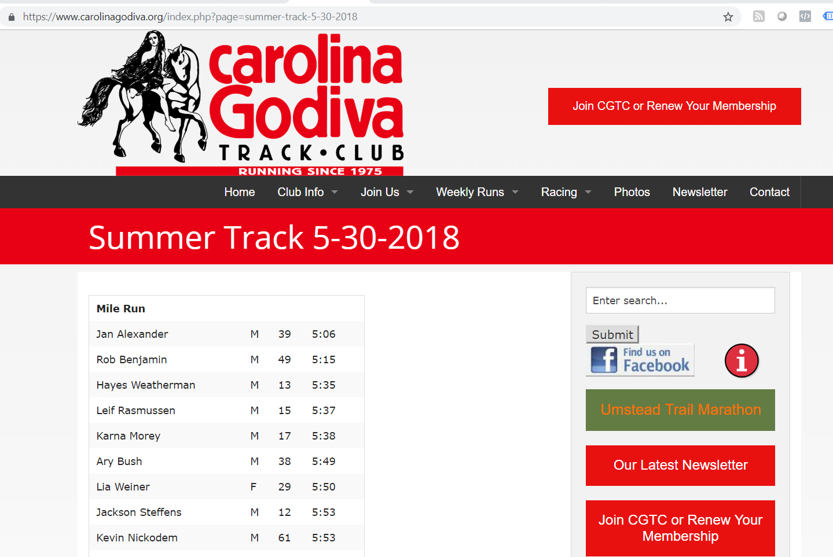
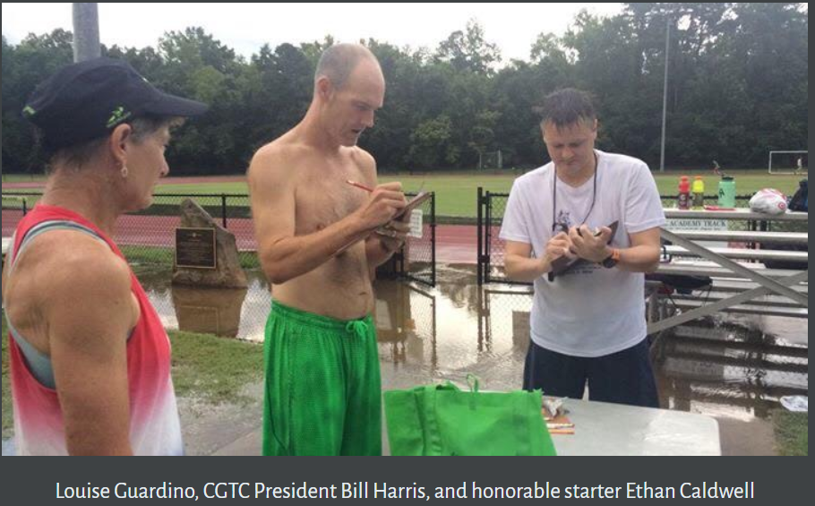
Notes:
In a fun coincidence, the Carolina Godiva Track Club offers free, donation-only track meets for all-ages that have
often been held on a track on this campus at 300 Stadium Drive, whereas we are now at 150 Stadium Drive.
Triangle Jupyter inspired me to make my first Jupyter Notebook an R notebook that used data I webscraped from
11 years of data so far: 2009-2018 and a couple other years. I want to talk about that notebook briefly and some lessons learned.

Slide 3
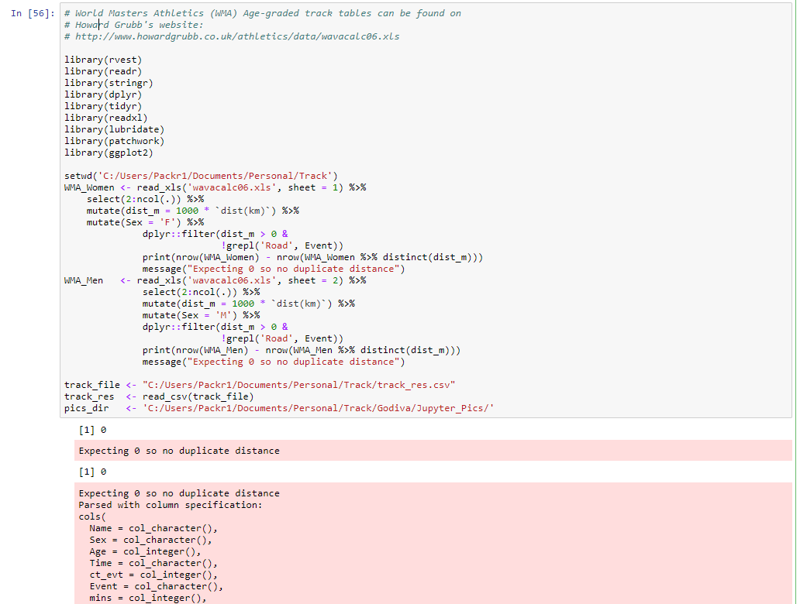
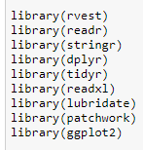
ctrl+enter R: Executes a single line Jupyter Notebook: Runs an entire cell
Ctrl+enter Use installed.packages() TO SEE WHERE PACKAGES STORED
Notes:
Someone brought up earlier some unexpected challenges in transitioning from R Studio to a Jupyter Notebook. I am happy to say
the biggest challenge I faced was web-scraping and not that transition, although there were challenges.
I copied the code from R Studio and discovered that the CTRL+ENTER hotkey executed an entire block instead of just a line.
That caused some unexpected delays.
Also a couple packages did not load as expected and so I had to use installed.packages() in R Studio and then in my Jupyter R notebook to identify to where in the Jupyter folder landscape I needed to copy the compiled package folder.
png function did not display the image even though line executed without error

Slide 4
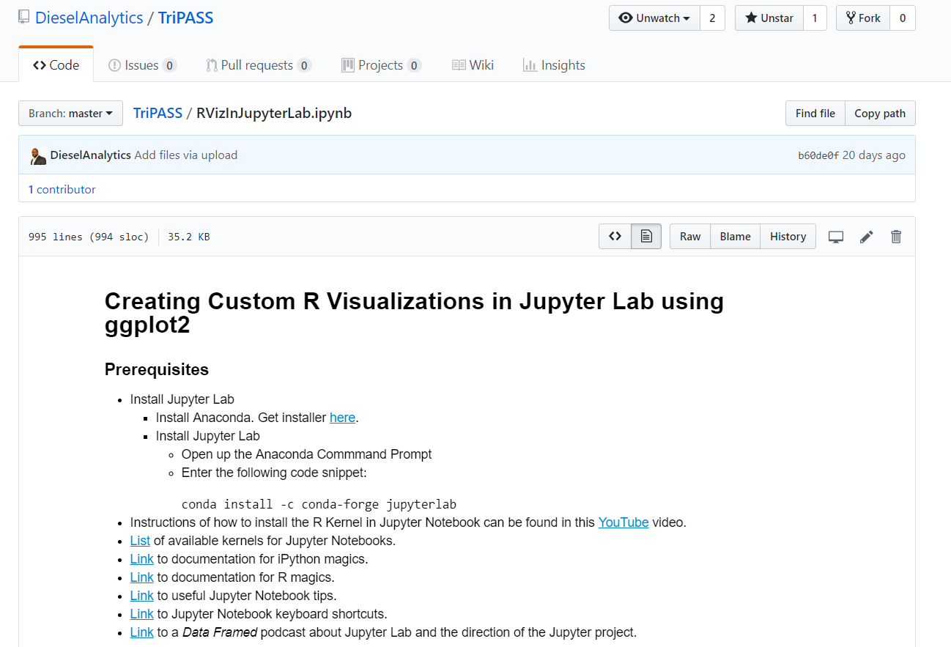
Getting started with jupyter notebooks (R)
Ryan Wade’s TriPASS presentation
Notes:
Someone brought up earlier some unexpected challenges in transitioning from R Studio to a Jupyter Notebook. I am happy to say
the biggest challenge I faced was web-scraping and not that transition, although there were challenges.
I copied the code from R Studio and discovered that the CTRL+ENTER hotkey executed an entire block instead of just a line.
That caused some unexpected delays.
Also a couple packages did not load as expected and so I had to use installed.packages() in R Studio and then in my Jupyter R notebook to identify to where in the Jupyter folder landscape I needed to copy the compiled package folder.
png function did not display the image even though line executed without error

Slide 5
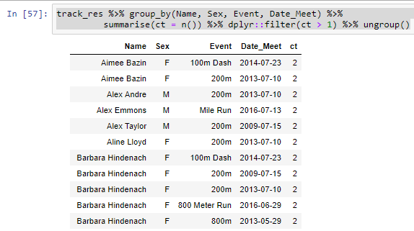
Using dplyr to identify extra records
Expected one record per Name, Sex,
Event, and Date
Notes:
And what was it.!
As Joan Pharr addressed in her comments about ValassisDigital using Jupyter notebooks and Github to explore different data
analysis techniques including those of machine learning, I plan to provide a base to kids I mentor through a group called 100 Black Men that they can then launch from in their own data adventures. I plan to post a Jupyter Notebook on Github and then they can fork
my repo and take off. I also am grateful to have the opportunity later to talk with those staying late and learn how JupyterLab might be a great tool to add.
Here, I show an example of some basic data munging I will work through with the kids. Grouping by Name, Sex, Event, and Date, we expected only record in the aggregated file I built by web-scraping the Carolina Godvia Track Club Summer Track Series Web Pages and instead…

Slide 6
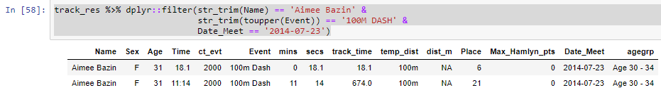
Using dplyr to identify extra records
Expected one record per Name, Sex,
Event, and Date
Notes:
Picked an example…discuss time for 100 M

Slide 7
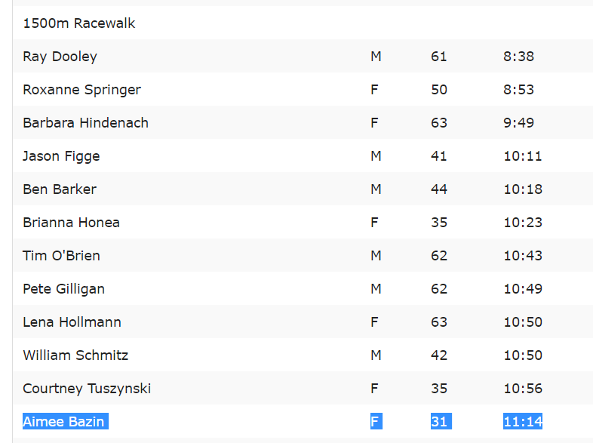
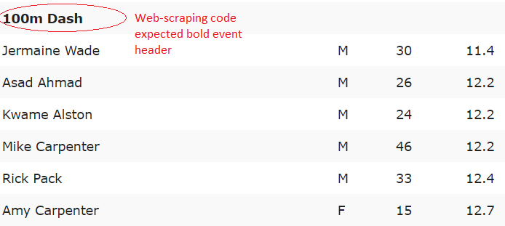
Using dplyr to identify extra records
Expected one record per Name, Sex,
Event, and Date
Notes:
Jupyter’s operation in the web browser will make moving between information sources quite easy and help keep the kids engaged. Aimee Bazin’s name appeared twice because my web-scraping code with the rvest r package needs to be tweaked to identify event header by not just the strong header that creates emboldened text.

Slide 8
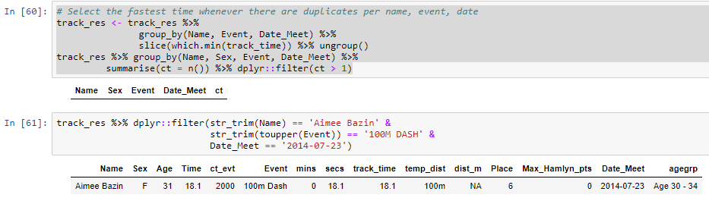
Using jupyter to teach #rstats
Ask mentees what number to use in the inequality
Notes:
Split more code out into separate cells. In the top cell filter function from the dplyr package, I can easily prompt kids with what number to put at the right of the inequality to check that there are no duplicates on Name, Sex, Event, and Date of Meet. You may notice that Sex is meeting in the top group_by and that will be another data munging bit to check. Are there are names associated with multiple genders in the same event and on the same date?
I’m excited.

Slide 9
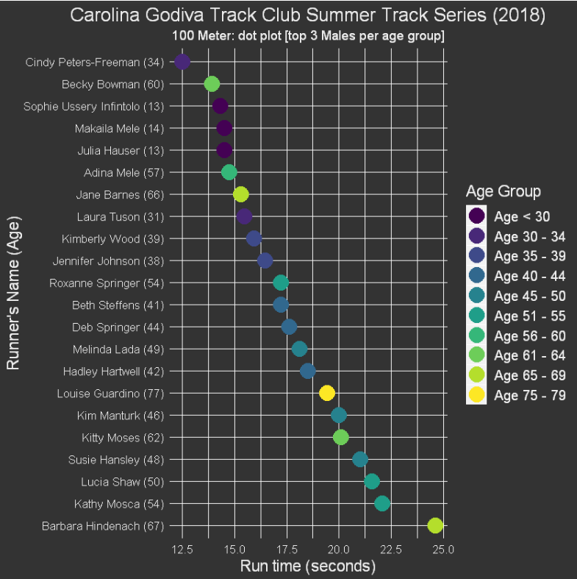
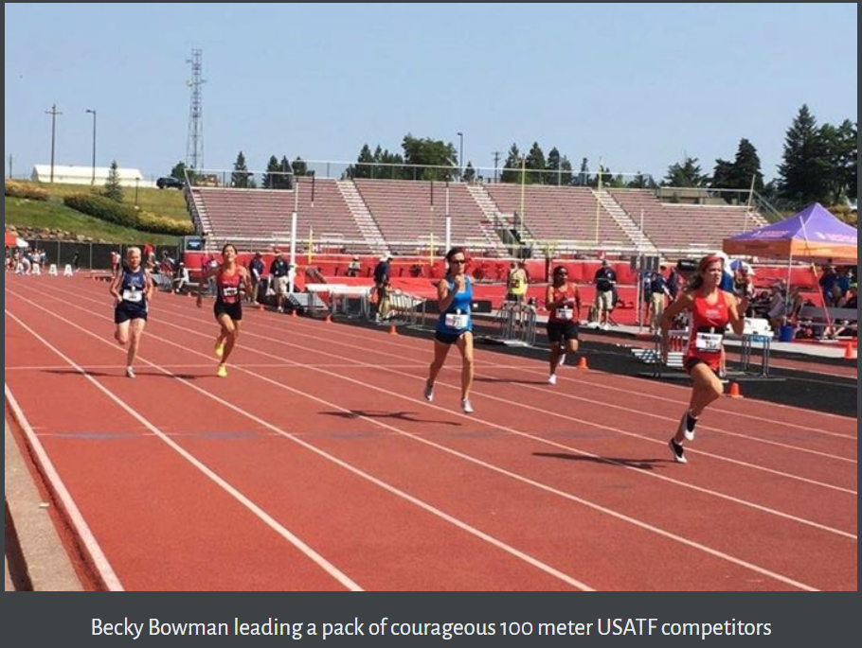
Beck
Notes:
I requested my notebook be added to the TriangleJupyter Github repo if anyone wants to review my current notebook. I’ll take my last bit of time to show a couple examples of visualizations, namely diverging dot plots in that notebook.
Becky Bowman is an inspiring Wilmington, NC resident who just turned 60 and is a national champion and national record holder in at least 100M.

Slide 10
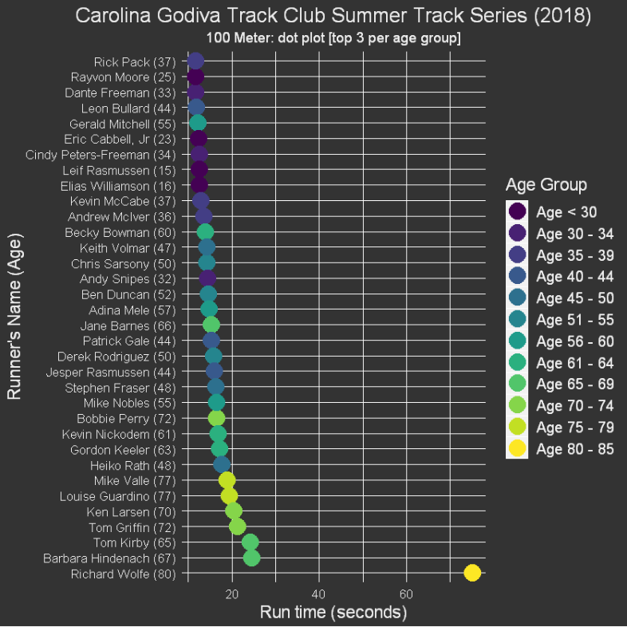
Notes:
Vanity. Also win the kids’ hearts…better or for worse they are more likely to identify with someone they perceive as a winner. Also a chance to talk about scale. My friend at the bottom compresses others’ results.

Slide 11
Sprinting in jupyter through r track results
RICK PACK (LABCORP DATA SCIENTIST)
Notes:
Alternate title

Slide 12
Teaching r with jupyter notebooks
Asking diverse populations to dance
Rick Pack
@rick_pack2 on Twitter
http://rickpackblog.wordpress.com

