Slide 1
Lesson 12: Admixture Graph
Wednesday August 1, 2018
9:00 – 11:30 am

Slide 2
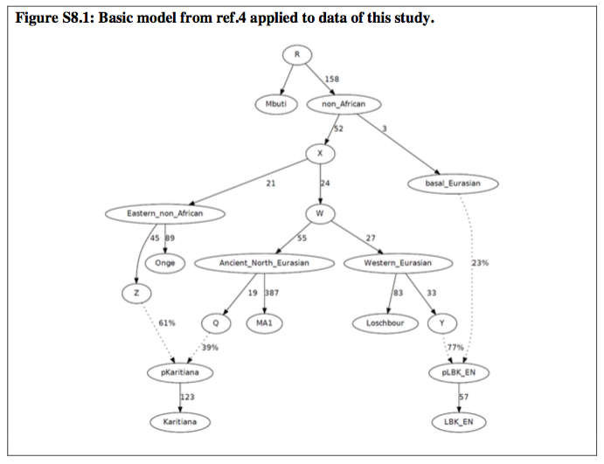
Admixture Graph

Slide 3
Admixture Graph
This should be a visually pleasing summary of results you have found already using other methods we’ve learned.

Slide 4
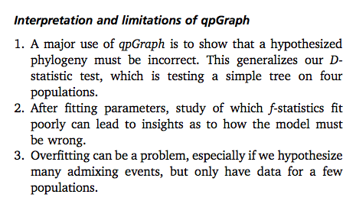
Patterson et al. (2012)
README for AdmixtureGraph
https://github.com/DReichLab/AdmixTools/blob/master/README.QPGRAPH

Slide 5
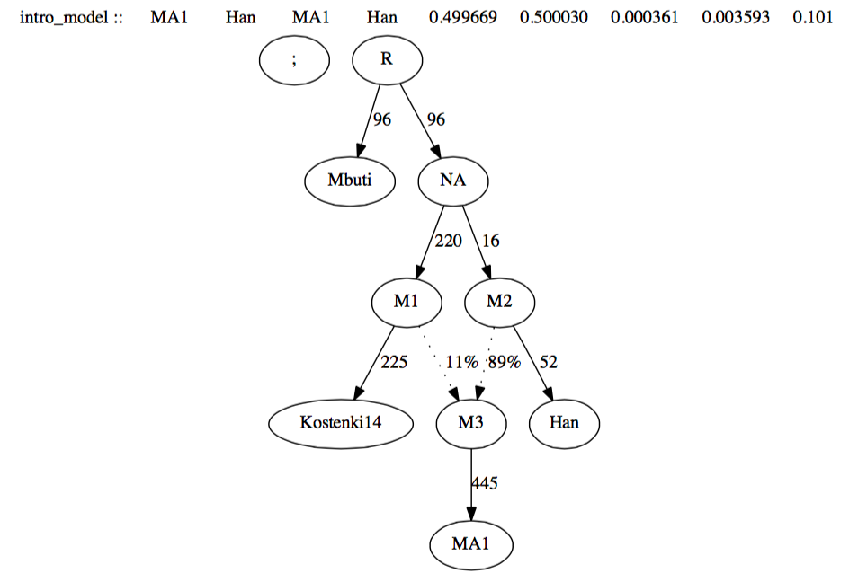

Slide 6
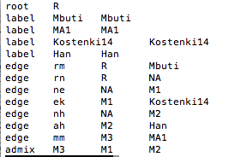
Root – starting point of your tree (root R)
Label – Each of your tips of tree (label PopID PopID)
Edge – each branch of tree (edge edgename node1 node2/tiplabel)
Admix – two lines indicating admixture (admix Target S1 S2)

Slide 7
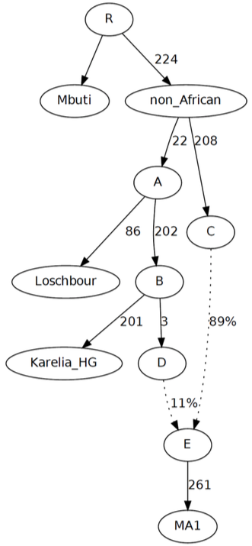
Activity
Can you write the graph in text form that the program qpGraph will interpret?
Try to run it using
qpGraph -p PARFILE -g GRAPHFILE -o GRAPHFILE.out -d GRAPHFILE.dot > GRAPHFILE.log
Then, to make a PS file:
dot -Tps GRAPHFILE.dot > GRAPHFILE.ps
Then, to make a PDF file:
ps2pdf GRAPHFILE.ps GRAPHFILE.pdf
Did you get the same graph?

Slide 8
How to use qpGraph
Start with a base graph – dependent on which populations may be relevant, previously published AdmixtureGraphs, etc.
Add one new population or individual at a time, trying it as an added branch to all possible branches (edge), or as a mixture of all possible pairs of two branches (admix).
Look to see which trees have |maxf|<3.
Use these trees to add further new populations or individuals.

Slide 9
Searching the Space
Look at the PDF files beginning with “Ami.Tianyuan.A2_*pdf” on my github page, under “Lesson12/”.
fALL = all pairs of admixtures
nALL = adding as single branch
Top right corner lists worst f-stat
Let’s find the best tree(s)!

Slide 10
Searching the Space - Activity
Now look at the PDFs beginning with “Malta1.Ami.Tianyuan*pdf”. What are the best trees here?

Slide 11
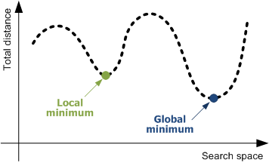
Problem of qpGraph
Manually searching the tree space.
Order of addition limits direction of gene flow.

Slide 12
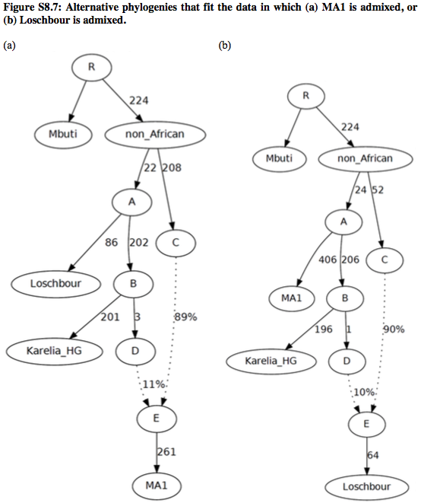
Loschbour, then Mal’ta1
Mal’ta1, then Loschbour

Slide 13
Things to Consider:
qpGraph is dependant on your hypotheses, so it needs to be done at the end.
Depending on who you include and how many admixture events you add, you can almost always get a tree that works. Thus, the key is keeping it as simple as possible and thoroughly searching within the space you JUSTIFY.
It is good at eliminating specific models you want to emphasize are NOT correct.
It is good for summarizing major conclusions of your study, but an important caveat is to remember there are likely other models not explored.

Slide 14
Rest of Course
Test on Friday
Mini-projects on Monday (10 am? Afternoon?)
mtDNA course Tuesday to Thursday with Albert

Slide 15
Exam
Written test, one worksheet of notes.
75 minutes, 10 am.
Predominantly Lessons 1 to 9.
Familiarity with major points and ancient individuals used in the Haak paper.
Understanding contamination estimates, sequencing, data processing that occurs in preparing a dataset.
Constructing the appropriate f3-, D-, and qpAdm analyses to answer your question.
Interpretation of f3-, D-, and qpAdm results
Developing hypotheses using PCA
Familiarity with uniparental markers and what you can learn from them.

Slide 16
Questions?
Office Hours
Rest of class today
Thursday 2-3 pm

