Slide 1
Lesson 10: qpAdm
Friday July 27, 2018
9:00 – 11:30 am

Slide 2
Important D-statistic relationships in Haak et al. (2015)
Class Discussion

Slide 3
Important D-statistic relationships in Haak et al. (2015)
Three main categories we will focus on:
Early Neolithic
Middle Neolithic
Late Neolithic/Bronze Age

Slide 4
Early Neolithic (LBK)
D(EUR, Esperstedt; LBK, Mbuti)<0 and D(EUR, LBK; Esperstedt, Mbuti)<0
Clade with Esperstedt relative to most EUR
Clade with MN/EN relative to LN/HG
D(EN, LBK; HG, Mbuti)~0
D(MN, LBK; HG, Mbuti)>0

Slide 5
Middle Neolithic (Yamnaya)
D(EUR, CW/Mot/Kar/Sam; Yamnaya, Mbuti)<0 and D(EUR no HG, Yamnaya; CW/Mot/Kar/Sam, Mbuti)<0
Yamnaya mostly clade with EHG and Corded_Ware
D(EN/MN, LN; Yamnaya, Mbuti)<0 but most D(EN/MN, Yamnaya; LN, Mbuti)~0 (but Karsdorf <0 and some others)
D(LN, Yamnaya; EN/MN, Mbuti)>0
What is going on here?

Slide 6
Middle Neolithic (Esperstedt)
D(EUR, SpainMN/EN/LBK; Esperstedt, Mbuti)<0 and D(EUR, Esperstedt; SpainMN/EN/LBK, Mbuti)<0
Esperstedt mostly groups with other MN and EN in Europe

Slide 7
Late Neolithic/Bronze Age (Corded Ware)
D(EUR, Yam/Mot/Kar/Sam; Corded_Ware, Mbuti)<0 and D(EUR no HG, Corded_Ware; Yam/Mot/Kar/Sam, Mbuti)<0
Corded_Ware mostly clade with EHG and Yamnaya
See D(EUR, Esperstedt; Corded Ware, Mbuti)<0 but D(EUR, Corded Ware; Esperstedt, Mbuti) mostly >=0

Slide 8
Late Neolithic/Bronze Age (Alberstedt)
D(EUR, CW/Esper/Mot; Alberstedt, Mbuti)<0 but D(EN/MN, Alberstedt; CW/Yam/Mot/Kar/Sam, Mbuti)<0
CW connections (and thus, Yamnaya connections), but also MN connections

Slide 9
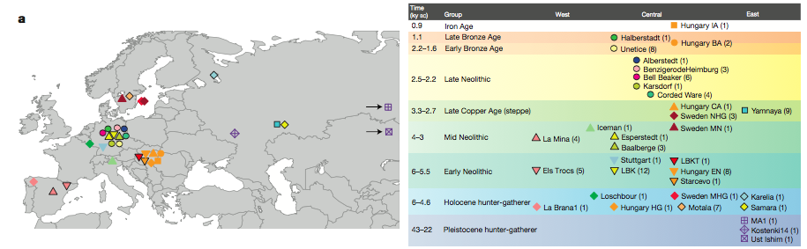
Comparing to Haak et al. (2015)
LN: Alberstedt: Corded Ware, Esperstedt, Motala
Benzigerode and Bell beaker: addtl Loschbour
CA: Yamnaya has strong connections to Mal’ta1 and EHG, but also to Corded Ware and others in LN
MN: More Baalberge (but also Esperstedt) have more connections to WHG than EN
LN: Corded Ware has strong connection to Yamnaya, EHG
EN: LBK, Starcevo like other EN (including Stuttgart) and present-day Sardinian
BA: Halberstedt, Unetice similar to LN
Spain EN and MN very similar patterns to EN and MN in Germany
Notes:
After class went through and present results, compare to conclusions in Haak et al 2015 paper

Slide 10
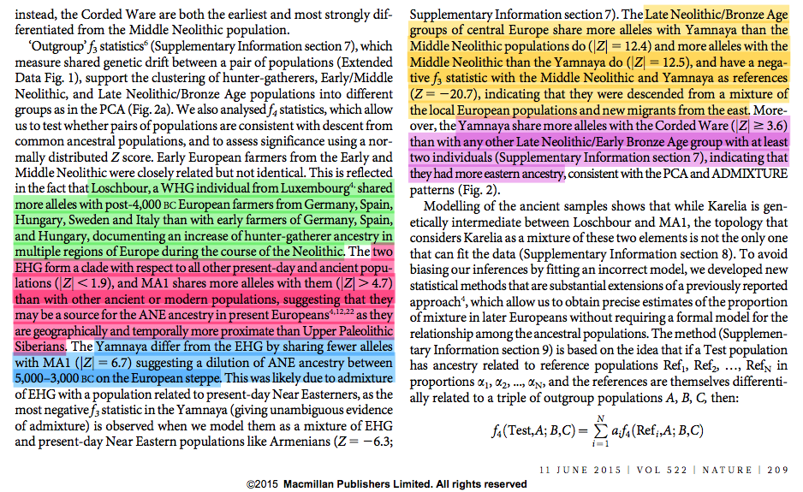
From the Haak et al. paper

Slide 11
Spain_EN, Yamnaya, Corded Ware
D(Spain_EN, Yamnaya; CW, Mbuti)<0 (-6.8)
D(Spain_EN, CW; Yamnaya, Mbuti)<0 (-14.3)
D(Yamnaya; CW; Spain_EN, Mbuti) <0 (-7.5)
?
Yamnaya
CW
Spain_EN
Mbuti

Slide 12
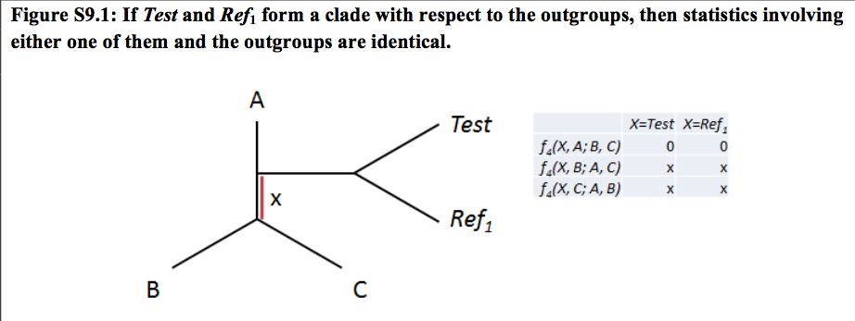
qpWave
f4(Test, A; B, C) = f4(Ref1, A; B, C)

Slide 13
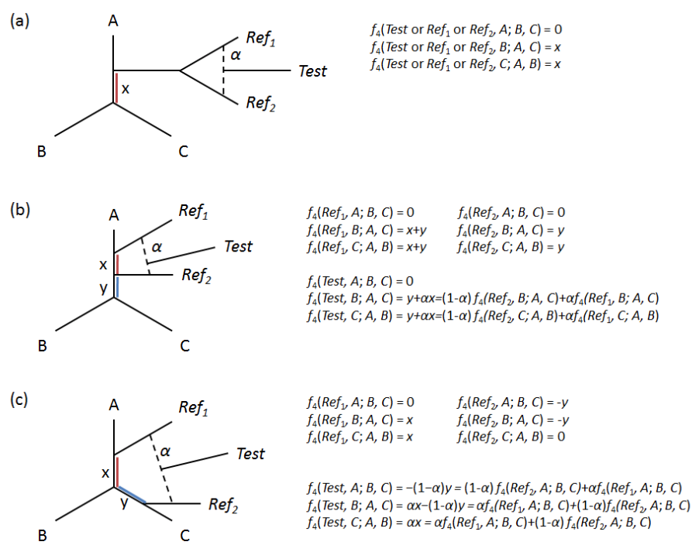
qpAdm

Slide 14
qpAdm
f4(Test, A; B, C) = α f4(Ref1, A; B, C) + (1-α) f4(Ref1, A; B, C)

Slide 15
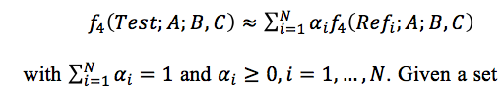
qpAdm
f4(Test, A; B, C) = α f4(Ref1, A; B, C) + (1-α) f4(Ref1, A; B, C)
More generally,

Slide 16
F4(Test; A, B, C)
A, B, and C are all outgroups, with m reference sets
If n outgroups, then n(n-1 choose 2) arrangements.
Matrix of n(n-1 choose 2) rows and m columns

Slide 17
≈
t
R
*
α^{T}
F4(Test; A; B, C)
F4(Ref₁; A; B, C)
F4(Ref₂; A; B, C)…
F4(Ref_{m}; A; B, C)
α₁
α₂
.
.
.
α_{m}
F4(Test; B; A, C)
F4(Ref₁; B; A, C)
F4(Ref₂; B; A, C)…
F4(Ref_{m}; B; A, C)
≈
F4(Test; C; A, B)
F4(Ref₁; C; A, B)
F4(Ref₂; C; A, B)…
F4(Ref_{m}; C; A, B)

Slide 18
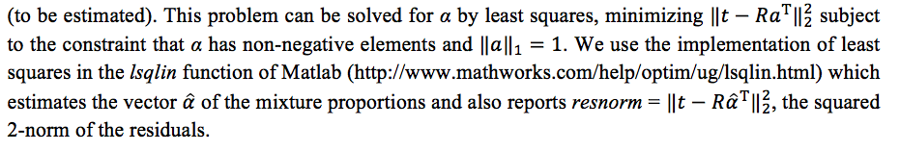
≈
t
R
*
α^{T}
F4(Test; A; B, C)
F4(Ref₁; A; B, C)
F4(Ref₂; A; B, C)…
F4(Ref_{m}; A; B, C)
α₁
α₂
.
.
.
α_{m}
F4(Test; B; A, C)
F4(Ref₁; B; A, C)
F4(Ref₂; B; A, C)…
F4(Ref_{m}; B; A, C)
≈
F4(Test; C; A, B)
F4(Ref₁; C; A, B)
F4(Ref₂; C; A, B)…
F4(Ref_{m}; C; A, B)

Slide 19
qpAdm: Some Thoughts
Outgroup choice – very vital!
No need to know phylogenetic relationships BUT
Cannot all be from same population – if identically related to Test and References, then no leverage to find admixture proportion.
No recent admixture from outgroup to Test/Ref
Don’t make this too big – computationally difficult and poor estimates result.
qpWave important
Assume T=test, S={Ref1, Ref2,…,Refm}
qpWave(S) must have n streams of ancestry (r=n-1)
qpWave(T,S) should not increase rank (n streams of ancestry)
In practice, we can try qpAdm without necessarily knowing qpWave conditions (but need n-1 streams of ancestry).

Slide 20
Spain_EN, Yamnaya, Corded Ware
D(Spain_EN, Yamnaya; CW, Mbuti)<0 (-6.8)
D(Spain_EN, CW; Yamnaya, Mbuti)<0 (-14.3)
D(Yamnaya; CW; Spain_EN, Mbuti) <0 (-7.5)
Who do we think are sources?
Who do we think is the test?
?
Yamnaya
CW
Spain_EN
Mbuti

Slide 21

qpAdm software
Just like qpWave, only ORDER MATTERS in the leftpop file.
TEST
REF1
REF2

Slide 22
qpAdm software
Just like qpWave, only ORDER MATTERS in the leftpop file.
What order do we want?
TEST
REF1
REF2

Slide 23

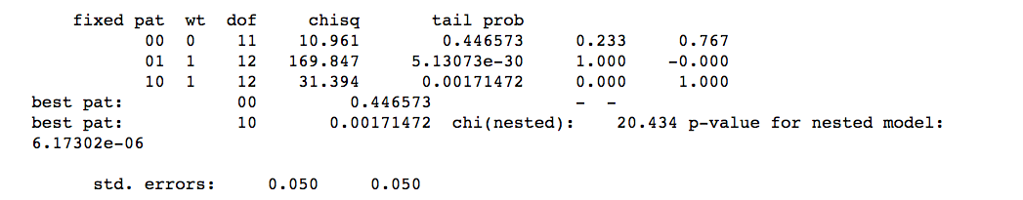
Results
qpAdm –p PARFILE > LOGFILE
00 is the mixture case.
01 means all ancestry from Ref1
10 means all ancestry from Ref2
1. Look at “tail prob” – if p>0.05, then that model is possible.
2. If ‘00’ is possible, then look at nested model – is ‘00’ better than ‘01’ or ’10’?
p-value for nested model (pnest) < 0.05, means you reject ’10’, so ‘00’ is better than ‘10’.
3. Look at f1, f2 → 0.233 Spain_EN and 0.767 Yamnaya with SE=0.05
4. Is min(f1,f2)-SE>0?

Slide 24
Results
qpAdm –p PARFILE > LOGFILE
Corded Ware seems to be a mixture of populations related to the Spain_EN and Yamnaya populations.
00 is the mixture case.
01 means all ancestry from Ref1
10 means all ancestry from Ref2
1. Look at “tail prob” – if p>0.05, then that model is possible.
2. If ‘00’ is possible, then look at nested model – is ‘00’ better than ‘01’ or ’10’?
p-value for nested model (pnest) < 0.05, means you reject ’10’, so ‘00’ is better than ‘10’.
3. Look at f1, f2 → 0.233 Spain_EN and 0.767 Yamnaya with SE=0.05
4. Is min(f1,f2)-SE>0?

Slide 25

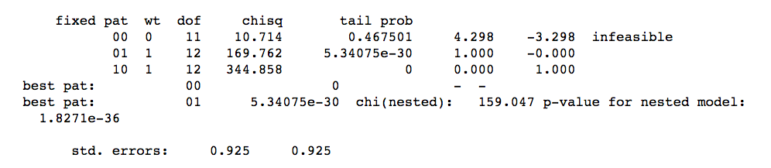

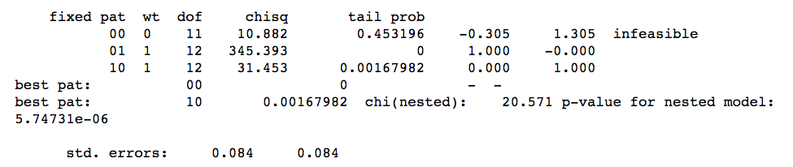
Spain_EN or Yamnaya as Test?

Slide 26
True reciprocal test
We can find gene flow into CW. What about gene flow into Spain_EN?
Need (Spain_EN; EN, CW) as (Test; Ref1, Ref2)
D(Spain_EN, Yamnaya; CW, Mbuti)<0 (-6.8)
D(Spain_EN, CW; Yamnaya, Mbuti)<0 (-14.3)
D(Yamnaya; CW; Spain_EN, Mbuti) <0 (-7.5)
?
Yamnaya
CW
Spain_EN
Mbuti

Slide 27
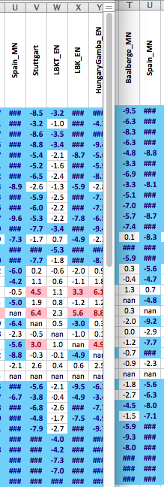
Gene flow into Spain_EN?
Test: Spain_EN
Ref1: Corded_Ware
Ref2: Spain_MN

Slide 28
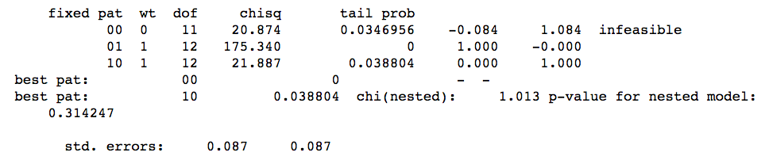
Gene flow into Spain_EN?
Test: Spain_EN
Ref1: Corded_Ware
Ref2: Spain_MN
Should try more than one.
Maybe bad source population?
Either way, do not see gene flow into Spain_EN, and with timing, geography, other populations, likely only gene flow into Corded Ware and not other way around.

Slide 29
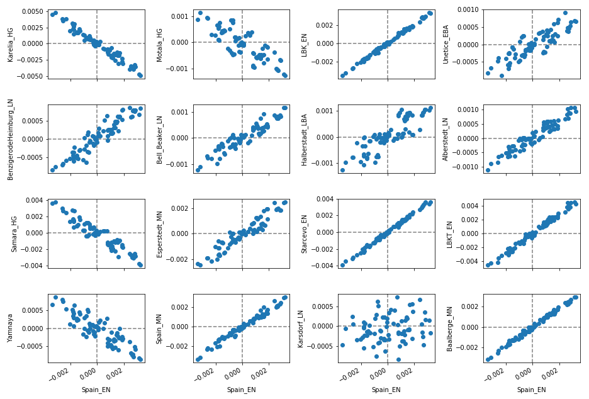
More intuition, maybe? F4(Corded Ware, X/Y; Out, Out)
Tight positive – x and y clade relative to Corded Ware
Loose positive – different relationship between x and y with Corded Ware
Negative – admixture!
*
*
*
*
*
*
*
*
*
**
*
*
*
*
*

Slide 30
Class Activity – Try a three reference qpAdm test.
What are the three sources of European ancestry?

Slide 31
Class Activity – Try a three reference qpAdm test.
What are the three sources of European ancestry?
Sources: LBK_EN, Loschbour, Yamnaya
Test Spain_EN, Esperstedt_MN, Corded_Ware_LN, or Unetice_EBA
Try to see if you can figure out how to read the table in the log file for three populations!
How much of each type of ancestry do you find?

Slide 32
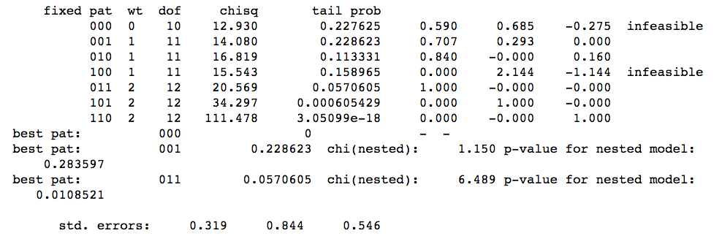
Three Source Case
000 is the full mixture case.
010, 001, 100 means two source mixture model.
110, 011, 101 means all ancestry from one source
1. Look at “tail prob” – if p>0.05, then that model is possible.
2. If 000, 010, 001, 100 are possible, then look at nested model – is ‘000’ better than two source models, better than the one source models??
p-value for pnest < 0.05, means reject model in same line, preferring model in above line.
3. Look at f1, f2, f3.

Slide 33
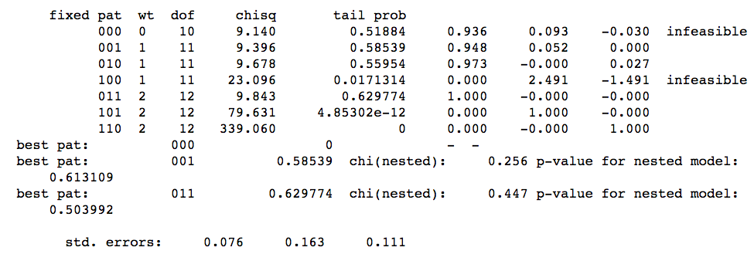
qpAdm(Spain_EN; LBK_EN, Loschbour, Yamnaya)

Slide 34
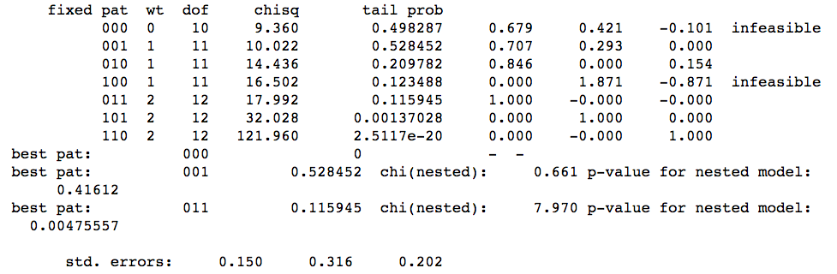
qpAdm(Esperstedt_MN; LBK_EN, Loschbour, Yamnaya)

Slide 35
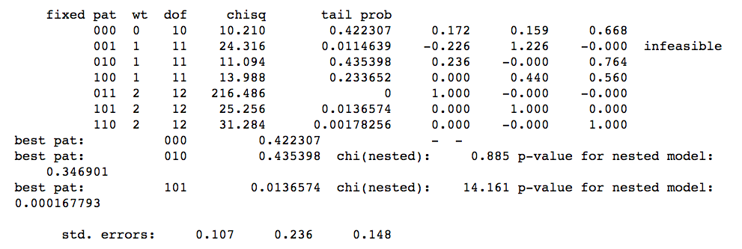
qpAdm(Corded_Ware_LN; LBK_EN, Loschbour, Yamnaya)

Slide 36
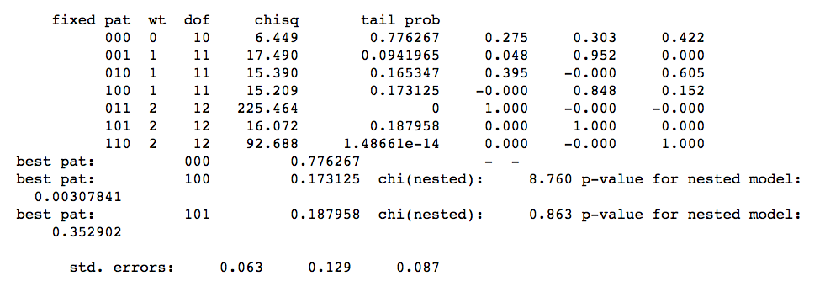
qpAdm(Unetice_LBA; LBK_EN, Loschbour, Yamnaya)

