Slide 1
Lesson 2: Introducing the Course (and Haak et al. 2015)
Wednesday July 11: 9:00 – 11:30 am
Notes:
Papers before Haak – What do we know?
Individuals in Haak paper
Computer check
Quick lessons in accessing and using server
Pick individuals per person
EIGENSTRAT and other data file formats

Slide 2
What did you learn from Professor Fu’s lecture?

Slide 3
What are you hoping to learn from this course?

Slide 6
Journal Clubs
Two papers per week (Monday 2-4 pm)
Short presentation in English within 15 minutes
Share background, main argument, opinion or questions
Every student prepares ≥2 questions per paper.
Date | Guide | Paper | Student Leader
2018.07.09 | QF+MY | Lipson,2017,Nature | 白帆
 |  | Skoglund,2016,Nature | 郎曼
2018.07.16 | HW | Lazaridis,2017,Nature | 王恬怡
 |  | Damgaard,2018,Nature | 刘俊岑，苗波
2018.07.23 | AK | Kivisild,2017,Human Genetic | 王文君
 |  | Rierux,2014,Mol Bio Evo | 郑泽权
2018.07.30 | HS | Damgaard,2018,Science | 张明
 |  | Ilardo,2018,Cell | 丁曼雨

Slide 8
Expectations
Meet MWF 9-11:30 am, with one W 2-4:30 pm class
Class is a mixture of lecture and discussions
Speaking in class – invited and encouraged!
Lecturers want you to learn and have fun
Do the homework!
Try your best – that’s all we ask for

Slide 9
Expectations
Meet MWF 9-11:30 am, with one W 2-4:30 pm class
Class is a mixture of lecture and discussions
Homework Presentation
New material
Lecture
Discussion
Class Activities (often in small groups)
Review/Questions

Slide 10
Expectations
Meet MWF 9-11:30 am, with one W 2-4:30 pm class
Class is a mixture of lecture and discussions
Speaking in class
Be ready to TALK and discuss previous material
Always ASK when you are confused
Don’t be afraid to speak English – practice makes perfect!

Slide 11
Expectations
Meet MWF 9-11:30 am, with one W 2-4:30 pm class
Class is a mixture of lecture and discussions
Speaking in class – invited and encouraged!
Lecturers want you to learn and have fun
Do the homework!
The best learning is here
Ask questions of each other and the lecturers
It will take time, but be patient

Slide 12
Expectations
Meet MWF 9-11:30 am, with one W 2-4:30 pm class
Class is a mixture of lecture and discussions
Speaking in class – invited and encouraged!
Lecturers want you to learn and have fun
Do the homework!
Try your best – that’s all we ask for

Slide 13
Homework
Trying to design homework to take at least 7-8 hours.
Mix of questions
Short answer/searching primary literature
Running introduced software
Writing short scripts to retrieve information, prepare data for analysis
More advanced scripts and/or thinking creatively.
You will upload homework onto the server – more later!
Be prepared to present some homework in future classes!

Slide 14
Preparing for the course
Does everyone have internet access?
Could everyone install jupyter notebook and the VPN?
Can everyone connect to the VPN?
In a Terminal, try ‘ssh student@192.168.1.2’
It will prompt you for a password (Ask me!).
This brings you to the ADMIN node, where you should work as little as possible.
Type ssh comput12
This brings you to computing node 12.
Type ‘htop’ and press enter.

Slide 15
Do’s and Don’ts of Server Access
htop – way to check CPU and memory usage
DON’T use too many CPUs (for class, use one/run)
DON’T use too much RAM (We will warn you about memory intense runs, but check in htop to be sure!)
Hard Disk Storage – limited space, make sure to only write new files into the folder you make for yourself at /public/adna/summer2018/
DON’T copy large data files into the home directory!

Slide 16
Useful Unix commands
less
cat
grep
paste
cut
sort
screen
head
tail
vim
mv
cp
rm
mkdir
pwd
man
wget
|
df -h

Slide 17
Make folder for your files
The main directory we will work in is:
/public/adna/student/
In 2018class/, make a folder for yourself titled “lastname_firstname/”
This is where you will make new folders and files for the course on the server.
Make a folder for your homework exercises. You will upload your home problems to this folder.

Slide 18
Tunneling to the comput node
Type vim ~/.ssh/config onto a Terminal or Cygwin window on your computer.
In the text file, press 'i' and then copy the 'Host...' and lower lines.
Press 'esc' and then ':', and then 'w' to save.
Press ':' and then 'q' to quit.
Try ssh student12 in your Terminal window – you should have to input the password twice, but then end up directly in the comput12 node!
Host student12
User student
HostName comput12
ProxyCommand ssh student@192.168.1.2 nc %h %p 2> /dev/null

Slide 19
Accessing jupyter notebook
After saving the new config file, type
'ssh -NfL localhost:8880:localhost:8880 student@student12' in your Terminal window.
If no error happens, open a web browser and type 'localhost:8880’
If they request a password, ask me!

Slide 20
Transferring files
ssh – need Terminal/Cygwin to login to server
jupyter notebook (and accessing remotely) – easy way of accessing server when writing scripts
scp – how to transfer files to and from server
scp -r student12:/public/adna/student/usefulfiles/ssh_config_file.txt .
-This transfers the text file from the server onto your computer.
scp –r ssh_config_file.txt student12:/public/adna/student/2018class/lastname_firstname/
-This transfers the text file from your computer onto the server.

Slide 21
Let’s begin!

Slide 22
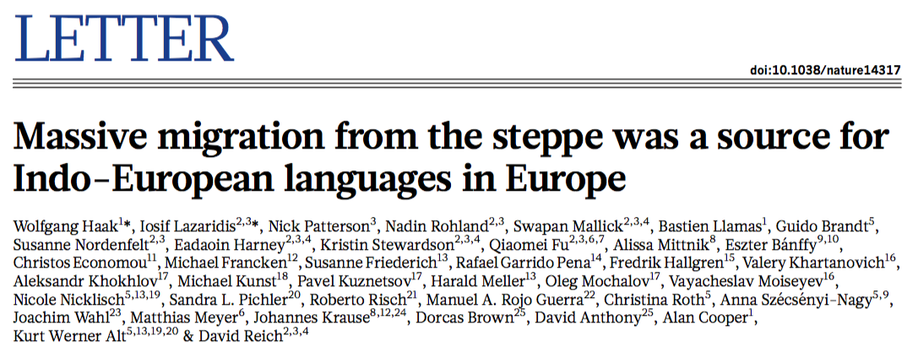
Haak et al. (2015)

Slide 23
Haak et al. (2015)
What can you tell me about this study?

Slide 24
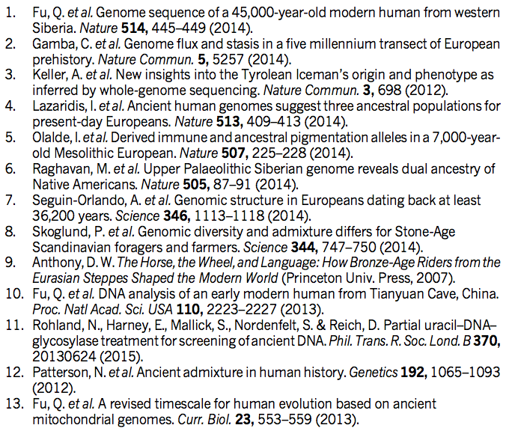
References

Slide 25
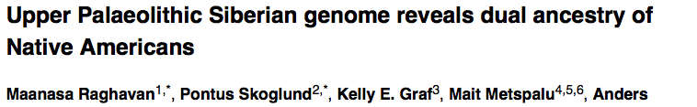
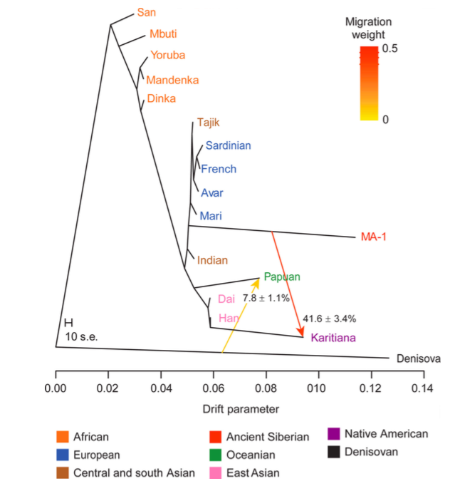
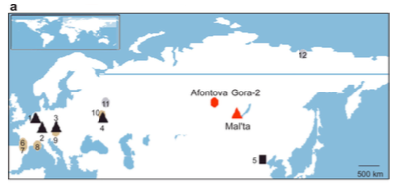

Slide 26
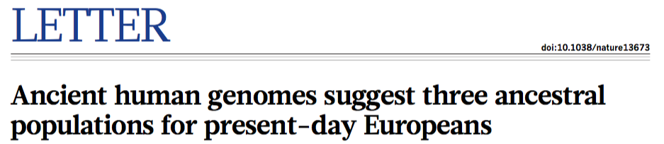
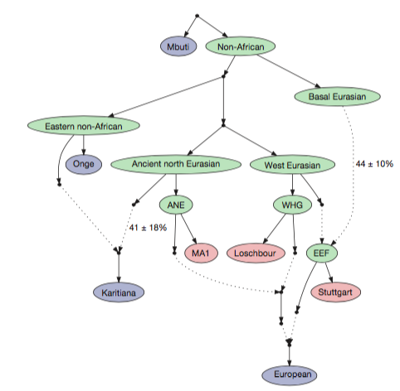
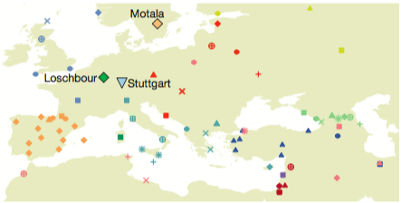

Slide 27
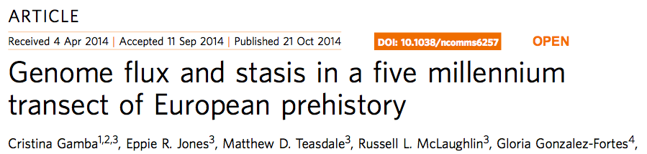
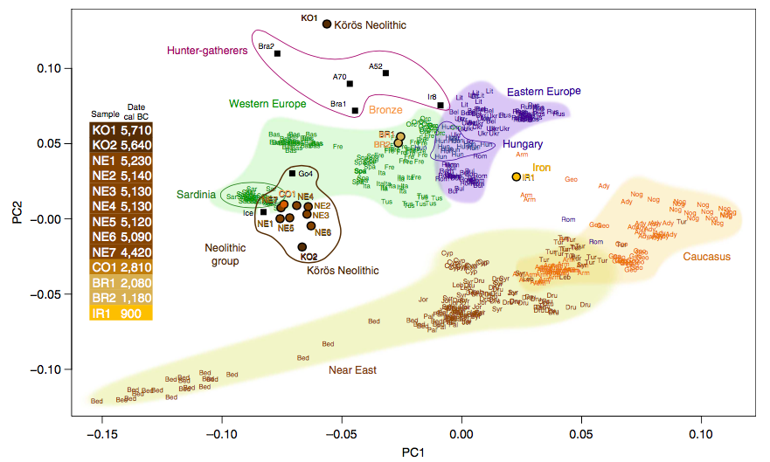

Slide 28
Major Players in Haak et al.
Western European H-G (WHG)
Eastern European H-G (EHG)*
Scandinavian H-G (SHG)
Early Neolithic (EN)*
Middle Neolithic (MN)*
Late Neolithic (LN)*
Bronze Age (BA)*
Present-day
Notes:
Haak et al D-stat results!

Slide 29
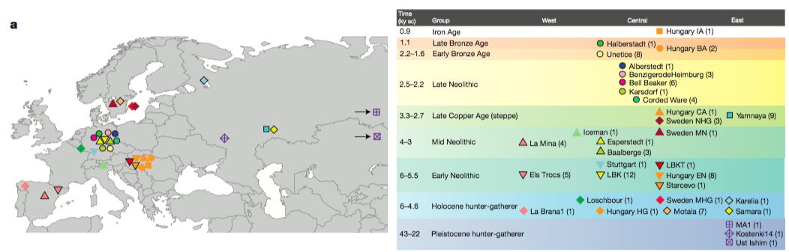
Ancient individuals available

Slide 30
What questions are there?

Slide 31
What questions are there?
If Europeans consist of three types of ancestry, when and how did each ancestry enter the European pool?
What are differences between western and eastern Europeans? At different time periods?
With many individuals from a small region (central Germany), what are local changes through time, and how does that compare to other regions?

Slide 32
Accessing the dataset
https://reich.hms.harvard.edu/datasets
AdmixTools: https://github.com/DReichLab/AdmixTools
PACKEDANCESTRYMAP format

Slide 33
Accessing the dataset
https://reich.hms.harvard.edu/datasets
AdmixTools: https://github.com/DReichLab/AdmixTools
PACKEDANCESTRYMAP format
CONVERTF helps us to convert to something readable – EIGENSTRAT format.

Slide 34
Accessing the dataset
https://reich.hms.harvard.edu/datasets
AdmixTools: https://github.com/DReichLab/AdmixTools
PACKEDANCESTRYMAP format
CONVERTF helps us to convert to something readable – EIGENSTRAT format.
The data can be found at /public/adna/student/data/
Let’s go to jupyter notebook.

Slide 35
Class Activity
Can we identify the ancient individuals in the dataset, and develop a text file containing extra information?
What information do we want?
Where do we look for this information?
As a class, we will fill out an Excel with this information, standardizing nomenclature.
Notes:
Country
Date
Associated archaeological culture
Other regional groupings?
Time period (what categories? BA, CA, etc)
Number samples available
Amount of missing data

Slide 36
Gathering info on our individuals.
We will divide into four groups, and each group will be responsible retrieving information for one of the four groups. I’ll do Motala.
EHG: Karelia, Samara
SHG: Motala
EN: LBK, LBKT, Starcevo, Spain_EN
MN/CA: Yamnaya, Esperstedt, Baalberge, Spain_MN
LN: Alberstedt, BenzigerodeHeimburg, Bell Beaker, Karsdorf, Corded Ware
BA/IA: Halberstadt, Unetice
Notes:
Haak et al D-stat results!

Slide 37
Assigning Ancient Individuals/Populations
ID | N | ID | N | ID | N
HungaryGamba_BA* | 2 | Corded_Ware_LN | 4 | Starcevo_EN | 1
HungaryGamba_CA* | 1 | SwedenSkoglund_MHG* | 1 | LaBrana1* | 1
HungaryGamba_IA* | 1 | SwedenSkoglund_NHG* | 3 | Loschbour* | 1
HungaryGamba_HG* | 1 | SwedenSkoglund_MN* | 1 | Motala_HG | 7
HungaryGamba_EN* | 8 | Yamnaya | 9 | Karelia_HG | 1
Halberstadt_LBA | 1 | Iceman* | 1 | Samara_HG | 1
Unetice_EBA | 7 | Esperstedt_MN | 1 | MA1* | 1
Alberstedt_LN | 1 | Baalberge_MN | 3 | Kostenki14* | 1
BenzigerodeHeimburg_LN | 3 | Stuttgart* | 1 | Ust_Ishim* | 1
Bell_Beaker_LN | 6 | LBKT_EN | 1 | Spain_MN (La Mina) | 4
Karsdorf_LN | 1 | LBK_EN | 12 | Spain_EN (Els Trocs) | 4
Each student will be responsible for one of the starred individuals.
Two students together responsible for Sweden data.
Two students together responsible for HungaryGamba data.
Eleven all together.
Bolded=Haak et al. data
*=Previously published data used in Haak et al. (2015)

