Slide 1
Lesson 9: qpWave
Wednesday July 25, 2018
9:00 – 11:30 am

Slide 2
Test!

Slide 3
Test: Friday August 3
Study lecture and exercises
No computer scripting
Focus on how to interpret results

Slide 4
So far, what can each of these tell us?
PCA
f-statistics
F3
Outgroup
Admixture
F4/D
Treeness
Admixture

Slide 5
Admixture
D-statistics show a connection, but not easy to argue direction of gene flow.
F3-statistics can show an admixed population, but does not always show when true, and it doesn’t show how much.
Can only consider two source populations

Slide 6
How do we know the direction of gene flow?
D(EA, EUR; AMER, AFR)>0
D(AMER, EUR; EA, AFR)>0
D(EA, AMER; EUR, AFR)<0
Logical arguments in D
Negative f3-statistic
qpWave/qpAdm…
?
EA
AMER
EUR
AFR

Slide 7
qpWave and qpAdm
Expansion on f-statistics, allowing study of direction of gene flow from N potential sources, even estimating the amount of admixture.
qpWave: number of sources
qpAdm: estimate amount of admixture

Slide 8
qpWave and qpAdm
Expansion on f4-statistics, allowing study of direction of gene flow from N potential sources, even estimating the amount of admixture.
qpWave: number of sources (Today)
qpAdm: estimate amount of admixture (Friday)

Slide 9
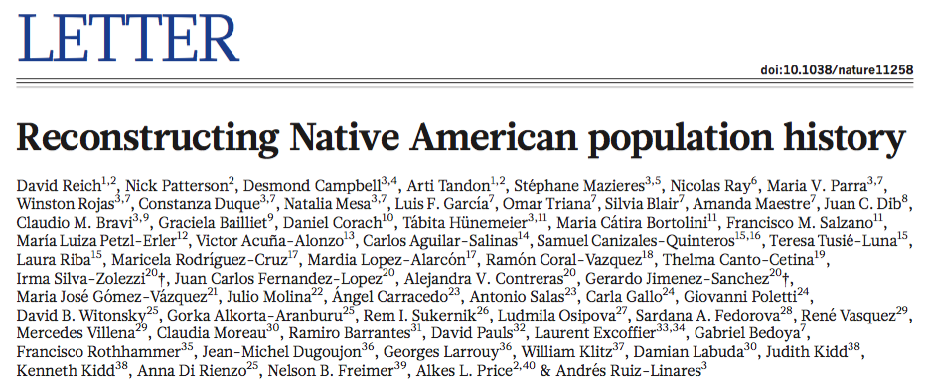
qpWave
Use Reich et al. (2012), where first introduced, to explore how qpWave works (Note S6)
https://reich.hms.harvard.edu/publications

Slide 10
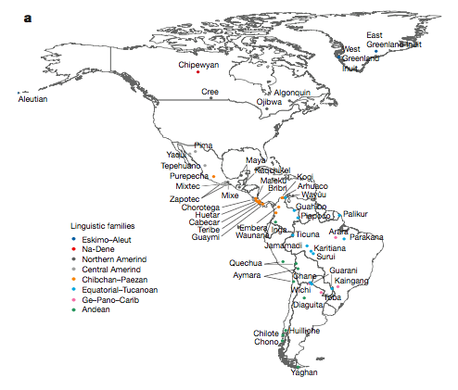
What do we know about Native Americans?
Northern Native Americans, Eskimo-Aleut
Southern Native Americans

Slide 11
What do we know about Native Americans?
Northern Native Americans, Eskimo-Aleut
How many streams of ancestries make up Native Americans?
Southern Native Americans

Slide 12
Outgroups and Related
Consider populations A, B, and C as outgroup to populations E and F, such that Out={A, B, C} and Main={E, F}. Then, if we focus on E and A,
We would expect f4(E, F; A, B)=f4(E, F; A, C)=0.
Note:
We are no longer considering treating one position as an outgroup.
Because E and F both show no special relationship to A or B, still expect symmetry.
A
E
C
B
F

Slide 13
Outgroups and Related
Consider populations A, B, and C as outgroup to populations E and F, such that Out={A, B, C} and Main={E, F}. Then, if we focus on E and A,
We would expect f4(E, F; A, B)=f4(E, F; A, C)=0.
Note:
We are no longer considering treating one position as an outgroup.
Because E and F both show no special relationship to A or B, still expect symmetry.
A
Southern Native Americans
Different Asian populations
C
B
Eskimo-Aleut

Slide 14
F4(AMER1, AMER2; Out1, Out2)
Consider each Native American in AMER, and each outgroup in OUT
F4(Southern, Northern; Asian, Asian) – deviations from zero indicate different streams of ancestry.
Contrast different northerns to each other:
F4(Southern, Northern1; Asian, Asian)
F4(Southern, Northern2; Asian, Asian)

Slide 15
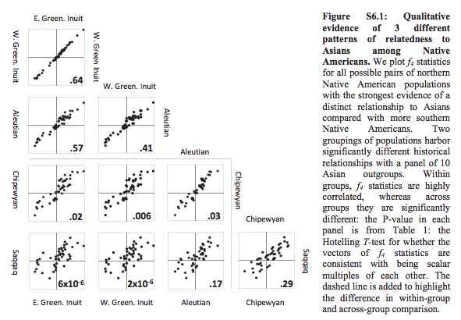
See three different patterns – two depicted below.

Slide 16
Statistically…
“If two Native American populations derive all their non-First American ancestry from the same ancestral stream of Asian gene flow, their vectors of f4-statistics are expected to be scalar multiples of each other, and [Reich et al. 2012] developed a formal statistical test for whether this is the case.” (p. 21, Note S6)

Slide 17
X(Q, S) = F4(Karitiana, Q; Han, S)
S
X(Q₁, S₁)
X(Q₁, S₂)
…
X(Q₁, S_{n})
…
X(Q₂, S₁)
…
…
Q
X(Q_{m}, S₁)
…
X(Q_{m}, S_{n})

Slide 18
X(Q, S)
S6.4 (p. 21): Let r be the rank of X, and n the number of independent gene flows into the Americas. Then,
r+1≤n
Thus, the number of streams of ancestry at minimum must be greater than one plus the rank of the matrix.
A likelihood ratio test can be used to compare rank r=k to rank r=k+1

Slide 19
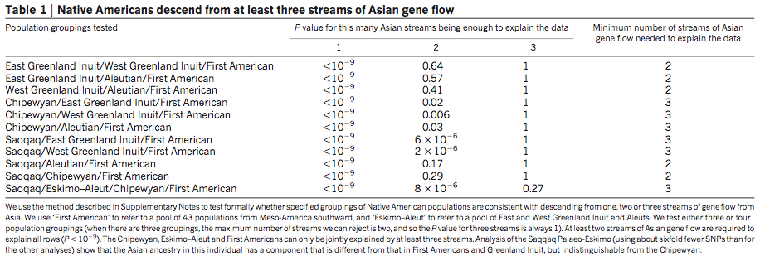
Table 1 in Reich et al. (2012)

Slide 20
Summary
Given a set of populations and a set of ‘outgroup’ populations, qpWave asks the minimum streams of ancestry required to explain the included populations.
If you expect three populations to have three distinct ancestries, but you find less than that, then perhaps finding admixture (stay tuned for qpAdm).

Slide 21
How to calculate qpWave?
Requires:
PAR file
Leftpop file (Main populations of interest)
Rightpop file (Outgroup populations)
Geno/snp/ind
Notes:
Qpwave – three streams of European ancestry

Slide 22
Populations
Leftpop
Loschbour, LBK_EN, Yamnaya
Rightpop
Han, Eskimo, Mbuti, Karitiana, Kharia, Onge, Ulchi

Slide 23
Results of qpWave
How many waves of ancestry are needed for these three European populations?
Which column do we look at below?

Slide 24
Results of qpWave
How many waves of ancestry are needed for these three European populations?
Which column do we look at below?
r=2, so n≥3 – therefore, at least three streams of ancestry to describe Loschbour, LBK_EN, and Yamnaya

Slide 25
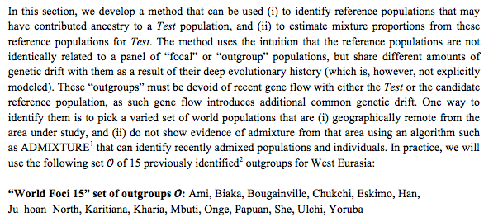
Populations
Leftpop
Spain_EN, Corded_Ware_LN, Yamnaya
Rightpop (SI 9 of Haak et al. 2015, p. 94)
Why do I kick some out?

Slide 26
Activity
Make the leftpop and rightpop files, as well as the par file.
Run qpWave
What is the minimum streams of ancestry that you find?
What are the p-values for each rank?
Does this make sense to you?

