Slide 1
Running and Interpreting ADMIXTURE 2018-07-30

Slide 2
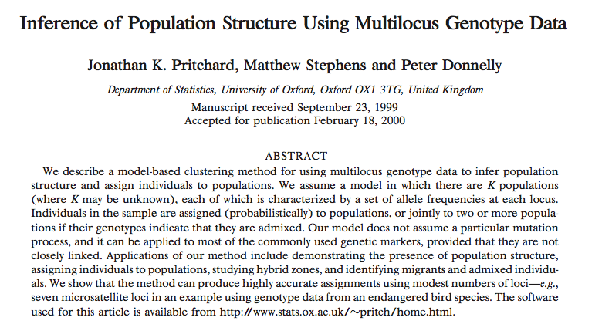
Invention of STRUCTURE
Pritchard 2000

Slide 3
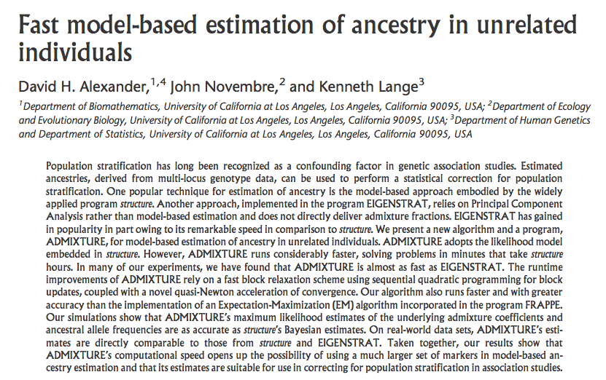
Acceleration and implementation for genomic data in ADMIXTURE
Alexander 2009

Slide 4
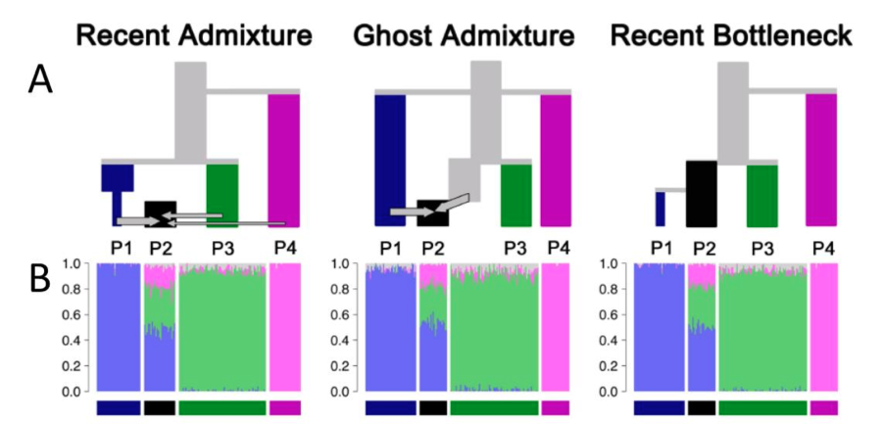
(mis)interpreting STRUCTURE/ADMIXTURE
Falush 2017

Slide 5
Resources
ADMIXTURE documentation
http://www.genetics.ucla.edu/software/admixture/download.html
MAP/PED format
http://www.gwaspi.org/?page_id=145
https://www.cog-genomics.org/plink2/formats#bed
Plink documentation
https://www.cog-genomics.org/plink/1.9/index
Flexibility of choosing K for interpretation
See paper: The first horse herders and the impact of early Bronze Age steppe expansions into Asia (http://science.sciencemag.org/content/early/2018/05/08/science.aar7711) , Supplemental information page 45 and page 14.

Slide 6
Homework
Automate admixture plotting
Files
Admixture results in ‘/public/adna/student/2018class/hongru_wang/admixture/’, plot for K=2-5
Finished graph is something similar to the example ‘lipson2018.admixture.pdf’
Software
Based on Rscript ‘admixture_barplot.R’
Use Pong: https://github.com/ramachandran-lab/pong
Other software you may find on the internet.
Requirements
Multiple K in one page
Fix label
Color for one population should not change
Questions on Haak et al ADMIXTURE (Figure S6.3)
By comparing the Yamnaya and Coreded_ware_LN ADMIXTURE graph (you should take the geographic distribution and age into account), what hypothesis will you propose?
By comparing Coreded_ware_LN and the samples that are dated just a bit earlier than Coreded_ware_LN, but geographically close, for example, HungaryGamba_CA, what hypothesis will you propose?
By comparing Corded_ware_LN and Bell_Beaker_LN, what hypothesis will you propose?
By examining the graph of Yamnaya samples, it seems to be a combination of blue and seagreen component. To figure out the origin of Yamnaya, we need to understand what these components are. The blue component is maximized in hunter-gatherers from the West, so they might be related? But what about the seagreen component? By just looking at the ADMIXTURE graph, what can you learn about the seagreen component?

