Slide 1
Lesson 7: Outgroup f3-statistics
Friday July 21, 2018: 9:00 – 11:30 am

Slide 2
Up to Now
Specific hypothesis testing – D-statistics
Survey tool – PCA
An f-statistic based survey tool – outgroup f3-statistics
Originated as a test of admixture, which you will learn next lesson.
Here, we are considering specifically:
f3(X, Y; Outgroup)

Slide 3
F-statistics
F2(A,B) – Thinking of allele frequency change.
In phylogenetics, the expectation is that f_{A}=f_{B}. This is because f_{N}, while it will randomly shift, under neutrality, it is expected that ON AVERAGE, it will stay the same.
N
A
B

Slide 4
F3(Outgroup; X, Y)
F3(Outgroup; A, B)
A
B
C
Outgroup

Slide 5
F3(Outgroup; X, Y)
What we are interested in are OVERLAPs, because where they are not, the frequency changes are independent, and thus, the expectation is zero.
F3(Outgroup; A, B)
A
B
C
Outgroup

Slide 6
F3(Outgroup; X, Y)
What we are interested in are OVERLAPs, because where they are not, the frequency changes are independent, and thus, the expectation is zero.
F3(Outgroup; A, B)
F3(Outgroup; A, C)
A
B
C
Outgroup

Slide 7
F3(Outgroup; X, Y)
Thus, we can test which groups show more genetic similarity to each other using the outgroup f3-statistic. Those with a higher f3 show more genetic similarity to each other than those with a lower f3.
What we are interested in are OVERLAPs, because where they are not, the frequency changes are independent, and thus, the expectation is zero.
A
B
C
Outgroup
F3(Outgroup; A, B)>F3(Outgroup; A, C)

Slide 8
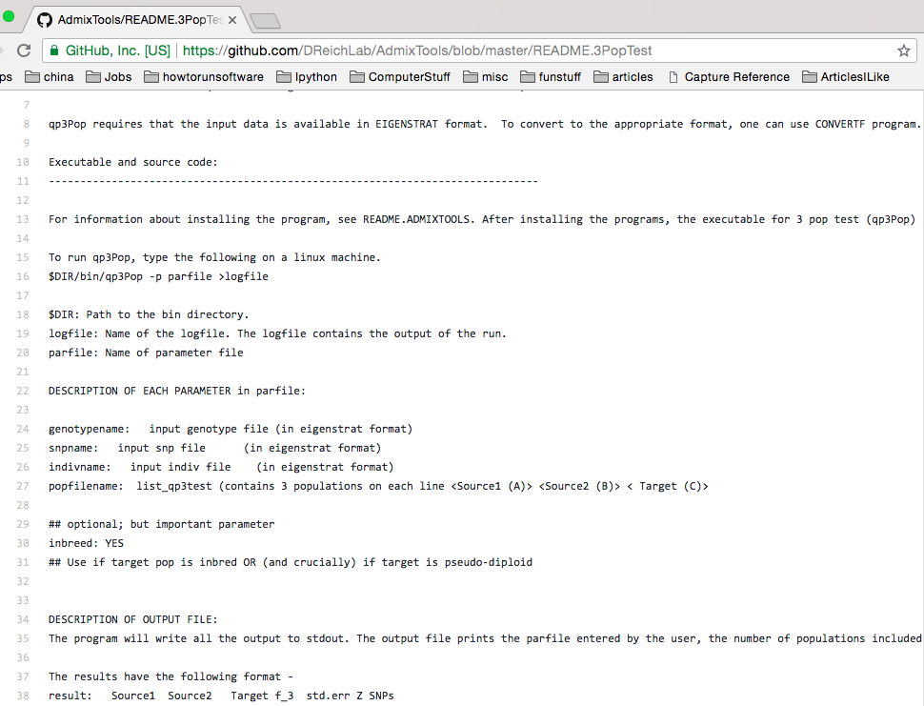
qp3Pop
https://github.com/DReichLab/AdmixTools/blob/master/README.3PopTest

Slide 9
qp3Pop
Make a pop file.
Make a par file.
Run qp3Pop –p [parfilename] > [logfilename]

Slide 10
F3(Karelia, X; Mbuti)
How should we find those populations that share the most genetic similarity to Karelia?

Slide 11
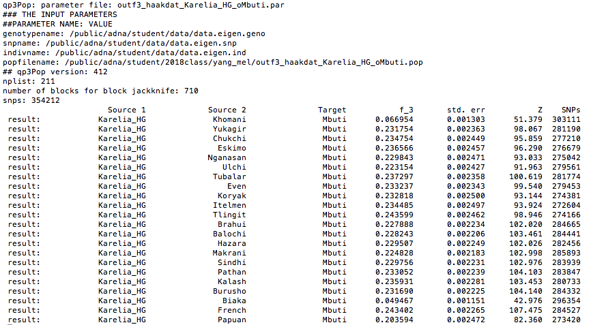
F3(Karelia, X; Mbuti)
How should we find those populations that share the most genetic similarity to Karelia?

Slide 12
F3(Karelia, X; Mbuti)
How should we find those populations that share the most genetic similarity to Karelia?
Transfer file to computer
Convert to excel
Sort
Examine

Slide 13
F3(Karelia, X; Mbuti)
How should we find those populations that share the most genetic similarity to Karelia?

Slide 14
Comparing f3 and D
D (or f4) is essentially equivalent to comparing two f3-statistics.
If F3(Karelia, X1; Mbuti)>F3(Karelia, X2; Mbuti), how do we determine is this difference is meaningful?
Use D-statistics!
Outgroup f3 is a good survey tool, but D-statistic does the actual hypothesis testing.

Slide 15
Making the pop file
I’ve provided a python script make_out f3pop.py, that takes as arguments the working directory, population to put in S1, and outgroup, and this outputs a POP file.
For each person, take one of the Haak et al. sets and get the outgroup f3-statistics for that set.
The run should take about seven minutes.

Slide 16
Ancient sets
EHG: Karelia, Samara
SHG: Motala
EN: LBK, LBKT, Starcevo, Spain_EN
MN/CA: Yamnaya, Esperstedt, Baalberge, Spain_MN
LN: Alberstedt, BenzigerodeHeimburg, Bell Beaker, Karsdorf, Corded Ware
BA/IA: Halberstadt, Unetice

Slide 17
Conclusions from outgroup f3 analysis

Slide 18
Groups – Exercise 7.3
HungaryGamba_EN (8)
Unetice_EBA (7)
BenzigerodeHeimburg_LN (3)
Bell_Beaker_LN (6)
Corded_Ware_LN (4)
Yamnaya (9)
Baalberge_MN (3)
LBK_EN (12)
Motala_HG (7)
Spain_MN (4)
Spain_EN (4)
Sweden_Skoglund_NHG (3)

Slide 19
Summarizing all the information
How does the Haak et al. (2015) paper summarize the outgroup f3 results?

Slide 20
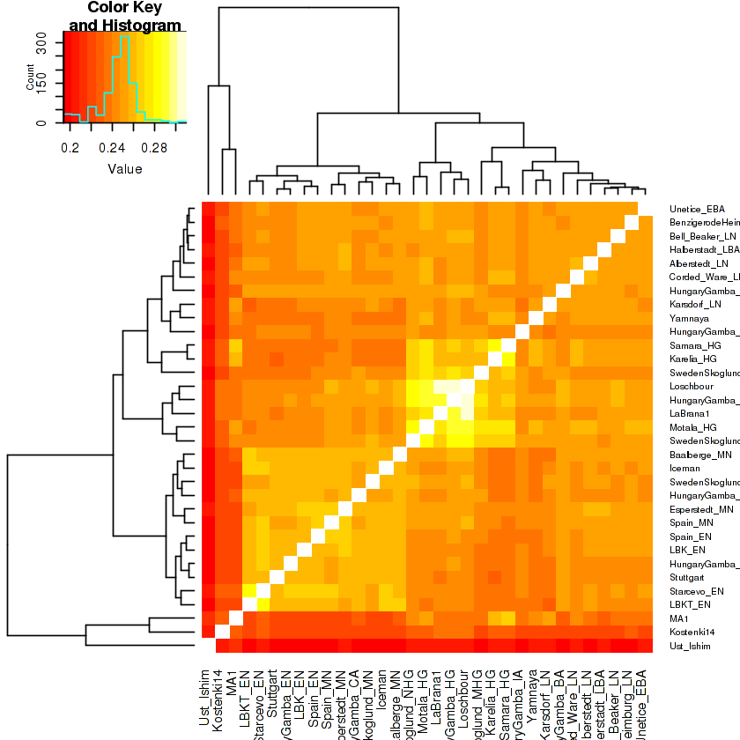
Heatmaps

Slide 21
F3-statistics
Outgroup f3-statistics were not original purpose of an f3-statistic – testing for admixture was.
The admixture test explored admixture into the the test population, which holds if F3(S1, S2; Test)<0.
No information on whether there was admixture if positive.
High population specific drift in Test can mask signal (p. 1068)
Negative result MUST mean Test is admixed, though whether the best sources are S1 and S2 is unknown.

Slide 22
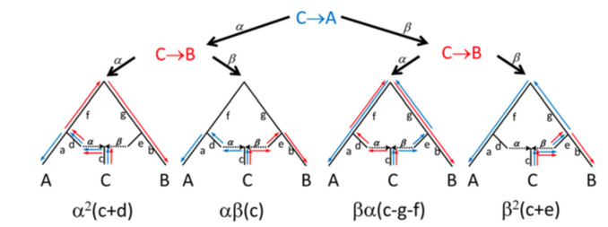

Negative f3-statistics – the admixture case, some theory
F3(A, B; C) - We need to consider all paths for admixture.

Slide 23
Negative f3-statistics – the admixture case, some theory
F3(A, B; C) - We need to consider all paths for admixture.
1. Only overlap matters!
2. Some algebra…

Slide 24
Negative f3-statistics – the admixture case, some theory
F3(A, B; C) - We need to consider all paths for admixture.
This term decides if F3 is negative!
If α or β is 0, then F3>0, while otherwise, F3 MIGHT be negative.

Slide 25
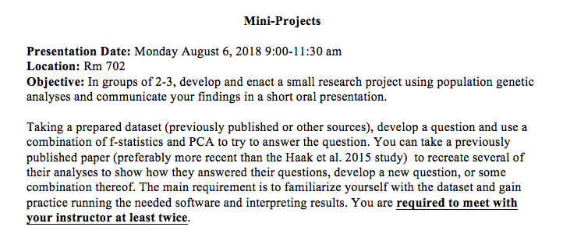
Mini-Project

Slide 26
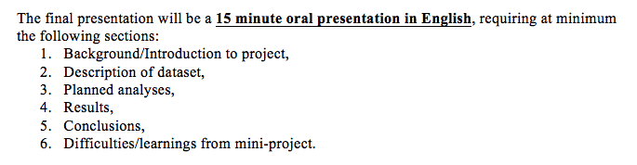
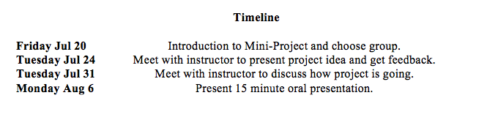
Mini-Project

Slide 27
Mini-Project
2:00 pm – Group
2:30 pm – Group
3:00 pm – Group
3:30 pm – Group
4:00 pm – Group

Slide 28
Mini-Project
Before Tuesday, explore some more recent papers, and see if there’s a region or dataset you’re interested in learning.
Highly recommend you use a dataset similar to the Haak dataset, as that way you don’t have to worry about file formats!
https://reich.hms.harvard.edu/datasets
Come with ideas, so I can help you develop them further!

Slide 29
Questions?

