Slide 1
Lesson 3: From bones to (pseudohaploid) genotypes
Wednesday July 11: 2:00 – 4:30 pm
Notes:
Have on board discussion – what are steps from bone to genotypes?

Slide 2
Many parts leading up to dataset used for analysis
Sampling of bone material
DNA extraction
DNA capture/shotgun sequencing
SNP Panels
Data Processing
Checking for contamination
Final dataset!
Screening of samples!

Slide 3
Bone material
Mostly from bony material
Best preservation, lowest microbial seems to be in petrous bone, so preferred choice
Strict lab procedures to avoid contamination, damage as little of skeletal remains as possible, and not waste materials (very little to begin with!)
Notes:
Image of petrous bone

Slide 4
Complications of aDNA
Short fragment length
Ancient DNA Damage
Environmental microbial DNA
Modern human contamination
Notes:
Image of petrous bone

Slide 5
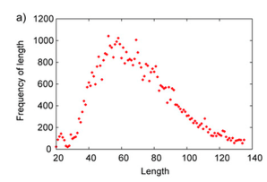
Short fragment length
Silica-based DNA extraction methods help capture more 30-50 bp fragments
Fu et al. 2013, Figure S1A
Notes:
Image of petrous bone

Slide 6
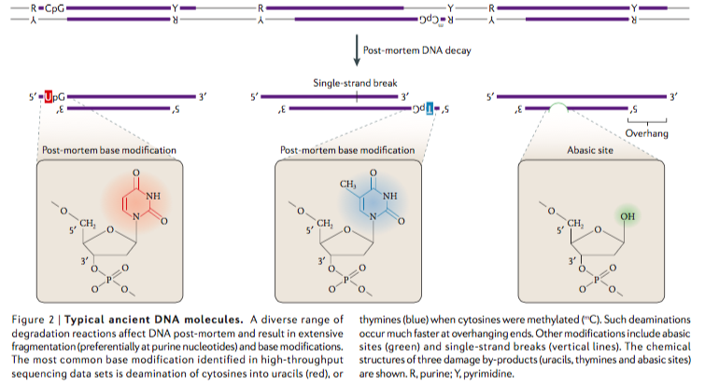
Ancient DNA Damage
Fragmentation occurs more often at purines (R)
Damage more likely at overhangs (single-stranded parts)
Most common: Deamination of cytosines
Abasic sites
Orlando et al. 2017 Figure 2
Notes:
Image of petrous bone

Slide 7
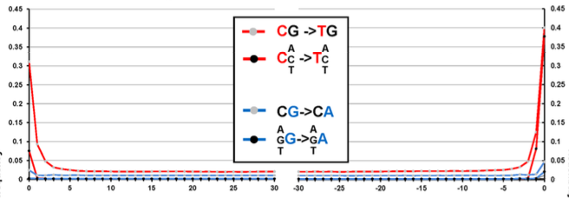
Ancient DNA Damage
Meyer et al. 2012, Figure S5
Characteristic high mutation frequency at read ends
See high deamination at fragment termini
Notes:
Image of petrous bone

Slide 8
Ancient DNA Damage
USER mix:
Uracil DNA glycosylase
Endonuclease VIII
Replaces deaminated cytosines with abasic sites and cleaves out abasic sites
Full USER-treatment – no damage left
Can also remove DNA damage except in some number of first and last positions of the reads, so possible to test for presence of characteristic DNA damage patterns, while making DNA libraries robust for popgen analysis
Transversions Only:
Remove transitions
A<->G, C<->T
Looking at biallelic sites where know alleles
Since deamination is a C->(U)T mutation, uncertain whether allele call is truly derived mutation or due to damage for A/G and C/T biallelic sites.
Notes:
Image of petrous bone

Slide 9
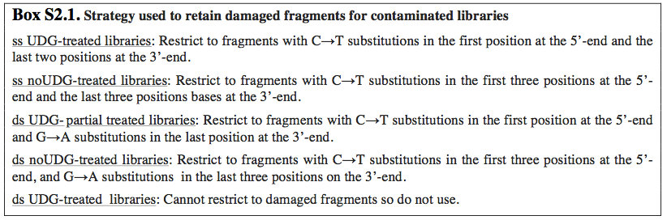
Two main library types
Double-stranded vs. single-stranded
Double-stranded is standard protocol using modern DNA
Single-stranded allows access to single-stranded fragments, which provides access to more endogenous material.
Below is the standard protocol currently used in the Fu lab for the differently prepared libraries
Fu et al. 2016, SI 2

Slide 10
Environmental Microbial DNA
Ancient DNA
Microbial DNA
~0.0003% chr21 DNA
<< 0.0001μg DNA
per gram tissue
Endogenous DNA
Shotgun sequencing very inexpensive and waste of resources!
Microbial
background

Slide 11
Target-probe hybridization: DNA Capture
Knowledge of probe
- need to know well, so usually present-day sample
- has been successful using probes that are 10-13% different from target
Customized biotinylated probes
- best for small regions (hundreds of kb to few Mb)
Microarrays
- can hold ~1 million probes
Known Adaptor Sequence
- Can amplify over and over - reusable
Ancient DNA
<< 0.0001μg DNA
per gram tissue
46.8% chr21 DNA
Endogenous DNA
What is being captured?
mtDNA
Bacterial plasmids
Short nuclear loci – SNP panels!
New techniques for whole genome capture
Microbial
background
Tianyuan, Fu et al. 2013

Slide 12
Common SNP Panels
Fu et al. (2015, Oase paper)
“390k”: 394,577 SNPs, ~90% on HO array (main set in Haak et al. 2015)
“840k”: 842,630 SNPs – rest on HO array, all SNPs on Illumina 610-Quad Array, all on Affymetrix 50k array, select other SNPs
“1000k”: 997,780 SNPs of all transversion polymorphisms in two Yoruba males or in the Altai Neanderthal (with MQ>99%) with chimp alleles available
“Archaic”: SNPs where Yoruba (1KG) are high frequency in one allele, with at least one archaic carrying alternative allele (~1.7M SNPs)
HO array: ~600k SNPs (Patterson et al. 2012)
1.2M: ‘390k’ + ‘840k’
2.2M: ‘390k’ + ‘840k’ + ’1000k’

Slide 13
bwa → SAMtools → Genotyping
Major Pipeline
Index and align fastq to reference (fasta)
Convert resulting SAM file to BAM file, including GQ and MQ filters as needed.
Convert BAM file to preferred data format (pseudohaploid calls, EIGENSTRAT?)
http://www.htslib.org/doc/samtools.html
Notes:
https://www.oagr.org.au/dataset/5
http://bio-bwa.sourceforge.net/bwa.shtml
http://quinlanlab.org/tutorials/samtools/samtools.html
http://gaworkshop.readthedocs.io/en/latest/contents/04_genotyping/genotyping.html

Slide 14
Relevant File Formats
FASTA – reference genome
FASTQ – raw read data, contains base quality scores
SAM – Sequence Alignment/Map Format – TAB delimited text format showing alignment of reads in FASTQ to reference.
BAM – Binary form of SAM, use samtools view to see information.
Notes:
https://www.oagr.org.au/dataset/5
http://bio-bwa.sourceforge.net/bwa.shtml
http://quinlanlab.org/tutorials/samtools/samtools.html
http://gaworkshop.readthedocs.io/en/latest/contents/04_genotyping/genotyping.html

Slide 15
Modern DNA contamination
Test for DNA damage on reads (before USER treatment)
Check for multiple allele calls in mtDNA
Check for multiple allele calls in non-recombining portion of X-chromosome
Pre-processing: damage-restricted fragments
Post-processing: likelihood methods
Using modern reference panels
Notes:
Ask students!

Slide 16
Modern DNA contamination
Checking mtDNA
Mapping reads to mtDNA genome
ContamMix v1.0-5
Fraction fragments matching reconstructed consensus better than pool of worldwide mtDNA sequences is low (<95%)
Lower bound of above value <85%
Checking X-chromosome in males
Base discordance between overlapping reads
ANGSD software: generates contamination estimate taking into account local sequence or alignment error from included reads.
http://popgen.dk/angsd/index.php/Contamination

Slide 17
What’s happening in Haak et al. (2015)?

Slide 18
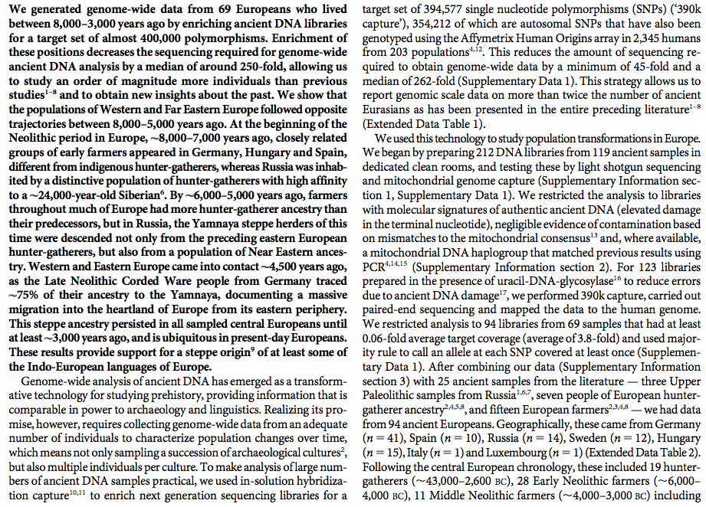
Haak et al. (2015) – 1st page

Slide 19
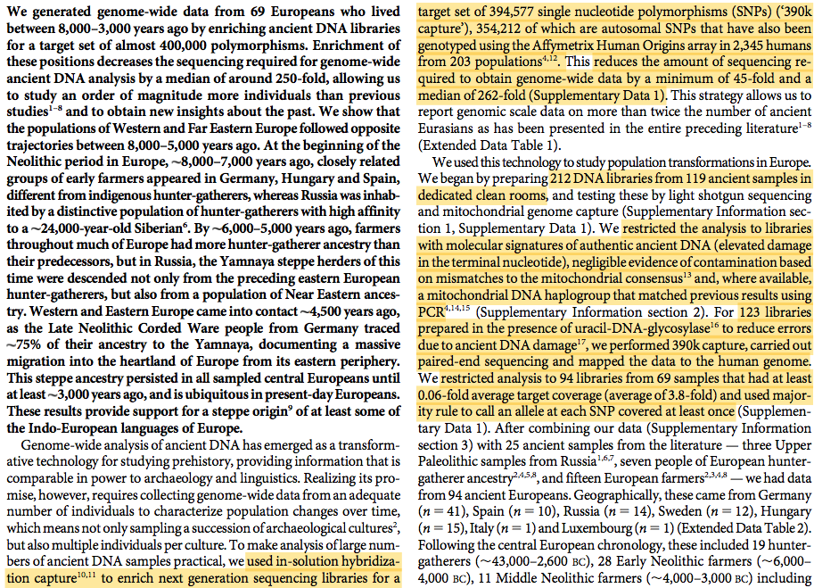
Haak et al. (2015) – 1st page

Slide 20
Haak et al. (2015) Strategy
Silica-based DNA extraction
Double-stranded library preparation with truncated barcoded Illumina adapters
No DNA damage repair – for screening
Shallow shotgun sequencing
Mitochondrial DNA capture and sequencing
Above can be used to test authenticity – do we find characteristic damage of aDNA? Tests of contamination using mtDNA
Full USER-treatment and partial UDG repair
SNP Capture on 390k dataset

Slide 21
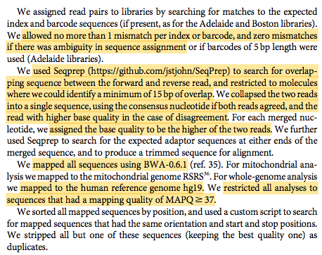
DNA Processing
Assign reads to libraries (using barcodes).
Determine sequence using forward and reverse reads with enough overlap. (Consider Base Quality)

Slide 22
DNA Processing
Assign reads to libraries (using barcodes).
Determine sequence using forward and reverse reads with enough overlap. (Consider Base Quality)
Map sequence using bwa to reference genome. (Consider Mapping Quality)
Remove duplicates.

Slide 23
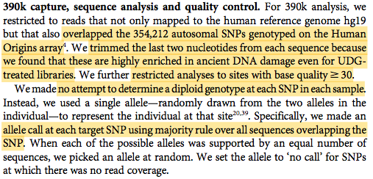
Preparing the dataset
Two things to note:
Is our sample high or low coverage? Difficult to call heterozygotes without high coverage (best if 30x, but at least >10x)
Average coverage does not mean we have every targeted SNP – if no fragment with high enough quality covers a SNP, then cannot call allele.
‘Pseudohaploid’ genotyping or allele calls – each individual is treated as haploid – one allele is chosen at random at the selected biallelic sites.

Slide 24
Exploring the Haak et al. data
EHG: Karelia, Samara
SHG: Motala
EN: LBK, LBKT, Starcevo, Spain_EN
MN/CA: Yamnaya, Esperstedt, Baalberge, Spain_MN
LN: Alberstedt, BenzigerodeHeimburg, Bell Beaker, Karsdorf, Corded Ware
BA/IA: Halberstadt, Unetice
Notes:
Haak et al D-stat results!

Slide 25
Activity
Pick new groups from the Haak et al. data
Use Supplementary Data 1 in (https://www.nature.com/articles/nature14317) to determine the average coverage for the 340k data per library, the fraction of libraries that were included for a set, mean contamination estimates, etc. If you have more time, look at other columns and see if you can understand what they mean and if there’s other interesting facts to share.
Should we add any of this information to our info file?

