Slide 1
JavaScript介绍
2019.2
Notes:
1语言：即学即用

Slide 2
TOC
JavaScript历史
浏览器中使用JavaScript →
jQuery →
Bootstrap
// 注意备注行有参考网址

Slide 3

JavaScript
JavaScript is a high-level, interpreted programming language that conforms to the ECMAScript specification.
It is a language that is also characterized as dynamic, weakly typed, prototype-based and multi-paradigm.
Alongside HTML and CSS, JavaScript is one of the three core technologies of the World Wide Web, enables interactive web pages.
Notes:
https://en.wikipedia.org/wiki/JavaScript
https://en.wikipedia.org/wiki/ECMAScript

Slide 4
related to Java
JavaScript was designed with Java's syntax and standard library in mind
both have a C-like，both typically sandboxed
all Java keywords were reserved in original JavaScript,
JavaScript's standard library follows Java's naming conventions,
Notes:
and JavaScript's Math and Date objects are based on classes from Java 1.0, but the similarities end there.

Slide 5
JavaScript: history
1993 NCSA Mosaic
Eich wrote one in 10 days, in May 1995, renamed JavaScript, deployed in the Netscape Navigator 2.0
the first edition of the ECMA-262 standard in June 1997, ECMAScript 2 in June 1998.
The 9th edition, officially known as ECMAScript 2018, was finalized in June 2018.
Notes:
https://en.wikipedia.org/wiki/Brendan_Eich
ECMA: European Computer Manufacturers Association
https://en.wikipedia.org/wiki/ECMAScript
https://github.com/tc39/ecma262 https://tc39.github.io/ecma262/

Slide 6
MS: JScript
(in 1996)JScript, a reverse-engineered implementation of JavaScript, was part of IE 3.
JScript is Microsoft's dialect of the ECMAScript standard.
JScript 10(JScript .NET) is a .NET implementation of JScript.
Notes:
https://en.wikipedia.org/wiki/JScript

Slide 7
Node.js
Node.js executes JavaScript code outside of a browser.
Node.js provide a collection of "modules" that handle various core functionality.
Node.js is primarily used to build network programs such as Web servers.
Node.js functions are non-blocking, while most PHP functions block until completion.
Node.js was built on the Google V8 JavaScript engine since it was open-sourced under the BSD license.
Notes:
https://en.wikipedia.org/wiki/Node.js
https://nodejs.org/
https://en.wikipedia.org/wiki/Chrome_V8

Slide 8
JavaScript engine: Chrome V8
V8 compiles JavaScript directly to native machine code before executing it, instead of more traditional techniques such as interpreting bytecode or compiling the whole program to machine code and executing it from a filesystem.
Notes:
https://v8.dev/
https://en.wikipedia.org/wiki/Chrome_V8
https://en.wikipedia.org/wiki/V8_engine

Slide 9
其他js engine
Blink V8
Trident(IE/MSHTML): JScript/Chakra
Gecko(Mozilla/Firefox) Spidermonkey/TraceMonkey/JägerMonkey/IonMonkey
WebKit JavaScriptCore/SquirrelFish Extreme
Presto Linear B/Futhark/Carakan
Notes:
https://en.wikipedia.org/wiki/Comparison_of_JavaScript_engines

Slide 10
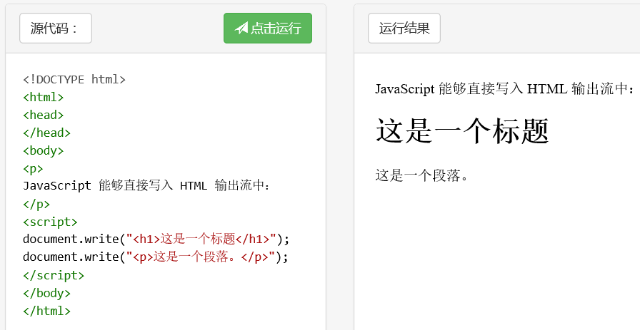
浏览器中的JavaScript 1
网页中加入js的几种形式
Notes:
http://www.runoob.com/try/try.php?filename=tryjs_intro_document_write

Slide 11
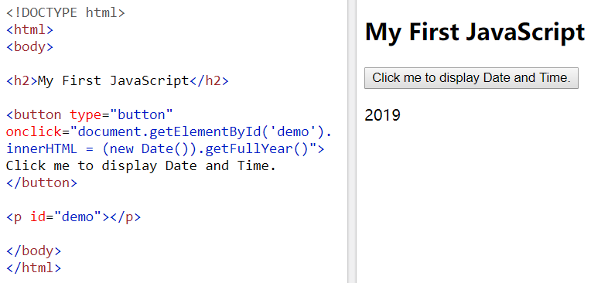
浏览器中的JavaScript 2
Notes:
https://www.w3schools.com/js/tryit.asp?filename=tryjs_myfirst

Slide 12
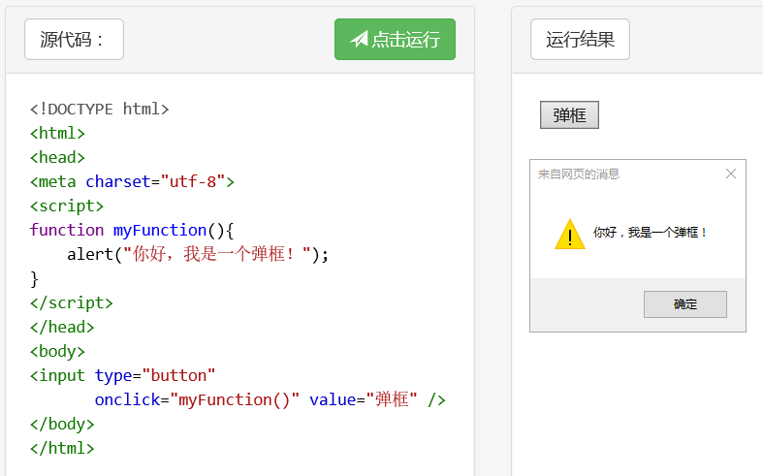
浏览器中的JavaScript 3
Notes:
http://www.runoob.com/try/try.php?filename=tryjs_alert

Slide 13

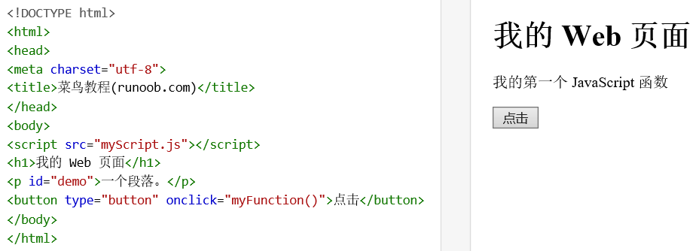
浏览器中的JavaScript 4
Notes:
http://www.runoob.com/try/try.php?filename=tryjs_externalexample

Slide 14
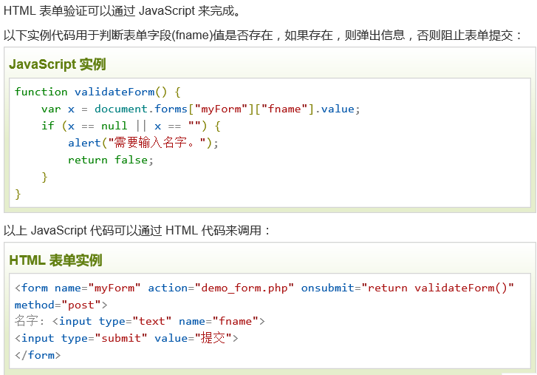
浏览器中js常用场景1

Slide 15
JavaScript数据类型
var length = 16;
var points = x * 10;
var lastName = "Johnson";
var cars = ["Saab", "Volvo", "BMW"];
var person = {firstName:"John", lastName:"Doe", age:5};

Slide 16
JavaScript函数(方法)
function myFunction(a, b) {
return a * b;}
var person = {
firstName: "John",
lastName : "Doe",
age : 6,
fullName : function()
{
return this.firstName + " " + this.lastName;
}
};

Slide 17
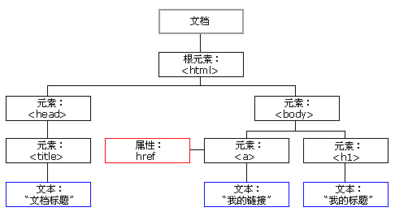
HTML DOM(文档对象模型)
文档对象模型（Document Object Model）
浏览器会在网页被加载时创建页面DOM

Slide 18
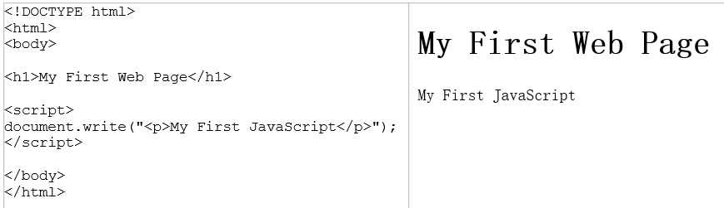
Notes:
http://www.w3school.com.cn/js/js_shuchu.asp

Slide 19
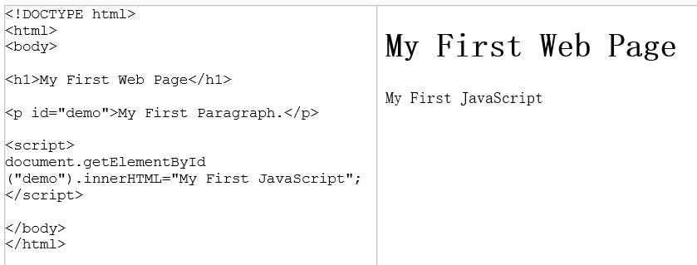

Slide 20
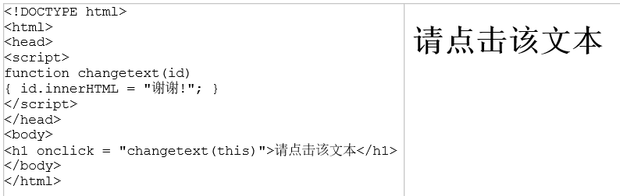

Slide 21
<div id="div1">
<p id="p1">这是一个段落。</p>
<p id="p2">这是另一个段落。</p>
</div>
<script>
var parent=document.getElementById("div1");
var child=document.getElementById("p1");
parent.removeChild(child);
</script>
Notes:
http://www.w3school.com.cn/js/js_htmldom_elements.asp
<div id="div1">
<p id="p1">这是一个段落</p>
<p id="p2">这是另一个段落</p>
</div>
<script>
var para=document.createElement("p");
var node=document.createTextNode("这是新段落。");
para.appendChild(node);
var element=document.getElementById("div1");
element.appendChild(para);
</script>

Slide 22
jQuery
jQuery是一个JavaScript库
jQuery极大地简化了JavaScript编程
jQuery很容易学习
jQuery, at its core, is a Document Object Model (DOM) manipulation library.
Notes:
https://en.wikipedia.org/wiki/JQuery
http://www.runoob.com/jquery/jquery-tutorial.html
https://jquery.com/

Slide 23
引用jQuery库
http://jquery.com/download/
http://code.jquery.com/jquery-3.3.1.min.js
<head>
<script src="jquery-1.10.2.min.js"></script>
</head>
Notes:
http://apps.bdimg.com/libs/jquery/2.1.4/jquery.min.js
https://lib.sinaapp.com/js/jquery/2.0.2/jquery-2.0.2.min.js

Slide 24
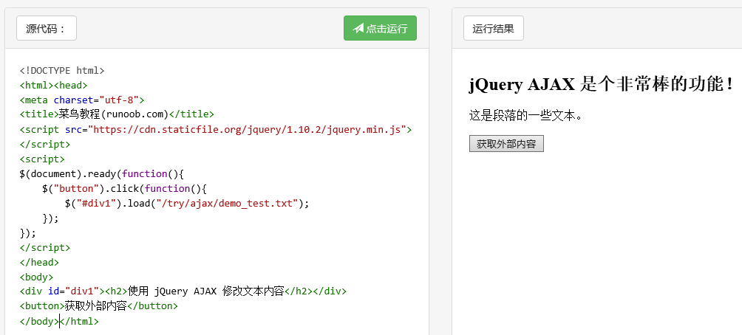
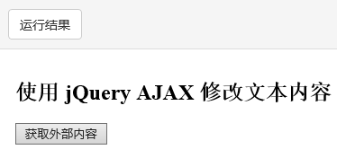

jQ效果举例
Notes:
http://www.runoob.com/try/try.php?filename=tryjquery_ajax_load
点击“获取外部内容”之后，“http://www.runoob.com/try/ajax/demo_test.txt”中的html片段被用于替换div1部分。

Slide 25


Slide 26
Bootstrap
Bootstrap，来自Twitter，基于 HTML、CSS、JAVASCRIPT，简洁灵活，使得 Web开发更加快捷，是受欢迎的前端框架。
https://www.bootstrapcdn.com/
为什么使用 Bootstrap？
  移动设备优先；
  主流浏览器都支持；
Notes:
https://stackpath.bootstrapcdn.com/bootstrap/4.3.1/css/bootstrap.min.css
https://stackpath.bootstrapcdn.com/bootstrap/4.3.1/js/bootstrap.min.js
https://stackpath.bootstrapcdn.com/bootstrap/4.3.1/js/bootstrap.bundle.min.js

Slide 27
响应式Web设计
Responsive Web design
是一种网络页面设计布局方法，其理念是集中创建页面的图片排版大小，可以智能地根据用户行为以及使用的设备环境进行相对应的布局。
Notes:
https://en.wikipedia.org/wiki/Responsive_web_design
Responsive Web Design, Ethan Marcotte
https://book.douban.com/subject/6521003/

Slide 28
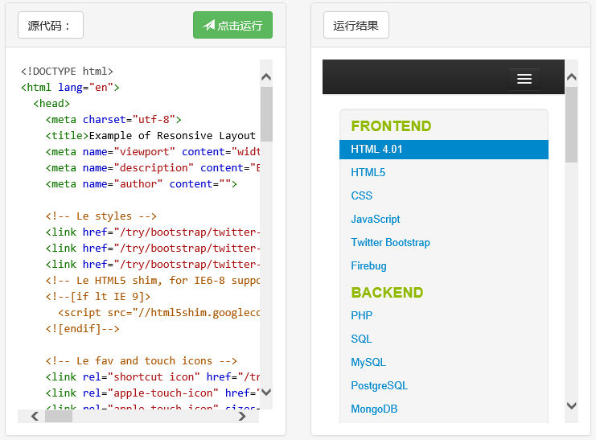
效果对比1
Notes:
http://www.runoob.com/try/try.php?filename=bootstrap-responsive-design

Slide 29
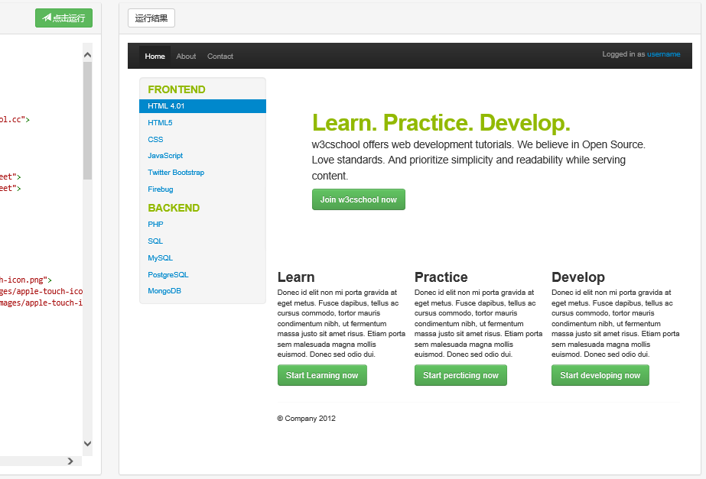
效果对比2
Notes:
当浏览器窗口变宽以后，自动多栏效果。

Slide 30
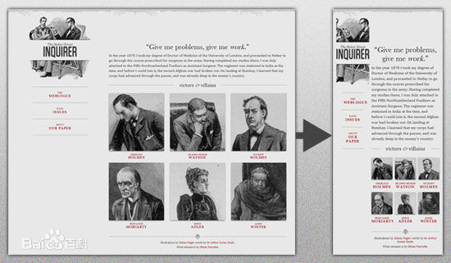

Slide 31
Q & A

