Slide 1
Python Introduction
Lecture 2 – theory

Slide 2
Python Interpreter?
Python is an interpreted high-level language
This means it uses an Interpreter to read the code from a Python file
The C++ is also high-level language but it compiles the code ( meaning it will turn the human understandable code into Machine Code

Slide 3
Python Interpreter?
Python on the other hand will translate the code into bytecode and this file have an extension (.pyc)
Python Interpreter comes with the Installation of Python

Slide 4
What is the difference compilation file and bytecode file?
The compilation file (from C++ for example) will be executed on the CPU
Python Interpreter uses a Virtual Machine known as CPython VM
This gives us power to execute this file on any operating system

Slide 5
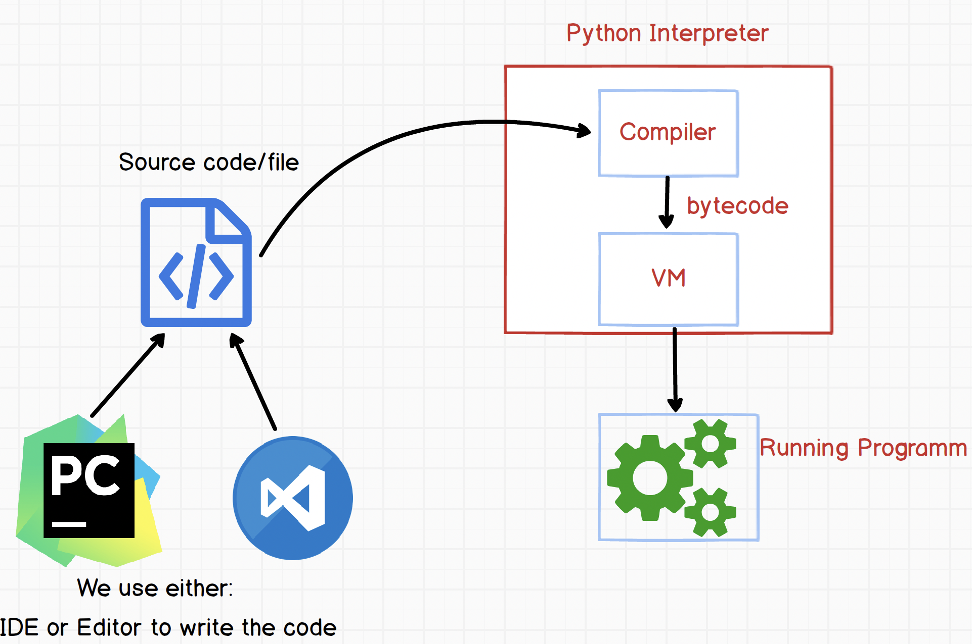
Here is the entire process

