Slide 1

Web Connection Security
Basic strategies for creating Secure Web Sites
Rick Strahl
West Wind Technologies
www.west-wind.com
www.west-wind.com/weblog
Session materials:
https://github.com/RickStrahl/swfox18_WebConnectionSecurity

Slide 2
Areas of Vulnerability
Web Security
Web Server Security - IIS
TLS Encryption
Authentication
Physical Access & Network
Who can get at the box?
Who can hack into the system
File system Permissions
Web Application Identity
Operating System
Who can access files on the machine
Middleware Technology
Who can hi-jack the application
Spoofing

Slide 3
Web Server Security The First line of defense

Slide 4
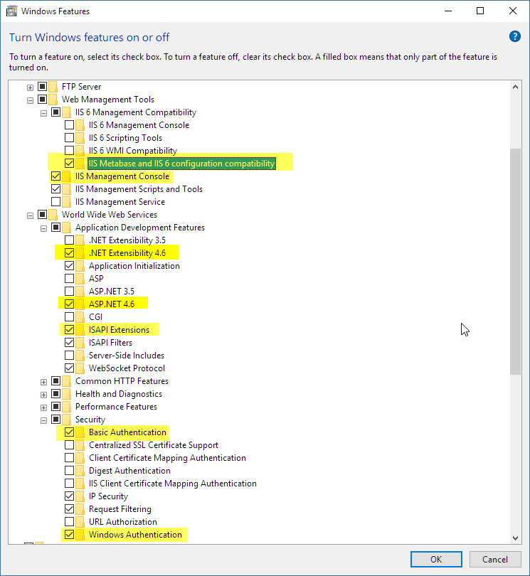
IIS Security
IIS – Secure by Default
Base Install has few features
Add only features you need
Install only what you need
Windows 10-7: Use Windows Features
Windows Server: Use Server Manager
Or: Use `install-iis-features.ps1` script
Required for Web Connection
.NET Support or ISAPI
Authentication: Basic and Windows
IIS 6 Metabase Compatibility (for auto config)
Optional and Useful
Tracing (Failed Request Traces)
Request Filtering
Static Content Compression

Slide 5
IIS -> Web Connection Application Hierarchy
Windows OS
Web Connection Server
YourApp.exe (1)
Launched via COM or as EXE
Can inherit Identity
Or: set via DcomCnfg
IIS Management Service
launches AppPools
Monitors for crashes/limits
restarts failed AppPools
Application Pool (1)
w3wp.exe
Host Process has its own Identity
Application Pool (2)
w3wp.exe
Host Process has its own Identity
Web Connection Server
YourApp.exe (2)
Launched via COM or as EXE
Can inherit Identity
Or: set via DcomCnfg

Slide 6
Web Server (IIS) and Identity
What Account is Running your Application
Application Pool is an IIS Host process for an application: w3wp.exe
Application Pool Identity determines rights of the Web site/virtual
Your FoxPro Server has its own Identity
The FoxPro server can and usually should inherit the App Pool Identity
COM: Always Use the Launching User
Let IIS Application Pool Determine Process Identity
One place to configure Identity
Prefer over setting DCOM Identity in COM
Don’t use Interactive for Production
IIS Shouldn’t run with a Console Open in Production
SYSTEM and Admin accounts run as is
NETWORK SERVICE is a good limited account to run
Do you need DCOM Config?
SYSTEM or Admin account: No
Any other account: Yes
Add user to Launch and Access rights

Slide 7
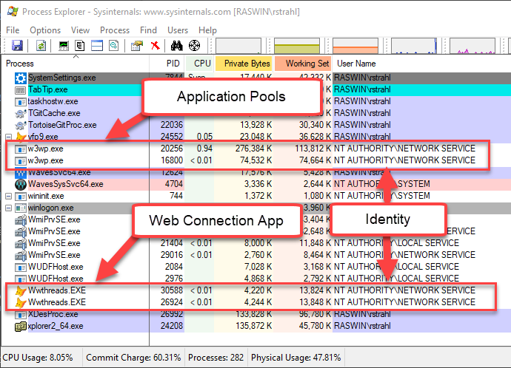
Application Pools and Web Connection Identity

Slide 8
DcomCnfg Sucks But… it’s not that bad!
What is DcomCnfg
Set Launch and Access Rights to any EXE COM server
Works fine for Desktop usage (Interactive is allowed)
Only Interactive can run visibly on the Desktop
For servers it may require configuration
DCOM Identity
Default Identity is the Launching User
Don’t change the DCOM Identity
Let IIS provide the Identity
Launch and Access Permissions
Configure Launch/Access *only if necessary*
SYSTEM, Adminstrators and INTERACTIVE just work
All other accounts have to be added
On the specific Server
Or for the specific COM Server
Make sure you run 32 bit version for FoxPro Servers: MMC comexp.msc /32

Slide 9
File System Security
IIS Maps Identity to Windows Credentials
Identity determines File System Access
Running under SYSTEM or Admin opens the entire system
SYSTEM is easy – it just works, but it’s not secure in case of hack
Mitigate Security
Use a reduced rights account
NETWORK SERVICE is a good low rights service
Or: A custom configured account
Make sure to add to System DCOM Launch Access settings!
Give local folder access only where access is needed
Typically: Web Folder + data folders
For SQL Server on remote servers use uid/pwd rather than Windows Auth
Is High Rights a Problem?
If you don’t get hacked? No.
But if there is a way into your app, attackers can roam the entire system

Slide 10
File System Access Guidelines
Choose a limited Application Pool Account
Read/Execute Access to Web Folder
Read/Execute Access in Application Folder
Read/Write Access in Data Folders
Better: Use a SQL Backend to not keep data local
Don’t allow Write Access in Web Folders
File Uploads can potentially write files accessible after upload
This avoids an accidental download to be accessible
If you do need write access do so selectively in a special folder
Optional: Read/Write web.config/wc.ini to persist config settings
Don’t allow Write Access in your Application Folders
Prevents possible overwriting of existing code or binaries
Exception: Data Folder – Data needs to read/write

Slide 11
Isolate your Data
Don’t allow direct access to Data from the Internet
Any data you access should preferably sit on a separate machine
Not accessible from the Web directly, only via internal machines
Requires a two-step hop to attack
Sql/NoSql Servers
Don’t expose servers to the Net directly (no open ports)
If you need to access internally use a VPN
If you really feel you must, use very strong uid/password combos and change them frequently
FoxPro Data
If you use FoxPro data remove rights only to users that need access
Preferrably store data off the Web Server
Remote shouldn’t be accessible directly from the Net

Slide 12
Protecting your Data
Securing your Data

Slide 13
Certificates: Protecting Traffic on the Wire
Encrypting Traffic with SSL/TLS
Encrypts data sent
Encrypts results
Doesn’t Validate the Hosting Site
No more excuses: SSL All the Things
Prevents Man-in-the-Middle Attacks
Any Authentication requires SSL
Lack of Certs cause SEO down-rankings
SSL/TLS Certificates
Have to be acquired from Certificate Authority
Have to be installed into Web Server
It’s free and easy with LetsEncrypt

Slide 14
SSL/TLS Certificates (continued)
Types of Certificates
Single Domain Certificates
Wildcard Certificates: Single Cert for all Sub-Domains
Use case: Multi-Tenant Web Sites
weblog.west-wind.com
support.west-wind.com
Getting Certificates
LetsEncrypt: Free certificates for single domains
Many providers can provide paid certificates (but why pay?)
Wildcard Certificates are usually not free
I use DnSimple - $100 for Wildcard certificate
LetsEncrypt
Free and easy to install and update
Use: LetsEncrypt-WinSimple Tool
Single step Command Line Install
Automatic updates (every 3 months)

Slide 15
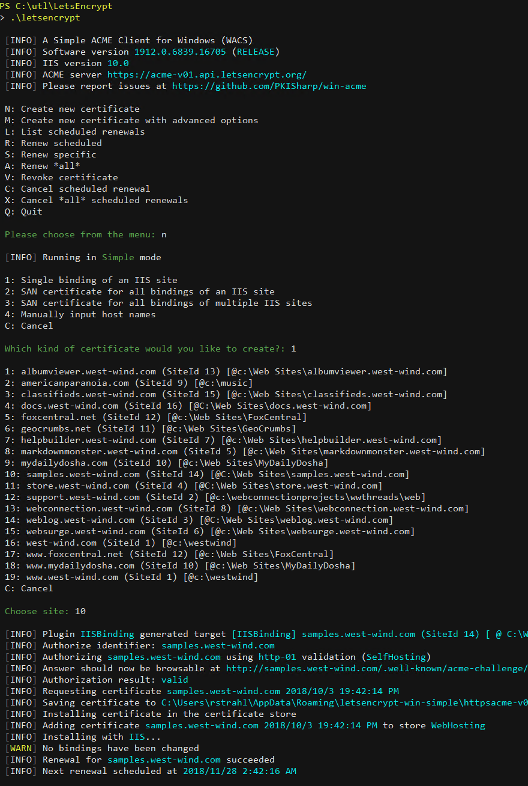
Lets Encrypt – Free Certificates
Free Single Domain Certificates
Open Source Free Service
Provided by Mozilla, Open Web Foundation and many more
Totally free and uncontrolled
ACME Protocol – Automating Certificate Management
Open Source Certificate API
Domain Validated – has to run on DNS Mapped Domain
Create, Revoke and Renew Certificates
Can be fully automated
Certificates installed in IIS in minutes!
Automatic renewal via tooling
Windows: Win-Acme (formerly LetsEncrypt-Win-Simple)
Single Executable, pick Web Site – Done!
Scheduled task to Renew expiring Domains
Latest Release: https://github.com/PKISharp/win-acme/releases

Slide 16
File System Security
Use a non Admin Identity
Create accounts with just the rights you need
Use that account for your Application Pool Identity + Fox Server
Most important defense
Locks out intruders, IF somebody should get in
Allows user/group access to resources
Minimize Users on Web Servers
Prefer LOCAL accounts over Domain accounts
Uses NTFS file/directory permissions
NTFS allows security on directories and files
Set with Explorer (ACL)
Cascading support
Web directories: Make sure IUSR_ has Read/Execute access
Remove/Deny IUSR_ for Admin/locked out directories

Slide 17
File Uploads: A common Attack Vector
File Uploads are Dangerous
File uploads can send malicious code to the server
Double and Triple check all file uploads
Know where you uploads are going
Ensure that uploads can’t send binaries or scripts
Be ProActive
Protect upload behind authenticated logins
Accept only specific file types
If you’re expecting an image, accept only images
Never store binaries/zip files in Web accessivle locations
Don’t make uploads available for download as is

Slide 18
Protecting your Application
Restricting Access to your Application

Slide 19
Web Authentication
What's Authentication
Checking that the user is who she says she is
Securing content based on Authorization
Custom Authentication (Web Connection)
wwUserSecurity
You control access via logic
You can validate against a database
You can use custom UI
Sublcass to extend base behavior
Recommended appraoch
Store user accounts as encrypted
Basic Authentication / Windows Auth
Uses Windows accounts/groups
Handled by IIS and Windows
You get notified whether user is logged in
Basic Authentication is not secure: Password travels as plain text

Slide 20
Basic/Windows vs UserSecurity
Web Connection supports two Auth Mechanisms
Basic/Windows Authentication
Based on Windows User Account
Easy – nothing to set, just works
Doesn’t scale – Windows user management not appropriate for Web apps
User Security
Uses a Cookie and Session to map User
Uses FoxPro class for logic
Uses FoxPro table by default
Meant to be subclassed for application specific customization
Don’t use Basic/Window Auth for Public Sites
UserSecurity is the way for public facing User management
Only use Basic/Windows auth for internal use or Admin blocking

Slide 21
Application Security
Server based Web Applications
Custom Authentication is the way to go
wwUserSecurity: You implement logic
Full control
Windows Authentication – good for admin interfaces
Basic Authentication – uses Windows accounts too
Token based Security for APIs
Login to retrieve a token
Use the token for subsequent access
More secure than passing uid/pwd each time
Tokens expire
Requires: Login/Logout endpoint and token mapping

Slide 22
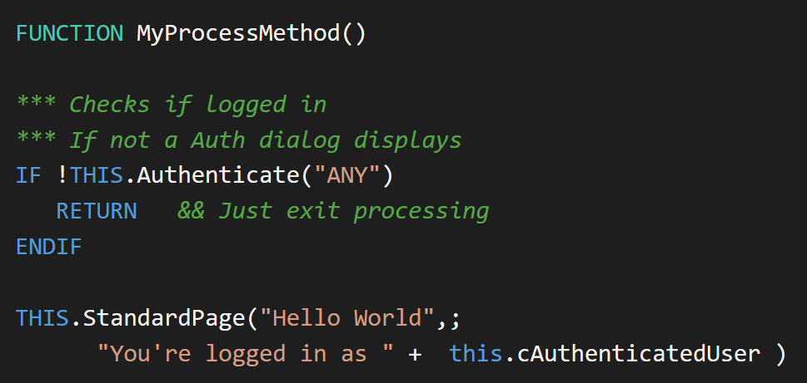
Simple Authentication

Slide 23
wwUserSecurity
Class and Databased Security
Basic implementation in wwUserSecurity.prg
Accesses database for validation (UserSecurity.dbf)
Simple Username, Password storage
Uses Session to persist (_LoginName)
Meant to be subclassed by your application to implement custom logic
Features
Support for password encryption
Add/Update/Delete/Load User
Extensible
Extend by subclassing wwUserSecurity
Process.cAuthenticationUserSecurityClass
Override Authenticate method
Use oData member

Slide 24
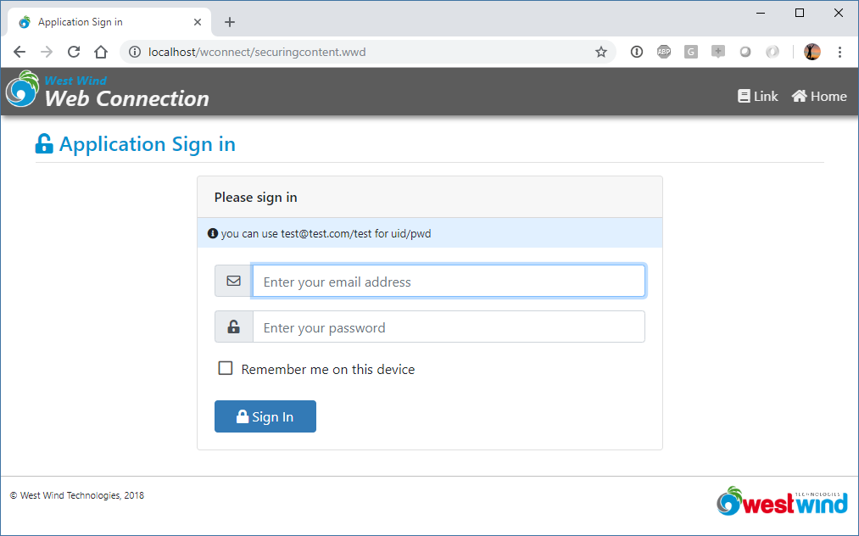
Very Limited UI Support
User Security requires HTML UI
Application Managed UI
You’re expected to create the User UI
Only Login Support
Only supports Authenticate() behavior
Shows Login form
No Support for:
Adding a User
Password Recovery
Change Password
New User Validation
Separate UserSecurity Sample Project

Slide 25
Security Customization in WWWC
Override wwUserSecurity
Allows overriding verification process
Replace wwUserSecurity.Authenticate() method
Perform whatever lookups required to auth
Overriding wwProcess Authentication Methods
Allows overriding of verification process
Allows overriding of visual process
Implement in your subclass of Process
Override OnAuthenticteUser() for custom code only login logic
Override Autenticate() for login logic including UI processing (high level)
Override OnAuthenticated() when a user is validated or logged in (every request)
Override OnShowAuthenticationForm() to override UI
Make sure to set: WebLogin_txtUsername, WebLogin_txtPassword

Slide 26
User Security Manager Sample
User Security requires additional Components
New User Profile Page
Password Recovery
User email verification
User Management to lookup, add, edit and delete users
UserSecurityManager Sample
Drop-in Process class
.usm extension maps to separate process class
Handles above tasks
Integration
Manually added to another project
Copy process class
Hookup .auth scriptmap and map to process
Copy Page templates in usermanager folder to Web site

Slide 27
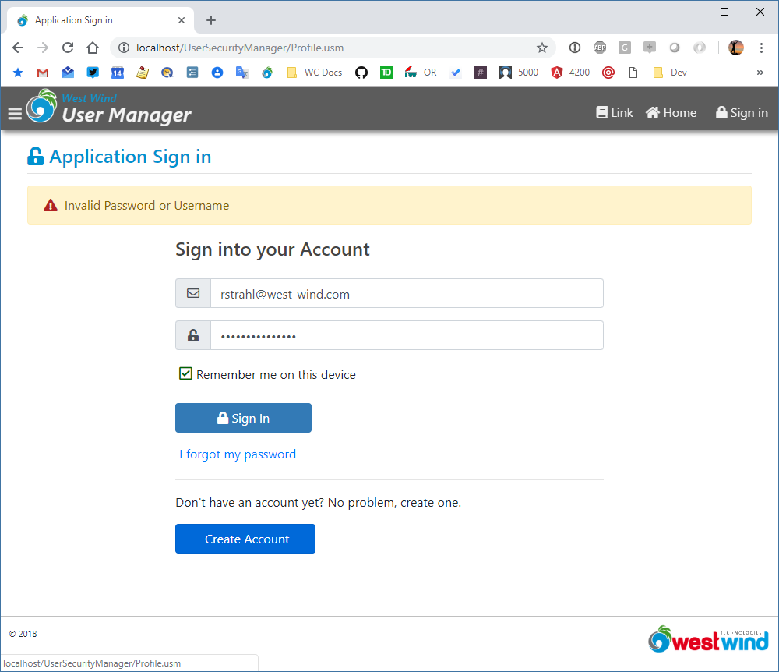

Slide 28
Locking down Web Connection
Areas of Concern
Your Application
Web Connection Administration Tools
Application
Applications are responsible for their own security
Use wwProcess.Authenticate to lock down individual requests
Web Connection Admin Security
Make sure to limit access to ~/Admin Folder
Remove IUSR_ Account from Windows Folder Security
Will force a login to access Admin.aspx page
Make sure to set AdminAccount in web.config or wc.ini
Default is ANY – change to specific account(s)
Will force login to access .NET or ISAPI Handler Admin Page

Slide 29
Script Attacks
The Devil’s in the User Input

Slide 30
SQL Injection – an old favorite
Hi-jack SQL commands
Add 'parameter' that extend a SQL command
Inserts code or functions into SQL
Potential to run VFP code
Common scenarios
QueryString/Form as direct SQL parameter
Susceptible only if you use String SQL commands
Workarounds
Use named parameters (?lcValue) where possible
Check QueryStrings and Form retrievals
Use [ ] as your string separator and filter [
Stick parameter 'in the middle' of SQL
Never, ever build literal strings for SQL code No: [select * from t where name = '] + lcName + [']
Instead use named parameters or variables Yes: [select * from t where name = ?lcName] Yes: [select * from t where name = lcName]

Slide 31
XSS – Cross Site Scripting
XSS Works by
Malicious user putting script into some input
Undetected script gets ‘rendered’ onto the page and executes
Page is compromised with nefarious code execution
Code sends data from page to another site
Script Attacks Can
Capture sensitive page data
Capture and broadcast cookies/Auth tokens/Credentials
Executing Unwanted Script on your Pages
User input must be checked for
<script> tags, Javascript: tags, onXXXX events on Elements
Preventing XSS Attacks
Best practice: Encode all captured input by Html Encoding
Use EncodeHtml() in code
Use <%: %> in Scripts/Templates (html encodes implicitly)
Strip all script code – SanitizeHtml() function in WC 6.25+

Slide 32
Mitigation

Slide 33
Checking for hacks
Use the logs
Web Connection Log
IIS Log
Patterns of access can tell a lot
Tell Tales
Attacks usually start with errors
Attackers tend to work to figure things out
Monitor errors carefully and examine
Set up your app to send you emails on errors

Slide 34
Responding to getting hacked
Too late, Too Late
If you got hacked it's usually too late
So: Be proactive in protecting your site and your data
Watch some videos on OWASP
Learn about some of the common ways you can get attacked
Lock out IP Addresses
If you can identify attacker start with locking out the IP addresses
If it continues shut the Site down
Better to be down than `leaking`!
There's nothing worse than compromising information
Customers will never forgive security breaches
It's illegal!
Hacking for malicious reasons is a crime
Contact the authorities
Even though chances are slim at least if you do find out who is responsible you have recourse

Slide 35
Thank you!
Resources
Github: Source Code, White Paper and Slides https://github.com/RickStrahl/SWFOX18_WebConnectionSecurity
Contact Rick
@RickStrahl on Twitter
https://weblog.west-wind.com
https://west-wind.com/wconnect/weblog/
rstrahl@west-wind.com

