Slide 1
Marking up the World with Markdown simple text based editing for Html content
Rick Strahl
West Wind Technologies
west-wind.com
weblog.west-wind.com
session materials: https://bitbucket.org/RickStrahl/swfox18_markdown

Slide 2
What is Markdown?
HTML Editing is a Pain
HTML Tag Soup
Direct editing of HTML for anything but layout is futile
Markdown represents HTML as Text
Text based markup language
Uses simple directives to represent common HTML concepts
Simple syntax that’s easy to learn
Very portable
Sharable
Great for developer text
Markdown and HTML
Markdown syntax supports limited HTML features
Markdown is a superset of HTML

Slide 3
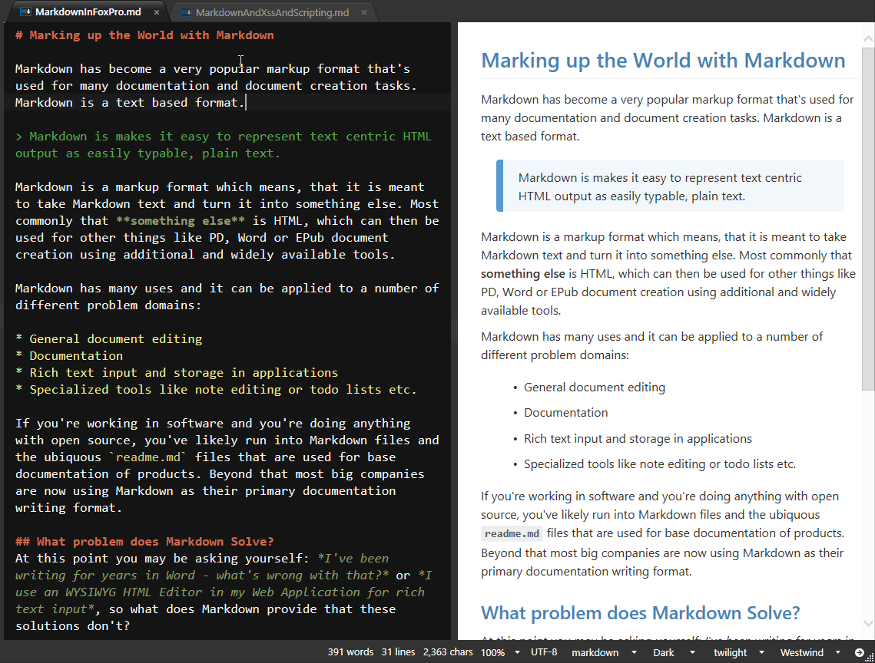
What does Markdown Look Like?

Slide 4
Why Markdown
Plain Text
No special Editors
Notepad or Editbox works
HTML represented as plain text
Simple
Easy to learn
Easy to type and edit
Raw Document Editing
You always see the raw Markdown
Any tooling adds raw Markdown you can look at and learn from
Productivity
Plain text is less distracting
Fast for writing

Slide 5
Why Markdown (continued)
Edit with any Editor
No special tooling required
Use Notepad, an Editbox or <textarea> on the Web
Easy to Compare and Share
Plain text works great for Source Control Merging
Documentation solutions *love* Markdown
Most source code repos render Markdown as HTML
Fast
Markdown is edited as plain text
Plain text allows for fast and efficient editors
Developer Friendly
Works with any text editor – including your favorite!
Easy support for code block embedding as plain text
Markdown is portable – easy cut and paste

Slide 6
Markdown for Documentation
Markdown is everywhere for Documentation
Uquititous for developer documentation solutions
Github, BitBucket have native Markdown rendering support
Editing and preview support
Documentation Solutions
docs.microsoft.com
Angular Docs
ReadTheDocs
KavaDocs
All use Markdown for editing of documentation content
Easy to Compare, Easy to Share
Markdown is text and so can be merged with Git
Markdown documents are easy to share in source code repositories
Source code repos have native Markdown rendering support

Slide 7
Markdown as static Web Content
Markdown is HTML
Markdown is easier to create than HTML
Useful for non-layout blocks of text or entire pages
Unlike HTML, can be edited by non-technical people
HTML Islands
Small blocks of Markdown inside of larger documents
Useful for largish blocks of text
Great for static sites
Easier to maintain than HTML text
Markdown Documents
Similar to the way Github/BitBucket serve Markdown
Simple to create pages on disk and served as Web content
Load Markdown output into a page/site template

Slide 8
Markdown for Applications
Anywhere you need rich text input
Replace text edit fields with Markdown fields
Useful both in Web or Desktop applications
Web and Desktop Apps
Natural fit for Web applications
Easy to build a mini editor in TextArea
Capture markdown and simply render out on display
Desktop can use Web Browser Control to preview output
Application Use Cases
Product catalog for an inventory system
User notes for any CMS style application
Messages posted to a support message board
Classifieds listings
Documentation system where Markdown is stored in a db

Slide 9
Markdown in Web Connection
Markdown is a perfect fit for Web Apps
Web Connection has built in support for Markdown
Markdown Parsing
Markdown Snippets in Scripts
Markdown Page Handler
Web Connection Markdown Features
MarkdownParser class
MarkDown() function
<Markdown></Markdown> in Scripts/Templates
Any static Markdown file with an `.md` extension rendered to HTML

Slide 10
Markdown in FoxPro
Using MarkDig .NET Parser

Slide 11
Markdown Parsing
Markdown has to be parsed to HTML
Markdown is just formatted text
Markdown has to be turned into HTML to be useful
Markdown can also be turned into other formats (PDF, WPF Layout etc)
You need a Parser to Convert
Recommend using .NET with wwDotnetBridge
Several parsers are available
Parser of Choice: MarkDig .NET Parser
Very fast processing
Provides many Markdown Extension features in box
Easily extensible for custom features
Creating a Wrapper MarkdownParser Class
Provide a class for encapsulating .NET logic
Provide a simple Markdown() helper function

Slide 12
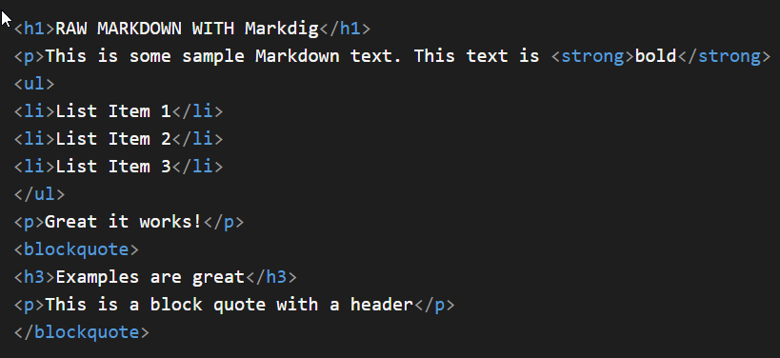
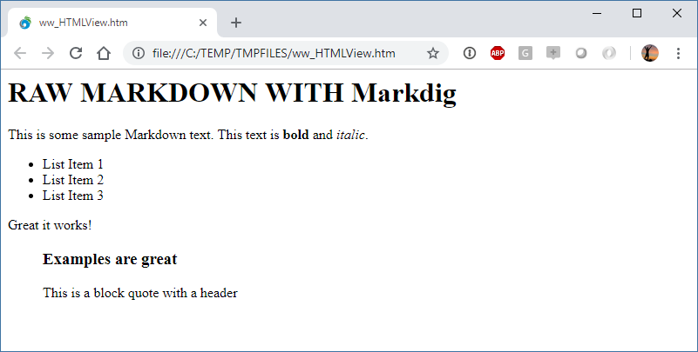
Markdown Output is an HTML Fragment

Slide 13
Styles need to be applied

Slide 14
HTML Sanitation
User Markdown Input is Dangerous
Markdown is HTML – raw HTML is allowed
Treat Markdown Input as you would raw HTML Input!
Sanitize your HTML
It’s important to sanitize Markdown user Input
XSS Attacks
Remove <script> tags
Remove javascript: directives
Remove onXXX events

Slide 15
Markdown Usage Examples
Ways that I use Markdown on a regular basis

Slide 16
Source Control
Social Source Control Sites
If you look at recent Open Source Projects: Docs and announcements are in Markdown
Github, BitBucket, Visual Studio Online etc.
Markdown is ubiquitous for documentation
Any repositories using GIT tend to use Markdown
Documentation
Markdown use for all announcement and documentation
Project descriptions
Changelogs
Documentation
Wikis

Slide 17
Documentation Creation
Markdown as a Documentation Format
Easy to write
Easy to integrate into Tooling
Raw Markdown Documents
Support in Source Code Repositories
All support direct display of Markdown as HTML
Specific tools for Documentation
Github Wikis, Atlassian Docs
Dedicated Tools
Tools can make documentation creation easier
Easier topic linking
Helpful tooling to bring in external content (images/links)
Doc Tools I’ve Built using Markdown
Html Help Builder
KavaDocs
Markdown Monster

Slide 18
Code Snippets and MicroBlogging with Gists
GitHub Gist
Code Snippet Sharing Site
Post code – share link on Social Media/Email
Snippets are API accessible and are embeddable
Has support for Markdown
Use Cases
Obviously: Code Snippet Sharing
Micro-blogging: Quick way to publish Markdown Content
Online Markdown Storage
Extended Code Snippet Sharing
Prefer to use Markdown than specific file syntax
Use Markdown instead of specific Code Snippet
Use Gist as Shared File Storage
Use Gist to store Markdown for say a Blog post
Application can load the Markdown from Gist via API

Slide 19
Application Integration
Markdown for any Memo style Text
Any application that stores block text can benefit from Markdown content
Application stored Text
Inventory Item Listings on a Web Site
Message board Topics
Examples:
Html Help Builder – Topic fields use Markdown
KavaDocs – Using Markdown files (plus Yaml headers) for docs
Web Store – Inventory descriptions as Markdown
Message Board – Message content stored as Markdown

Slide 20
Static Web Site Management
Markdown is great for Web Content
About Pages
Privacy Policy
Content as Markdown
Example: Host your own Blog
Simply publish Markdown file + images to your site
Markdown Parser that knows to render .md files
Find a useful folder structure: https://mySite.com/posts/2018/09/17/My-Title.md

Slide 21
Thank you!
Resources
BitBucket: Source Code, White Paper and Slides https://bitbucket.org/RickStrahl/swfox16_signalr
Sample SignalR Site (up for a short while after SWFox17) http://signalrswf.west-wind.com
Contact Rick
@RickStrahl on Twitter
https://weblog.west-wind.com
https://west-wind.com/wconnect/weblog/
rstrahl@west-wind.com

