Slide 1
Enhance your Web Applications with VueJs incremental enhancements with VueJs
Rick Strahl
West Wind Technologies
www.west-wind.com
www.west-wind.com/weblog
Session materials:
https://github.com/RickStrahl/SWFOX2019_VueJs

Slide 2
Server Side or Client Side?
Server Side
Single Page App
Content Heavy
Highly indexed content (SEO)
Simple data entry
Single focus operations
Server side tends to be easier to build
Examples:
E-commerce Sites
Message Boards
Site Administration
Reporting Sites
Simple management interfaces
Highly interactive Apps
Dynamic data
Lots of data entry
Many components on a single page
Client side tends to be more complex
Examples:
Insurance claim forms (lots of fields)
Auto-parts management (dynamic)
Dashboards
Games
Desktop Replacements
Streaming content

Slide 3
Hybrid Applications
The best of both worlds
Mixing Server Side and Client Side
Render most content on the server
Enhance incrementally with JavaScript
Development with App Silos
Rather than one big SPA – create smaller App Silos
Allows breaking complex apps into smaller pieces
Easier to work with and maintain than one big massive SPA
Useful for:
Content heavy sites that needs some dynamic features
Existing server sites that need to add interactive forms
Ideal for existing sites or sites that work well as server apps

Slide 4
The Modern JavaScript Dilemma
JavaScript used to be a toy
Originally designed for scripting simple things
Initially hampered by a laughable feature set
JavaScript has matured
Many language improvements
Javascript is now the most popular development language
Client side and server side (NodeJs)
ES 2015+/ES6+ adds many language enhancements
JavaScript has been blazing fast – the browser is the runtime
Complexity has grown Exponentially
Modern frameworks require build systems
No more simple add a script and run some code – you have to build
You have to pick a framework – and there are many choices

Slide 5
Taking a Stand
You have to make choices
Pick what works for you
Different models for different apps
For Hybrid Apps (Page Silos)
jQuery is still a good choice for simple page manipulation and AJAX
jQuery controls exist for almost anything
Less relevant today as DOM includes many features
VueJs for page level ‘apps’ that require data binding
VueJs provides features of Angular, React, in a small package
VueJs still works with plain old JavaScript
For SPA Apps
I like to use Angular – other choices are React, Vue, Ember etc.
Angular is very complex to start, but very efficient to build large apps with
Angular’s approach is closest to Desktop application concepts
Any of the SPA frameworks require knowledge of a lot of support technologies

Slide 6

still useful for simple things

Slide 7
Out of Favor, but still Useful
Out of favor, because…
DOM features provide a lot of similar functionality now
Frameworks like Angular/React use declarative models
Declarative models require very little direct DOM interaction
Still useful, because…
Still way easier for DOM manipulation than raw DOM
Many small utility features
Ajax/HTTP functionality baked in including basic parsing
Very small for what it provides (~30k packed and gzipped)
Imperative UI Updates
You explicitly interact with the DOM
Write values into DOM nodes, read values from DOM nodes
Use Cases
For any small UI interactions
Small data models, minimal DOM updates
UI controls – a lot of UI controls you find rely on jQuery (Bootstrap does)

Slide 8
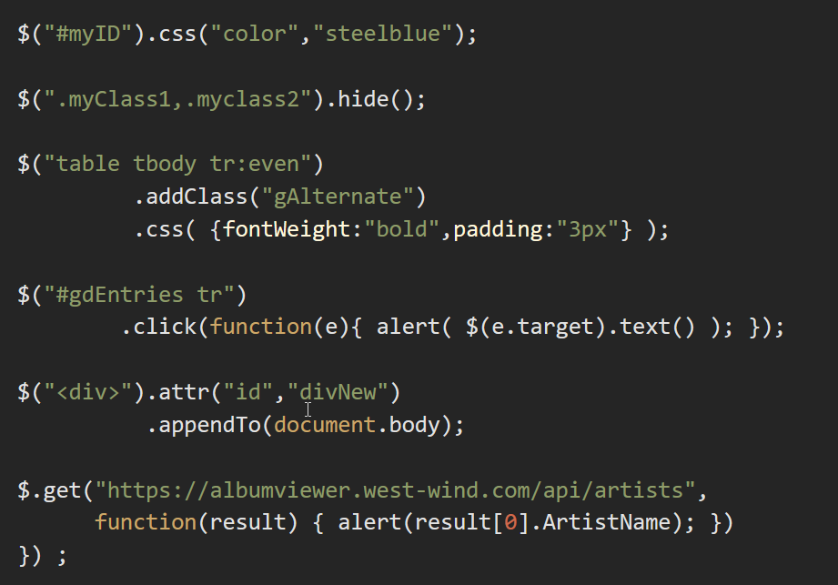
Some basic jQuery Examples

Slide 9

VueJs
the new light-weight framework

Slide 10
What is VueJs
Small but very powerful Framework
Supports both small and large scenarios
Can also work for full featured SPA via Vue CLI
Small: ~40kb minified and gzipped
Easy JavaScript Framework
Can be dropped into pages with a <script> tag
Works great with plain old ES5 JavaScript
Provides many features 'big frameworks' provide
Key Feature
Model based Data Binding
Allows for declarative programming
Code to the model, not the UI

Slide 11
What is VueJs
Great Option for 'mini-page SPA’
Simple script reference – no transpilation needed
Very simple MVC style model
How it works
Assign a model to Vue instance
Vue handles binding the model to DOM elements
Model data changes, UI updates
Very easy and very productive
Removes most direct DOM manipulation code
Can also replace most jQuery logic

Slide 12
Working with Vue
Add a Script Reference
Drop a <script> reference into the page
Vue is small (~40k packed and gzipped)
Create a Model
A model contains data to be bound to the view
A model contains methods that handle events
A model also contains your own helper code
Create HTML that references Vue Constructs
Bind values with v-bind (or :) or {{ expression }} interpolation
Two-way bind input values with v-model
Handle events with v-on (or @)
Many other directives v-for to looping, v-if and v-show for conditional
Create a Vue instance
Each component has its own instance
Allows for nested ‘components’
Each instance binds to a DOM node
Bindings bind down the hierarchy

Slide 13
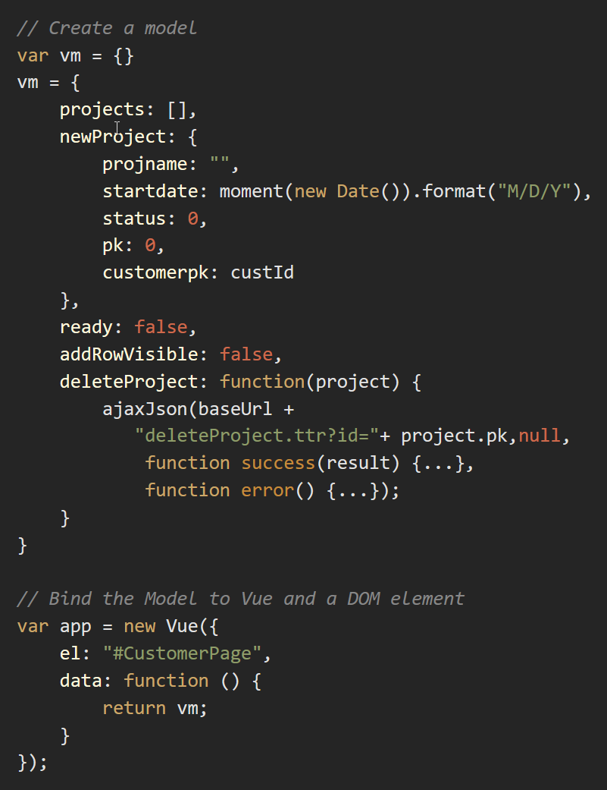
Vue Setup
Model
vm by convention. Create a separate var so you can reference it inside of the object map
Properties
Properties can be bound using v-bind or {{}} expressions
Methods can be referenced from event handlers. You can pass objects to methods so in v-for you can pass the iterated item
Vue Instance configure Vue instance by assigning a model and pointing at a DOM node that it’s applied to

Slide 14
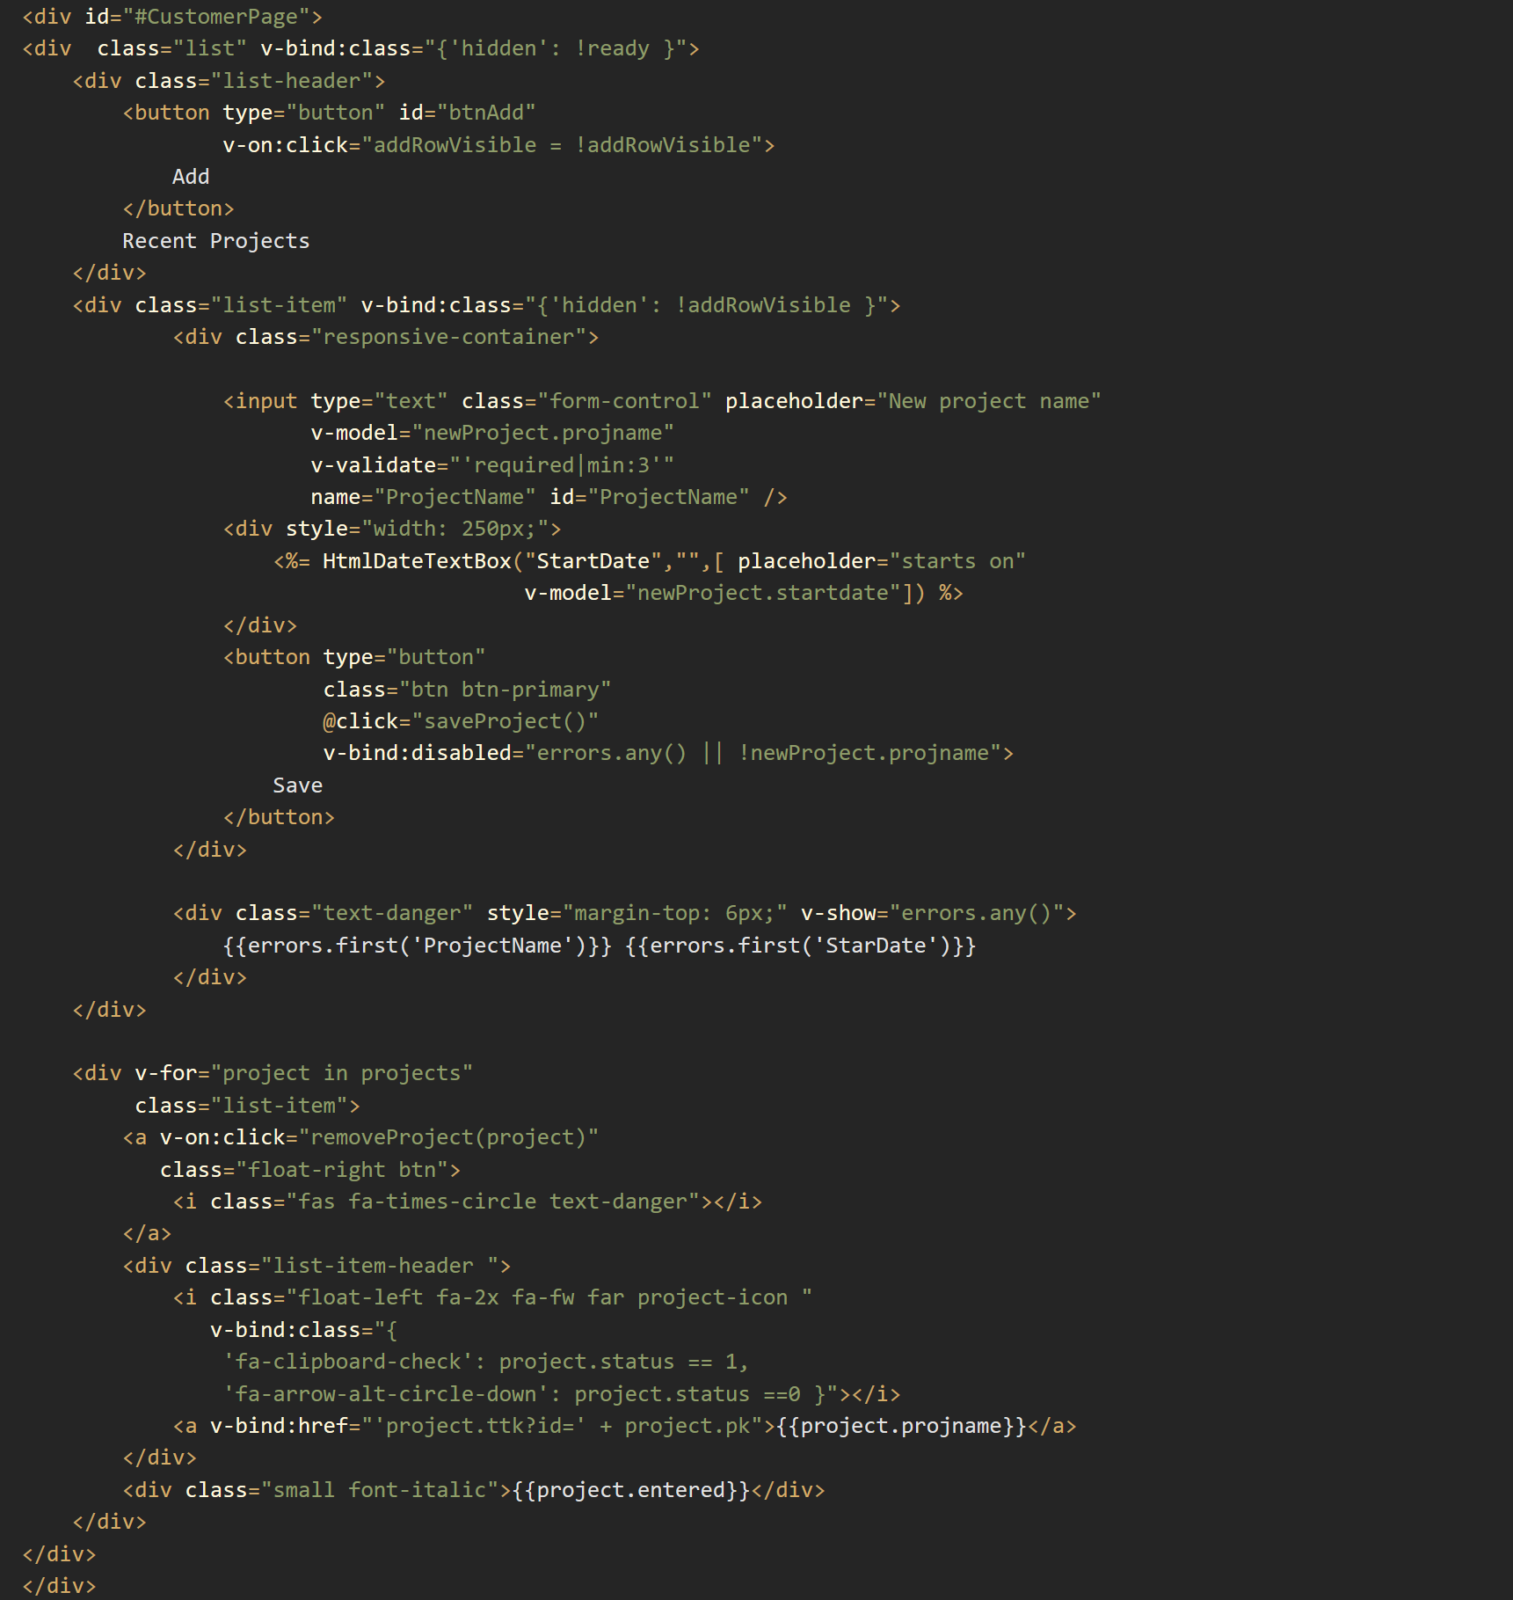
HTML View
Bindings
v-bind:attribute (or :attribute)
{{ project.projname }} Interpolation
v-bind:class="{ 'hidden': project.inactive }"
Events
v-on:click (or @click)
v-on:customEvent
Model Binding
v-model="projName"
Directives
v-for="project in projects"
v-show v-if conditional rendering
Validation
Use Vee-Validate
v-validate expressions
errors object to bind to
errors.any() to check for errors
.invalid, .pristine,.valid CSS tags assigned

Slide 15
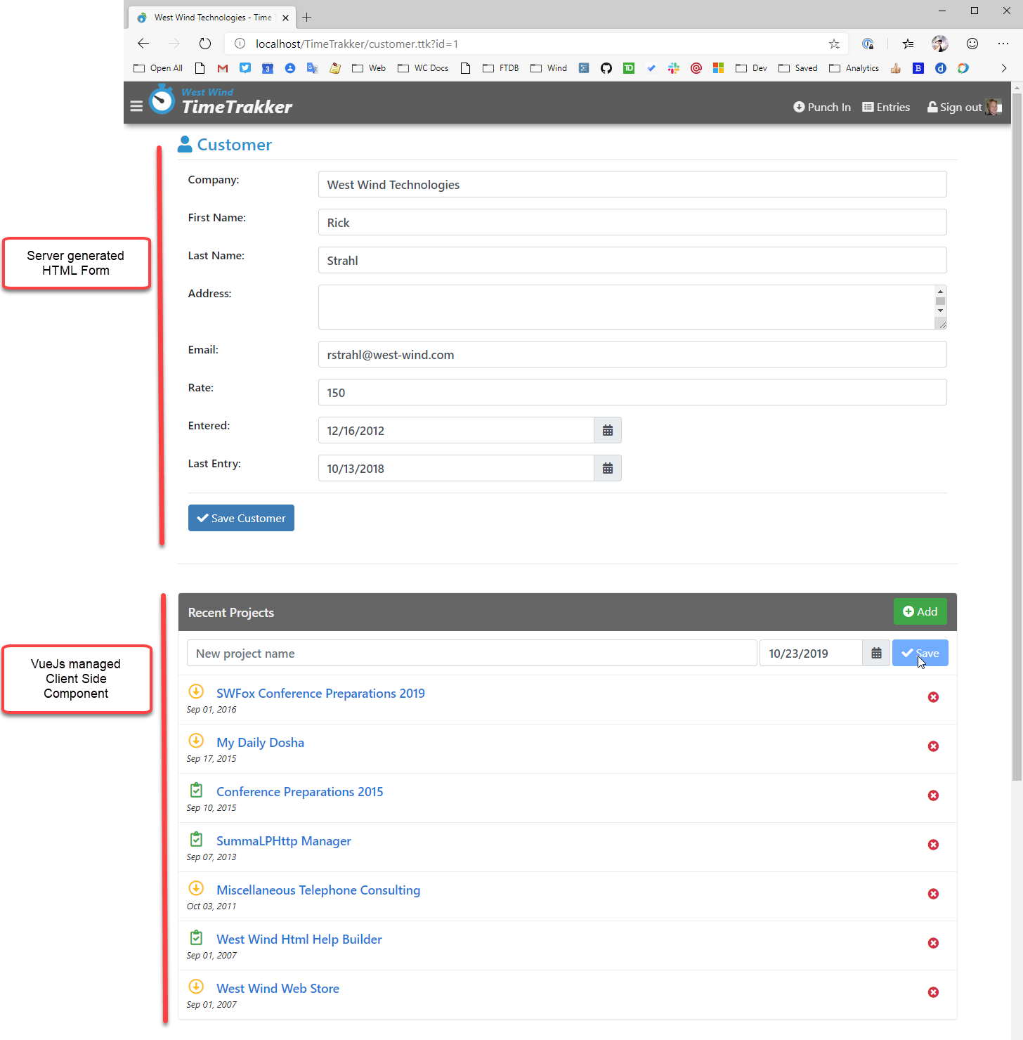
Mixing Vue into existing Content
Server Rendered Page
Initially rendered on Server
Static HTML for main portion
Main Form submits with full Page Refresh
Standard MVC/Scripting etc.
Quick to build server side
Interactive Component loads Dynamically
After page load load the list of projects
More interactive component
JavaScript makes this easier to build
More user friendly to interact with
No Page Refreshes

Slide 16
Vue for Full Featured SPA Apps
Vue SPA Apps
Based on WebPack
Provides full Build Process like Angular/React etc.
Support for Routing
Support for State Management
Vue CLI
Vue CLI provided Build, Run, Debug Services
Live Reload Server
Wraps WebPack Features into its own Configuration
Vue Templates
.vue Pages
Single File Templates
Combine HTML Template, CSS and Code
Templates are treated as Components

Slide 17
Vue For SPA Development
Same Concepts - more Features than StandAlone
Full Framework
Routing Support
Using ES 2016+ or Typescript (through transpilation)
Web Components Support
Fast Dev Cycle
Live Reload and Live Debugging
See your changes as you work!
Focus on Component Development
Each .vue file is a self contained Component
Dependency access via JavaScript Module Loading
Ideally break down logic into small re-usable components
Components are small and easy to maintain

Slide 18
Serving Data from FoxPro with Web Connection JSON REST Services
server side implementation

Slide 19
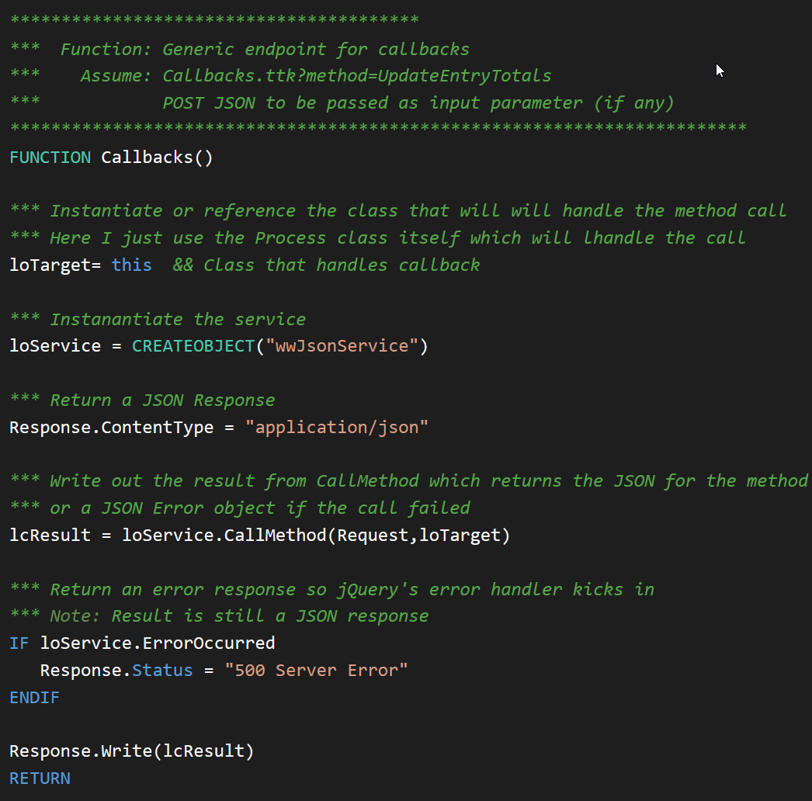
wwJsonService – JSON Processor
Low Level Class that handle REST requests
Parses incoming JSON to an object
Calls a method
Captures result from the method
Serializes the result
Handles errors and returns JSON error info
Used by wwRestProcess
wwRestProcess uses wwJsonService under the hood
Wraps a process class that routes directly to methods
Method mapping work just like other wwProcess class
One optional JSON input parameter, one result
Serialization is all handled
Pluggable
You can plug wwJsonService into existing Process classes
Single request that forwards all calls to wwJsonService
Can also be used in non-Web Connection solutions

Slide 20
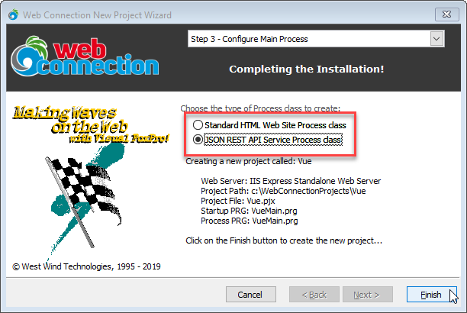
Creating REST Services
Use the New Project/Process Wizard
Creates a new Project or Process class
Attaches it to an existing application
wwRestProcess Class
Special wwProcess implementation
Accepts single JSON parameter
Input can be complex object
Produces a JSON value response
Your code is linear FoxPro code: Accept a parameter return a result value
Class handles deserialization of input, deserialization of Return

Slide 21
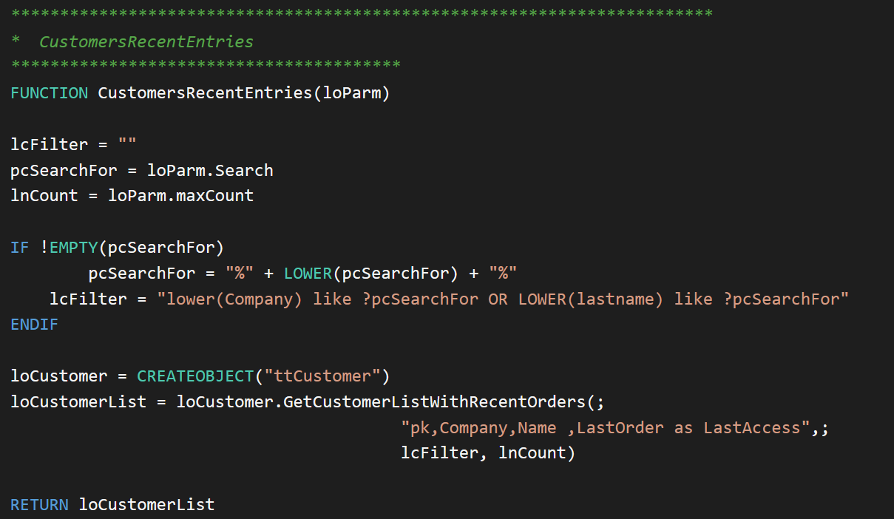
wwRestService Methods
POST http://localhost/tt/CustomersRecentEntries.rest HTTP/1.1
Single Input Parameter:
deserialized from JSON
User code – any FoxPro code
to produce a result value
Result value:
serialized to JSON

Slide 22
Extensionless Urls
Extensionless Urls
Clean URLs – purely aesthetic
Urls that don’t have an extension /tt/customers.ttr vs. /tt/customers
Extensionless URLs are re-mapped as if they had an extension
Using UrlRewrite to rewrite Urls
Requires installation of URL Rewrite Module
Set up a generic UrlRewrite Rule
Override wwProcess::OnUrlRewrite
Extensionless Urls are routed to OnUrlRewrite
Method has to parse the URL and then call other methods
Exact steps in the documentation https://webconnection.west-wind.com/docs/_3k812udq3.htm
Pretty much a cut and paste configuration

Slide 23
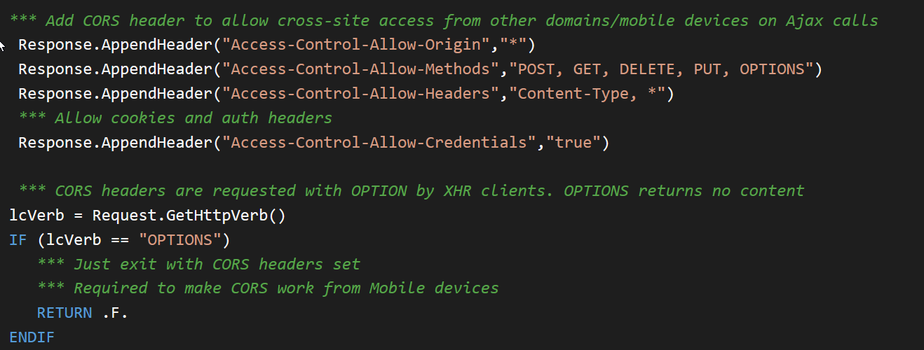
JavaScript Clients need CORS
Cross Origin Resource Sharing
By default browsers can’t access data from another server
Cross-domain XHR/Fetch request fail without CORS in client browser
Server has to allow access to the data
Server presents CORS headers to specify what can be accessed
When do you need it?
JavaScript clients calling to domain other than server domain
Not needed for non-JavaScript clients or same domain JavaScript calls
Uncomment code in OnProcessInit() for REST Service

Slide 24
Summary
Use jQuery for Simple Page Interactions
jQuery still offers a lot of value, even in HTML5
Easy to use, lots of utility, very flexible for batch operations
Ajax support built in
Small for what it offers (~40kb packed and gzipped)
Use Vue for more Complex Page SPA
Vue binds data using Models
Code to the Model not the UI
Very little DOM manipulation required
Works great for managing objects and list data
Combine as needed
You can use jQuery with Vue for the few DOM/UI edge cases
If edge cases are really simple, use DOM instead of jQuery
If you use AJAX then jQuery is a good fit still

Slide 25
Thank you!
Resources
Github: Source Code, White Paper and Slides https://github.com/RickStrahl/SWFOX2019_VueJs
Contact Rick
@RickStrahl on Twitter
https://weblog.west-wind.com
https://west-wind.com/wconnect/weblog/
rstrahl@west-wind.com

