Slide 1

Building and Consuming FoxPro REST and API Services
Rick Strahl
West Wind Technologies
www.west-wind.com
www.west-wind.com/weblog
Session materials:
https://github.com/RickStrahl/VirtualFoxFest2021-FoxProRest

Slide 2

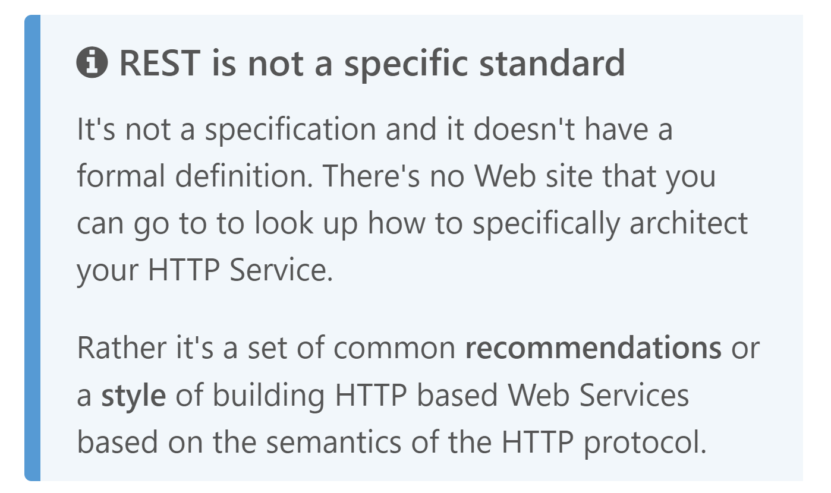
REST
Representational State Transfer
2000

Slide 3
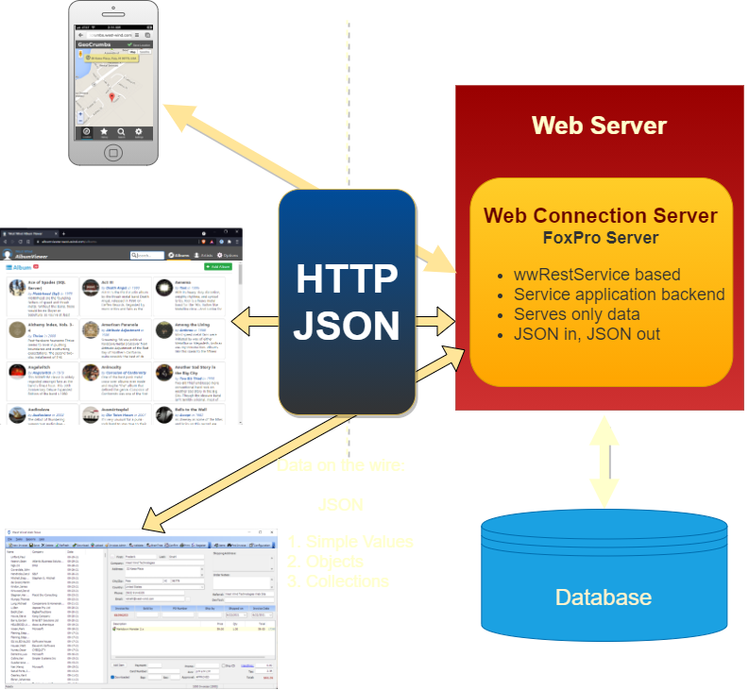
Web API Services for the REST of Us
Representational State Transfer
Huh?
Representational: Uniform resource access (URL + Verb)
State: Data sent between client and server, typically JSON
Transfer: The HTTP Protocol that carries the data
In Simple Terms
A mechanism to host Web API Services
Universal access via HTTP from anywhere
Not a Standard but a Recommendation
Recommendation means open to interpretation
Loose set of recommendations
The opposite of a complex server architecture like SOAP
Built around HTTP and JSON
Unique Resource Routes via URLs
Actions via HTTP Verbs (GET, POST, PUT, Delete etc.)
Headers: Separation of Meta Data and Content Data
Secure encryption via https://
Built-in caching support
JSON as data transport

Slide 4
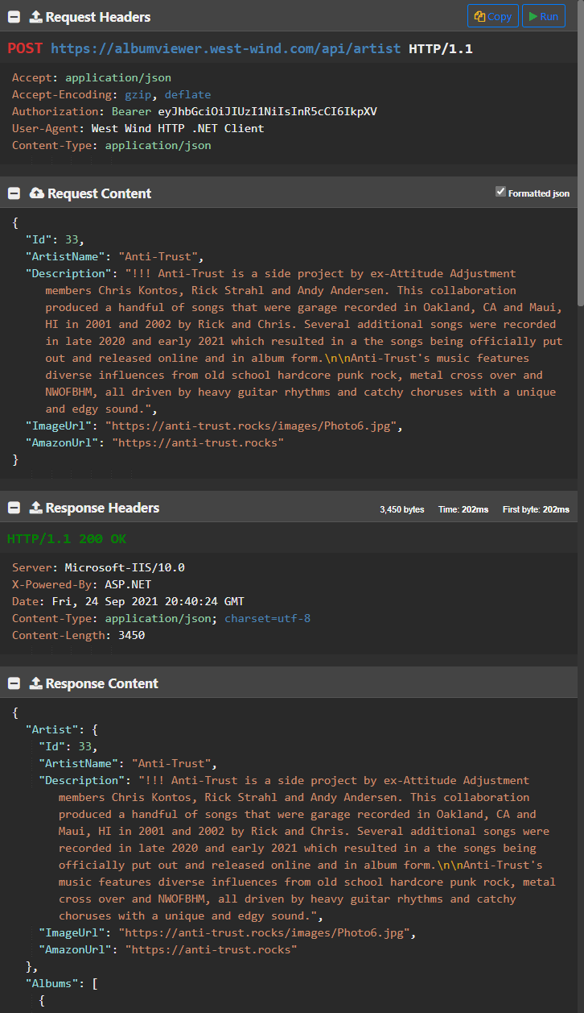
Anatomy of a REST Request
APIs over HTTP
URLs provide unique routing
Verbs provide the Action to take (GET, POST, DELETE)
Request & Response Headers provide Meta Data
Transactional Request and Response (transactional)
Stateless
Sending Requests
Specify URL to route, Verb for action
Every requests sends HTTP Headers
HTTP POST or PUT to send data
Data is serializeed as JSON (optional)
Receiving Responses
Request returns Status Codes (200, 401, 401, 500 etc.)
Response Meta Data via HTTP Headers
Server returns data as JSON
Standard Error Codes for Request Status

Slide 5
REST Application Scenarios for FoxPro
Calling REST APIs from FoxPro
What you need:
HTTP Client
JSON Serializer
Creating REST API Services with Foxpro
What you need:
Web Server
Web Application Framework (ie. Web Connection, ASP.NET etc.)
REST Framework
or: JSON Serializer for manual handling

Slide 6
Tools for Calling a REST Service
HTTP Client
WinHTTP, WinInet
wwHttp (West Wind tools)
curl (command line tool)
Chilkat HTTP
JSON Serializer
JSON Serialization and JSON Parsing
Couple of options:
wwJsonSerializer
nfJson
Calling the Service
Serialize any data to send to JSON
Call the server over HTTP
Get back JSON response
Deserialize JSON

Slide 7
Calling REST APIs from FoxPro
Interacting with Remote services
via HTTP and JSON

Slide 9
Summary
Use jQuery for Simple Page Interactions
jQuery still offers a lot of value, even in HTML5
Easy to use, lots of utility, very flexible for batch operations
Ajax support built in
Small for what it offers (~40kb packed and gzipped)
Use Vue for more Complex Page SPA
Vue binds data using Models
Code to the Model not the UI
Very little DOM manipulation required
Works great for managing objects and list data
Combine as needed
You can use jQuery with Vue for the few DOM/UI edge cases
If edge cases are really simple, use DOM instead of jQuery
If you use AJAX then jQuery is a good fit still

Slide 10
Thank you!
Resources
Github: Source Code, White Paper and Slides https://github.com/RickStrahl/SWFOX2019_VueJs
Contact Rick
@RickStrahl on Twitter
https://weblog.west-wind.com
https://west-wind.com/wconnect/weblog/
rstrahl@west-wind.com

