Slide 1

wwDotnetBridge Revisited Interfacing with .NET from Visual FoxPro
Rick Strahl
West Wind Technologies
www.west-wind.com
www.west-wind.com/weblog
Materials: https://github.com/RickStrahl/swfox2024-wwdotnetbridge-revisited

Slide 2
About this session
You’ll find out:
Why you would want to integrate .NET
Why you should use wwDotnetBridge
How to call .NET components from FoxPro
How to create your own .NET components

Slide 3
Why .NET?
.NET is easy to extend FoxPro with: COM
.NET support supports COM Interop
Direct integration into FoxPro especially with wwDotnetBridge
Provides access to many Windows system features
You can easily build your own components
Huge Eco System
Native Windows features are exposed as .NET components
1000’s of third party libraries for anything you can think of
NuGet Package manager makes it easy to get components
Great way to Extend FoxPro
.NET is now easy to build with the .NET SDK (command line)
You can build your own small components
Great for getting your feet wet
Easy to integrate with FoxPro code
Reusable for future .NET use cases (Web app, API, Phone)

Slide 4
What is wwDotnetBridge and why do we need it?
Native COM Interop is Limited!
.NET natively supports COM interop
Unfortunately, it’s very limited
Requires object to be registered with COM
COM has limited type translation features
wwDotnetBridge works around the Limitations
Still uses COM Interop
Provides a custom .NET Runtime loader
Provides a .NET Proxy object
The proxy creates COM instances
You can use COM features as-is when possible
The proxy helps operations that don’t work over COM

Slide 5
How wwDotNetBridge Works
Open Source
Free to use and modify
Source Code on GitHub
Also: Commercial versions in
Web Connection and West Wind Client Tools
Architecture
Win32 CLR Loader loads .NET runtime into FoxPro
wwDotNetBridge .NET proxy loads into host domain
Objects are instantiated through proxy as COM instances
Access values/object/members directly if possible
Or use proxy for extended functionality
Required Components
wwIPStuff.dll/crlLoader.dll – contains the native Win32 Loader
wwDotNetBridge.dll - .NET class that provides helper functions
wwDotNetBridge.prg – FoxPro front-end for .NET class

Slide 6
wwDotNetBridge Architecture
Hosting Process (YourApp.exe)
.NET Runtime Host (Application Domain)
.NET Object call methods and access properties on this class
wwDotNetBridge.dll
.NET Proxy – provide .NET helpers
ClrLoader.dll (or wwIPStuff.dll) loads .NET Runtime on first access (Win32)
COM Interop
wwDotnetBridge.prg
FoxPro front end class
YourCode.prg
Whatever code needs .NET access

Slide 7
10 Examples of wwDotnetBridge Usage
wwDotnetBridge 101 – Load, Create, Invoke, Get/Set
Create a powerful String Formatter
Add Markdown Parsing to your Applications
Use a Two-Factor Authenticator Library
Add Spellchecking to your applications
Humanize numbers, dates, measurements
File Watcher and Live Reload (Event Handling)
Async: Print Html to Pdf
Async: Use OpenAI for common AI Operations
Translations
Summary
Generic Completions
Image Generation
Create a .NET Component and call it from FoxPro

Slide 8
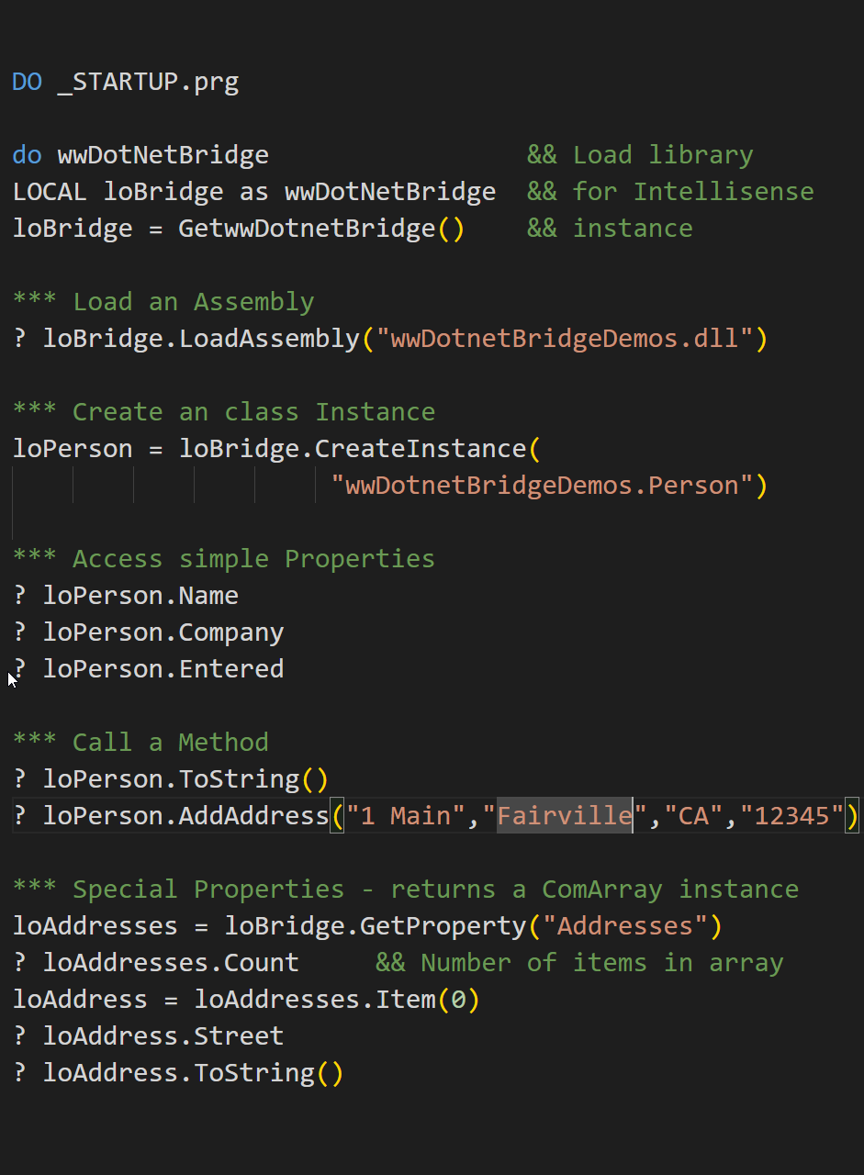
wwDotnetBridge 101
Create wwDotnetBridge
DO wwDotnetBridge (loads library)
loBridge = GetwwDotnetBridge() (gets cached instance)
Load Assemblies (dlls)
loBridge.LoadAssembly("wwdotnetbridgedemos.dll")
Always check for errors (.T. or .F. and check .cErrorMsg)
Create a .NET Object Instance
loObj = loBridge.CreateInstance("wwDotnetBridgeDemos.Person")
Use Namespace.Classname – It’s Case Sensitive!
Instance is a COM object
Directly access Properties and Methods that COM supports
Use Intrinsic methods (InvokeMethod/GetProperty/SetProperty)
Invoke a method
Direct: loPerson.DoSomething(lvValue)
Special: loBridge.InvokeMethod(loPerson,"DoSpecial", lvValue2)
Get/Set Properties/Helpers
Direct: loPerson.Name = "Rick"
Special: loBridge.SetProperty(loPerson,"LongValue", 10)
Special: loBridge.GetProperty(loPerson,"LongValue")
Use ComArray for Arrays and Collection

Slide 9
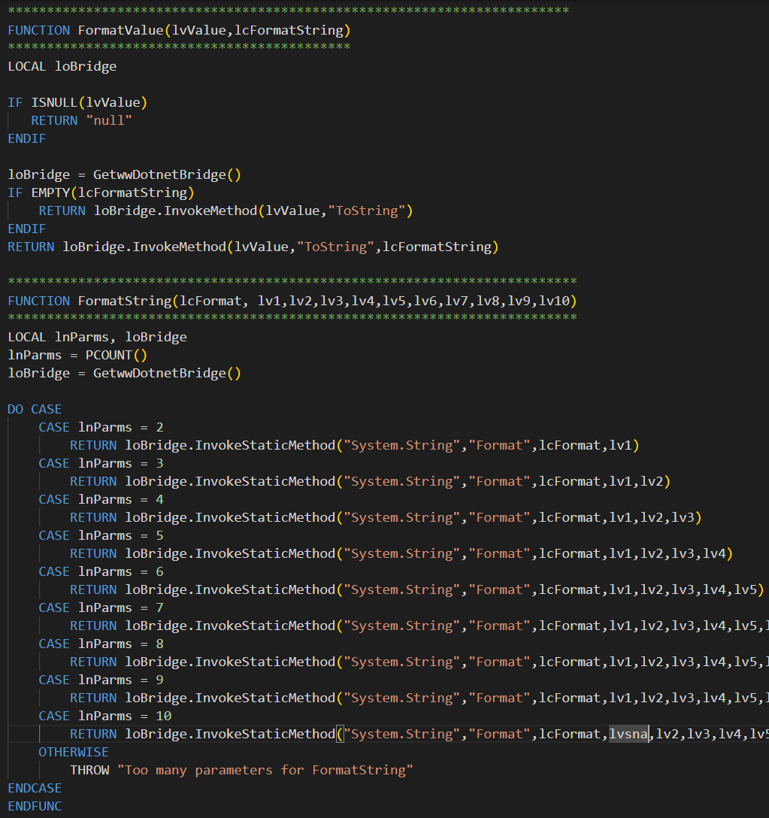
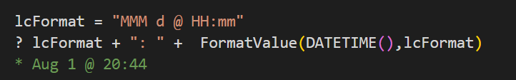
Creating a String Formatter
Take advantage of .NET String Formatting
Works with any type of value
Supports many useful formatting options
Supports Value Embedding
Implemented as FoxPro Function Wrappers
FormatValue()
Turns a single value to string
Works with simple FoxPro values
Or .NET types
Many format options
FormatString()
C Style Template expansion using {n}
Uses {0}, {1}, {2:formatString} for expansions
Invokes Static Method
Lots of overloads
InvokeMethod() requires EXACT signature match

Slide 10
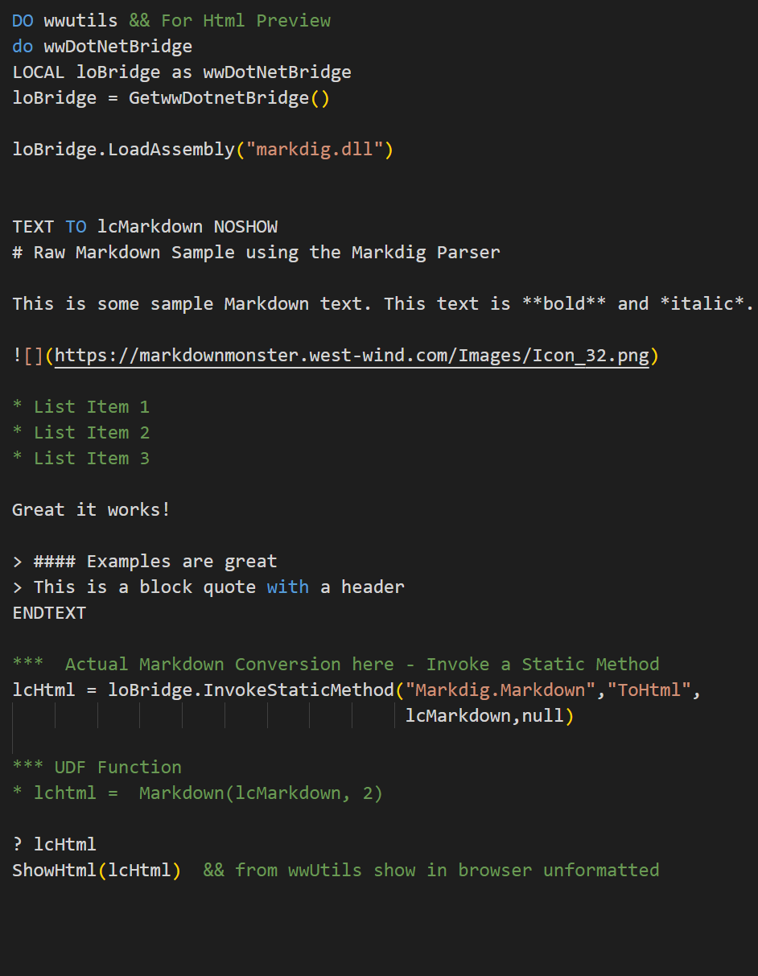
Markdown Parsing
Uses Markdig Third Party Library
Widely used in 3rd party and Microsoft applications
Using an older 2018 version for single DLL dependency
Markdown
Powerful text format for creating HTML content
Renders plain text format -> HTML
Widely used – GitHub, Blogs, Support, Documentation, Wikis
Converts to HTML using Parser (Markdig)
Useful for
Formatted Memo Text input in Web applications
Documentation
Used in: Message Board, Help Builder, Markdown Monster
Add HTML Templating
Markdown renders ‘raw’ HTML fragment
You need a page to make Markdown look nice
Use Templating to flow Markdown into consistent styling
Demonstrates
Interfacing with a third party library
Creating a FoxPro wrapper class that manages lifetime
https://github.com/xoofx/markdig

Slide 11
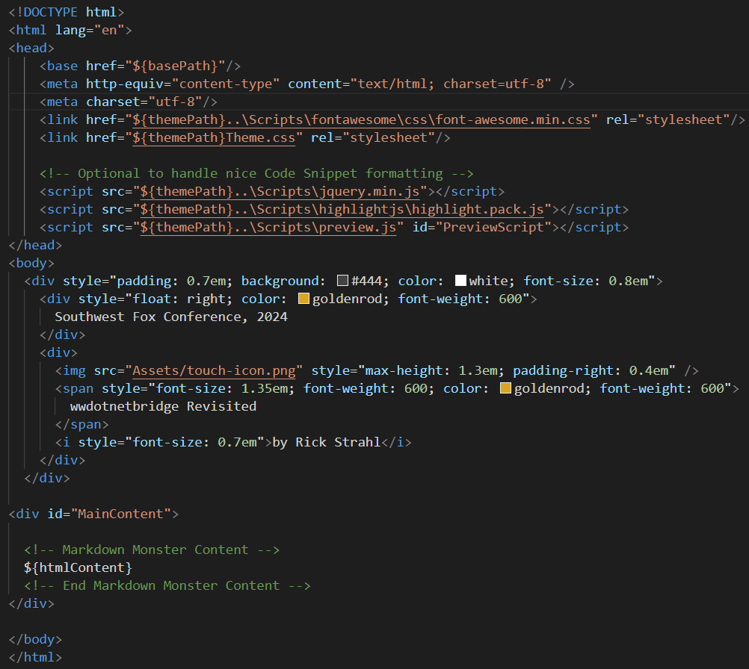
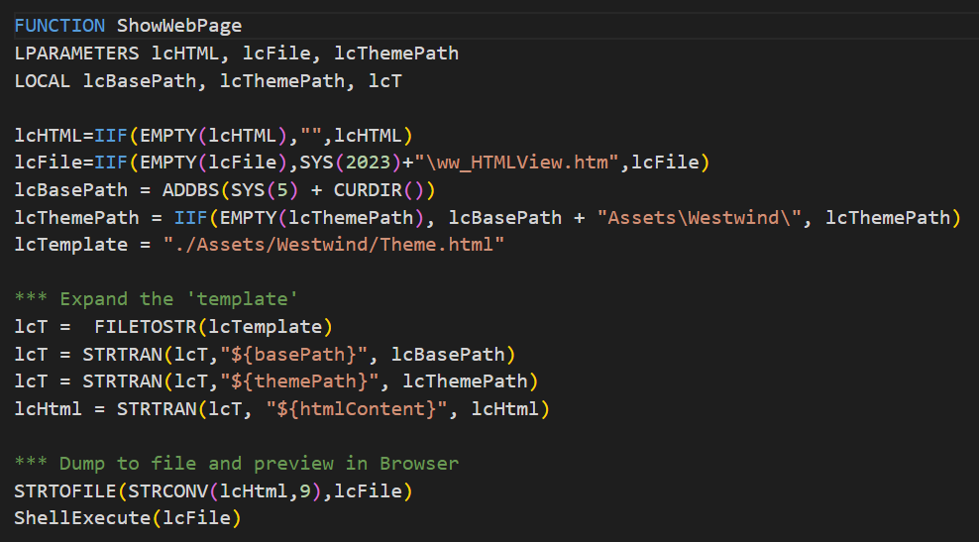
Html Templates to Render Markdown (continued)
Template for Nice Html Output
Markdown produces a raw HTML fragment
On it’s it’s own it’s pretty ugly
Use a template or Web Page that includes CSS styling
Handle Code Snippet formatting
Integrated into Web Content
If you are using a Web app, apply app styles
Styling is applied from Application Styles
Add Markdown specific styling if necessary (code, quotes etc.)
For Desktop use local Html Templates
Create an Html Page template that includes styling
Render HTML into the template
Beware of TextMerge() - mangles linefeeds
Instead use RegEx or StrTran() to replace content

Slide 12
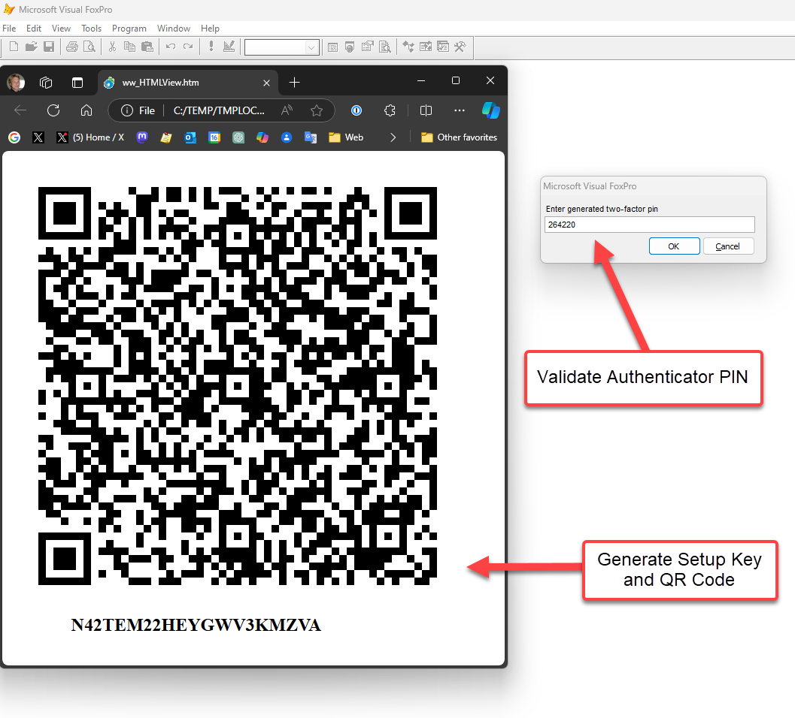
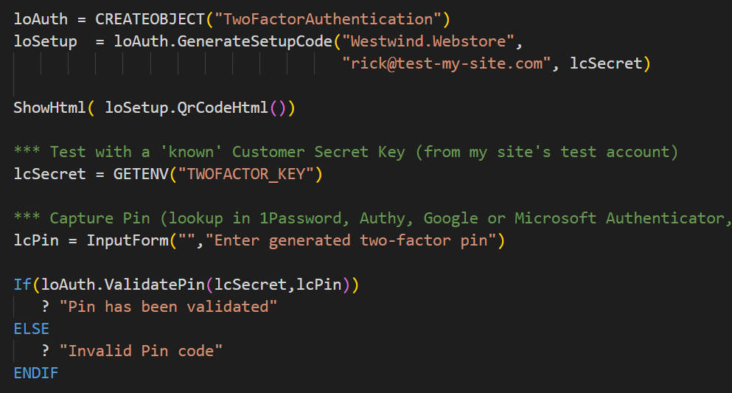
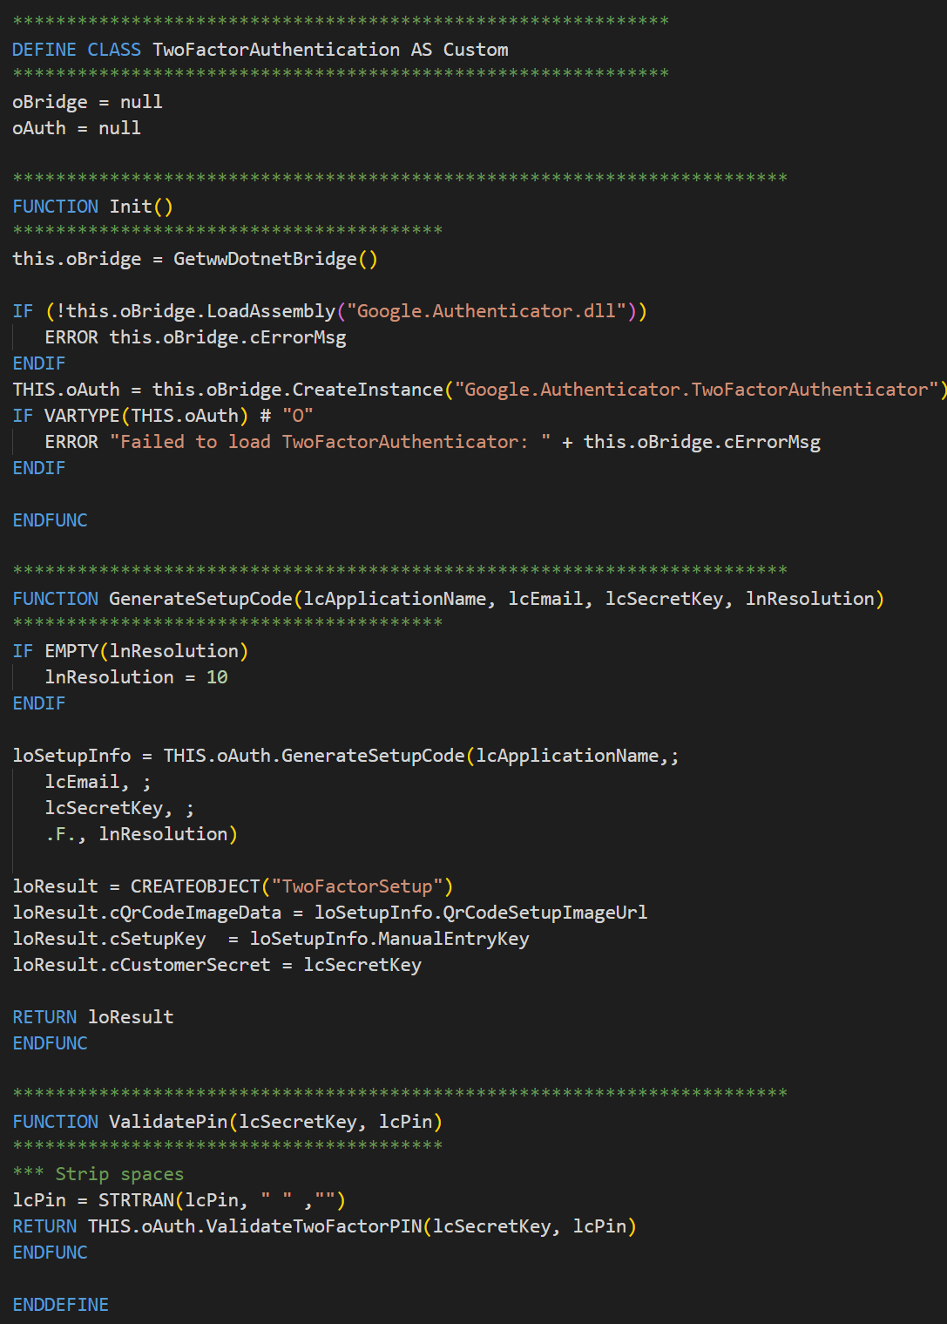
Two-Factor Authentication
Two Factor Authentication
Used on Web Sites for second level authentication
Typically generates a QR Code to setup
Uses an Authenticator app to validate codes
Included sample provides the tools to handle setup and validation in your applications
.NET Google.Authenticator Library
Can create QR Code and Setup Code
Generates a Setup key
Can validate a generated key against Setup Key
Despite its name works with ANY authenticator Authy, 1Password, Microsoft Authenticator, Google Authenticator etc.
Invoke Directly from FoxPro
Library has a simple interface
Direct calls from FoxPro
Use HTML to display QR Code
https://github.com/BrandonPotter/GoogleAuthenticator

Slide 13
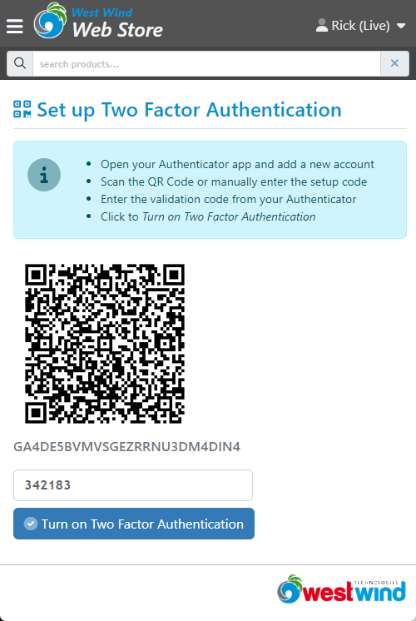
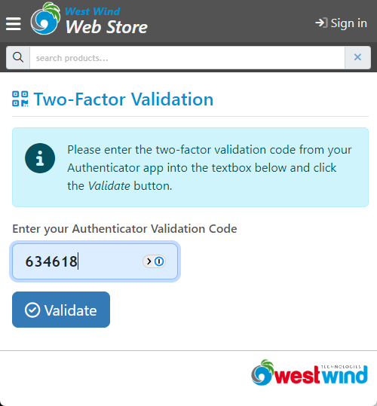
Two Factor Authentication (continued)

Slide 14
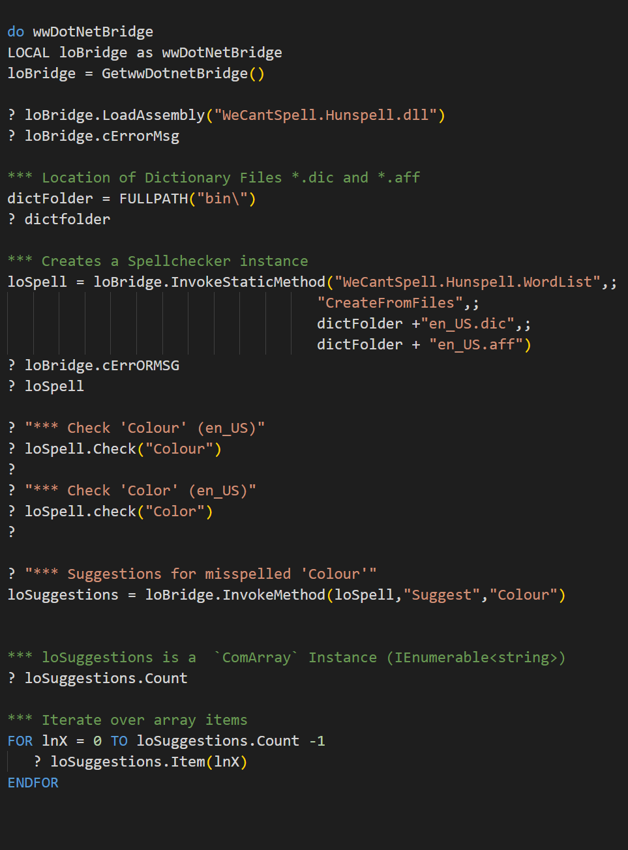
Spell Check Words
Uses WeCantSpell.Hunspell
Spell check words
Suggest words for misspelled
.NET Version of widely use Hunspell lib
Works with any Open Office Dictionary
Useful for
Document applications that need check spelling
Can be integrated into any tool that allows for word parsing
Example: Help Builder, Markdown Monster via Ace Editor
Updated from NHunspell
This library is newer
No native Win32 dependency on hunspell.dll
.NET Standard 2.0 (has additional .NET dependencies)
Demonstrates
Static Method invocation
ComArray for Generics
Creating FoxPro Wrapper Class around a Third Party Library
https://github.com/aarondandy/WeCantSpell.Hunspell

Slide 15
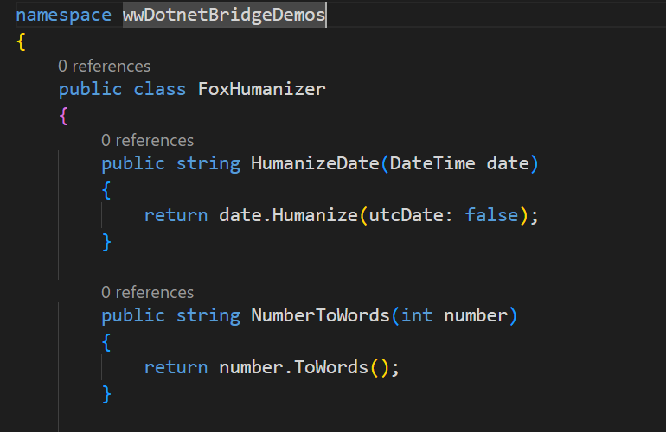
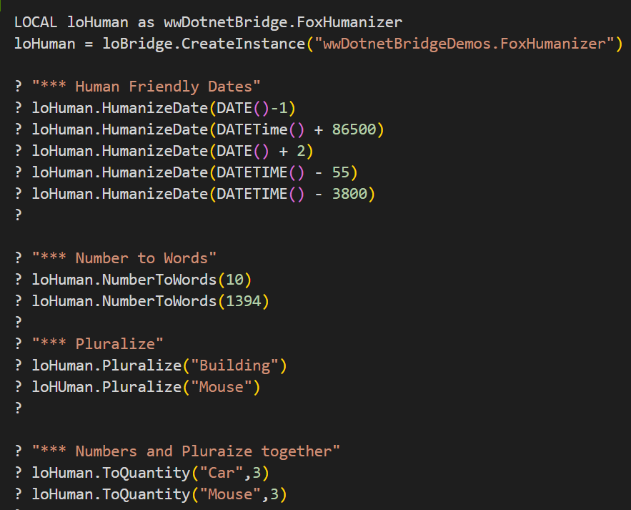
Humanize Common Data
Powerful Formatter for Data
Dates and Numbers to humanized strings
Pluralization (nouns, numeric counts)
Common Units (kb, mb, etc.)
CamelCasing, SnakeCasing, KebabCasing
Much, much more!
Uses a Wrapper Class
Humanizer is built using .NET Extension classes
Tons of overloads and type tweaks
These are difficult to figure out from FoxPro
Possible to call from FoxPro using InvokeStaticMethod()
Much easier to create class in .NET and call from FoxPro
https://github.com/Humanizr/Humanizer

Slide 16
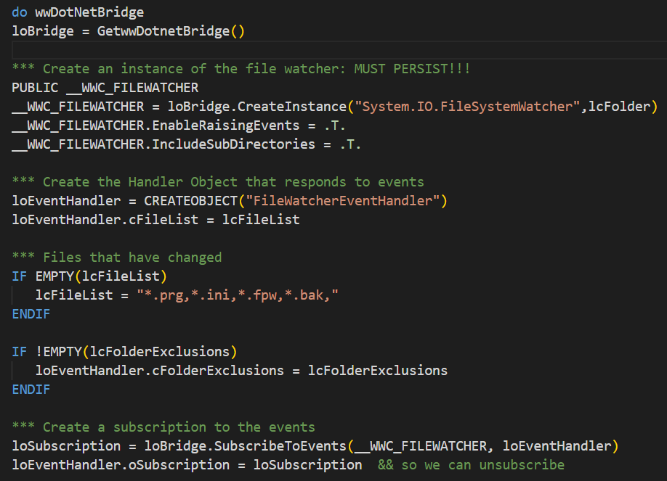
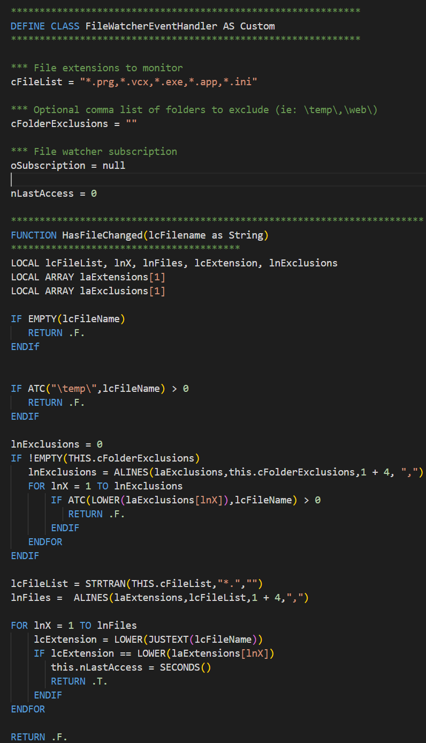
File Watcher with Events
Monitor Changes in the File System
Uses: System.IO.FileSystemWatcher
Event driven watcher monitors file system
Fires events when file state changes
Change, add, delete, rename etc. events
Requires Event Handling/Callbacks
Useful for
Live Reload Server in Web Connection
Monitor an edited Document for changes and refresh
Update File/Directory Lists in Real Time
Event Handling
Subscribe to an event
Get called back on response
Requires a Callback object that implements event interface
Currently requires that all events are implemented (will change in the future with selective implememtation)

Slide 17
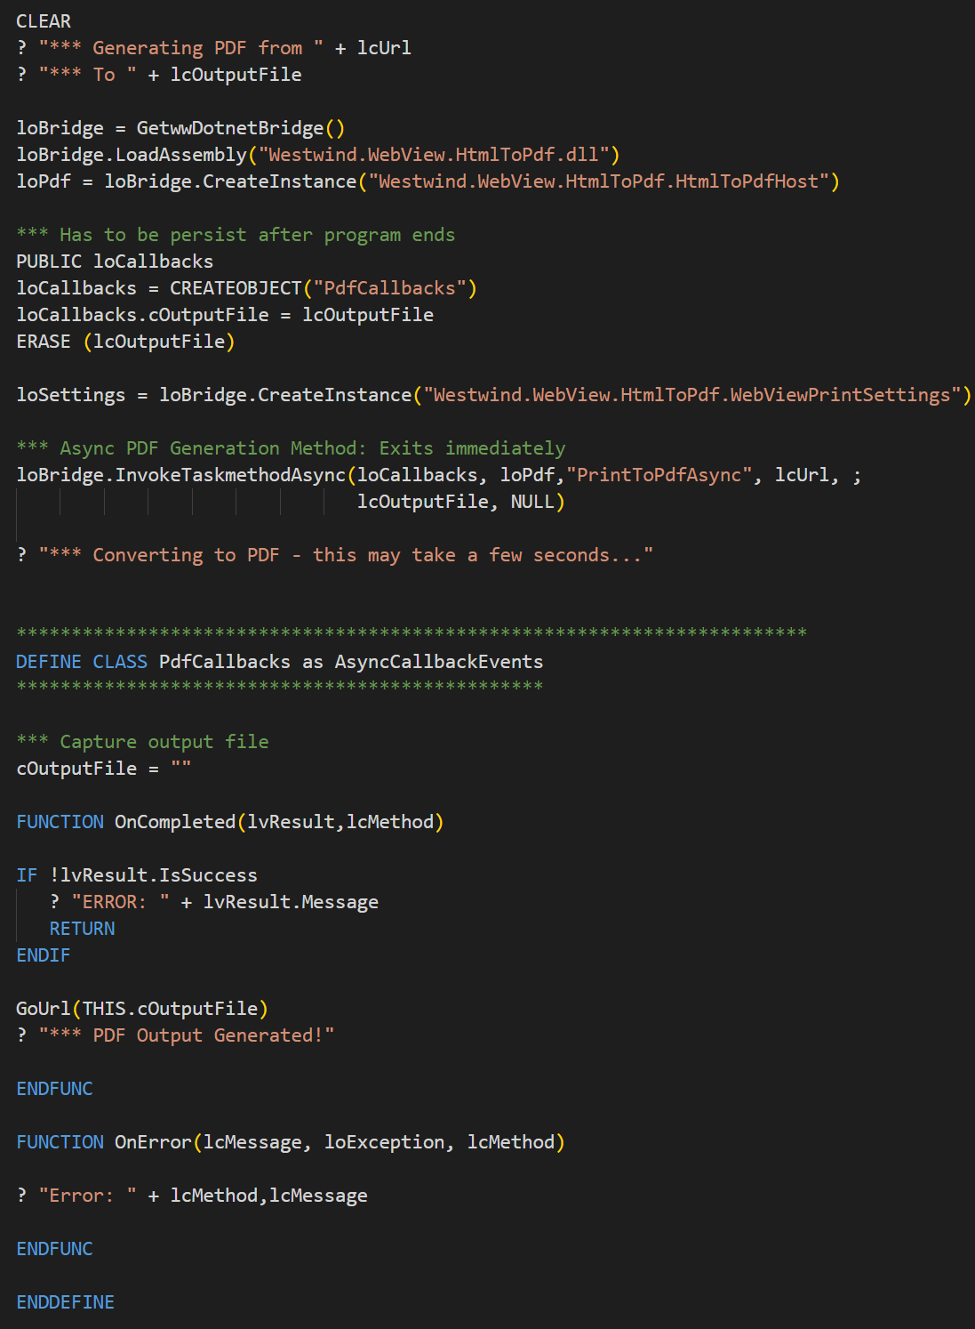
Async: Convert HTML to PDF
Uses Westwind.WebView.HtmlToPdf
Converts local HTML files
Converts URL Content to PDF
Use Edge WebView Runtime
Works on Desktop and inside of IIS
Useful for Output Generation
Fairly easy to generate HTML
Great for mixed content
Markdown -> HTML -> PDF
In Web Apps can be used for Page Previews
Demonstrates Async Operation
Callbacks used to handle completion
Make sure Callback class stays in scope!
Use PUBLIC
Attach to an App-Level component (goServer, goApp, goHelp etc.)
https://github.com/RickStrahl/WestWind.WebView.HtmlToPdf

Slide 18
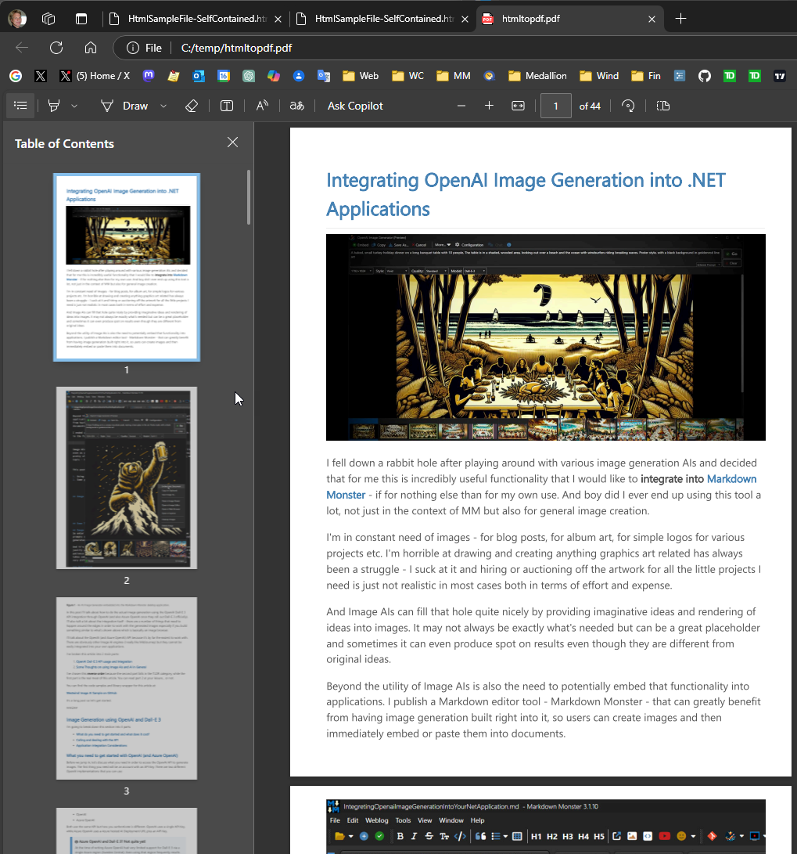
Html To Pdf Generation (continued)

Slide 19
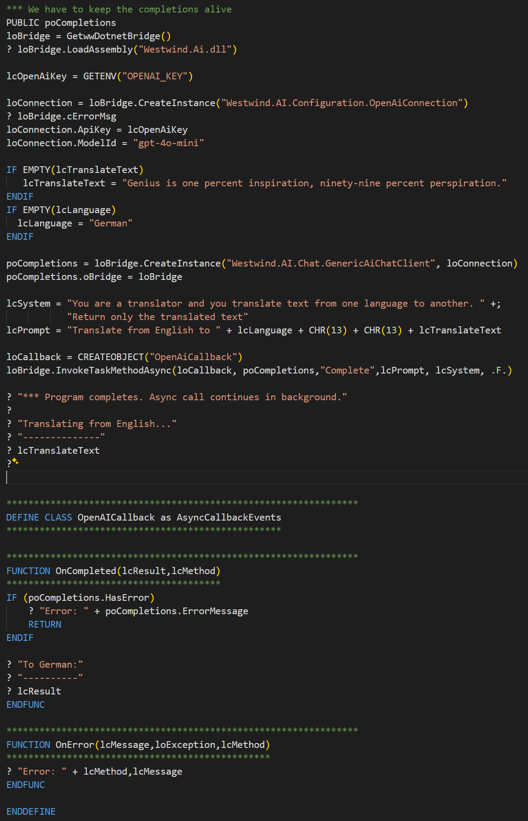
Async: OpenAI Chat Completions
Call to OpenAI Asynchronously
API Calls are made to a service
OpenAI Services can be online or local
Calls take a while to process
Results are returned asynchronously
Some Examples
Summarize Text and Summarize from Web
Translate Text
Grammar Completion
Generic AI Calls
Interactive Chat
Demonstrates
Async Calls to .NET
Callbacks via Callback object
Callbacks have to stay alive (PUBLIC or attached to active object)
https://github.com/RickStrahl/Westwind.Ai

Slide 20
Best Practices
Configuration
Allow assemblies to load from Network
Version Conflicts and Assembly Redirects
Build your own Components
If .NET Logic is even remotely complex Prefer to build a .NET Component and call from FoxPro rather than try complex wwDotnetBridge translations
.NET is now fairly low Impact
Build from the Command Line
Single install .NET SDK lets you build, run, publish
You can use any editor
Tooling
You can use whatever Editor you like
Visual Studio is not required, but still the best .NET Environment for full featured .NET work.
For building small components a Text Editor is all you need

Slide 21
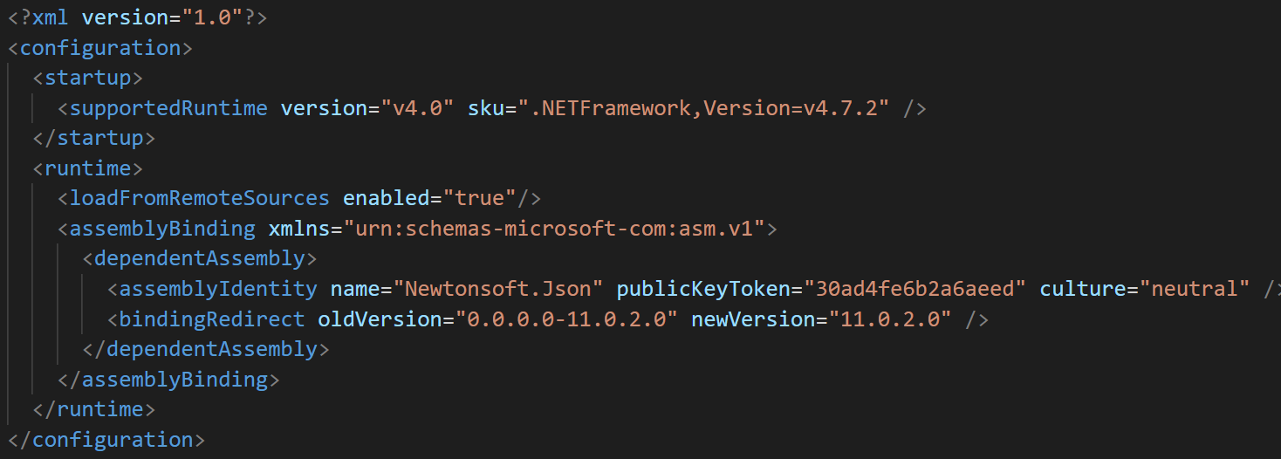
Application Config Files
Application Configuration for .NET
Same folder as EXE – your app or Fox IDE: Vfp9.exe.config or YourApp.exe.config
Specifies:
Runtime Version (optional – acts as a minimum version check)
Network Behavior: enable loadFromRemoteSources
Assembly Redirects

Slide 22
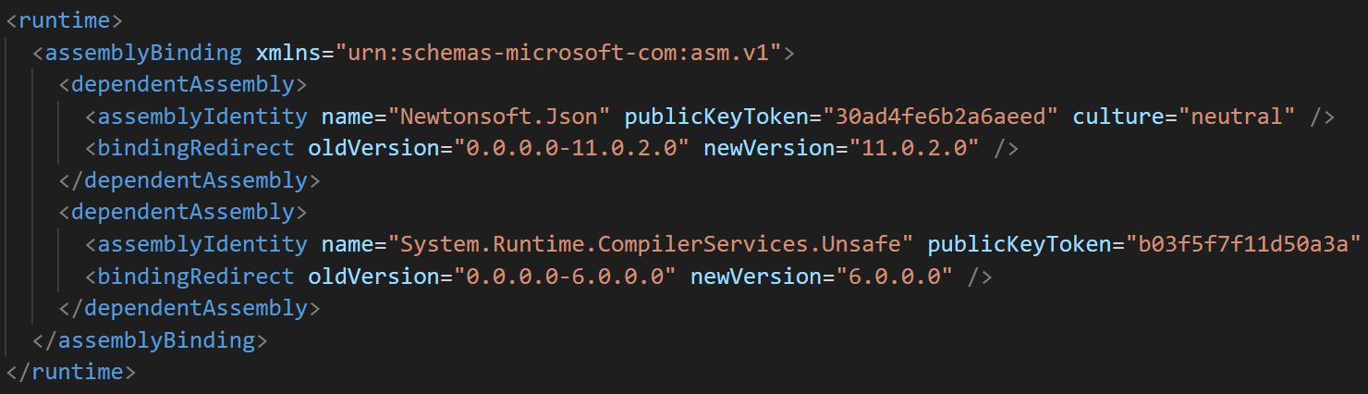
Version Conflicts: Assembly Redirects
Versions Happen!
Different components often have different versions of .NET dependencies
Example: Many versions of Newtonsoft.Json
Assembly Redirects
Allows overriding of versions
oldVersion and newVersion keys
Important: Use AssemblyVersion, not FileVersion

Slide 23
.NET Calling: Don’t OverComplicate Things
Calling .NET Code from FoxPro Directly
No dependencies, simple API
Just call directly or create a wrapper functions/classes
But: wwDotnetBridge can be verbose and finicky!
Create .NET Wrapper Library
If the .NET code is long – consider writing it in .NET
Easier to create lengthy .NET Code than FoxPro Interop code
It’s now easy to create a .NET DLL and call that from FoxPro
You can combine many features into a single DLL
Create a FoxPro Wrapper Class
Always, always abstract .NET Code
At minimum create a wrapper function
Better yet, create a component wrapper class
Should manage loading of library and instance
Should handle and capture errors

Slide 24
Creating your own .NET Components
Install the .NET SDK
Single download and install
Works with any editor, runs from Command Line
Create a new Class Library Project
dotnet new classlib –f netstandard2.0 [–n <projName>]
Creates a project in –n folder
Requires some fixup for net472
Or: Simply copy and paste template project & rename the .csproj file to your project
Build your Project
dotnet build
Optionally set an <OutputPath>

Slide 25
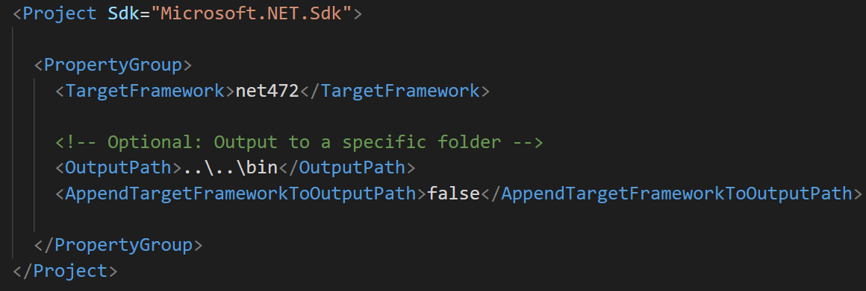
Project File
ClassLibrary Project file is generic
Only required field is TargetFramework
Use net472 or net481

Slide 26
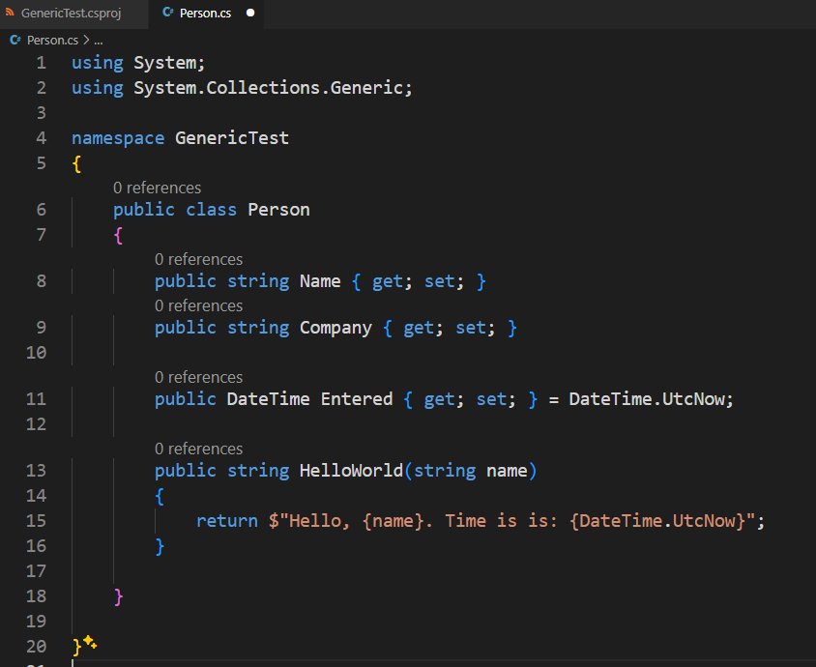
Class File

Slide 27
Building and Running the Project
Command Line
dotnet build in Project directory
Output by default goes into project /bin folder
Optionally use <OutputPath> to send to different path
Visual Studio
Build and run inside of Visual Studio
Easy but requires a full install of Visual Studio
Allows debugging from FoxPro Exe
Community Edition is free for most users
Visual Studio Code
Includes build and run tools (C# Dev Kit)
Works, but very inconsistent
Run in Visual FoxPro
Load wwDotnetBridge
Load assembly with LoadAssembly(yourAssembly.dll)
Go to town on your class API!

Slide 28
Summary
Lots of cool .NET Stuff available
Many Windows features are exposed through .NET
Many open source and 3rd parties available
With wwDotnetBridge you can access most of it!
wwDotnetBridge makes it EASY!
Call any .NET components without registration
Opens up most of .NET to FoxPro
Access most .NET features including Generics, Value Types, Collections, Enums, Static members etc.
Helpers for types that suck in FoxPro: ComArray, ComValue
Create Wrappers for Complex Code
Easier to create .NET code to interface with complex APIs
.NET SDK makes it easy – no Visual Studio required
Create FoxPro friendly wrapper classes in .NET
Call the wrappers from FoxPro

Slide 29
Resources
Code Samples, Slides and White Paper: https://github.com/RickStrahl/swfox2024-wwdotnetbridge-revisited
Session Notes
Session White Paper
Download Sample Code
wwDotnetBridge Documentation
Where to get wwDotnetBridge
Available on GitHub – Free and Open Source https://github.com/RickStrahl/wwDotnetBridge
Also distributed with (commercial version):
West Wind Internet and Client Tools
West Wind Web Connection
West Wind .NET Articles
Focus on .NET development with a VFP perspective
http://www.west-wind.com/articles.aspx

