Slide 1
Snowflake Iceberg Performance Benchmark
Comprehensive Performance Testing Framework

Slide 2
Introduction
Welcome to the Snowflake Iceberg Performance Testing Suite demonstration. This comprehensive framework enables you to compare the performance, cost, and characteristics of four different Snowflake table formats using the industry-standard TPC-DS benchmark.

Slide 3
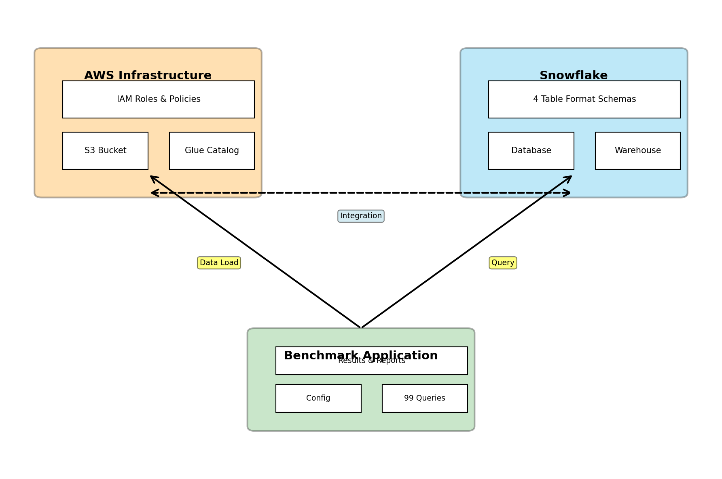
System Architecture & Configuration

Slide 4
What is This Project?
This project is a comprehensive performance testing framework designed to evaluate and compare four different Snowflake table storage formats:
Native Snowflake Tables - Standard Snowflake managed tables with full Snowflake optimization
Iceberg Snowflake-Managed - Apache Iceberg format with Snowflake's native catalog integration
Iceberg AWS Glue-Managed - Apache Iceberg format with external AWS Glue catalog for cross-platform compatibility
External Tables - External tables pointing directly to Parquet files in S3

Slide 5
Why Does This Matter?
As organizations modernize their data architectures, they face critical decisions about data storage formats:
Performance: Which format delivers the best query performance for your workload?
Cost: What are the total cost implications including compute, storage, and cloud services?
Compatibility: Do you need cross-platform compatibility or vendor lock-in?
Features: Which format supports the features you need (ACID transactions, time travel, versioning)?
This benchmark provides data-driven insights to make informed architectural decisions.

Slide 6
TPC-DS Benchmark Context
TPC-DS (Transaction Processing Performance Council Decision Support) is the industry-standard benchmark for decision support systems. It includes:
99 standardized queries covering real-world analytical workloads
24 tables (17 dimension tables, 7 fact tables) representing a retail data warehouse
4 query categories:
Reporting Queries (1-20): Standard business reporting and dashboards
Ad-hoc Queries (21-40): Business analysis and exploration
Iterative Queries (41-60): Multi-step analytical processes
Data Mining Queries (61-99): Advanced analytics and statistical analysis

Slide 7
TPC-DS Benchmark Context
The benchmark provides a realistic, comprehensive workload that mirrors production analytical environments.

Slide 8
Use Cases and Target Audience
Primary Use Cases:
Architecture Evaluation: Compare table formats before making architectural decisions
Performance Optimization: Identify performance bottlenecks and optimization opportunities
Cost Analysis: Understand total cost of ownership across different formats
Migration Planning: Evaluate migration from one format to another
Capacity Planning: Understand resource requirements for different formats
Target Audience:
Data architects and engineers

Slide 9
Use Cases and Target Audience
Performance engineers
Cost optimization teams
Technical decision makers
Snowflake administrators

Slide 10
Why This Comparison Matters
Format | Strengths | Use Cases
Native | Best performance, full Snowflake features | Snowflake-only environments, maximum performance
Iceberg SF | ACID transactions, time travel, versioning | Data lakes with Snowflake, version control needs
Iceberg Glue | Cross-platform compatibility, AWS ecosystem | Multi-engine environments, AWS-native stacks
External | Cost-effective, direct S3 access | Read-heavy workloads, cost optimization

Slide 11
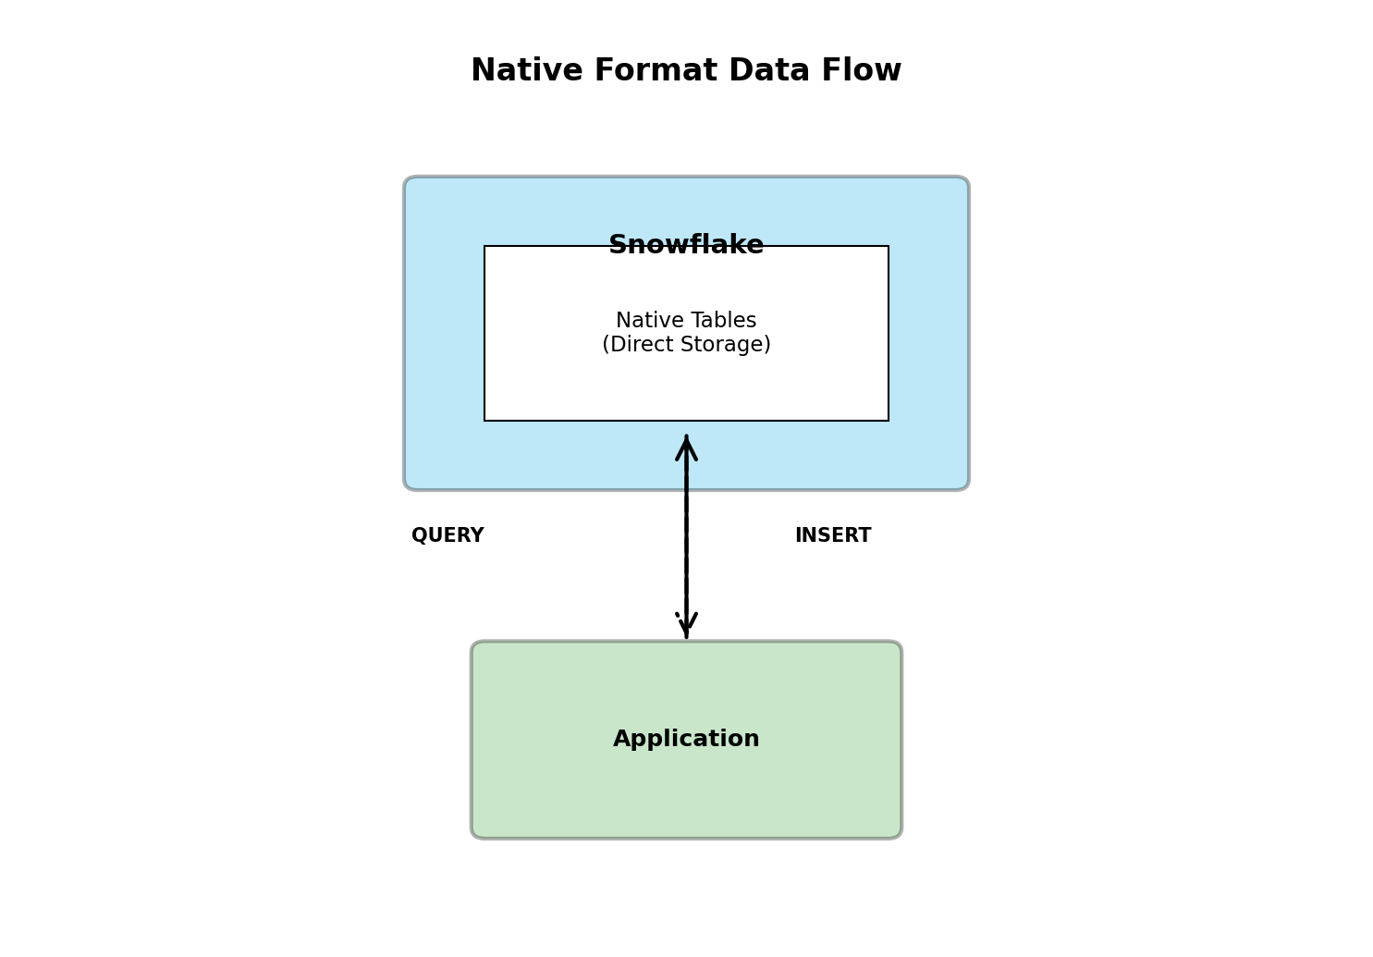
Native Format Data Flow

Slide 12
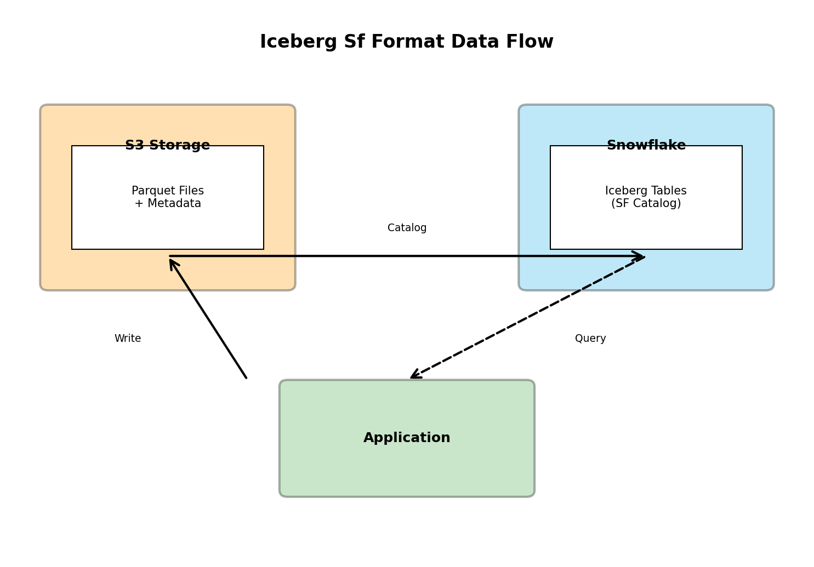
Iceberg Sf Format Data Flow

Slide 13
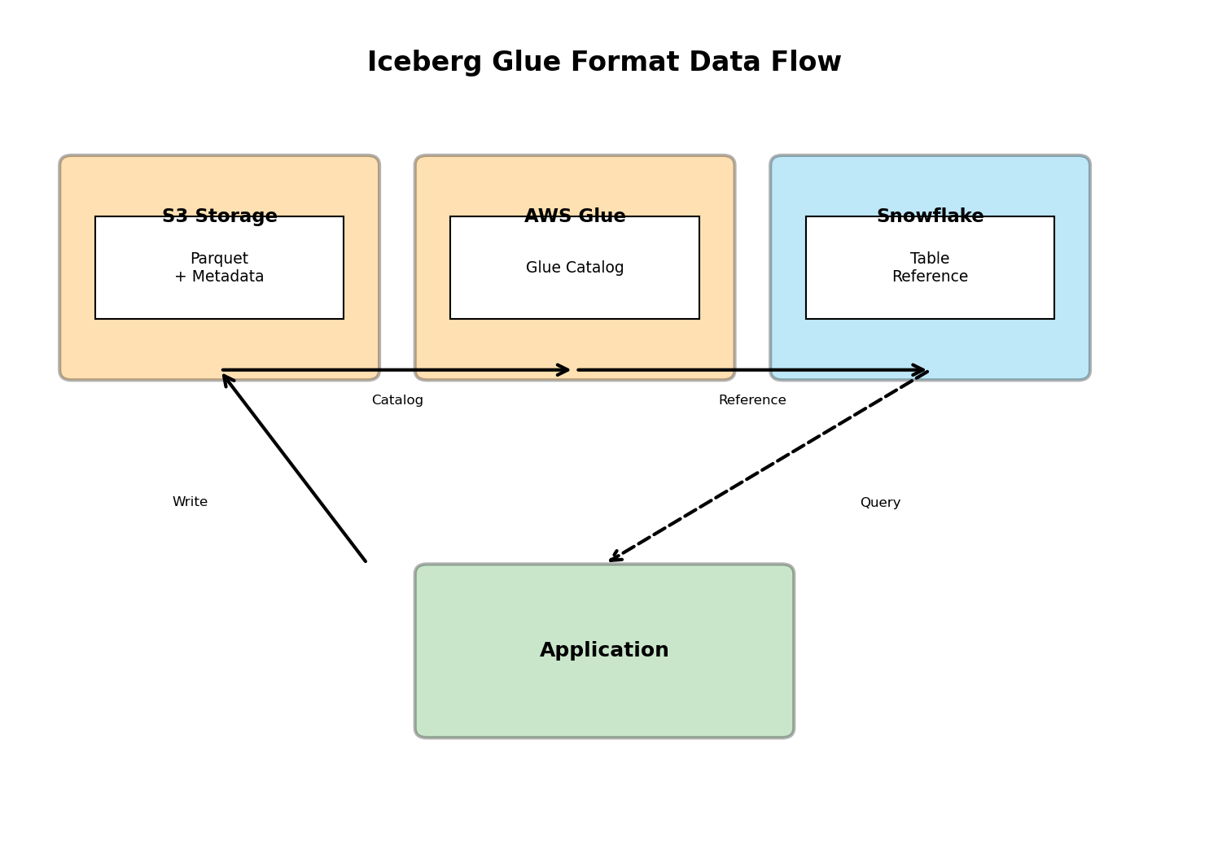
Iceberg Glue Format Data Flow

Slide 14
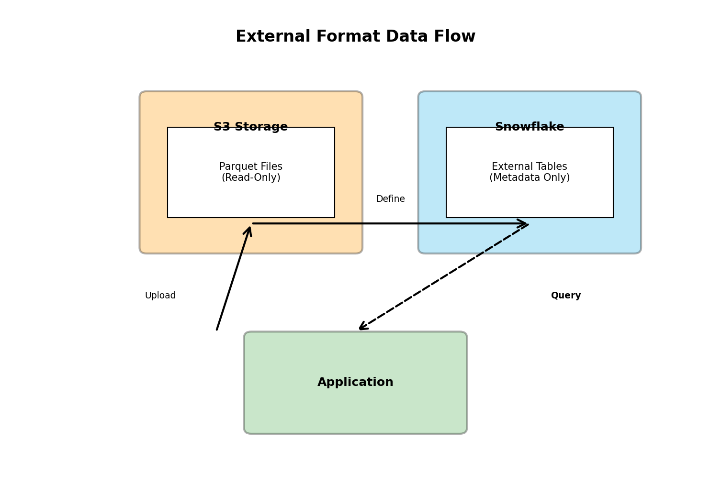
External Format Data Flow

Slide 15
Required Software
Python 3.8 or higher
```bash
python --version # Should show 3.8+
```
Python Dependencies
```bash
pip install -r requirements.txt
```

Slide 16
Required Software
Key dependencies include:
snowflake-connector-python - Snowflake connectivity
pandas, numpy - Data processing
matplotlib, seaborn - Visualization
boto3 - AWS integration
pyyaml - Configuration management
Terraform (for AWS infrastructure setup)
```bash

Slide 17
Required Software
terraform --version
```
Spark (optional, for Glue table creation if using Iceberg Glue format)

Slide 18
Required Accounts and Access
Snowflake Account
ACCOUNTADMIN role or equivalent permissions
Warehouse created and running
Permissions for:
External volume creation
Catalog integration creation
Database and schema creation
AWS Account (for Iceberg Glue and External formats)

Slide 19
Required Accounts and Access
S3 bucket access
AWS Glue catalog access (for Iceberg Glue format)
IAM roles configured for Snowflake integration
Appropriate region (recommended: same region as Snowflake)

Slide 20
Environment Configuration
Environment Variables
```bash
cp env.example .env
# Edit .env with your credentials
```
Required variables:
SNOWFLAKE_USER - Your Snowflake username
SNOWFLAKE_ACCOUNT - Your Snowflake account identifier

Slide 21
Environment Configuration
SNOWFLAKE_WAREHOUSE - Warehouse name
SNOWFLAKE_DATABASE - Database name (default: tpcds_performance_test)
SNOWFLAKE_ROLE - Role (typically ACCOUNTADMIN)
SNOWFLAKE_PRIVATE_KEY_FILE - Path to RSA private key
AWS_REGION - AWS region
AWS_S3_BUCKET - S3 bucket name
AWS_GLUE_DATABASE - Glue database name (if using Iceberg Glue)
Load Environment Variables

Slide 22
Environment Configuration
```bash
set -a && source .env && set +a
```

Slide 23
Data Requirements
The benchmark requires TPC-DS test data. You have two options:
Use Existing Data: If data is already loaded in Snowflake
Generate and Load Data: Run the data loading pipeline
```bash
cd setup/data/
python main.py --action full --scale-factor 0.1 # For quick demo (100MB)
```
Scale factors:
0.01 - ~10MB (quick testing)
0.1 - ~100MB (development/demo)
1.0 - ~1GB (standard testing)
10.0 - ~10GB (performance testing)

Slide 24
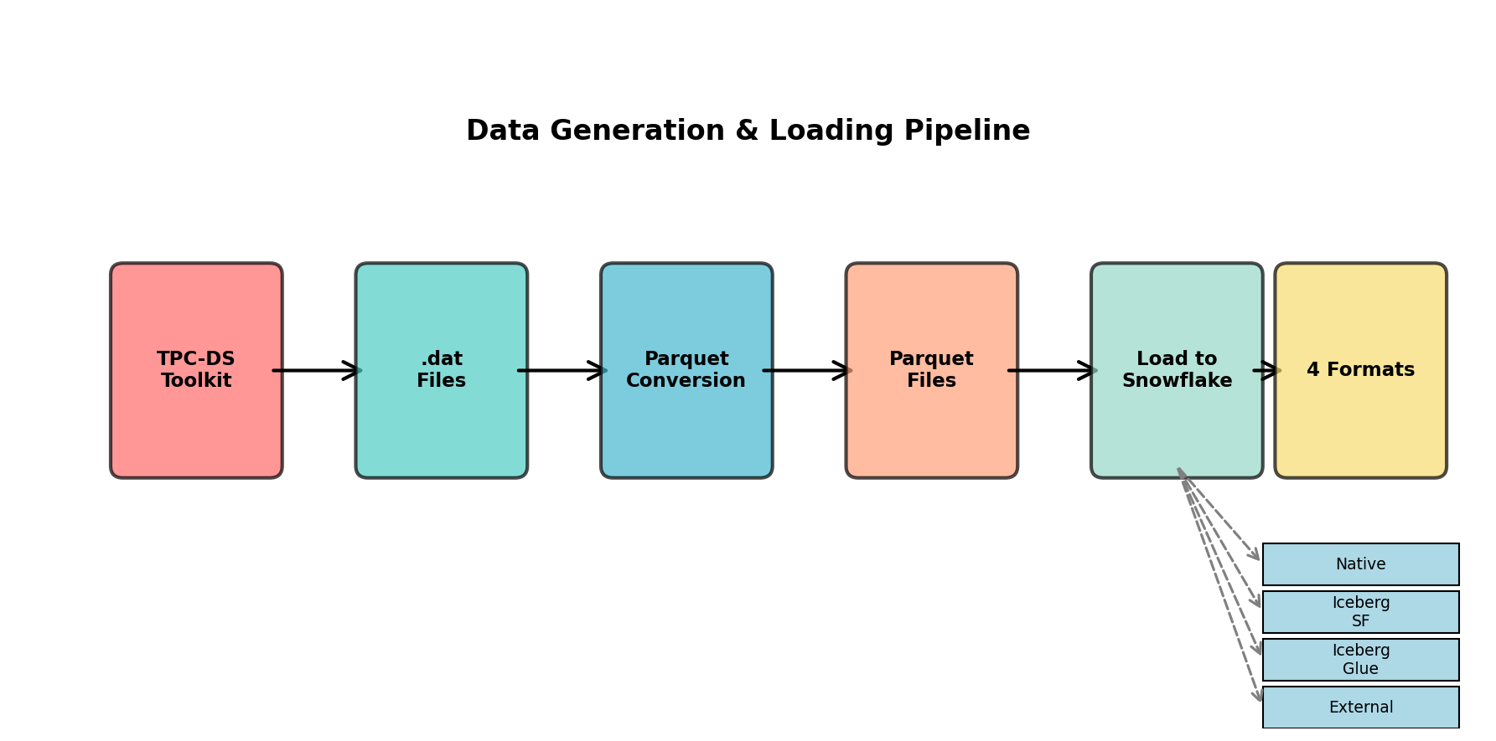
Data Generation & Loading Pipeline

Slide 25
Infrastructure Setup
Before running benchmarks, ensure infrastructure is set up:
AWS Infrastructure (if using Iceberg/External formats)
```bash
cd setup/infrastructure/
terraform init
terraform apply
```
Snowflake Schemas

Slide 26
Infrastructure Setup
Execute SQL scripts in setup/schemas/
Or use the master script: @setup/schemas/create_tpcds_objects.sql
Glue Tables (only for Iceberg Glue format)
```bash
cd setup/glue/
python scripts/create/create_glue_tables.py
```
Data Loading

Slide 27
Infrastructure Setup
```bash
cd setup/data/
python main.py --action full --scale-factor 0.1
```
Note: For a quick demo, you can skip full infrastructure setup and use test mode with existing data.

Slide 28
Quick Start - Test Mode
For a demonstration or quick validation, use test mode which runs a limited set of queries:

Slide 29
Load environment variables
Overview of Load environment variables

Slide 30
Run quick test (5 queries per format)
Overview of Run quick test (5 queries per format)

Slide 31
Standard Test - All Queries
For comprehensive benchmarking:

Slide 32
Run all 99 queries across all 4 formats
Overview of Run all 99 queries across all 4 formats

Slide 33
Custom Test Options
#### Test Specific Formats

Slide 34
Test only Native and Iceberg Snowflake formats
Overview of Test only Native and Iceberg Snowflake formats

Slide 35
Test queries 1-20 (Reporting queries)
Overview of Test queries 1-20 (Reporting queries)

Slide 36
Use custom configuration file
Overview of Use custom configuration file

Slide 37
Command-Line Options Summary
python benchmark/src/main.py [OPTIONS]
Options:
--test-mode Run in test mode (limited queries, faster)
--formats FORMATS Test specific formats (space-separated)
--query-range START END Test specific query range
--config PATH Use custom configuration file
--help Show help message

Slide 38
Configuration Customization
Edit benchmark/config/perf_test_config.yaml to customize:
Test Modes: Quick, standard, comprehensive, stress
Performance Thresholds: Max execution time, memory limits
Reporting Options: HTML, JSON, CSV, PDF generation
Query Settings: Timeouts, caching, safety limits
Cost Pricing: Snowflake credits, AWS pricing

Slide 39
Execution Flow
When you run the benchmark, here's what happens:
Initialization
Loads configuration
Connects to Snowflake
Validates environment
Query Execution (per format)
For each query:
Warmup run(s) to prime caches

Slide 40
Execution Flow
Test run(s) with metrics collection
Error handling and retries
Metrics storage
Metrics Collection
Execution time
Data scanned (bytes)
Rows produced
Cache hit ratio

Slide 41
Execution Flow
Credits used
Memory usage
Cost calculations
Analysis and Reporting
Statistical analysis
Format comparison
Cost analysis
Report generation

Slide 42
Monitoring Progress
The benchmark provides real-time progress updates:
[INFO] Starting performance test...
[INFO] Testing format: native
[INFO] Executing query 1/99: q01.sql
[INFO] Query 1 completed in 2.3s
[INFO] Executing query 2/99: q02.sql
...

Slide 43
Monitoring Progress
Logs are saved to benchmark/logs/tpcds_perf_test.log for detailed tracking.

Slide 44
Output Locations
All results are saved to the results/ directory:
results/
├── performance_data/ # Raw performance metrics
│ └── tpcds_performance_data_TIMESTAMP.csv
├── reports/ # Generated reports
│ └── tpcds_performance_report_TIMESTAMP.html
├── tpcds_performance_report_TIMESTAMP.json
└── tpcds_analytics_TIMESTAMP.json

Slide 45
Report Types
#### 1. HTML Reports (Interactive)
Location: results/reports/tpcds_performance_report_TIMESTAMP.html
Features:
Interactive performance charts
Format comparison tables
Query performance rankings
Success rate analysis
Cost breakdowns

Slide 46
Report Types
Visual format comparisons
How to View:

Slide 47
Open in browser
Overview of Open in browser

Slide 48
Key Metrics Explained
#### Performance Metrics
Execution Time (seconds)
Time to complete query execution
Lower is better
Includes query compilation and execution
Data Scanned (bytes)
Amount of data read from storage
Indicates query efficiency

Slide 49
Key Metrics Explained
Lower is better (with same results)
Rows Produced
Number of result rows
Validates query correctness
Should match across formats
Cache Hit Ratio (%)
Percentage of data served from cache
Higher is better

Slide 50
Key Metrics Explained
Indicates query pattern efficiency
#### Cost Metrics
Compute Credits
Snowflake compute credits consumed
Based on warehouse size × execution time
Formula: (Warehouse Multiplier × Seconds) / 3600
Compute Cost (USD)
Cost based on credits × credit price

Slide 51
Key Metrics Explained
Default: $3 per credit
Storage Cost (USD)
Snowflake storage costs (Native format)
S3 storage costs (External formats)
Based on data volume and storage class
Total Cost (USD)
Sum of all cost components
Includes compute, storage, S3 requests, Glue API calls, data transfer

Slide 52
Key Metrics Explained
#### Warehouse Metrics
Warehouse Size: X-Small (1x) through 4X-Large (128x)
Warehouse Multiplier: Credit consumption multiplier
Auto-suspend Time: Idle time before suspension

Slide 53
Format Comparison Insights
The reports provide several comparison views:
Overall Performance Ranking
Which format is fastest overall
Performance by query category
Consistency across query types
Cost Comparison
Total cost per format
Cost per query

Slide 54
Format Comparison Insights
Cost-performance ratio
Query-Specific Analysis
Which format performs best for specific queries
Query patterns that favor certain formats
Optimization opportunities
Statistical Analysis
ANOVA tests for format differences
Confidence intervals

Slide 55
Format Comparison Insights
Effect sizes

Slide 56
Interpreting Results
#### Performance Winners
Look for:
Fastest Average Execution Time: Best overall performance
Most Consistent Performance: Lowest standard deviation
Best Cache Utilization: Highest cache hit ratios
Best for Specific Query Types: Format-specific strengths
#### Cost Winners
Look for:

Slide 57
Interpreting Results
Lowest Total Cost: Most cost-effective format
Best Cost-Performance Ratio: Best value
Lowest Compute Costs: Most efficient warehouse usage
Lowest Storage Costs: Most efficient storage utilization
#### Trade-offs
Consider:
Performance vs. Cost: Faster formats may cost more
Features vs. Performance: More features may impact performance

Slide 58
Interpreting Results
Compatibility vs. Optimization: Cross-platform may sacrifice optimization

Slide 59
Example Results Interpretation
Scenario: Native format is 20% faster but 30% more expensive than External format.
Insights:
Native provides better performance for time-sensitive workloads
External provides better cost efficiency for batch workloads
Decision depends on performance requirements vs. budget constraints
Recommendation: Use Native for real-time dashboards, External for batch reporting.

Slide 60
Business Value Proposition
This benchmark provides quantifiable, data-driven insights for critical architectural decisions:
Risk Mitigation
Make informed decisions before committing to a format
Avoid costly migrations due to poor initial choices
Understand trade-offs before implementation
Cost Optimization
Identify cost savings opportunities
Optimize warehouse sizing

Slide 61
Business Value Proposition
Reduce total cost of ownership
Performance Optimization
Identify performance bottlenecks
Optimize query patterns
Right-size infrastructure
Strategic Planning
Plan migrations with confidence
Evaluate new technologies

Slide 62
Business Value Proposition
Support business case development

Slide 63
Technical Insights Provided
The benchmark delivers comprehensive technical analysis:
Performance Characteristics
Query execution patterns
Format-specific optimizations
Cache behavior
Resource utilization
Scalability Analysis
Performance at different data volumes

Slide 64
Technical Insights Provided
Warehouse size optimization
Concurrent query handling
Cost Breakdown
Component-level cost analysis
Cost drivers identification
Optimization opportunities
Statistical Validity
Multiple test runs for reliability

Slide 65
Technical Insights Provided
Confidence intervals
Statistical significance testing

Slide 66
Cost Optimization Opportunities
The benchmark identifies specific optimization opportunities:
Warehouse Sizing
Right-size warehouses based on workload
Balance performance vs. cost
Optimize auto-suspend settings
Query Optimization
Identify slow queries
Optimize data scanning

Slide 67
Cost Optimization Opportunities
Improve cache utilization
Format Selection
Choose format based on workload
Optimize for cost vs. performance
Consider feature requirements
Storage Optimization
Optimize S3 storage classes
Implement lifecycle policies

Slide 68
Cost Optimization Opportunities
Reduce storage costs

Slide 69
Decision-Making Support
The benchmark provides actionable insights for:
Architecture Decisions
Which format to use for new projects
Migration planning
Hybrid architecture design
Performance Tuning
Query optimization priorities
Infrastructure sizing

Slide 70
Decision-Making Support
Caching strategies
Cost Management
Budget planning
Cost allocation
ROI calculations
Capacity Planning
Resource requirements
Scaling strategies

Slide 71
Decision-Making Support
Performance projections

Slide 72
Real-World Applications
#### Use Case 1: New Data Lake Architecture
Scenario: Building a new data lake and deciding between formats.
Value: Benchmark provides performance and cost data to make informed decision.
Outcome: Choose format that balances performance, cost, and feature requirements.
#### Use Case 2: Migration Planning
Scenario: Migrating from Native to Iceberg format.
Value: Understand performance impact and cost implications before migration.
Outcome: Plan migration with confidence, optimize for target format.

Slide 73
Real-World Applications
#### Use Case 3: Cost Optimization
Scenario: Reducing Snowflake costs.
Value: Identify cost drivers and optimization opportunities.
Outcome: Reduce costs by 20-40% through format optimization and warehouse sizing.
#### Use Case 4: Performance Troubleshooting
Scenario: Queries running slower than expected.
Value: Compare performance across formats to identify bottlenecks.
Outcome: Optimize queries and infrastructure based on benchmark insights.

Slide 74
ROI Considerations
Investment:
Setup time: 2-4 hours (one-time)
Test execution: 2-6 hours (per test run)
Analysis time: 1-2 hours
Returns:
Cost Savings: 20-40% reduction in cloud costs
Performance Gains: 10-30% improvement in query performance
Risk Reduction: Avoid costly architectural mistakes

Slide 75
ROI Considerations
Time Savings: Faster decision-making with data-driven insights
Break-Even: Typically achieved within first month of implementation.

Slide 76
Competitive Advantages
Organizations using this benchmark gain:
Data-Driven Decisions: Make decisions based on data, not assumptions
Cost Efficiency: Optimize costs while maintaining performance
Performance Excellence: Achieve best-in-class query performance
Strategic Flexibility: Understand trade-offs for future planning

Slide 77
Immediate Actions
Run Your First Benchmark
```bash
# Quick test to validate setup
python benchmark/src/main.py --test-mode
```
Review Results
Open HTML report in browser
Review format comparisons

Slide 78
Immediate Actions
Identify key insights
Analyze Your Workload
Map your queries to TPC-DS query categories
Identify which formats perform best for your patterns
Consider cost implications

Slide 79
Going Beyond the Demo
Full Benchmark Suite
Run comprehensive test with all 99 queries
Test multiple scale factors
Compare different warehouse sizes
Custom Analysis
Export CSV data for custom analysis
Create custom visualizations
Integrate with your analytics tools

Slide 80
Going Beyond the Demo
Continuous Monitoring
Run benchmarks regularly
Track performance trends
Monitor cost changes
Optimization Implementation
Implement format recommendations
Optimize warehouse sizing
Tune queries based on insights

Slide 81
Advanced Usage
Custom Query Testing
Add your own queries to the benchmark
Test format-specific optimizations
Validate performance improvements
Multi-Scale Factor Analysis
Test at different data volumes
Understand scalability characteristics
Plan for growth

Slide 82
Advanced Usage
Cost Modeling
Model costs for different scenarios
Plan budgets based on benchmark data
Calculate ROI for optimizations

Slide 83
Resources and Documentation
Main README: README.md - Project overview
Setup Guide: setup/README.md - Detailed setup instructions
Benchmark Guide: benchmark/README.md - Testing framework documentation
Cost Optimization: docs/cost-optimization-guide.md - Cost analysis guide
Troubleshooting: docs/troubleshooting-journey.md - Common issues and solutions

Slide 84
Getting Help
Review troubleshooting guides in docs/
Check logs in benchmark/logs/ and results/logs/
Verify environment configuration
Test Snowflake connectivity separately

Slide 85
Contributing
If you find improvements or have suggestions:
Report issues
Contribute optimizations
Share benchmark results (anonymized)
Improve documentation

Slide 86
Summary
The Snowflake Iceberg Performance Benchmark provides a comprehensive, data-driven approach to evaluating table storage formats. By running this benchmark, you gain:
Quantifiable Performance Data: Real metrics on execution time, throughput, and efficiency
Cost Insights: Detailed cost breakdowns and optimization opportunities
Decision Support: Data-driven recommendations for architectural choices
Risk Mitigation: Understand trade-offs before committing to a format
Whether you're evaluating formats for a new project, planning a migration, or optimizing costs, this benchmark provides the insights you need to make informed decisions.
Start your benchmark today and make data-driven architectural decisions!

Slide 87
Summary
Quantifiable Performance Data: Real metrics on execution time, throughput, and efficiency
Cost Insights: Detailed cost breakdowns and optimization opportunities
Decision Support: Data-driven recommendations for architectural choices
Risk Mitigation: Understand trade-offs before committing to a format

