Slide 1



AI Fundamentals REST, Playground, Code
Rick Caudle
Principal Cloud Solution Architect
Notes:
This session is designed to dive into the fundamentals of AI. Just like building a house, you need to have a strong foundation, so if you want to be a solid developer of AI solutions, it’s very important to have a strong understanding of the fundamentals.

Slide 2







Agenda
Prompt Engineering
Chat Completions
Agentic Workflow
Postman & Curl
Code Samples
RAG
AI Playground
Notes:
Our agenda for today is to dive into prompt engineering, why it’s important and various patterns, we will also talk about agentic workflows, the next big thing, Retrieval Augmented Generation, Chat Completions, using Postman & Curl to learn the endpoints and also using the AI Playground to experiment. If time permits we will dive into some code samples.

Slide 3
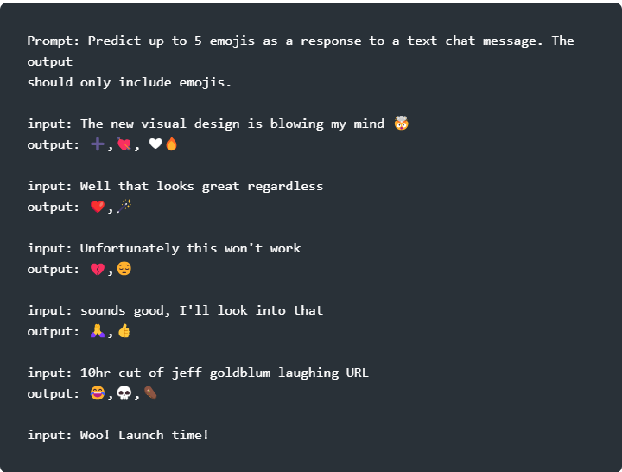
Prompt Engineering
Zero, One and Few-Shot prompting
Why is the Sky Blue?
Zero-Shot
One-Shot
Few-Shot
Chain-of-thought
Great Linkedin post on prompt engineering
Notes:
Zero-Shot: Simplest type of prompt, provides no example to the model, just instructions
One-Shot: shows the model one clear, descriptive example of what you like to imitate.
Few-Shot: shows the model multiple examples of the input and output.
Chain-of-thought: Encourages the LLM to explain its’ reasoning. Combine it with few-shot to get better results

Slide 4
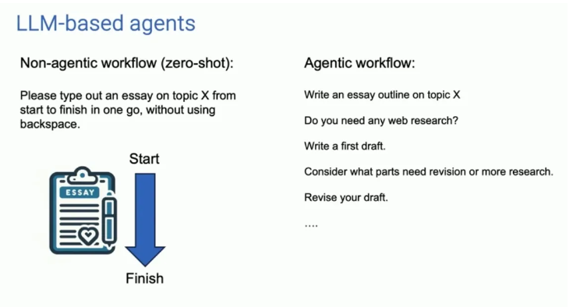
Agentic workflow
Yields remarkably better results
Interactions today are mostly non-agentic
Prompt generate a response
Agentic allows for more intuitive workflows
Agentic Reasoning
Generate the code but also evaluate the output
Tool Utilization
Planning
Self-RAG (Self-Reflective)
Notes:
Agentic workflow is a new way of leveraging the power of LLMs. You provide a task, it plans the steps needed, writes a first draft, does some reflection, makes changes then completes the task. What makes this so powerful is the ability to make use of tools, can take advantage of Self-Reflective RAG. A good example of this is the AutoGen Framework, or Assistants API. But, you can actually so this today without Assistants API or AutoGen, you can leverage something like the Semantic Kernel.
Let’s more onto RAG now.

Slide 5
(RAG) Retrieval Augmented Generation
Injecting external knowledge
Interactions today are mostly non-agentic
Prompt generate a response
Agentic allows for more intuitive workflows
Agentic Reasoning
Generate the code but also evaluate the output
Tool Utilization
Planning
Self-RAG (Self-Reflective)
Great Linkedin post on prompt engineering
Notes:
Retrieval = retrieve information from a data source
Augment = add this date to the prompt
Generation = allow for generation of better responses using the retrieved data.
RAG is one of the most important patterns that is being used with the LLMs today. For example, if you invoke a plugin to retrieve some data then you hand that data to the LLM for summarization, you are using RAG. It qualifies as RAG if are you retrieve any data that the LLM has no knowledge of then you use that information with the LLM. A good example would be allowing your Chat Bot to provide weather information. LLMs cannot tell you want the current weather is based on the knowledge they have been trained on, it has to be injected into the prompt.

Slide 6
AOAI: REST APIs
Understand the AOAI REST API reference
chat/completions
extensions/chat/completions
Request Body
Response Body
Temperature
Top_p
Notes:
Temperature: A setting that controls how “creative” or “random” the output is. Low-Temp = more deterministic, like following a strict recipe. High-Temp = Wild! Output becomes more random, like a chef experimenting.
Top_p: Is like a spotlight, focuses on the most likely words during text generation. Default = 1.0 so model considers all words, but it you lower it, only the most probable words get attention. It’s a way to control the variety of words in the output, so this does impact the token usage.

Slide 7
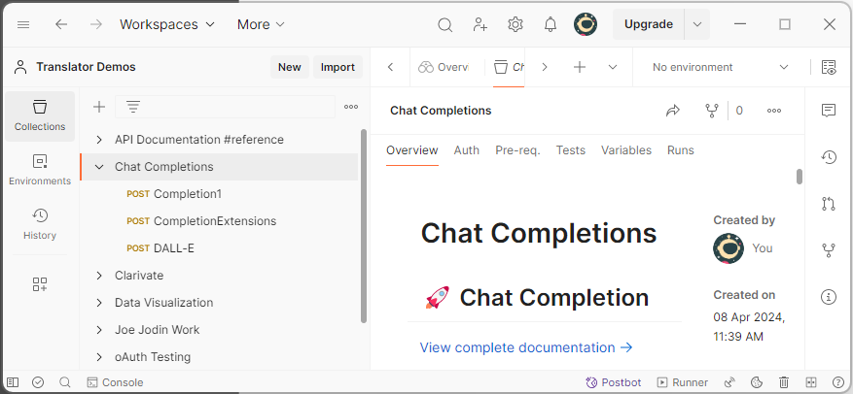
Postman or Curl
Quickest way to learn how the endpoints work
Install Postman
Build POST requests for Completions, Extensions Completions, Image Generation etc.
Understand the Request/Response Bodies
Building Collections
Required Headers
Notes:
Temperature: A setting that controls how “creative” or “random” the output is. Low-Temp = more deterministic, like following a strict recipe. High-Temp = Wild! Output becomes more random, like a chef experimenting.
Top_p: Is like a spotlight, focuses on the most likely words during text generation. Default = 1.0 so model considers all words, but it you lower it, only the most probable words get attention. It’s a way to control the variety of words in the output, so this does impact the token usage.

Slide 8
Azure Open AI Playground
Testing and Learning concepts with the Playground
Simple Chat Completion
(RAG) / Chat with your data
Building Indexes with Playground
Building Indexes without Playground
Notes:
Temperature: A setting that controls how “creative” or “random” the output is. Low-Temp = more deterministic, like following a strict recipe. High-Temp = Wild! Output becomes more random, like a chef experimenting.
Top_p: Is like a spotlight, focuses on the most likely words during text generation. Default = 1.0 so model considers all words, but it you lower it, only the most probable words get attention. It’s a way to control the variety of words in the output, so this does impact the token usage.

Slide 9

Code Samples
Let’s write some code!
Notes:
10

