Slide 1



Semantic Kernel 101 Basics to Advanced Concepts
Lesson 2 Prompts and Plugins
Host:
Rick Caudle
Cloud Solution Architect
Notes:
In this week’s session for Lession 2 we are going to start diving into SK Prompts and Plugins. These two areas are the core of SK that make it so powerful. Lets get right into the agenda for today’s lesson.

Slide 2
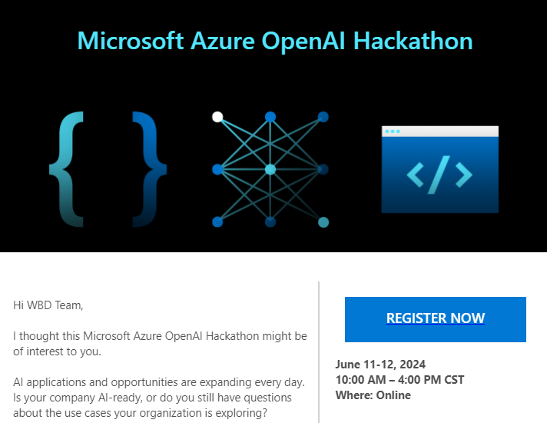
Important Message!!
Sign-up as a Coach!!
https://forms.office.com/r/X7rK5cc4Xj
Notes:
https://forms.office.com/r/X7rK5cc4Xj

Slide 3



Agenda
What are SK prompts?
What are plugins?
LET’s write some code
Notes:
Let’s get right into the Agenda. I have 3 guest speakers joining us today. Matthew will be providing us with SK roadmap update, Sophia will provide a doc/sample update and Chris will give an update on Features. I will then dive into Why SK then we will dive right into Lesson 1 by building our first app.

Slide 4
SK: Plugins
::5
Building blocks for you AI solution
Define the tasks the Kernel should complete
Can include native code and prompts
Serving as one of the core features and body of your AI solution
Can use built-in or create your own
Can pass arguments to prompt
Can load Prompts into Plugin collection for Auto Invoke
Notes:
Before we get into the prompts I want to reiterate the importance of understanding the Chat Completion API structures, specifically the messages array. 1st – I’d recommend that you take a close look at the Azure OpenAI REST API reference document. 2nd – I would recommend that you play with the Chat Completion endpoints using Postman. You can find a Postman Chat Completion Collection in my AI Fundamentals repo. So all of you are familiar with Interpolated Strings. You can see I have a simple C# example in-which I am injected the age and name of a person using an Interpolated string. This is a fundamental concept that exists in most languages. So now lets take this Interpolated String example and use it with Semantic Kernel. Here you see I have an Input Variable and a prompt variable which is an interpolated string. Now, by combining our knowledge of the Chat Completion Message Structure, we and use that in our Interpolated string. I am showing you this because there are various ways to deal with Prompts in Semantic Kernel and each have their place. We see each of these concepts in action when I get to the actually demos.

Slide 5
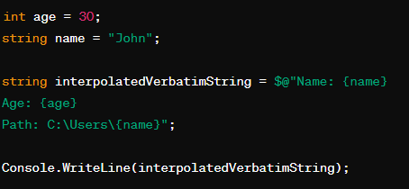
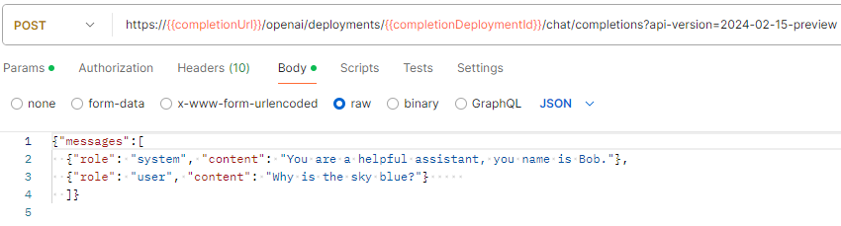
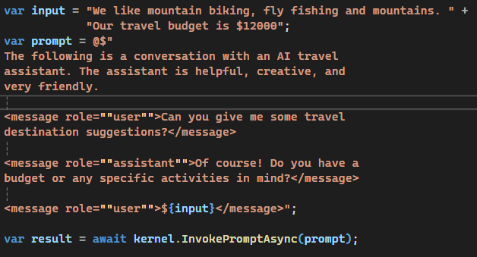
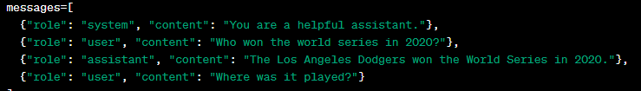
SK: Prompts
::5
Chat Completion Message Structure
Interpolated Strings
Chat Completion – Message Structure
https://github.com/Rickcau/AI-Fundamentals
Notes:
Before we get into the prompts I want to reiterate the importance of understanding the Chat Completion API structures, specifically the messages array. 1st – I’d recommend that you take a close look at the Azure OpenAI REST API reference document. 2nd – I would recommend that you play with the Chat Completion endpoints using Postman. You can find a Postman Chat Completion Collection in my AI Fundamentals repo. So all of you are familiar with Interpolated Strings. You can see I have a simple C# example in-which I am injected the age and name of a person using an Interpolated string. This is a fundamental concept that exists in most languages. So now lets take this Interpolated String example and use it with Semantic Kernel. Here you see I have an Input Variable and a prompt variable which is an interpolated string. Now, by combining our knowledge of the Chat Completion Message Structure, we and use that in our Interpolated string. I am showing you this because there are various ways to deal with Prompts in Semantic Kernel and each have their place. We see each of these concepts in action when I get to the actually demos.

Slide 6
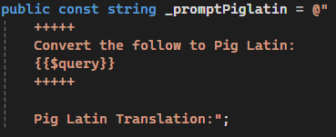
SK: Prompts
::3
SK Template Language
Templated Language
Can also use Interpolated Stings
Can inject Message Roles into Prompt
Use inline or load from file
Can Invoke plugins from prompt
Can pass arguments to prompt
Can load Prompts into Plugin collection for Auto Invoke
Interpolated Strings
Notes:
Let’s take a look at how we use prompts in Semantic Kernel. We have the typical SK Template Language which you see here. You can see it uses a similar pattern that you say in the Interpolated String I just showed you with the exception that it uses two curly braces on each side. The $query denotes an argument that I can pass into the prompt when it’s loaded. I can also use this syntax to call functions that are exposed via plugins. SK understands the Chat Completion Message structure so you can inject that into your prompt as well, as demonstrated with this last example.

Slide 7
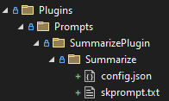
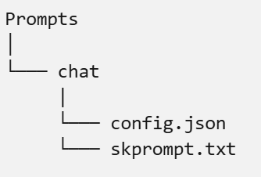
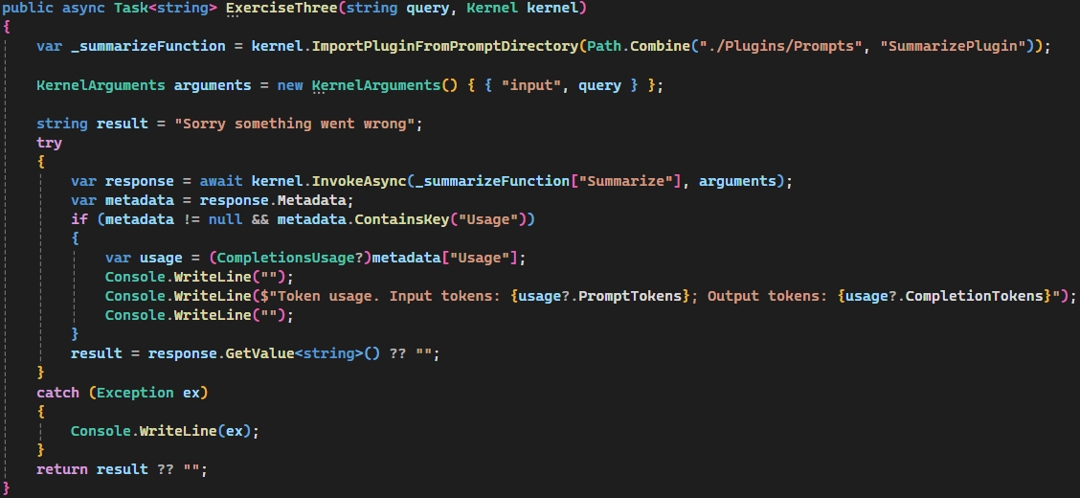
SK: Prompts – Load from file
::2
Folder Structure I use
Folder Structure
Example: Loading from file/directory
Notes:
Now, let’s talk about loading prompts from file. This is a very powerful feature as you can change your prompts without redeploying the app, all you have to do is change the files on disk. We use the ImportPluginFromPromptDirectory() to load the plugins/prompts from disk. We say plugins/prompts

Slide 8
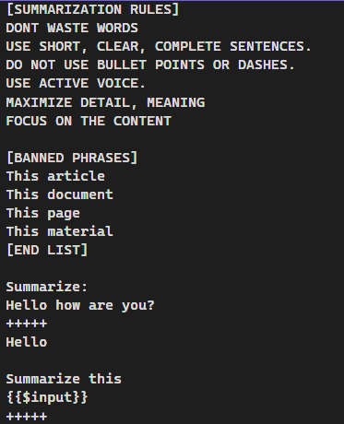
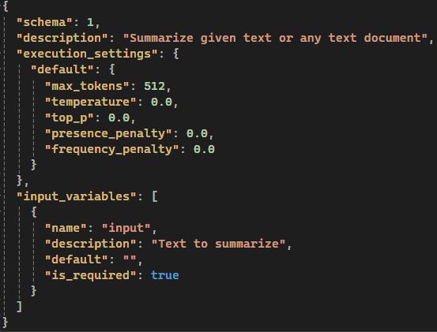
SK: Prompts – Load from file
::2
Folder Structure
skprompt.txt
config.json
Notes:
10

Slide 9

Why SK?
Easy to use and lightweight
Parity across .NET, Python and Java
Committed to not introducing anymore breaking changes to non-experimental features as of V1.0
More connectors to the most popular models i.e. Gemini, Llama, Mistral, Claude and many others
Make it easier to support Multi-Modal experiences i.e. audio, images, videos etc.
Integrated agent support
Notes:
In order to make complex and use AI based solutions, you really need more than just the power of the LLM. What you need are ways to integrate with the power of the models and this is where framework like Semantic Kernel can take your solutions to the next level. SK is easy to use and is lightweight, you can expect parity across .NET, Python and Java and this is not something we can say about Langchain today. We are committed to not introducing anymore breaking changes for non-experimental features as of 1.0.
You can expect to see more connectors for the most popular models like Gemini, Lama, Claude and many more.
We will make it easier to support Multi-Modal experiences i.e. interacting with audio, images, videos etc.
We already have first-class for support for agents AKA Assistants API, and you can expect this to be a very important workstream. I fully expect customer will be refactoring many of their solutions to use Agents soon.
I hope this helps you better understand why making use of Orchestration Framework like SK is a good idea. Let’s get right into building our first SK App.

Slide 10

Let’s build our first SK App!
Notes:
As noted earlier, this session is intended to be a hands-on keyboard type of

