Slide 1



Semantic Kernel 101 Basics to Advanced Concepts
Lesson 2 Plugins & Prompts
Host:
Rick Caudle
Cloud Solution Architect
Notes:
In this week’s session for Lession 2 we are going to start diving into SK Prompts and Plugins. These two areas are the core of SK that make it so powerful. Lets get right into the agenda for today’s lesson.

Slide 2
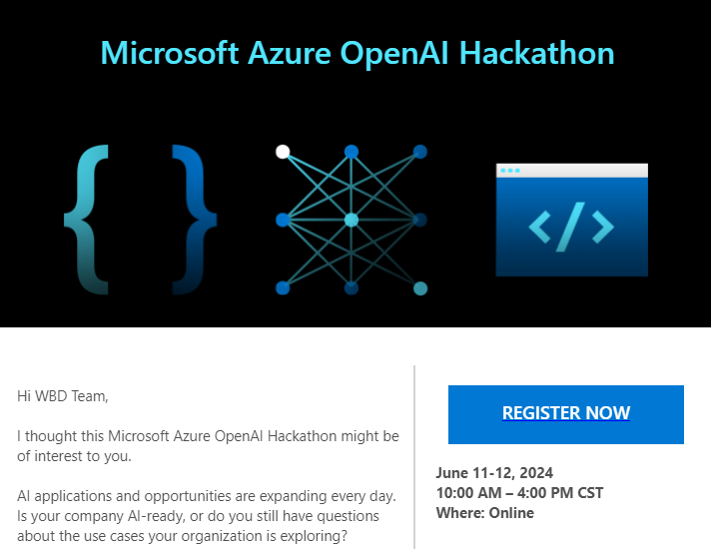
Important Message!!
Sign-up as a Coach!!
https://forms.office.com/r/X7rK5cc4Xj
Notes:
https://forms.office.com/r/X7rK5cc4Xj

Slide 3



Agenda
What are plugins?
What are SK prompts?
LET’s write some code

Slide 4
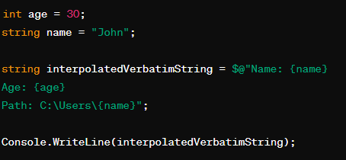
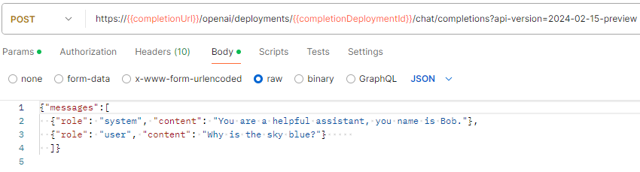
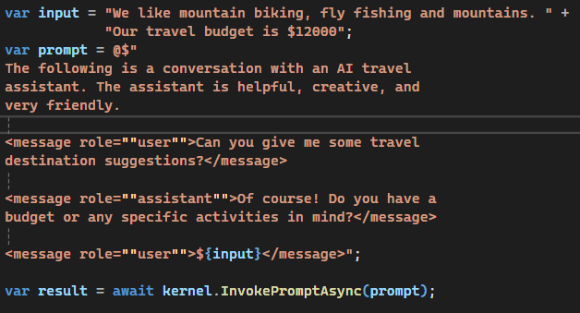
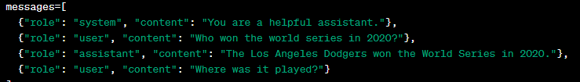
Chat Completion
::5
Chat Completion Message Structure
Interpolated Strings
Chat Completion – Message Structure
https://github.com/Rickcau/AI-Fundamentals
Notes:
Before we get into the prompts I want to reiterate the importance of understanding the Chat Completion API structures, specifically the messages array. 1st – I’d recommend that you take a close look at the Azure OpenAI REST API reference document. 2nd – I would recommend that you play with the Chat Completion endpoints using Postman. You can find a Postman Chat Completion Collection in my AI Fundamentals repo. So all of you are familiar with Interpolated Strings. You can see I have a simple C# example in-which I am injected the age and name of a person using an Interpolated string. This is a fundamental concept that exists in most languages. So now lets take this Interpolated String example and use it with Semantic Kernel. Here you see I have an Input Variable and a prompt variable which is an interpolated string. Now, by combining our knowledge of the Chat Completion Message Structure, we and use that in our Interpolated string. I am showing you this because there are various ways to deal with Prompts in Semantic Kernel and each have their place. We see each of these concepts in action when I get to the actually demos.

Slide 5
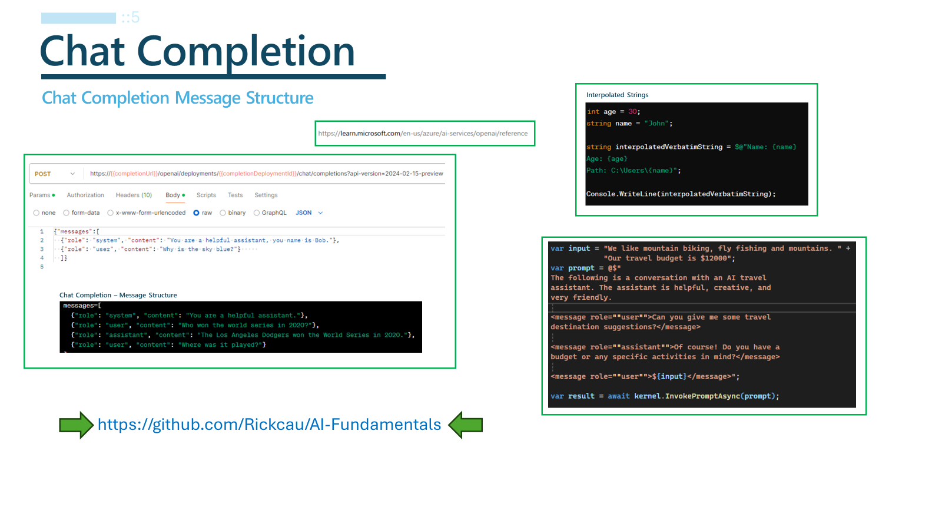

Slide 6
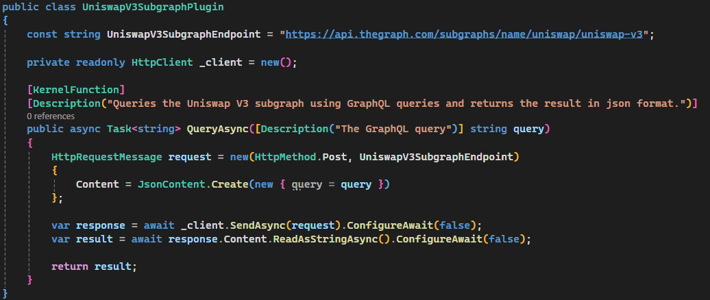
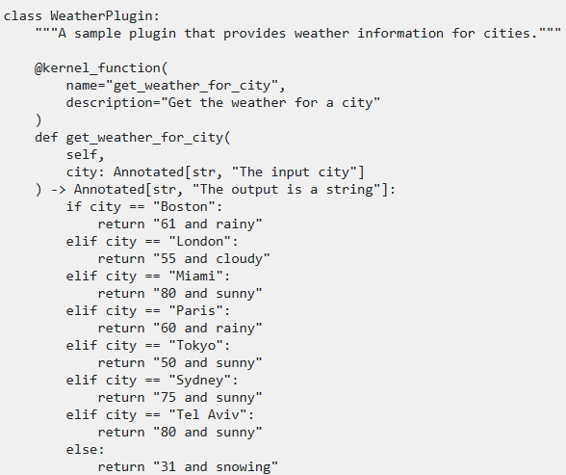
SK: Plugins
::2
Basically, everything is a Plugin!
Building blocks for you AI solution
Define the tasks the Kernel should complete
Can include native code and prompts
Serves as one of the core features and body of your AI solution
Can use built-in or create your own
Can pass arguments
Can load Prompts into Plugin collection for Auto Invoke
Notes:
Before I dive into Native Plugins, let me cover the prompt aspect of SK

Slide 7
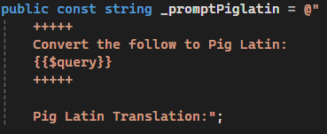
SK: Prompts
::3
SK Template Language
Templated Language
Can also use Interpolated Stings
Can inject Message Roles into Prompt
Use inline or load from file
Can Invoke plugins from prompt
Can pass arguments to prompt
Can load Prompts into Plugin collection for Auto Invoke
Interpolated Strings
Notes:
Let’s look at how we use prompts in Semantic Kernel and how those become plugins. We have the typical SK Template Language which you see here. You can see it uses a similar pattern that you say in the Interpolated String I just showed you with the exception that it uses two curly braces on each side. The $query denotes an argument that I can pass into the prompt when it’s loaded. I can also use this syntax to call functions that are exposed via plugins. SK understands the Chat Completion Message structure so you can inject that into your prompt as well, as demonstrated with this last example.

Slide 8
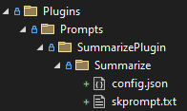
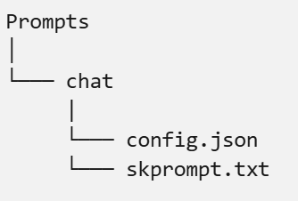
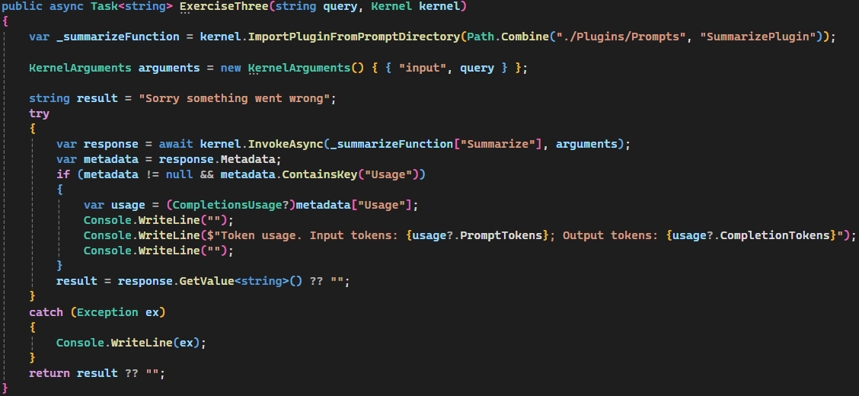
SK: Prompts – Load from file
::2
Folder Structure I use
Folder Structure
Example: Loading from file/directory
Notes:
Now, let’s talk about loading prompts from file. This is a very powerful feature as you can change your prompts without redeploying the app, all you have to do is change the files on disk. We use the ImportPluginFromPromptDirectory() to load the plugins/prompts from disk. We say plugins/prompts

Slide 9
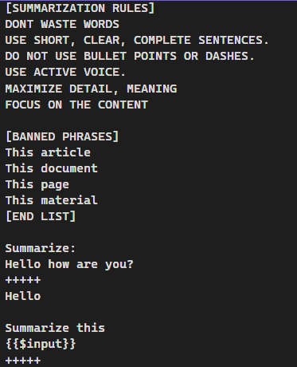
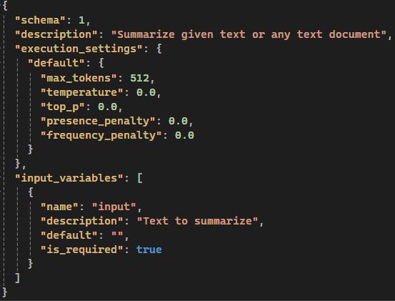
SK: Prompts – Load from file
::2
Folder Structure
skprompt.txt
config.json
Notes:
10

Slide 10

Let’s dive into the code.
Notes:
As noted earlier, this session is intended to be a hands-on keyboard type of

