Slide 1
INGEGNERIA DEI SISTEMI SOFTWARE M - 72939
a.a. 2019-2020
Antonio Natali - antonio.natali@unibo.it
https://github.com/anatali/iss2020LabBo
Link a lezioni

Slide 2
INGEGNERIA
Da https://it.wikipedia.org/wiki/Ingegneria:
L'ingegneria è la disciplina, a forte connotazione tecnico-scientifica, che ha come obiettivo l'applicazione di conoscenze e risultati propri delle scienze matematiche, fisiche e naturali per produrre sistemi e soluzioni in grado di soddisfare esigenze tecniche e materiali della società attraverso le fasi della progettazione, realizzazione e gestione degli stessi.

Slide 3
Ingegneria del software
Da https://it.wikipedia.org/wiki/Ingegneria_del_software
disciplina che si occupa dei processi produttivi e delle metodologie di sviluppo finalizzate alla realizzazione di sistemi software.
si propone una serie di obiettivi legati all'evoluzione dello sviluppo del software (inteso come attività industriale) sia da un punto di vista tecnologico (per esempio attraverso la definizione di nuovi linguaggi di programmazione) che metodologico (per esempio il perfezionamento dei modelli di ciclo di vita del software).

Slide 4
INGEGNERE
Realizza progetti
Da cui si realizzano prodotti
Partendo da una analisi del problema dato
Definito da un insieme di requisiti
PROBLEMA
Difficoltà che richiede un adattamento o un comportamento particolare, o di cui si impone il superamento.
PROBLEMATICA
Complesso dei temi presi in considerazione in rapporto a determinati rami del sapere o a determinati interessi.

Slide 5
INGEGNERE DEL SOFTWARE
MAIN GOAL: Implement a feature that matches specification and works efficiently, but at minimum development and maintenance cost, using minimum effort and in minimum amount of time (and optionally get maximum payment for doing so)
Per noi, un INGEGNERE che fa suo il motto:
there is no code without a project,
no project without problem analysis , and
no problem without requirements
See also:
https://www.quora.com/As-a-programmer-what-is-your-favorite-motto

Slide 6
OUR GOALS
(Learn to) design, build (deploy/maintain) software systems …
made of software components …
that interact in a local environment and/or via Internet …
whose behavior is expressed in some programming language (Java, Kotlin, Python, JavaScript/Node, C, C++, … ) …
with the aim to solve problems in application domains (e.g. IOT ) that demands distributed, heterogeneous systems based on (micro)services and Domain Driven Design
by following a ‘hands on’ approach (learning by doing/by example)
working in teams of (3 person each)
according to agile, incremental and model-driven development

Slide 7
Software systems
Not ‘simply’ algorithms , but … ???
… we will discuss and ‘discover’

Slide 8
Software component
At language level:
Function
Object
Coroutine
Actor
Agent
…
At architecture (layered, subsumption, hexagonal …) level:
Views – Models – Controllers / DAO( DataAccesObjects)
(Micro)Services
Plugins
API
…

Slide 9
Component Interaction
Produre-call
Message-passing (local or remote)
Synchronous / Asynchronous
…
Request-response (HTTP – REST )
CoAP
TCP / UDP / …
…

Slide 10
Programming language
Looking at … :
https://en.wikipedia.org/wiki/List_of_programming_languages
https://en.wikipedia.org/wiki/List_of_programming_languages_by_type
https://en.wikipedia.org/wiki/Comparison_of_programming_languages
https://en.wikipedia.org/wiki/History_of_programming_languages
… we could get lost
Towards technology-independence (being technology-aware)
means not being biased towards any particular platform or software language.
It’s about selecting the right technology that fits the solution, not fitting the solution around the technology.

Slide 11
Distributed systems
A distributed system is a system whose components are located on different networked computers, which communicate and coordinate their actions by passing messages to one another.
The components interact with one another in order to achieve a common goal.
….

Slide 12
Domain Driven Design
an approach to software development for complex needs by connecting the implementation to an evolving model (A system of abstractions that describes selected aspects of a domain and can be used to solve problems related to that domain).

Slide 13
Agile software development
Requirements and solutions evolve through the collaborative effort of self-organizing and cross-functional teams and their customer(s)/end user(s).
Scrum è un framework agile per la gestione del ciclo di sviluppo del software, iterativo ed incrementale, concepito per gestire progetti e prodotti software o applicazioni di sviluppo.
https://www.scrumguides.org/docs/scrumguide/v2017/2017-Scrum-Guide-Italian.pdf

Slide 14
Model Driven Software Development
The approach centers itself on building models of a software system.
MODEL
A model is an abstraction of the system being studied from different perspectives: Structure, Interaction, Behavior (External)
https://www.martinfowler.com/bliki/ModelDrivenSoftwareDevelopment.html
https://en.wikipedia.org/wiki/Model-driven_engineering

Slide 15
Activities
Il laboratorio costituisce una parte essenziale del corso e la frequenza è pressochè indispensabile.
Gli studenti sono tenuti a progettare e costruire in modo incrementale sistemi software, che verranno valutati insi eme al docente, in modo da acquisire una retroazione immediata sul lavoro svolto (autovalutazione) , che potrà essere utilizzata per modificare/migliorare quanto sviluppato.
La valutazione finale consiste nelle presentazione e discussione degli artefatti prodotti in relazione alla costruzione di un sistema software (dello stesso tipo di quello discusso nei CaseStudy proposti durante il corso) che rispetti i requisiti pubblicati l'ultima settimana di lezione.
Questi artefatti possono essere prodotti in modo individuale oppure, preferibilmente, attraverso un lavoro cooperativo svolto in gruppi di 2/3 studenti.

Slide 16
Application0
Design and build a software system to control a DDR (differential drive robot) so that:
The robot is able to explore in a sistematic and autonomus way a room
By showing (in real time) a picture of the explored space

Slide 17
Teaching and Assessment methods
The examination will performed in two-phases.
The first phase starts by publishing a set of requirements and ends with the production of a prototype of a software system satisfying the requirements, toghether with a project site. This phase can be delevoped both in individual way or in a team.
The second phase consists of a individual discussion of the work, in which the student is invited to present the relevant project choices with reference to the theroretical/practical concepts learned during the course.
ESEMPI
TemaFinale1 - TemaFinale2 - TemaFinale3

Slide 18
WORFLOW
Beyond ‘traditional’ programming models: from Java to Kotlin and Node
Towards heterogenous distributed systems by means of DDR Robots based on Arduino and Raspberry
Software design and development : from bottom-up to top-down
-------------------------------------------------------------------------------------------
From problems to projects: the role of requirement/problem analysis and of test planning. The need of MDSD.
The issue of distribution: need of a methodology (design patterns), of proper tools/frameworks and DDD.
From ‘programs’ to Software Architectures based on (micro)services: the need of ‘technoloy independence’ (e.g. from network protocols UDP,TCP,HTTP,CoAP, framerworks, etc. …)
-----------------------------------------------------------------------------------------
Beyond UML: introduction of a custom metamodel / language
Using executable models for agile, incremental software development
Towards automatic code generation: software factories

Slide 19
WORK TO DO
Acquire a paper-notebook and a pencil
Fill our workflow template with your data/photo and print it on a SINGLE SHEET
Download and install tools reported in LabBo2020StartUp
Attempt to fill (at your best) the template with reference to Application0 and print it on a SINGLE SHEET
--------------------------------------------------------------------------------
Evaluate the possibility to build a DDR
Read
https://www.scrumguides.org/docs/scrumguide/v2017/2017-Scrum-Guide-Italian.pdf

Slide 20
Domande (su un sistema)
Cosa deve fare → committente
Cosa deve essere → analista
Quale struttura-interazione-comportamento sono necessari tenendo conto dei vincoli che sorgono dai requisiti e dal problema in sè
Cosa è opportuno che sia → analista
Tenendo conto delle tecnologie, dell’andamento del mercato, delle risorse umane, economiche, temporali, etc.
Come è fatto → progettista
Quale struttura-interazione-comportamento ha il sistema finale tenendo conto dei vincoli dall’analisi e dei criteri (pattern) usati per risolvere le forze (anche contrastanti) in gioco

Slide 21

Workflow
Sviluppiamo l’analisi dei requisiti e l’analisi del problema
Esprimendo fatti rilevanti attraverso modelli essenziali
Discutiamo in modo sistematico avvalendoci di modelli basati su meta-modelli custom
Usiamo i modelli come se fossero il nuovo codice sorgente costruendo generatori di codice usando Xtext (pg. 206)
Realizziamo in modo automatico la schematic part avvelendoci dei design pattern per sistemi distribuiti
Impostiamo piani di collaudo ancor prima di avere iniziato la fase di progettazione
Realizziamo un primo prototipo di prodotto e interagiamo con il committente

Slide 22
Non c’è … senza analisi
NON iniziamo la fase di progetto prima di avere assestato la fase di analisi dei requisiti e l’analisi del problema, con relativa peer-review, al fine di
Individuare i principali sottosistemi
Capire quali tecnologie sono necessarie
Valutare i punti critici, i rischi e i costi
Pianificare l’uso delle risorse e i tempi
Distribuire il lavoro tra le persone

Slide 23
Generic Entity
Data base
Function
Procedure Call
Object
Object with
internal Tread)

Slide 24
Dispatch
Actor
Request
QActor
Reply
Service
Event
CounterMsg
senderActor
receiverActor
counterActor

Slide 25
High-level
application code
(model)
instanceof
qa metamodel
Defined in project
it.unibo.Qactork
SoftwareFactory
(Eclipse Pluigins)
generates
Kotlin code
Inherits from
Runs over
it.unibo.Qactork_1.2.3.jar
it.unibo.Qactork.ide_1.2.3.jar
it.unibo.Qactork.ui_1.2.3.jar
Qak Infrastructure
it.unibo.qakactor-2.3.jar

Slide 26
ctxSender
% SYSTEM DESCRIPTION
context( ctxSender, "192.168.43.229","TCP", "8010" ).
context( ctxReceiver, "192.168.43.229","TCP","8020").
qactor( qasender, ctx1, ‘QActorSender’ ).
qactor( qareceiver, ctx2, ‘QActorReceiver’).
PORT
A message sent by a qactor
to another qactor
is inserted in the message queue
of the destination actor
NodeProxy
ctxReceiver
ReceiverCoroutine
creates
PORT
CtxSeerverAgent
CtxServerAgent : created at start-up
SenderAgent : created a start-up
ReceiverAgent : created at each conn request

Slide 27
ctxSender
ctx…
NodeProxy
TCP
PORT
TCP
PORT
sender
NodeProxy
NodeProxy
NodeProxy
ctxReceiver
ReceiverCoroutine
creates
TCP
PORT
receiver

Slide 28
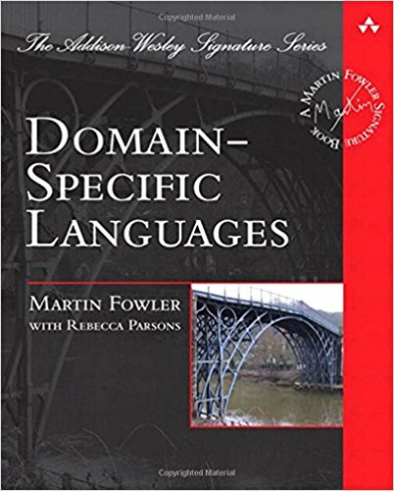
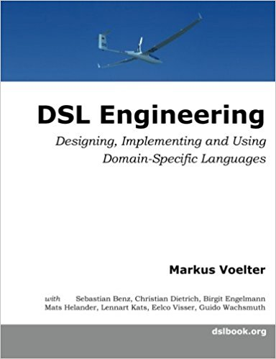
DSL
Domain-Specific Languages
Fowler presents effective techniques for building DSL, and guides software engineers in choosing the right approaches for their applications. This book's techniques may be utilized with most modern object-oriented languages; the author provides numerous examples in Java and C#, as well as selected examples in Ruby
This book provides a thorough introduction to DSL, relying on today’s state of the art language workbenches.
The book provides details about the implementation of DSLs with lots of code. It uses three state-of-the-art but quite different language workbenches: JetBrains MPS, Eclipse Xtext and TU Delft’s Spoofax.
2010
2013
ISBN-10: 0321712943
ISBN-13: 978-0321712943
ISBN-10: 1481218581
ISBN-13: 978-1481218580

Slide 29
VISION
S
architectural
dimensions
B
I
BUSINESS LOGIC
DOMAIN-RELATED TERMINOLOGY
WHAT
APPLICATION LEVEL
Logical Architecture
HOW
HIGH
( MODEL – CONTROL - VIEW )
MAPPING LEVEL
SoftwareFactory
LOW
PLATFORM LEVEL
EDGE
FOG
CLOUD
CONCRETE (IOT) WORLD

Slide 30
ActorBasic
kaq
kactor
abstract actorBody
Message-driven
ApplQActor
override
actorBody
ActorBasic
inherits
kaq
abstract actorBody

Slide 31
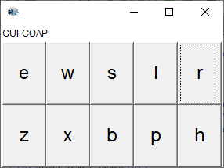
inherits
Message-based (fsm)
ApplFsmQActor
body
ActorBasic
ActorBasicFsm
fsmwork
kaq
abstract actorBody
override actorBody

Slide 32
sonarsimulator
datalogger
datacleaner
distanceFilter
sonarsimulator
datalogger
datacleaner
distanceFilter
qasink
sonarHCSR04SupportActor
robotDataSourceArduino
datacleaner
distanceFilter
obstacle

Slide 33
Domande (su un sistema)
Cosa deve fare → committente
Cosa deve essere → analista
Quale struttura-interazione-comportamento sono necessari tenendo conto dei vincoli che sorgono dai requisiti e dal problema in sè
Cosa è opportuno che sia → analista
Tenendo conto delle tecnologie, dell’andamento del mercato, delle risorse umane, economiche, temporali, etc.
Come è fatto → progettista
Quale struttura-interazione-comportamento ha il sistema finale tenendo conto dei vincoli dall’analisi e dei criteri (pattern) usati per risolvere le forze (anche contrastanti) in gioco

Slide 34
Specifica della grammatica
grammar it.unibo.xtext.Entities with org.eclipse.xtext.common.Terminals
generate entities "http://www.unibo.it/xtext/Entities"
Model : (imports+=Import)*
(types+=Type)* ;
Import : 'import' importURI = STRING;
Type: SimpleType | Entity;
SimpleType: 'type' name = ID;
Entity : 'entity' name=ID ('extends' extends= [ Entity ] )? '{'
properties+=Property*
'}';
Property: 'property' name=ID ':' type= [ Type ] ( many ?= '[]')?;
EBNF notation
The grammar is a collection of Rules.
Rules start with their name followed by : and ending with ;
The editor provides code completion and constraint checking for the grammars themselves

Slide 35
a:Int, b:Int
Int
Unit
k:Int
Int
sendMsg(
jsonString: String)
socket
clientWenvTcpObj
(starts a coroutine to read sonar data)
ctx1
ctx2

Slide 36
init ….
end …
move …
domove( cmd: String )
socket
robotActorTry
virtualRobotSupport
(starts a sensorObserver coroutine that
sends messages to robotActorTry)
sensor ….
collision …
ε-move
init
doInit
end
doEnd
working
move
doMove
sensor
doSensor
ε-move
collision
doCollision

Slide 37
collision
doCollision
start
doInit
end
doEnd
receive
stop
doStop
resume
ε-move
doResume
sensor
elabSensor

Slide 38
Dispatch
Request
Reply
Event
msg(move, dispatch, main, robotactor, w, 1)
domove( cmd: String )
socket
robotActor
virtualRobotSupport
(starts a sensorObserver coroutine that
sends messages to robotActor)
msg(sensor,dispatch,vr,robotactor, collision-bottle2, 6)

Slide 39
Init
explore
Explore
Explore ( an empty room )
stepdone
explore
Step
ε-m
Rotate
Robot
Init
stepfail
stepdone
Rotate
ε-m
Step
stepfail
Stopped
stop
stop
Direction DOWN : Rotate 90 Left
Direction UP : Rotate 90 Right

Slide 40
R
start
collision
left
down
Init
collision
up
right
collision
collision
goon
init
start
working
sensor
endOfStep
stop
end
resume
stop
stopped
end
[ nStep < 4 ] collision

Slide 41
ε-m
Dt=2sec
init
activateR
stopR
stop
start
Dt=1sec
resume
resumeR
robotboundary
user
robotboundary
virtualRobotSupport
socket
start
stop
resume
sensor (collision)

Slide 42
ε-m
endtime
stepOk
init
ε-m
work
step
doStep
sensor
stepKo
gauge
timeractor
endtime
init
ε-m
waitcmd
timer
waitcmd
ε-m

Slide 43
msg1
s2
s0
ε-m
s1
endtime
msg2
msg2
s3
ε-m
reply
ε-m
sensor
stepKo
discard
gauge
init
ε-m
waitcmd
step
doStep
checkStep
(delay stepTime)
sensor
gauge
endtime
timeractor
[ else ]
sendDone
reply

Slide 44
s0
forward cmd to itself
ε-m
s1
ε-m
s2
cmd
tout
s3

Slide 45
init
init
request r1
r1
ε-m
ε-m
work
ε-m
replyTo r1
handleRequest
a1
handleReply

Slide 46
init
init
request r1
r1
ε-m
work
ε-m
r2
handleRequest
askFor r2
handleAskFromCaller
ε-m
a1
replyTo r2
a1
answerAfterAsk
replyTo r1
handleReply

Slide 47
publish
MQTT broker
BROWSER
xxxx
subscribe
yyyy
publish

Slide 48
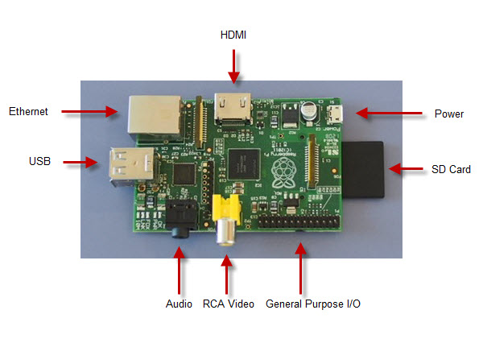
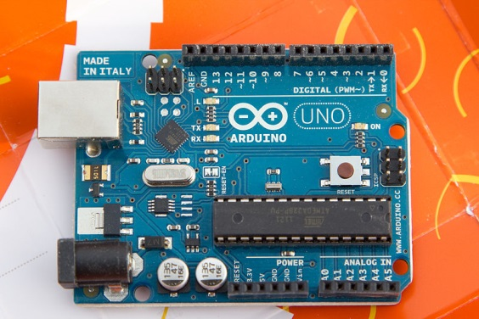

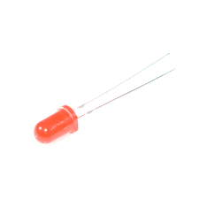
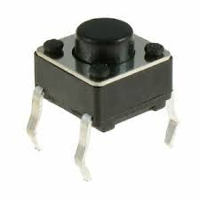

click
led is listener
of button?
button
led
button
led
???
Polling:
led calls button
click

Slide 49
button
led
Polling:
led calls button
button
led
Mazzuca
button
led
led is called
by button
button
led
led perceives
button events
button
control
led
(3)
socket

Slide 50
button
control
led
button
control
led
button
control
led
control
led
???
button
click
(2)
(3)
(3)
socket

Slide 51
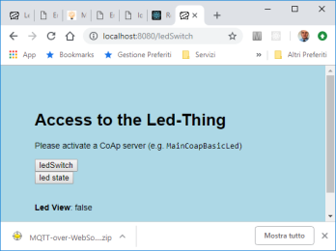
browser
frontend
control
led
???

Slide 52
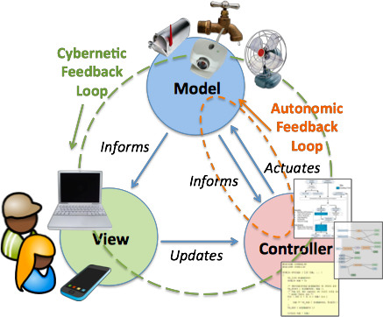
MVC
The Model-VIew-Controller macro pattern provides a framework for the structured division of responsibility between people and software in IoT applications. It also provides a framework for high level interoperability between data sources, control elements, and UI elements.
The Model is a representation or an abstraction of the physical things and their attributes, which informs a Controller.
The Controller is software which makes actuation decisions based on the information, and sends actuation commands to the thing using it’s modeled affordances.
The software goal is to maintain a desired state of the thing through it’s model.

Slide 53
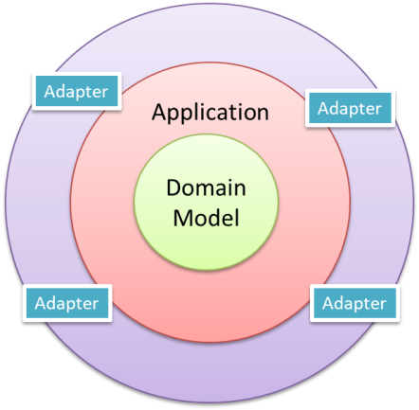
SISTEMI: una visione ‘olistica’
VISTE DI UN SISTEMA
Dal di fuori (cosa fa)
Dal di dentro (come è fatto)
ARCHITETTURA ESAGONALE
The connection between the inside and the outside part of the system is realized via abstractions called ports and their implementation counterparts called adapters.

Slide 54
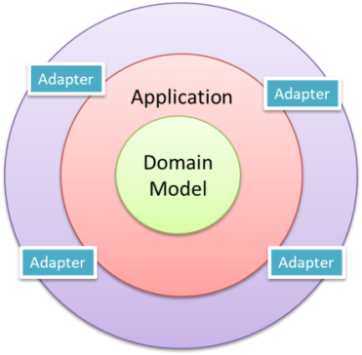
Hexagonal Architecture (Port-Adapter)
Alistair Cockburn
Allow an application to equally be driven by users, programs, automated test or batch scripts, and to be developed and tested in isolation from its eventual run-time devices and databases.
As events arrive from the outside world at a port, a technology-specific adapter converts it into a usable procedure call or message and passes it to the application. The application is blissfully ignorant of the nature of the input device.
When the application has something to send out, it sends it out through a port to an adapter, which creates the appropriate signals needed by the receiving technology (human or automated).
The application has a semantically sound interaction with the adapters on all sides of it, without actually knowing the nature of the things on the other side of the adapters.

Slide 55


persistence
Input
handling
Application
service
Domain
model
Output
adapter
Security
GUI
Security
Transactions
Task coordination
Entities
Business Logic
Domain events
Repositories
Documents
Cache
Inherits or use? → The resource USES the model

Slide 56
R
R
step
Matrice n x m
0
1
nc-1
0
R
1
nr-1

Slide 57
user
robotboundary
start
stop
resume
step
Application Logic
sensor/collision
Reusable Logic
stepper
stepOk
stepKo
Reusable worker (no policy)
w | s | h …
basicrobot
virtualRobotSupportApp
Virtual / Concrete robot
R

Slide 58
sensor/collision
w | s | h …
alien
basicrobot
virtualRobotSupportApp
collisionEvent
R

Slide 59
"unibo/qak/xxx"
Fsm
subscribed
MQTT
broker
is_a
publish
"unibo/qak/events"
xxx
publish
alien
Ref to the owner

Slide 60
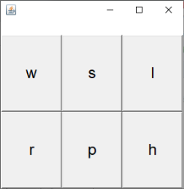
Ref to the owner
"unibo/qak/basicrobot"
Fsm
MQTT
broker
is_a
publish
subscribed
w | s | h …
basicrobot
alien
sensorData
virtualRobotSupportApp
R
endwork
end
ε-m
init
waitcmd
sensor
handlesensor
ε-m
w | s | h …
cmd
execcmd
ε-m

Slide 61
localController
(owner)
"unibo/qak/basicrobot"
sensorData
propagated
MQTT
broker
publish
‘alien’ entity
basicrobot
publish
(a command)
command
dispacth
mqttSupport
sensorData
virtualRobotSupportApp
remoteController
R

Slide 62
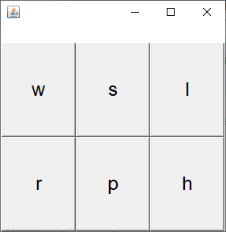
Gui
publish cmd dispatch
"unibo/qak/basicrobot"
MQTT
broker
"unibo/qak/events"
sensorObserver
publish sensor event
basicrobot
collision
robotboundary
virtualRobotSupport
start
stop
resume
socket
robotboundary
start
stop
resume
sensor (collision)

Slide 63
resume
s0
start
work
stop
stopped
collision
endWork
[ NumStep<4 ]
wall
[ NumStep==4 ]
collision
collision
cmd( M )
start
stop
resume
basicrobot
robotboundary
step
stepDone
stepFail
robotSupport
virtualRobotSupportQak
mbotSupport
robotDataSourceArduino
TCP socket
Serial

Slide 64
ctxrobotboundary
ctxbasicrobot
collision
start
stop
resume
step
cmd
8018
robotboundary
8020
basicrobot
resume
s0
start
work
stop
stopped
collision
endWork
[ NumStep<4 ]
wall
[ NumStep==4 ]

Slide 65
[ NumStep<4 ]
basicrobot
stepDone
stepdone
ε-m
init
start
working
stepfail
stepFail
[ NumStep==4 ]
resume
stop
stopped
end

Slide 66
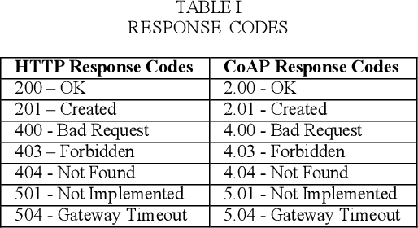
ε-m
Timeout
counter++
[ counter==0 ]
watch
s0
handleAlarm
[ counter==0 ] alarm
ε-m
end
[ counter !=0 ]

Slide 67
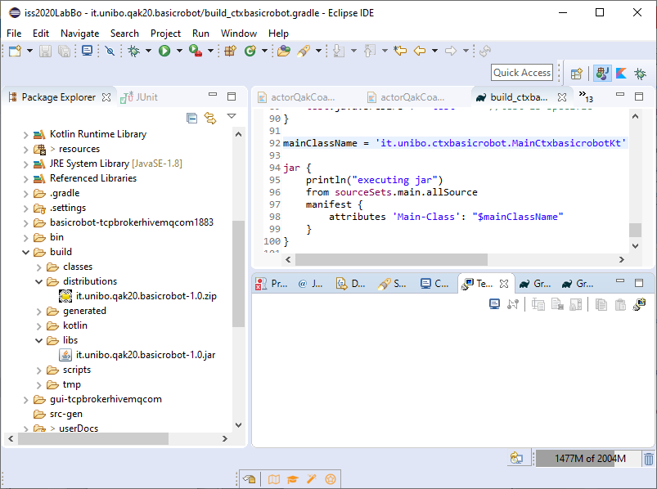

Slide 69
Nuovo progetto
it.unibo.bls20
Note: If the run fails with Error: Could not find or load main class it may mean that the IDE can't find the *Kt Kotlin file related to the main class. To fix this, edit the corresponding Run Configuration in the Dependencies tab (or the Classpath tab, depending on the Eclipse version), choose Advanced and enter the folder containing the kotlin generated .class files (for example: build/classes/kotlin/main).

Slide 70
Disponibile
Versione 1.2.4
it.unibo.Qactork.ide_1.2.4.jar
it.unibo.Qactork.ui_1.2.4.jar
it.unibo.Qactork_1.2.4.jar
Aggiornare Qak runtime versione
it.unibo.qakactor-2.4.jar

Slide 71
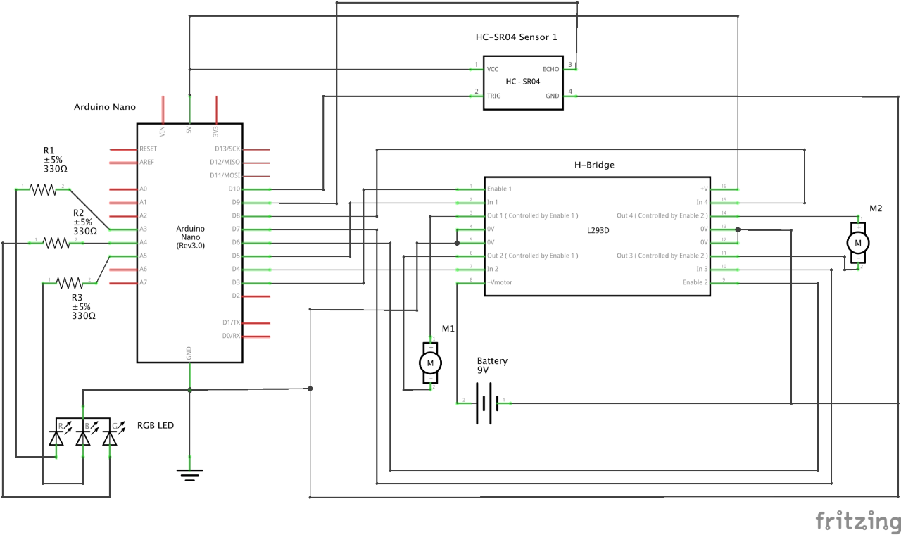
Ugo Cavalcanti (ugoleone.cavalcanti@studio.unibo.it) : schema connessioni Arduino

