Slide 1
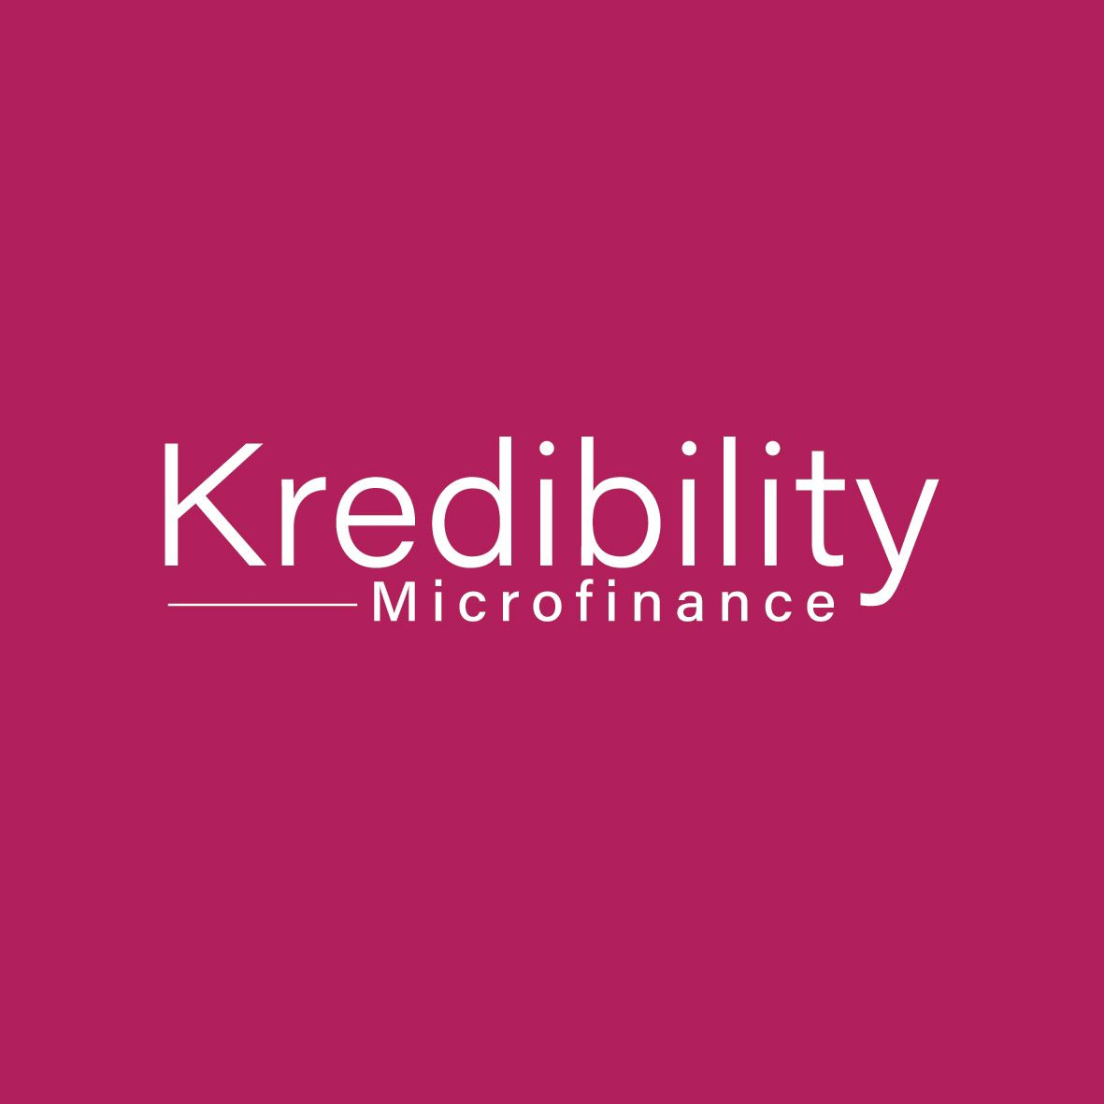
BRAND KIT
Kredibility Finance
01 Brand Identity & Logo
02 Colour Palette
Your Growth, Our Commitment.
03 Typography
RBZ Licensed Microfinance Institution
04 Tone of Voice
05 Brand Personality
01 / 05

Slide 2
BRAND IDENTITY & LOGO
01
Logo Guidelines
Clear Space
Maintain clear space equal to the height of the "K" around the logo on all sides.
Minimum Size
Never reproduce the logo smaller than 24px / 8mm in height to ensure legibility.
On White
Preferred — use the Magenta logo on a white or light background.
On Magenta
"Your Growth, Our Commitment."
Reverse white logo on solid Magenta (#B5135A) backgrounds only.
Never Alter
Do not stretch, rotate, recolour, add effects or modify the logo in any way.
02 / 05

Slide 3
COLOUR PALETTE
02
A palette built on trust, warmth and confidence — anchored by Kredibility Magenta.
Kredibility Magenta
Deep Ink
Warm Ink
Rose
Off-White
White
#B5135A
#161011
#5C3D4A
#F0D0DC
#FAF5F7
#FFFFFF
Primary — CTAs, headings, accents
Body copy, strong headings
Secondary text, captions
Dividers, light backgrounds
Page backgrounds, cards
Primary background (60% usage)
03 / 05

Slide 4
TONE OF VOICE
03
How Kredibility speaks — to every client, on every channel.
Confident
Warm
Clear
Purposeful
We speak with authority. We know our product, our sector and our clients. We make clear, direct statements — never hedging.
Finance can feel cold. We choose warmth. We acknowledge real lives, real pressures and real goals — we speak to the person.
No jargon, no surprises. Kredibility explains costs, timelines and requirements in plain, honest language everyone understands.
Every word earns its place. We do not pad or oversell. Each message connects to growth — the client's and Zimbabwe's.
SAY
SAY
SAY
SAY
We offer fast, flexible loans designed for your life.
We're here to help you get there — whatever your goal.
Repay over 3–18 months. You will always know the full cost.
Grow your business. We will help you fund it.
AVOID
AVOID
AVOID
AVOID
We might be able to help with a possible loan option.
Loan eligibility is determined by underwriting criteria.
Subject to affordability metrics and regulatory compliance.
Explore our vast suite of unique financial solutions today!
04 / 05

Slide 5
BRAND PERSONALITY
05
The
Kredibility
Promise
Kredibility feels like:
A trusted colleague
"Your Growth,
Our Commitment."
Not a bank behind glass. Kredibility feels like a knowledgeable friend who genuinely wants to help you move forward.
A growth enabler
Every interaction should leave clients feeling capable and supported — not judged. We fund ambition, not desperation.
Trustworthy
Empowering
Grounded & Zimbabwean
We are local. We understand the rhythms of Zimbabwean business and family life — practical, resilient, forward-looking.
Accessible
Transparent
Honest & transparent
Local
Human
Clients always know where they stand. No hidden fees, no vague timelines. Trust is our most valuable asset.
© 2026 Kredibility Finance (Private) Limited | kredibilityfinance.co.zw | RBZ Licensed

