Slide 1

PROJECT REPORT
SUBMITTED BY:
NAME:PRAGYAN PROTIM GOSWAMI
BRANCH:COMPUTER SCIENCE
INTERN ID: N241503254
TASK SUBMISSION NUMBER: NAV2403320

Slide 2
CONTENTS
Topic
INTRODUCTION
ABOUT ME
PROJECT DESCRIPTION
PROJECT COMPLETION
CONCLUSION

Slide 3
INTRODUCTION
This Project is a part of the web development internship tasks given by Navodita Infotech as a part of 5 other tasks shared.In this project,we have developed a user friendly blog website with a user friendly dashboard and an admin page along with an index page with displays all the blogs together and a user can be able to read,edit manage and publish different blogs according to their requirement.The main tools used in this project are HTML,CSS and JavaScript . Other tools include Classic editor, differnt fonts from google and other different tools.This project contains different pages to manage different topics,users and posts entered by the user alltogether
I would like to thank Navodita Infotech for giving me this wonderfull oppurtunity to work on such a vibrant project and help me gain new experience and improve my webdev skills altogether.This project has greatly enhanced my skills and help me get an understanding about web development in a indepth manner.

Slide 4
ABOUT ME
My name is Pragyan Protim Goswami.I am a 3rd year Student from KIIT University, Bhubaneshwar, Orrisa.I completed my middle and high school from DPS Duliajan with a Percentage of 93.4% and 92% respectively.I have a current CGPA of 8.7 in my BTech Career.My Skill-Set include programming C,C++,Python and JavaScript. I recently completed a web development course from Internshala.I have also work with upcoming companies like SoarX as an Campus Ambassador.I have done 2-3 projects on C and python and 1 project on Web Development.
I would like to say that i had a great time doing this project as a part of internship.I have gained an ample amount of skills and experience doing this project.I would like to thank Navodita Infotech for giving me this oppurtunity to do an virtual internship with them and make a fruithfull progress in my future

Slide 5
PROJECT DESCRIPTION-BLOG WEBSITE
1
INDEX.HTML
4
TOPICS.HTML
This is the main webpage where we have an attractive looking blog website
Here, we manage different topics that a blog can be based on eg:Poetry , Life Lesson etc
2
READ.HTML
5
USER.HTML
Here,We can read a full Blog in detail and search for other available blogs
Here we can add and remove different users on the basis of their requirement
3
LOGIN AND REGISTER.HTML
6
POSTS.HTML
Here we can login and register different users and add or manage posts.
Here we can control different posts and manage and add different posts from different users

Slide 6
PROJECT COMPLETION
I have attached all the screenshots regarding the web development project that i made.

Slide 7
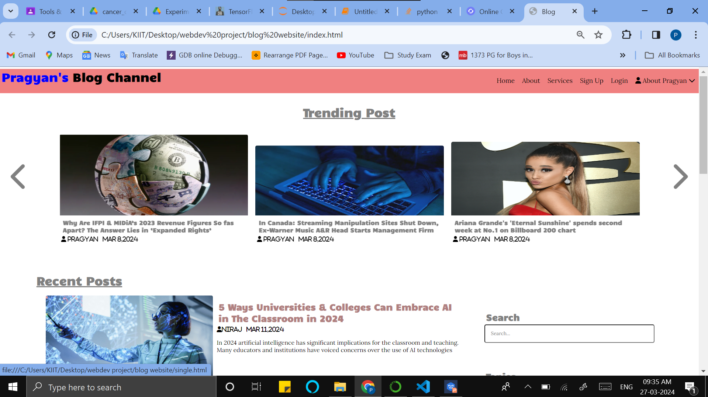
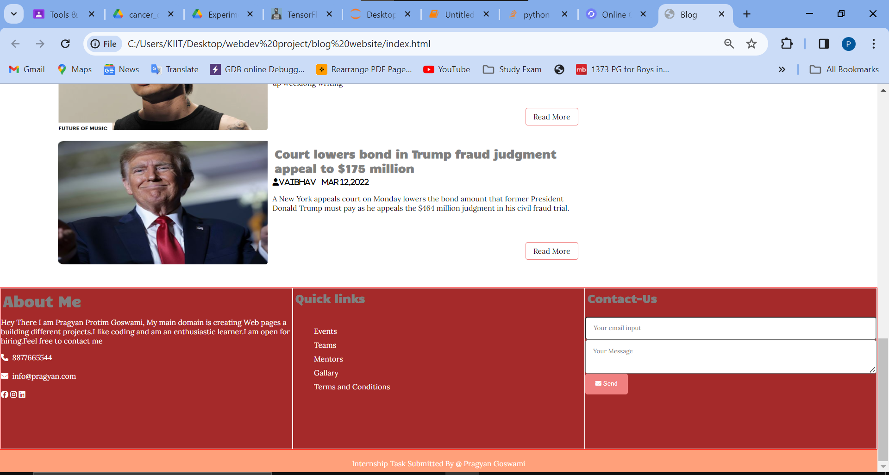
PROJECT COMPLETION (INDEX.HTML)

Slide 8
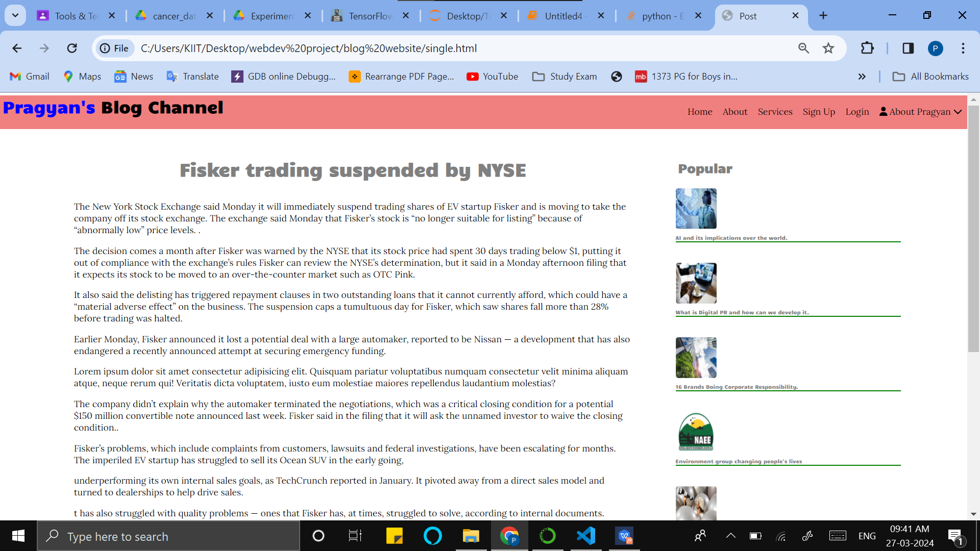
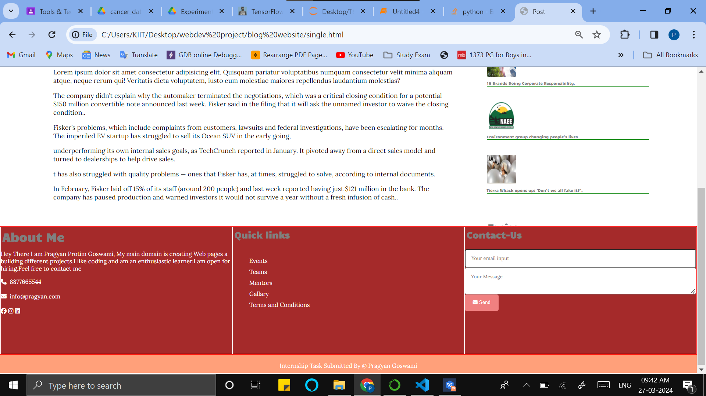
PROJECT COMPLETION (CREATE.HTML)

Slide 9
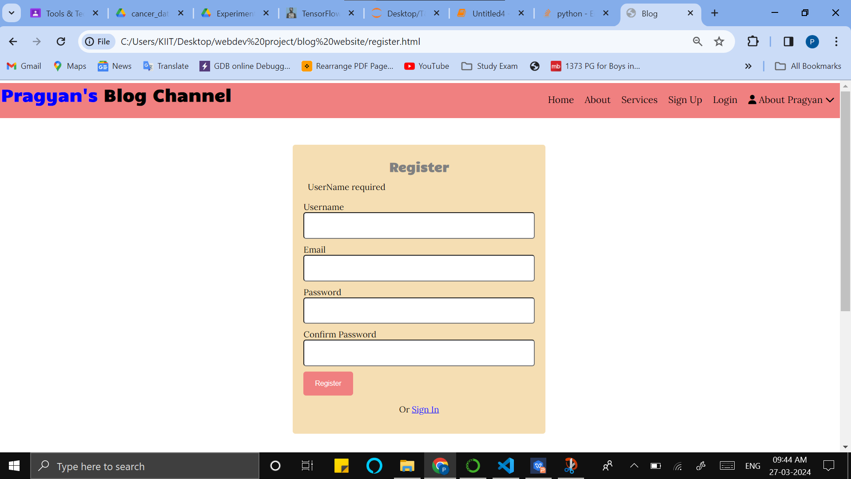
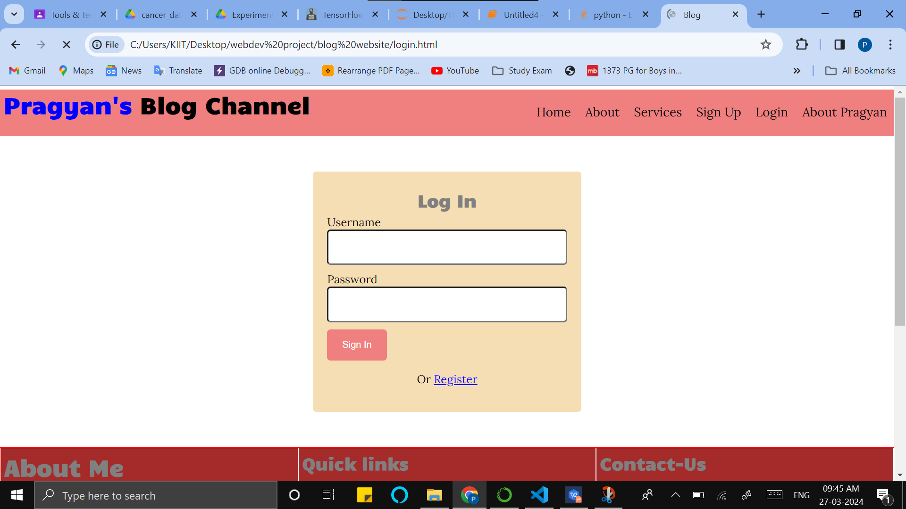
PROJECT COMPLETION (LOGIN AND REGISTER.HTML)

Slide 10
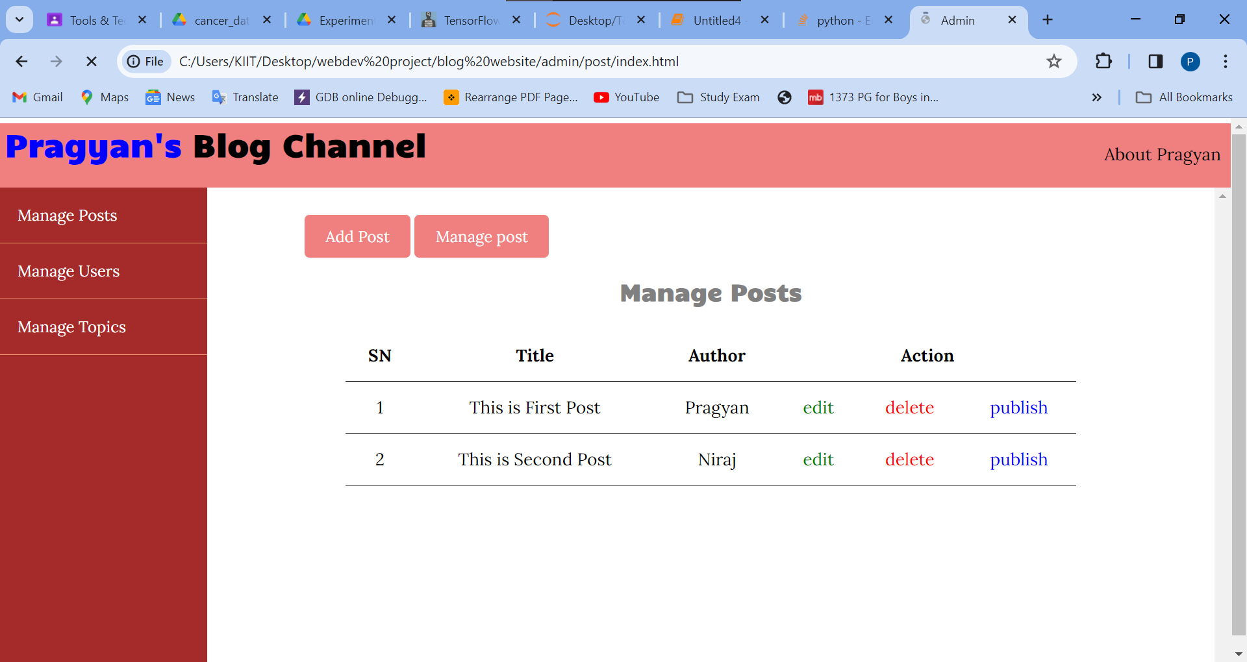
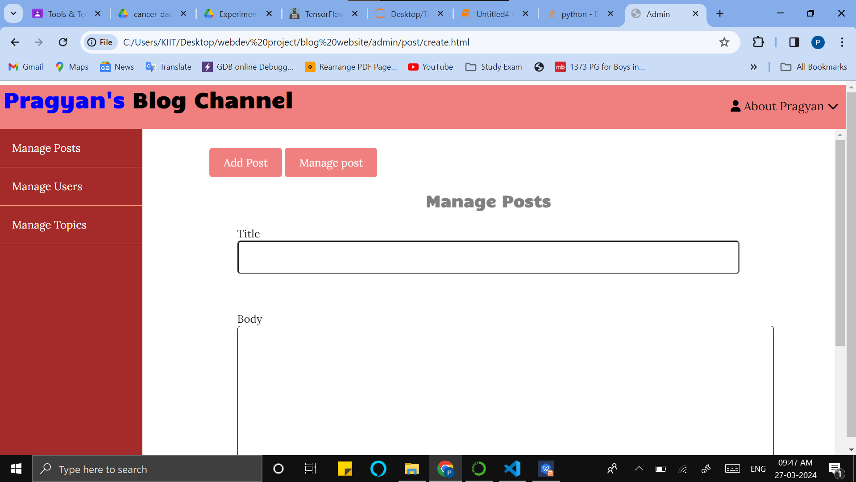
PROJECT COMPLETION (POSTS.HTML)

Slide 11
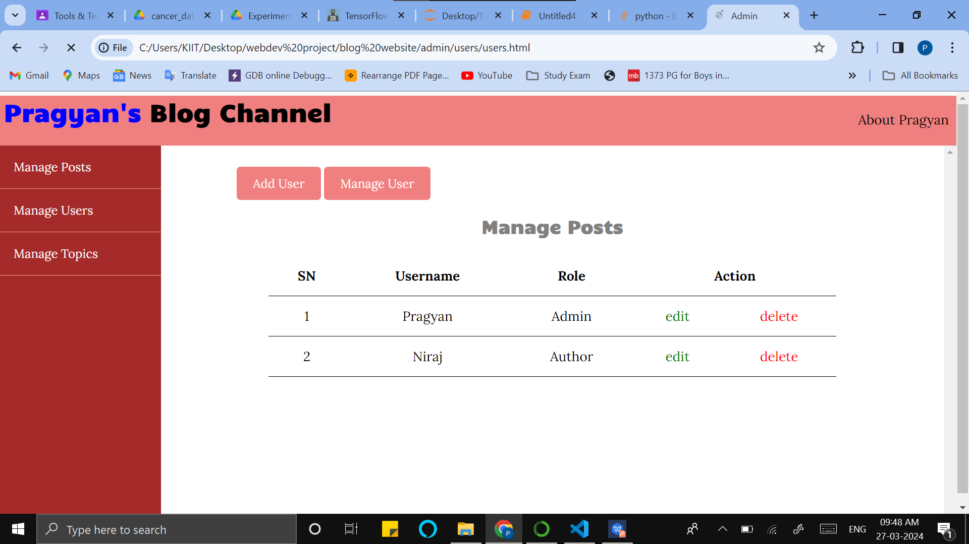
PROJECT COMPLETION (USERS.HTML)

Slide 12
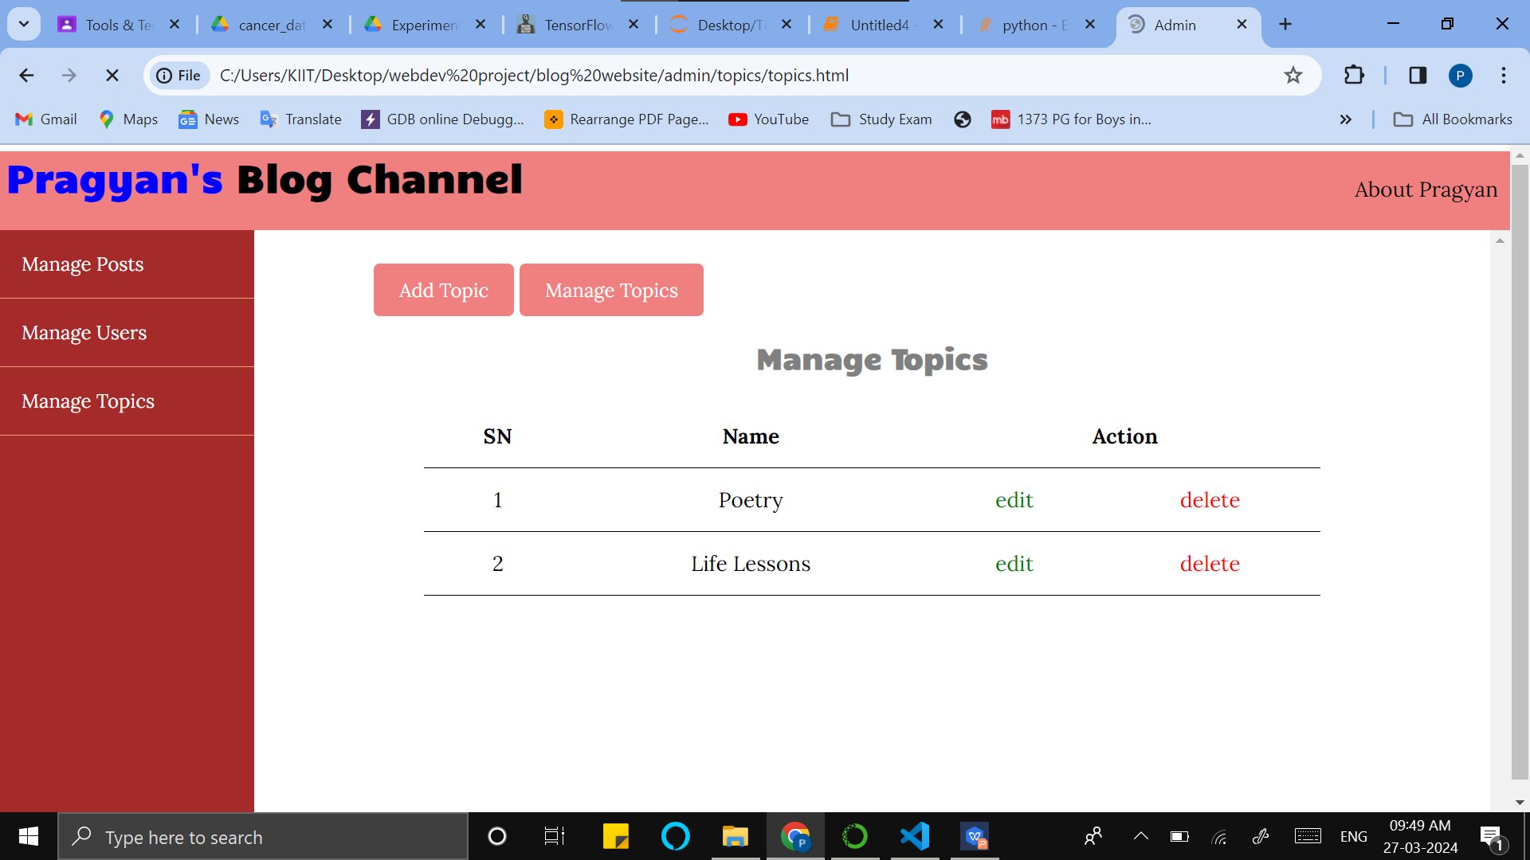
PROJECT COMPLETION (TOPICS.HTML)

Slide 13
CONCLUSION
Through this entire project, we get to learn various tags and attributes related to the functioning of a website.We also learn about different types of JavaScript functions available and proper usage of them.We get to learn about different usages of css attributes and how to uses different properties in the backend of a website
We also learn about the PARAM ,@media tags which help to optimise the website for smaller screens and make it more effecient

Slide 14
THANKS

