Slide 1
Analysis of Egocentric Videos
Jing Qin, Zifan Wang
05/05/2016

Slide 2
Video & Audio Player
Part1: Video
Thread tvideo = new Thread(new PlayVideo( ));
Part1: Audio
Thread twav = new Thread(new PlayWav( ));
Part1: Buttons
Play
Pause
stop

Slide 3
Egocentric Video Summarization
video_name.rgb
input
getSummaryPointer()
output
List of each section’s first frame
Step1:
Get first frame of each section.
Using the change of luminance(Y) in YCrCb color space between two frames.
getSummaryPointer():
Calculate luminance difference between each frame and its previous frame.
If the difference larger than the threshold, add it to FirstFrame list.
If the interval of two sections less than 75 frames, merge them to one section.

Slide 4
Egocentric Video Summarization (Cont.)
video_name.rgb
audio_name.wav
FirstFrame List
getSummary()
Summary.rgb
Summary.wav
index.txt
input
output
Step2:
Extract the summary of original video and audio according to FirstFrame List produced in last step.
getSummary():
Compute the length of each section and save all these segments together to Summary.rgb.
Save corresponding audio segments to Summary.wav
Output first frames of each section as a .txt document (index.txt).

Slide 5
Indexing into Egocentric Videos
query_name.rgb
input
histogramOfImage()
output
the histogram of the query image
Step1:
Compute the normalized histogram of query image.

Slide 6
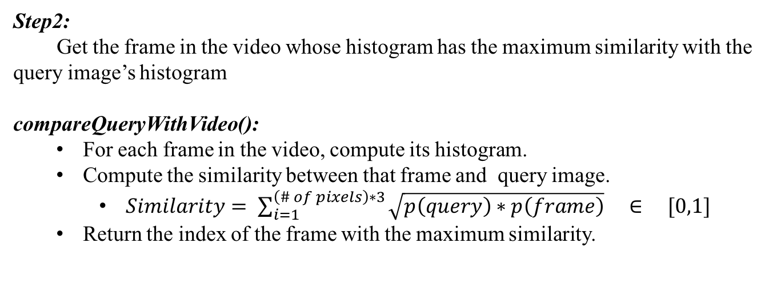
Indexing into Egocentric Videos (Cont.)
video_name.rgb
query_name.rgb
compareQueryWithVideo()
index of the frame in video with the max similarity to query
input
output
Step2:
Get the frame in the video whose histogram has the maximum similarity with the query image’s histogram
compareQueryWithVideo():
For each frame in the video, compute its histogram.
Compute the similarity between that frame and query image.
$Similarity= \sum_{i=1}^{\left(\# of pixels\right)∗3}{\sqrt{p\left(query\right)∗p\left(frame\right)} ∈ [0,1]}$
Return the index of the frame with the maximum similarity.

Slide 7
Indexing into Egocentric Videos (Cont.)
original video & audio
query_name.rgb
summary video & audio
index.txt
showIndex()
play the summary of the section which contains the query image
input
output
Step3:
Find the section contains the query image and display it.
showIndex():
Find the start & end point frame
Compute the similarity between that frame and query image.
Return the index of the frame with the maximum similarity.

Slide 8
THANK YOU
For Your Patient Watching

