Slide 1





PPC130
Surerewards Daily Insights
2022-26-April

Slide 2
Report Outline
> Customer Registration
> Product Sales By Location
> Products Sales Performance
> Product Sales By Date
> Product Sales By Region
> Customer Receipts Upload
> Customer Engagement
> Receipts Validation

Slide 3
Customer Registration

Slide 4
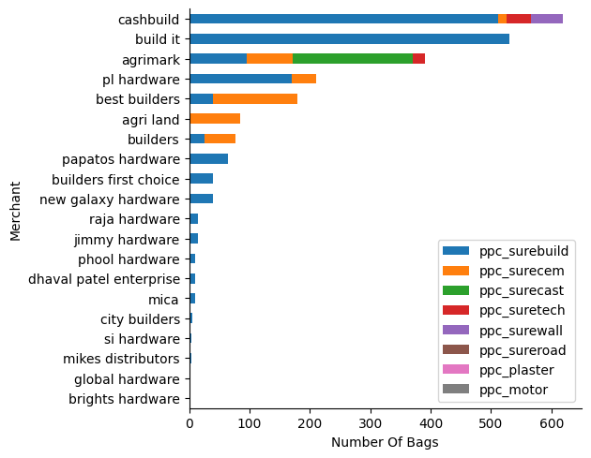
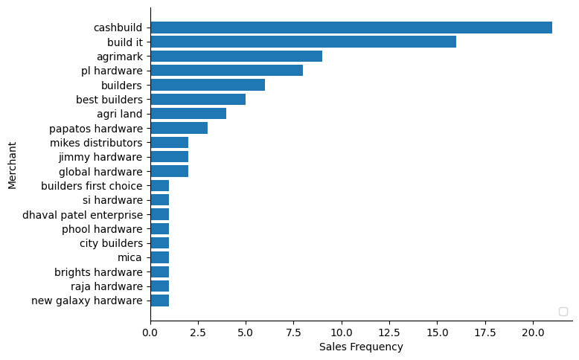
Top 20 Performing Merchant
> Visual on the left shows top 20 merchant performing by product and the total number of bags
> Visual on the right shows top 20 merchant performance by the number of customers who made sales

