Slide 1
CAPSTONE PRESENTATION
Predictive Layer
LSTM Master Table · Google Cluster Trace v3
Multi-Tenant Kubernetes Scheduler | May 2026
Data Extraction — LSTM Master Table
1 / 12
Notes:
SOURCE TABLES: instance_usage, instance_events, collection_events (Google Cluster Trace v3, Cell A, May 2019, accessed via BigQuery). SPOKEN SCRIPT: "Good [morning/afternoon]. This presentation walks through the final consensus extraction approach we designed for training our LSTM resource forecasting model. The data comes from Google's publicly available cluster usage traces — a month-long telemetry record from a production Borg cell. We'll cover each step of the extraction pipeline, the design decisions behind it, and how the resulting master table maps directly to the objectives of our scheduling framework."

Slide 2
Agenda
Dataset Schema
Dataset Extraction
EDA
Baseline LSTM model
Predictive Layer — LSTM Master Table
2 / 12

Slide 3
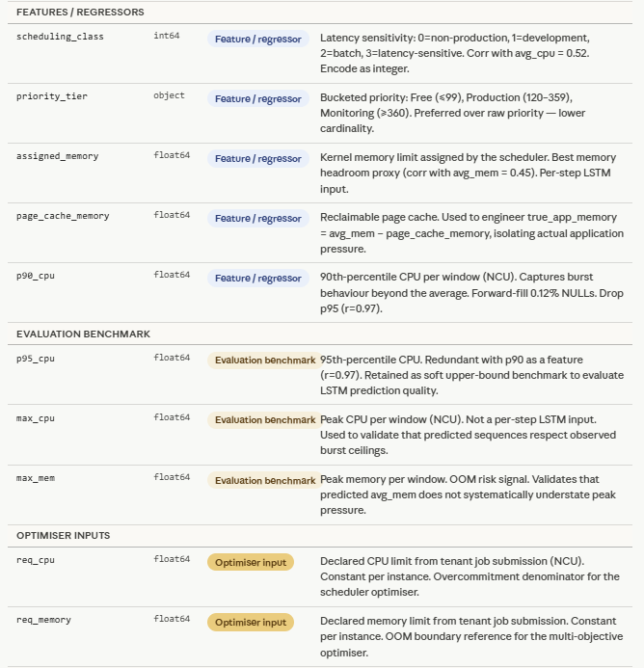
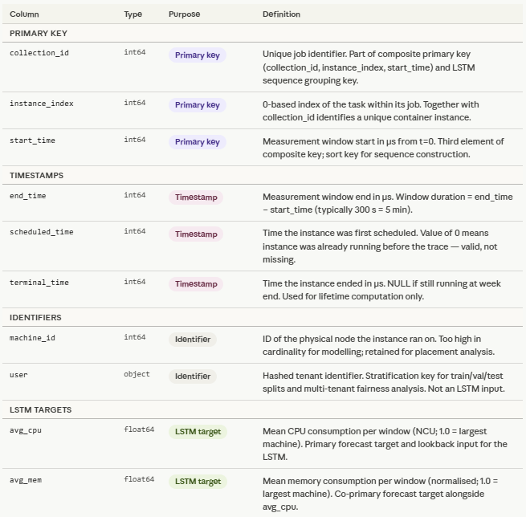
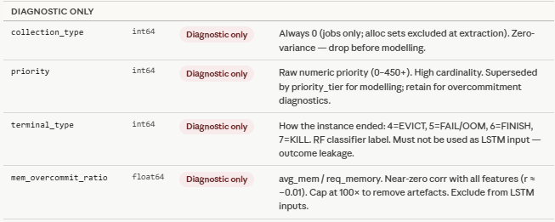
Final Master Table — 24 Columns
★ = Primary LSTM prediction targets
9 / 12
Data Extraction — LSTM Master Table
Notes:
SOURCE TABLES: instance_usage (cols 1-6, 10-18), instance_events (cols 7-9, 19-22), collection_events (col 24), Python gap detection (sub_seq_id col 10). KEY CONCEPTS: sub_seq_id is a Python-computed integer that increments each time a monitoring gap >300 seconds is detected within one instance. The LSTM sequence key is (collection_id, instance_index, sub_seq_id) — NOT (collection_id, instance_index) alone. mem_overcommit_ratio is diagnostic only — EDA confirmed correlation of -0.09 with avg_mem, so it carries no predictive signal. assigned_memory (correlation 0.764 with avg_mem) is the preferred memory headroom proxy. SPOKEN SCRIPT: "The final master table has 26 columns organised into six functional groups. The two LSTM targets — avg_cpu and avg_mem — are highlighted in blue. The optimiser outputs are derived from the predicted sequences after training, not direct model outputs. The diagnostic group contains mem_overcommit_ratio, which our EDA showed has essentially no correlation with actual memory usage — we keep it for interpretability but exclude it from the feature set."

Slide 4
Dataset Overview
Extraction Pipeline
One row per 5-minute telemetry window per container instance.
It combines resource usage measurements with scheduling context, tenant identity, and declared resource limits — all required by the LSTM prediction layer and the multi-objective optimiser.
Raw tables
instance_usage · instance_events · collection_events
CTEs 1–6 (filters & enrichment)
Eligibility · LOST exclusion · Terminal type · Requests · Tenant · Quality gate
What is it for?
Predict
future avg_cpu and avg_mem sequences per instance (lookback 12 steps, horizon 6 steps)
Usage quality gate
First-pass sequence floor ≥ 12 windows · zero-CPU filter
Classify
instance risk profile — stable vs. at-risk — via a Random Forest classifier
Final SELECT — 24 columns
Optimise
pod placement across three objectives: memory utilisation · fairness · SLA compliance
Full instance-level telemetry + all enrichments
Mode A — Full GCS
Mode B — Sample CSV
Data Extraction — LSTM Master Table
2 / 12
Notes:
SOURCE TABLES: All three source tables (instance_usage, instance_events, collection_events) feed the pipeline. KEY CONCEPTS: avg_cpu = average CPU rate per window in Normalised Compute Units [0,1]. avg_mem = average memory per window in normalised bytes [0,1]. LSTM lookback = 12 × 5-min windows = 60 minutes of history. Horizon = 6 × 5-min windows = 30 minutes of prediction. SPOKEN SCRIPT: "The master table holds one row per five-minute measurement window per container instance. Everything the LSTM, the Random Forest classifier, and the optimiser need is in one place. The extraction runs as a sequence of six filtering CTEs before the final row-level join. At the end, two output modes are available — a full unsampled export to Google Cloud Storage for LSTM training, and a smaller deterministic sample as a CSV file for manual exploration and supervisor review.“
The project defines two complementary data access modes for the winner dataset. Mode B produces a lightweight deterministic sample — approximately 0.3% of all jobs selected via MOD(collection_id, 1000) < 3 across the full week — saved as a local CSV and Parquet file of under one million rows, which is fast to load in any environment, requires no cloud credentials, and is ideal for EDA, methodology validation, and supervisor review, but is statistically unrepresentative of the full workload population because it over-selects long-running stable services and under-represents Free-tier and short-lived batch jobs. Mode A is the full production extraction, writing all qualifying instances across the full week as 220 partitioned Parquet shards to Google Cloud Storage, covering approximately 134 million rows and 1.36 GB compressed, which provides the complete population needed for LSTM training and generalisation but requires GCS credentials and careful memory management in Colab since loading all shards simultaneously crashes free-tier RAM, making it necessary to process one shard at a time using PyArrow's batch reading API rather than a single pd.read_parquet() call.

Slide 5
Why Instance-Level Grain?
The problem with job-level aggregation
The instance-level solution
Inst 0: avg_mem = 0.010 (safe)
1. LSTM predicts per-instance sequences
Inst 1: avg_mem = 0.011 (safe)
2. Inst 2 peak memory predicted → OOM risk flagged
3. Predictions aggregated by collection_id
Inst 2: avg_mem = 0.028 ⚠ near limit 0.029
4. Job footprint = SUM(cpu) · MAX(memory) across instances
Job-level average: avg_mem = 0.0163 ✓ appears safe
5. Optimiser schedules with full risk visibility
Instance 2 is 96% of its memory limit — at risk of OOM kill — but invisible in the job average.
A job in the Google trace can contain hundreds of individual container instances, each running on a different machine with its own distinct CPU and memory consumption pattern — two instances within the same job can behave completely differently depending on their assigned workload, their position in a distributed pipeline, or the machine they land on. Aggregating to the job level would average out these differences and produce a single smoothed signal that misrepresents what any individual container actually consumes, making the predictions useless for the scheduler, which must make placement decisions at the container level. Taking the job-level maximum instead of the mean is not a solution either, because it would force the scheduler to treat every instance as if it were the most resource-hungry instance in the job, systematically over-provisioning memory across all nodes and directly undermining the memory utilisation objective the optimiser is designed to maximise — replacing one distortion with an even more conservative one that defeats the purpose of forecasting altogether. The optimiser needs to know how much memory each individual pod will demand on a specific node, not what the job consumes on average or at its peak across all nodes, so forecasting at the instance level is the only grain that directly feeds actionable scheduling decisions.
Data Extraction — LSTM Master Table
11 / 12
Notes:
SOURCE TABLES: instance_usage — all resource metrics are at instance grain. Aggregation to job level happens in Python/the optimiser after LSTM prediction, not at extraction time. KEY CONCEPTS: OOM kill = Out-of-Memory kill. The Linux kernel enforces memory limits at the container (cgroup) level. A job with 10 parallel instances where one instance approaches its memory limit looks safe in a job-level average — the other 9 instances bring the mean down. This is why job-level forecasting is insufficient. max_mem from the LSTM prediction is used (not avg_mem) for OOM risk assessment — it captures the worst-case window within the horizon. SPOKEN SCRIPT: "This is probably the most important architectural decision in the project. The kernel enforces memory limits per container — not per job. So a job with ten instances looks perfectly safe in aggregate even if one container is seconds away from an OOM kill. Our LSTM predicts at the instance level to catch exactly this situation. After prediction, we aggregate to the job level — summing CPU and taking the maximum memory across all instances — to give the optimiser a complete risk picture before it places any pod."

Slide 6
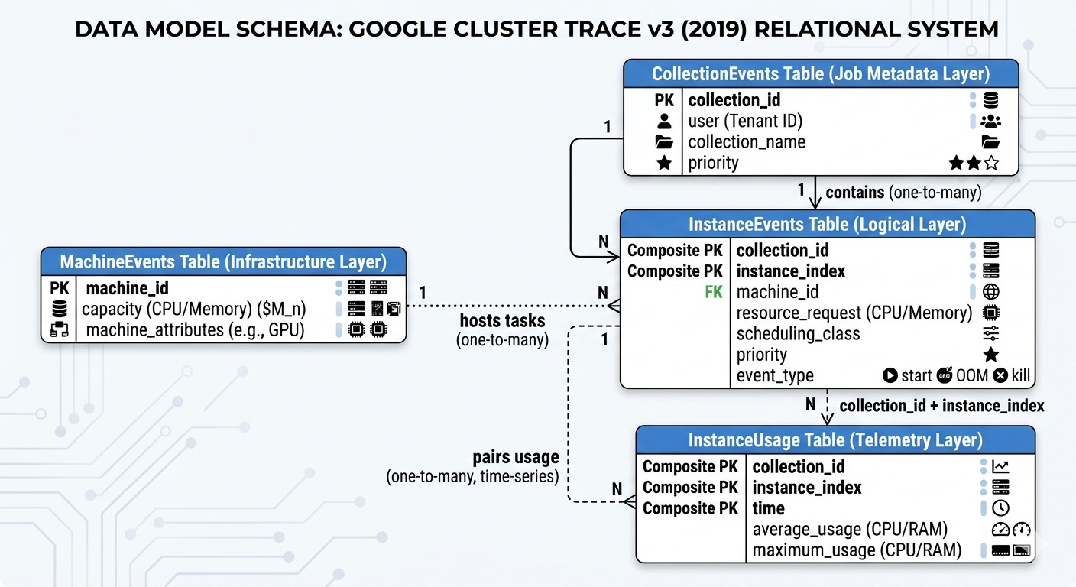
ERD

Slide 7
CTE 1 — stable_instances · instance_events
src: instance_events
Example output row
The source table is instance_events, which records every lifecycle event for every container instance in the cluster. Its primary key is composed of (collection_id, instance_index, time, type). One row of this table means: at timestamp time, instance instance_index of job collection_id experienced a lifecycle transition of type to type.
INNER JOIN
collection_id | instance_index | scheduled_time | termination_count
201428 | 30 | 0 | 0
160102691 | 431 | 12,450,000,000 | 0
1495106086 | 7 | 5,400,000,000 | 0
What this step does
Requires a SCHEDULE event (type=3) — instance must have been assigned to a node and started running
Zero termination events (types EVICT, FAIL, FINISH, KILL) within the full week window — any termination removes ALL usage rows for that instance; no partial sequences survive. Exclusion: “LOST” (unreliable telemetry)
Instances that fail this check are excluded at the identifier level before usage rows are ever retrieved
Guarantees that every sequence in the master table is temporally continuous. The LSTM cannot learn from broken sequences — a container that was evicted mid-window produces an artificial drop that is a scheduling event, not a consumption pattern.
Data Extraction — LSTM Master Table
3 / 12
Notes:
SOURCE TABLE: instance_events. Primary key: (collection_id, instance_index, time, type). One event row = one lifecycle transition. KEY CONCEPTS: collection_id = unique job identifier. instance_index = 0-based position of this container within its parent job. scheduled_time = 0 means the instance was already running before the trace began — valid data per Google documentation. SCHEDULE (type 3), EVICT (4), FAIL (5, includes OOM), FINISH (6), KILL (7), LOST (8). SPOKEN SCRIPT: "The first CTE is the eligibility gate. We require that every container was actually assigned to a machine and ran continuously throughout our observation window. If a container was evicted, killed, or failed at any point during the week, all of its telemetry rows are dropped — not just the rows near the termination. This is a deliberate design choice we inherited from Approach 1: we trade population breadth for sequence integrity, which is what the LSTM needs.“
Exclusion: LOST instances have unreliable telemetry. The monitoring system knows the container stopped but cannot produce a clean exit record.

Slide 8
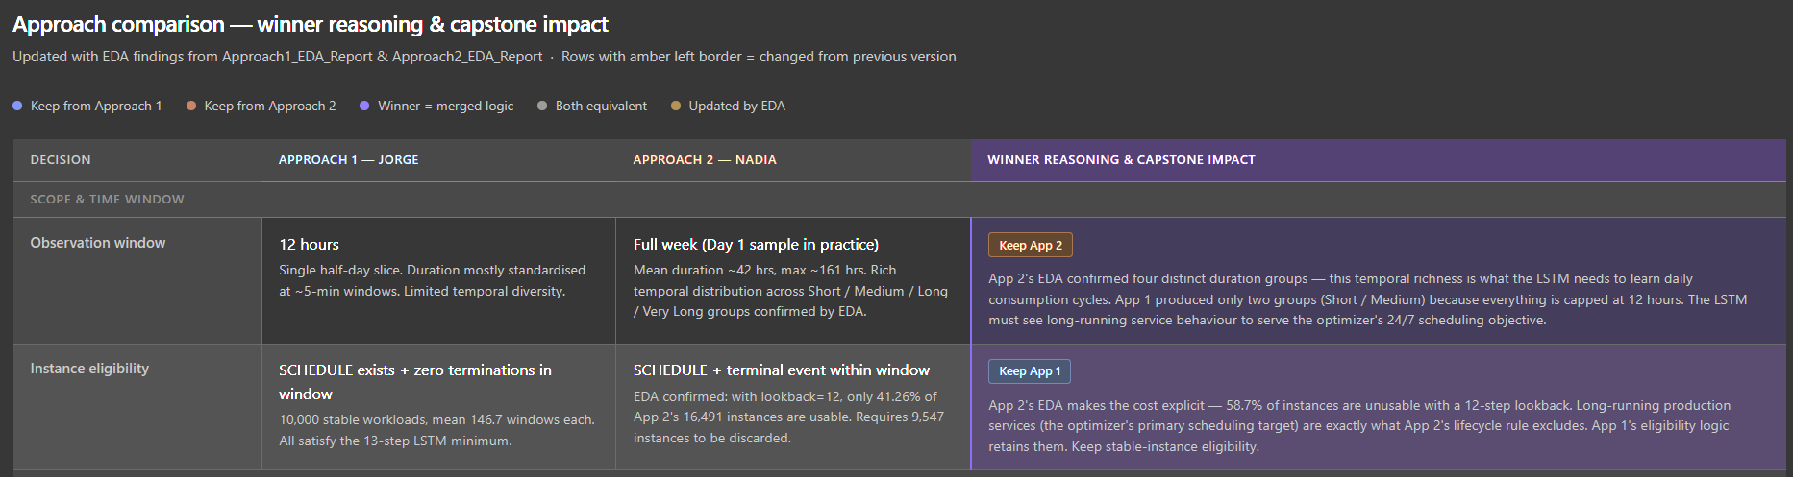
CTE 1 — stable_instances · instance_events
src: instance_events
Approach 2's rule requires that an instance both starts and terminates within the observation window — which sounds methodologically clean, but it has a structural consequence: any container that is still running at the end of the week is automatically excluded. Long-running production services, which are persistent by design and never terminate within a fixed time window, are therefore completely absent from Approach 2's training data.
These are precisely the workloads the scheduler most needs to manage — they hold memory for extended periods, they have strict SLA requirements, and they represent the instances where an OOM prediction error has the highest operational cost. The EDA shows: 58.7% of Approach 2's instances are unusable with a 12-step lookback, meaning the lifecycle completeness requirement discards more than half the population before training even begins.
Approach 1's rule — require a SCHEDULE event but zero termination events during the window — keeps these long-running services in the dataset precisely because it does not require them to end. The trade-off is explicit: we lose the ability to observe how each instance's lifecycle concludes within the training window, but we gain a training population that actually represents the kinds of workloads the scheduler will encounter in production. The terminal event type column partially compensates for this loss — it records how each instance eventually ended so the Random Forest classifier can distinguish stable from at-risk profiles without the LSTM needing to have seen the termination itself.
Data Extraction — LSTM Master Table
3 / 12

Slide 9
CTE 2 — lost_instances · instance_events
src: instance_events
What this step does
Example output row
ANTI-JOIN
Targets only LOST events (type=8) — instances whose termination record is missing from the source data
Applied as an explicit anti-join: any instance appearing in this list is excluded from the final output, even if it somehow passed CTE 1
Makes the exclusion auditable — the reason for removal is visible in the query logic, not hidden inside a count filter
collection_id
instance_index
88200912
14
LOST instances have unreliable telemetry. The monitoring system knows the container stopped but cannot produce a clean exit record. Training on these sequences would introduce unpredictable endings that corrupt the LSTM's learned patterns.
Data Extraction — LSTM Master Table
4 / 12
Notes:
SOURCE TABLE: instance_events. Only LOST events (type=8) within the week window are read. KEY CONCEPTS: A LOST event means the cluster scheduler detected the instance had stopped but the original termination record was absent from the log — typically due to monitoring system overload or a network partition. DISTINCT deduplicates instances with multiple LOST events. SPOKEN SCRIPT: "The second CTE builds an explicit exclusion list of LOST containers. The reason we make this a separate CTE rather than folding it into CTE 1's termination count is transparency — using an anti-join makes the exclusion visible, testable, and easy to audit. Any future team member reading the query immediately sees which instances were excluded and why."

Slide 10
CTE 3 — terminal_info · instance_events
src: instance_events
What this step does
Example output row
LEFT JOIN
Captures the terminal event type for each instance — EVICT (4), FAIL / OOM (5), FINISH (6), KILL (7)
A new column absent from both prior approaches: Approach 1 never captured it; Approach 2 used it as a filter but never stored it
Instances still running past the week end have terminal_type = NULL — valid; they are long-running stable services
collection_id
inst_idx
terminal_time
terminal_type
160102691
431
589.2B µs
4 (EVICT)
terminal_type is the label used by the Random Forest classifier to distinguish stable instances (FINISH) from at-risk instances (EVICT, FAIL, KILL) — without requiring failure-mode sequences in the LSTM training data.
Data Extraction — LSTM Master Table
5 / 12
Notes:
SOURCE TABLE: instance_events. Reads types 4, 5, 6, 7 across the full trace (no time window restriction — captures terminations that occur after the week ends too). KEY CONCEPTS: EVICT (4) = descheduled due to preemption or machine failure. FAIL (5) = program failure including OOM kills — the kernel killed the container for exceeding its declared memory limit. FINISH (6) = completed normally. KILL (7) = cancelled by user, driver, or parent job exit. SPOKEN SCRIPT: "The third CTE is entirely new relative to our two original approaches. We store the terminal event type as a column — not just as a filter — so our Random Forest classifier can learn which instance profiles are associated with normal completion versus eviction or OOM failure. This is the handoff point between the LSTM prediction layer and the classification layer in our architecture."

Slide 11
CTE 4 — inst_requests · instance_events
src: instance_events
Here, we capture how much CPU and memory the instance is expected to need. These declarations are the upper bounds — the instance may be throttled (CPU) or killed (memory) if it exceeds them. One row of this CTE means: instance X of job Y was submitted with declared CPU limit req_cpu, declared memory limit req_memory, at scheduling “priority”, and latency sensitivity “scheduling_class”.
Example output row
LEFT JOIN
collection_id | instance_index | req_cpu | req_memory | priority | scheduling_class
201428 | 30 | 0.0625 | 0.0293 | 120 | 3
160102691 | 431 | 0.0039 | 0.0024 | 99 | 0
1495106086 | 7 | 0.0156 | 0.0117 | 115 | 2
What this step does
Reads SUBMIT events (type=0) — the moment a user declares how much CPU and memory the container needs
req_cpu (EDA correlation 0.50 with max_cpu) and req_memory define the overcommitment headroom the optimiser can exploit
scheduling_class and priority are captured here — class 3 (latency-sensitive) requires tighter LSTM prediction intervals than class 0–2 (batch)
Data Extraction — LSTM Master Table
6 / 12
Notes:
SOURCE TABLE: instance_events. Only SUBMIT events (type=0) with non-null resource_request.cpus and resource_request.memory are read. GROUP BY (collection_id, instance_index) with MIN() captures the original baseline declaration. KEY CONCEPTS: req_cpu = declared CPU limit in NCU — CPU above this is throttled. req_memory = declared memory limit in normalised bytes — memory above this triggers an OOM kill. scheduling_class: 0=non-production, 1=development, 2=batch, 3=latency-sensitive (revenue-generating). priority tiers: Free (≤99), Best-effort Batch (100-115), Mid-tier (116-119), Production (120-359), Monitoring (≥360). SPOKEN SCRIPT: "CTE 4 brings in the declared resource requests from the job submission event. These are critical for two reasons: the optimiser needs req_memory to know how much overcommitment headroom exists before an OOM kill, and scheduling_class tells the optimiser which containers have strict SLA requirements. Our EDA confirmed scheduling_class correlates 0.268 with actual CPU usage and 0.605 with priority — it is a genuinely predictive feature.“
Priority determines which workloads get access to cluster resources first when there is competition — higher numbers win, and the scheduler will preempt lower-priority containers to make room for higher-priority ones.
Scheduling class is a separate label (0–3) that describes how latency-sensitive a workload is — not whether it gets resources, but how the machine treats it once it does, with class 3 (latency-sensitive, revenue-generating services) receiving the tightest local quality-of-service guarantees and class 0 (non-production) receiving the most relaxed treatment.

Slide 12
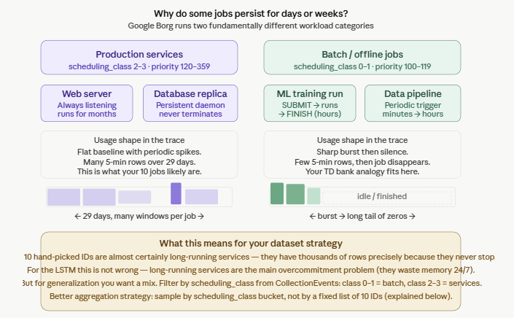
Why jobs are alive during long periods? Understanding of ‘scheduling_class’
The Google cluster runs two fundamentally different populations. A short transactional job (your mobile app analogy) would be a batch job: it arrives, bursts for a few minutes, and disappears from the trace. But a service — like the API server that handles all TD Bank mobile requests — runs continuously for days or months, which is why it appears across thousands of 5-minute windows.

Slide 13
CTE 5 — tenant_map · collection_events
src: collection_events
This table records lifecycle events for entire jobs (collections). This CTE specifically reads SUBMIT events (type=0) to extract the tenant identity (user field) associated with each job. One row of this CTE means: job collection_id was submitted by tenant user.
Example output row
INNER JOIN
collection_id
user (hashed)
201428
mNk3pQrZ8x...
What this step does
Reads collection-level SUBMIT events — the only place where the hashed tenant identifier (user field) is reliably populated
Excludes alloc sets (alloc_collection_id IS NULL) — infrastructure reservations that are not real tenant workloads
user is required for two purposes: the fairness objective and the stratified train/val/test split to prevent cross-tenant data leakage
EDA confirmed the top tenant accounts for ~61% of all jobs. Without per-tenant stratified splitting, the LSTM overfits to the dominant tenant's consumption pattern and performs poorly on minority tenants — the ones most at risk of unfair scheduling.
Data Extraction — LSTM Master Table
7 / 12
Notes:
SOURCE TABLE: collection_events. Unlike instance_events which records per-instance events, collection_events records job-level events. The user field is a hashed opaque base64 string — equal values identify the same tenant but the string cannot be decoded. KEY CONCEPTS: alloc_collection_id IS NULL = this is a real job, not an alloc set. Alloc sets are internal resource reservations used to pre-allocate cluster capacity; they do not represent real tenant workloads. Tenant identity is required for the multi-tenant fairness objective of the optimiser, which ensures equitable resource allocation across all tenants regardless of job count. SPOKEN SCRIPT: "CTE 5 is the only CTE that reads collection_events rather than instance_events — because tenant identity is a property of the job, not the individual container. We exclude alloc sets at this stage, which filters out internal cluster infrastructure reservations. The user field is a hashed string — we can compare tenants for equality and measure concentration, but we cannot identify individual Google engineers or services behind the hash."

Slide 14
CTE 6 — usage_quality · instance_usage
src: instance_usage
instance_usage contains one row per 5-minute measurement window per instance, recording CPU and memory consumption during that window. This CTE aggregates the usage rows to verify that each qualifying instance has enough measurements to be useful for LSTM training. One row of this CTE means: instance instance_index of job collection_id passed all eligibility checks and has at least 12 telemetry windows with non-trivial CPU activity.
Example output row
INNER JOIN
collection_id | instance_index
201428 | 30
160102691 | 431
1495106086 | 7
What this step does
First-pass sequence floor: COUNT(*) ≥ 12 windows — at least 1 hour of observed behavior, the minimum chosen to allow enough historical behavior to train the LSTM
Zero-CPU filter: AVG(average_usage.cpus) > 0.000001 NCU — removes ghost containers loading binaries or holding empty alloc reservations
This is Pass 1 of a two-pass floor. Pass 2 runs in Python after gap detection — each piece of a split sequence is independently re-checked. A piece below 12 windows after a gap split is discarded, even if the original instance had hundreds of windows.
Data Extraction — LSTM Master Table
8 / 12
Notes:
SOURCE TABLE: instance_usage. Primary key: (collection_id, instance_index, start_time). One row = one 5-minute telemetry window for one instance. This is the largest table — hundreds of GB for the full month. KEY CONCEPTS: The two-pass floor exists because BigQuery enforces the minimum on the full pre-gap sequence, but Python's gap detection splits sequences at monitoring interruptions. A split piece may be shorter than 12 windows even if the original instance had 144. The second pass discards these short pieces after splitting. collection_type = 0 means jobs only — alloc set rows (collection_type = 1) are excluded at the usage row level as a second safeguard. SPOKEN SCRIPT: "CTE 6 is the quality gate for the usage data itself. We enforce two conditions: the instance must have at least 12 measurement windows — one hour of history — and its average CPU must be above a near-zero threshold to exclude containers that are idle or pre-loading binaries. But this is only the first pass. In Python, after we detect monitoring gaps and split sequences at gap boundaries, we re-apply the same 12-window minimum to every resulting piece independently."

Slide 15
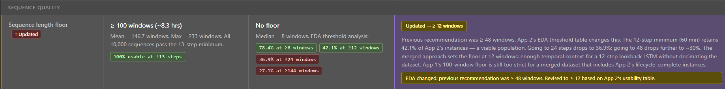
CTE 6 — usage_quality · instance_usage
src: instance_events
Approach 1 set 100 windows (8.3 hours), but Approach 2's EDA threshold table made the population cost of those stricter floors concrete: at 24 windows only 36.9% of instances survive, at 48 windows roughly 30% survive, and at 100 windows only 27.1% survive — each step above the architectural minimum discards a large fraction of the dataset for a relatively small gain in sequence quality. Twelve windows was therefore chosen as the lowest defensible floor: it retains 42.1% of the population, preserves diversity across short burst jobs and long-running services, and leaves the final decision about lookback length and padding strategy to the preprocessing notebook, where it belongs.
Data Extraction — LSTM Master Table
6 / 12
Notes:
SOURCE TABLE: instance_events. Only SUBMIT events (type=0) with non-null resource_request.cpus and resource_request.memory are read. GROUP BY (collection_id, instance_index) with MIN() captures the original baseline declaration. KEY CONCEPTS: req_cpu = declared CPU limit in NCU — CPU above this is throttled. req_memory = declared memory limit in normalised bytes — memory above this triggers an OOM kill. scheduling_class: 0=non-production, 1=development, 2=batch, 3=latency-sensitive (revenue-generating). priority tiers: Free (≤99), Best-effort Batch (100-115), Mid-tier (116-119), Production (120-359), Monitoring (≥360). SPOKEN SCRIPT: "CTE 4 brings in the declared resource requests from the job submission event. These are critical for two reasons: the optimiser needs req_memory to know how much overcommitment headroom exists before an OOM kill, and scheduling_class tells the optimiser which containers have strict SLA requirements. Our EDA confirmed scheduling_class correlates 0.268 with actual CPU usage and 0.605 with priority — it is a genuinely predictive feature.“
Priority determines which workloads get access to cluster resources first when there is competition — higher numbers win, and the scheduler will preempt lower-priority containers to make room for higher-priority ones.
Scheduling class is a separate label (0–3) that describes how latency-sensitive a workload is — not whether it gets resources, but how the machine treats it once it does, with class 3 (latency-sensitive, revenue-generating services) receiving the tightest local quality-of-service guarantees and class 0 (non-production) receiving the most relaxed treatment.

Slide 16
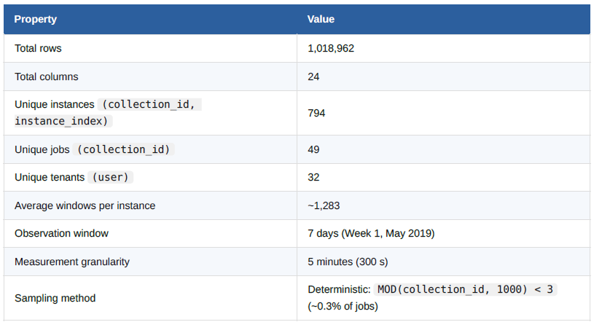
EDA – General Description
9 / 12
Notes:
SOURCE TABLES: instance_usage (cols 1-6, 10-18), instance_events (cols 7-9, 19-22), collection_events (col 24), Python gap detection (sub_seq_id col 10). KEY CONCEPTS: sub_seq_id is a Python-computed integer that increments each time a monitoring gap >300 seconds is detected within one instance. The LSTM sequence key is (collection_id, instance_index, sub_seq_id) — NOT (collection_id, instance_index) alone. mem_overcommit_ratio is diagnostic only — EDA confirmed correlation of -0.09 with avg_mem, so it carries no predictive signal. assigned_memory (correlation 0.764 with avg_mem) is the preferred memory headroom proxy. SPOKEN SCRIPT: "The final master table has 26 columns organised into six functional groups. The two LSTM targets — avg_cpu and avg_mem — are highlighted in blue. The optimiser outputs are derived from the predicted sequences after training, not direct model outputs. The diagnostic group contains mem_overcommit_ratio, which our EDA showed has essentially no correlation with actual memory usage — we keep it for interpretability but exclude it from the feature set."

Slide 17
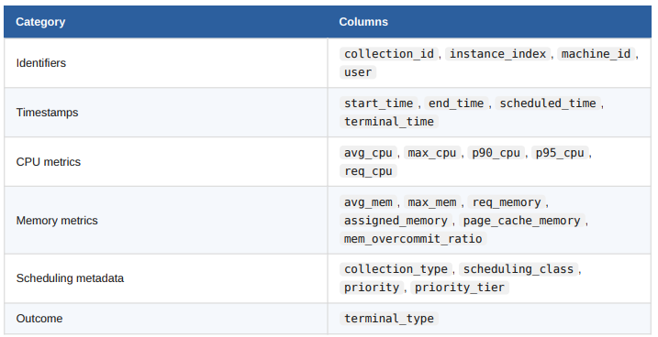
EDA – Columns Inventory
9 / 12
Notes:
SOURCE TABLES: instance_usage (cols 1-6, 10-18), instance_events (cols 7-9, 19-22), collection_events (col 24), Python gap detection (sub_seq_id col 10). KEY CONCEPTS: sub_seq_id is a Python-computed integer that increments each time a monitoring gap >300 seconds is detected within one instance. The LSTM sequence key is (collection_id, instance_index, sub_seq_id) — NOT (collection_id, instance_index) alone. mem_overcommit_ratio is diagnostic only — EDA confirmed correlation of -0.09 with avg_mem, so it carries no predictive signal. assigned_memory (correlation 0.764 with avg_mem) is the preferred memory headroom proxy. SPOKEN SCRIPT: "The final master table has 26 columns organised into six functional groups. The two LSTM targets — avg_cpu and avg_mem — are highlighted in blue. The optimiser outputs are derived from the predicted sequences after training, not direct model outputs. The diagnostic group contains mem_overcommit_ratio, which our EDA showed has essentially no correlation with actual memory usage — we keep it for interpretability but exclude it from the feature set."

Slide 18
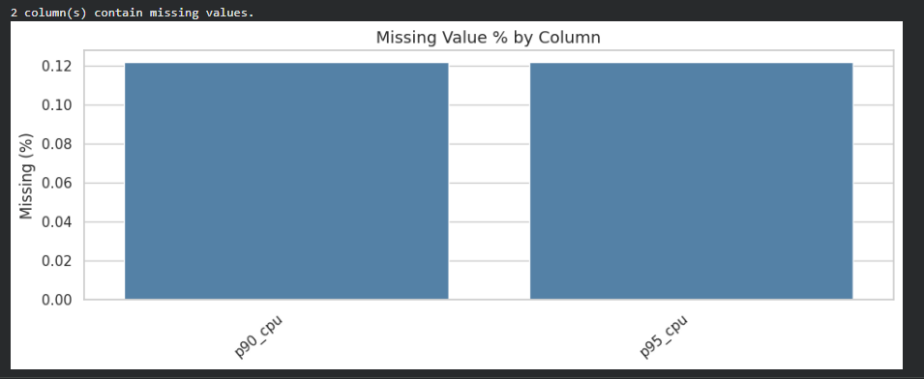
EDA – Most Important Findings - 1
Dataset is nearly perfect quality — 0 duplicates, 0 negative durations, only 0.12% missing values
9 / 12
Notes:
SOURCE TABLES: instance_usage (cols 1-6, 10-18), instance_events (cols 7-9, 19-22), collection_events (col 24), Python gap detection (sub_seq_id col 10). KEY CONCEPTS: sub_seq_id is a Python-computed integer that increments each time a monitoring gap >300 seconds is detected within one instance. The LSTM sequence key is (collection_id, instance_index, sub_seq_id) — NOT (collection_id, instance_index) alone. mem_overcommit_ratio is diagnostic only — EDA confirmed correlation of -0.09 with avg_mem, so it carries no predictive signal. assigned_memory (correlation 0.764 with avg_mem) is the preferred memory headroom proxy. SPOKEN SCRIPT: "The final master table has 26 columns organised into six functional groups. The two LSTM targets — avg_cpu and avg_mem — are highlighted in blue. The optimiser outputs are derived from the predicted sequences after training, not direct model outputs. The diagnostic group contains mem_overcommit_ratio, which our EDA showed has essentially no correlation with actual memory usage — we keep it for interpretability but exclude it from the feature set."

Slide 19
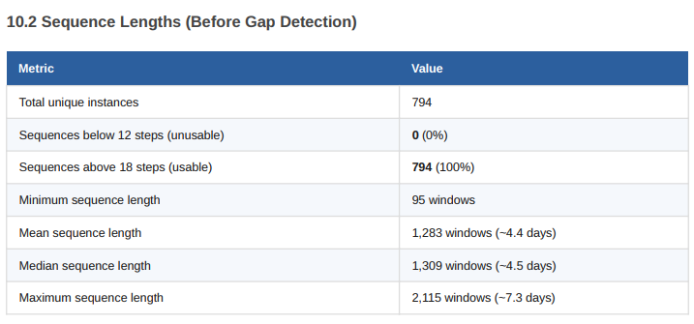
EDA – Most Important Findings - 2
100% sequence usability — All 794 instances meet the 12-window minimum; ~1.009M training pairs available
9 / 12
Notes:
SOURCE TABLES: instance_usage (cols 1-6, 10-18), instance_events (cols 7-9, 19-22), collection_events (col 24), Python gap detection (sub_seq_id col 10). KEY CONCEPTS: sub_seq_id is a Python-computed integer that increments each time a monitoring gap >300 seconds is detected within one instance. The LSTM sequence key is (collection_id, instance_index, sub_seq_id) — NOT (collection_id, instance_index) alone. mem_overcommit_ratio is diagnostic only — EDA confirmed correlation of -0.09 with avg_mem, so it carries no predictive signal. assigned_memory (correlation 0.764 with avg_mem) is the preferred memory headroom proxy. SPOKEN SCRIPT: "The final master table has 26 columns organised into six functional groups. The two LSTM targets — avg_cpu and avg_mem — are highlighted in blue. The optimiser outputs are derived from the predicted sequences after training, not direct model outputs. The diagnostic group contains mem_overcommit_ratio, which our EDA showed has essentially no correlation with actual memory usage — we keep it for interpretability but exclude it from the feature set."

Slide 20
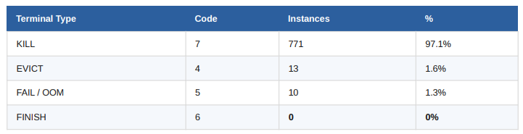
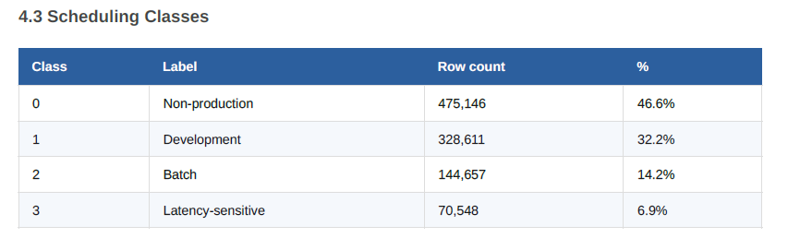
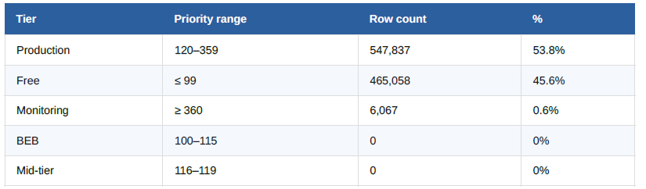
EDA – Most Important Findings - 3
No FINISH events — 97.1% KILL, 0% FINISH
9 / 12
Notes:
SOURCE TABLES: instance_usage (cols 1-6, 10-18), instance_events (cols 7-9, 19-22), collection_events (col 24), Python gap detection (sub_seq_id col 10). KEY CONCEPTS: sub_seq_id is a Python-computed integer that increments each time a monitoring gap >300 seconds is detected within one instance. The LSTM sequence key is (collection_id, instance_index, sub_seq_id) — NOT (collection_id, instance_index) alone. mem_overcommit_ratio is diagnostic only — EDA confirmed correlation of -0.09 with avg_mem, so it carries no predictive signal. assigned_memory (correlation 0.764 with avg_mem) is the preferred memory headroom proxy. SPOKEN SCRIPT: "The final master table has 26 columns organised into six functional groups. The two LSTM targets — avg_cpu and avg_mem — are highlighted in blue. The optimiser outputs are derived from the predicted sequences after training, not direct model outputs. The diagnostic group contains mem_overcommit_ratio, which our EDA showed has essentially no correlation with actual memory usage — we keep it for interpretability but exclude it from the feature set."

Slide 21
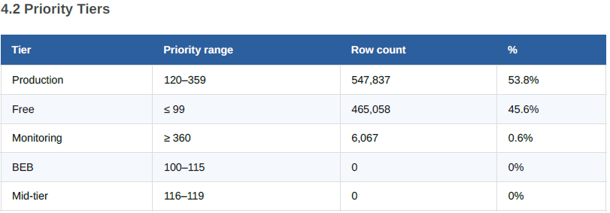
EDA – Most Important Findings - 3
9 / 12
Notes:
SOURCE TABLES: instance_usage (cols 1-6, 10-18), instance_events (cols 7-9, 19-22), collection_events (col 24), Python gap detection (sub_seq_id col 10). KEY CONCEPTS: sub_seq_id is a Python-computed integer that increments each time a monitoring gap >300 seconds is detected within one instance. The LSTM sequence key is (collection_id, instance_index, sub_seq_id) — NOT (collection_id, instance_index) alone. mem_overcommit_ratio is diagnostic only — EDA confirmed correlation of -0.09 with avg_mem, so it carries no predictive signal. assigned_memory (correlation 0.764 with avg_mem) is the preferred memory headroom proxy. SPOKEN SCRIPT: "The final master table has 26 columns organised into six functional groups. The two LSTM targets — avg_cpu and avg_mem — are highlighted in blue. The optimiser outputs are derived from the predicted sequences after training, not direct model outputs. The diagnostic group contains mem_overcommit_ratio, which our EDA showed has essentially no correlation with actual memory usage — we keep it for interpretability but exclude it from the feature set."

Slide 22
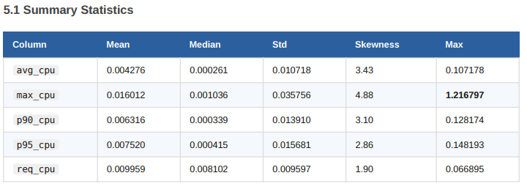
EDA – Most Important Findings - 4
Extreme CPU overprovisioning — Median instance uses only 7% of declared CPU; massive optimization opportunity
9 / 12
Notes:
SOURCE TABLES: instance_usage (cols 1-6, 10-18), instance_events (cols 7-9, 19-22), collection_events (col 24), Python gap detection (sub_seq_id col 10). KEY CONCEPTS: sub_seq_id is a Python-computed integer that increments each time a monitoring gap >300 seconds is detected within one instance. The LSTM sequence key is (collection_id, instance_index, sub_seq_id) — NOT (collection_id, instance_index) alone. mem_overcommit_ratio is diagnostic only — EDA confirmed correlation of -0.09 with avg_mem, so it carries no predictive signal. assigned_memory (correlation 0.764 with avg_mem) is the preferred memory headroom proxy. SPOKEN SCRIPT: "The final master table has 26 columns organised into six functional groups. The two LSTM targets — avg_cpu and avg_mem — are highlighted in blue. The optimiser outputs are derived from the predicted sequences after training, not direct model outputs. The diagnostic group contains mem_overcommit_ratio, which our EDA showed has essentially no correlation with actual memory usage — we keep it for interpretability but exclude it from the feature set."

Slide 23
EDA – Most Important Findings - 4
Dataset is nearly perfect quality — 0 duplicates, 0 negative durations, only 0.12% missing values
100% sequence usability — All 794 instances meet the 12-window minimum; ~1.009Mtraining pairs available
No FINISH events — 97.1% KILL, 0% FINISH
Extreme CPU overprovisioning — Median instance uses only 7% of declared CPU; massiveoptimization opportunity
9 / 12
Notes:
SOURCE TABLES: instance_usage (cols 1-6, 10-18), instance_events (cols 7-9, 19-22), collection_events (col 24), Python gap detection (sub_seq_id col 10). KEY CONCEPTS: sub_seq_id is a Python-computed integer that increments each time a monitoring gap >300 seconds is detected within one instance. The LSTM sequence key is (collection_id, instance_index, sub_seq_id) — NOT (collection_id, instance_index) alone. mem_overcommit_ratio is diagnostic only — EDA confirmed correlation of -0.09 with avg_mem, so it carries no predictive signal. assigned_memory (correlation 0.764 with avg_mem) is the preferred memory headroom proxy. SPOKEN SCRIPT: "The final master table has 26 columns organised into six functional groups. The two LSTM targets — avg_cpu and avg_mem — are highlighted in blue. The optimiser outputs are derived from the predicted sequences after training, not direct model outputs. The diagnostic group contains mem_overcommit_ratio, which our EDA showed has essentially no correlation with actual memory usage — we keep it for interpretability but exclude it from the feature set."

Slide 24
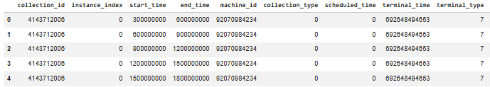
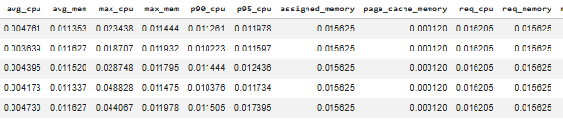
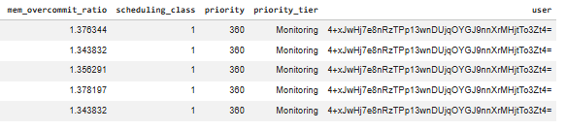
Final Master Table — 24 Columns
Column | Purpose
collection_id | Primary key
instance_index | Primary key
start_time | Primary key
end_time | Timestamp
scheduled_time | Timestamp
terminal_time | Timestamp
machine_id | Identifier
user | Identifier
avg_cpu | LSTM target
avg_mem | LSTM target
scheduling_class | Feature / regressor
priority_tier | Feature / regressor
assigned_memory | Feature / regressor
page_cache_memory | Feature / regressor
p90_cpu | Feature / regressor
p95_cpu | Evaluation benchmark
max_cpu | Evaluation benchmark
max_mem | Evaluation benchmark
req_cpu | Optimiser input
req_memory | Optimiser input
collection_type | Diagnostic only
priority | Diagnostic only
terminal_type | Diagnostic only
mem_overcommit_ratio | Diagnostic only
OPTIMISER OUTPUTS
DIAGNOSTIC ONLY
9 / 12
Notes:
SOURCE TABLES: instance_usage (cols 1-6, 10-18), instance_events (cols 7-9, 19-22), collection_events (col 24), Python gap detection (sub_seq_id col 10). KEY CONCEPTS: sub_seq_id is a Python-computed integer that increments each time a monitoring gap >300 seconds is detected within one instance. The LSTM sequence key is (collection_id, instance_index, sub_seq_id) — NOT (collection_id, instance_index) alone. mem_overcommit_ratio is diagnostic only — EDA confirmed correlation of -0.09 with avg_mem, so it carries no predictive signal. assigned_memory (correlation 0.764 with avg_mem) is the preferred memory headroom proxy. SPOKEN SCRIPT: "The final master table has 26 columns organised into six functional groups. The two LSTM targets — avg_cpu and avg_mem — are highlighted in blue. The optimiser outputs are derived from the predicted sequences after training, not direct model outputs. The diagnostic group contains mem_overcommit_ratio, which our EDA showed has essentially no correlation with actual memory usage — we keep it for interpretability but exclude it from the feature set."

Slide 25
Reading One Row — What Each Value Means
collection_id=201428 · instance_index=30 · start_time=600,000,000 µs · sub_seq_id=0 · avg_cpu=0.0412 · avg_mem=0.0219 · max_cpu=0.0645 · req_memory=0.0293 · scheduling_class=3 · priority=120 · terminal_type=6 · user=mNk3pQrZ...
collection_id = 201428
avg_mem = 0.0219
The unique job identifier. All instances of this job share this ID.
Used 2.2% of the maximum machine memory — well within its declared limit of 2.9%.
instance_index = 30
max_cpu = 0.0645
The 31st container within that job (0-based). Identifies one specific container.
Peak CPU in this window was 6.5% — a burst ratio of ~1.6× the average.
start_time = 600,000,000 µs
scheduling_class = 3
This window started 600 seconds after t=0 — the very first measurement in the trace.
Latency-sensitive workload. Requires the tightest LSTM prediction intervals and SLA enforcement.
sub_seq_id = 0
priority = 120
No monitoring gap detected before this window. This is the first continuous piece for this instance.
Production tier — will not be preempted by lower-priority workloads.
avg_cpu = 0.0412 NCU
terminal_type = 6
This container used 4.1% of the maximum machine CPU during this 5-minute window.
This instance eventually finished normally (FINISH) — labelled as stable by the RF classifier.
Data Extraction — LSTM Master Table
10 / 12
Notes:
SOURCE TABLES: This row comes from the inner join of instance_usage (all usage metrics) with stable_instances (scheduled_time), terminal_info (terminal_type), inst_requests (req_cpu, req_memory, scheduling_class, priority), tenant_map (user), and Python gap detection (sub_seq_id). KEY CONCEPTS: NCU = Normalised Compute Unit — CPU is scaled so the largest machine in the cluster = 1.0. Memory similarly normalised. Burst ratio = max_cpu / avg_cpu — shows how spiky the workload is. sub_seq_id=0 means no gaps were detected before this window in this instance's sequence. SPOKEN SCRIPT: "Let's ground the schema in a concrete example. This row tells us that at the very start of the trace, container 30 of job 201428 was running as a production-tier, latency-sensitive workload. It was consuming about 4% of a machine's CPU and 2.2% of its memory — well within its declared limits. The burst factor of 1.6 on CPU is relevant: the LSTM needs to learn that this workload occasionally spikes above its average, and the optimiser needs headroom to absorb that. And because this instance eventually finished normally, the Random Forest classifier will label it as stable."

Slide 26
Next Steps in the Pipeline
01 Preprocessing
02 LSTM Baseline Training
03 Optimisation + Evaluation
Forward-fill p90_cpu · p95_cpu · page_cache_memory
Train on Week 1 (days 1–7, Cell A)
Feed LSTM predictions into multi-objective optimiser
Engineer true_app_memory = avg_mem − page_cache_memory
Predict avg_cpu and avg_mem sequences (horizon = 6 steps)
Test on Week 2 (days 8–14 — held-out, never seen during training)
Min-max normalise per sequence · construct lookback/horizon tensors
Derive peaks · P90 · P95 · variance from predicted sequences
Report: memory utilisation · scheduling fairness · SLA violations
Stratify train / val / test split by user (tenant) 70 / 15 / 15
Evaluate per-tenant and per-scheduling-class prediction error
Academic comparison: instance-level vs. job-level forecasting baseline
Dataset ready at: gs://capstone-cluster-lstm/winner_dataset/week1_final/
Data Extraction — LSTM Master Table
12 / 12
Notes:
DATASET LOCATION: gs://capstone-cluster-lstm/winner_dataset/week1_final/ — 220 Parquet files, ~1.36 GB compressed. Week 2 (test set, days 8-14) to be extracted after supervisor validation using identical query logic with updated time window constants. KEY CONCEPTS: Week 1 / Week 2 split preserves temporal ordering — training always precedes testing. This is academically stronger than a random split within one week. The test set comes from a genuinely independent time period. Per-tenant evaluation is mandatory because the top tenant accounts for ~61% of jobs — aggregate metrics mask performance on minority tenants. SPOKEN SCRIPT: "The extraction pipeline is complete and the Week 1 dataset is live in Google Cloud Storage, re-sharded so every container's complete sequence is in a single file. The immediate next step is the preprocessing notebook, which will construct the LSTM input-target tensor pairs and produce the stratified train/validation/test split. We then train on Week 1 and evaluate on a held-out Week 2 — a temporal split that is both methodologically sound and directly relevant to how a real-world scheduler would be deployed and evaluated. Thank you."

Slide 27
LSTM Pipeline Overview
1. Load Data
2. Feature Eng.
3. Build Sequences
winner_sample_v1.csv
~1M rows, 5-min intervals
true_app_memory
sin/cos time encoding
Lookback: 144 steps (12h)
Horizon: 6 steps (30 min)
4. Train LSTM
5. Evaluate
6. Output
2 LSTM layers + dropout
Tenant-aware split
MAE, RMSE, SMAPE, R²
Per-target metrics
optimizer_lstm_predictions.csv
Job-level aggregation

Slide 28
Feature Engineering & Design Choices
Selected LSTM Inputs
Key Design Decisions
avg_cpu / avg_mem
Primary targets & input history
true_app_memory
Page cache is reclaimable by the OS. Subtracting it gives a more accurate view of real application memory pressure for overcommitment.
p90_cpu
Burst/spike intensity signal
Cyclical Time (sin/cos)
assigned_memory
Memory headroom signal
23:00 and 00:00 are numerically distant but temporally adjacent. sin/cos encoding preserves this cyclical continuity for the LSTM.
page_cache_memory
Reclaimable cache estimation
Leakage Prevention
true_app_memory
avg_mem − page_cache_memory
Excluded: terminal_type, terminal_time, max_mem, p95_cpu. These contain future information that would give the model an unfair advantage.
scheduling_class
Workload priority/sensitivity
Tenant-Aware Split
sin_time / cos_time
Cyclical time encoding
Training and testing never share tenants, ensuring a realistic evaluation with no tenant leakage.

Slide 29
Model Architecture & Training Setup
Input
(12h × features)
LSTM Layer 1
(temporal patterns)
LSTM Layer 2
(high-level repr.)
Dropout
(regularization)
Dense Output
(CPU + Mem × 6)
Sequence Design
Why 12-hour lookback?
Lookback: 144 steps = 12 hours of history Horizon: 6 steps = 30 minutes ahead "Given 12h of CPU/memory behavior, predict the next 30 min"
✓ Captures trends, spikes & usage cycles ✓ Computationally efficient vs 24-48h windows ✓ Avoids outdated data noise from longer histories
Outputs: avg_cpu · avg_mem · predicted_peak · predicted_p90/p95 · predicted_cpu_variance · predicted_mem_variance → Job-level aggregation

Slide 30
Optimizer-Ready Outputs & Job-Level Aggregation
Instance-Level LSTM
Job-Level Footprint
Optimization Scheduler
Instance A → CPU/Mem forecast
→ predicted_avg_cpu
✓ Smart resource allocation
→ predicted_avg_mem
Instance B → CPU/Mem forecast
✓ Safe memory overcommitment
→ predicted_peak_cpu
aggregate
by job
→ predicted_peak_mem
✓ SLA-aware scheduling
Instance C → CPU/Mem forecast
→ predicted_p90_cpu
✓ Proactive scaling decisions
Instance D → CPU/Mem forecast
→ predicted_p95_mem
Output file: optimizer_lstm_predictions.csv | Grouped by: collection_id + target_start_time | References: Borg (2015), Dominant Resource Fairness, Heracles

Slide 31
Optimizer-Ready Output Formulas & Job-Level Footprints
1. Instance-Level Summary from 6-Step Forecast
2. Job-Level Resource Footprints
For each instance, LSTM predicts: t+5, t+10, t+15, t+20, t+25, t+30
Predictions are first made per instance, then grouped by:
predicted_avg_cpu
= mean(predicted_cpu_6_steps)
collection_id + target_start_time
predicted_peak_cpu
= max(predicted_cpu_6_steps)
cpu_footprint
= sum(predicted_avg_cpu across instances)
predicted_p90_cpu
= 90th percentile(predicted_cpu_6_steps)
predicted_cpu_variance
= variance(predicted_cpu_6_steps)
aggregate
mem_footprint
= max(predicted_avg_mem across instances)
predicted_avg_mem
= mean(predicted_mem_6_steps)
predicted_peak_mem
= max(predicted_mem_6_steps)
p90_cpu_footprint
= sum(predicted_p90_cpu across instances)
predicted_p95_mem
= 95th percentile(predicted_mem_6_steps)
p95_mem_footprint
= max(predicted_p95_mem across instances)
predicted_mem_variance
= variance(predicted_mem_6_steps)
Meaning: future sequence → optimizer-ready summary statistics
Simple explanation: predict each instance → combine into job demand for the optimizer

Slide 32
Model Evaluation Results
Memory Prediction (avg_mem) ✓ Strong Performance
Memory Result Summary
High R² (0.73) confirms the model successfully captures memory usage variability and temporal patterns. Low MAE and Median AE (0.000279) indicate stable, consistent predictions — suitable for safe overcommitment and SLA-aware scheduling.
0.727
0.000765
37.2%
R²
MAE
SMAPE
Strong fit
Very low error
Moderate %
CPU Prediction (avg_cpu) ✗ Challenging
CPU Result Summary
Low R² (0.09) indicates the model struggles with CPU variability. CPU workloads are bursty, irregular, and low-magnitude — making accurate forecasting fundamentally harder. SMAPE of 100%+ is expected for near-zero CPU time series.
0.088
0.003189
100.9%
R²
MAE
SMAPE
Weak fit
Moderate error
Very high %

Slide 33
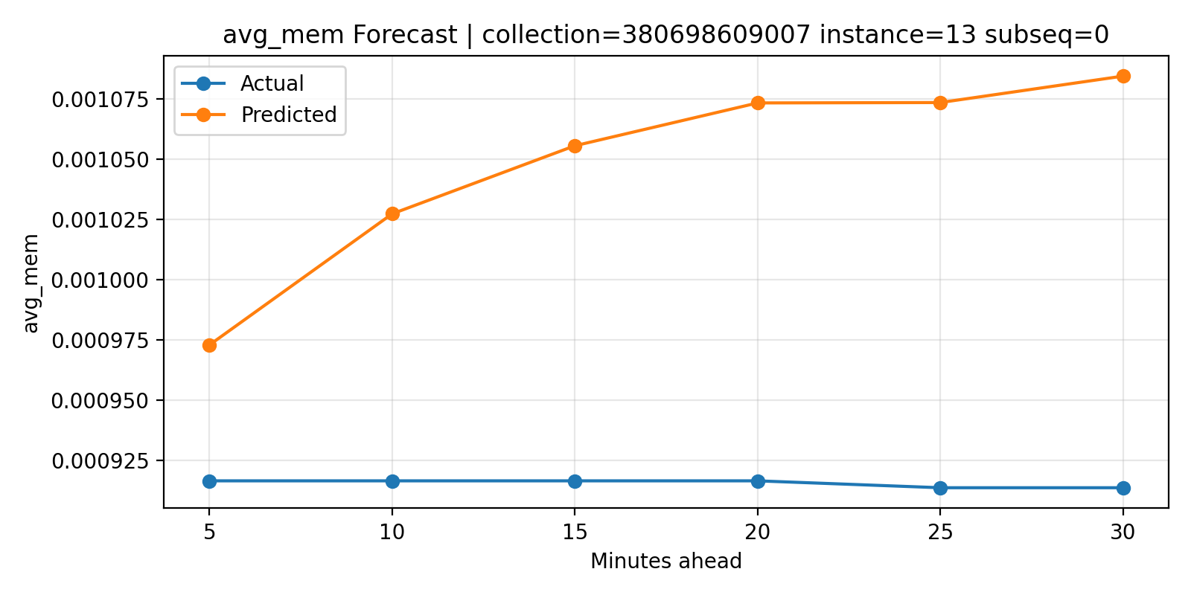
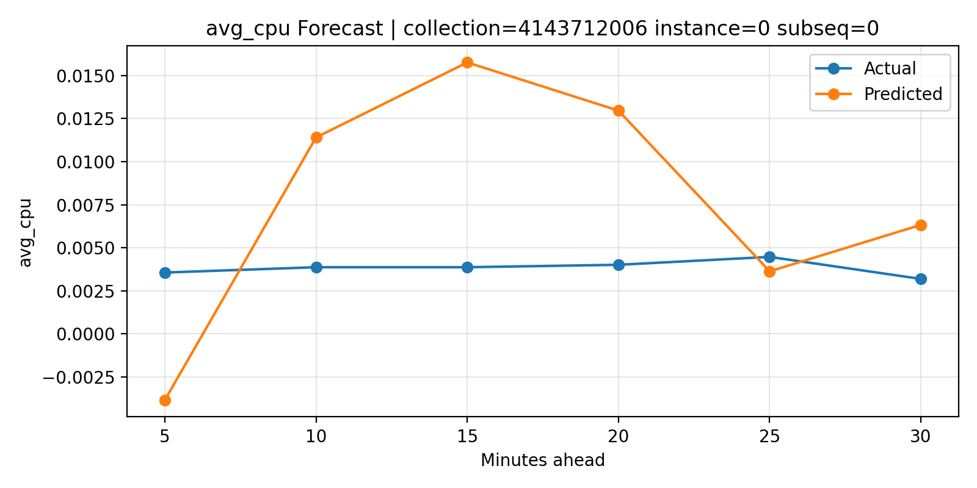
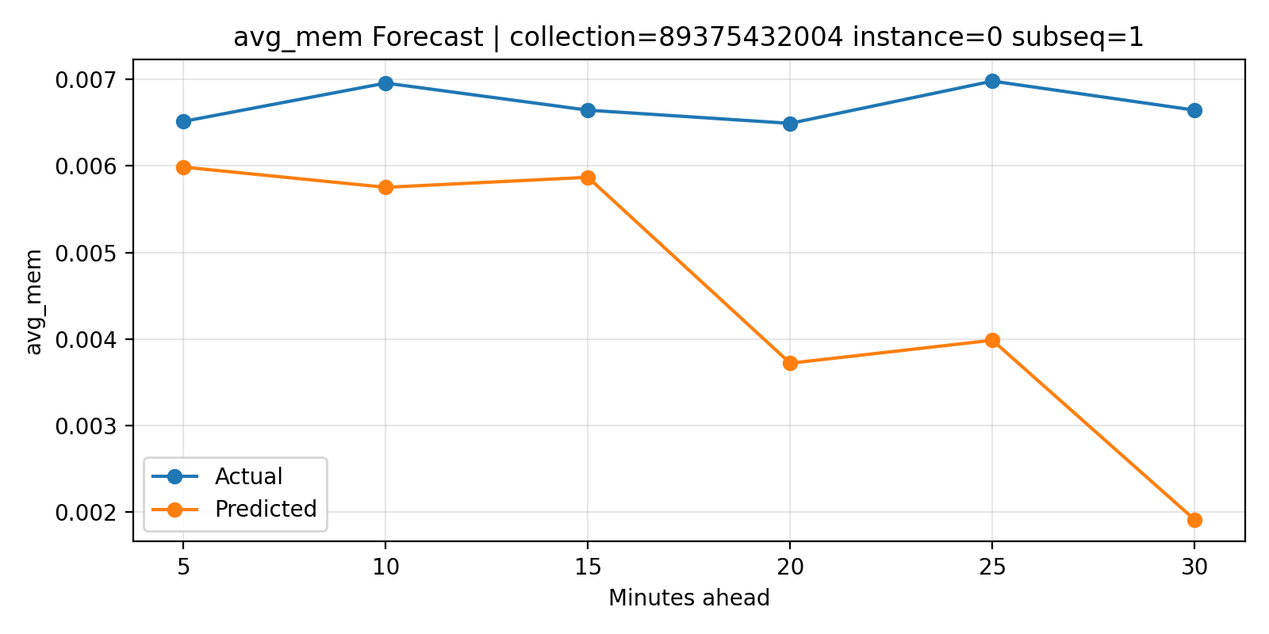
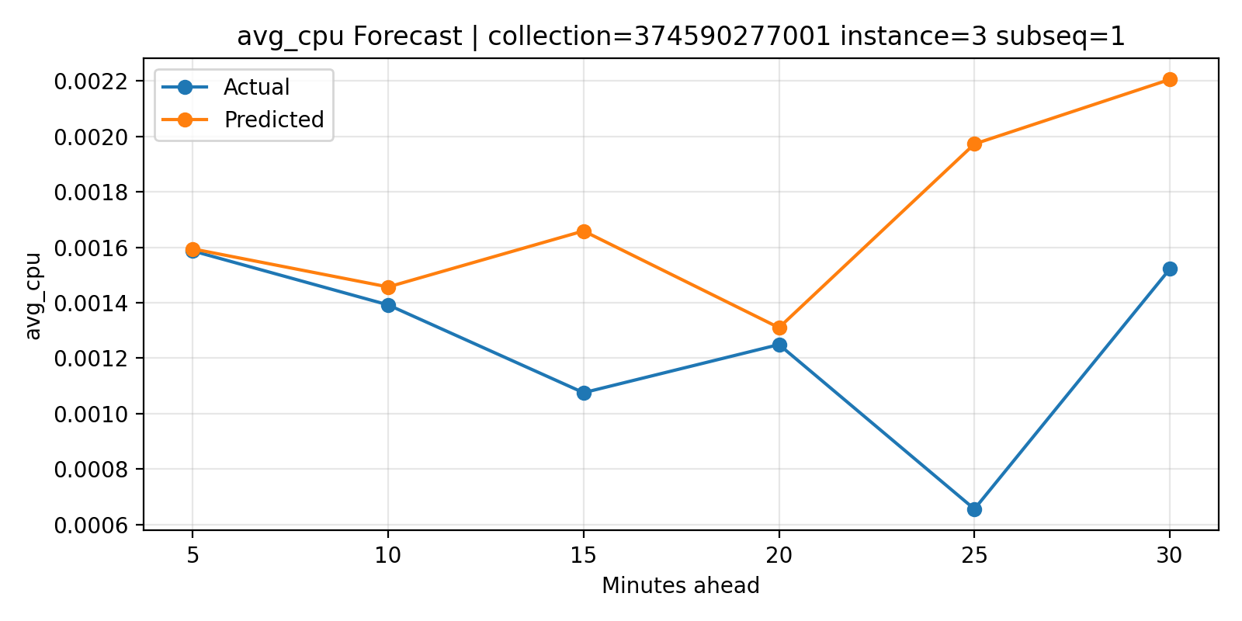
Forecast Examples: What Good & Poor Predictions Look Like
Memory — Collection 380B (Good)
CPU — Collection 414B (Poor)
Memory — Collection 893B (Diverging)
CPU — Collection 374B (Moderate)
Notes:
These charts provide qualitative evaluation of the forecasting behavior. They show whether the predicted sequence follows the actual workload trend over the forecasting horizon, helping us visually assess stability, trend learning, spike handling, and forecast drift beyond numerical metrics alone.
Good → Prediction closely follows the actual workload trend
Moderate → Model captures the general direction but not perfectly
Poor → Model fails to capture bursty or unstable workload behavior
Diverging → Prediction error increases over longer forecast horizons
The examples are consistent with the evaluation metrics. Memory forecasting generally performs better because memory usage is smoother and more stable, while CPU forecasting is harder due to bursty and dynamic workload behavior.
We included qualitative forecast examples because average metrics alone do not fully explain model behavior in cloud workload forecasting. Visual inspection helps evaluate stability, trend learning, burst handling, and forecast drift.

Slide 34
Comparison with Other Research Papers
Study | Dataset / Task | Metrics Used | Reported Results | Our Result
Alshboul et al. (2026), “An LSTM-Based Resource Prediction Model in Google” | Google Cluster 2019, CPU & memory request prediction | MSE, MAE, RMSE | CPU: MSE ≈ 0.00132, MAE ≈ 0.0216, RMSE ≈ 0.0364. Memory: MSE ≈ 0.0029, MAE ≈ 0.0249, RMSE ≈ 0.0537. | CPU: MAE 0.003189, RMSE 0.007726. Memory: MAE 0.000765, RMSE 0.001534
Kofi (2025), “Data-Driven Cloud Workload Optimization…” | Google Cluster Trace, workload/CPU/RAM prediction | R², MSE, RMSLE | CPU: R² 0.99, MSE 128.89, RMSLE 0.16. RAM: R² 0.99, MSE 131.29, RMSLE 0.14. | CPU: R² 0.0878. Memory: R² 0.7266
Kidane et al. (2025), “Hybrid Autoencoder–LSTM Framework” | Synthetic + Wikipedia workload forecasting | RMSE / prediction loss, computational metrics | Reports RMSE/prediction loss and horizon-based errors, but not directly CPU/memory Google Cluster values. | CPU + memory evaluated separately with MAE, RMSE, SMAPE, R², Median AE

Slide 35
Comparison with Related Work
Study | Dataset | CPU MAE | Mem MAE | CPU RMSE | Mem RMSE
Alshboul et al. (2026) | Google Cluster 2019 | 0.0216 | 0.0249 | 0.0364 | 0.0537
Ours (LSTM V1) | Google Cluster Trace | 0.003189 | 0.000765 | 0.007726 | 0.001534
Kofi (2025) | Google Cluster Trace | — | — | — | —
Our Differentiators vs. Alshboul et al.
✓ EDA-driven feature engineering: We used correlation analysis to remove redundant features (e.g. max_mem ≈ avg_mem, r=0.98)
✓ Leakage prevention: Strict exclusion of terminal_type, terminal_time, and future-derived columns
✓ true_app_memory: Novel feature capturing real memory pressure after page cache subtraction
✓ Tenant-aware split + optimizer outputs: Prevents tenant leakage; exports P90/P95/variance for scheduling

