Slide 1
PREDICTIVE LAYER
LSTM Resource Forecasting
Course: DAMO 699 — Capstone Project Project: Optimal Shared Memory Utilization with Service Level Guarantees in Multi-Tenant Clusters

Slide 2
Data Extraction
Tenant Selection · Dataset Construction · Final Dataset Overview

Slide 3
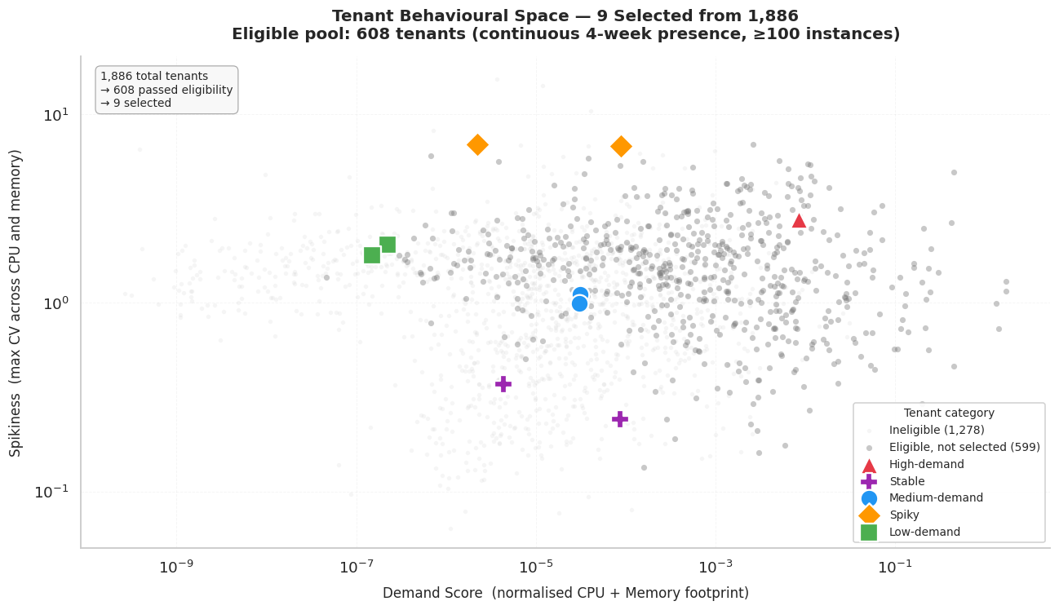
Tenant Selection: Selecting 9 Representative Tenants from 1,886
Eligibility Filters →
Continuous presence across all 4 weeks of May 2019
Minimum 100 instances total
Result: pool reduced from 1,886 → 608 eligible tenants
608 → 9 Selected tenants based on behaviour patterns
Category | # Selected | Demand Percentile
High-demand | 1 | (p94.1%)
Medium-demand | 2 | (p50.0%, p50.2%)
Low-demand | 2 | (p10.3%, p9.5%)
Spiky | 2 | (p99.8%, p99.6%)
Stable | 2 | (p94.1%, p88.9%)
*Percentile anchors computed on full 1,886-tenant universe to avoid selection bias
Notes:
Each dot is one tenant from the cluster. The horizontal axis measures how much resources a tenant consumes overall (demand score — low on the left, high on the right). The vertical axis measures how unpredictable their usage is (spikiness/CV (coefficient of variance) — calm at the bottom, erratic at the top). Both axes are on a log scale because the values span several orders of magnitude.
Why the 9 selected tenants cover the space
The grey dots are the 608 eligible tenants we did not select — they fill the middle of the chart. Our 9 selected tenants (the coloured shapes) deliberately sit at different corners and positions of that cloud:
High-demand (red triangle) — far right, meaning the heaviest resource consumer in the cluster
Spiky tenants (orange diamonds) — top of the chart, meaning the most erratic and unpredictable usage regardless of their demand level
Stable tenants (purple crosses) — bottom of the chart, meaning very predictable flat usage
Medium-demand (blue circles) — center of the cloud, representing the typical average tenant
Low-demand (green squares) — far left, representing the lightest resource consumers
The key message for the slide
Rather than picking 9 random tenants, we selected tenants that sit at the extremes and the center of this behavioural space. This ensures the LSTM model is trained and tested on the full range of demand patterns the optimization model will encounter in production — from the most predictable to the most erratic, and from the lightest to the heaviest workloads.

Slide 4
Dataset Extraction
Justification
Data Extraction
Rather than a stratified random sample of instances, the dataset was constructed by extracting all activity belonging to 9 selected tenants in full.
This design decision is motivated by the optimization model architecture:
The real-time MILP and plan-ahead MISOCP both operate at the tenant level — machines are assigned to tenant groups, not to individual jobs
A stratified instance sample would break the temporal continuity of each tenant's workload, making it impossible to model demand patterns at the tenant-period level (u[i,h]) required by the plan-ahead model
Capturing full tenant lifecycles preserves job-to-job dependencies, relationships, and weekly demand cycles that are essential for LSTM sequence construction
Google Cluster-Usage Traces v3 — Cell A, May 2019
Accessed via BigQuery (google.com:google-cluster-data:clusterdata_2019_a)
Tables used: instance_usage, collection_events, instance_events
31-day trace, ~microsecond-resolution timestamps, normalised resource units (NCU)
Limitation: 511 intermittent/short-lived tenants not represented — model generalisation to transient workloads is out of scope
Notes:
Filters applied during extraction:
collection_type retained as-is (jobs and alloc sets both included)
No zero-CPU or stability filters applied at extraction — all eligibility decisions deferred to preprocessing
LOST terminal type retained in full_lifecycle; excluded from lstm_sequences
terminal_type retained as metadata only, not as an LSTM feature (future leakage risk)

Slide 5
Final Dataset: Structure & Key Fields
Summary
period_h — the 5-minute planning period index since the start of the trace. Period 1 is the first 5 minutes of May 1, period 8,929 is the last period of May 31.
collection_id — unique identifier for the job. This is the unit of prediction for both optimization models.
instance_index — position of the task within the job. Most jobs have only one task (index 0).
avg_cpu — average CPU consumption during the 5-minute window, in normalised units (NCU).
avg_mem — average memory consumption during the 5-minute window, in normalised bytes.
p90_cpu — 90th percentile of CPU usage samples within the window.
assigned_memory — the memory limit enforced by the OS kernel for this instance.
page_cache_memory — memory used for file caching by the OS on behalf of this instance.
req_cpu — CPU amount the user declared when submitting the job.
req_memory — memory amount the user declared at submission.
scheduling_class — job latency sensitivity tier: 0 = non-production, 2 = batch, 3 = latency-sensitive.
instance_age_windows — how many 5-minute windows this instance has been running at the time of this record.
n_instances_in_collection — total number of tasks in this job.
Dataset | tenant_full (9)
Rows | 1,336,507
Instances | 14,180
Collections | 11,302
Collection types | Jobs + alloc sets
Days covered | 31
Key columns — sample rows table
period_h | collection_id | instance_index | tenant | avg_cpu | avg_mem | p90_cpu | assigned_ memory | page_cache_ memory | req_cpu | req_memory | scheduling_ class | instance_age_ windows | n_instances_ in_collection
1 | 20129862067 | 0 | High-demand | 0.0111 | 0.0209 | 0.014236 | 0.0364 | 0.0002 | 0.044 | 0.0364 | 2 | 1 | 2
1 | 346742037008 | 0 | Medium-1 | 0.0002 | 0.0008 | 0.000277 | 0.0022 | 0.0006 | 0.0081 | 0.0022 | 0 | 1 | 1
1 | 374547936418 | 0 | Stable-1 | 0.002 | 0.0066 | 0.002193 | 0.0076 | 0.0001 | 0.0187 | 0.0069 | 3 | 1 | 3
1 | 360146492471 | 0 | Spiky-2 | 0.001 | 0.0145 | 0.001297 | 0.1072 | 0.0016 | 0.0077 | 0.0013 | 2 | 1 | 1
Notes:
Column Definitions
period_h — the 5-minute planning period index since the start of the trace. Period 1 is the first 5 minutes of May 1, period 8,929 is the last period of May 31.
collection_id — unique identifier for the job. This is the unit of prediction for both optimization models.
instance_index — position of the task within the job. Most jobs have only one task (index 0).
tenant — the workload owner, mapped from the hashed user field. Used for plan-ahead aggregation, never an LSTM feature.
avg_cpu — average CPU consumption during the 5-minute window, in normalised units (NCU).
avg_mem — average memory consumption during the 5-minute window, in normalised bytes.
p90_cpu — 90th percentile of CPU usage samples within the window. This is the direct source of the pred_cpu_p95 target variable for the real-time model.
assigned_memory — the memory limit enforced by the OS kernel for this instance. Represents the ceiling the scheduler committed to this job.
page_cache_memory — memory used for file caching by the OS on behalf of this instance. Included for completeness but not an LSTM feature.
req_cpu — CPU amount the user declared when submitting the job. Often a poor predictor of actual usage (r = 0.069 correlation with max_cpu).
req_memory — memory amount the user declared at submission. Moderate predictor of actual usage (r = 0.52 correlation with avg_mem).
scheduling_class — job latency sensitivity tier: 0 = non-production, 2 = batch, 3 = latency-sensitive.
instance_age_windows — how many 5-minute windows this instance has been running at the time of this record. Used to construct LSTM sequences.
n_instances_in_collection — total number of tasks in this job. Drives the aggregation strategy: if > 1, predictions are taken as max across all instances.
Row 1 — High-demand, period 1 This is a Batch job (scheduling_class = 2) from the heaviest tenant in the cluster, observed in the very first 5-minute window of the trace. It has 2 instances in the collection (n_instances_in_collection = 2) and has been running for exactly 1 window (instance_age = 1), meaning it just started. It requested 0.044 NCU of CPU and 0.0364 normalised bytes of memory, but is actually consuming 0.0111 NCU on average with a p90 spike of 0.014 — meaning its actual CPU usage is about 4× lower than what it declared. Memory consumption (0.0209) is also below the assigned limit (0.0364), suggesting the user over-requested resources, which is a common pattern in production clusters.
Row 3 — Spiky-1, period 662 This row illustrates exactly why Spiky-1 is classified as erratic. Both avg_cpu and avg_mem are zero, and p90_cpu is missing (NA) — meaning this instance was running but consuming no measurable resources during this particular 5-minute window. This is a known trace behaviour where a job is in RUNNING state but no process is actively executing, typically during idle waiting periods. Period 662 corresponds to roughly day 2 of the trace, which falls in Spiky-1's near-zero activity phase before its burst event in weeks 4–5. This row would be excluded from LSTM training by the zero-CPU filter applied during preprocessing.

Slide 6
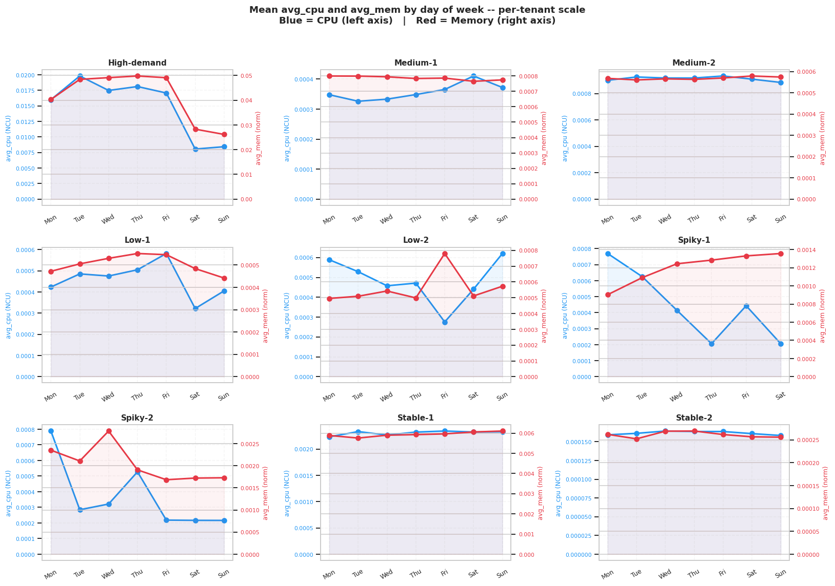
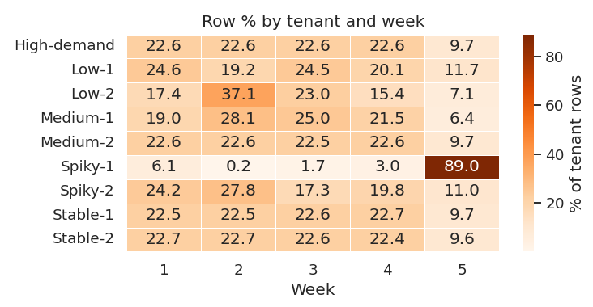
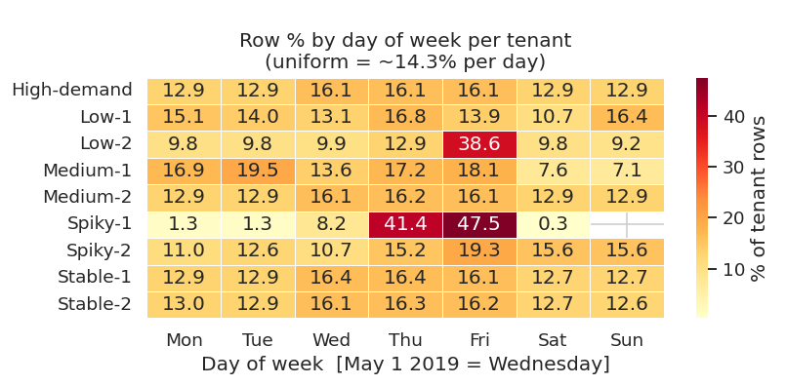
EDA: Temporal Patterns — Weekly and Daily Demand Cycles
Notes:
All 9 tenants are present across all weeks, confirming the eligibility filter worked correctly. Stable-1, Stable-2, Medium-2, and High-demand show near-uniform weekly distributions (~22% per week), indicating consistent workload behaviour suitable for time-series modelling. One clear exception is Spiky-1 concentrates 89% of its rows in Week 5.
Most tenants distribute rows uniformly across weekdays (~14.3% per day is the expected baseline), however Spiky-1 is the clear difference with 41.4% of its rows on Thursday and 47.5% on Friday, confirming its activity is event-driven rather than continuous, and Low-2 shows a similar Friday concentration (38.6%).
Each panel is one tenant. The blue line is CPU (left axis) and the red line is memory (right axis) across the days of the week. Each tenant has its own scale so you can see the pattern within that tenant clearly — you cannot compare the height of bars across tenants, only the shape of the lines within each panel.
Key stories per tenant group
High-demand is the most dramatic panel. CPU peaks on Tuesday and drops sharply on Saturday–Sunday to about half its weekday level. Memory follows a similar but softer drop. This is the clearest business-hours workload in the dataset.
Medium-1 and Medium-2 are relatively flat across the week with minor fluctuations.
Low-1 and Low-2 show more erratic day-to-day patterns despite their small footprint. Low-2 has a notable Friday CPU spike. This is expected for small tenants where a single job starting or stopping creates a visible percentage change.
Spiky-1 shows an interesting divergence — CPU drops mid-week while memory climbs toward the weekend. This decoupling between CPU and memory is unusual and reflects the burst nature of this tenant where memory can linger after a CPU spike ends.
Spiky-2 shows a strong Monday CPU peak that drops through the week. Memory behaves somewhat independently again.
Stable-1 and Stable-2 are the flattest panels in the entire chart. Both CPU and memory lines are nearly horizontal across all seven days — visually confirming their near-zero coefficient of variation and why they serve as the predictable baseline in the dataset.
The one-sentence takeaway for your slide:
Each tenant has a distinct weekly fingerprint — from perfectly flat (Stable) to sharply business-hours driven (High-demand) to erratic and decoupled (Spiky) — confirming that day-of-week is a tenant-specific feature rather than a global cluster pattern, and that a single forecasting model must learn these individual behaviours separately.

Slide 7
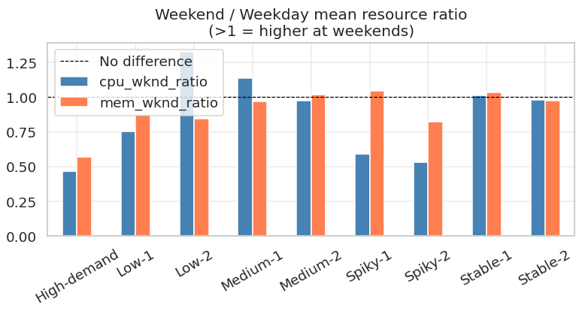
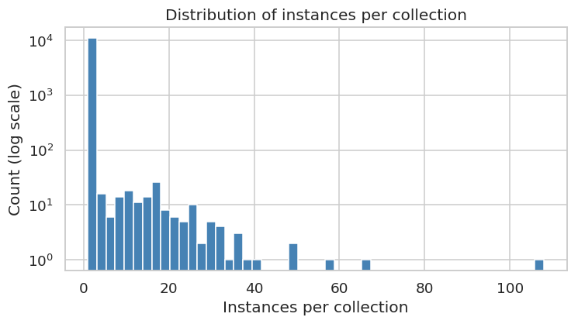
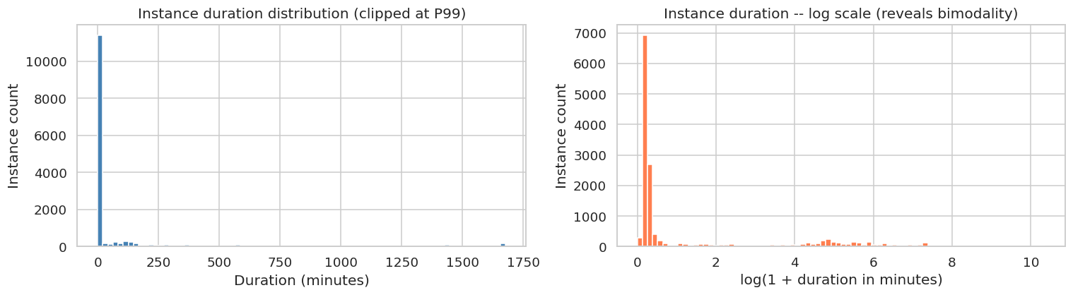
EDA: Instance Structure & Lifecycle — Short-Lived Jobs Dominate
Notes:
The dashed line at 1.0 is the reference point meaning "no difference between weekdays and weekends." Every bar above 1.0 means that tenant uses more resources on weekends, every bar below 1.0 means they use less on weekends compared to weekdays.
High-demand and Spiky-2 have the lowest CPU bars (around 0.47 and 0.53) — meaning their CPU consumption nearly halves on weekends. These are clearly business-hours workloads that slow down when people are not at work.
Medium-1 and Low 2 are tenants whose CPU goes slightly above 1.0 on weekends — suggesting some of its process run more heavily over the weekend, possibly scheduled maintenance or data pipeline jobs.
Stable-1 and Stable-2 have both bars sitting right at 1.0 — meaning their resource usage is completely indifferent to the day of the week. This confirms they are always-on services running continuously regardless of business hours.
Memory bars (orange) are much closer to 1.0 across all tenants compared to CPU bars (blue) — meaning memory consumption stays relatively constant regardless of the day, while CPU is the resource that fluctuates with human activity patterns.
The one-sentence takeaway for your slide:
CPU demand is sensitive to business hours for most tenants, while memory remains stable — making weekday a useful feature for CPU forecasting but less critical for memory prediction.
97.8% of collections are single-instance jobs, with a long-tail distribution reaching a maximum of 108 instances per collection. For the multi-instance collections, the intra-collection memory standard deviation reaches up to 0.048 normalised bytes, meaning instances within the same collection behave differently enough that they must be predicted individually and then aggregated to collection level by taking the max across instances (for the Real Time model).
Instance duration is strongly bimodal: 78.7% of instances terminate within 5 minutes (median 0.3 min), while 1.5% run longer than one day

Slide 8
Outliers and Seasonality Analysis

Slide 9
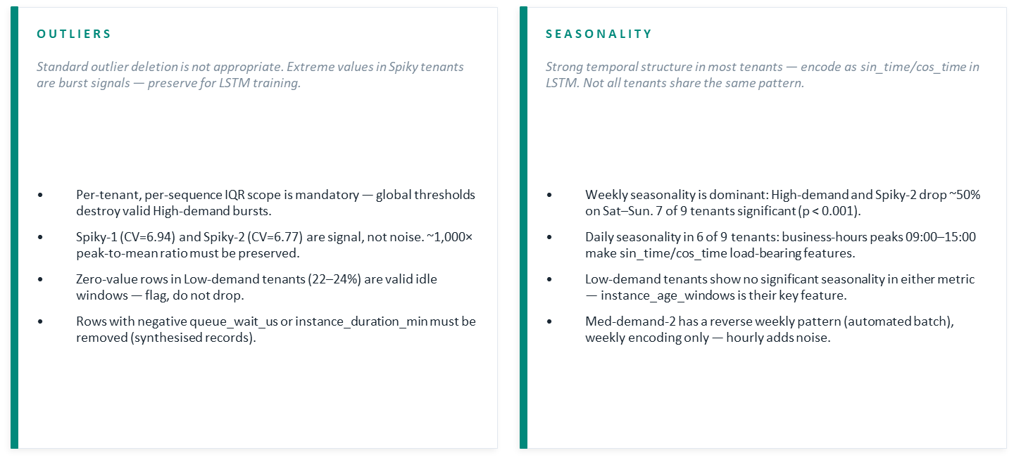
Outliers and Seasonality Analysis

Slide 10
Outlier Analysis — Statistics
avg_cpu (NCU)
avg_mem (norm. bytes)
Tenant | n | CV | IQR out. | IQR% | 3σ | Zeros | p99 | Max
High-demand | 769k | 2.76 | 104,475 | 13.6% | 13,580 | 10,354 | 0.177 | 10.72
Med-demand-1 | 139k | 1.00 | 12,436 | 9.0% | 1,823 | 2,283 | 0.0017 | 0.014
Med-demand-2 | 113k | 0.95 | 160 | 0.1% | 8 | 877 | 0.0028 | 0.007
Low-demand-1 | 1.2k | 2.04 | 72 | 5.9% | 14 | 295 | 0.0034 | 0.086
Low-demand-2 | 0.8k | 1.78 | 124 | 16.2% | 9 | 167 | 0.0005 | 0.356
Spiky-1 | 7.0k | 6.94 | 815 | 11.6% | 108 | 174 | 0.0041 | 0.377
Spiky-2 | 197k | 6.77 | 25,079 | 12.7% | 4,478 | 1,143 | 0.0020 | 1.254
Stable-1 | 55k | 0.24 | 3,011 | 5.5% | 15 | 217 | 0.0055 | 0.006
Stable-2 | 55k | 0.37 | 2,339 | 4.3% | 206 | 187 | 0.0002 | 0.006
Tenant | n | CV | IQR out. | IQR% | 3σ | Zeros | p99 | Max
High-demand | 769k | 1.35 | 38,494 | 5.0% | 18,553 | 0 | 0.296 | 0.314
Med-demand-1 | 139k | 0.21 | 7,941 | 5.7% | 151 | 34 | 0.0011 | 0.0017
Med-demand-2 | 113k | 0.02 | 33 | 0.0% | 0 | 0 | 0.0006 | 0.0006
Low-demand-1 | 1.2k | 0.28 | 71 | 5.8% | 8 | 19 | 0.0009 | 0.0016
Low-demand-2 | 0.8k | 0.17 | 51 | 6.7% | 7 | 33 | 0.0007 | 0.0012
Spiky-1 | 7.0k | 1.96 | 481 | 6.8% | 109 | 4,299 | 0.0092 | 0.0415
Spiky-2 | 197k | 1.79 | 24,432 | 12.4% | 5,117 | 0 | 0.0089 | 0.0396
Stable-1 | 55k | 0.13 | 3,183 | 5.8% | 0 | 0 | 0.0060 | 0.0060
Stable-2 | 55k | 0.19 | 2,227 | 4.1% | 133 | 168 | 0.0004 | 0.0019

Slide 11
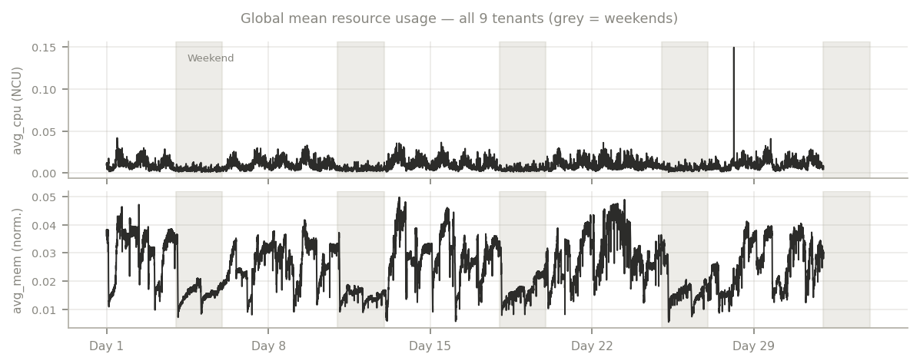
Seasonality Analysis — Time Series & Hypothesis Test
Global mean · Kruskal-Wallis H-test · avg_cpu and avg_mem

Slide 12
Seasonality Analysis — Time Series & Hypothesis Test
Global mean · Kruskal-Wallis H-test · avg_cpu and avg_mem
Kruskal-Wallis H-test is used because resource distributions are heavily skewed and zero-inflated — violating ANOVA normality assumptions. Significant results (p < 0.001) confirm the temporal patterns in Figures 4 & 5 are statistically real, justifying sin_time/cos_time features in the LSTM.
Tenant | cpu Daily | cpu Daily p | cpu Weekly | cpu Weekly p | mem Daily | mem Daily p | mem Weekly | mem Weekly p
High-demand | *** | < 10⁻¹⁰ | *** | < 10⁻¹⁰ | *** | < 10⁻¹⁰ | *** | < 10⁻¹⁰
Med-demand-1 | *** | < 10⁻¹⁰ | *** | < 10⁻¹⁰ | *** | < 10⁻¹⁰ | *** | < 10⁻¹⁰
Med-demand-2 | ns | 0.122 | *** | 3.0e-9 | ns | 0.244 | *** | 4.1e-5
Low-demand-1 | ns | 0.095 | ns | 0.400 | ns | 0.181 | ns | 0.496
Low-demand-2 | ns | 0.081 | ns | 0.385 | ns | 0.165 | ns | 0.571
Spiky-1 | *** | 1.1e-76 | *** | 2.3e-16 | *** | 2.4e-35 | *** | 6.7e-8
Spiky-2 | *** | < 10⁻¹⁰ | *** | 5.4e-81 | *** | < 10⁻¹⁰ | *** | 4.2e-42
Stable-1 | *** | < 10⁻¹⁰ | *** | 1.7e-33 | *** | < 10⁻¹⁰ | *** | 3.1e-19
Stable-2 | *** | 2.3e-83 | *** | 1.4e-195 | *** | 8.7e-44 | *** | 2.1e-102

Slide 13
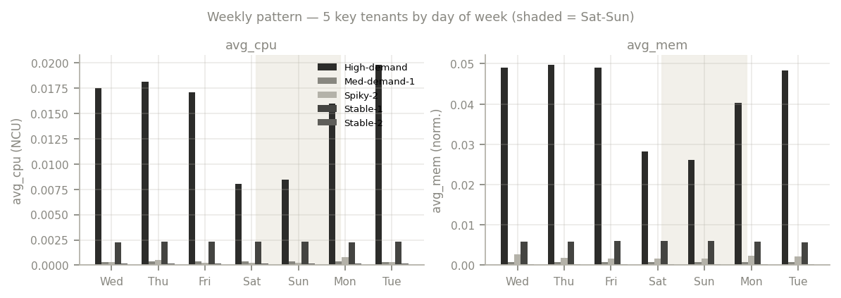
4. Seasonality Analysis — Daily & Weekly Patterns

Slide 14
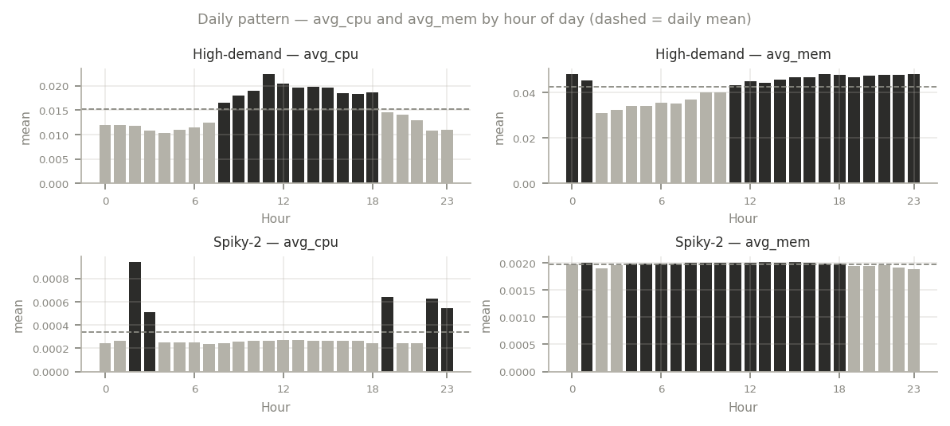
Seasonality Analysis — Daily & Weekly Patterns
Hour-of-day and day-of-week aggregations · avg_cpu and avg_mem

Slide 15
LSTM model
Feature Selection · Model Comparison · Inputs for Optimization Layer

Slide 16
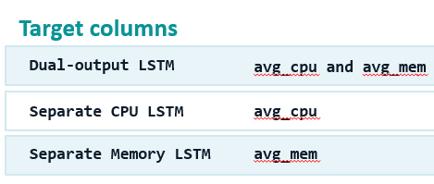
Feature Selection
avg_cpu
Past CPU behaviour — input for CPU & memory forecasting
avg_mem
Past memory behaviour — input for CPU & memory forecasting
p90_cpu
CPU peak/percentile signal
assigned_memory
Memory allocation context
page_cache_memory
Separates real pressure from cached memory
true_app_memory
Engineered: avg_mem − page_cache_memory
req_cpu / req_memory
Requested resource allocation
scheduling_class
Scheduling behaviour context
priority_tier_encoded
Encoded priority tier (categorical)
sin_time / cos_time
Cyclical time encoding
hour_from_start
Relative time position in sequence
time_step_index or instance_age_windows
Sequence age / workload progress
n_instances_in_collection
Collection-level workload size

Slide 17
Feature Selection – Excluded Features
Column | Dual | CPU | Mem | Reason
collection_id | Excl. from model input | X | X | Identifier only; keep for metadata/output
instance_index | Excl. from model input | X | X | Internal sequence key only
sub_seq_id | Excl. from model input | X | X | Internal sequence key only
machine_id | X | X | X | Machine identifier; may cause unwanted memorization
user | X | X | X | Tenant ID metadata, not direct model input
collection_type | Excluded | Excluded | Excluded | Could be encoded later, not needed for baseline
alloc_collection_id | X | X | X | Many missing values and identifier-like
submit_time | Excl. from model input | X | X | Metadata; may be transformed instead
scheduled_time | Excl. from model input | X | X | Metadata; may be transformed instead
terminal_time | X | X | X | Possible future/lifetime leakage
terminal_type | X | X | X | Terminal outcome, not safe as forecasting input

Slide 18
Feature Selection – Excluded Features
Column | Dual | CPU | Mem | Reason
collection_submit_time | Excl. from direct input | X | X | Use derived timing features instead
missing_type_submit | X | X | X | Mostly missing / missingness indicator
missing_type_schedule | X | X | X | Many missing values
max_cpu | Excl. for baseline | Excl. for baseline | Excl. for baseline | Peak value may make comparison less clean
max_mem | Excl. for baseline | Excl. for baseline | Excl. for baseline | Peak value may make memory prediction too direct
p95_cpu | X | X | X | Field name kept; actual value should be P90 CPU
mem_overcommit_ratio | X | X | X | Derived from memory/request relationship
priority | Excl. if using priority_tier_encoded | X | X | Avoid duplicate priority information
period_h | Excl. from model input | X | X | Use for plan-ahead output aggregation
end_time | Excl. from model input | X | X | Use start_time ordering instead
instance_duration_min | Excl. for baseline | Excl. for baseline | Excl. for baseline | Lifetime-related; may cause leakage depending on when known

Slide 19
Output — Model Comparison
Results of MAE, RMSE, SMAPE and R² for the developed LSTM forecasting models in the conducted experiments
Experiment | Memory LSTM |  |  | CPU LSTM |  |  | Dual LSTM (CPU) |  |  | Dual LSTM (Memory)
 | Training | Testing |  | Training | Testing |  | Training | Testing |  | Training | Testing
MAE
1 Main model | 0.003068 | 0.005016 |  | 0.008873 | 0.009826 |  | 0.008451 | 0.014863 |  | 0.003098 | 0.015112
2 (W1->W2) | 0.003086 | 0.006326 |  | 0.007643 | 0.011275 |  | 0.007062 | 0.010376 |  | 0.002894 | 0.010080
3 (W1-W2->W3) | 0.004072 | 0.005013 |  | 0.008290 | 0.009456 |  | 0.008024 | 0.008500 |  | 0.003906 | 0.005204
4 (W1-W3->W4) | 0.003789 | 0.005863 |  | 0.008507 | 0.008585 |  | 0.008448 | 0.008535 |  | 0.003733 | 0.005877
RMSE
1 | 0.009366 | 0.013275 |  | 0.026046 | 0.028435 |  | 0.025546 | 0.040229 |  | 0.009508 | 0.057314
2 | 0.008761 | 0.013192 |  | 0.023678 | 0.028615 |  | 0.022080 | 0.028099 |  | 0.008019 | 0.017201
3 | 0.011407 | 0.013640 |  | 0.023992 | 0.027280 |  | 0.024081 | 0.026800 |  | 0.011744 | 0.014549
4 | 0.010866 | 0.016264 |  | 0.025756 | 0.025872 |  | 0.025089 | 0.026225 |  | 0.009893 | 0.014391
SMAPE (%)
1 | 30.50 | 39.37 |  | 100.22 | 115.57 |  | 78.36 | 92.74 |  | 42.65 | 48.06
2 | 34.39 | 44.39 |  | 76.67 | 100.90 |  | 80.11 | 120.83 |  | 37.67 | 108.32
3 | 30.64 | 39.81 |  | 99.97 | 103.75 |  | 89.46 | 88.00 |  | 34.79 | 44.76
4 | 34.46 | 40.30 |  | 120.51 | 120.40 |  | 78.17 | 83.06 |  | 37.14 | 47.39
R² (%)
1 | 96.67 | 93.98 |  | 38.32 | 37.78 |  | 40.46 | 27.80 |  | 96.57 | 89.44
2 | 96.63 | 93.22 |  | 37.24 | 30.05 |  | 45.43 | 32.56 |  | 97.18 | 88.48
3 | 94.43 | 93.08 |  | 41.38 | 30.24 |  | 40.95 | 32.67 |  | 94.10 | 92.12
4 | 95.36 | 89.42 |  | 38.68 | 33.38 |  | 41.82 | 31.55 |  | 96.16 | 91.72
✓ Selected: Separate Memory LSTM (Test R² = 93.98%) + Separate CPU LSTM (Test R² = 37.78%) | Dual LSTM not selected — weaker generalization on testing set

Slide 20
Input for Optimization Layer
Input for Real-Time Scheduler
Input for Plan-Ahead Scheduler
Per-collection job predictions
Aggregate tenant-period demand
collection_id | tenant_id | prediction_time | pred_mem_mb | pred_cpu_p95
tenant_id | period_index (0, 6, 12, 18) | u | sigma2
pred_cpu_p95:
Field name kept; actual value = P90 CPU peak
u[i,h]:
Sum of predicted peak memory for tenant i in period h
pred_mem_mb:
Peak memory over job lifetime / 30-min cap
sigma2[i,h]:
Variance estimate; fallback = (0.20 × u)² if unavailable
Aggregation:
LSTM predicts at instance level → aggregated to collection_id
Grid:
Full 9 tenants × 4 periods = 36 rows (no nulls)
Fallback logic:
Known ID → prediction | Known tenant → tenant median | Unknown → global median
Missing tenant:
Use tenant median u; no history → global median
Input files:
real_time_memory_part_output.csv + real_time_cpu_part_output.csv
period_index:
Converted from trace-based to optimizer slots: 0, 6, 12, 18
Merge key:
collection_id + tenant_id + prediction_time
Input files:
Separate Memory LSTM plan_ahead_scheduler_output_memory.csv
API/Wrapper Layer (prediction_api.py): reads both CSVs → exposes predict_memory(collection_id), predict_cpu(collection_id), predict_workload(tenant_id, hours) for optimizer team

