Slide 1
Vulkan introduction
The workshop part. You stuck around thusfar. Well done. Was I not that bad or are you just trying to be polite?

Slide 2
Your mission
Convert provided forward-rendered application to one with deferred shading
Deadline: I guess by 5 o’clock? You could also do it at your own leisure at home.
Any sense of purpose in later life as a result of completing this task: Not really, although it might help in understanding the API?

Slide 3
Your mission
It is recommended to group up
Especially if your laptop does not support Vulkan!
My own attempt took ~50 minutes
Bearing in mind this is with experience both in the API and the application!
… But with plenty of shameful mistakes along the way

Slide 4
What is a deferred renderer anyway?
I guess the clue might already be in the title. Spoiler alert..?
It’s also technically called “Deferred shading” what I actually mean to say, not like “Deferred lighting” and any potential other implications of “Deferred” in this context

Slide 5
Deferred rendering basics
Optimization for lighting calculations
Ensures lighting only occurs on visible pixels
Larger performance hit for few lights, less performance hit the more lights you add (scales a lot better)
A proper deferred shading technique would also only do it on those pixels which could potentially be affected by it, but we’ll keep it simple
Touches on many key concepts in Vulkan

Slide 6
Deferred rendering basics
Optimization for lighting calculations
Ensures lighting only occurs on visible pixels
A proper deferred shading technique would also only do it on those pixels which could potentially be affected by it, but we’ll keep it simple
Shading itself occurs the exact same way as in forward
But is deferred to a later subpass 😉

Slide 7
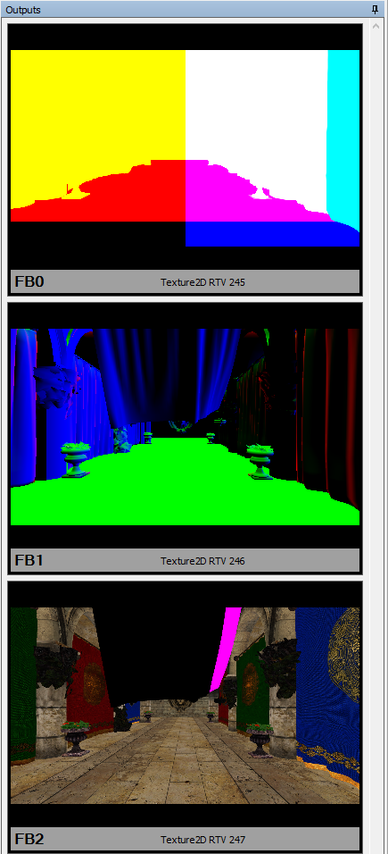
Implementation pointers
Rather than rendering the final color of any pixel to a color attachment, you want to write all properties you will need to determine lighting to be rendered into one or more color attachment(s)
One stage fills a number of “G-Buffers”
Commonly color attachments with per-pixel properties

Slide 8
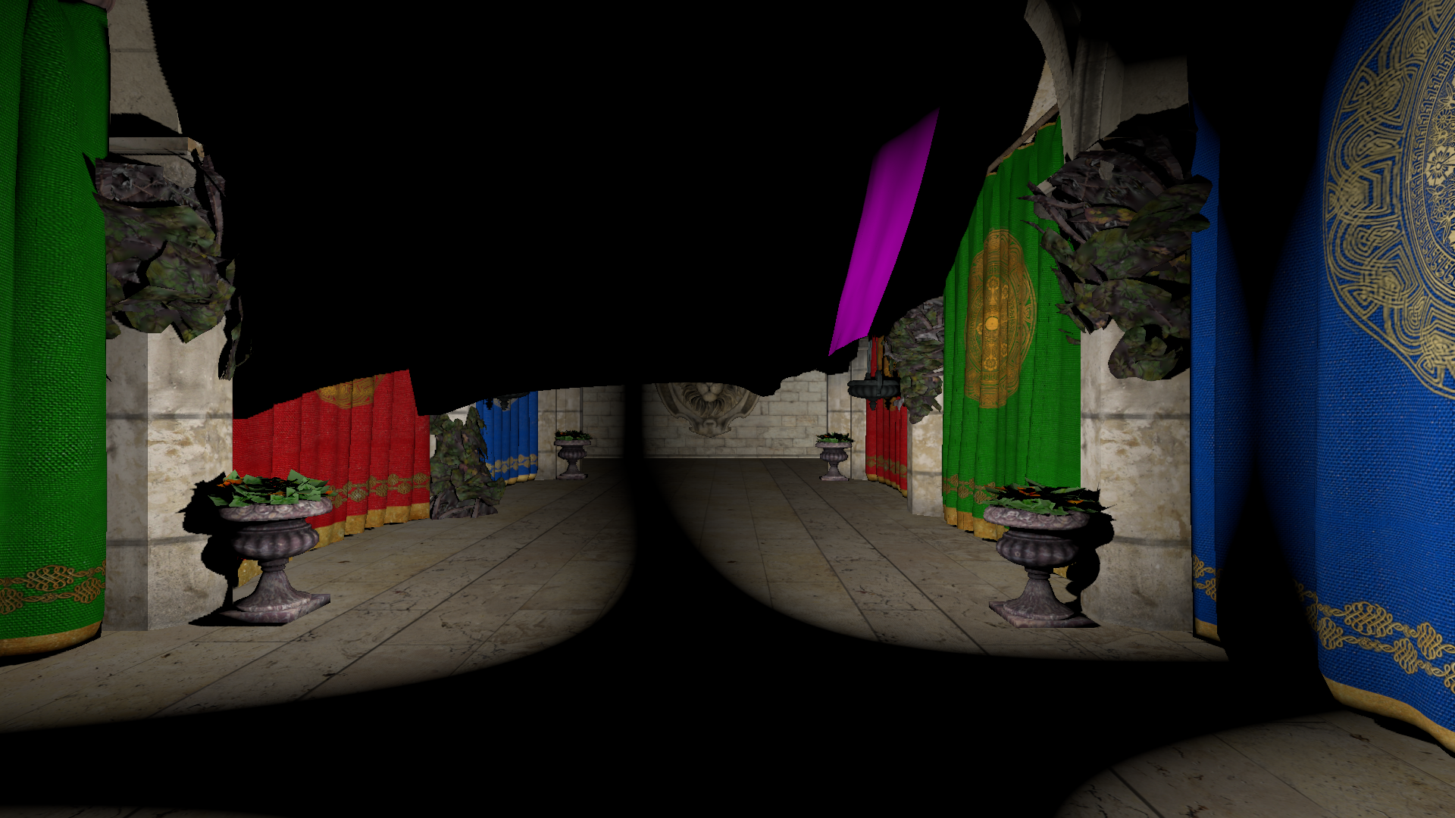
Implementation pointers
A later stage will then take in the properties and composite it into the final image

Slide 9
Git going
TODOTODOTODOTODOTODOTODOTODOTODOTODOTODOTODO
Actually upload stuff so people can download it you dingus
TODOTODOTODOTODOTODOTODOTODOTODOTODOTODOTODO

